Slide 1
7 Segment
Rotating Display
with Enter Button

Slide 2
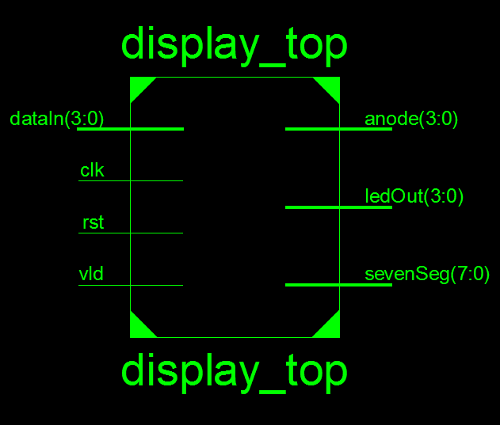
Design Top Level:

Slide 3
Design Top Level:
Inputs
dataIn[3:0] will be tied to the switches (SW3-SW0) on the board.
clk will be connected to the clock pin.
rst will be connected to the button BTN0 on the board.
vld will be tied to the button BTN3 on the board.
Outputs
anode[3:0] will be connected to 7 segment anode pins.
sevenSeg[7:0] will be connected to each of the seven segment displays.
ledOut[3:0] will be showing the last input on leds (LD3-LD0).

Slide 4
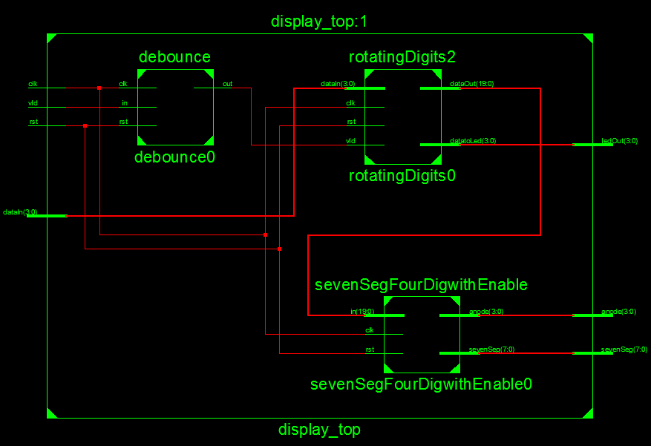
Submodule Connections:

Slide 5
Submodule Connections:
There are three modules inside the topmodule.
Interface module takes input number, store numbers with valid input until 4 numbers are stored and output the number with rotation.
debounce module takes noisy vld input from BTN3 and gives out clean valid signal.
SevenSegFourDig module takes the output from the interface module and produce anode and sevenSeg outputs for seven segment display.

Slide 6
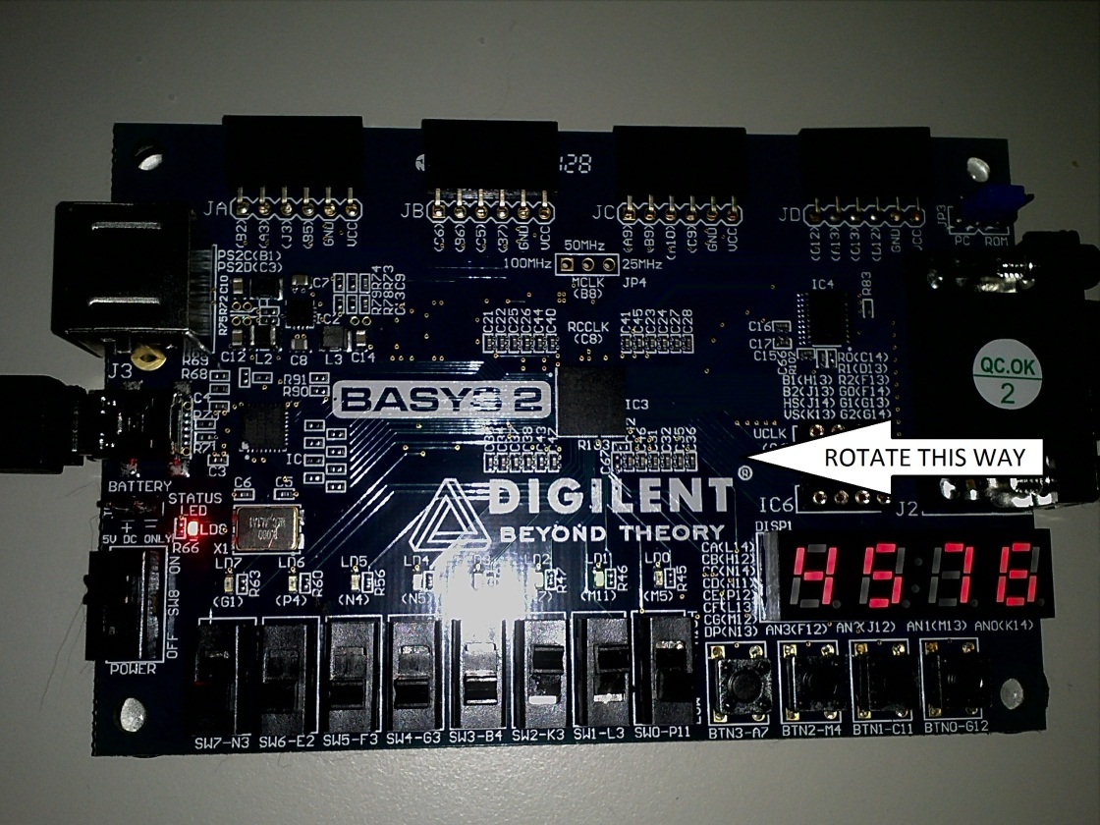
Design Behavior:
Data is entered from the 4 rightmost switches. To validate the number a valid button is arranged. The four digit hexadecimal number that will rotate is entered one digit at a time and stored whenever the valid button is pressed. The number is updated only when all four digits are entered.

Slide 7
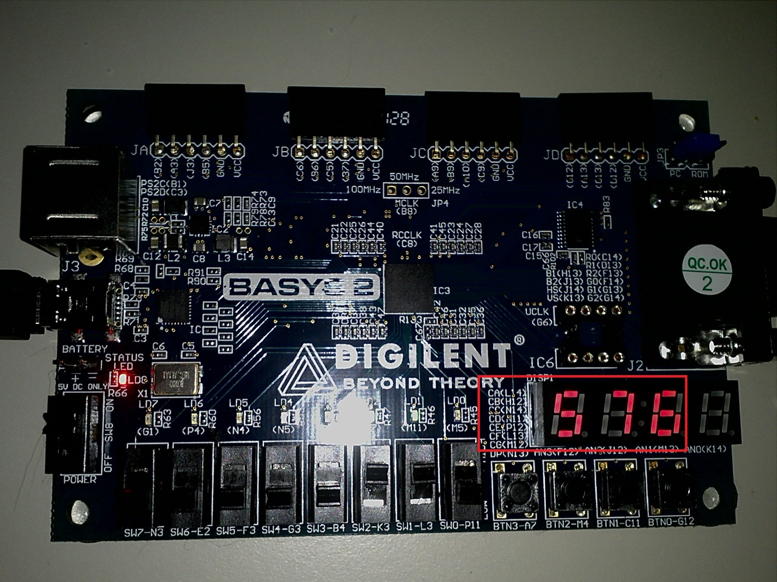
Design Behavior:

Slide 8
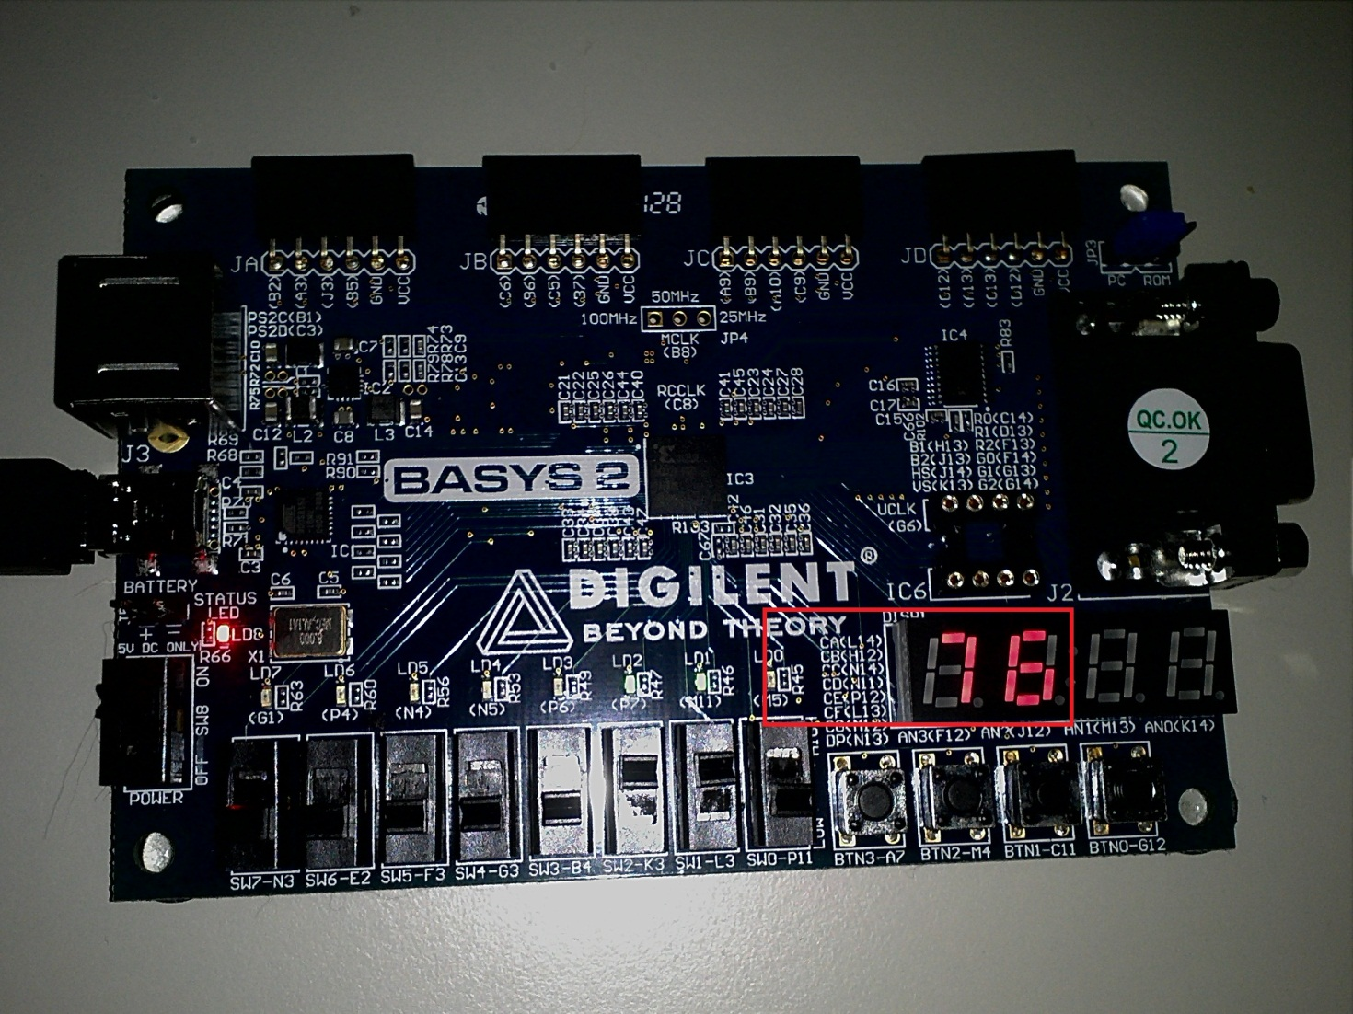
Design Behavior:

Slide 9
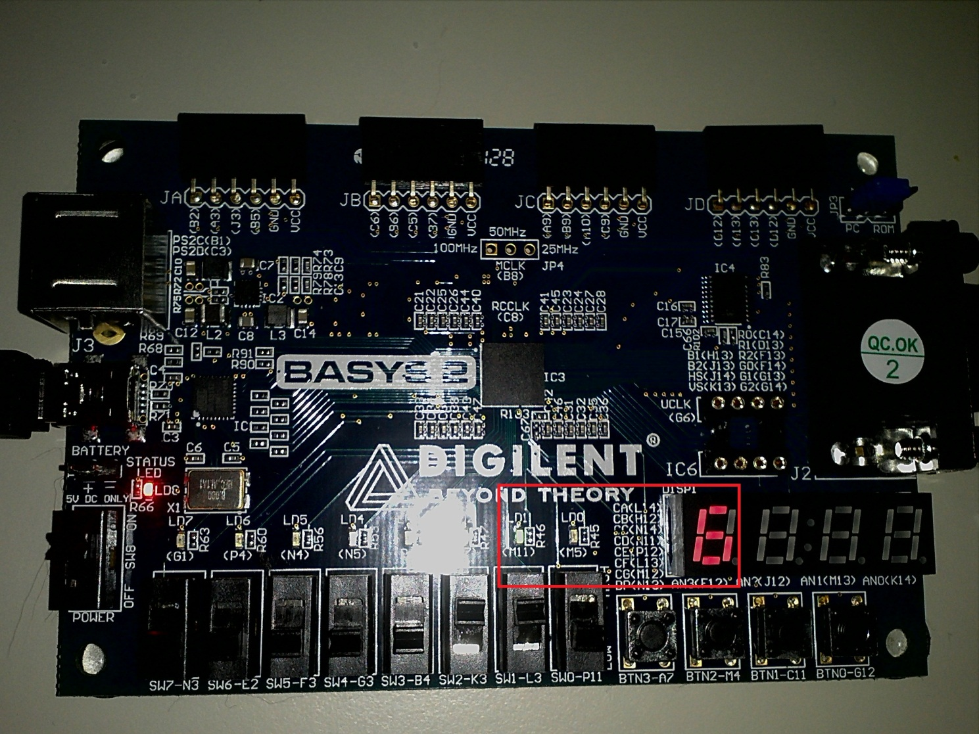
Design Behavior:

Slide 10
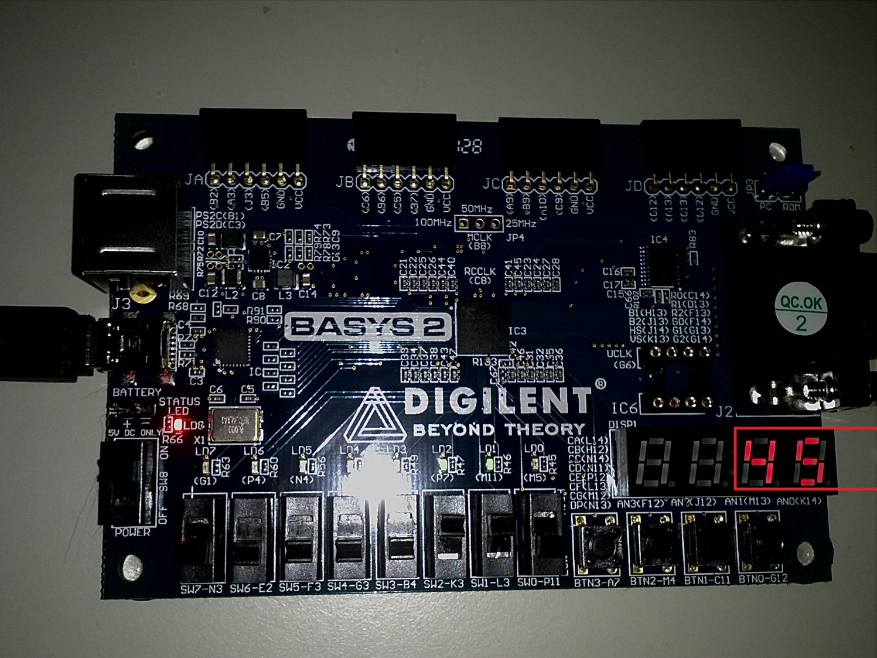
Design Behavior:

