Slide 1
7 Segment Display Driver

Slide 2
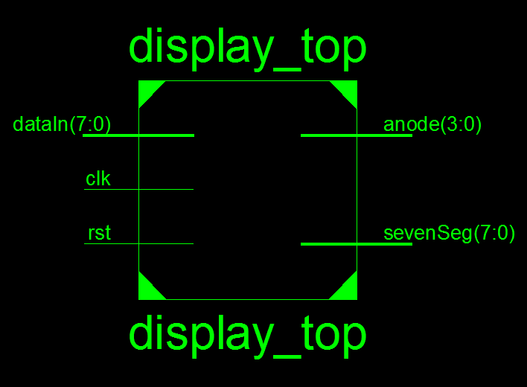
Design Top Level:

Slide 3
Design Top Level:
Inputs
dataIn[7:0] will be tied to the switches (SW7-SW0) on the board.
clk will be connected to the clock pin.
rst will be connected to the button BTN0 on the board.
Outputs
anode[3:0] will be connected to 7 segment anode pins.
sevenSeg[7:0] will be connected to each of the seven segment displays.

Slide 4
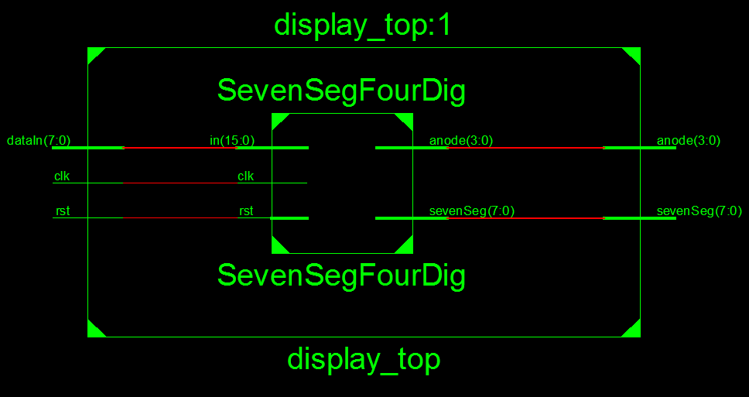
Submodule Connections:
Be aware that dataIn[7:0] is connected to in[15:0]. You should divide in[15:0] to 4 equal parts and connect the two highest bits to zero, while connecting the lower two bits to dataIn[n:n-1] pins.

Slide 5
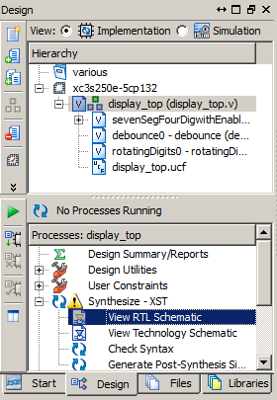
Viewing Schematics:
To see the schematics of your design:
Select the «Design» tab on the left side of the screen
Choose «Implementation» on «View» tab on the top.
Select top level of your design on the «Hierarchy» section.
In the «Processes» section just below «Hierarchy» section, expand «Synthesize – XST» and run «View RTL Schematic».

Slide 6
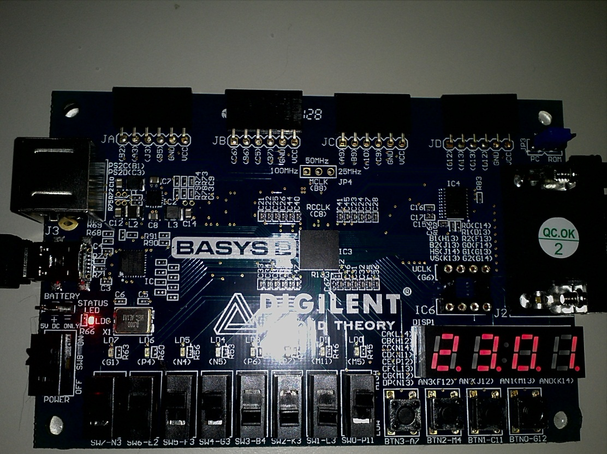
Design Behavior:
As it can be seen from the picture above, 4 different 2-bit data (max value = 3) will be entered from switches and the output should be observed on 7-Segment Display instantaneously.

