Slide 1
AIN 422
Second Article Presentation
Alper Mert
Muhammet Batuhan Doğan

Slide 2
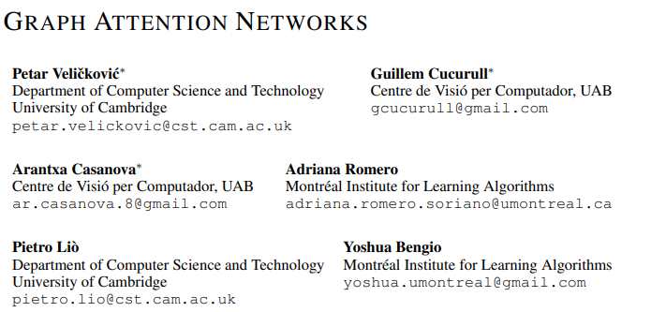
Title & Authors of the Paper
Source: Screenshot from “Graph Attention Networks”, ICLR 2018

Slide 3
Motivation
Graphs are very popular.
Attention mechanisms made huge impact on NLP/Deep Learning domain.
GAT bridges the gap between Graph Neural Networks (GNN) and Attention.
Notes:
Graph Neural Networks (GNN) have become essential for processing non-Euclidean data structures (social networks, molecules...). However, early GNN models lacked the ability to weigh the importance of neighbors dynamically. Inspired by the success of Attention Mechanisms in NLP (transformers), GAT was introduced to be a solution for this problem.
Our motivation for choosing this paper lies in its foundational role in modern Geometric Deep Learning and its potential for further improvements.

Slide 4
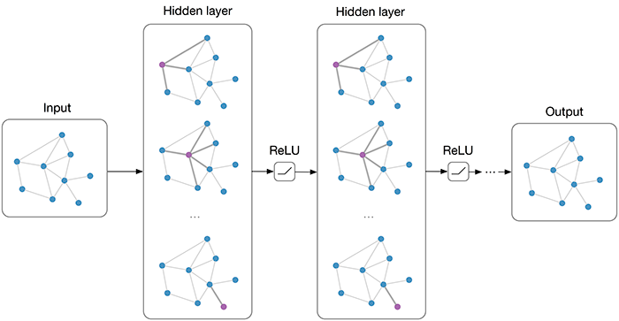
Problem Statement
Previous model -> Graph Convolutional Networks (GCN). (Kipf & Welling, 2017)
GCN treats all neighbors equally (isotropic).
GAT solution: Learning to assign different importance weights to different neighbors (anisotropy).
Source: Graph Convolutional Networks | Thomas Kipf | Google DeepMind
Notes:
As mentioned, GCN has fundamental limitation due to its isotropic behaviour. In a GCN, the aggregation of neighbor information is static. It relies purely on the graph structure (specifically, the degree of the nodes) to determine weights. Formally, the weight assigned to a neighbor j is 1/√(deg_i * deg_j) . This means if a node has 10 neighbors, GCN treats them all as roughly equally important, structurally speaking. This approach is often suboptimal in real-world scenarios. For example, in a citation network, a paper might cite 20 references, but only 1 or 2 are fundamental to its premise. An isotropic model cannot distinguishingly prioritize these key connections.
GAT addresses this by introducing anisotropy. It employs a trainable attention mechanism that looks at the features of the neighbors, not just their existence. This allows the model to learn disparate importance weights for different neighbors, enabling it to focus on the most relevant information and ignore noise.

Slide 5
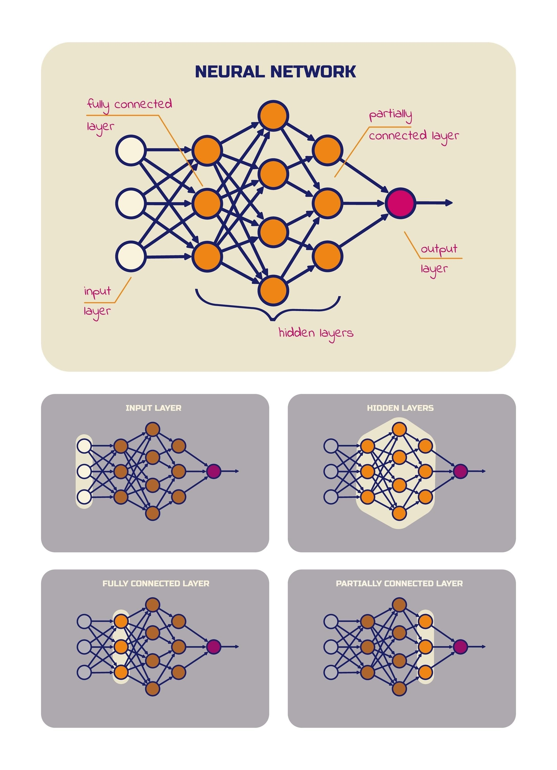
Methodology
The Attention mechanism:
Steps:
  Linear Transformation (W): Applied to every node.
  Concatenation: Combining source and target node features.
  Normalization: Softmax
Multi-Head Attention: Using K independent attention heads to stabilize learning.
Source: Google Gemini
Notes:
The goal of the mathematical structure is to compute an attention coefficient e_ij representing the importance of neighbor j to i. The process consists of three main steps:
Linear Transformation: First, a shared weight matrix W is applied to the feature vectors of every node (h). This projects the input features into a higher-level representation suitable for attention.
Attention Mechanism: The mechanism itself is a single layer feed-forward, parameterized by a weight vector a. We concatenate the transformed features of the source and target nodes (W_h_i || W_h_j). The vector a then maps this high-dimensional concatenation to a single scalar value. A LeakyReLu activation(with negative slope 0.2) is applied to introduce non-linearity.
Normalization: The raw scores e_ij can be arbitrary real numbers. To make them comparable and usable as weights, we normalize them using SOftmax over all neighbors of node i. This ensures the coefficients sum to 1.
Finally, to stabilize learning (similar to Transformer models in NLP), GAT employs Multi-Head Attention. We compute K independent attention mechanisms in parallel. For intermediate layers, their outputs are concatenated(preserving all information); for the final output layer, they are averaged(to produce a single prediction).

Slide 6
Experiment Hardware Environment
NVIDIA GeForce RTX 3070
4GB VRAM

Slide 7
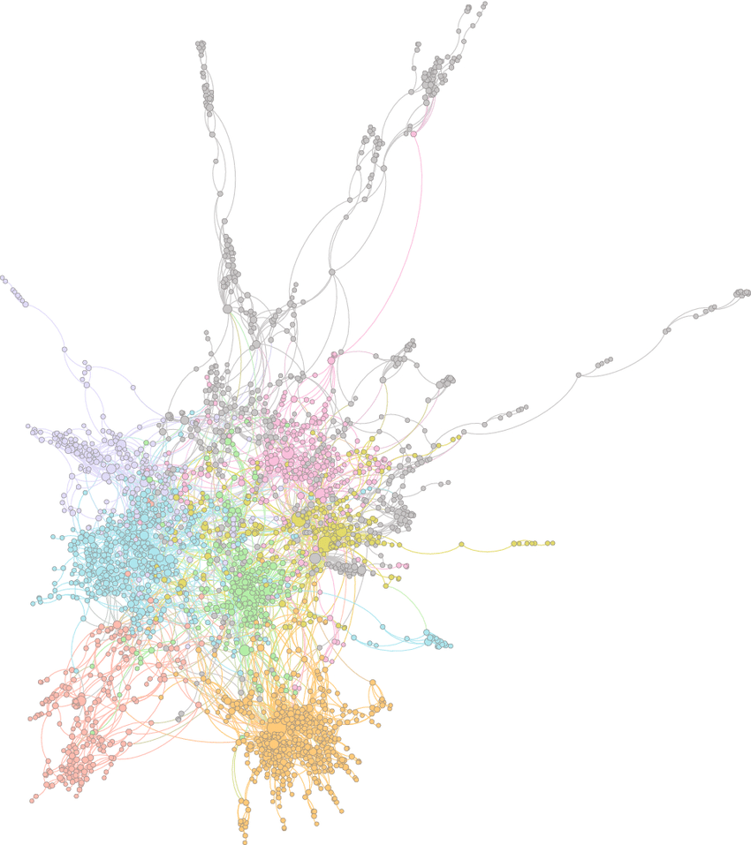
Dataset: CORA (Scientific Publications)
Nodes: 2708 scientific papers
Edges: 5429 citation links
Node Features: 1433 dimensional binary vector(Bag-of-Words)
Prediction Task: Classification into 7 categories
Data Split:Standard Planetoid split (140 Train, 500 Val, 1000 Test)
Notes:
To reproduce the paper's results and test our contribution, we selected the Cora dataset, which is widely considered the 'MNIST' of graph learning benchmarks. It represents a network of scientific publications.
In this graph, every node represents a unique scientific paper—there are roughly 2,700 of them. The edges represent citation links. In the original data, these are directed (A cites B), but following the GAT paper's methodology, we treated the graph as undirected to allow information to flow in both directions between related papers.
For the input features, we don't feed the raw text of the papers into the model. Instead, each paper is represented by a Bag-of-Words vector of size 1,433. This is a binary vector where a '1' means a specific keyword exists in the paper, and '0' means it doesn’t
Our goal is Node Classification. We have 7 different subject classes like Neural Networks or Genetic Algorithms. We train the model using only a very small fraction of labeled nodes—just 140 papers—and the model must learn to predict the subjects of the remaining papers by aggregating feature information from their neighbors.

Slide 8
Implementation Strategy
Framework Transition: Tensorflow to PyTorch
Masked Self Attention: Nodes only attend to their direct neighbors
First Layer: 8 Attention Heads (Concatenated)
Second Layer: 1 Output Head (Classification)
Hyperparameters:
  Learning rate: 0.005
  Weight decay: 0.0005
  Dropout:0.6
  Epochs: 200(with Early Stopping patience: 100)
Notes:
Moving on to our implementation strategy. While the original paper utilized TensorFlow, we chose to implement the model from scratch using PyTorch.
The core of our code is the Masked Self-Attention mechanism. For every node, the model learns a dynamic weighting score—essentially asking, 'How important is this neighbor to me?'. We implemented a masking operation where non-connected nodes are assigned negative infinity scores. When passed through the Softmax function, these become zero, so the model only aggregates information from valid neighbors.
Following the paper's specific configuration for Cora, we used a Multi-Head structure with 8 heads in the first layer to stabilize learning, followed by a single output head. This baseline implementation achieved 82.10% accuracy, which successfully reproduces the results reported in the original paper, confirming that our foundation is solid.

Slide 9


Our Contribution: Dynamic Head Attention
Paper’s:
Ours:
Head 1, Head 2, … Head 8
Average
Output
Head 1, Head 2, … Head 8
Learned weights
Output
Notes:
After building the baseline model, we noticed an area of ​​improvement in the original structure. The standard GAT model simply averages the information from eight different 'heads' in the final layer, combining it. In other words, the model gives equal weight to the opinions of each head.
We questioned this assumption. We said, 'Maybe Head 3 is an expert at recognizing AI articles, while Head 5 is better at Genetics articles.' Why should we treat them all equally?
That's why we added a mechanism to the model called 'Dynamic Head Attention.' The model no longer blindly averages its output; it uses a second layer of weights that calculate how reliable each head is for the current node. In other words, the model applies attention not only to its neighbors but also to its own internal mechanisms.

Slide 10
Results
Approach | Paper Accuracy | Our Accuracy
Baseline GAT | 83% | 82.10%
Dynamic Head GAT |  | 82.00%
Notes:
Moving on to our experimental results. First, looking at the Baseline GAT , we achieved a test accuracy of 82.10%. This is a significant success for us because it closely matches the benchmark results reported in the original paper.
However, when we look at our Dynamic Head GAT, we see an accuracy of 82.00%. Essentially, the performance remained comparable to the baseline, but we did not observe the improvement we hypothesized. The natural question is: Why? Our analysis points to Data Scarcity and Over-parameterization.
As I mentioned earlier, the Cora training set contains only 140 nodes. By adding a secondary attention mechanism to learn 'Head Importance,' we increased the model's complexity. With such limited data, the model struggled to learn meaningful weights for the heads—it simply didn't have enough examples to differentiate between a 'good' head and a 'bad' head.«
As a results we think for small, graphs like Cora, simple aggregation strategies—like averaging—are robust enough. Our proposed mechanism would likely be more effective on larger, more complex datasets where the distinction between heads is more critical.

Slide 11

Contribution II: Edge-Enhanced GAT
The original approach depends only on the node features.
Idea: In domains like Chemistry, the type of connection(edge)is as important as the connected atoms(node).
Our goal: To incorporate edge features into the GAT attention mechanism.
Notes:
While analyzing the GAT structure, a brief idea came to our minds: the attention mechanism depends solely on node features, but not the edge attributes. In citation networks like Cora, this may be acceptable as edges are binary. However, in domains like social networks, chemistiry; edge features are important too. Our hypothesis is that incorporating edge embeddings directly into the attention scoring function will allow the model to differentiate neighbors not just by the node type but also how they are connected (edge type).

Slide 12

Structure
Dataset change: MUTAG dataset (https://huggingface.co/datasets/graphs-datasets/MUTAG)
Proposed formula:
Implementation:
  Base class: Inherited from "torch_geometric.nn.MessagePassing".
  Projection: Added a dedicated learnable Linear layer to project edge attributes to the hidden dimension.
  Logic: Overrode the message function to perform 3-way concatenation(source node + target node + edge between them) before the attention calculation.
Notes:
To test our hypothesis, we switched our dataset as MUTAG dataset, which contains rich edge features to representing chemical bonds. In this dataset, nodes represents atoms, edges represents chemical bond. We mathematically extended the attention formula to perform a 3-way concatenation: Source Node, Target Node and the Edge Feature between them. For implementation, we did not rely on pre-built layers. Instead, we created a custom layer inheriting from MessagePassing in PyTorch Geometric. We introduced a separate learnable linear projection for edge attributes and overrode the function to inject edge information into the attention computation before the Softmax normalization.

Slide 13
Results
MODEL | DESCRIPTION | ACCURACY
Baseline | Original GAT(node only) | 72.95%
PyG Built-in | Standard Library with edges | 75.06%
Scratch | Custom edge-enhanced | 77.22%
Notes:
Since MUTAG data size is small(contains 187 graphs only), we used 10-Fold Cross Validation. The results strongly support our hypothesis. The Baseline GAT(node-only) achieved 72.95%. Simply adding edge features using standard library functions improved this to 75.06%. However, our custom "From-Scratch" implementation, which optimizes the mathematical integration of edges into the attention mechanism, achieved the highest accuracy of 77.22%. This 4.27% improvement over the baseline is significant and proves that edge features are critical for graph classification in molecular tasks.
Using larger dataset may increase the accuracy and presents the edge features importance better.

Slide 14
Criticism
Strenghts:
Attention weights allow us to visualize and understand which neighbors are most influential.
The self-attention mechanism is parallelizable.
Weakness
For dense graphs, storing attention coefficients for every edge creates a high memory footprint.
Notes:
Critically analyzing the paper, we identified several strengths. First, its Inductive Capability: Unlike previous spectral methods like GCN, GAT can learn on one graph and apply that knowledge to completely new, unseen graphs. Second, Interpretability: The attention weights give us a 'window' into the model's decision-making, showing us exactly which neighbors are influencing the prediction.
However, GAT is not without limitations. The most significant one we encountered personally is Memory Intensity. Since GAT computes attention for every single edge, the memory usage scales with the number of edges, not just nodes. During our implementation, we faced 'Out of Memory' errors because the intermediate matrices for attention calculation became too large, forcing us to optimize the code. Additionally, the paper itself admits that efficient batching of these sparse graph operations is technically difficult compared to standard image processing.

Slide 15

Thanks for listening ☺

