Slide 1

Notes:
Cover — Muhammadhisam Pala

Slide 2
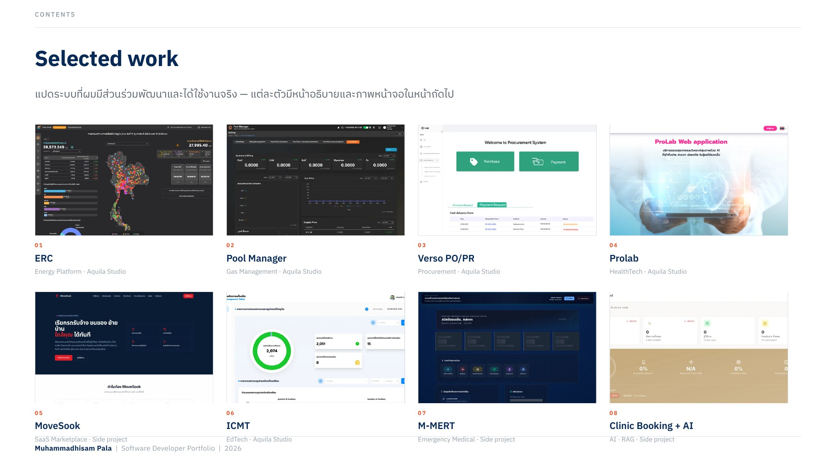
Notes:
Selected work

Slide 3
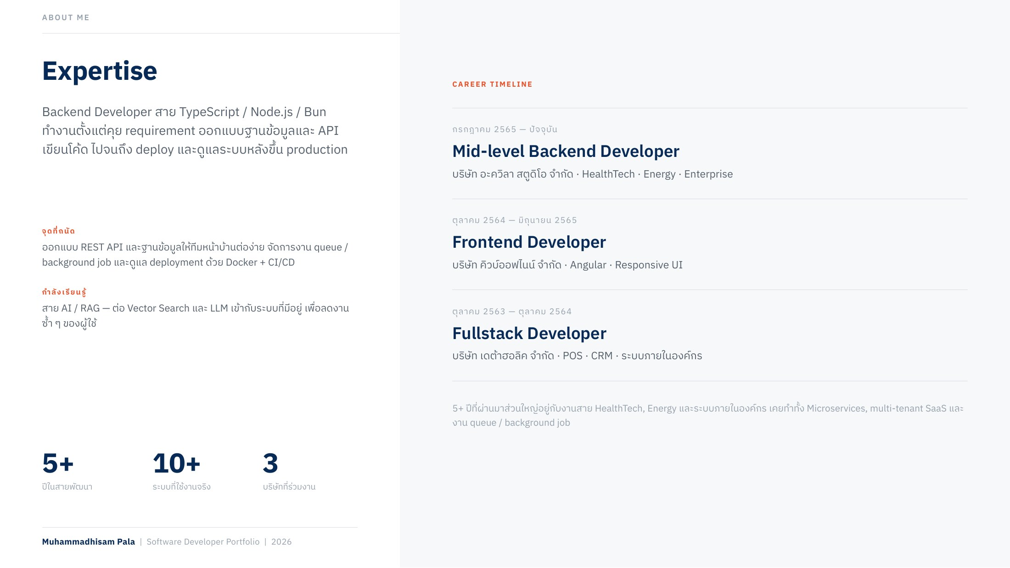
Notes:
Expertise & career timeline

Slide 4
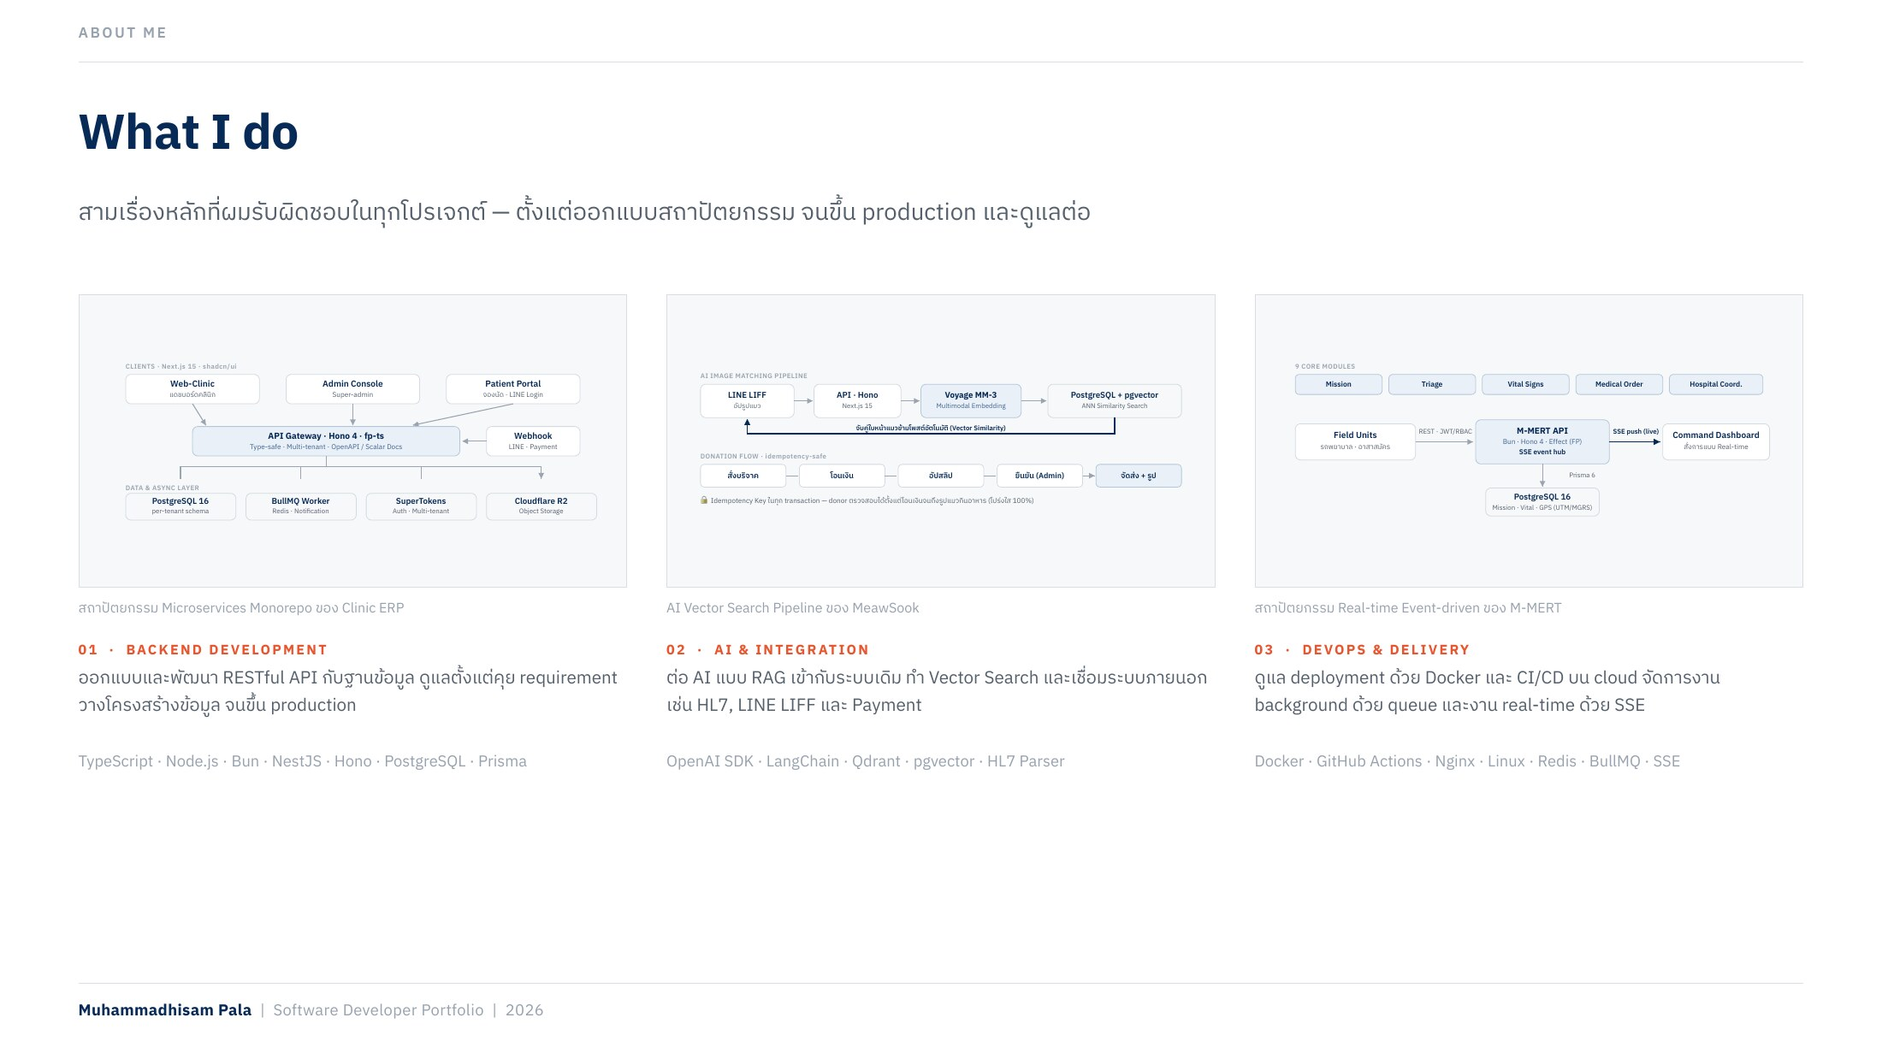
Notes:
What I do

Slide 5
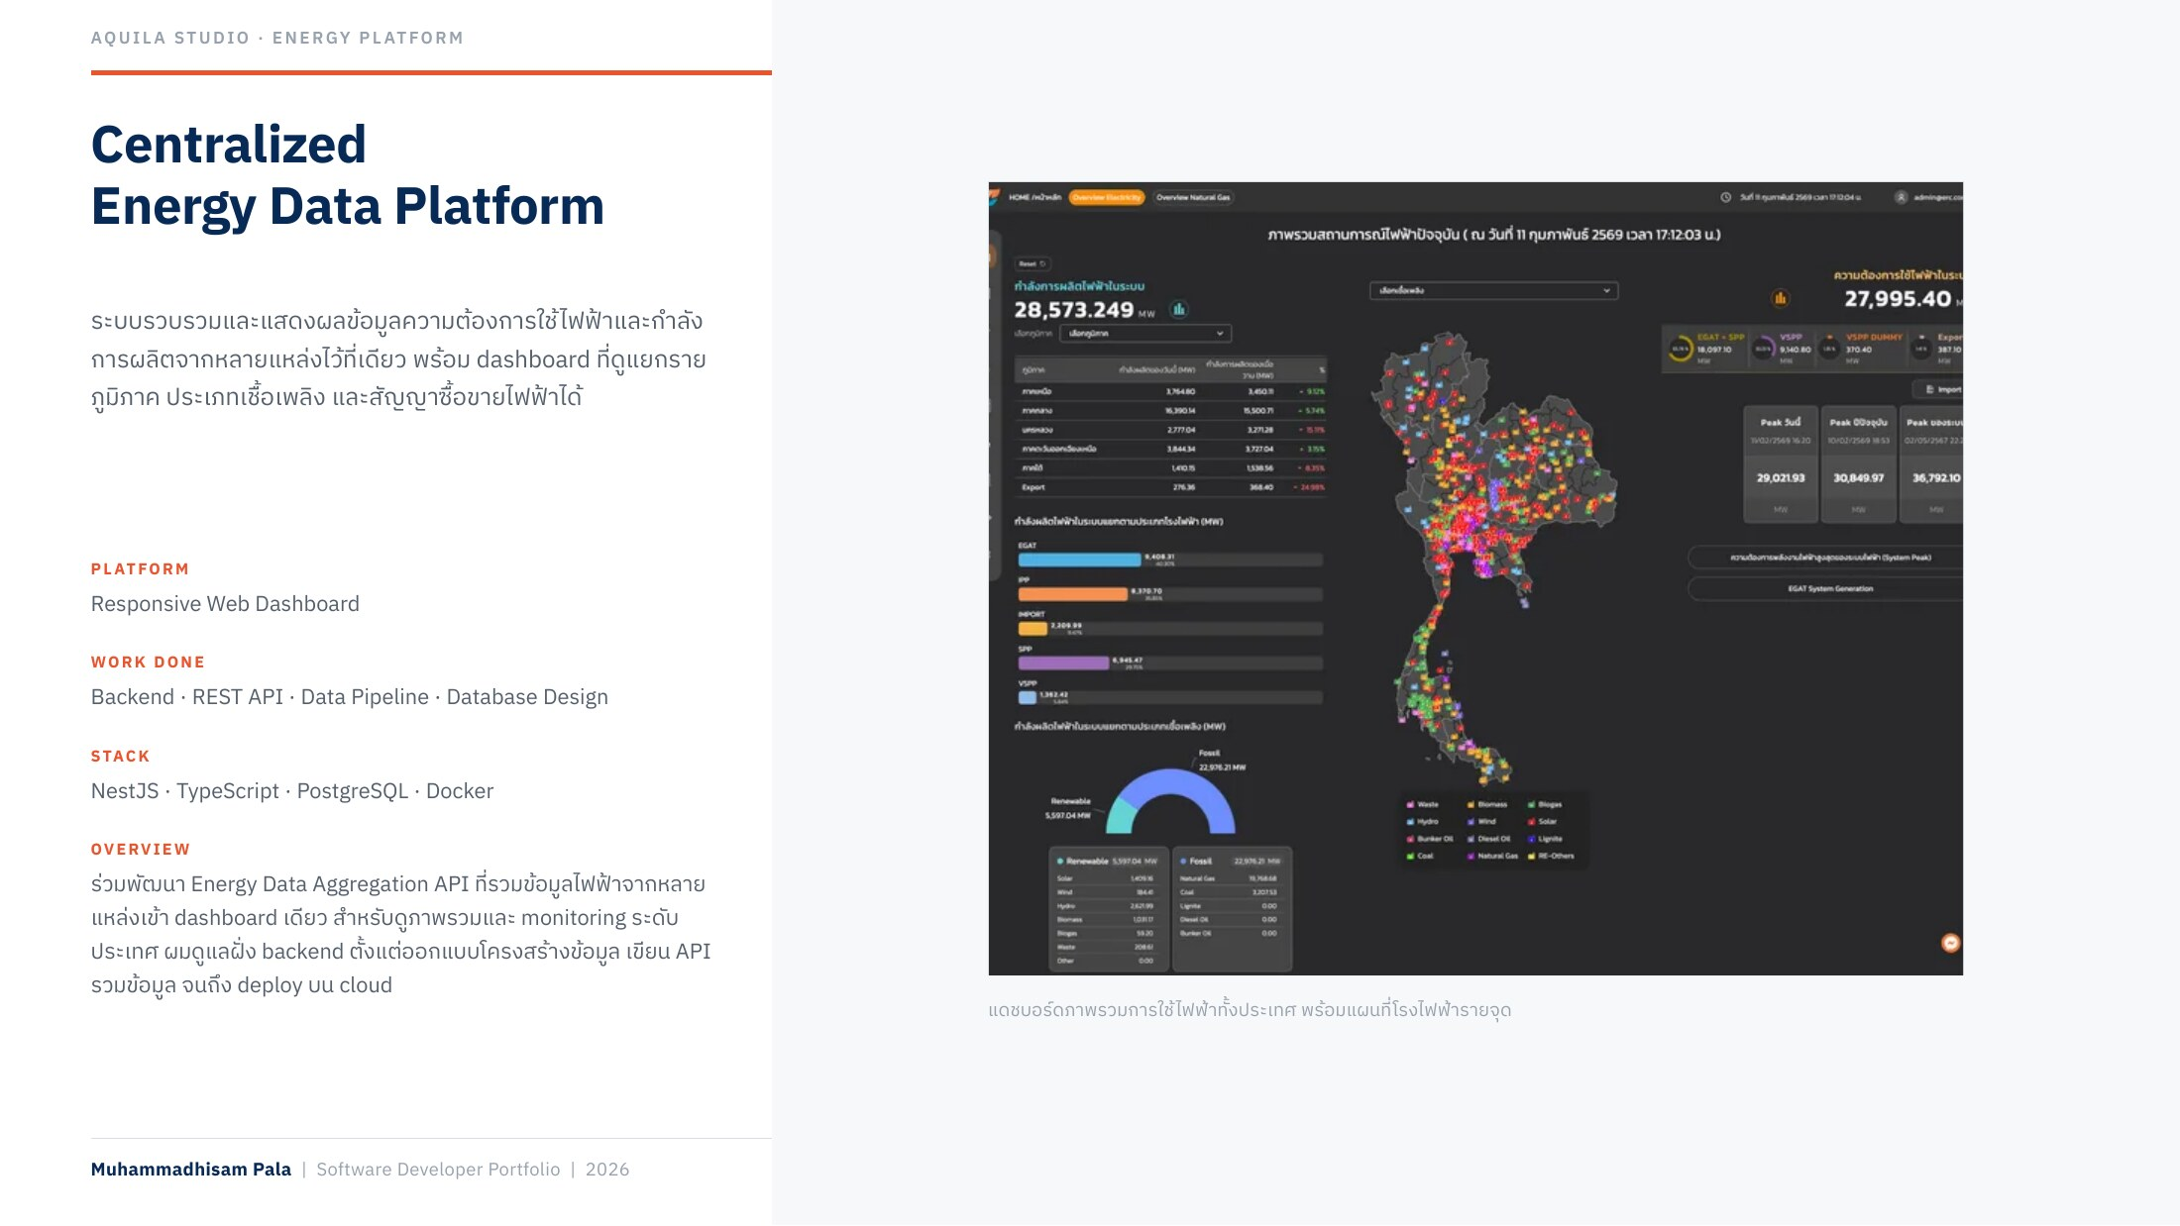
Notes:
ERC — Centralized Energy Data Platform

Slide 6
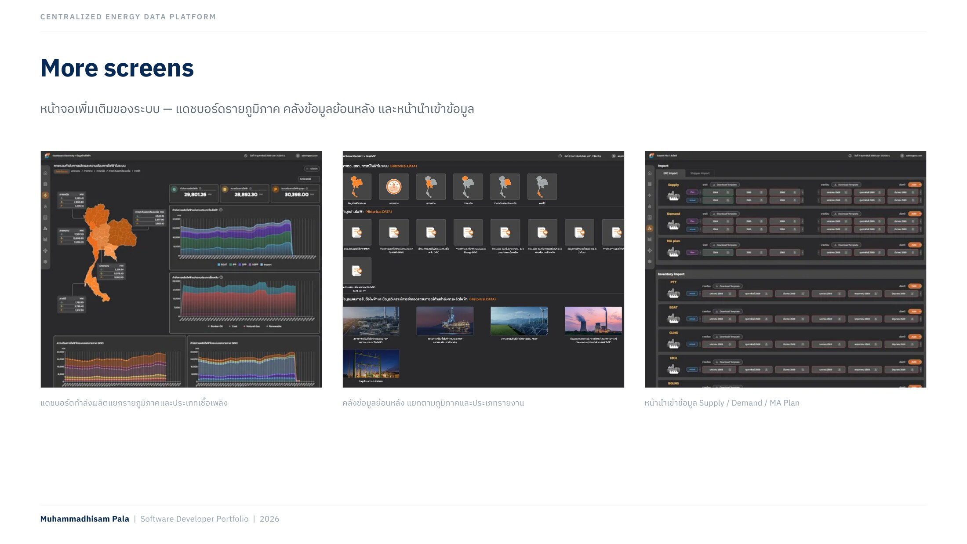
Notes:
ERC — More screens

Slide 7
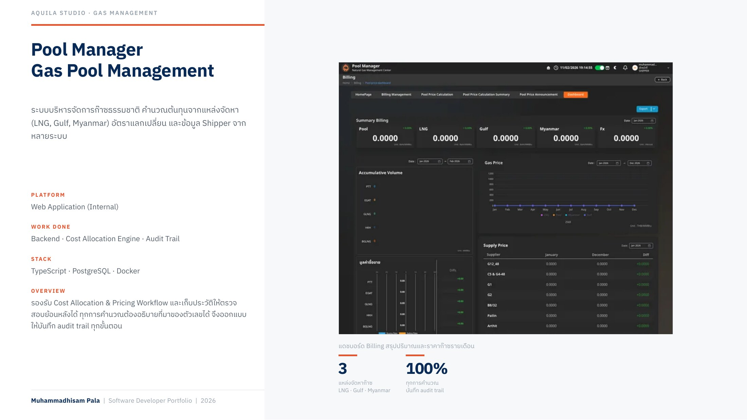
Notes:
Pool Manager — Gas Pool Management

Slide 8
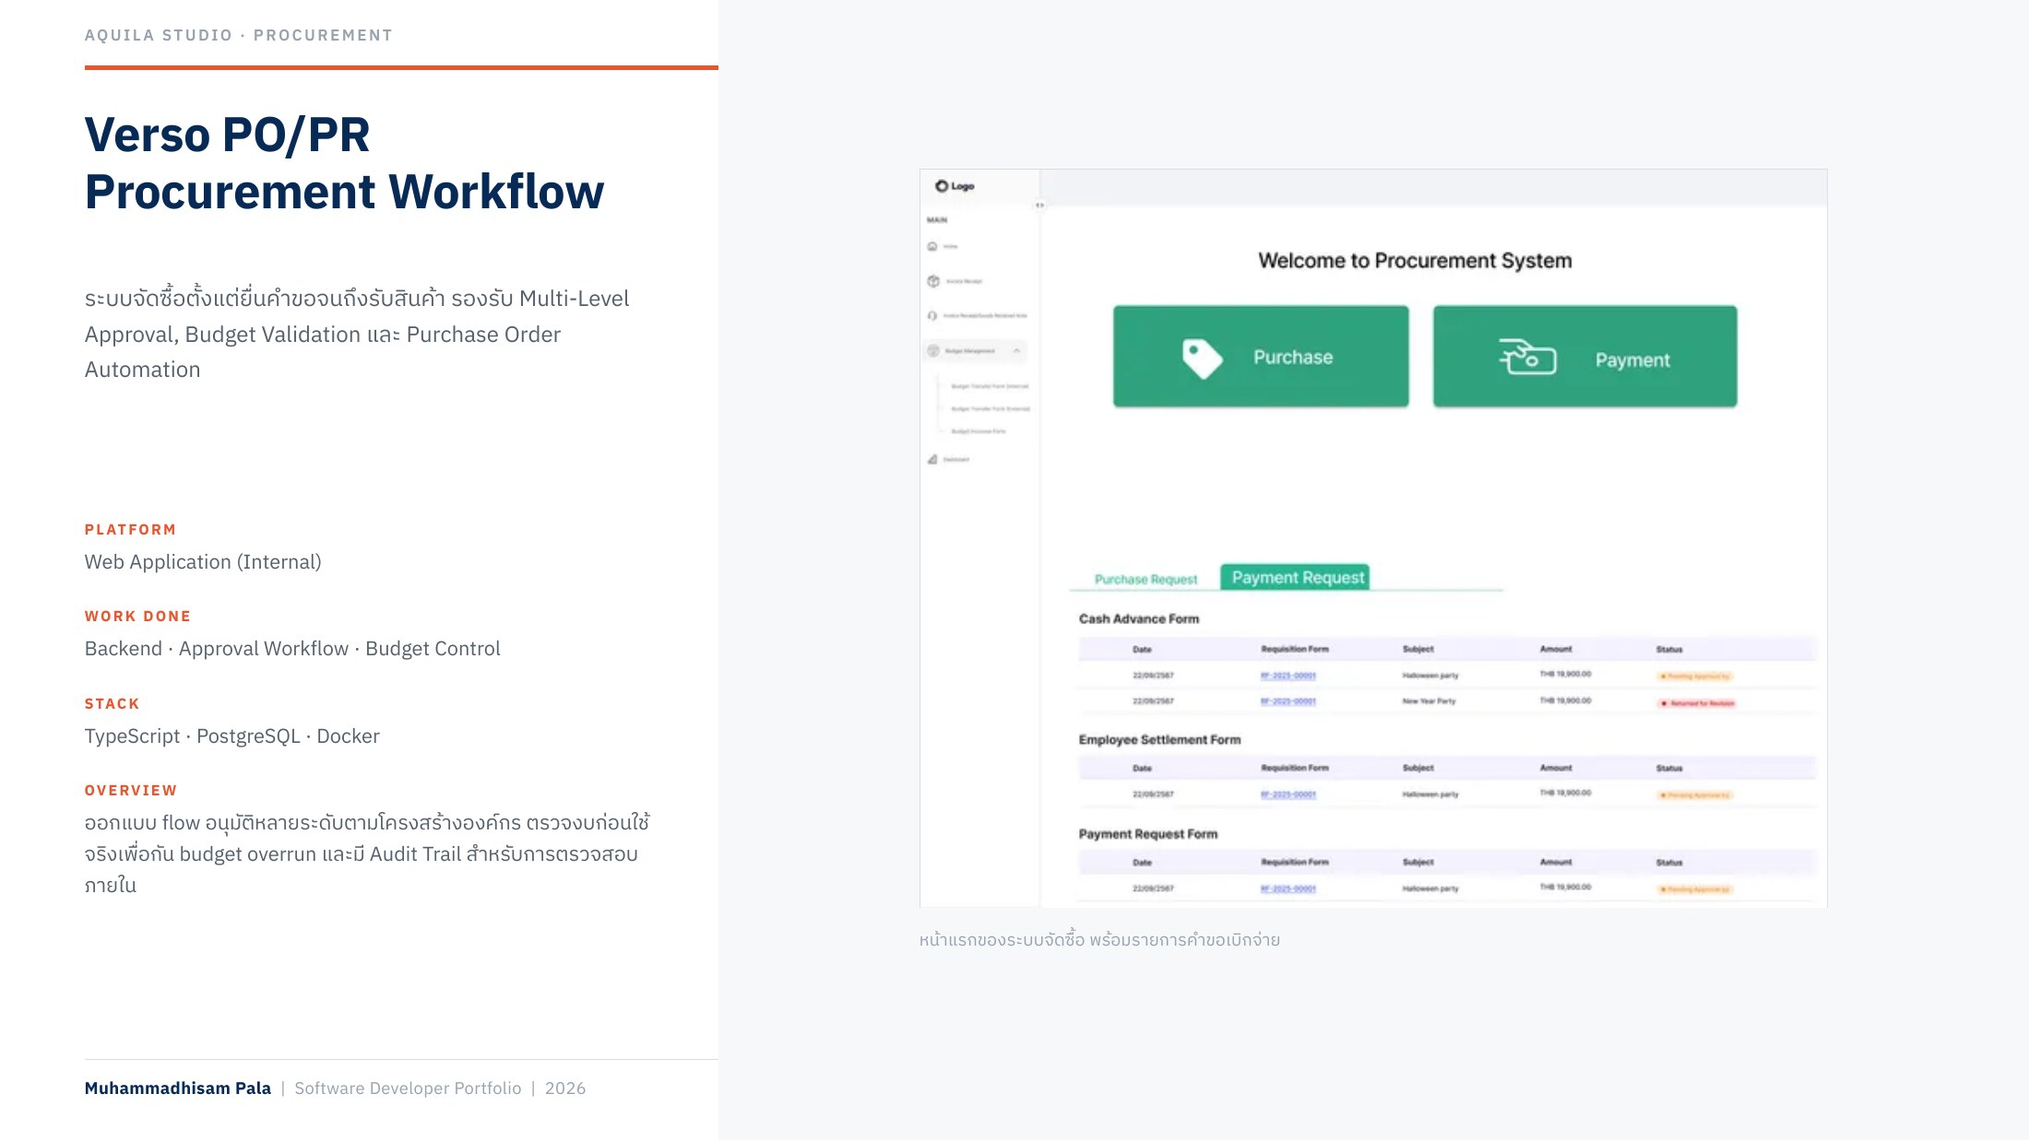
Notes:
Verso PO/PR — Procurement Workflow

Slide 9
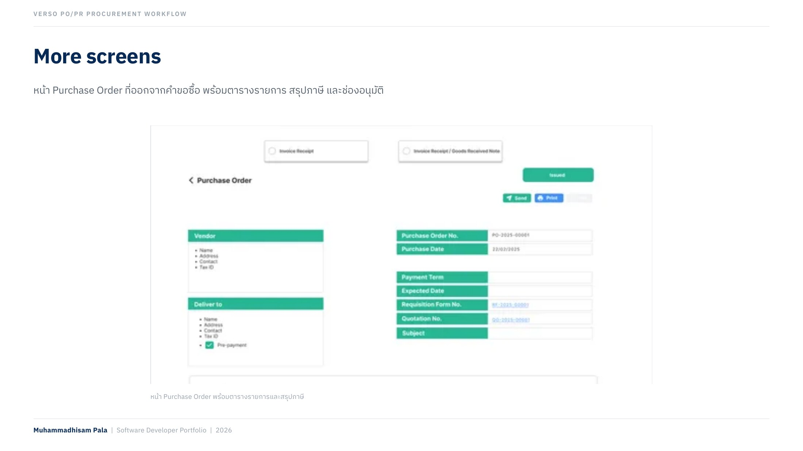
Notes:
Verso PO/PR — More screens

Slide 10
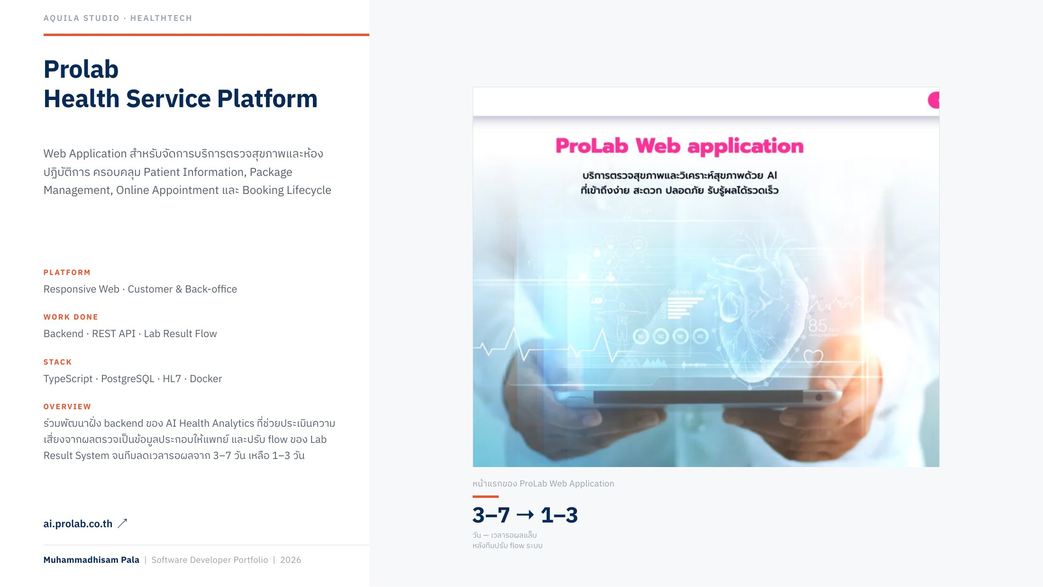
Notes:
Prolab — Health Service Platform

Slide 11
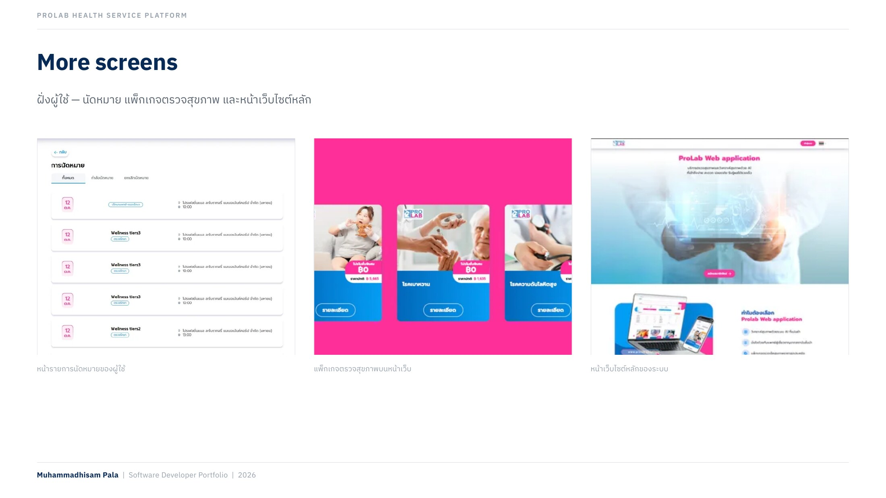
Notes:
Prolab — More screens

Slide 12
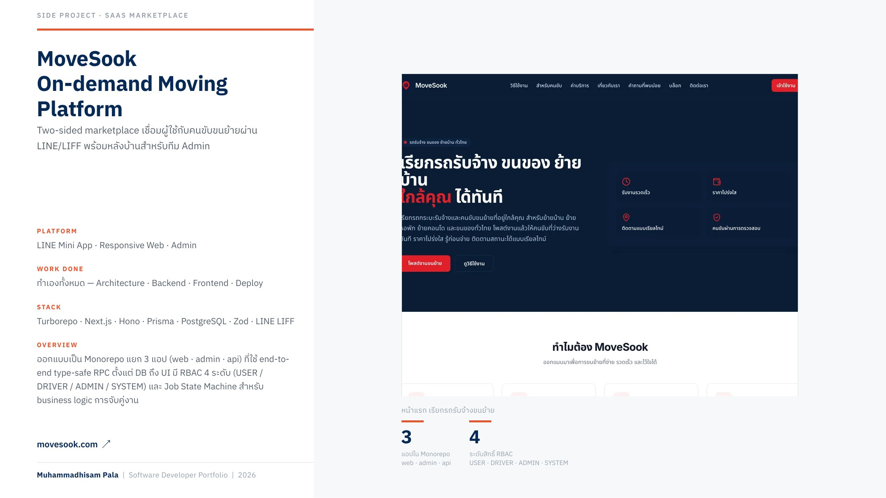
Notes:
MoveSook — On-demand Moving Platform

Slide 13
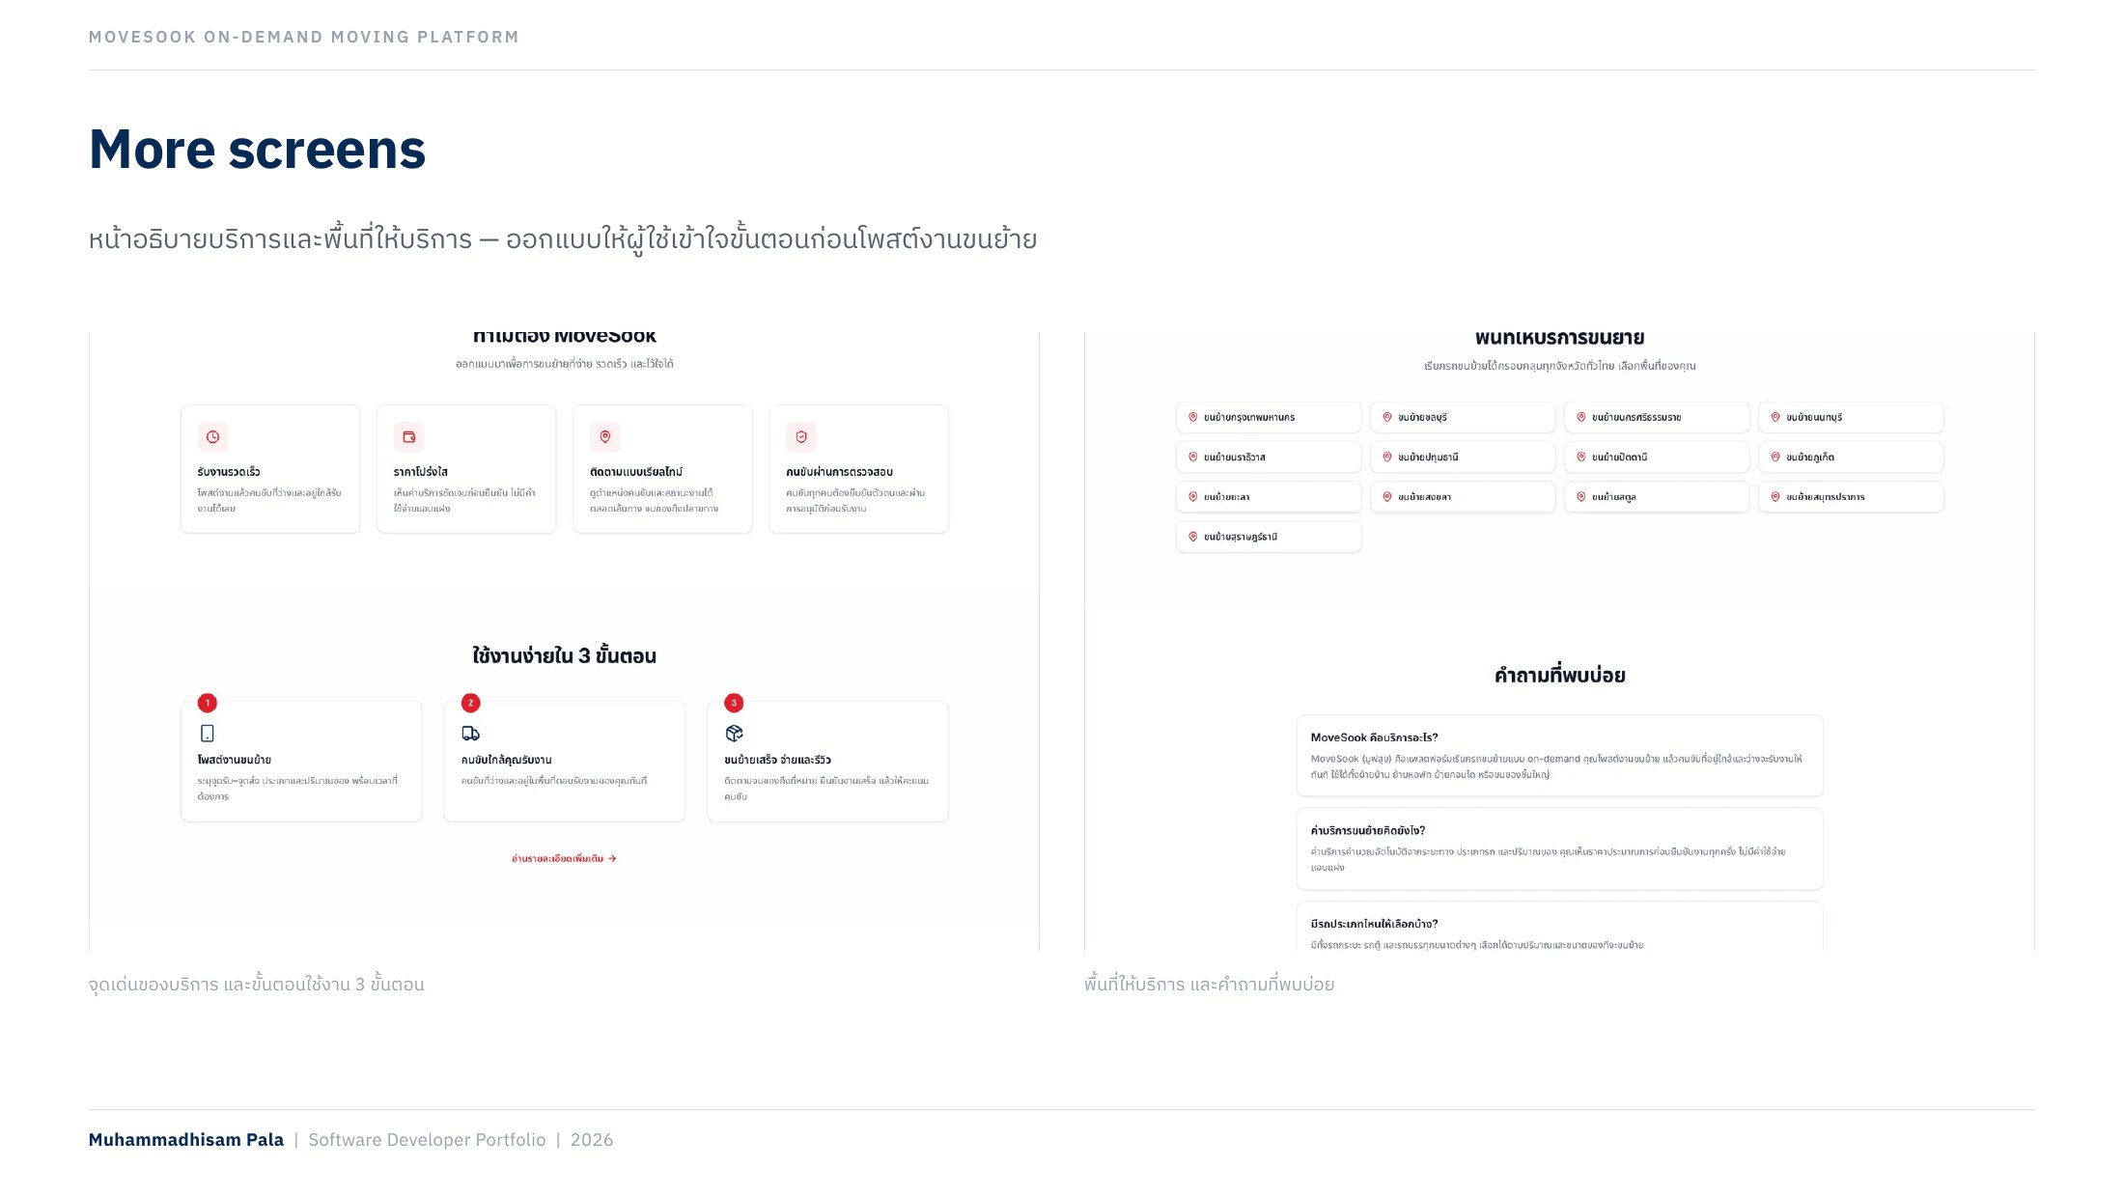
Notes:
MoveSook — More screens

Slide 14
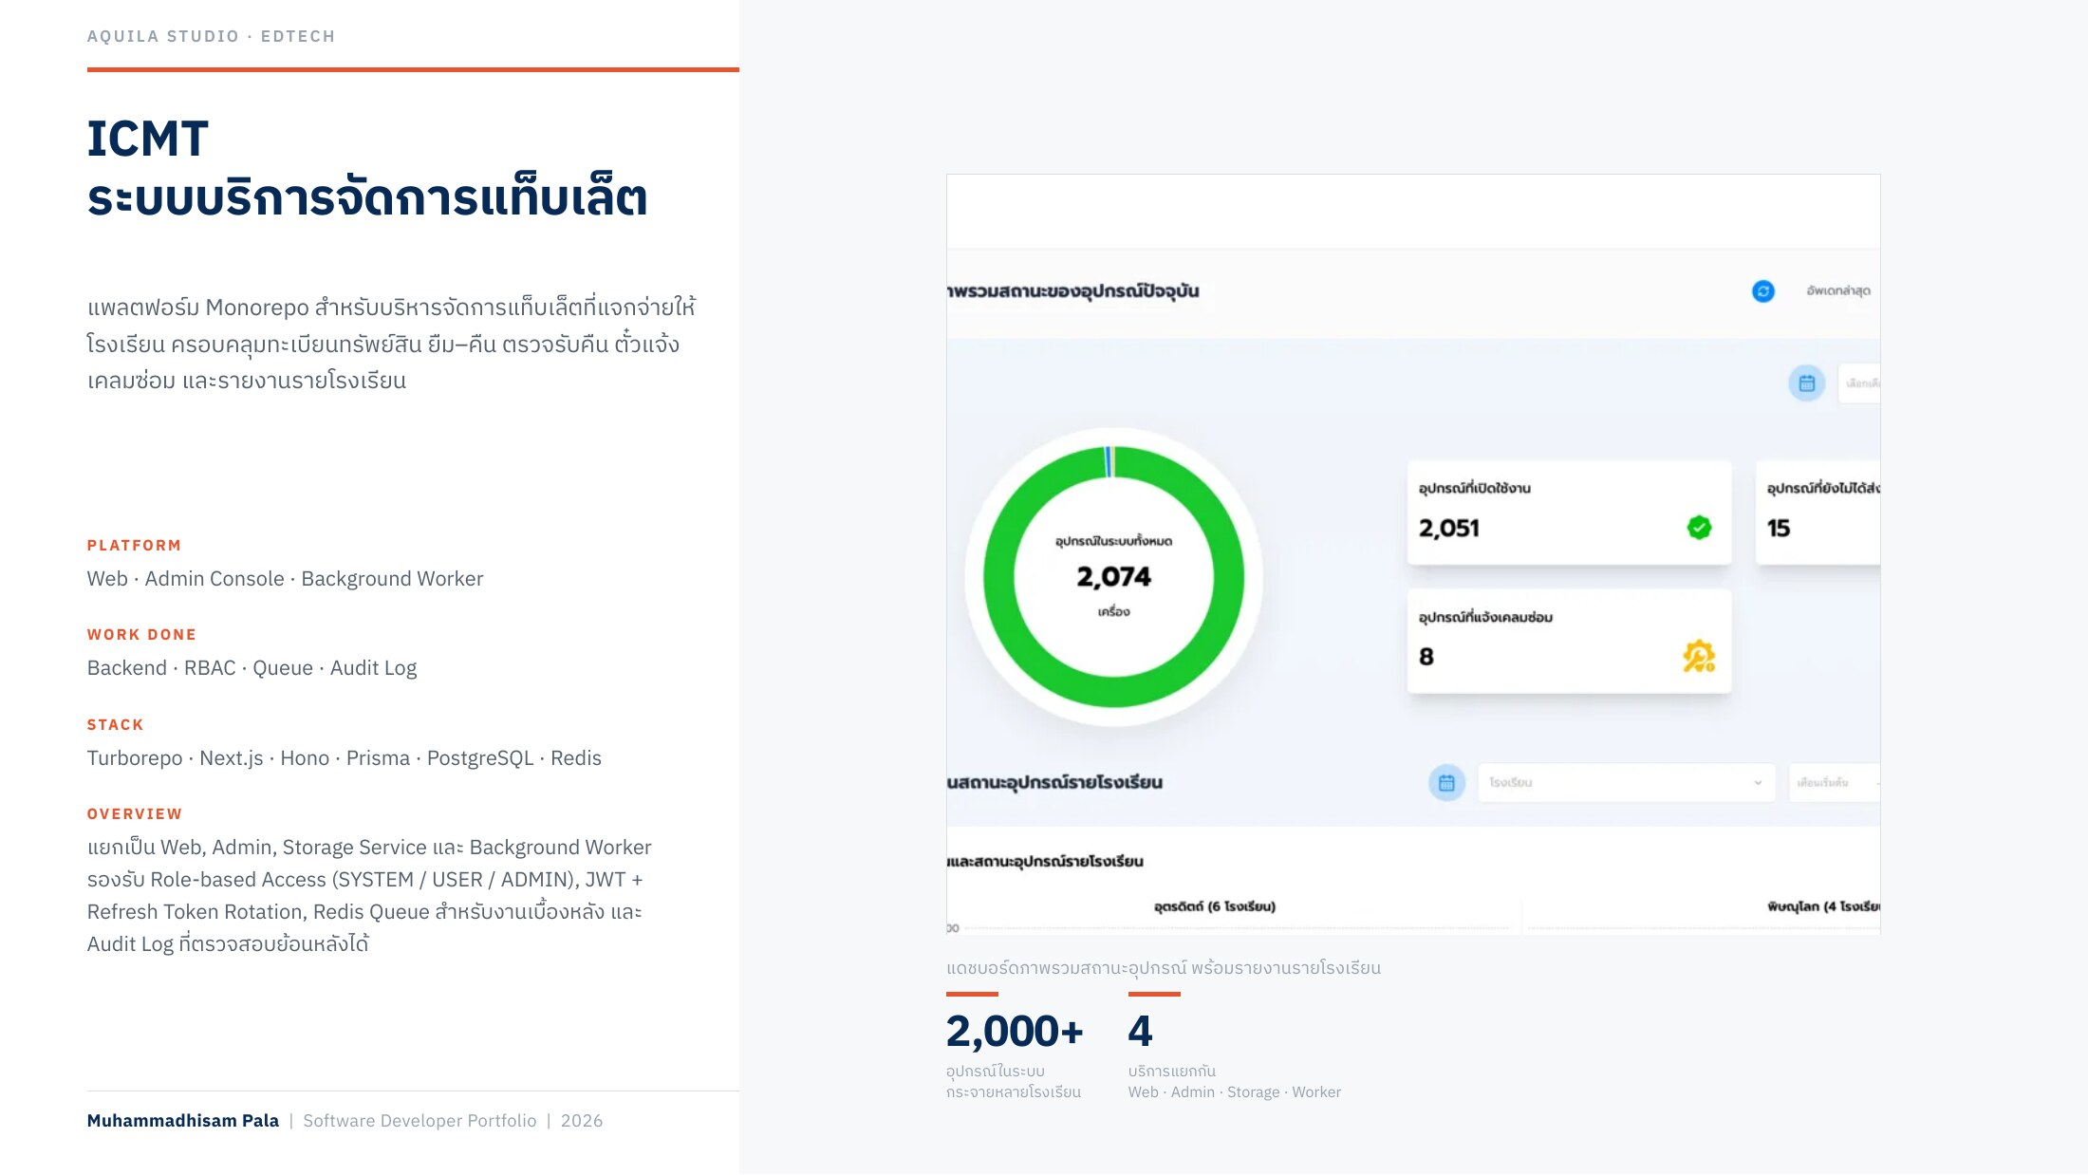
Notes:
ICMT — ระบบบริการจัดการแท็บเล็ต

Slide 15
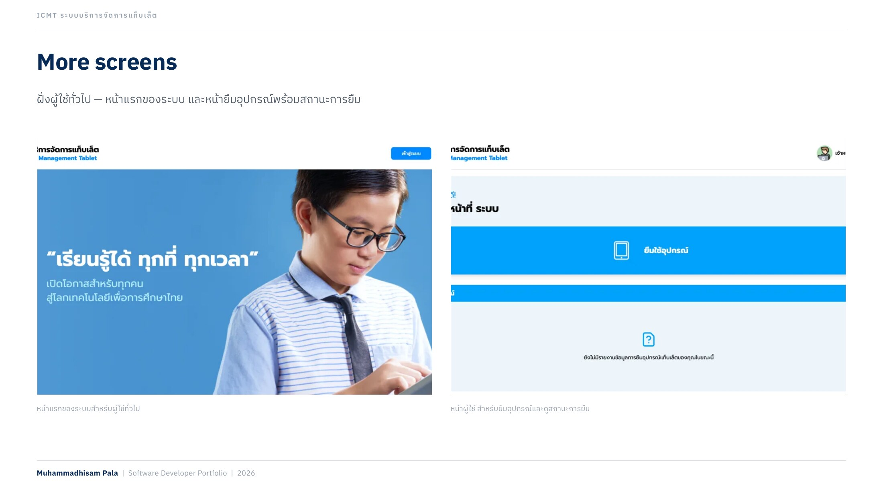
Notes:
ICMT — More screens

Slide 16
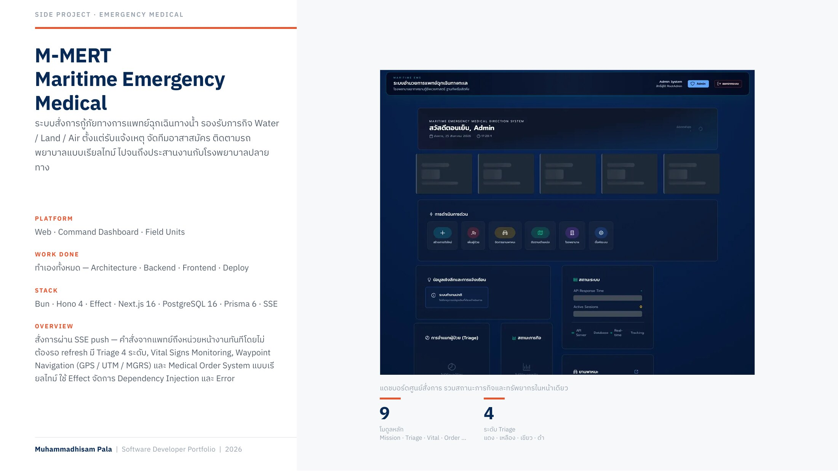
Notes:
M-MERT — Maritime Emergency Medical

Slide 17
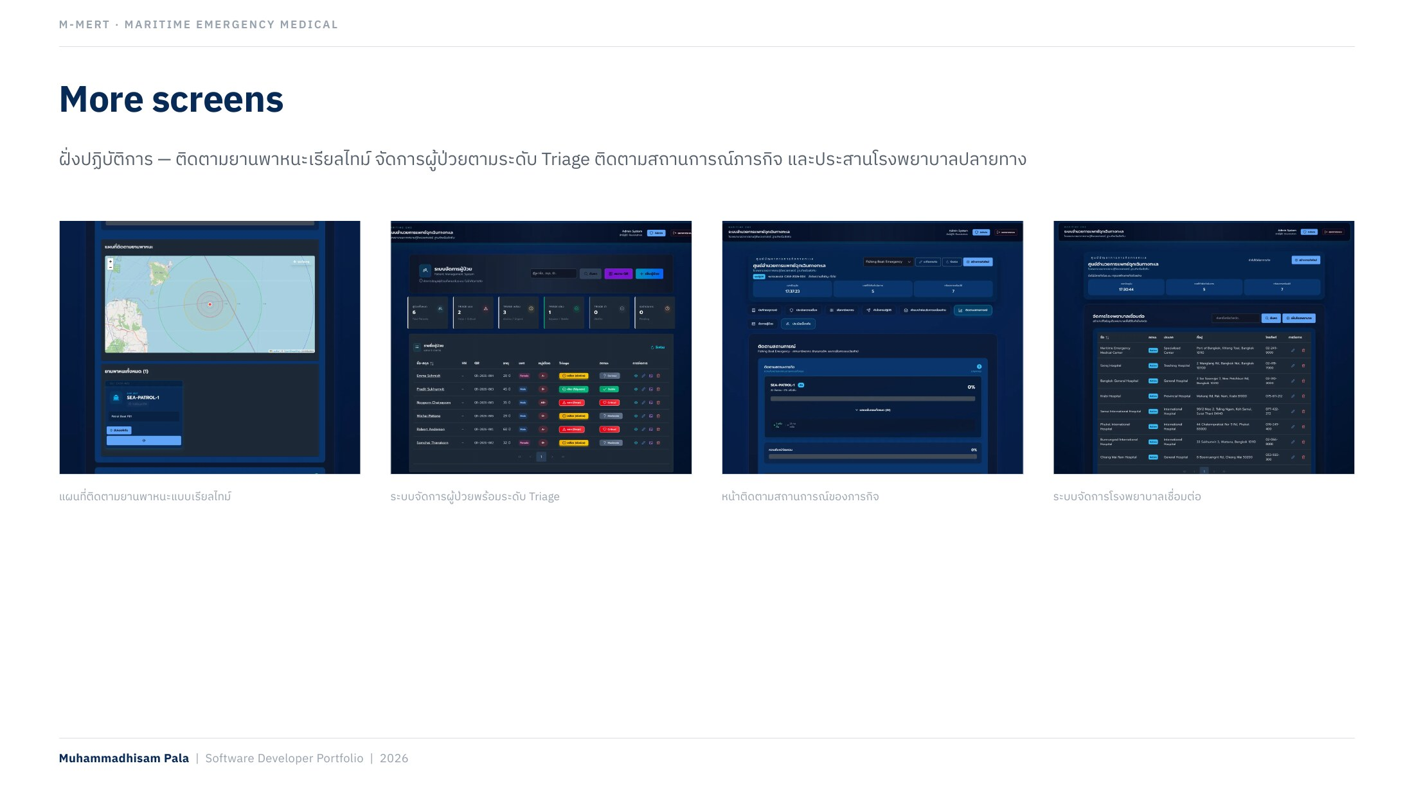
Notes:
M-MERT — More screens

Slide 18
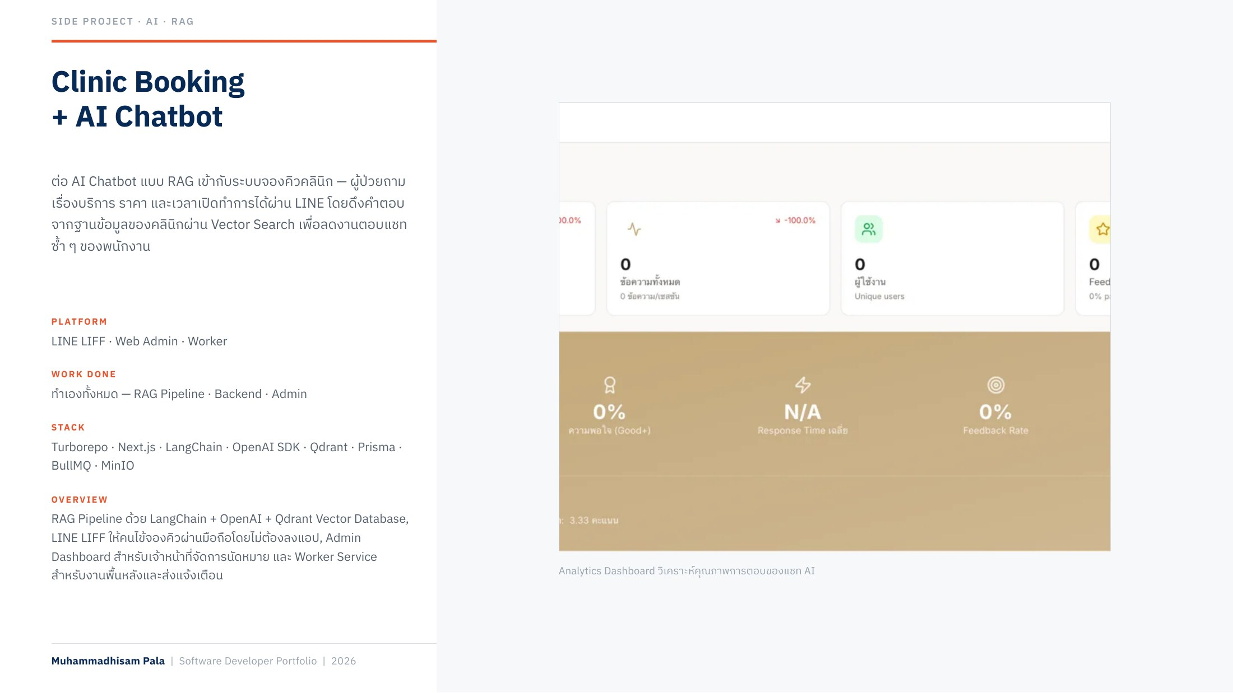
Notes:
Clinic Booking + AI Chatbot

Slide 19
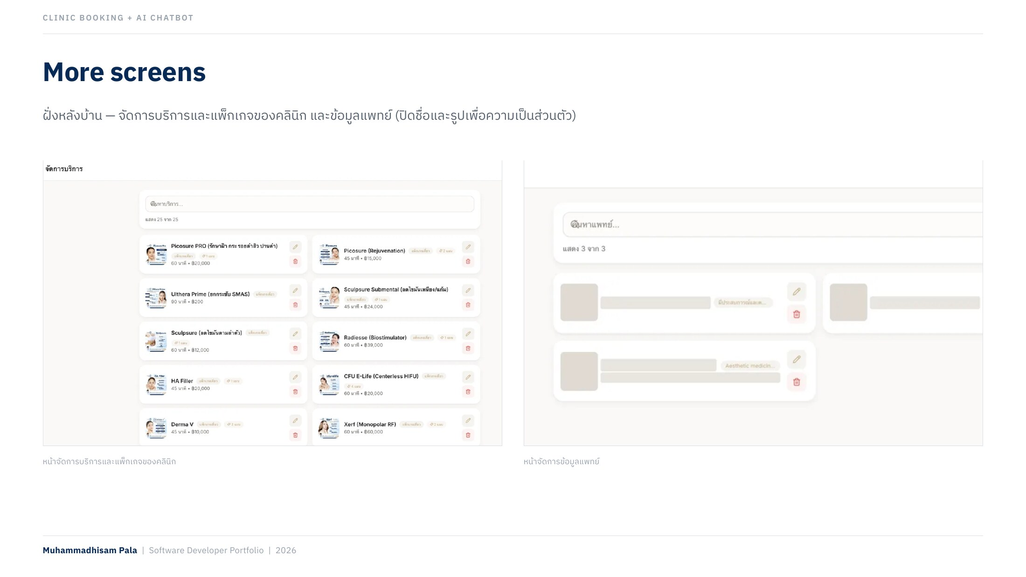
Notes:
Clinic Booking + AI — More screens

Slide 20
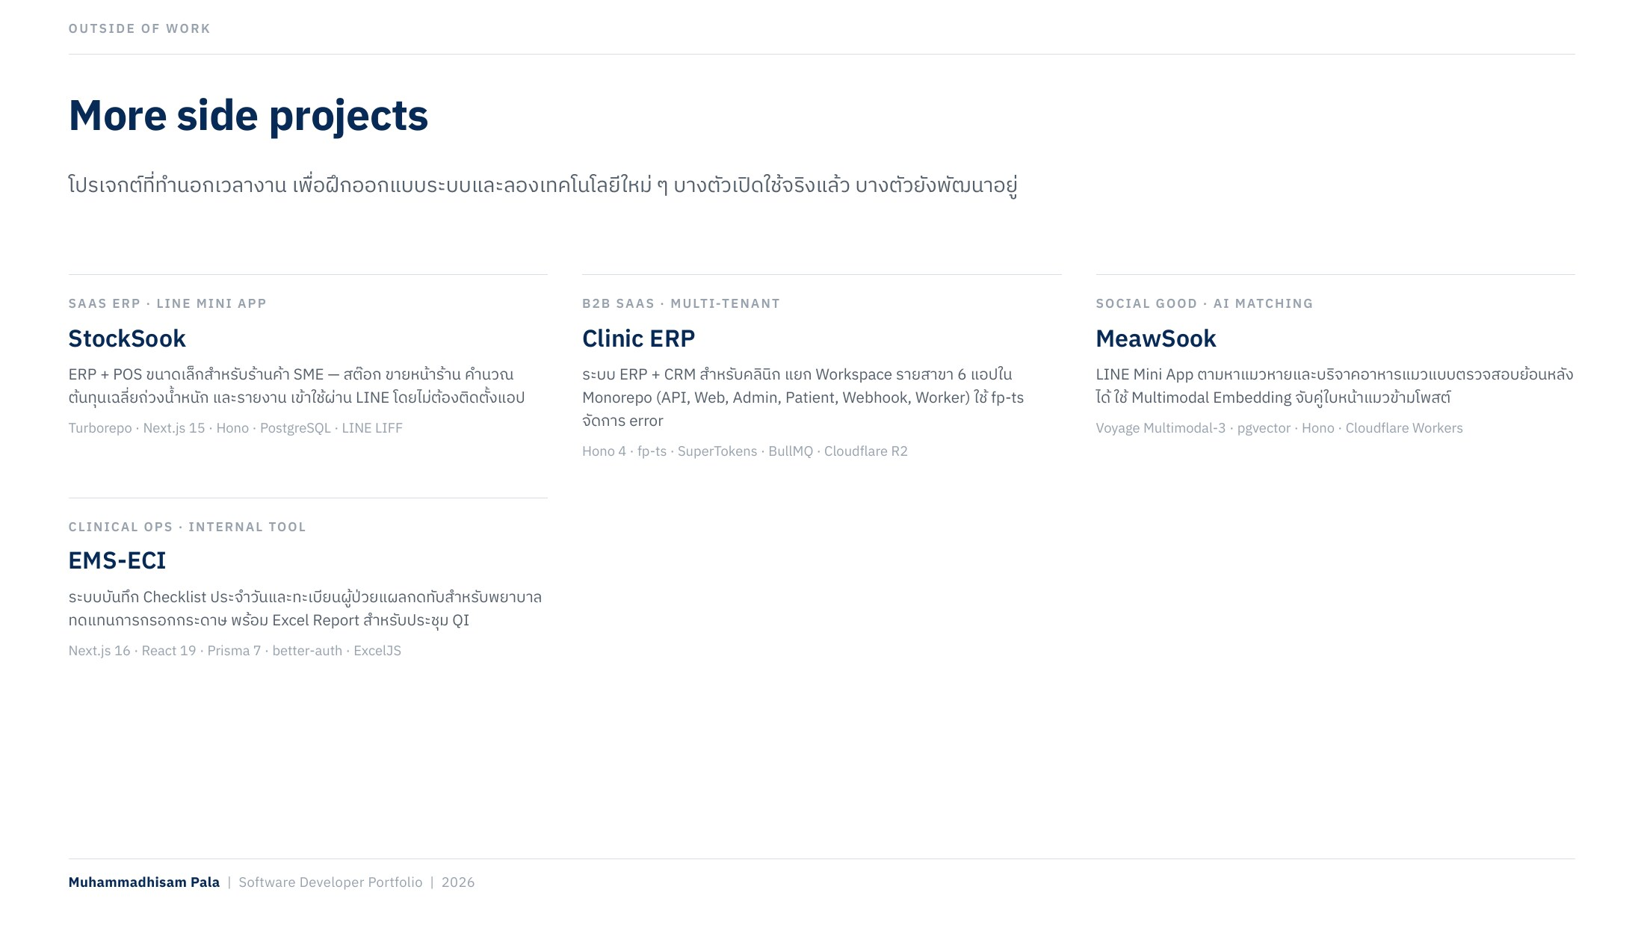
Notes:
More side projects

Slide 21
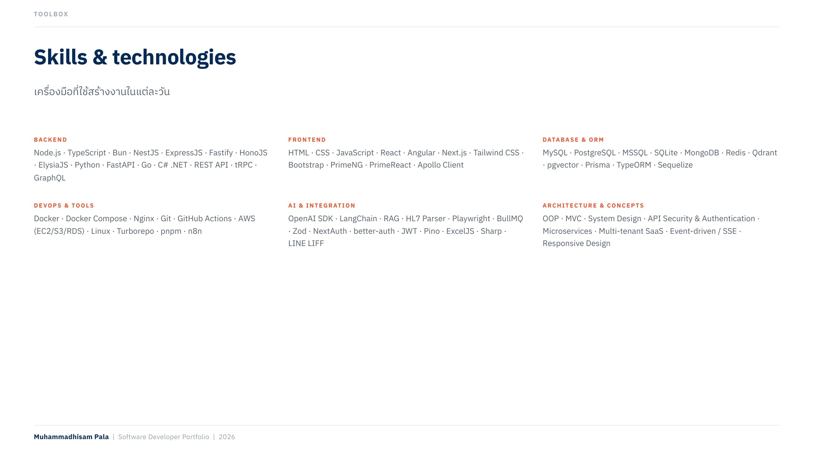
Notes:
Skills & technologies

Slide 22

Notes:
Thank you

