Slide 1
Annotating is Interesting

Slide 2
Intro
Annotating is the process of adding notes or comments to a text while reading it. Annotations can include highlighting or underlining important passages, writing in the margins, using symbols or codes to indicate key ideas, asking questions, making connections to other texts or ideas, and summarizing key points. The purpose of annotating is to actively engage with the material, deepen understanding, and retain information for future reference.

Slide 3
What makes Annotating an Interesting activity ?
Annotating can be an interesting activity because it involves actively engaging with a text and thinking critically about its content. It can help to enhance reading comprehension by encouraging the reader to analyze, interpret, and reflect on the material. Annotating can also be a creative outlet, as readers can use different colors, symbols, and formats to make their notes visually appealing and organized. Additionally, annotating can help to personalize the reading experience and make it more memorable, as readers can add their own insights and connections to the text. Overall, annotating is an active and interactive approach to reading that can enhance the learning process and make it more enjoyable.

Slide 4
Strategies for Annotating
Highlighting
Description Outline
Margin notes
Summarizing

Slide 5
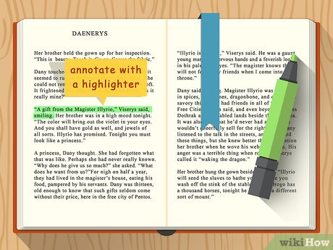
Highlighting
Highlighting is a common method of annotating that involves using a marker or pen to emphasize important words, phrases, or sentences in a text. Highlighting can be an effective way to quickly identify and review key information in a text.

Slide 6
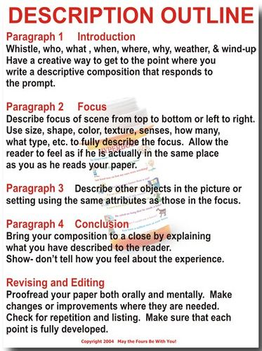
Descriptive Outline
A descriptive outline typically includes complete sentences or phrases that describe each section of the project or paper, including any key details or examples that will be included. It may also include information about the organization and structure of the content, such as the order in which ideas will be presented or the types of sources that will be used to support the argument.

Slide 7
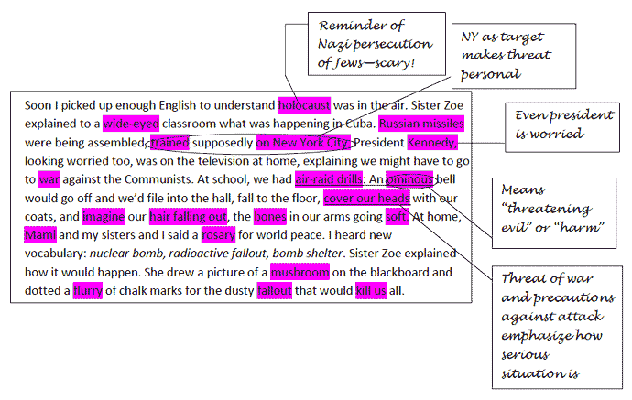
Margin notes
Margin notes are additional comments or annotations that a reader adds to the margins of a text, and they can include key words and phrases, summaries of important points, questions, and personal reflections. When readers become fully engaged with the material, they may even feel like they are having a conversation with the author, which can help them uncover and explore their own thoughts and opinions on the topic at hand. Ultimately, taking notes and making marginal comments can help readers better understand and connect with the material they are reading.

Slide 8
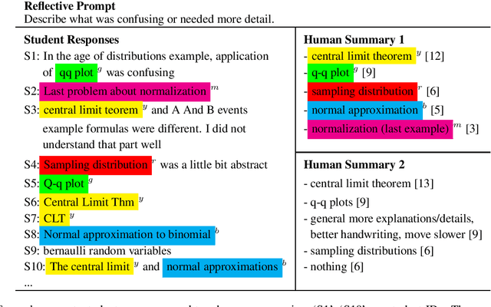
Summarizing
Simply locating important ideas in a text is not enough to ensure a full comprehension of the material. Instead, paraphrasing these ideas is a helpful technique for reinforcing your understanding and preparing for any written work that may result from the reading. Taking concise notes in the margins next to key ideas can provide a useful summary that is easily accessible on the text itself. When you can condense a sentence or paragraph into just a few words, it demonstrates a clear grasp of the underlying concepts and should make it easier to incorporate them into your own writing.

Slide 9
The Conclussion is…
Annotating is a powerful tool that can significantly enhance reading comprehension and retention. By making notes in the margins of a text, readers can identify and mark important information, clarify confusing concepts, and engage in a dialogue with the author. Effective annotation techniques may include underlining, highlighting, paraphrasing, and summarizing, and the use of different colored pens or pencils can help to differentiate between different types of annotations. Ultimately, annotating allows readers to actively engage with the text, improving their understanding and helping them to better retain and recall the information they have read. It is a valuable skill that can be applied to academic reading as well as personal reading, and is an essential tool for success in college and beyond.

Slide 10
Thanks

