Slide 1

Topic 6: Digital Marketing
Real-time Trend Analysis of Amazon's Bestseller
Group 8: Muhao Chen - A20456889
2022-02
Notes:
https://drive.google.com/drive/folders/1T6Wk3Vs3zjKDe0em48UTKgHnJevHWLBm?usp=sharing

Slide 2
Requirements and Feature List
Requirements? Why?
Best Sell Time
User:
Login.
Select the Monitor Catagory.
Manage the Sale Trend.
Manage the Rating Trend.
Manage Customers’ Focus on Bestsellers.
Manage Customers’ Focus on Sellers with high scores.
Admin:
Login.
Adjust the Monitor Catagory According to Users’ Choice.
Manage Users.
Adjust supply and marketing.
Ex: Mask due to COVID-19
Customer’s Focus
Caputure hot spot and marketing.
Ex: Biden, and love the logo. Cold, and more thick clothing.
ML system:
Predict the Sale Trend
Predict the Rating Trend
Monitor and Predict
Monitor and predict the trend to adjust.

Slide 3
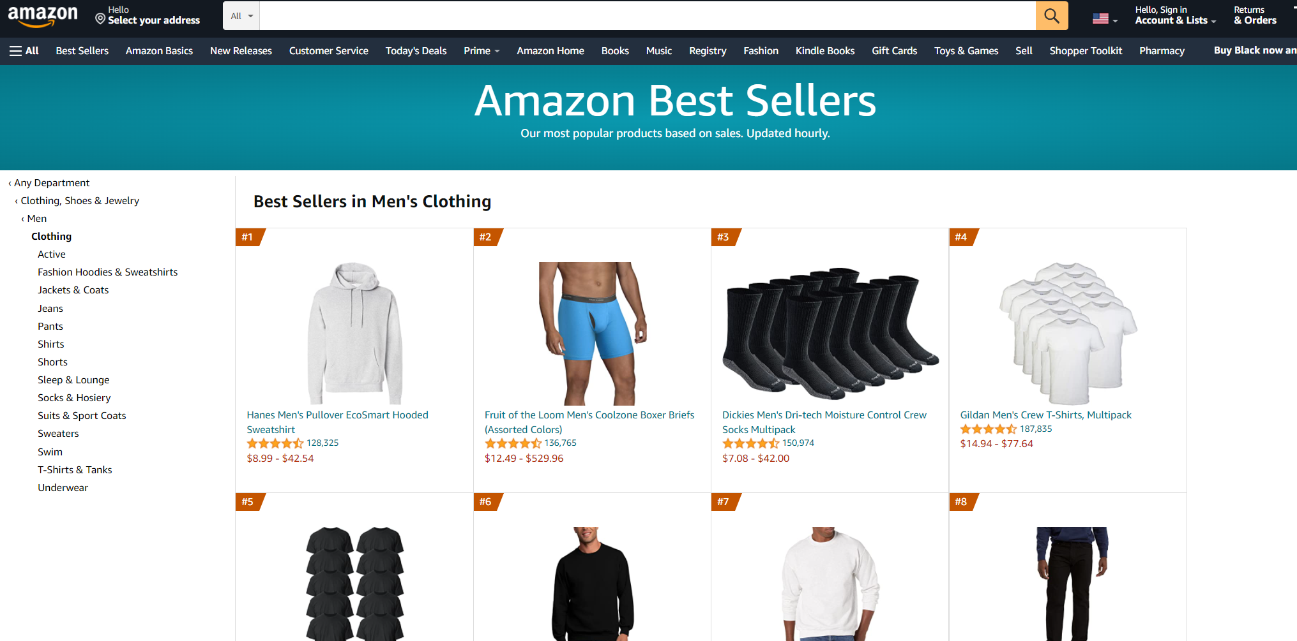

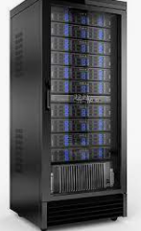

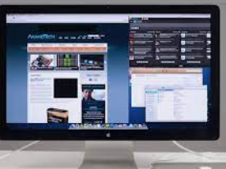
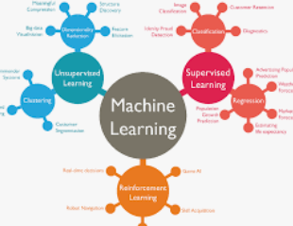
Full Stack Development
Database
Client App
Client App
ElasticSearch
PostgreSQL
Internet
ML system
Browser,Angular
Node.js,Express
Tensorflow(LSTM)

Slide 4
Use Cases
Actor | Use Case | Brief Description
User | Login | Input User ID and Password to login, wait for response.
 | Select the Monitor Catagory | Choose the monitor catagory given by sys, and submit.
 | Choose the Monitor Range | Choose how many bestseller to be monitored, from 10 to 30.
 | Manage the Sale Trend | Click and see the 12-hour trend of sale number.
 | Manage the Rating Trend | Click and see the 12-hour trend of average rating.
 | Manage Customers’ Focus on Bestsellers | Click and see the customers’ focus on bestsellers.
 | Manage Customers’ Focus on Sellers with high scores. | Click and see the customers’ focus on Sellers with high scores.
 | Download the data | click the download button and receie xlsx file.
Admin | Login | Input User ID and Password to login, wait for response.
 | Adjust the Monitor Catagory According to Users’ Choice. | Receive the monitor catagory submitted by user and adjust the url to be crasped.
 | Add user | input user’s company, User ID and Password to DB.
 | Search user | input user’s User ID and Password to search in DB.
ML system | Predict the Sale Trend | Use LSTM algorithm to analyze the sale trend
 | Predict the Rating Trend | Use LSTM algorithm to analyze the rating trend

Slide 5
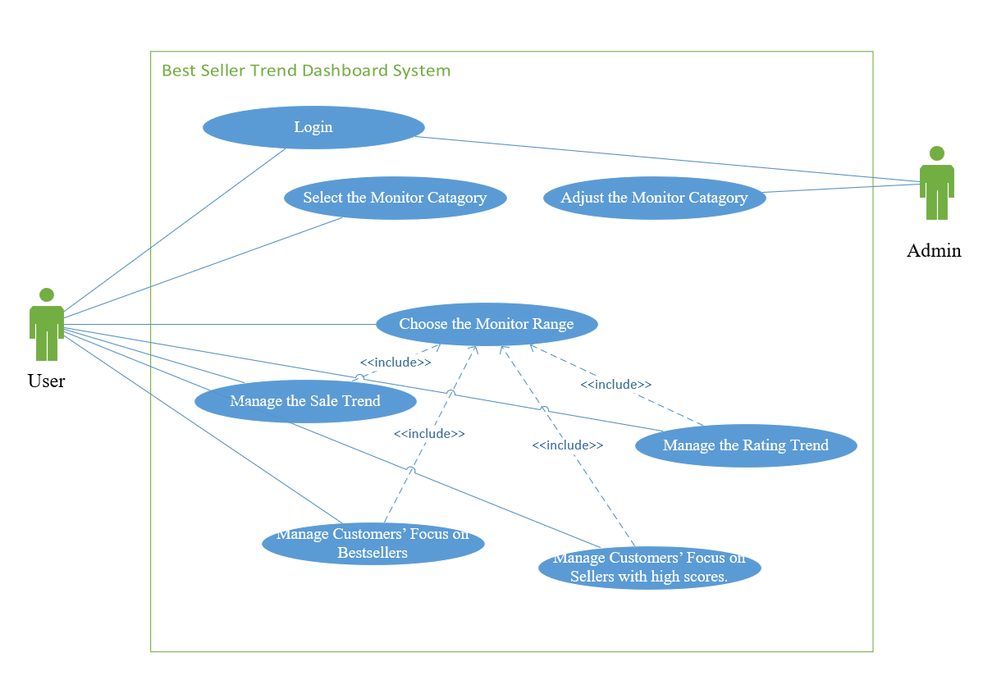
Use Cases Diagram

Slide 6
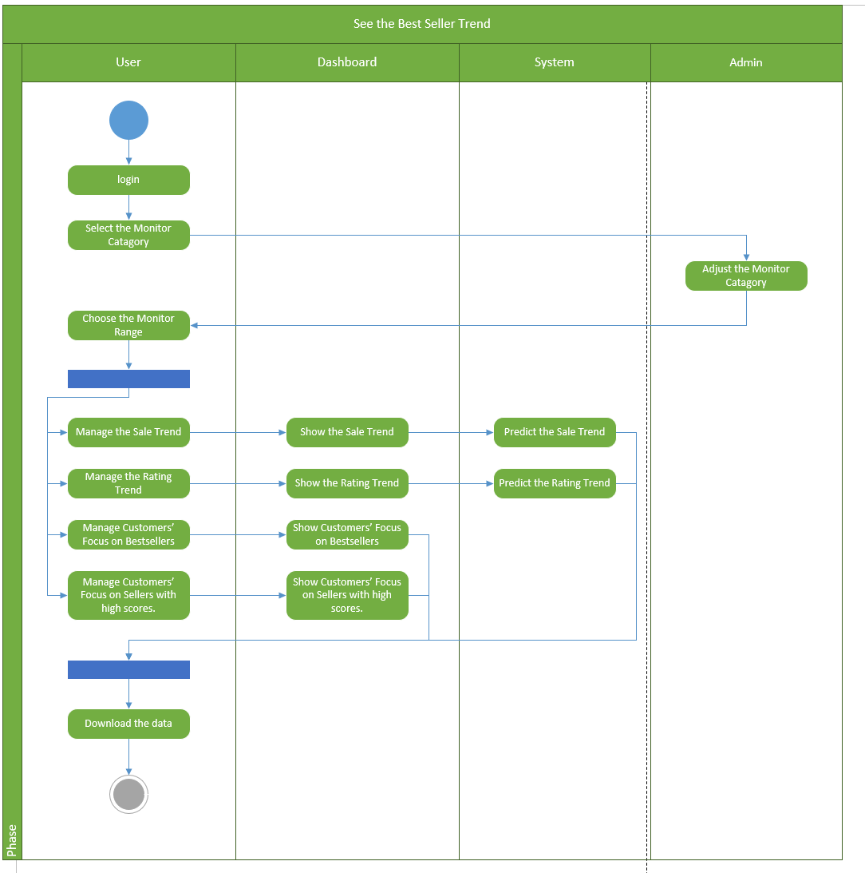
Activity Diagram for User

Slide 7
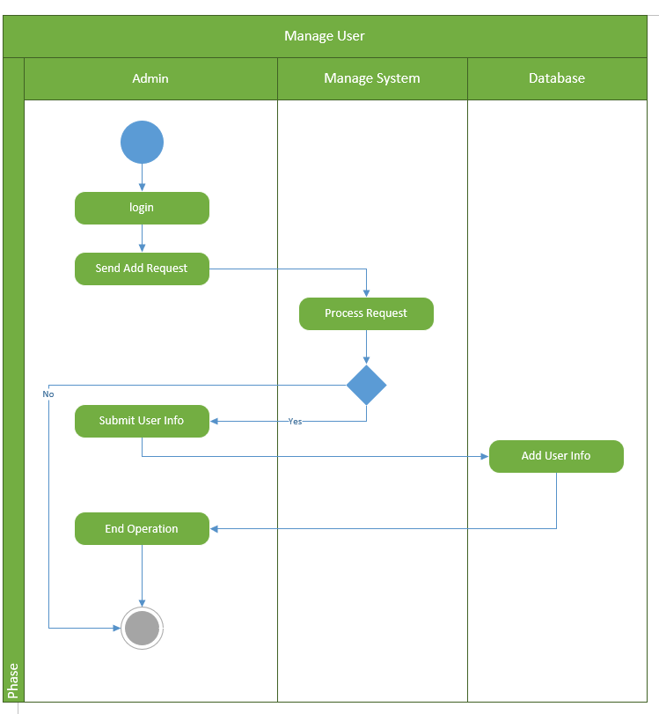
Activity Diagram for Admin

