Slide 1

Topic 6: Digital Marketing
Real-time Trend Analysis of Amazon's Bestseller
Phase 2
Group 8: Muhao Chen - A20456889
2022-03
Notes:
https://drive.google.com/drive/folders/1T6Wk3Vs3zjKDe0em48UTKgHnJevHWLBm?usp=sharing

Slide 2
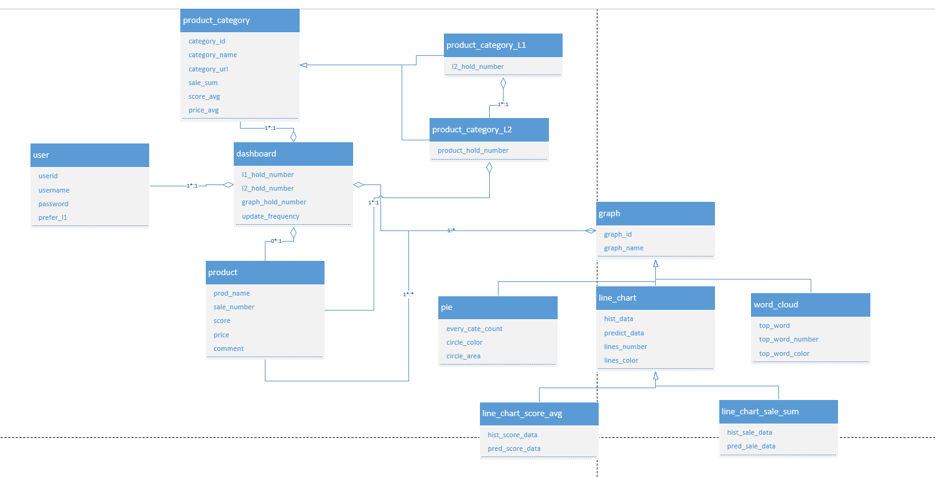
Domain Model

Slide 3
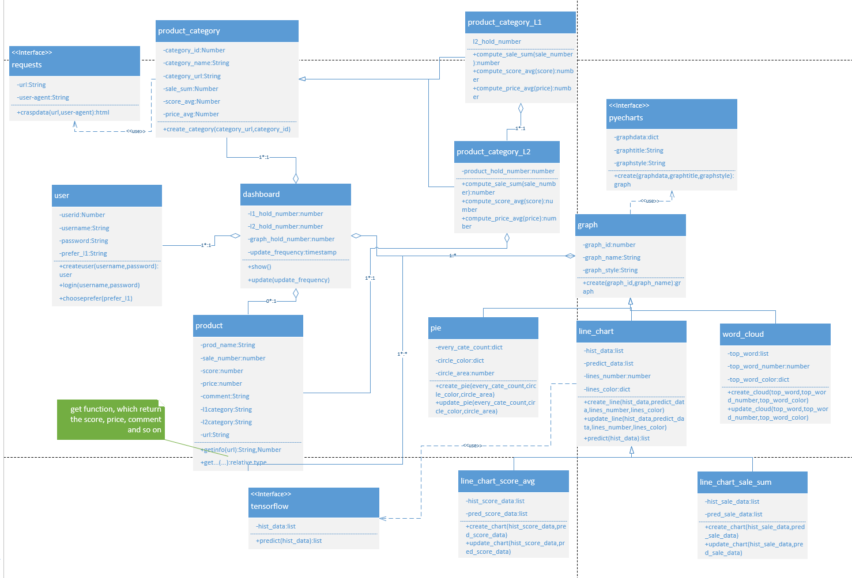
Class Diagram Design Model

Slide 4
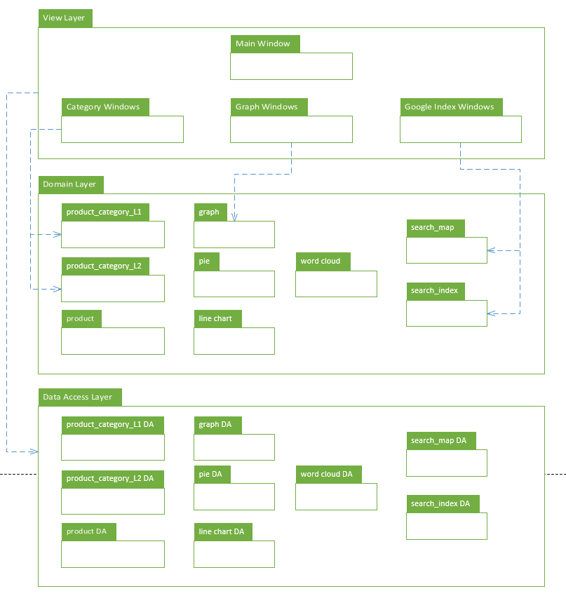
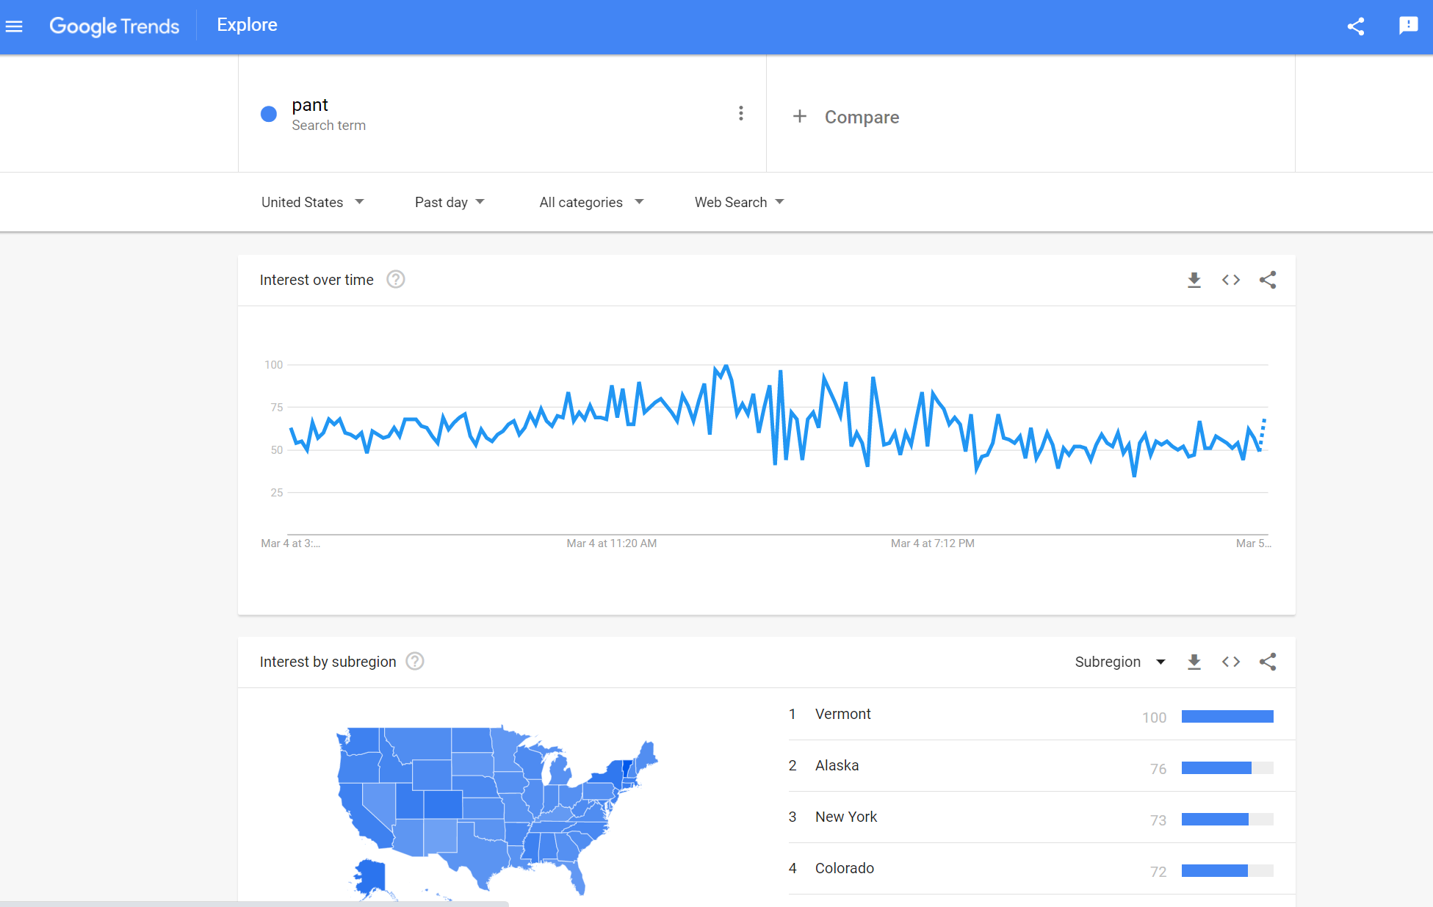
Package Diagram Design Model

Slide 5
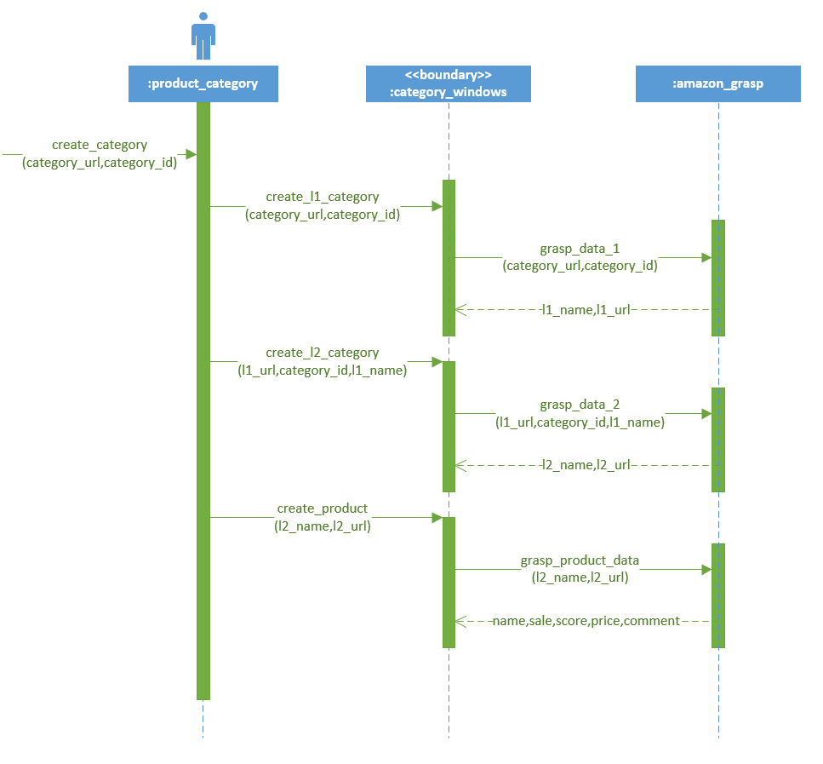
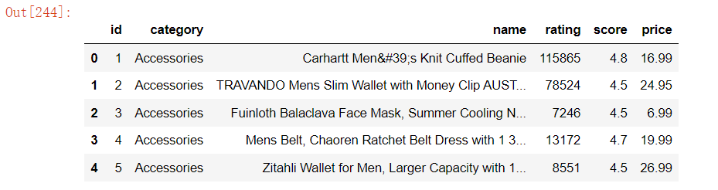
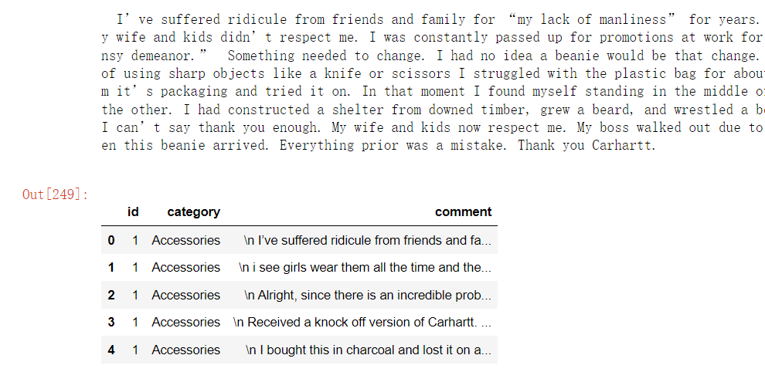
Sequence Diagram: Create_Category
product information
product comment

Slide 6
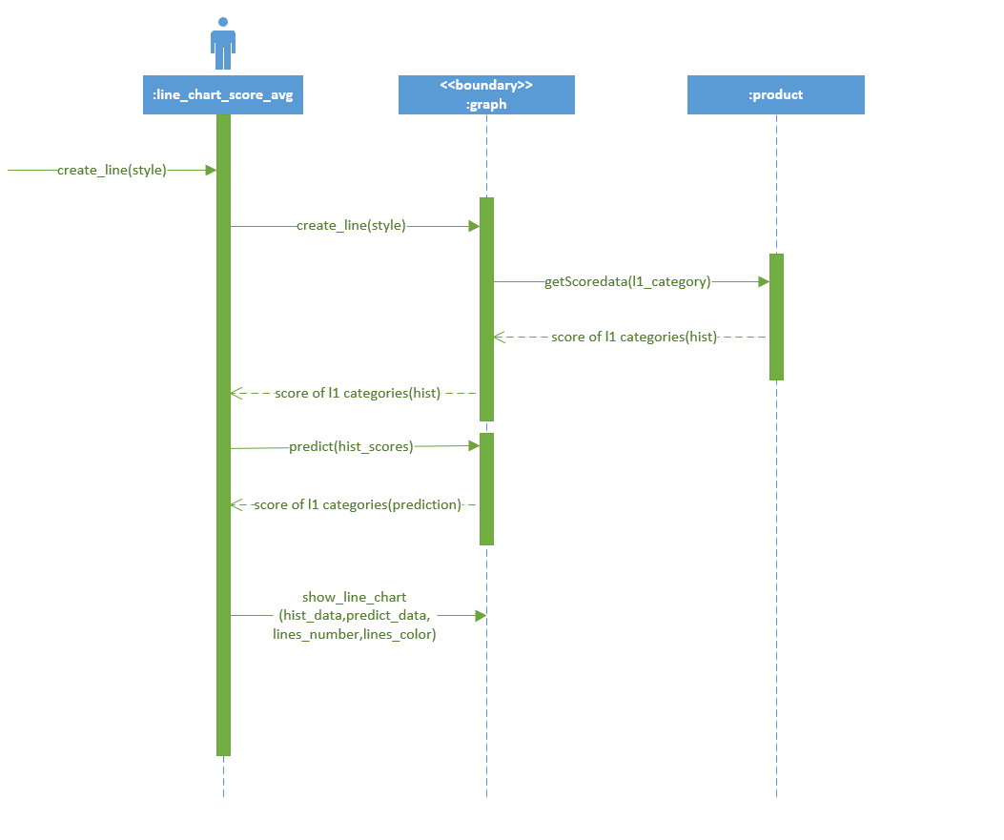
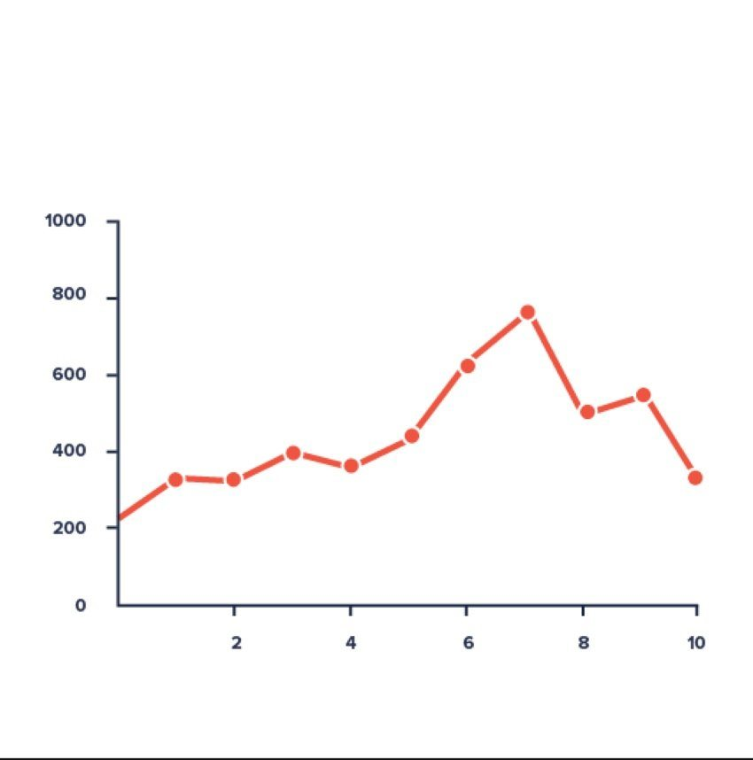
Sequence Diagram: Create_Line_Chart
Line Chart Ex.
History(6hours)
Prdiction
(3hours)

Slide 7
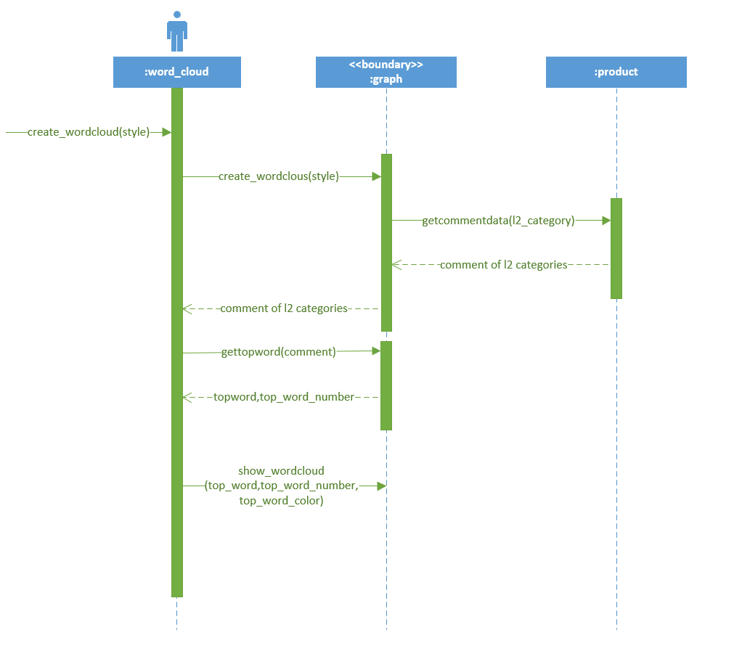
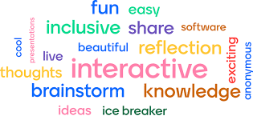
Sequence Diagram: Create_Word_Cloud
Word Cloud Ex.

