Slide 1
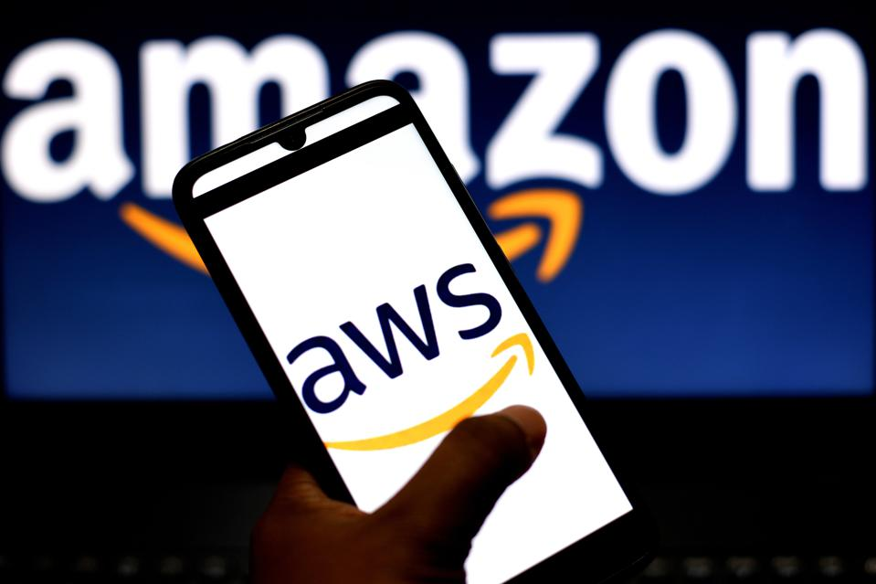
Topic 6: Digital Marketing
Real-time Trend Analysis of Amazon's Bestseller
Phase 3
Group 8: Muhao Chen - A20456889
2022-04
Notes:
https://drive.google.com/drive/folders/1T6Wk3Vs3zjKDe0em48UTKgHnJevHWLBm?usp=sharing

Slide 2






Architecture
Root Project
Get Data
Amazon
Google
Get Amazon Items
Django REST
Get Amazon comment
api/v1
Nginx
Load
Balance
Google Search Trend
Get Google Search
api/v2
Visualize Trend
WebPage
visualization
Sale, Score,price visualization
api/v3
Sale Predication
Comment Visualization

Slide 3
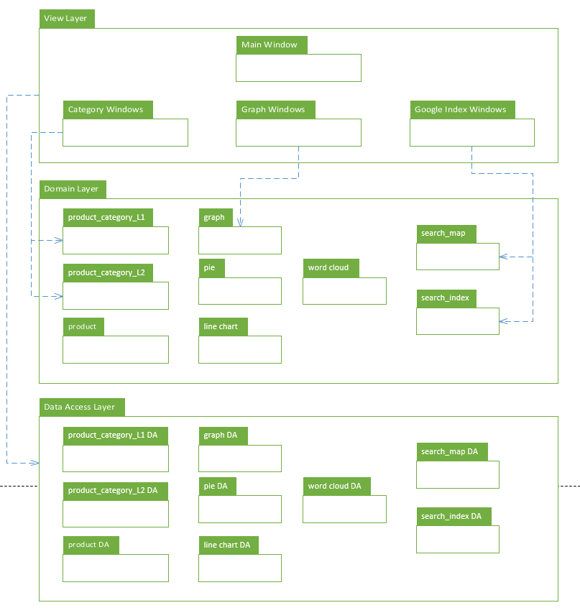
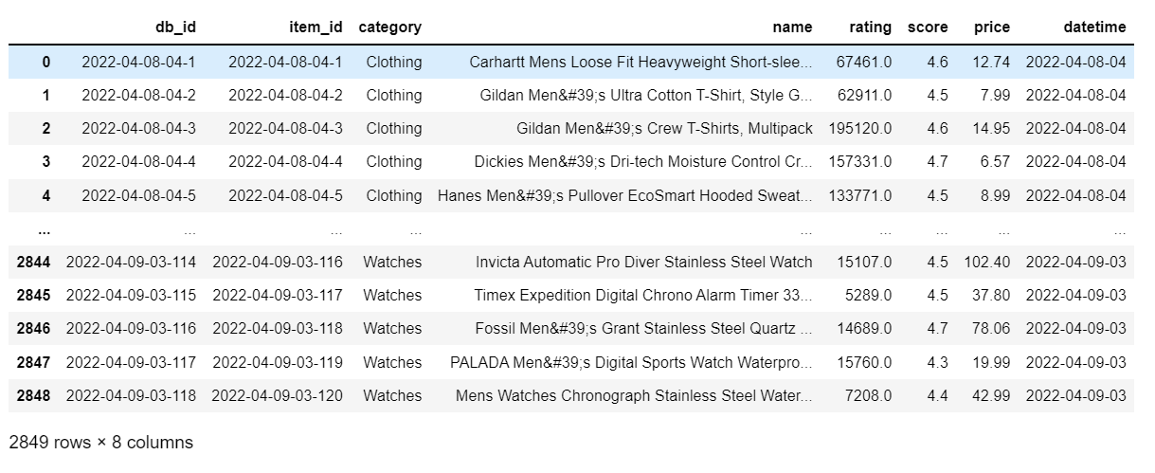
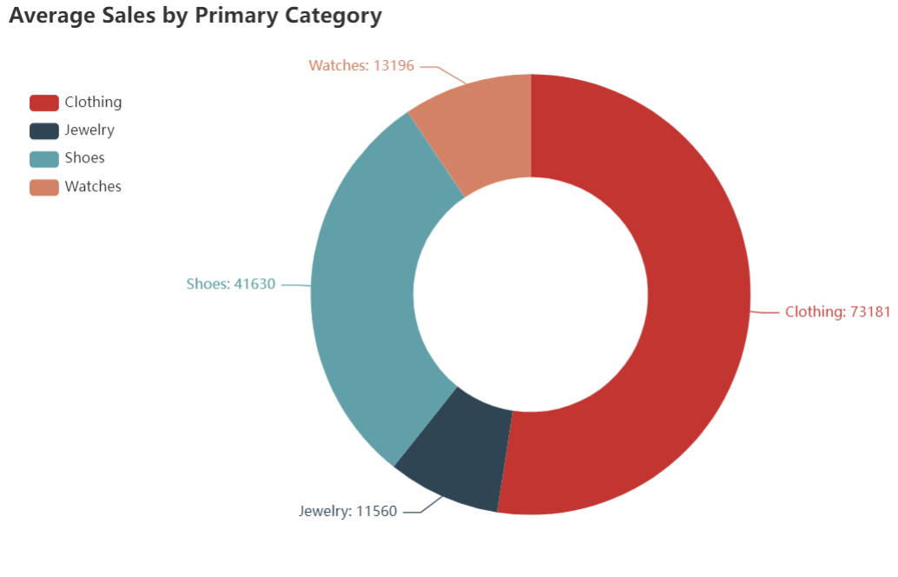
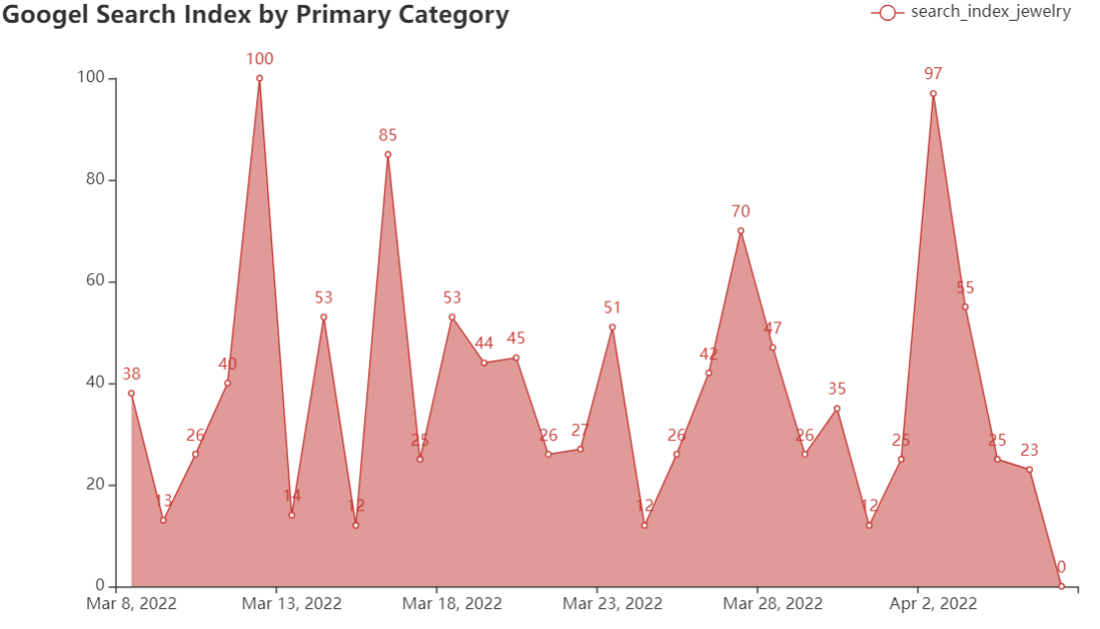
Package Diagram Design Model
Example:

Slide 4
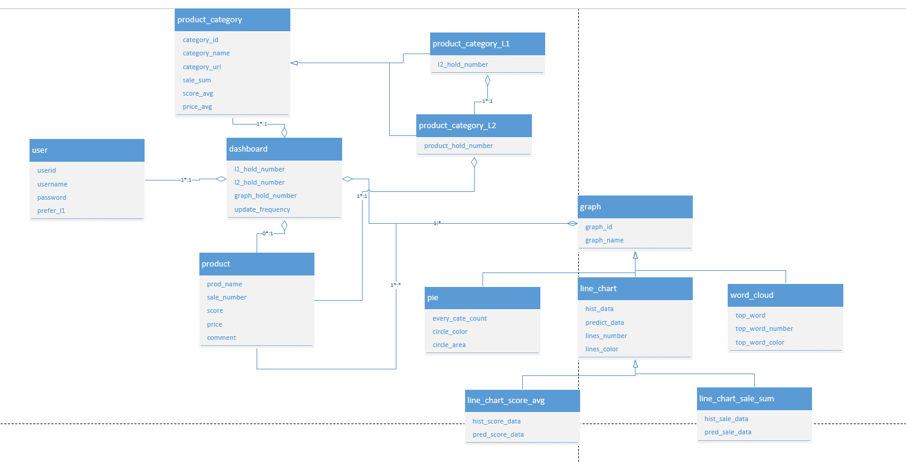
Domain Model

Slide 5
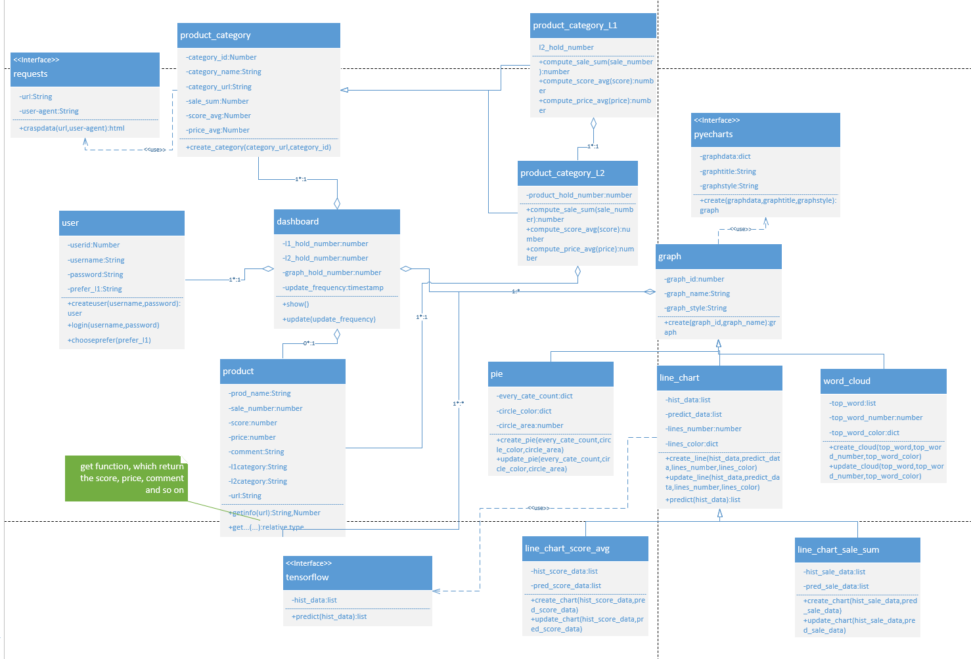
Class Diagram Design Model
Singleton Pattern
Factory Method Pattern

Slide 6
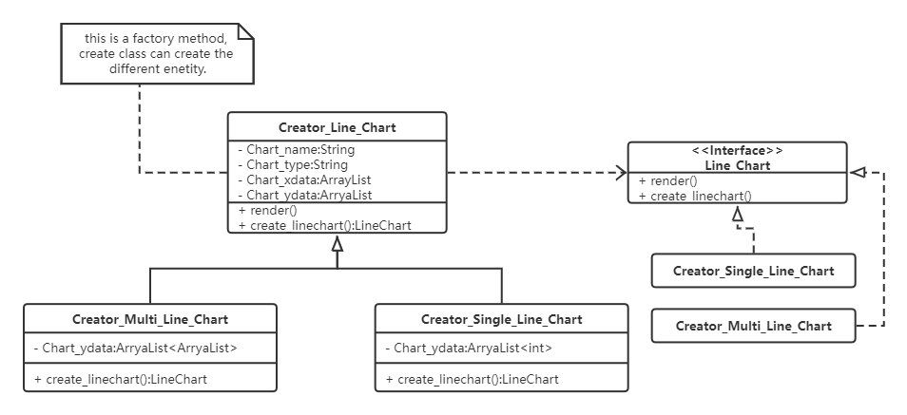
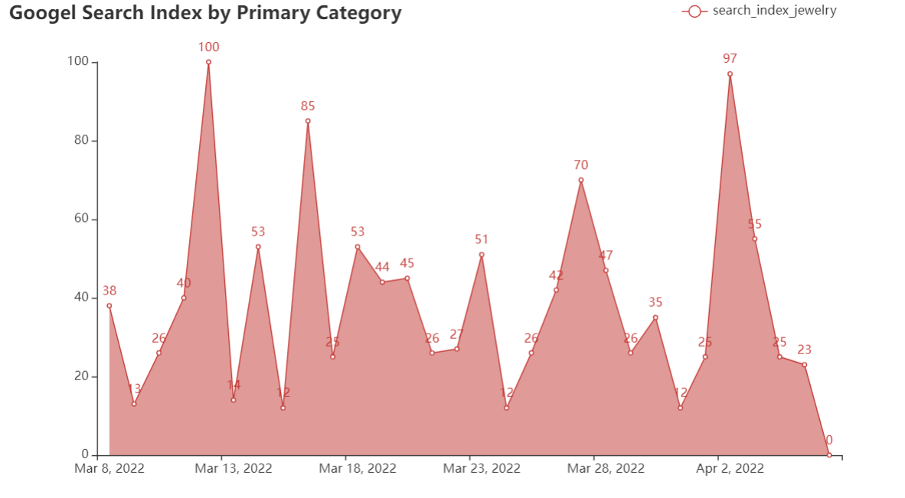
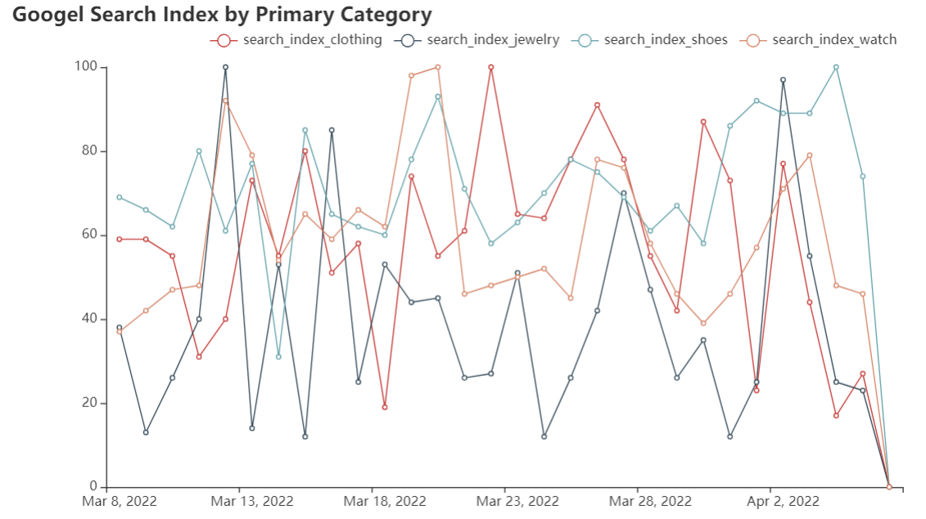
Factory Method Pattern
Examples:
I use the line-chart to be an example.
Single-Line-Chart
Multi-Line-Chart

Slide 7
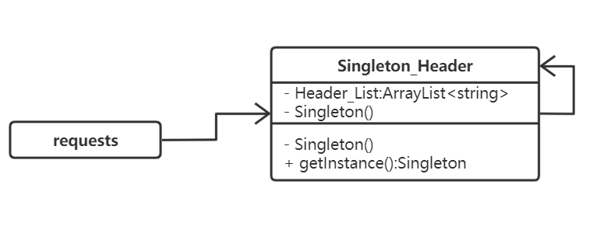
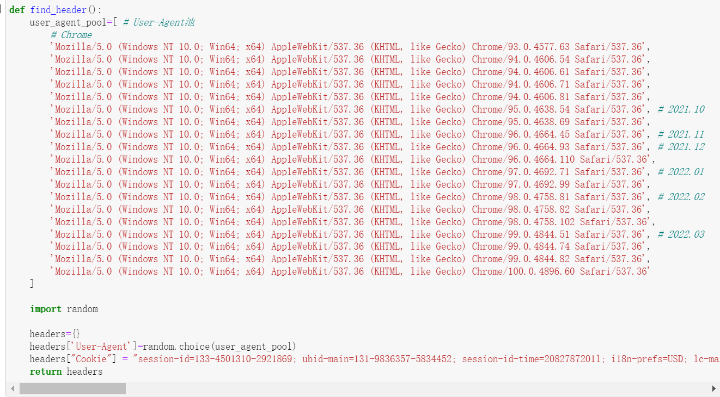
Singleton Pattern
Examples:
I use the header entity, which is only one.
Header_List should be unique, and other class uses this unique and only entity.

Slide 8
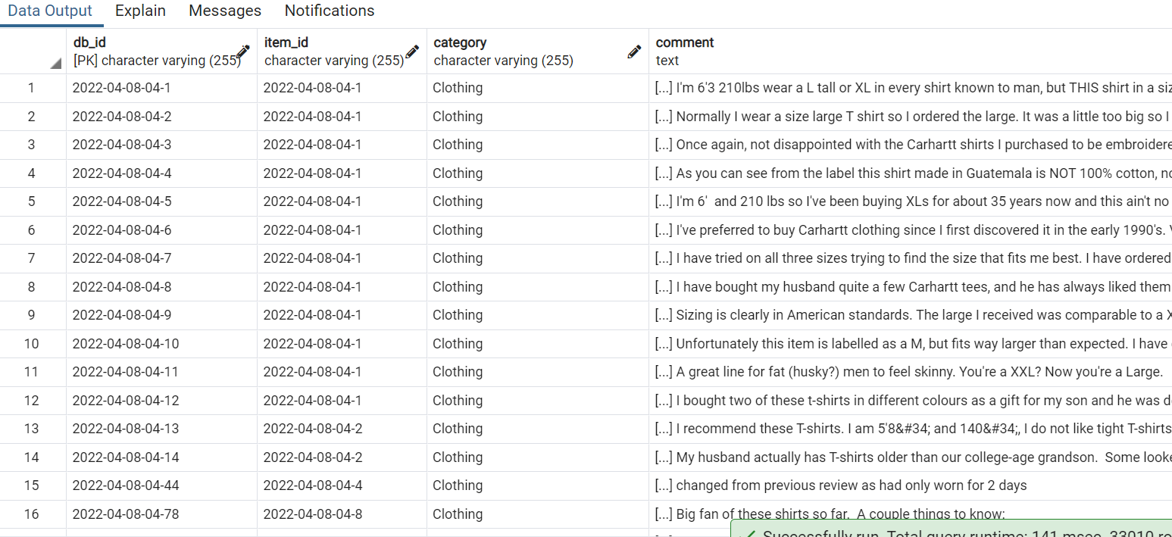
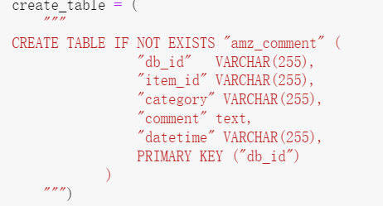
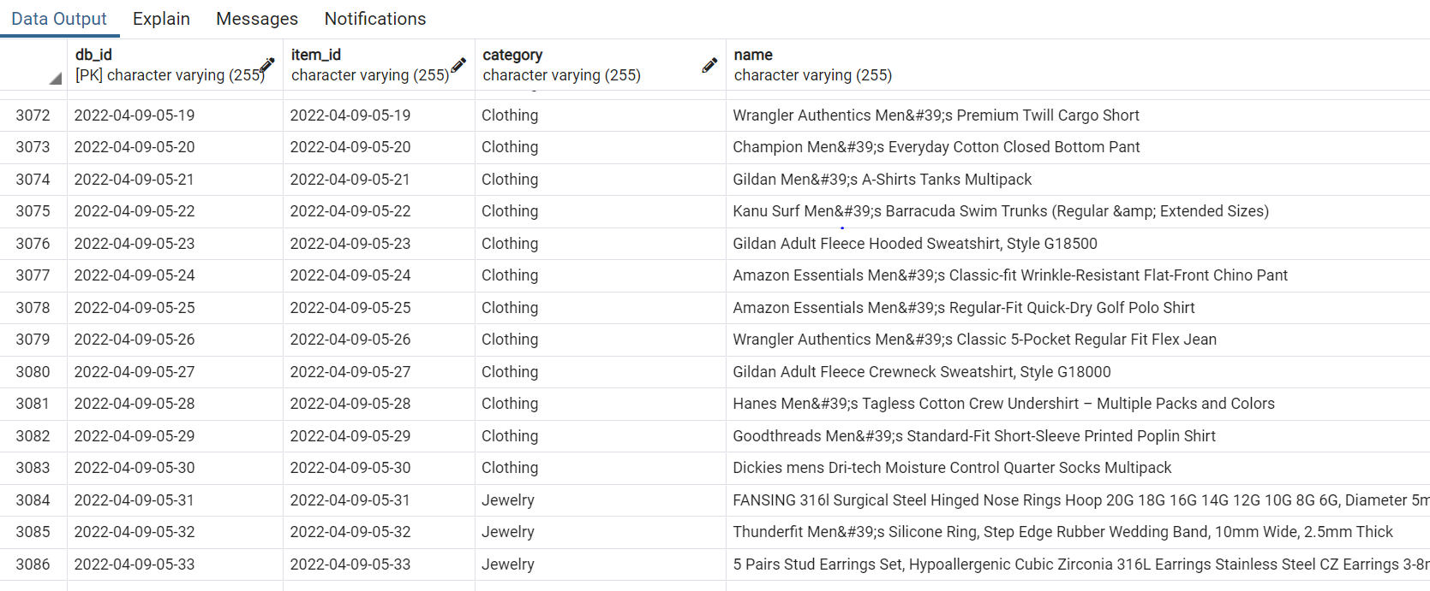
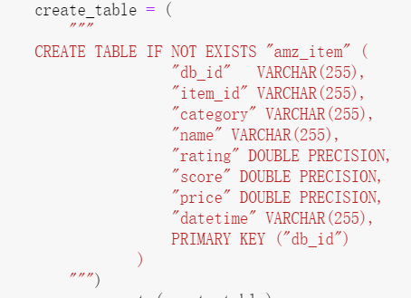
Collect Data - Amazon
Root Project
Get Amazon comment
Get Data
Get Amazon Items
Get Amazon comment
Get Amazon Items

Slide 9
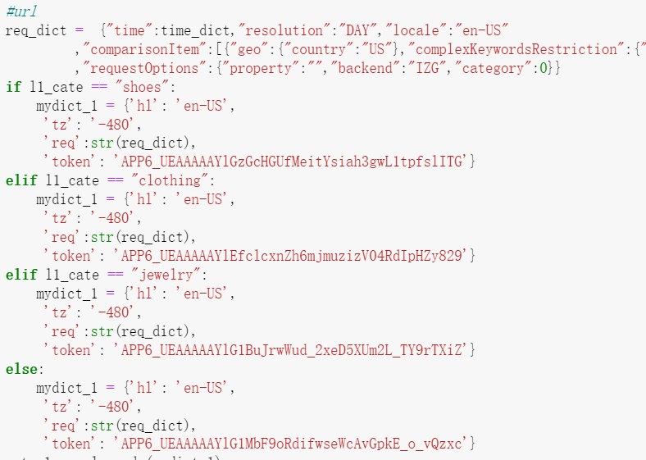
Google Search Trend
Get Google Search
Google Search Trend
Get Google Search
{“value”:”man clothing”
“date”:”nowtime-30,nowtime”
}
query → url
re(return_data)
Visualize Trend
Google
Visualize Trend

Slide 10
visualization
L1-Category-Visualization
[“clothing”,“jewelry ,“shoes”,“watch”]
(1) Average sales of 4 categories, pie chart.
(2) Average total scores, bar chart.
(3) Average total sales and prediction, line chart. (tensorflow)
(4) Price Heatmap.
(5) Comment word cloud.(LDA models)
visualization
Sale, Score,price visualization
Sale Predication
L2-Category-Visualization
Comment Visualization
For example, in “clothing”, there are 30 items per hour
(1) Top 6 items’ sales, pie chart.
(2) Average total sales and prediction, line chart. (tensorflow)
(3) Average total score and prediction, line chart. (tensorflow)
(4) Comment word cloud. (LDA models)

Slide 11
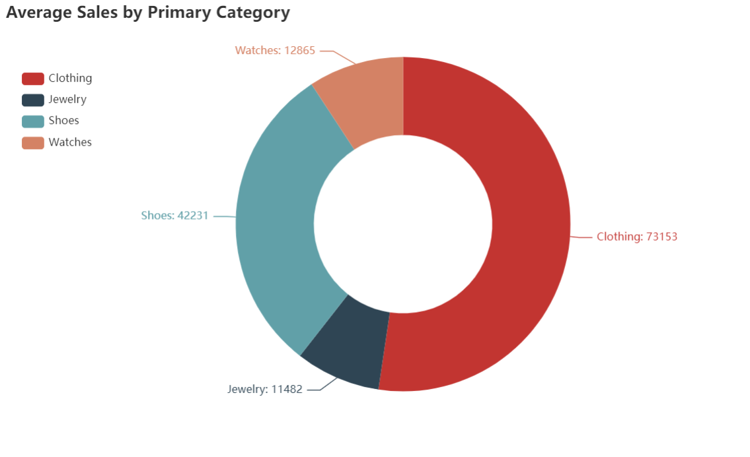
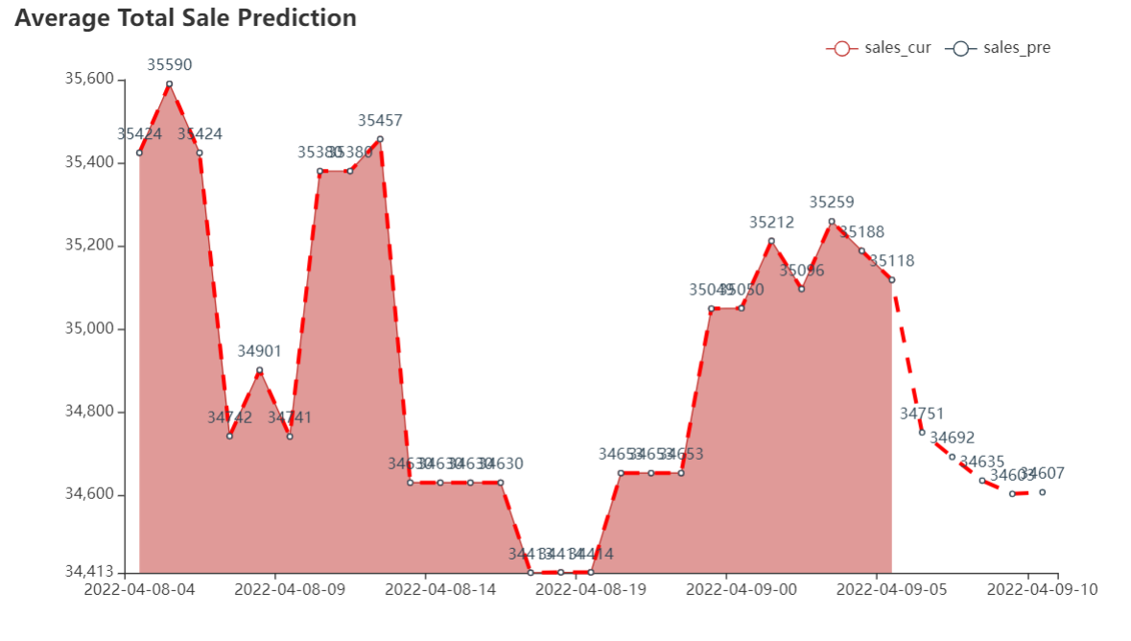
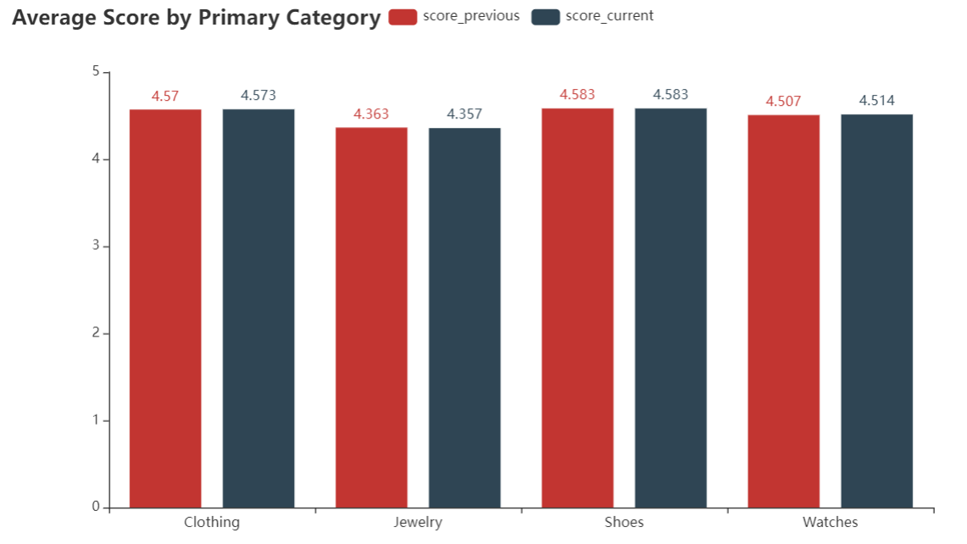
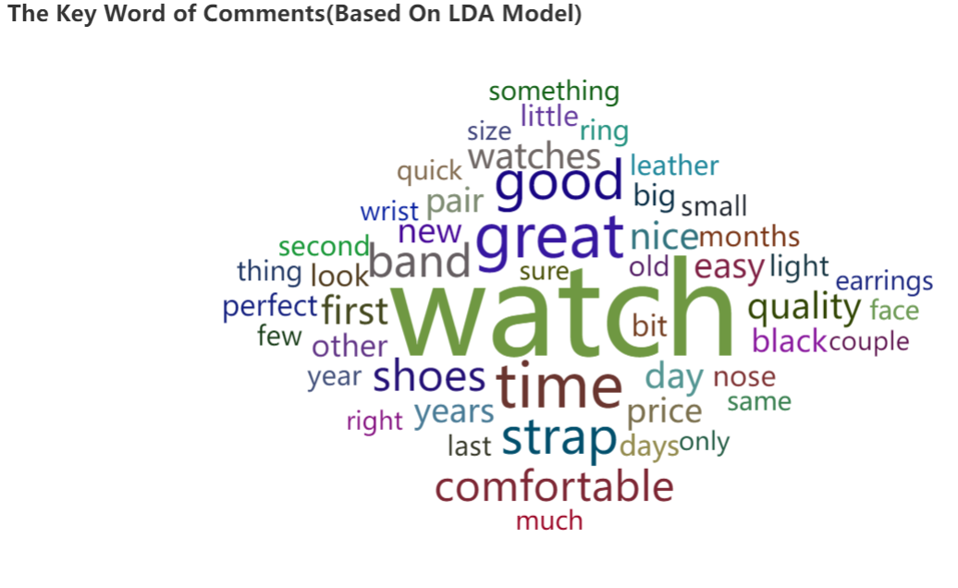
L1-Category-Visualization

Slide 12
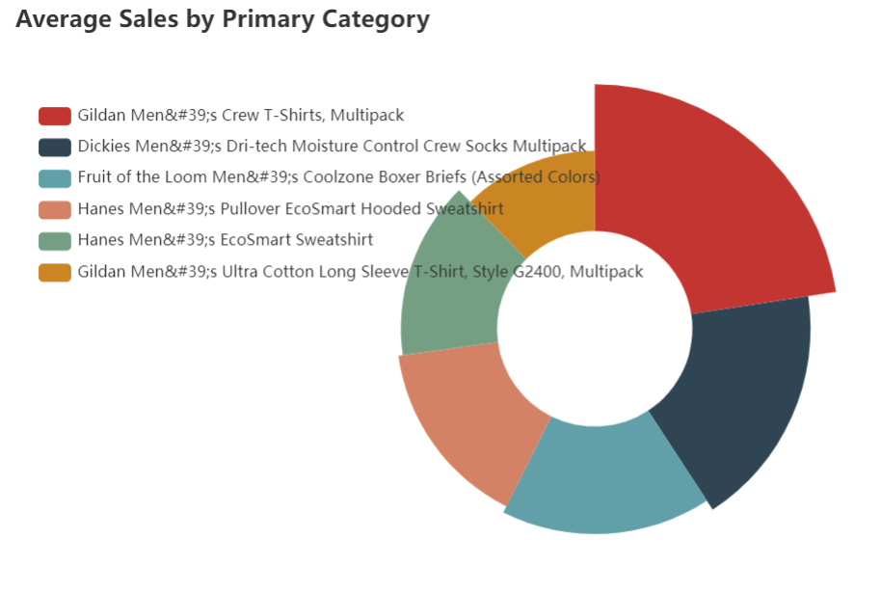
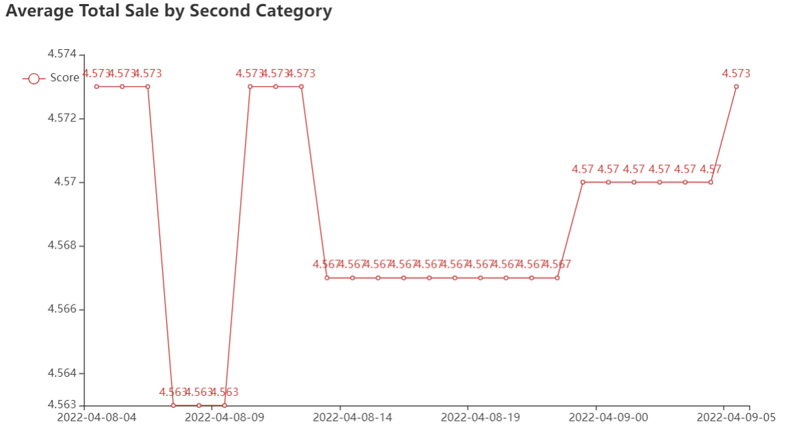
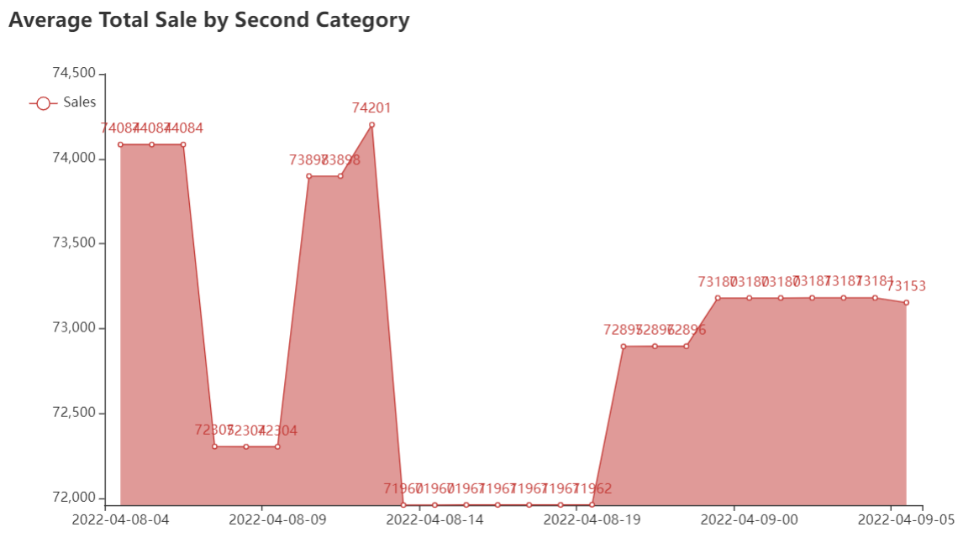
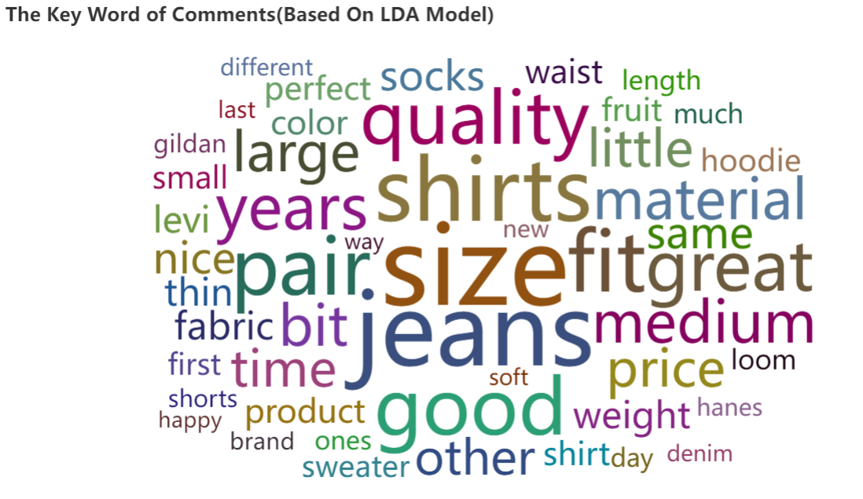
L2-Category-Visualization

