Slide 1
Lab 3
Muhammad Arif

Slide 2
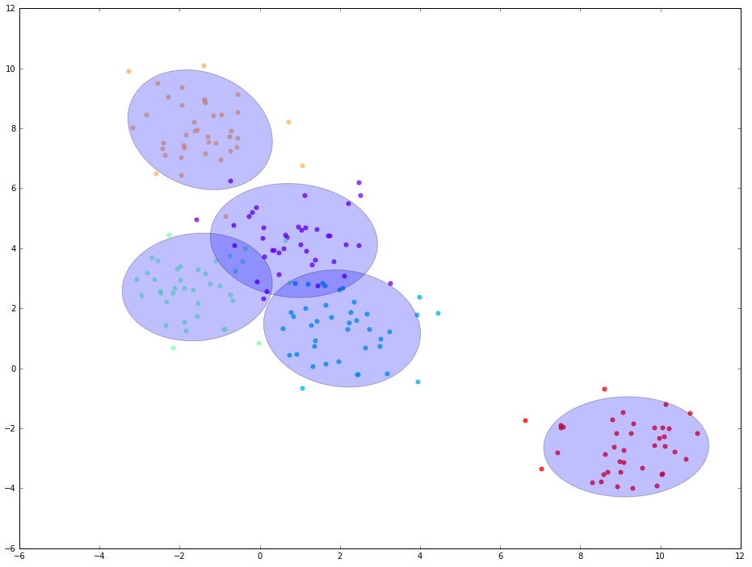
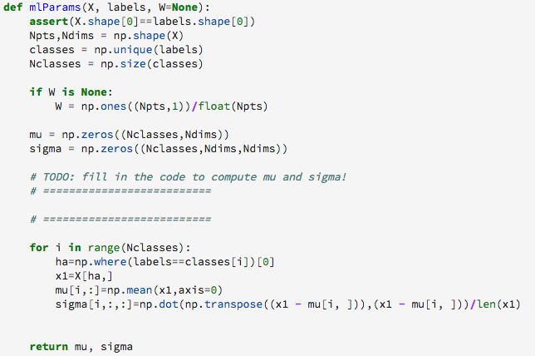
Assignment 1

Slide 3
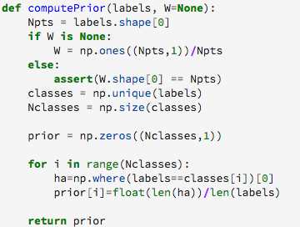
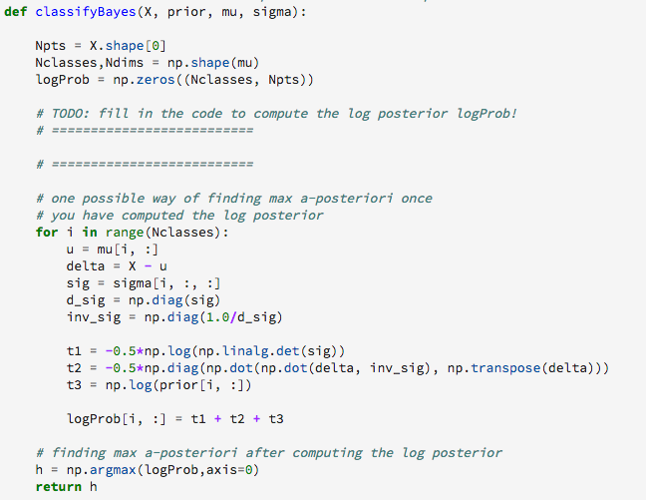
Assignment 2
1)
2)

Slide 4
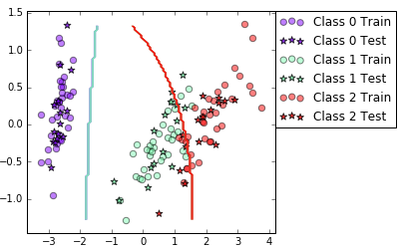
Assignment 3
When there’s no significant correlation between features
Decision boundary is not good, Class 0 is definitely uncorrelated with others, but Class 1 and Class 2 seems correlated.
Possible Solution:
Use non-naïve Bayesian
Manipulate the data by non-linear transformation (log)

Slide 5
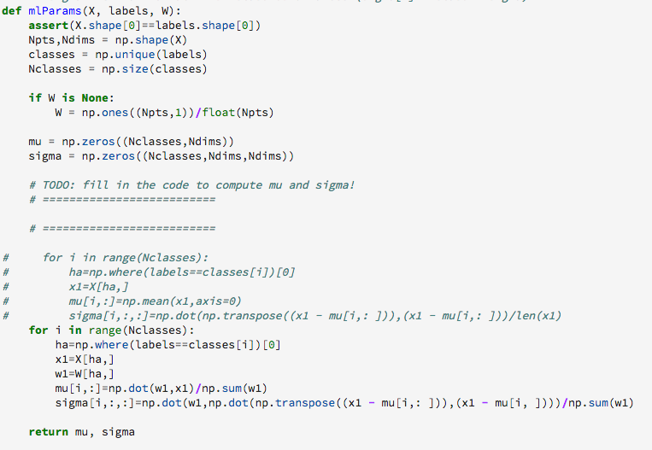
Assignment 4

Slide 6
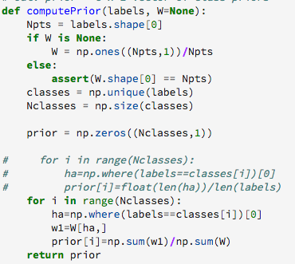
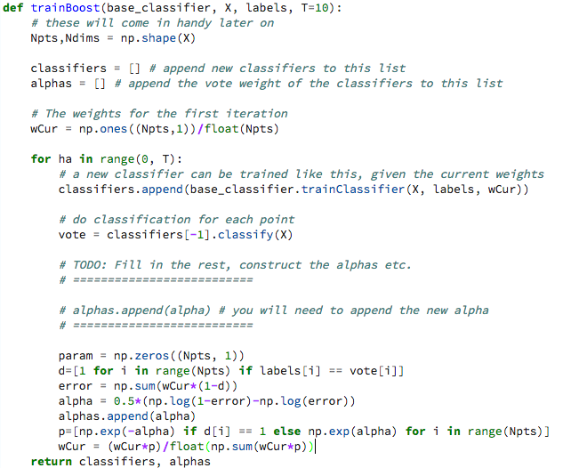
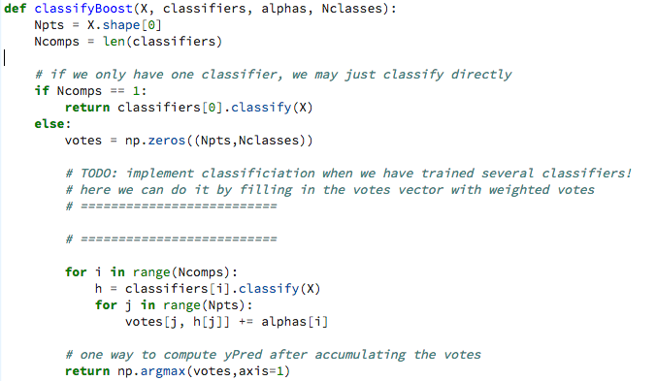
Assignment 5
1)
2)
3)

Slide 7
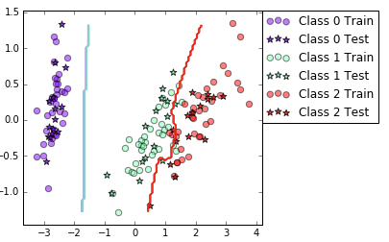
Assignment 5 (cont.)
Yes, since boosting is learning from previous error. They tried to put some weights to improve classification accuracy
The boundary is more complex when dealing with high correlated data
(Not too sure about the question) Yes, until certain point. Boosting can improve the performance by employing the weight
Final mean classification accuracy 89.2 with standard deviation 4.34
Final mean classification accuracy 94.1 with standard deviation 6.72

Slide 8
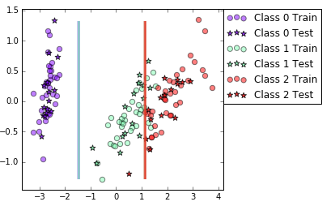
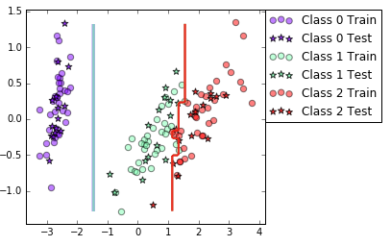
Assignment 6
 | DecTree | Boost
Iris | 92.4 (3.71) | 94.6 (3.65)
Vowel | 64.1 (4) | 86.9 (3.08)
Yes, since boosting is learning from previous error. They tried to put some weights to improve classification accuracy
The boundary is more complex when dealing with high correlated data
(Not too sure about the question) Yes, until certain point. Boosting can improve the performance by employing the weight

Slide 9
Assignment 7
Outliers: No Boosting. Boosting will be adding weight to outliers
Irrelevant Inputs: ??
Predictive Power: Boosting. It improves accuracy, low bias (simple model). Downside is that variance can go higher
Scalability: No Boosting. Boosting is very heavy computational process due to the iteration and votings.

