Slide 1
Installation of Microbiome Workshop Softwares
Do this once only! There’s no need to do this multiple time

Slide 2
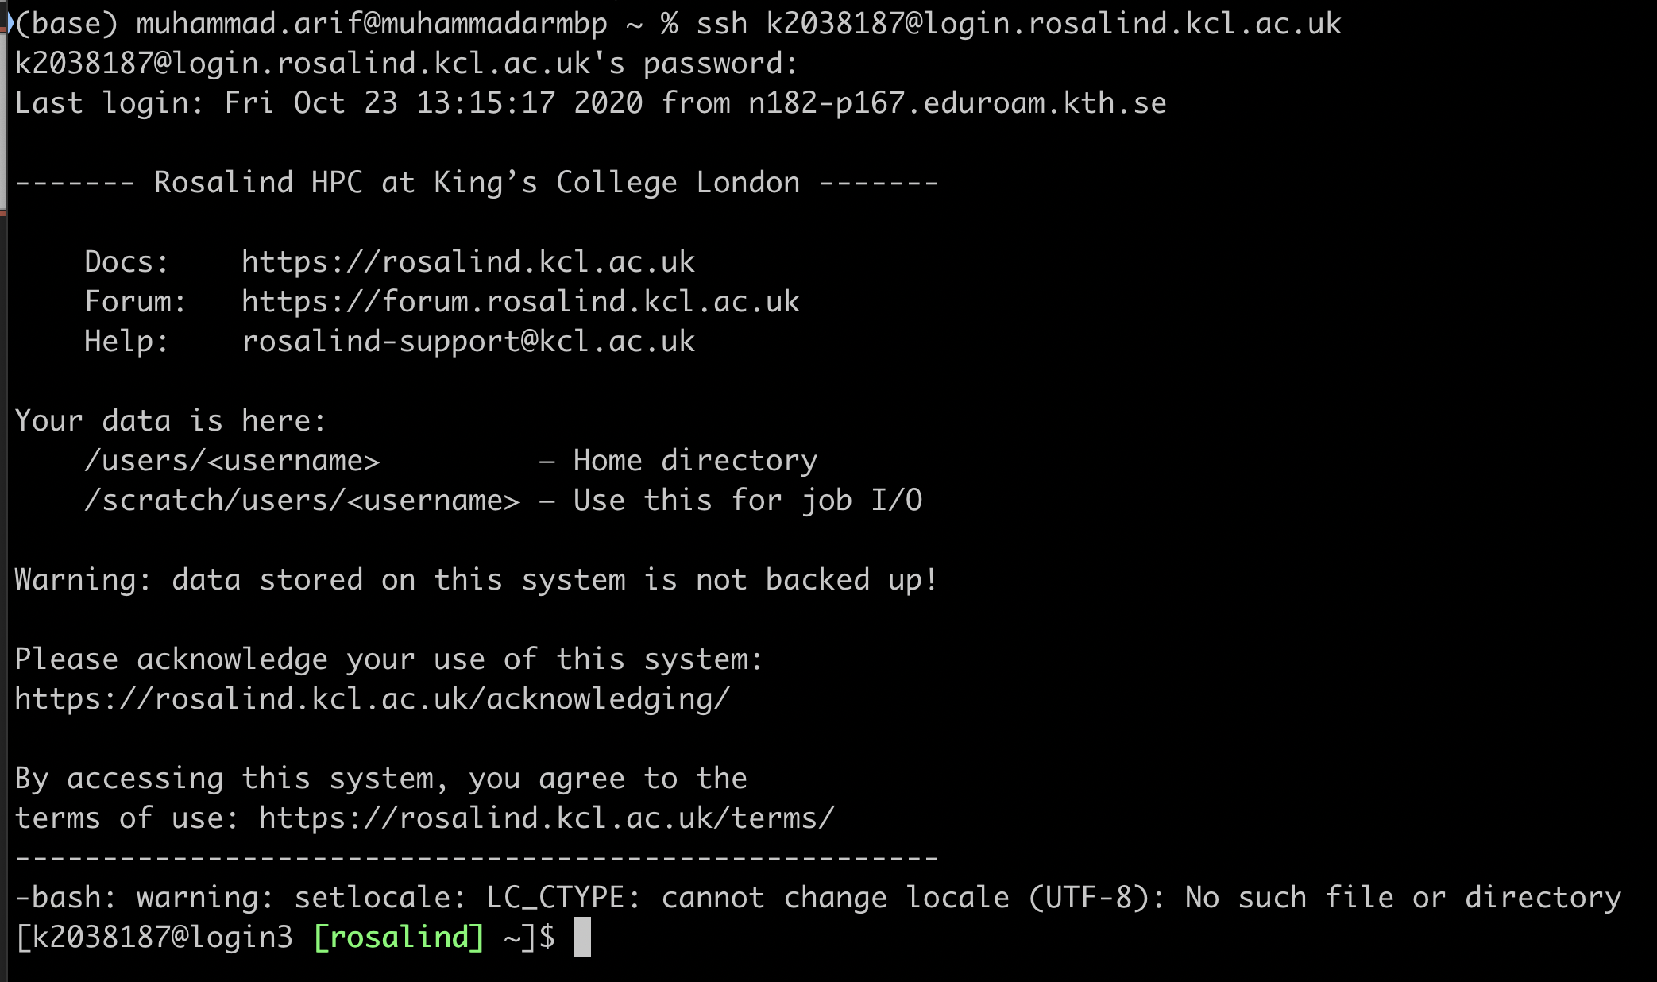
1. Login to Rosalind
Command: ssh kNumber@login.rosalind.kcl.ac.uk

Slide 3
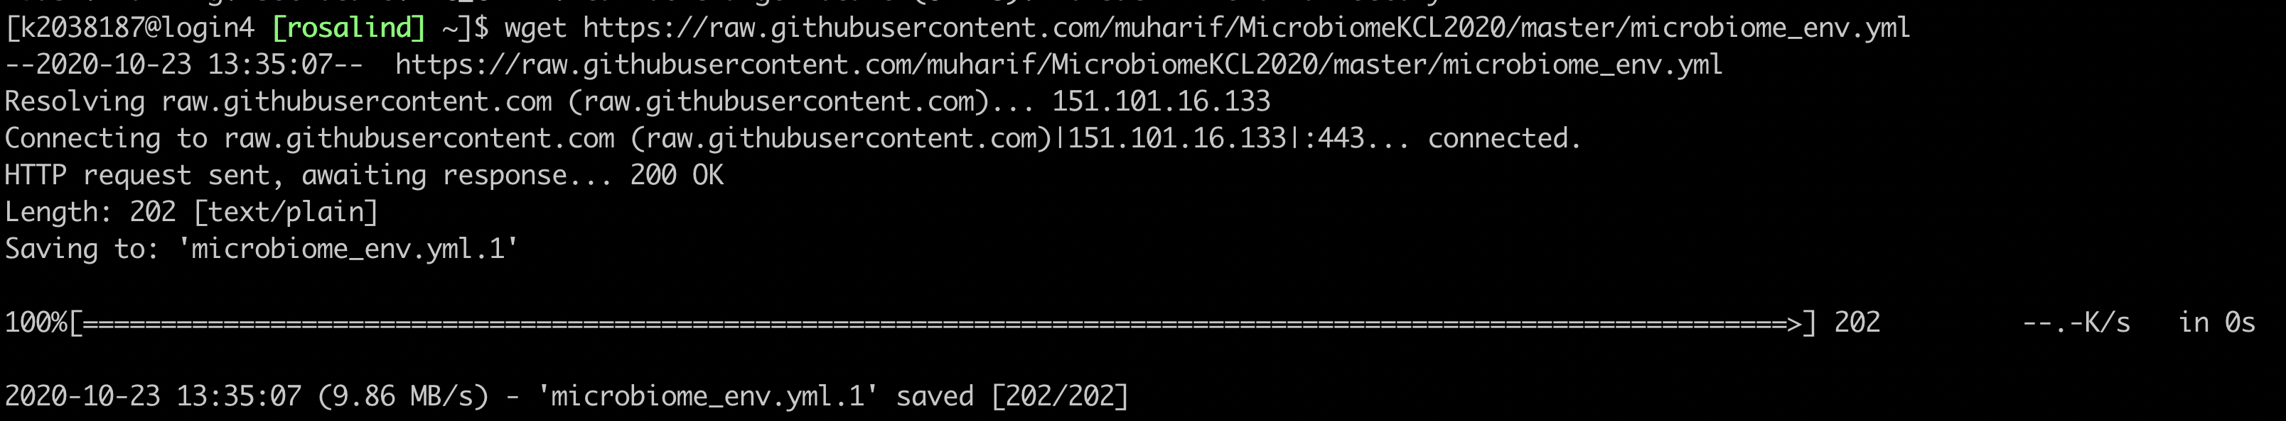
2. Download Conda Environment file
Command:
wget https://raw.githubusercontent.com/muharif/MicrobiomeKCL2020/master/MicrobiomeWS/microbiome_env.yml

Slide 4
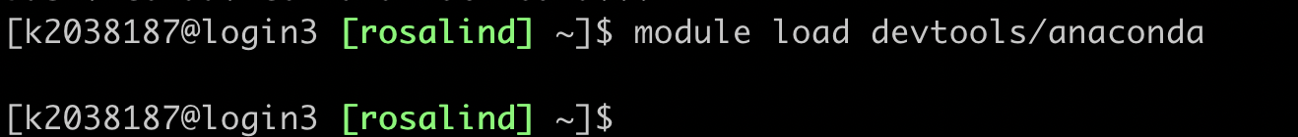
3. Load Anaconda Module in Rosalind
Command: module load devtools/anaconda
Warning: No output is expected.

Slide 5
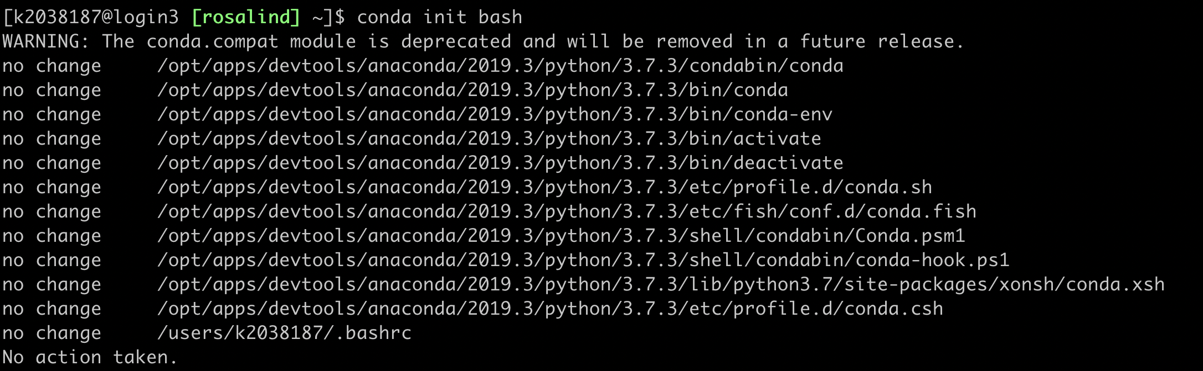
4. Load Conda Init
Command: conda init bash

Slide 6
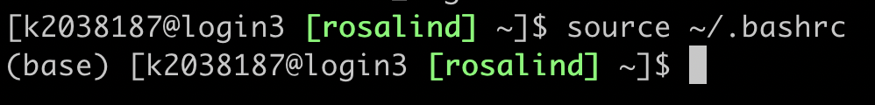
5. Restart the shell
Command: source ~/.bashrc
You should see (base) in your shell now

Slide 7
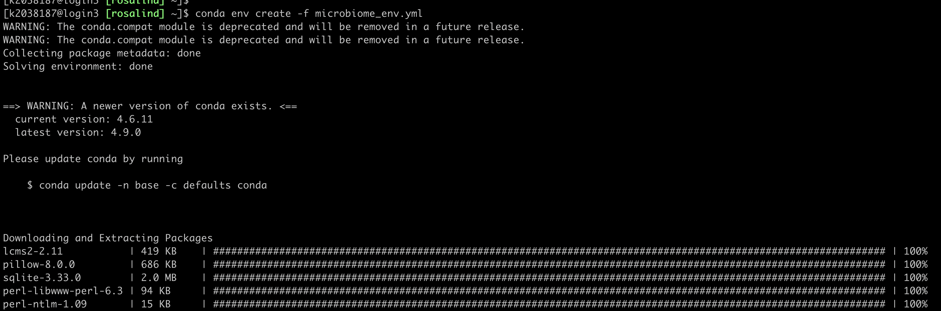
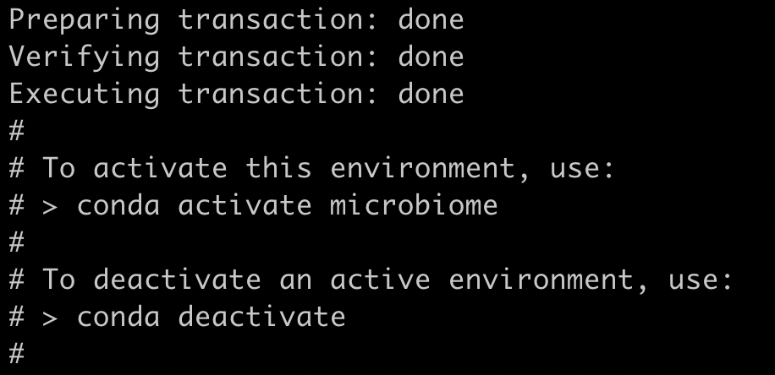
6. Create Conda Environment
Command: conda env create -f microbiome_env.yml
Warning: This might take a while, wait until you see something like this

Slide 8
7. Load Conda Environment
Command: conda activate microbiome
You should see (microbiome) in your shell now

Slide 9
7. Copy the database to your own folder
Command:
cp -r /mnt/lustre/datasets/mhdmsc/ metaphlan_databases ~/
You should see (microbiome) in your shell now

Slide 10
Entering Microbiome Environment
Do this everytime you login to Rosalind and want to do microbiome analysis

Slide 11
Load Conda Environment
Command: conda activate microbiome
You should see (microbiome) in your shell now

Slide 12
Next Commands
Don’t forget to run the metaphlan after loading the environment (slide 9)
Going into interactive mode:
srun -p shared --pty /bin/bash
Move to microbiome environment:
conda activate microbiome
Load Bowtie2:
module load apps/bowtie2
Going into home directory:
cd ~ OR cd /users/kNumber
Download Example Sequences (Filtered):
wget https://raw.githubusercontent.com/muharif/MicrobiomeKCL2020/master/MicrobiomeWS/SRS014459-Stool.fasta.gz
Running metaphlan2 (assuming your file is downloaded in home directory, check with ls):
metaphlan SRS014459-Stool.fasta.gz --input_type fastq --nproc 16 > microbiome_workshop_results.txt

Slide 13
In case of error
If you don’t see (base) in the shell: Redo Step 3-5 from installation step
If you get error “conda not found”: Redo step 3-5 from installation step
If you get error “Could not find conda environment XXXX”: Redo the installation step

