Slide 1
Rosalind

Slide 2
How to access Rosalind HPC server (Linux)
SSH protocol → via command
SFTP protocol → via files
HTTP protocol → via webpage

Slide 3
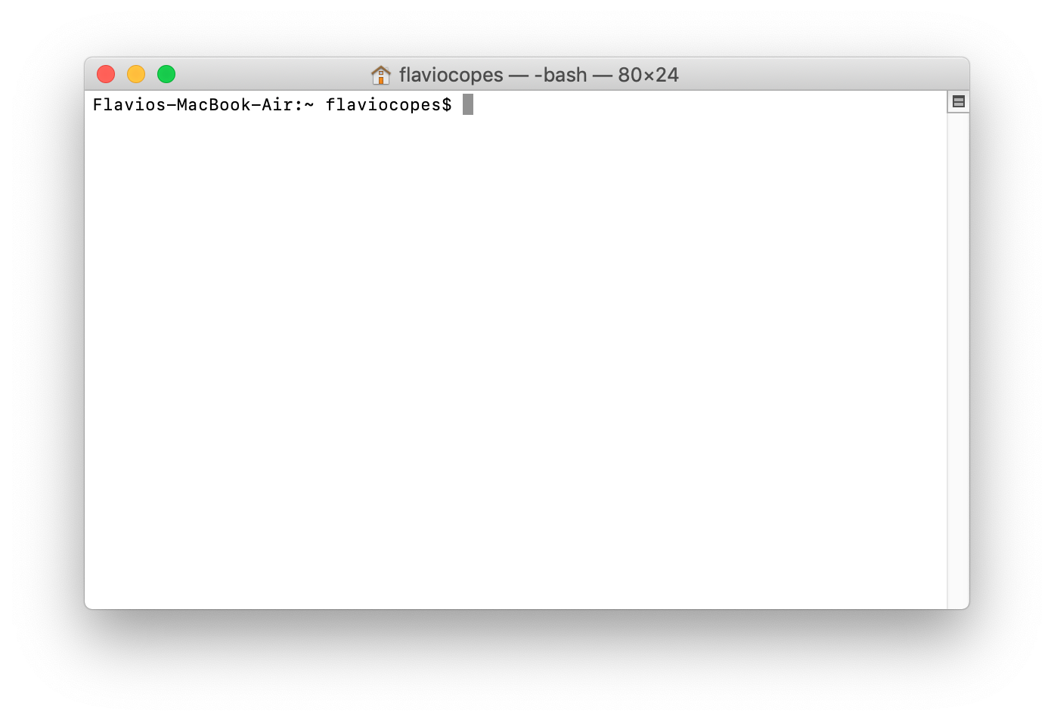
How to access Rosalind HPC server (Linux)
Macbook → Use Terminal → providing Unix/Linux commands and SSH terminal

Slide 4
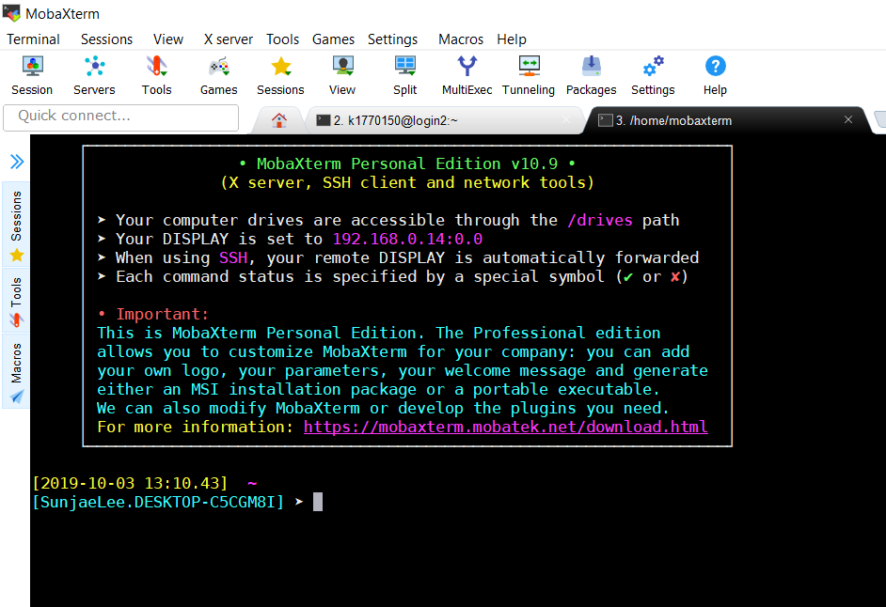
How to access Rosalind HPC server (Linux)
Windows laptop → Install Moba-Xterm software → providing Unix/Linux commands on Windows & SSH terminal

Slide 5
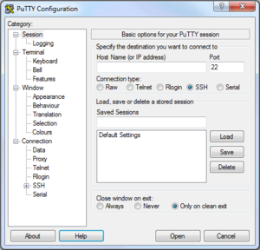
How to access Rosalind HPC server (Linux)
Putty → free and most simple program for SSH terminal

Slide 6
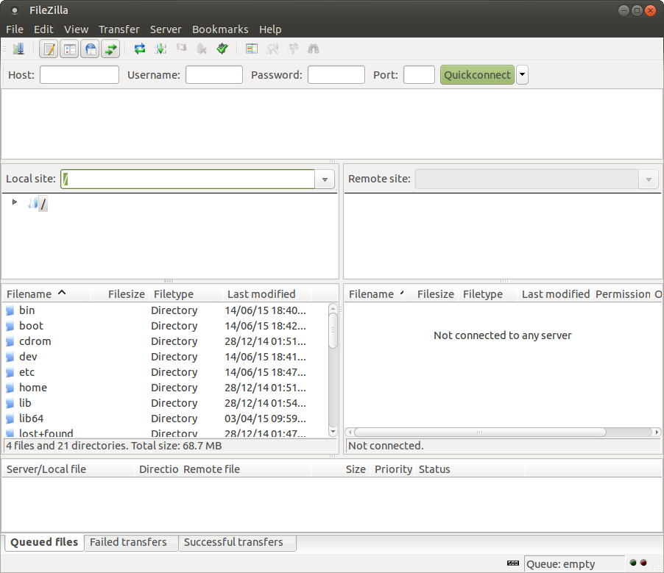
Transferring Data To Rosalind
Download FileZilla (Client) to connect via SFTP
https://filezilla-project.org/
MobaXterm supports SFTP transfer as well (Slow)

Slide 7
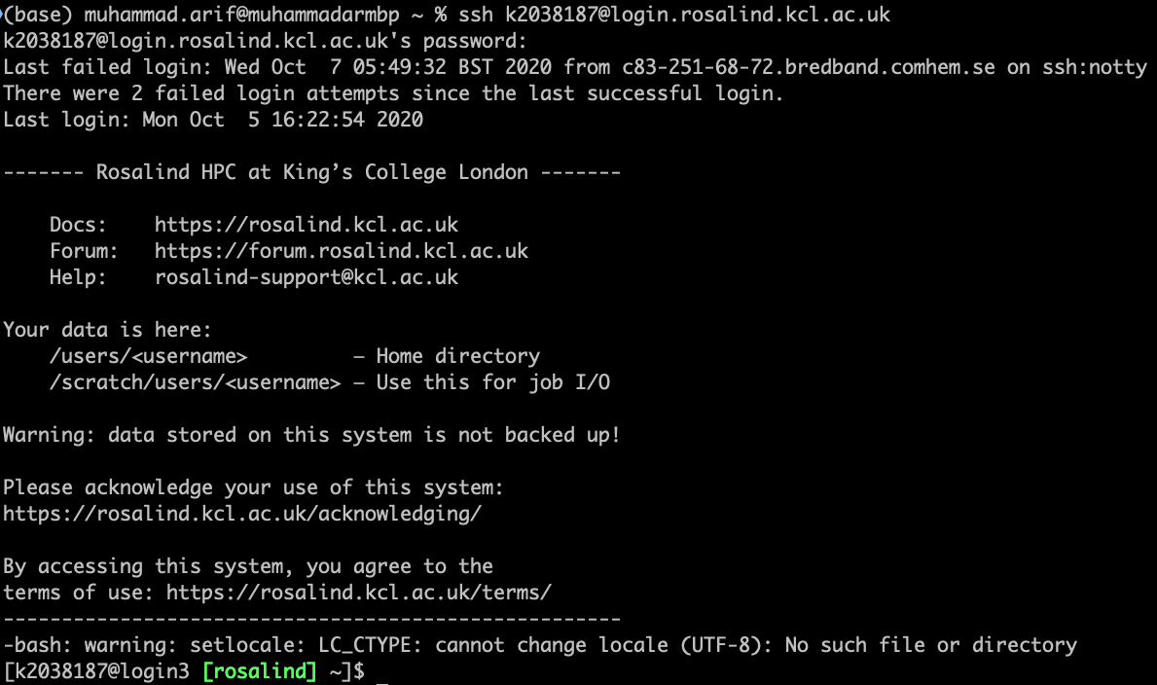
How to login Rosalind
Open SSH client program (MobaXterm, Putty, Terminal)
Login command:
ssh (YOUR_ID)@(SSH address)
ssh kxxxxx@login.rosalind.kcl.ac.uk
and type your password!

Slide 8
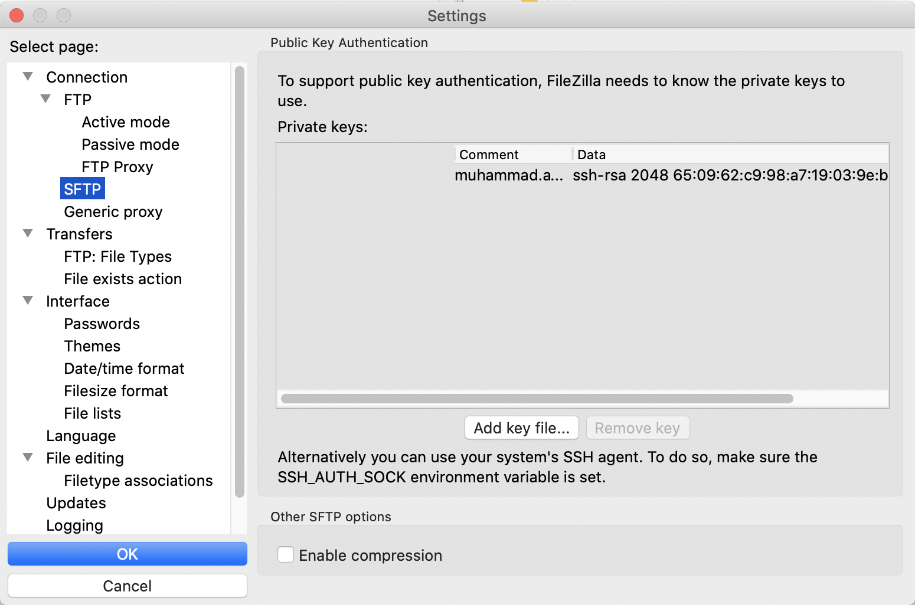
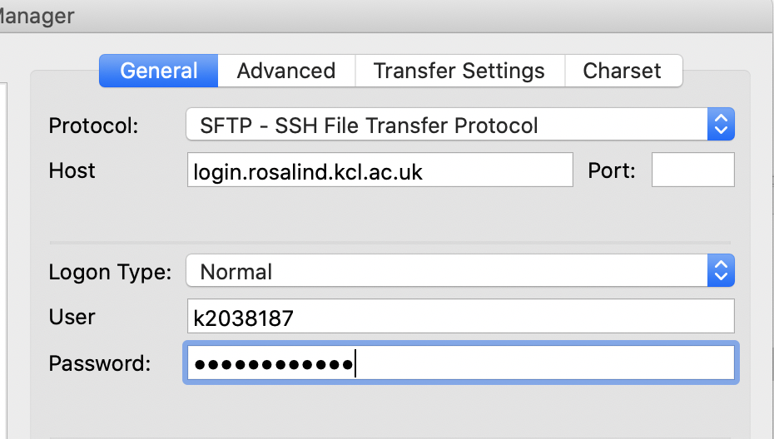
Transferring Data To Rosalind
Always add your private key first (Once)
Edit → Setting → SFTP → Add Key file
Select your id_rsa (not id_rsa.pub)
Reminder:
C:\Users\your_username\.ssh\id_rsa (Windows)
/Users/your_username/.ssh/id_rsa (MacOS)
You can also open terminal, then copy the id_rsa to desktop
cp ~/.ssh/id_rsa ~/Desktop/
Then Load it to filezilla from desktop
After that, add Rosalind into the Site Manager
File → Site Manager (or the top left corner icon)

Slide 9

Architecture of HPC
Login node
CPU
Memory
Network drive
Grid Engine Scheduler
Computational node
Computational node
Computational node
x 100

Slide 10
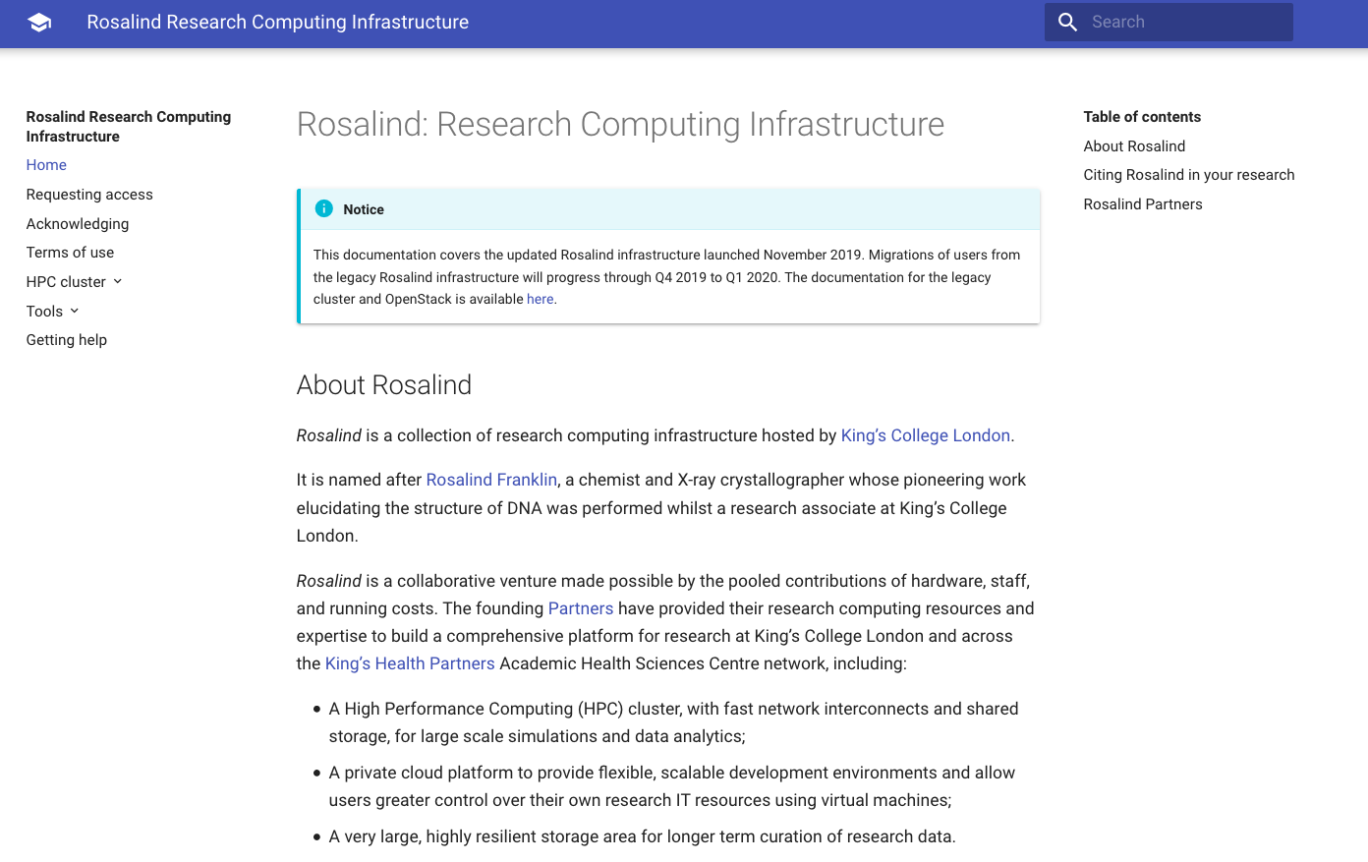
Rosalind Documentation
https://rosalind.kcl.ac.uk

Slide 11
Tasks
1) Make a folder in your home directory, 2) make 3 random files (tip: touch) and 3) show list of files you made
1) Change the content of the file (tip: nano), 2) copy any text from any webpage (find long one) to the file, and 3) explore the files using head, tail, less, etc that we’ve learned yesterday
1) upload any files of your laptop or desktop to your home location at Rosalind server and 2) show list of files you uploaded
30 min for practice
Notes:
http://www.hypexr.org/linux_scp_help.php

Slide 12
How to load installed packages
Several applications are not available by default → you should check pre-installed module on the system (module), otherwise you should install it by yourself or ask root administrator to install it
module avail → you can check all possible applications to load
module load package_name
module load bioinformatics/R
module load general/matlab/2015b
module load general/python/2.7.10
module unload package_name
module list → it shows currently loaded applications

Slide 13
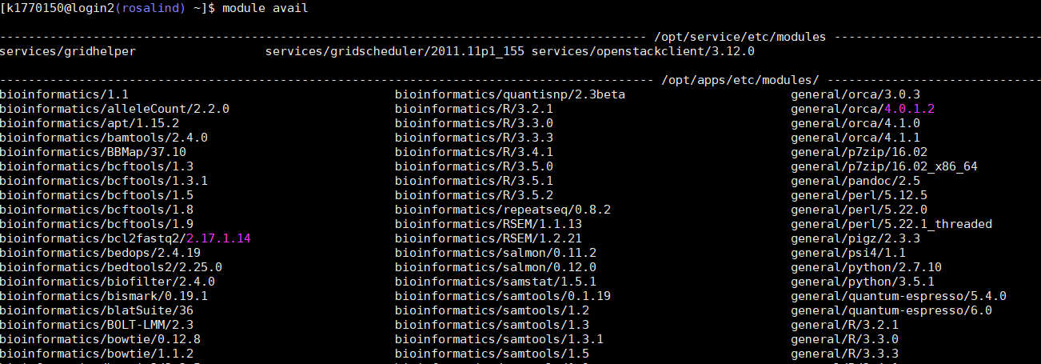

Slide 14
Job submission
Interactive mode vs Batch mode
Login node
Grid Engine Scheduler
Computational node (interactive)
Computational node
Computational node

Slide 15
Job submission
Interactive mode vs Batch mode
Login node
Grid Engine Scheduler
Computational node (interactive)
Computational node
Computational node

Slide 16
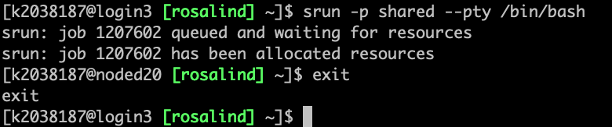
Interactive Mode
Interactive mode:
srun -p shared --pty /bin/bash
Use “exit” command to quit from the interactive mode

Slide 17
Batch Mode
job.sh
#!/bin/bash –l
#SBATCH --output=/scratch/users/%u/%j.out
echo "Hello, World! From $HOSTNAME"
sleep 15
echo "Goodbye, World! From $HOSTNAME"
Batch mode:
Make job script, job.sh
Submitting job:
sbatch –p shared job.sh
Checking status of job
squeue -u yourKNumber
Checking the result of your job (explore the folder)
/scratch/users/yourKnumber/

Slide 18
How much resource are you using
How much space you are using at Rosalind
lfs quota -h /mnt/lustre
How much space that you have in your home directory
Which processes are running now
top, htop (escaping by “q”)

Slide 19
Tasks
Download file by job submission (batch mode)
Tip: use wget function
File link: ftp.sra.ebi.ac.uk/vol1/fastq/ERR589/ERR589353/ERR589353_1.fastq.gz
Check it’s status (tip: squeue –u Knumber), wait until the job is done
Check if the file is already there and check its size (tip: ls –alth)

Slide 20
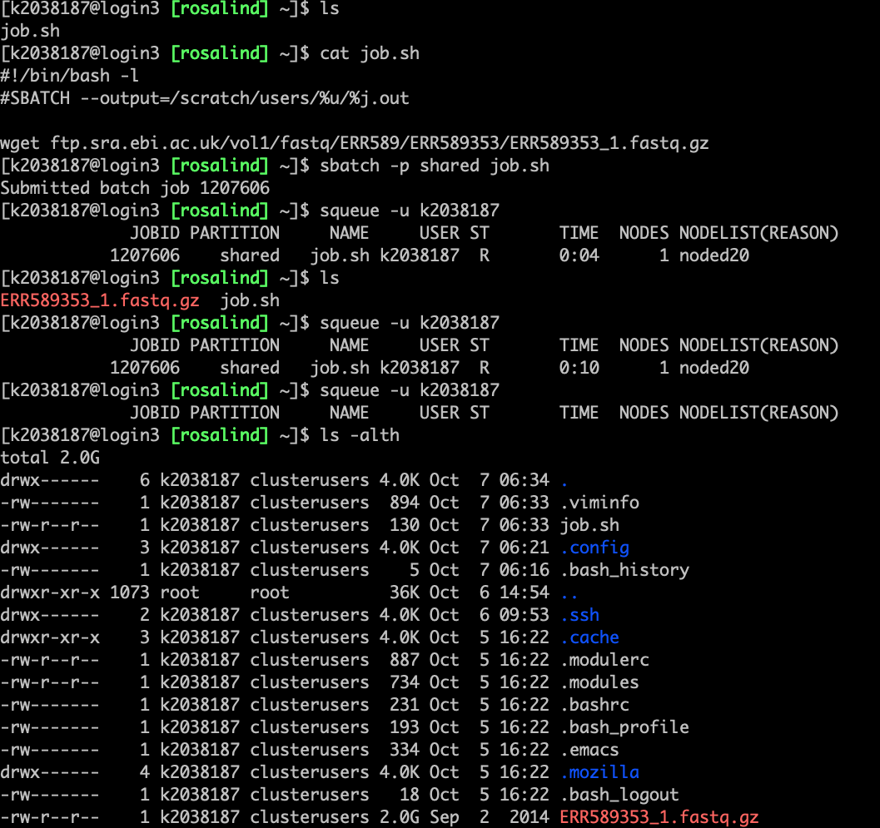

Slide 21
Tasks
Check the usage of your space in the home directory
Decompress downloaded gzip file:
Tip: gzip -d file
Check if the file is extracted there and check its size (tip: ls –alth)
Make a folder named “Dataset” in your home directory and move both files there (remember about wildcard? *)
Move to the new directory
Delete the compressed file (tip: rm, file suffix .gz)
Printing head of file:
Tip: head filename
Find any sequence pattern of your interest from a file
Tip: grep AGGAGGAGGTTCA filename (you can change the sequences)

Slide 22
Tasks
Move to interactive mode
Printing head of file:
Tip: head filename
Check for the format of FASTQ file (standard NGS format)
Read about fastq format to understand the what each line means
https://emea.support.illumina.com/bulletins/2016/04/fastq-files-explained.html
Find any sequence pattern of your interest from a file
Tip: grep AGGAGGAGGTTCA filename (you can change the sequences)
Bonus: count how many lines of your sequence are there?
(tip: grep sequence file | wc –l)

Slide 23
Shell scripting
Declaration of variables:
var1=341
(there is no space between =, var1, and 341)
var2=$(($var1 + 12))
Printing value of variables:
echo $var1
echo ${var1}
Printing environment variables:
echo $PWD
echo $HOME

Slide 24
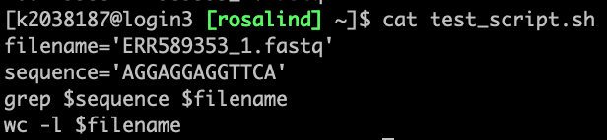
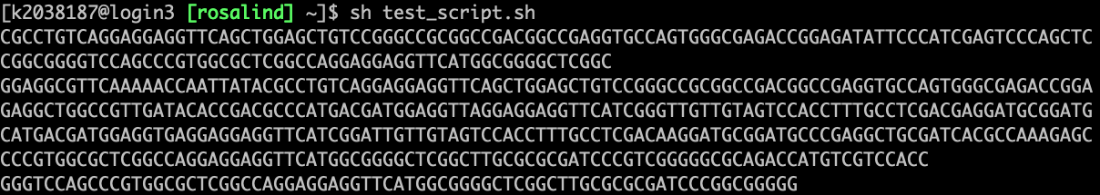
Task
Make sure that you are in the interactive mode (if not, move there)
Open an empty file with nano
Perform the previous grep command using shell script
In the last line, calculate how many lines the file has
.
.
.

Slide 25
Credits
Many were adopted from C3SE introduction course

