Slide 1

Introduction to Linux
Muhammad Arif
http://muharif.net

Slide 2
Materials
Agenda:
Introduction and Basic of Linux
Generating SSH Key
Basic Linux Workshop
Rosalind Workshop (Day 2)
Materials are uploaded to the same web page
I finally have access to KEATS, but not yet added there
https://muharif.github.io/MicrobiomeKCL2020/

Slide 3

GNU/Linux
Open source operating system (UNIX-like/UN*X/*nix)
Developed in the 90s
Free to Download and Install (support comes with fee)
Example of Linux Distribution (Distros):
Ubuntu → easiest for beginner
Fedora
Red Hat
Debian
etc
Similar architectures, tailored for different purpose.

Slide 4
Why Linux?
Free! (as opposed to Windows, OSX, UNIX)
Open source (easy support/Improvement)
Big Communities
Multiuser, Multiprogramming
Secure!!

Slide 5
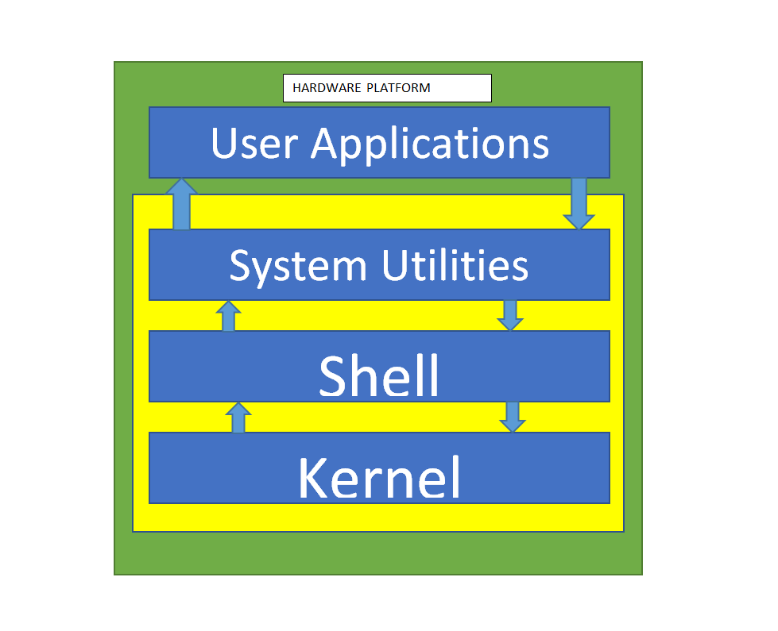
Linux OS architecture
Kernel (Linux):
The core component of the OS
Distributor of all the
Handling memory/processor allocation
Shell:
The user interface of the OS
Similar with CLI/Terminal
Similar to programming language: something that the OS and user both understand
Systems Utilities:
Liable to personal/individual task

Slide 6
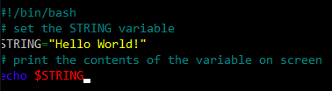
Shell Script
Programming that can be done with Shell
Specific programming language and syntax
Usually quite easy for mostly simple functionalities
Setup environment
Executing program
Data/Log Interpretation
No extra installation needed
Very useful simple functions in High Performance Computing (HPC) or automation of Routine jobs

Slide 7
Why learning Linux?
Widely used as development OS by programmers
Used in almost all high-performance computing (HPC)
Example: Rosalind @ KCL
Analysis of big data, for example: Next-Generation Sequencing Data
Transcriptomic, Microbiome, proteomics, and other omics data
Easily occupy > 1 TB for a single cohort!
Open source OS
Big community, in general and specific to biology
Easy fix for most problems

Slide 8
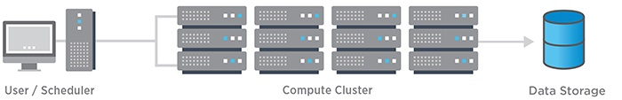

High–Performance Computing (HPC)
Source: NetApp
A set of computing servers
Can be used in parallel
Significantly increasing the computing power
Decreasing processing time
Used for analysis of big data/complex calculations

Slide 9
Bus vs Train Example
Bus
Fast Train
Transporting 50-60 people at a time
Max Speed: 100 kmph
Using same road as normal traffic
No backup during breakdown until replacement comes
Transporting > 100 people per train car (1 train → > 3 cars in parallel)
Max Speed: 300 kmph
Special road, no traffic jam
Backup is always ready in case of a car breaking down

Slide 10

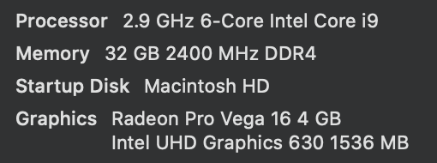
Architecture of HPC
Login node
CPU
Memory
Network drive
Grid Engine Scheduler
Computational node
Computational node
Computational node
x 100

Slide 11


Slide 12
Pre-Workshop: Generate your SSH Key

Slide 13
Generating SSH Key
SSH Key is used as replacement of passwords to login to Linux
For accessing Rosalind, we need SSH key!
Generate your SSH Key:
Windows 10: https://phoenixnap.com/kb/generate-ssh-key-windows-10
MacOS: https://secure.vexxhost.com/billing/index.php/knowledgebase/171/How-can-I-generate-SSH-keys-on-Mac-OS-X.html
Find your SSH Public Key:
C:\Users\your_username\.ssh\id_rsa.pub (Windows)
~/.ssh/id_rsa.pub (MacOS)

Slide 14
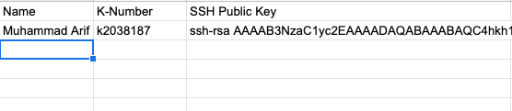
Upload your SSH Public Key
Open your public SSH key with a text editor
Upload your SSH Public Key to google sheet
https://docs.google.com/spreadsheets/d/10M3pKjYFvHleAbBbgB97nBk6F527eB3YVAc659L_YzU/edit?usp=sharing
Your SSH Keys will be forwarded to Rosalind Team so that you will be given an account (Saeed and Myself will take care of this)

Slide 15
Pre-Workshop: Register to Webminal

Slide 16
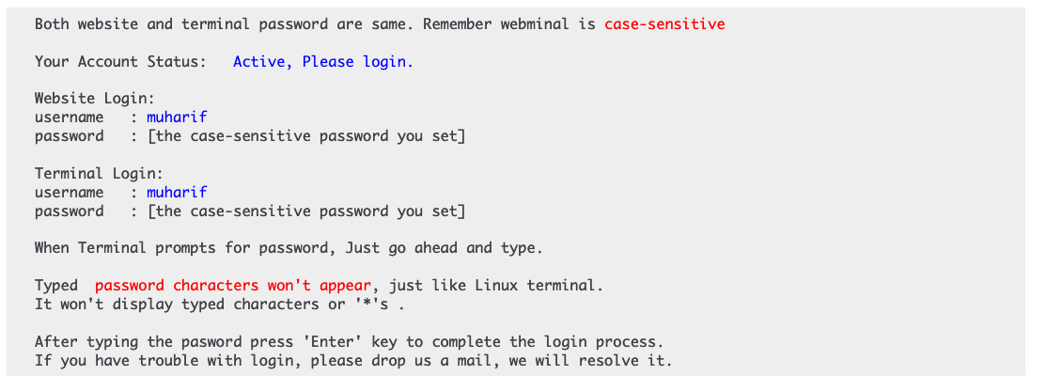
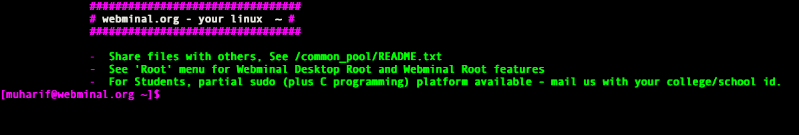
Webminal
Web-based linux terminal
Good for learning
Register here:
https://www.webminal.org/
Confirm your email
Wait for 2 minutes (Check profile page, until it shows “Active” status)
Once your account is active, click on “Terminal” on the top menu
Login with your username and password (case sensitive)

Slide 17
Alternative Web-Based Terminal
http://copy.sh

Slide 18
1st Exercise: how to check your files/directories

Slide 19
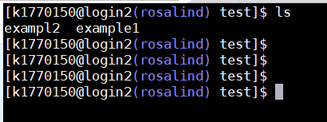
List files and directories
ls: list files of current directory or specified directory
Exercise:
touch test_file_1 test_file2 #touch → to create empty files
ls
ls -a
ls -al
ls -alt
ls -alth
ls --help
Advanced exercise?
mkdir test & touch test/example1 & touch test/example2 & ls -altrh test

Slide 20
List files and directories
Answers:
touch test_file_1 test_file_2 → creating two empty files
ls → simply showing files in this directory
ls -a → showing all files, including hidden files
ls -alt → sorting files by modification time
ls -alth → sorting files by modification time and showing file size by readable format

Slide 21
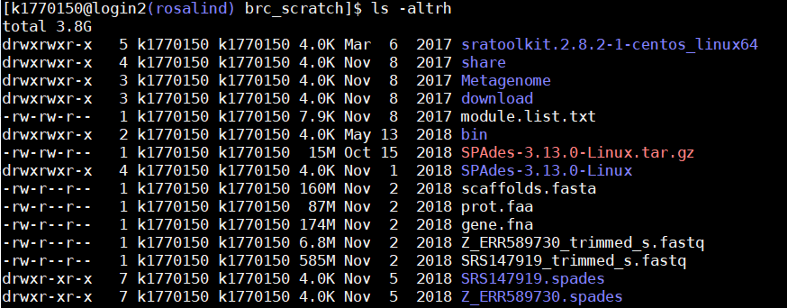
Permission codes
user ownership
group ownership
file size
modification time

Slide 22
Making and deleting directories
mkdir (your_directory)
check if your directory is created: ls command
rmdir (your_directory)
check if your directory is deleted: ls command

Slide 23
Changing to a different directory
Go to your_directory
cd (your_directory)
Go to parent directory
cd ..
Go to previous directory
cd -
Go to specific directory
cd (full_path_of_directory)
cd /users/kXXXX/test
cd -
Find path of your current directory
pwd

Slide 24
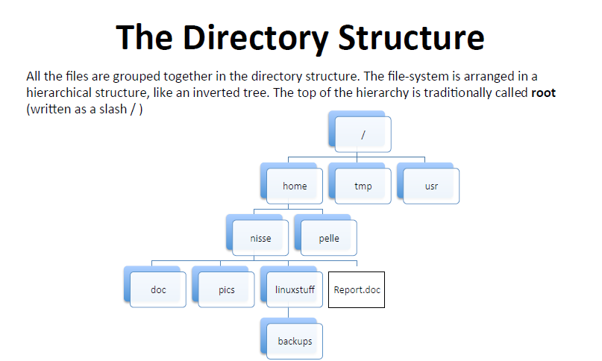
Root permission
Group permission
User ”nisse"
/home/nisse/report.doc
User permission
Please note “home” folder in rosalind is different: e.g. /users/nisse

Slide 25
2nd Exercise: how to control your files/directories

Slide 26
Copying and moving files/directories
Copy file1 to file2:
cp file1 file2
example: touch test1.txt mkdir test_dir cp test1.txt test_dir/test1.txt
Copy all contents of dir1 to dir2
cp -r dir1 dir2
Move file1 to file2 (or directories)
mv file1 file2
It can also rename your file
Example: mv /users/kXXX/test_dir/test1.txt /users/kXXX/test1.txt

Slide 27
Removing files and directories
rm file1 → remove file 1
rmdir directory1 → remove directory1 (please note that directory1 should not have any files)
WARNING: commands below should be carefully executed → deleted files will not be retrieved
rm test* → removing files of names beginning with “test”
rm * → remove all files
“*” called a wildcard, which matches all patterns
Most dangerous command in Linux:
rm –rf *
It deletes all of your files and directories if you executed at the root or home folder

Slide 28
Displaying content of file
cat file1 → printing all contents of file1
less file1 → brief file viewer → you can see next page by “space bar” and escape by “q”
head file1 → printing first few lines of file
tail file1 → printing last few lines of file
grep “pattern” file1 → searching a file for “pattern”

Slide 29
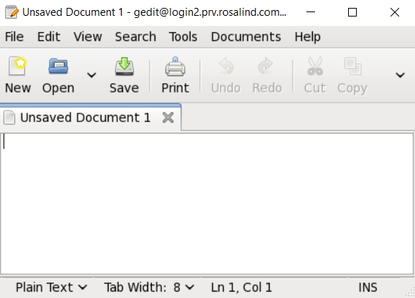
Text file editor
Graphical editor: gedit
Command line editor: vi, nano, emacs, …
30 min for practice

Slide 30
How to control your processes
Foreground vs background
Your jobs can be executed as background (multi-tasking)
command & → running command in background
Ctrl + C → killing job in the foreground
Ctrl + Z → suspending job running in the foreground
bg → background the suspended job
ps → list current processes
jobs → list current jobs
kill -9 1231 → kill process number 1231
kill %1 → kill job number 1
history → list commands you typed previously

Slide 31
How much resource are you using
How much space you are using at Rosalind
lfs quota -h /mnt/lustre
Which processes are running now
top, htop (escaping by “q”)

Slide 32
End of Day 1

Slide 33
Rosalind

Slide 34
How to access Rosalind HPC server (Linux)
SSH protocol → via command
SFTP protocol → via files
HTTP protocol → via webpage

Slide 35
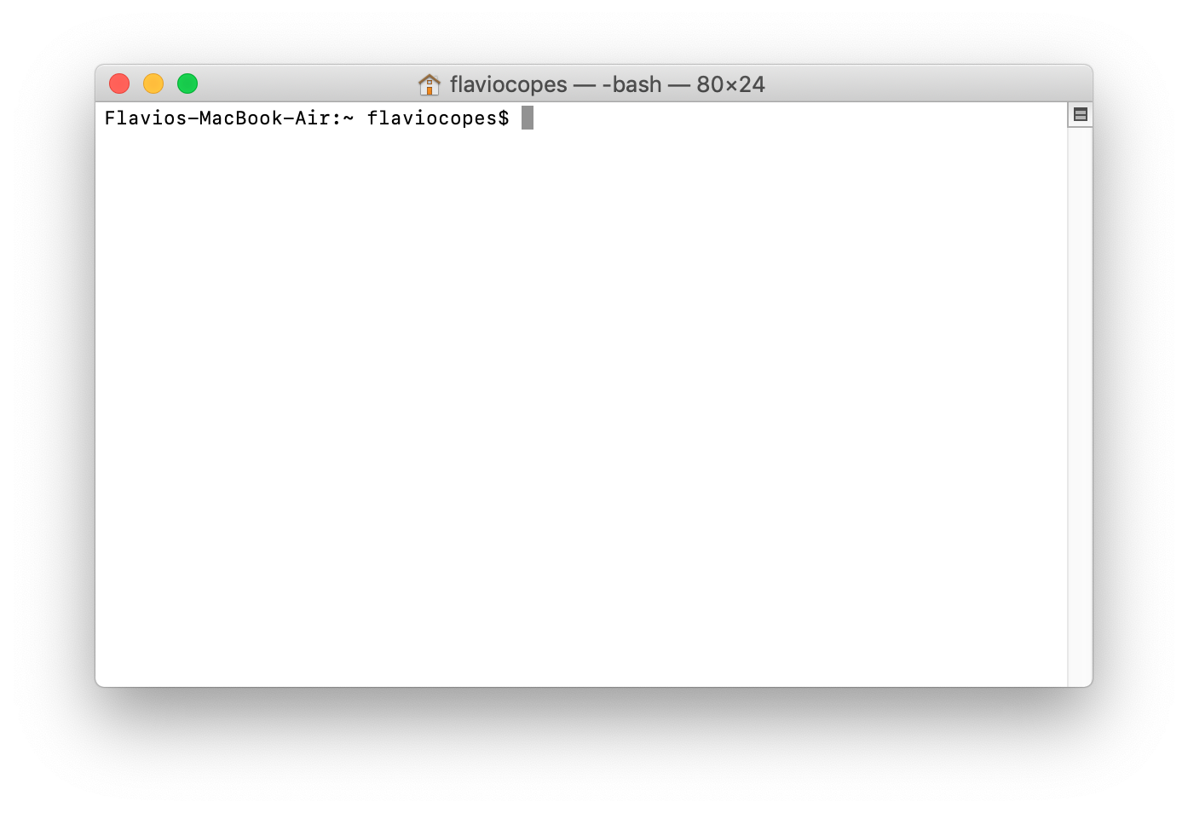
How to access Rosalind HPC server (Linux)
Macbook → Use Terminal → providing Unix/Linux commands and SSH terminal

Slide 36
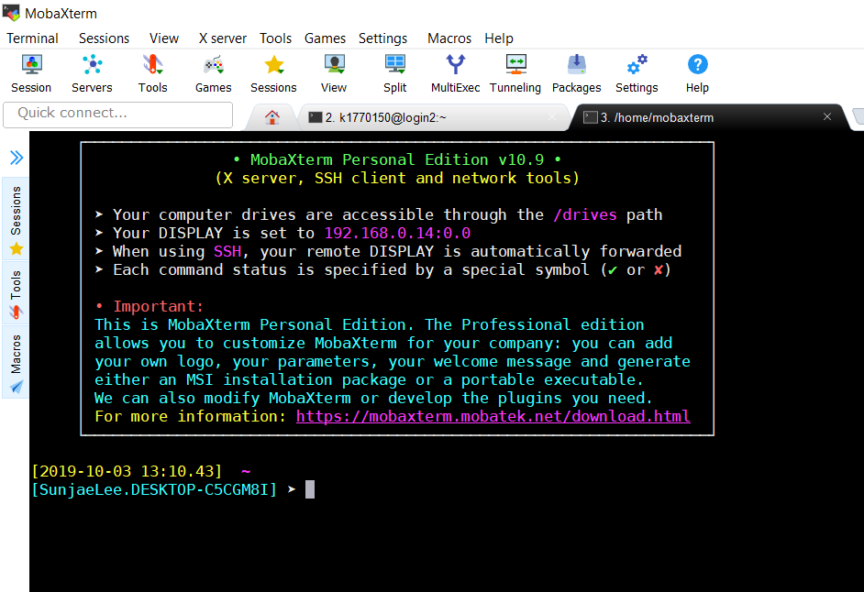
How to access Rosalind HPC server (Linux)
Windows laptop → Install Moba-Xterm software → providing Unix/Linux commands on Windows & SSH terminal

Slide 37
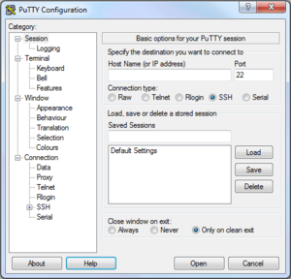
How to access Rosalind HPC server (Linux)
Putty → free and most simple program for SSH terminal

Slide 38
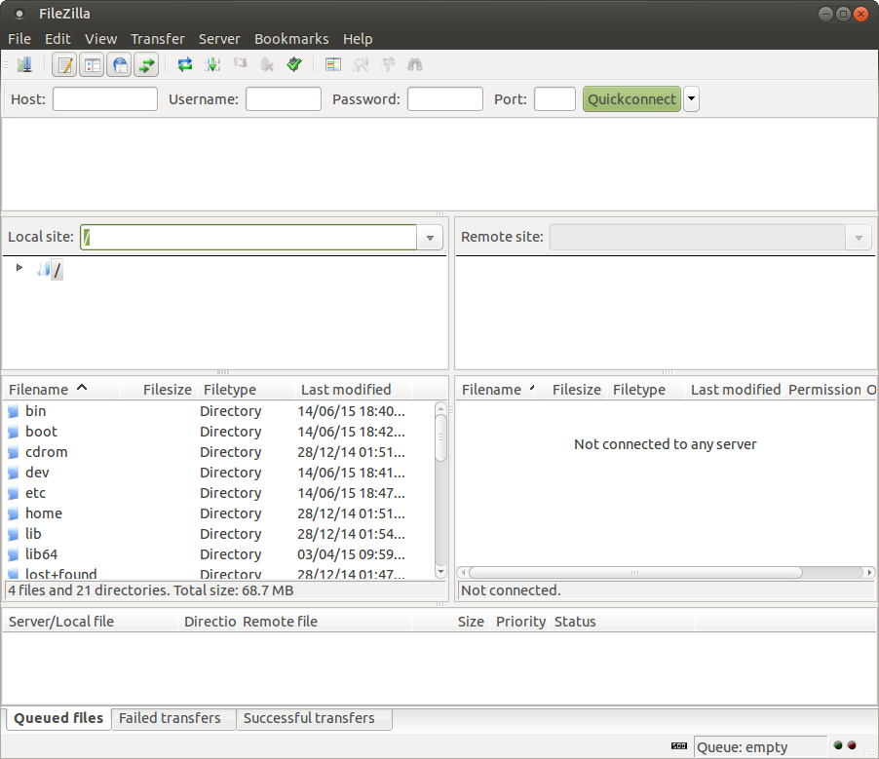
Transferring Data To Rosalind
Download FileZilla (Client) to connect via SFTP
https://filezilla-project.org/
MobaXterm supports SFTP transfer as well

Slide 39
Then how can I upload files to Rosalind?
Use SFTP programs:
Winscp
Filezilla
Moba-Xterm itself has a SFTP function
But it is slow for file transfer

Slide 40
Tasks
1) find brc_scratch folder from your home location, 2) make any files (tip: touch) and 3) show list of files you made
1) upload any files of your laptop or desktop to your home location at Rosalind server and 2) show list of files you uploaded
30 min for practice
Notes:
http://www.hypexr.org/linux_scp_help.php

Slide 41
How to use VPN
To access Rosalind cluster server, we need IP address allowed to login
We use VPN (virtual private network) setting instead
For Windows laptop: install OpenVPN
https://openvpn.net/community-downloads/
Copy config file (Rapunzel.ovpn) into OpenVPN configuration folder (e.g. C:\User\<username>\OpenVPN\config)
For Macbook: install tunnelblick
https://tunnelblick.net/

Slide 42
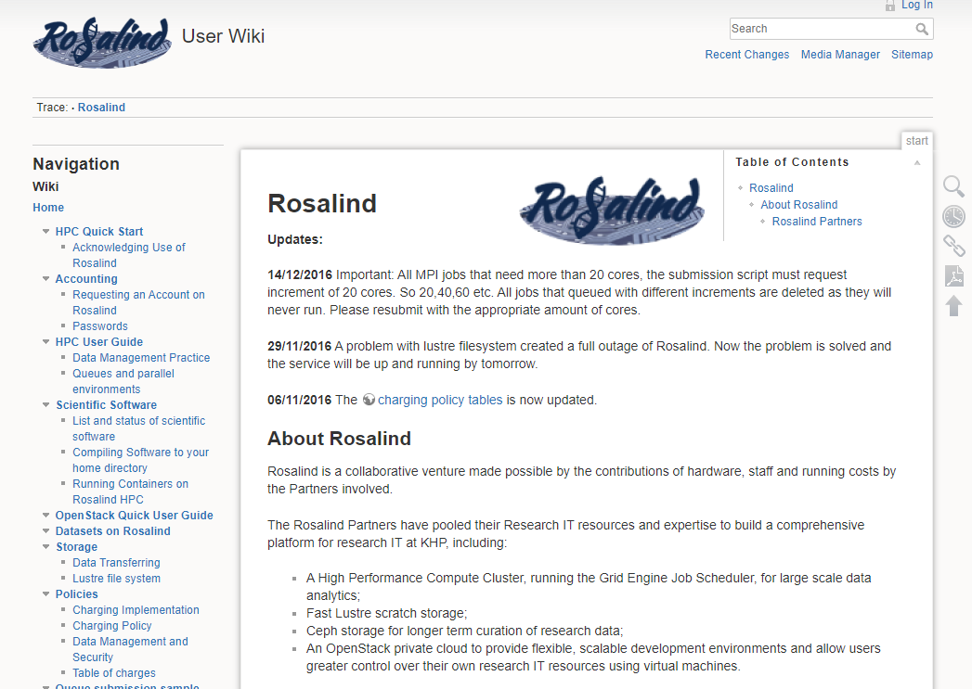
How to login Rosalind
https://user-wiki.rosalind.kcl.ac.uk/doku.php

Slide 43

How to login Rosalind
Open SSH client program (MobaXterm, Putty, Terminal)
Login command:
ssh (YOUR_ID)@(SSH address)
ssh kxxxxx@login1.rosalind.kcl.ac.uk
ssh kxxxxx@login2.rosalind.kcl.ac.uk
and type your password!

Slide 44
How to load installed packages
Several applications are not available by default → you should check pre-installed module on the system (module), otherwise you should install it by yourself or ask root administrator to install it
module avail → you can check all possible applications to load
module load package_name
module load bioinformatics/R
module load general/matlab/2015b
module load general/python/2.7.10
module unload package_name
module list → it shows currently loaded applications

Slide 45
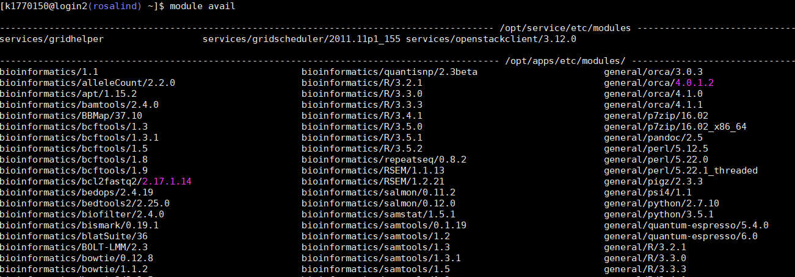

Slide 46
Job submission
Interactive mode vs Batch mode
Login node
Grid Engine Scheduler
Computational node (interactive)
Computational node
Computational node

Slide 47
Job submission
Interactive mode vs Batch mode
Login node
Grid Engine Scheduler
Computational node (interactive)
Computational node
Computational node

Slide 48
Job submission
Interactive mode:
qrsh -q InterLowMem.q
qrsh -q InterLowMem.q -pe smp 10 (use 10 cores)

Slide 49
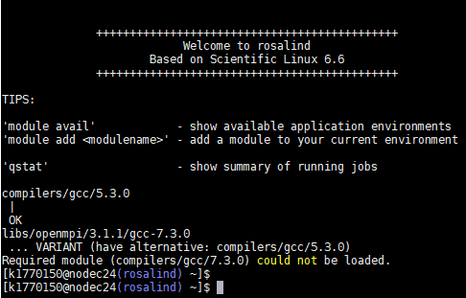

Job submission
You can quite your interactive mode by exit command

Slide 50
Job submission
job.sh
#!/bin/sh
#$ -pe smp 16
#$ -cwd
#$ -N id9.meteor.left
#$ -q HighMemLongterm.q,LowMemShortterm.q,LowMemLongterm.q
#$ -j y
#$ -R y
#$ -l h_vmem=18G
#$ -l h_rt=5:00:00
## any commands for execution ##
wget aaa.ttt.tttx
echo “download finished”
Batch mode:
Make job script, job.sh
Submitting job:
qsub job.sh
Checking status of job
qstat

Slide 51
Shell scripting
Declaration of variables:
var1=341
(there is no space between =, var1, and 341)
var2=$(($var1 + 12))
Printing value of variables:
echo $var1
echo ${var1}
Printing environment variables:
echo $PWD
echo $HOME

Slide 52
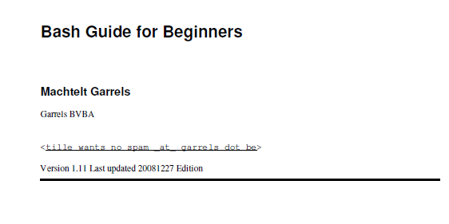
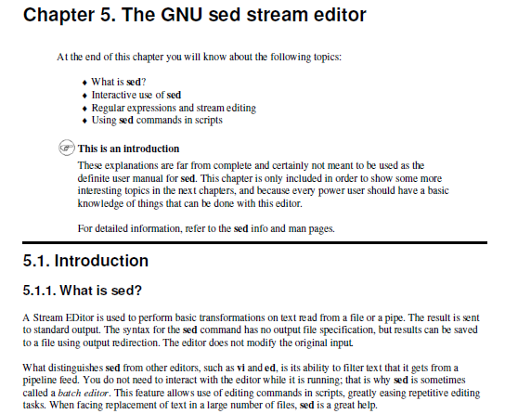
Bash scripting

Slide 53
How much resource are you using
How much space you are using at Rosalind
lfs quota -h /mnt/lustre
Which processes are running now
top, htop (escaping by “q”)

Slide 54
Tasks
Download file by job submission (batch mode)
Tip: use wget function
File link: ftp.sra.ebi.ac.uk/vol1/fastq/ERR589/ERR589353/ERR589353_1.fastq.gz
Decompress downloaded gzip file:
Tip: gzip -d file
Printing head of file:
Tip: head
Find any sequence pattern of your interest from a file
Tip: grep AGGAGGAGGTTCA file

Slide 55
Credits
Many were adopted from C3SE introduction course

