Slide 1
Installation of Microbiome Workshop Softwares
Do this once only! There’s no need to do this multiple time

Slide 2
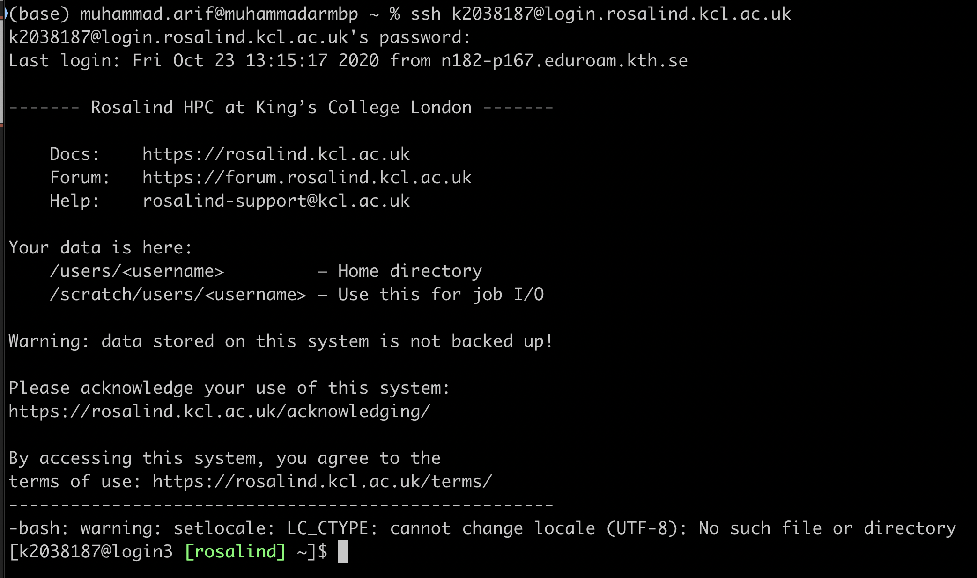
1. Login to Rosalind
Command: ssh kNumber@login.rosalind.kcl.ac.uk

Slide 3
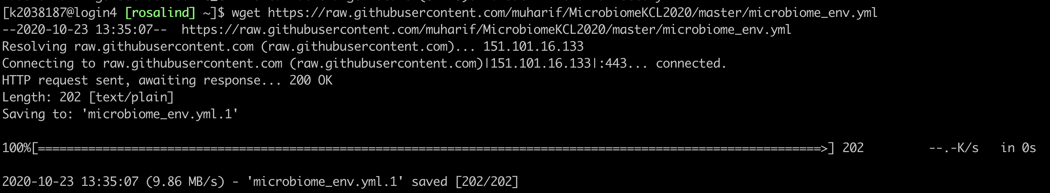
2. Download Conda Environment file
Command:
wget https://raw.githubusercontent.com/muharif/MicrobiomeKCL2020/master/microbiome_env.yml

Slide 4
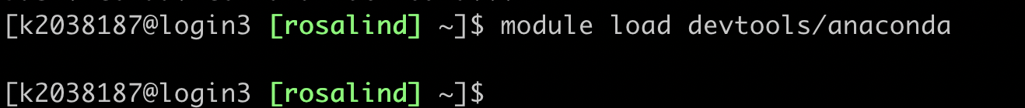
3. Load Anaconda Module in Rosalind
Command: module load devtools/anaconda
Warning: No output is expected.

Slide 5
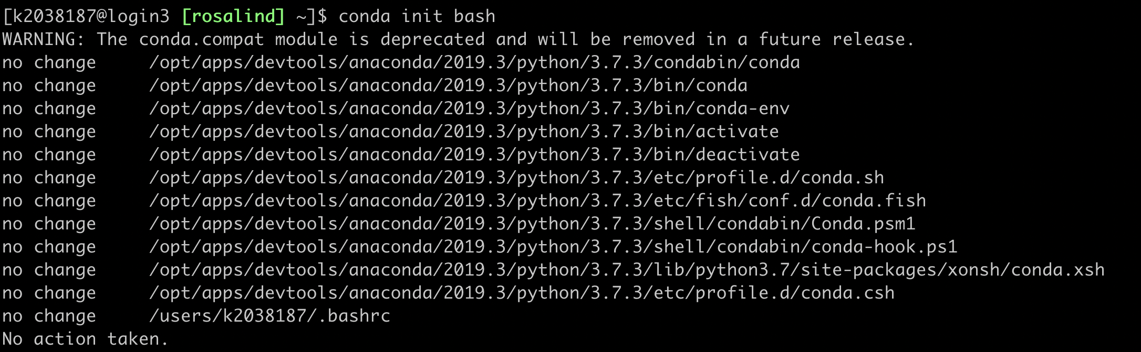
4. Load Conda Init
Command: conda init bash

Slide 6
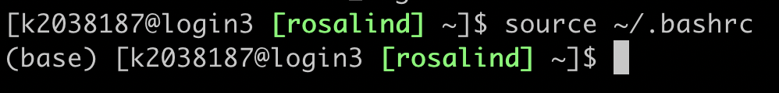
5. Restart the shell
Command: source ~/.bashrc
You should see (base) in your shell now

Slide 7
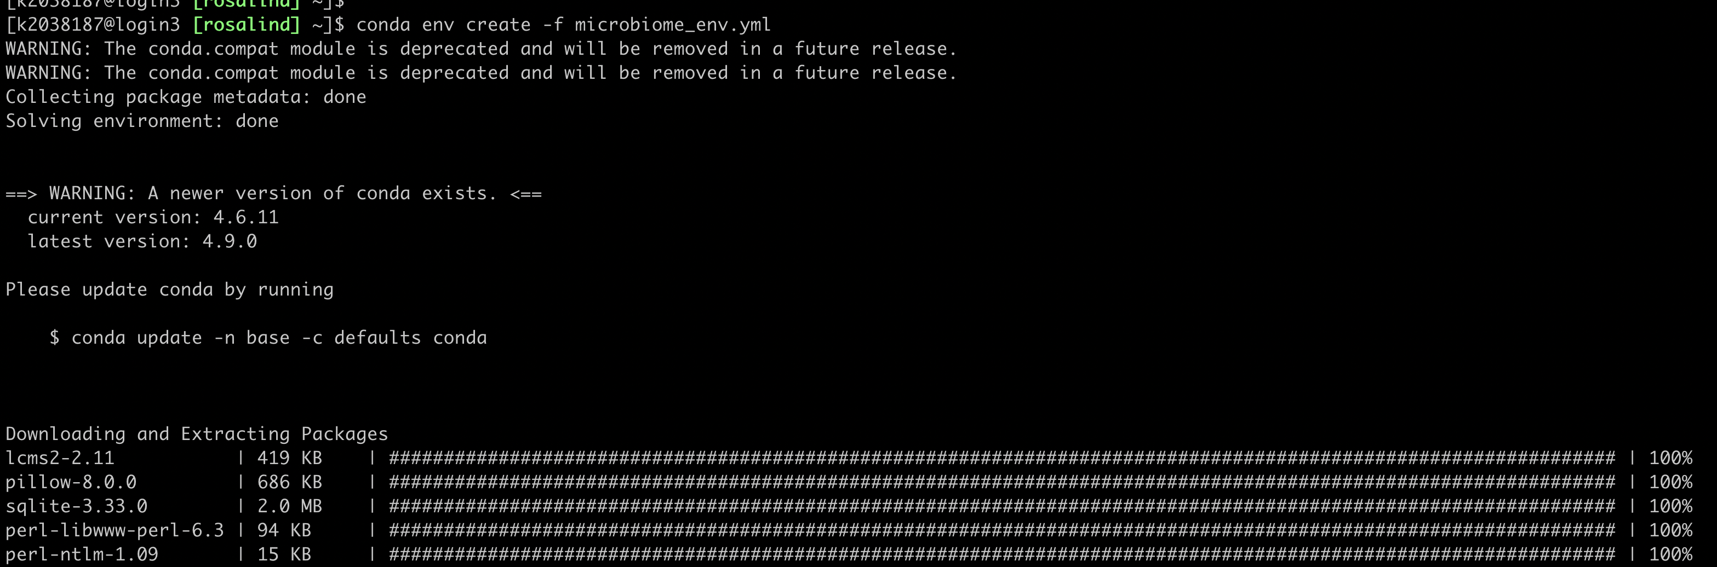
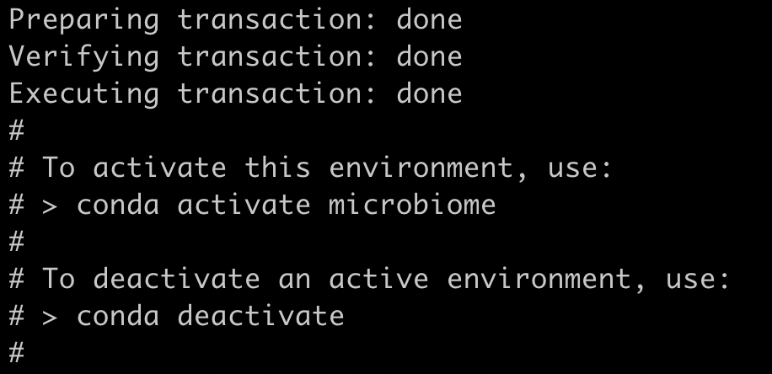
6. Create Conda Environment
Command: conda env create -f microbiome_env.yml
Warning: This might take a while, wait until you see something like this

Slide 8
Entering Microbiome Environment
Do this everytime you login to Rosalind and want to do microbiome analysis

Slide 9
Load Conda Environment
Command: conda activate microbiome
You should see (microbiome) in your shell now

Slide 10
Example Command
Running metaphlan2:
metaphlan2.py /path/to/file/filtered_wrkshpF.fastq --input_type fastq --nproc 16 > /path/to/file/metaphlan2_filtered_wrkshpF.txt
Don’t forget to run the metaphlan2 after loading the environment (slide 9)

Slide 11
In case of error
If you don’t see (base) in the shell: Redo Step 3-5 from installation step
If you get error “conda not found”: Redo step 3-5 from installation step
If you get error “Could not find conda environment XXXX”: Redo the installation step

