Slide 1


Probability
Muhammad arif
http://muharif.net

Slide 2
Agenda
Basic Probability Theory:
Introduction
Random Variables
Distributions
Probability Density Function and Cumulative Distribution Function
Statistical Inference
Central Limit Theorem
Sampling Problems
Hypothesis Testing
The Future

Slide 3
Question Statistics and Probability: What’s the difference?

Slide 4
Probability
How likely an event to happen?
How likely a proposition is true?
Likelihood of something to happen in the future
Numberical descriptions of the likelihood (0 < P < 1):
0 → Impossible
1 → Certainty

Slide 5

Examples (Fair)
Coin toss:
1 of 2 possible outcomes
Probability: ½ or 0.5 or 50%
Rolling a die:
1 of 6 possible outcomes
Probability: 1/6
If I roll a die 600 times, what’s the probability of getting a 6?

Slide 6
Examples (Unfair)
Picking balls from a bag:
5 blue and 1 red balls
Probability Blue: 5/6
Probabilty Red: 1/6
Homework: If I picked the balls 2000 times, what’s the probability of getting 2 blue balls in a row? What about 3 blue balls and 1 red in a row?

Slide 7



Random Variables
All the examples were random variables
Other examples:
Smoking status of a city resident (Discrete)
Weight of new-born baby (continuous)
Etc
Random variables cannot be predicted
Probability can help to describe the occurrence of random variables

Slide 8
Distributions (Discrete Random Variable)
Bernoulli experiment:
Two possible outcomes
P(success) = p
P(failed) = 1-p
When repeated multiple times → Binomial Distributions
Another example:
Poisson Distribution

Slide 9
Distributions (Continous Random Variable)
Taking continuous values, instead of discrete values
Example:
Baby weight
BMI of city population
Described by the probability density functions
Examples:
Normal Distribution
Exponential Distribution

Slide 10
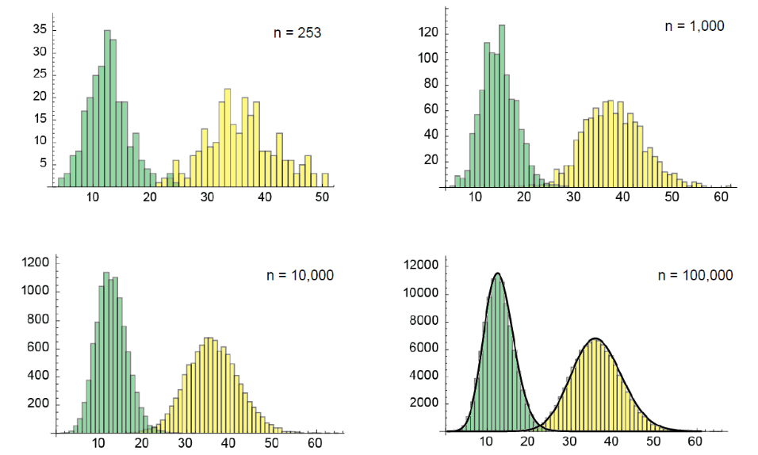
Law of Large Number
The more number of experiments performed, the closer the result to the expected value.

Slide 11
Probability Density Function (PDF) Cumulative Distribution Function (CDF)
PDF: Function that provides the probabilities of occurrence of different possible outcomes in an experiment
Area under the curve
CDF: the probability that will take a value less than or equal to

Slide 12
Probability Density Function (PDF) Cumulative Distribution Function (CDF)
P(X = 3.5)
PDF: Function that provides the probabilities of occurrence of different possible outcomes in an experiment
Area under the curve
CDF: the probability that will take a value less than or equal to

Slide 13
Probability Density Function (PDF) Cumulative Distribution Function (CDF)
F(3.5)
P(X < 3.5)
PDF: Function that provides the probabilities of occurrence of different possible outcomes in an experiment
Area under the curve
CDF: the probability that will take a value less than or equal to

Slide 14
Standard Deviation
The spread of the PDF
The slope of the CDF

Slide 15
Is it always normal distribution?
Normal
Skewed
Median &
Mean
median
mean

Slide 16
Statistical Inference
Muhammad arif
http://muharif.net

Slide 17







Central Limit Theorem
Remember law of large number?
The more number of experiments (single observed variable), the sample means always approaches a normal distribution
Regardless of the original distribution

Slide 18
Hypothesis Testing
Determination if a claim/proposition is true or false
Claim → Hypothesis
Null Hypothesis (H₀): Hypothesis to be tested → The default assumption
Alternative Hypothesis (H₁): Hypothesis that are different/opposite of the null hypothesis
In testing hypothesis → We want H₁ to be true (H₀ to be false)
Example: Checking if the mean (μ) between two distribution is the same
H₀: μ₁ == μ₂
H₁: μ₁ != μ₂

Slide 19
Student T-Test
One of the hypothesis testing tool
To check if the data distribution is following Student T-Distribution
2-sample test: checking if the 2 normal distributions has the same means

Slide 20
Types of Hypothesis Testing
1-tailed test
H₀: Value > μ
H₀: μ > Value
2-tailed test
H₀: μ != Value

Slide 21
P-Value
Measure of the evidence to reject H₀
Probability of getting the observed value/part of the distributions that are not in H₀
Low P-Value (ex: P-Value <= 0.05) → Possibility of rejecting H₀ is high
High P-Value (ex: P-Value > 0.05) → H₀ is possibly true
H₀: μ > Value
H₀: μ < Value
H₀: μ != Value

Slide 22
Accuracy
Goal: Minimizing False Positives and False Negatives
Healthy
Disease
Healthy
Disease
Healthy
Disease
High Cut-Off:
Type I Error
High False Positives
False Alarm
Low Cut-Off:
Type II error
High False Negatives
Missing Real Results
Moderate Cut-Off:
Balance

Slide 23
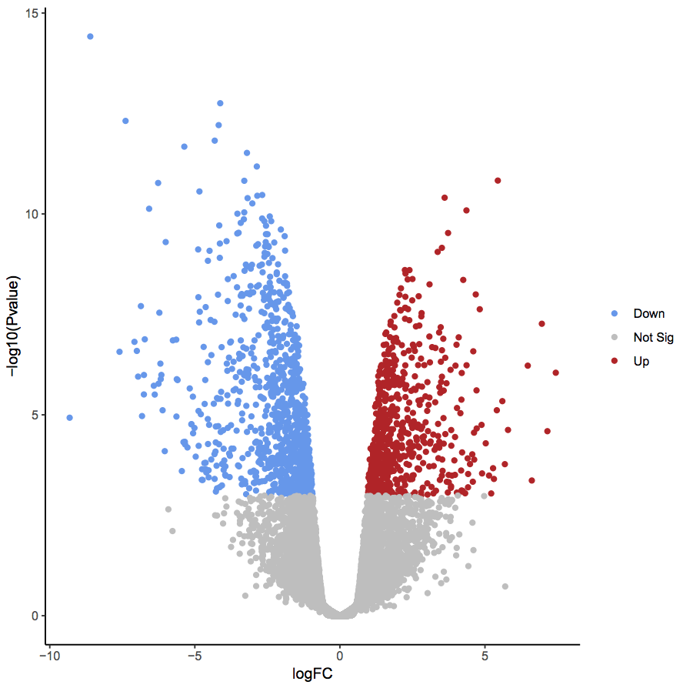
Multiple Hypothesis Testing
In Omics/Big Data Analysis, we are always performing thousands of independent hypothesis tests
Example:
Transcriptomic Analysis: Comparison of 20K Genes between healthy and disease state
Proteomics: 1000 Proteins to compare
Metabolomics: > 1000 Metabolites to compare
Etc
With normal p-value (nominal p-value) < 0.05 → 5% of the “significant” results are by chance
Not representative anymore of the real error rate

Slide 24
Multiple Hypothesis Testing
P-Value has to be corrected/adjusted, based on the observed variable numbers
Goal: To control Type I Error (False positive)
Ways to correct or adjust P-Values:
Family-Wise Error Rate (FWER) → Probability of significant set has one or more false positive
Bonferroni, Tukey, Sidak, Holm
False Discovery Rate (FDR) → Predicted Proportion of False Positive result in the significant set
Benjamini-Hochberg

Slide 25
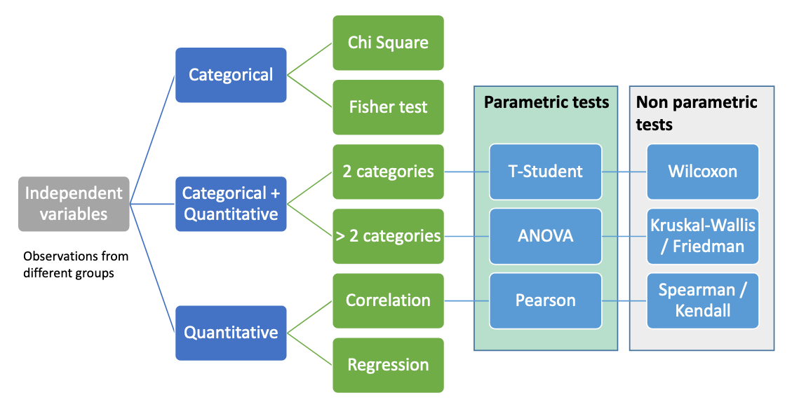
Statistical Tests (Independent)

Slide 26
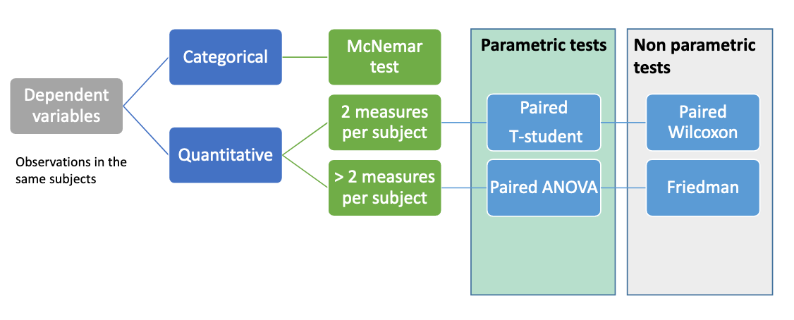
Statistical Test (Dependent)

Slide 27
Question What’s next? What to do with all this?

Slide 28
