Slide 1
Installation of Microbiome Workshop Softwares
Do this once only! There’s no need to do this multiple time

Slide 2
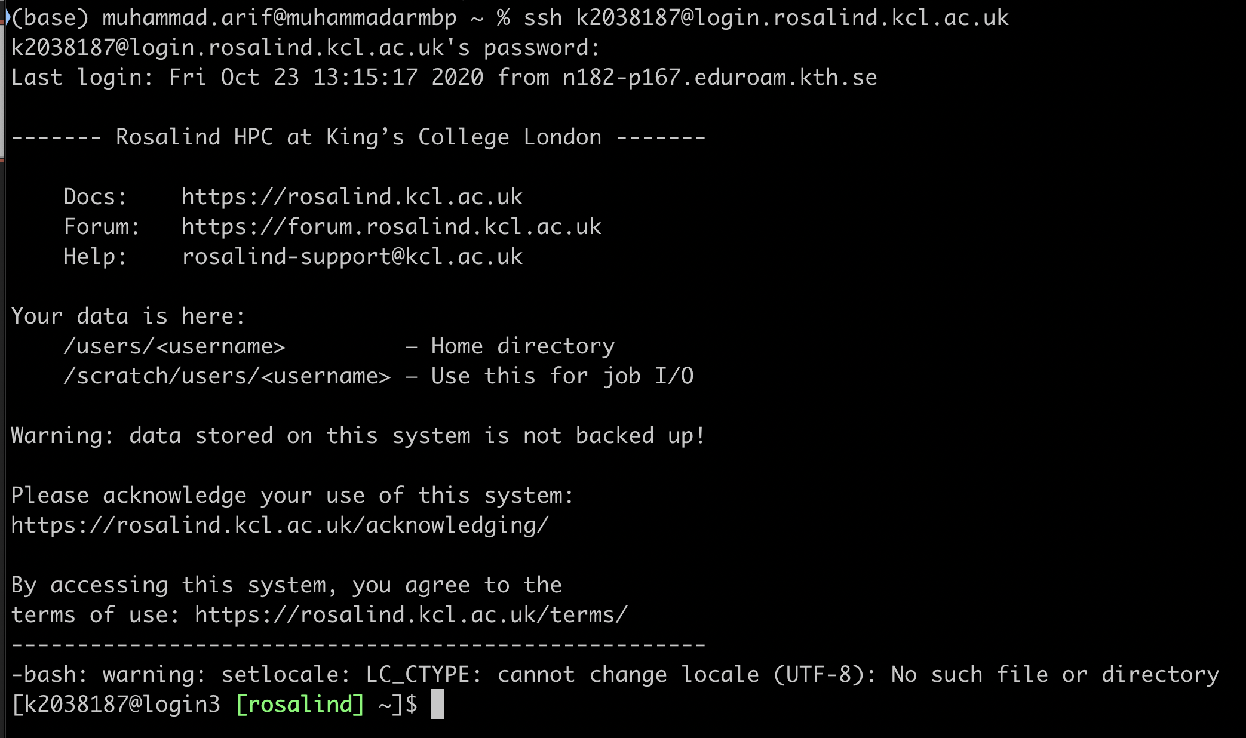
1. Login to Rosalind
Command: ssh kNumber@login.rosalind.kcl.ac.uk

Slide 3
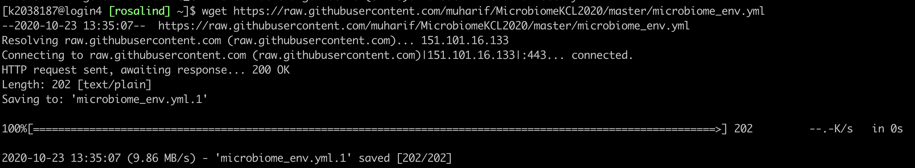
2. Download Conda Environment file
Command:
wget https://raw.githubusercontent.com/muharif/MicrobiomeKCL2020/master/MicrobiomeWS/microbiome_env.yml

Slide 4
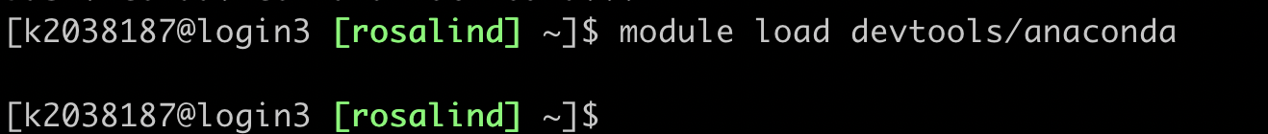
3. Load Anaconda Module in Rosalind
Command: module load devtools/anaconda
Warning: No output is expected.

Slide 5
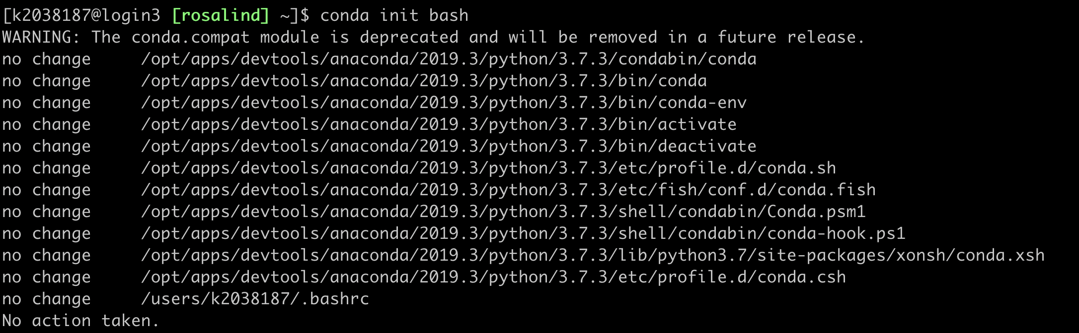
4. Load Conda Init
Command: conda init bash

Slide 6
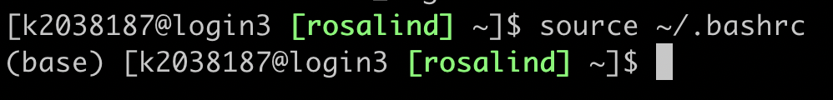
5. Restart the shell
Command: source ~/.bashrc
You should see (base) in your shell now

Slide 7
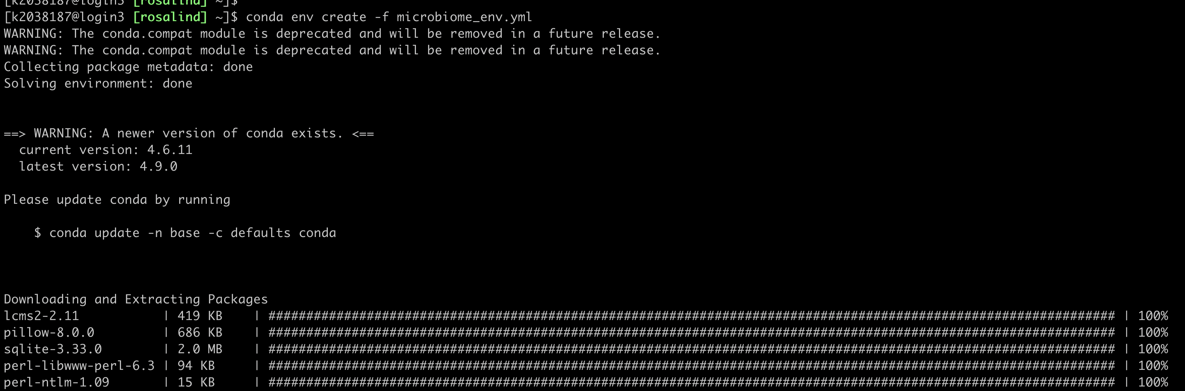
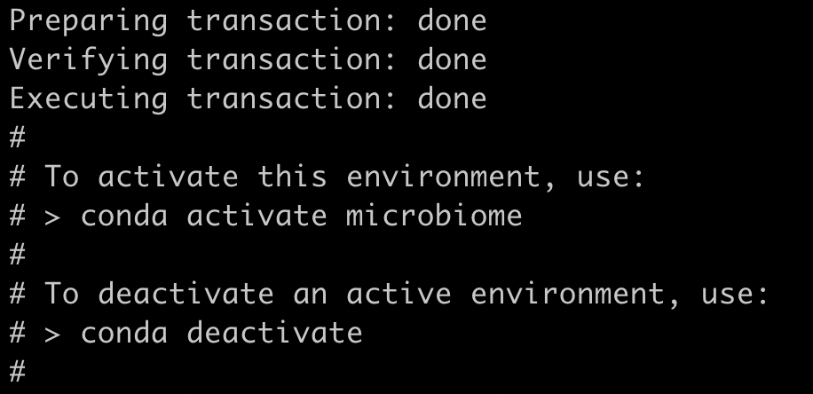
6. Create Conda Environment
Command: conda env create -f microbiome_env.yml
Warning: This might take a while, wait until you see something like this

Slide 8
7. Copy the database to your own folder
Command:
cp -r /mnt/lustre/datasets/mhdmsc/metaphlan_databases ~/
This might take a while, no output

Slide 9
Entering Microbiome Environment
Do this everytime you login to Rosalind and want to do microbiome analysis

Slide 10
Load Conda Environment (example, do it after interactive mode, next slide)
Command: conda activate microbiome
You should see (microbiome) in your shell now

Slide 11
Commands to read microbiome data
Go into interactive mode:
srun -p shared --pty /bin/bash
Move to microbiome environment:
conda activate microbiome
Load Bowtie2:
module load apps/bowtie2
Going into home directory:
cd ~ OR cd /users/kNumber
Download Example Sequences (Filtered):
wget https://raw.githubusercontent.com/muharif/MicrobiomeKCL2020/master/MicrobiomeWS/SRS014459-Stool.fasta.gz
Running metaphlan2 (assuming your file is downloaded in home directory, check with ls):
metaphlan SRS014459-Stool.fasta.gz --input_type fasta --nproc 16 --bowtie2db metaphlan_databases/ > workshop_results.txt

Slide 12
In case of error
If you don’t see (base) in the shell: Redo Step 3-5 from installation step
If you get error “conda not found”: Redo step 3-5 from installation step
If you get error “Could not find conda environment XXXX”: Redo the installation step

