Slide 1
FX Master – Machine Learning Practice
Team 3: Pauline, Flora, MD
Dec-2022

Slide 2
TABLE OF CONTENTS
01
02
03
BACKGROUND
GOAL & METHODOLOGY
DATA PREP & MODEL TRAINING
04
05
06
MODEL EVALUATION
SUMMARY
FUTURE EXPLORATION

Slide 3
01 BACKGROUND

Slide 4
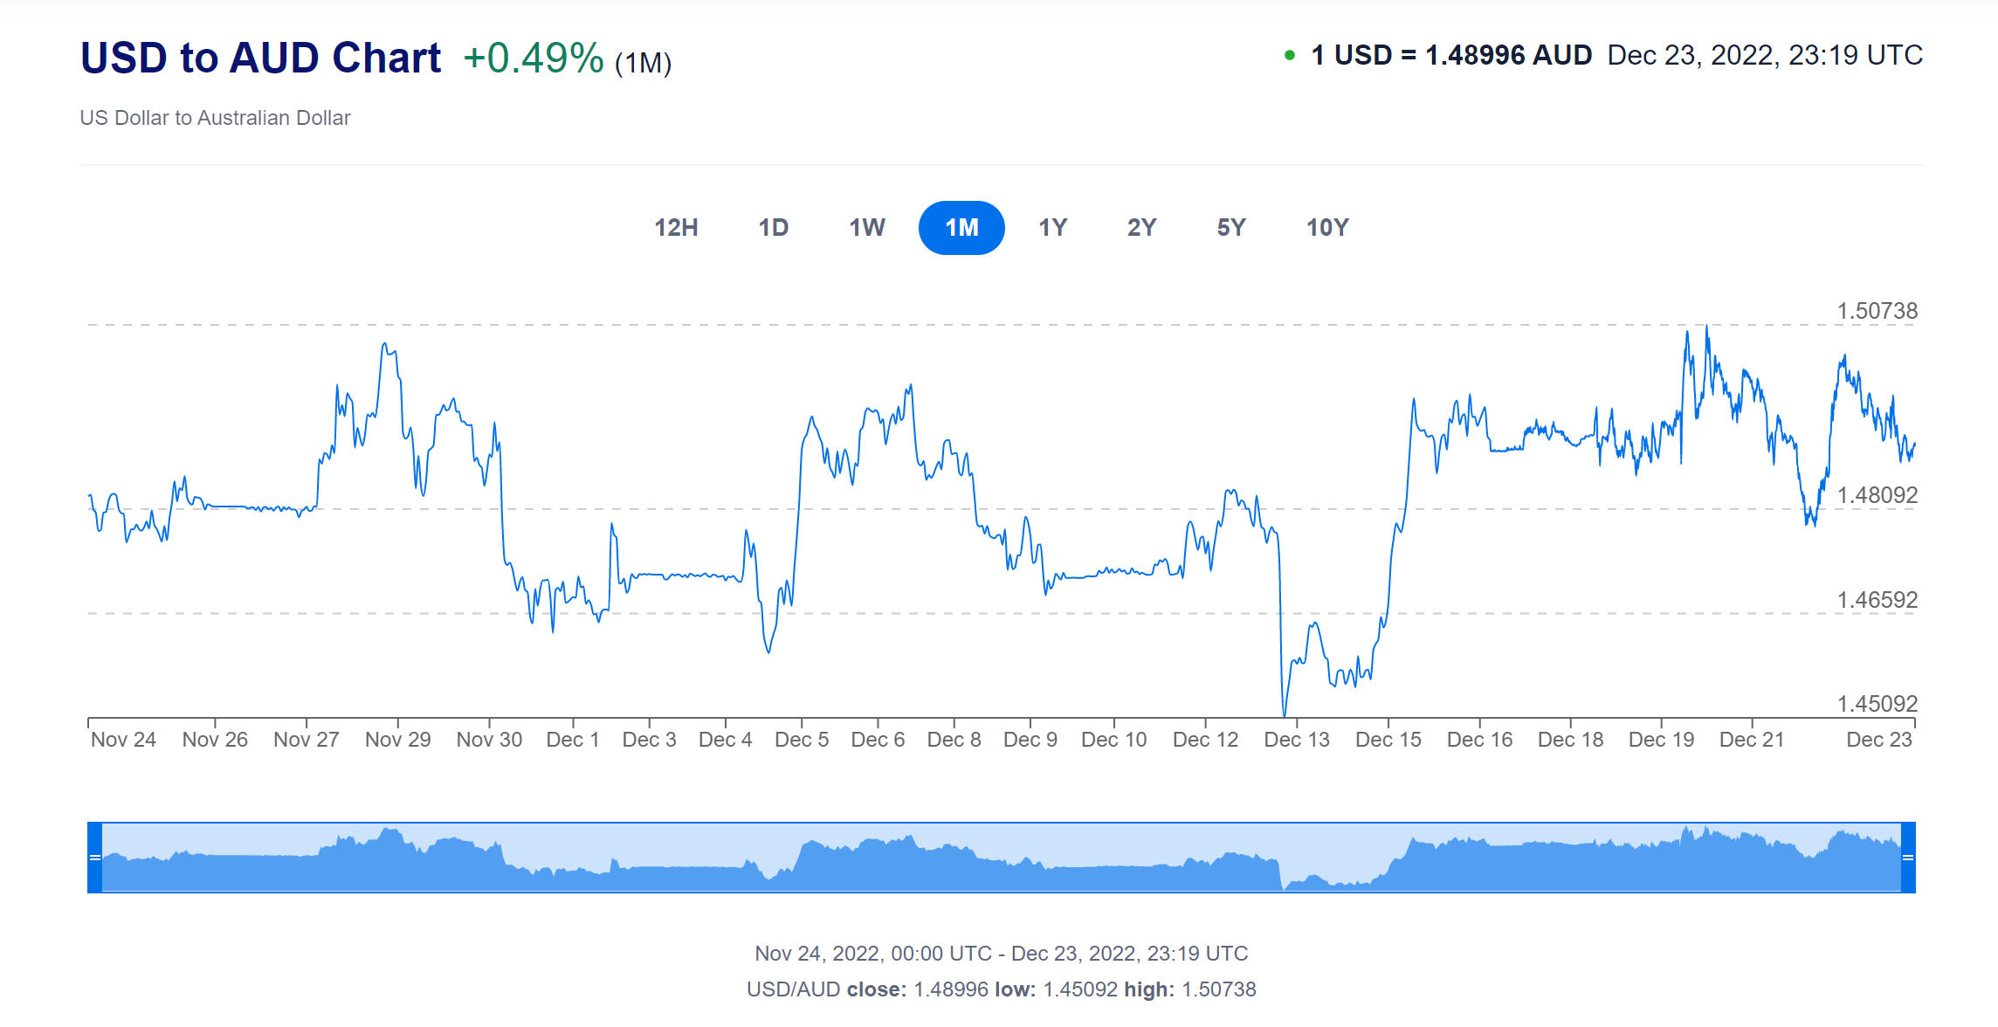
MOTIVATION
This project is motivated by analysing different factors that may influence the FX rates and try to use machine learning models to predict the moving direction of the exchange rate.
Currency exchange rate is one of the most important determinants of a country's relative level of economic health.
A higher-valued currency makes a country's imports less expensive and its exports more expensive in foreign markets.
Exchange rates matter on a smaller scale as well: they impact the real return of an investor's portfolio.
Exchange rates are relative and are expressed as a comparison of the currencies of two countries.
Notes:
Aside from factors such as interest rates and inflation, the currency exchange rate is one of the most important determinants of a country's relative level of economic health.
Exchange rates play a vital role in a country's level of trade, which is critical to most every free market economy in the world. For this reason, exchange rates are among the most watched, analyzed and governmentally manipulated economic measures.
But exchange rates matter on a smaller scale as well: they impact the real return of an investor's portfolio. Here, we look at some of the major forces behind exchange rate movements.

Slide 5
PROBLEM STATEMENT
SCOPE:
This project focuses on only one currency pair: USD/AUD
PROBLEM STATEMENT:
Try to predict the moving direction of the fx rate
We can use the same approach to do the research on other currency pairs, changing the different factors that may influence the FX rate
Notes:
Aside from factors such as interest rates and inflation, the currency exchange rate is one of the most important determinants of a country's relative level of economic health.
Exchange rates play a vital role in a country's level of trade, which is critical to most every free market economy in the world. For this reason, exchange rates are among the most watched, analyzed and governmentally manipulated economic measures.
But exchange rates matter on a smaller scale as well: they impact the real return of an investor's portfolio. Here, we look at some of the major forces behind exchange rate movements.

Slide 6
02 GOAL & METHODOLOGY

Slide 7
GOALS
GOAL No. 1
GOAL No. 2
GOAL No. 3
Research on different factors that may have greater influence on the fx rate fluctuation
Predict the moving direction of the future fx rate (Up or Down) using binary classification
Compare different models and try to find the better model for the prediction

Slide 8
STEPS
STEP 1
STEP 3
STEP 2
STEP 4
1. Data Preparation: Deciding on the factors that may influence the fx rates and how to pull of the historic data for the code
3. Make predictions and draw the plots
2. Train & Test the data: using different split of training/test data set to fine tune the optimised accuracy of the model
4. Model Evaluation

Slide 9
03 DATA PREP &
MODEL TRAINING

Slide 10
FACTORS THAT MATTERS
UNEMPLOYMENT RATE
INTEREST RATE
INFLATION RATE
INDEXES
Determine how policy will react to the labour market conditions. Monetary policy changes—or even a lack thereof—can always lead to the value of a currency heading either up or down.
Higher interest rates attract foreign capital and cause the exchange rate to rise. Lower interest rates tend to decrease exchange rates.
Typically, a country with a consistently lower inflation rate exhibits a rising currency value, as its purchasing power increases relative to other currencies.
USD index: AUD and USD have a negative correlation.
Australian commodity price index: Higher commodity export prices mean an increase in demand for AUD. Indeed, the AUD is often referred to as a ‘commodity currency’.

Slide 11
MODEL SUMMARY
LOGISTIC REGRESSION
NEURAL NETWORK
ADABOOST
AdaBoost algorithm, short for Adaptive Boosting, is a Boosting technique used as an Ensemble Method in Machine Learning. It is called Adaptive Boosting as the weights are re-assigned to each instance, with higher weights assigned to incorrectly classified instances.
Logistic regression is an example of supervised learning. It is used to calculate or predict the probability of a binary (yes/no) event occurring. An example of logistic regression could be applying machine learning to determine if a person is likely to be infected with COVID-19 or not.
A neural network is a method in artificial intelligence that teaches computers to process data in a way that is inspired by the human brain. It is a type of machine learning process, called deep learning, that uses interconnected nodes or neurons in a layered structure that resembles the human brain.

Slide 12
ISSUE AROSE
Data Granularity : Resample monthly and quarterly data to daily data
Historical data (inflation) not available on monthly data before 2017
No data on non-trading days
Data in 2D matrix: Stack
Data need to be concatenated with date rather than numbers

Slide 13
TRAINING PROCESS (with Code)
First read in all the data
Drop unnecessary features
Pass data in date_time format
Resample the data to daily format
Unannualized the data
Make binary signal
Split training and testing data by time: time series
StandardScaler
Set up each model
Fit X_train_scaled to model
Predict with model
Evaluate models

Slide 14
04 MODEL EVALUATION

Slide 15
MODEL EVALUATION
Accuracy score
Classification report
Confusion matrix & plot
Normalised confusion matrix
ROC Curve: Receiver Operating Characteristic
AUC: area under the curve. A model whose predictions are 100% wrong has an AUC of 0.0; one whose predictions are 100% correct has an AUC of 1.0.

Slide 16
MODEL EVALUATION
0.94
0.74
0.53
LOGISTIC REGRESSION
ADABOOST
NEURAL NETWORK
AUC Comparison

Slide 17
MODEL EVALUATION
AUC | Inflation Rate & Interest Rate | Add USD Index & Commodity Index | Add USD Index & Commodity Index & Unemployment Rate
AdaBoost Classifier | 0.711 | 0.737 | 0.732
Logistic Regression | 0.962 | 0.939 | 0.954
Neural Network | 0.494 | 0.530 | 0.525

Slide 18
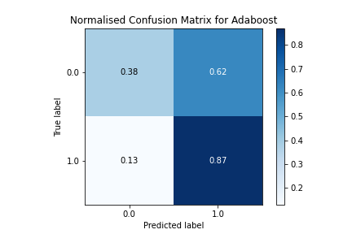
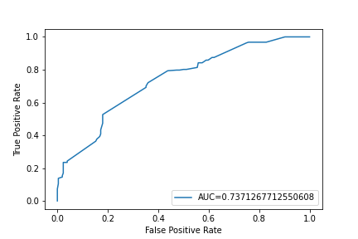
ADABOOST CLASSIFIER PERFORMANCE
MODERATE Performance: When the true label is 0, 38% of the time the machine can predict it correctly; when the true label is 1, 87% of the time the machine can predict it correctly. The AUC score is 0.74, which is better than random guessing, but there is still room for improvement.

Slide 19
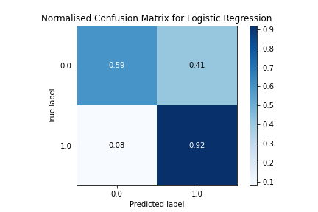
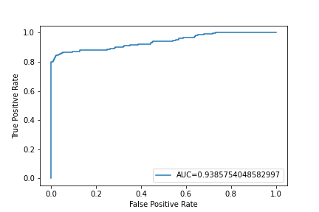
LOGISTIC REGRESSION PERFORMANCE
BEST Performance: When the true label is 0, 59% of the time the machine can predict it correctly; when the true label is 1, 92% of the time the machine can predict it correctly. Also, the AUC score is 0.94, which is a nearly perfect result.

Slide 20
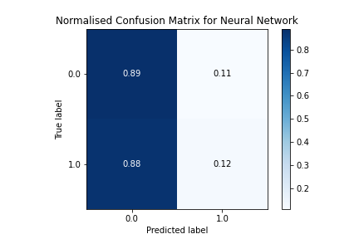
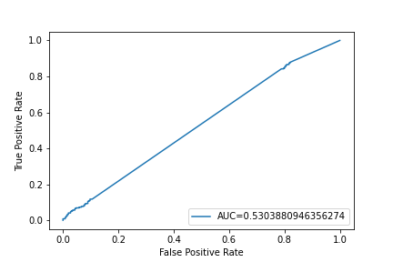
NEURAL NETWORK PERFORMANCE
POOR Performance: Most of the time, regardless of the true label of 0 or 1, the model is likely to predict it as 0. Also, the AUC score is close to 0.5, which is similar to the result of random guessing.

Slide 21
Accuracy
 | Inflation Rate & Interest Rate | Add USD Index & Commodity Index | Add USD Index & Commodity Index & Unemployment Rate
AdaBoost Classifier | 0.581 | 0.622 | 0.676
Logistic Regression | 0.716 | 0.751 | 0.622
Neural Network | 0.494 | 0.517 | 0.492

Slide 22
05 SUMMARY

Slide 23
CONCLUSION
We were able to predict the moving direction of forex price change with the Logistic Regression Model at a 75% accuracy level.
Our original hypothesis regarding the choice of data is correct for some factors, as the data set “Inflation+Interest+Indices” give us the highest AUC, except the Neural Network Model.
Best Model: Logistic Regression
Second Best Model: Adaboost Classifier
Worst Model: Neural Network
We left unemployment rate out as it does not provide significant improvement on AUC.

Slide 24
DIFFICULTIES FACED
The forex rate of two currencies is determined by numerous factors. We tried few factors whereas had to let go many other factors affecting the exchange rate like trade news, balance of payment, war, etc. We decided which factors to keep based on comparison of AUC.
Oppose to what we expected, the more factors we added to the Logistic Regression Model, the lower its AUC is. So we did more research and found out that this can be due to the default algorithm (L2).
We had a weird result for Logistic Regression, all the “y_pred” were 1. So we reviewed the code closely, and found out that we fit in X_train instead of X_train_scaled. So we have corrected it and received a significant improvement in the result.

Slide 25
06 FUTURE EXPLORATION

Slide 26
1. Add more factors into the datasets e. g. Gross Domestic Product (GDP), Gross National Income (GNI), Balance of Payment (BOP), Export & Import Figures which may influence the FX rate 2. Try different split of the training/testing dataset 3. Use more models for prediction, e.g. ARIMA 4. Acquire larger dataset, e.g. 20 years of data instead of 10 years and check if this can improve the accuracy of the predictions 5. Find enough number of features that can optimize the neural network model
FURTHER EXPLORATION

Slide 27
APPENDIX
NEW MACHINE LEARNING MODEL
AdaBoost Classifier
NEW LIBRARY USED
Scikitplot : to plot the confusion metrics
NEW API USED
tradermade

Slide 28
THANK YOU!

