Slide 1

4
Elementary Functions
Book: A First Course in Complex Analysis with Applications by Dennis G. Zill and
Patrick D. Shanahan.

Slide 2
Elementary Complex Analytic Functions
Complex Exponential and Logarithmic Functions
Complex Powers
Trigonometric and Hyperbolic Functions

Slide 3
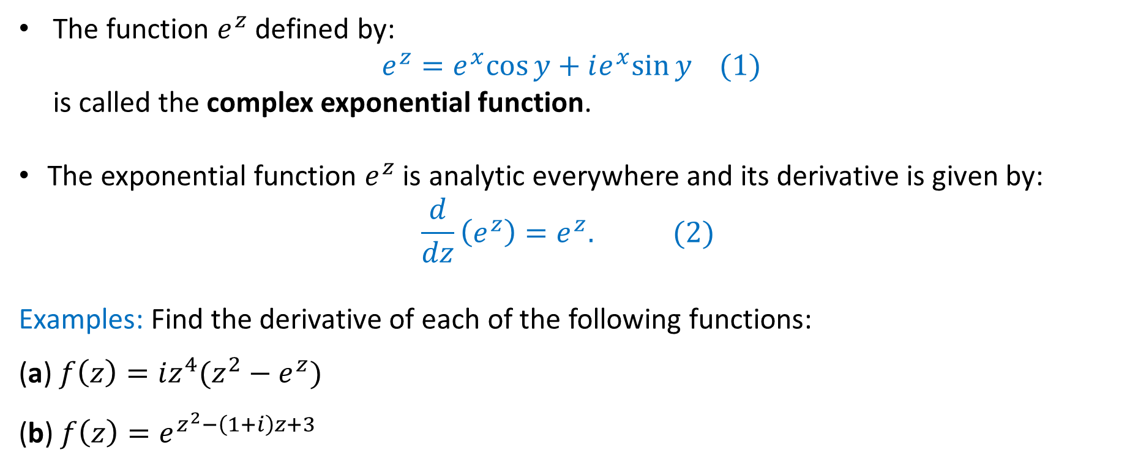
Complex Exponential Function
The function $e^{z}$ defined by:
$e^{z}=e^{x}cos⁡y+ie^{x}sin⁡y (1)$
is called the complex exponential function.
The exponential function $e^{z}$ is analytic everywhere and its derivative is given by:
$$\frac{d}{dz}\left(e^{z}\right)=e^{z}. (2)$$
Examples: Find the derivative of each of the following functions:
(a) $f\left(z\right)=iz^{4}(z^{2}−e^{z})$
(b) $f\left(z\right)=e^{z^{2}−\left(1+i\right)z+3}$

Slide 4
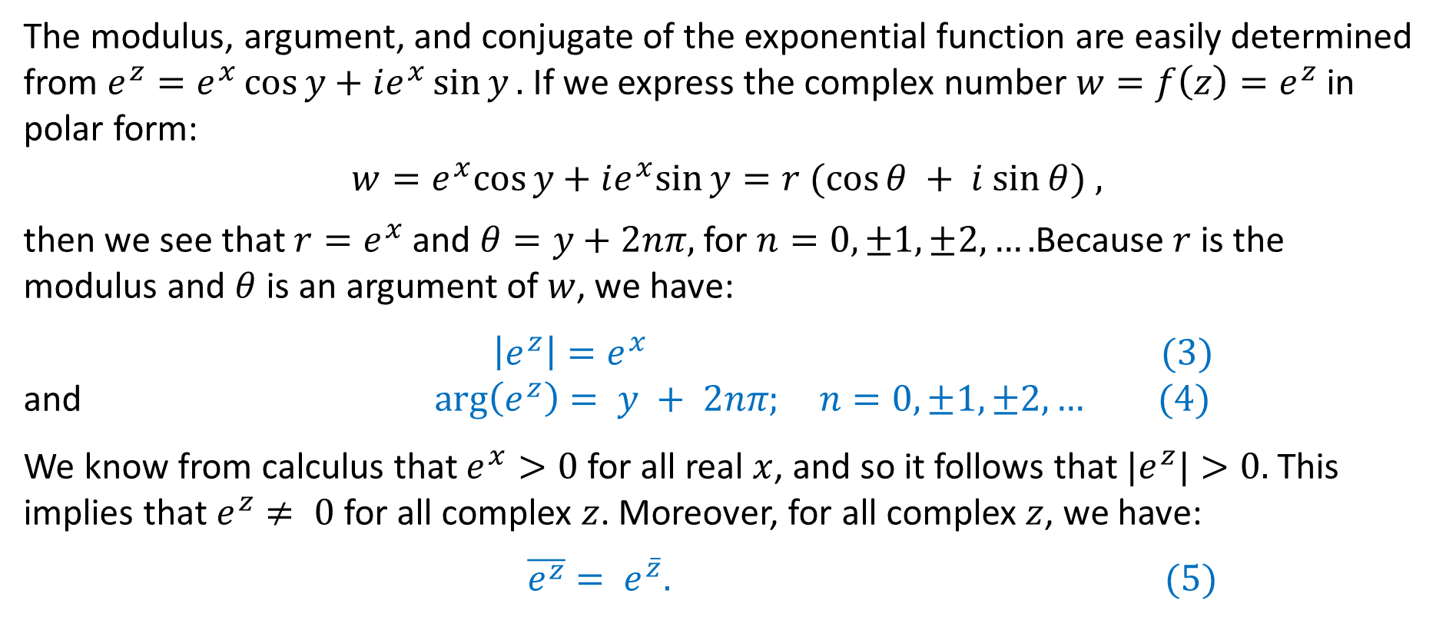
Modulus, Argument, and Conjugate
The modulus, argument, and conjugate of the exponential function are easily determined from $e^{z}=e^{x}\cos{y}+ie^{x}\sin{y}.$ If we express the complex number $w=f\left(z\right)=e^{z}$in polar form:
$w=e^{x}cos⁡y+ie^{x}sin⁡y=r (cos⁡θ + i sin⁡θ) ,$
then we see that $r=e^{x}$ and $θ=y+2nπ,$ for $n=0,±1,±2,….$Because $r$is the modulus and $θ$ is an argument of $w$, we have:
$\left|e^{z}\right|=e^{x} (3)$
and $\arg\left(e^{z}\right)= y + 2nπ; n=0,±1,±2,… (4)$
We know from calculus that $e^{x}>0$ for all real $x$, and so it follows that $|e^{z}|>0.$ This implies that $e^{z}≠ 0$ for all complex $z$. Moreover, for all complex $z$, we have:
$\overline{e^{z}}= e^{\overline{z}}. (5)$

Slide 5
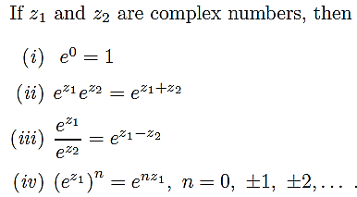

Algebraic Properties of $e^{z}$

Slide 6
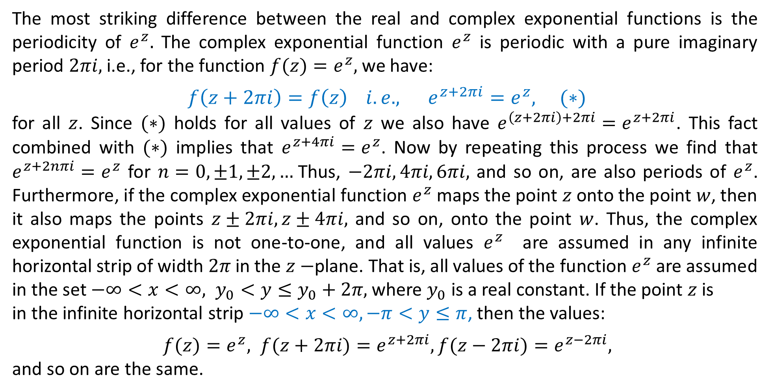

Periodicity of $e^{z}$
The most striking difference between the real and complex exponential functions is the periodicity of $e^{z}.$ The complex exponential function $e^{z}$ is periodic with a pure imaginary period $2πi,$ i.e., for the function $f(z)=e^{z},$ we have:
$f\left(z+2πi\right)=f\left(z\right) i.e., e^{z+2πi}=e^{z}, (∗)$
for all $z$. Since $(∗)$ holds for all values of $z$ we also have $e^{\left(z+2πi\right)+2πi}=e^{z+2πi}$. This fact combined with $(∗)$ implies that $e^{z+4πi}=e^{z}$. Now by repeating this process we find that $e^{z+2nπi}=e^{z}$ for $n=0,±1,±2,…$Thus, $−2πi, 4πi, 6πi,$ and so on, are also periods of $e^{z}$. Furthermore, if the complex exponential function $e^{z}$ maps the point $z$ onto the point $w$, then it also maps the points $z±2πi,z±4πi,$ and so on, onto the point $w$. Thus, the complex exponential function is not one-to-one, and all values $e^{z}$ are assumed in any infinite horizontal strip of width $2π$ in the $z−$plane. That is, all values of the function $e^{z}$ are assumed in the set $−∞<x<∞, y_{0}<y≤y_{0}+2π,$ where $y_{0}$ is a real constant. If the point $z$ is
in the infinite horizontal strip $−∞<x<∞, −π<y≤π$, then the values:
$f(z)=e^{z}, f(z+2πi)=e^{z+2πi}, f(z−2πi)=e^{z−2πi},$
and so on are the same.

Slide 7
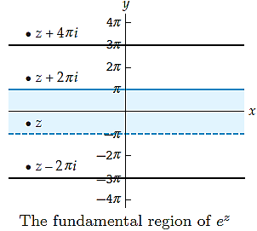
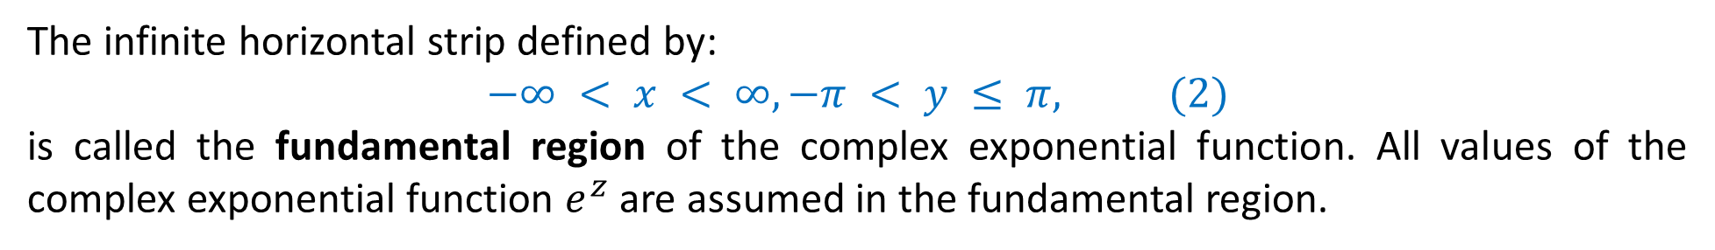

fundamental region of $e^{z}$
The infinite horizontal strip defined by:
$$−∞ < x < ∞, −π < y ≤ π, (2)$$
is called the fundamental region of the complex exponential function. All values of the complex exponential function $e^{z}$ are assumed in the fundamental region.
The basic property satisfied by a fundamental region of a periodic function is that if one knows the behaviour of the function on the fundamental region, one can use the periodicity to find out the behaviour of the function everywhere, and that it is the smallest region with that property.

Slide 8
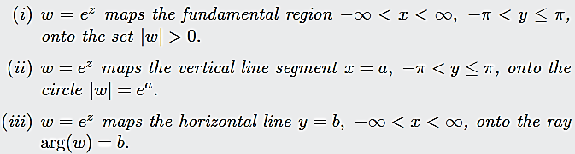
The Exponential Mapping Properties

Slide 9
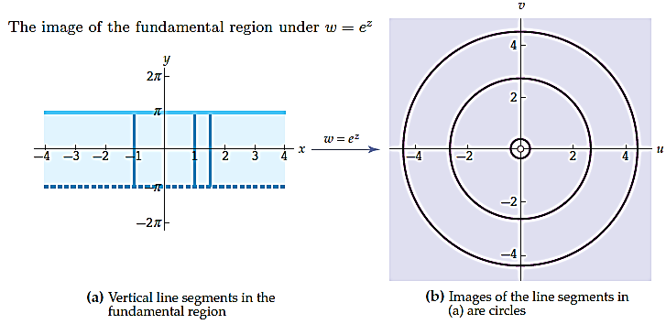
The Exponential Mapping

Slide 10
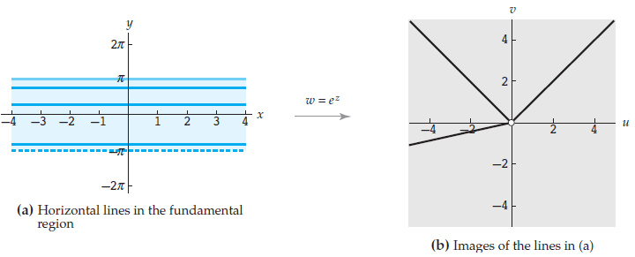
The Exponential Mapping

Slide 11
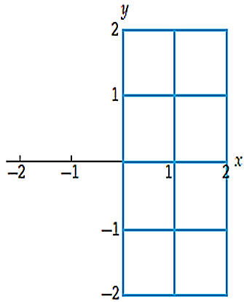
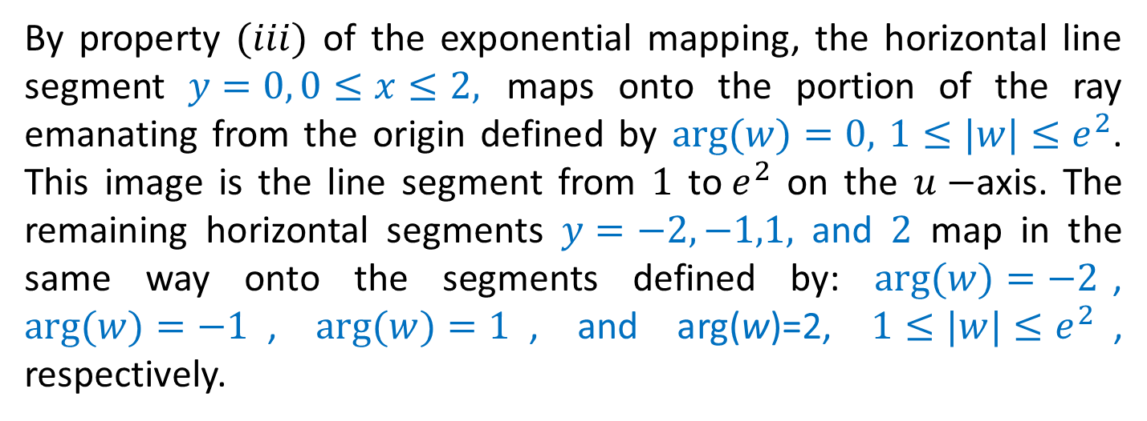
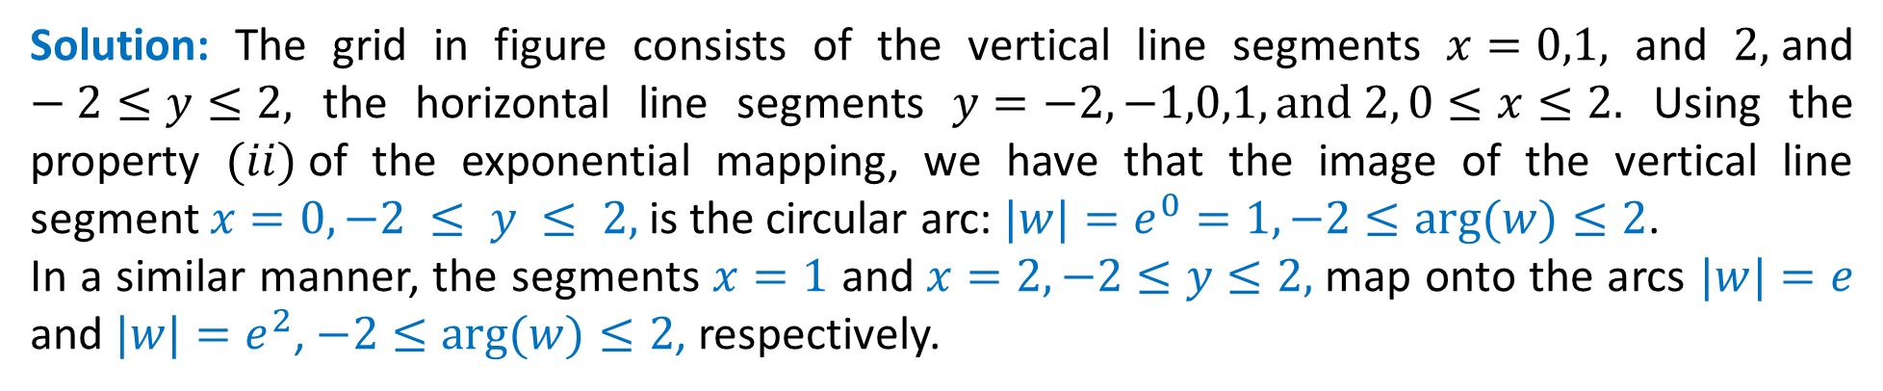
Example: Exponential Mapping of a Grid
Find the image of the grid shown in figure under $w=e^{z}$.
Solution: The grid in figure consists of the vertical line segments $x=0,1,$ and $2,$and $−2≤y≤2,$ the horizontal line segments $y=−2,−1,0,1, and 2, 0≤x≤2.$ Using the property $(ii)$of the exponential mapping, we have that the image of the vertical line segment $x=0, −2 ≤ y ≤ 2,$ is the circular arc: $|w|=e^{0}=1, −2≤arg⁡(w)≤2$.
In a similar manner, the segments $x=1$ and$x=2, −2≤y≤2,$ map onto the arcs $|w|=e$ and $|w|=e^{2}$, $−2≤arg⁡(w)≤2$, respectively.
By property $(iii)$ of the exponential mapping, the horizontal line segment $y=0, 0≤x≤2,$ maps onto the portion of the ray emanating from the origin defined by $arg⁡(w)=0,$ $1≤|w|≤e^{2}$. This image is the line segment from $1$ to$e^{2}$ on the $u−$axis. The remaining horizontal segments $y=−2,−1,1,$ and $2$ map in the same way onto the segments defined by: $arg⁡(w)=−2$, $arg⁡(w)=−1$, $arg⁡(w)=1$, and arg(w)=2, $1≤|w|≤e^{2}$, respectively.

Slide 12
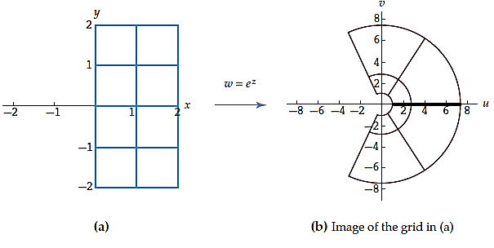
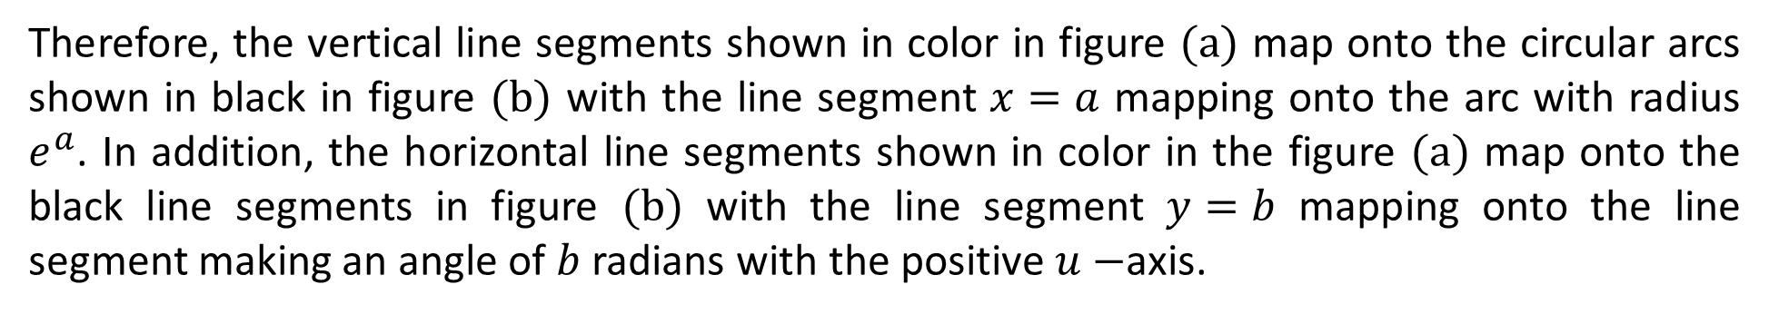
Example: Exponential Mapping of a Grid
Therefore, the vertical line segments shown in color in figure $(a)$ map onto the circular arcs shown in black in figure $(b)$ with the line segment $x=a$ mapping onto the arc with radius $e^{a}$. In addition, the horizontal line segments shown in color in the figure $(a)$ map onto the black line segments in figure $(b)$ with the line segment $y=b$ mapping onto the line segment making an angle of $b$ radians with the positive $u−$axis.

Slide 13
Practice Questions
Exercise 4.1:
Q-1 to Q-20

Slide 14
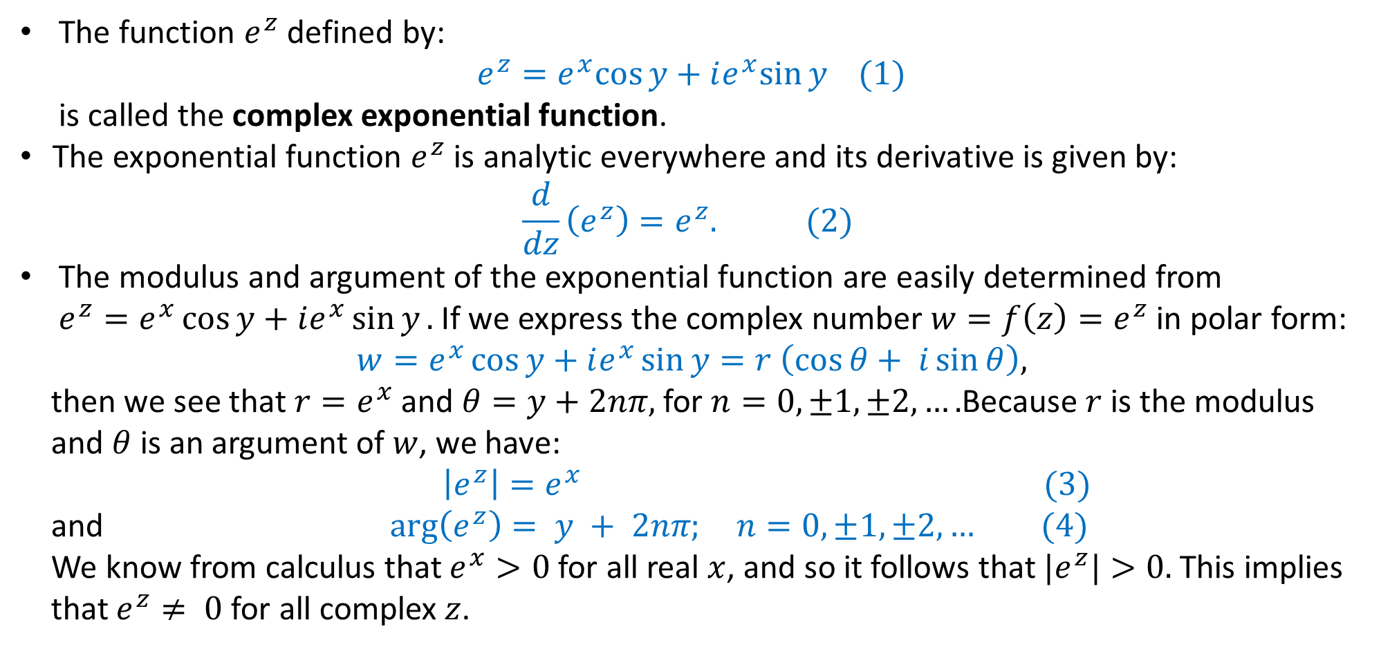
Complex Exponential Function
The function $e^{z}$ defined by:
$e^{z}=e^{x}cos⁡y+ie^{x}sin⁡y (1)$
is called the complex exponential function.
The exponential function $e^{z}$ is analytic everywhere and its derivative is given by:
$$\frac{d}{dz}\left(e^{z}\right)=e^{z}. (2)$$
The modulus and argument of the exponential function are easily determined from $e^{z}=e^{x}\cos{y}+ie^{x}\sin{y}.$ If we express the complex number $w=f\left(z\right)=e^{z}$in polar form:
$w=e^{x}\cos{y}+ie^{x}\sin{y}=r \left(\cos{θ}+ i\sin{θ}\right),$
then we see that $r=e^{x}$ and $θ=y+2nπ,$ for $n=0,±1,±2,….$Because $r$is the modulus
and $θ$ is an argument of $w$, we have:
$\left|e^{z}\right|=e^{x} (3)$
and $\arg\left(e^{z}\right)= y + 2nπ; n=0,±1,±2,… (4)$
We know from calculus that $e^{x}>0$ for all real $x$, and so it follows that $|e^{z}|>0.$ This implies
that $e^{z}≠ 0$ for all complex $z$.

Slide 15
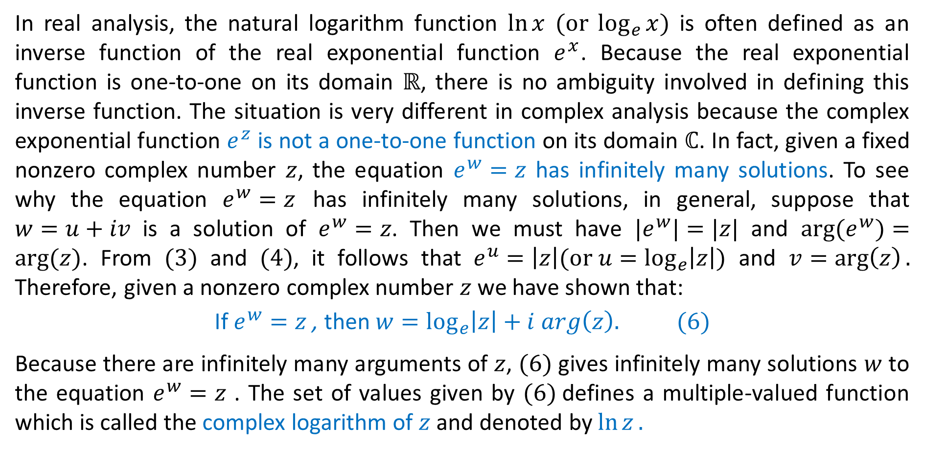
Complex Logarithmic Function
In real analysis, the natural logarithm function $\ln{x} (or \log_{e}{x})$ is often defined as an inverse function of the real exponential function $e^{x}$. Because the real exponential function is one-to-one on its domain $ℝ$, there is no ambiguity involved in defining this inverse function. The situation is very different in complex analysis because the complex exponential function $e^{z}$ is not a one-to-one function on its domain $ℂ$. In fact, given a fixed nonzero complex number $z$, the equation $e^{w}=z$ has infinitely many solutions. To see why the equation $e^{w}=z$ has infinitely many solutions, in general, suppose that $w=u+iv$ is a solution of $e^{w}=z$. Then we must have $|e^{w}|=|z|$ and $arg⁡(e^{w})=arg⁡(z)$. From $(3)$ and $(4)$, it follows that $e^{u}=\left|z\right|(or u=\log_{e}\left|z\right|)$ and $v=\arg\left(z\right).$ Therefore, given a nonzero complex number $z$ we have shown that:
If $e^{w}=z$ , then $w=\log_{e}\left|z\right|+i arg\left(z\right). (6)$
Because there are infinitely many arguments of $z$, $(6)$ gives infinitely many solutions $w$ to the equation $e^{w}=z$ . The set of values given by $(6)$defines a multiple-valued function which is called the complex logarithm of $z$ and denoted by $\ln{z}.$

Slide 16
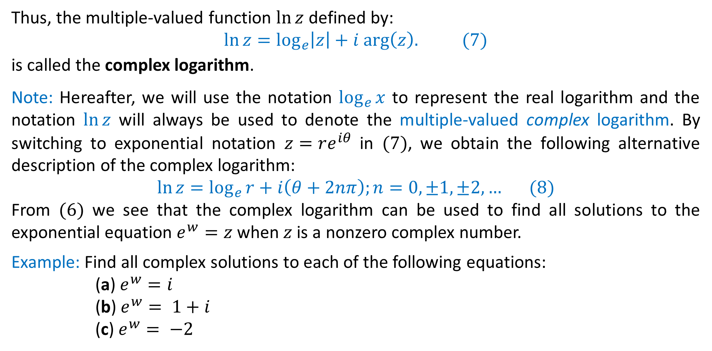
Complex Logarithmic Function
Thus, the multiple-valued function $ln⁡z$ defined by:
$\ln{z}=\log_{e}\left|z\right|+i arg\left(z\right). (7)$
is called the complex logarithm.
Note: Hereafter, we will use the notation $\log_{e}{x}$ to represent the real logarithm and the notation $ln⁡z$ will always be used to denote the multiple-valued complex logarithm. By switching to exponential notation $z=re^{iθ}$ in $(7)$, we obtain the following alternative description of the complex logarithm:
$$\ln{z}=\log_{e}{r}+i\left(θ+2nπ\right);n=0,±1,±2,… (8)$$
From $(6)$ we see that the complex logarithm can be used to find all solutions to the exponential equation $e^{w}=z$ when $z$ is a nonzero complex number.
Example: Find all complex solutions to each of the following equations:
(a) $e^{w}=i$
(b) $e^{w}= 1+i$
(c) $e^{w}= −2$

Slide 17
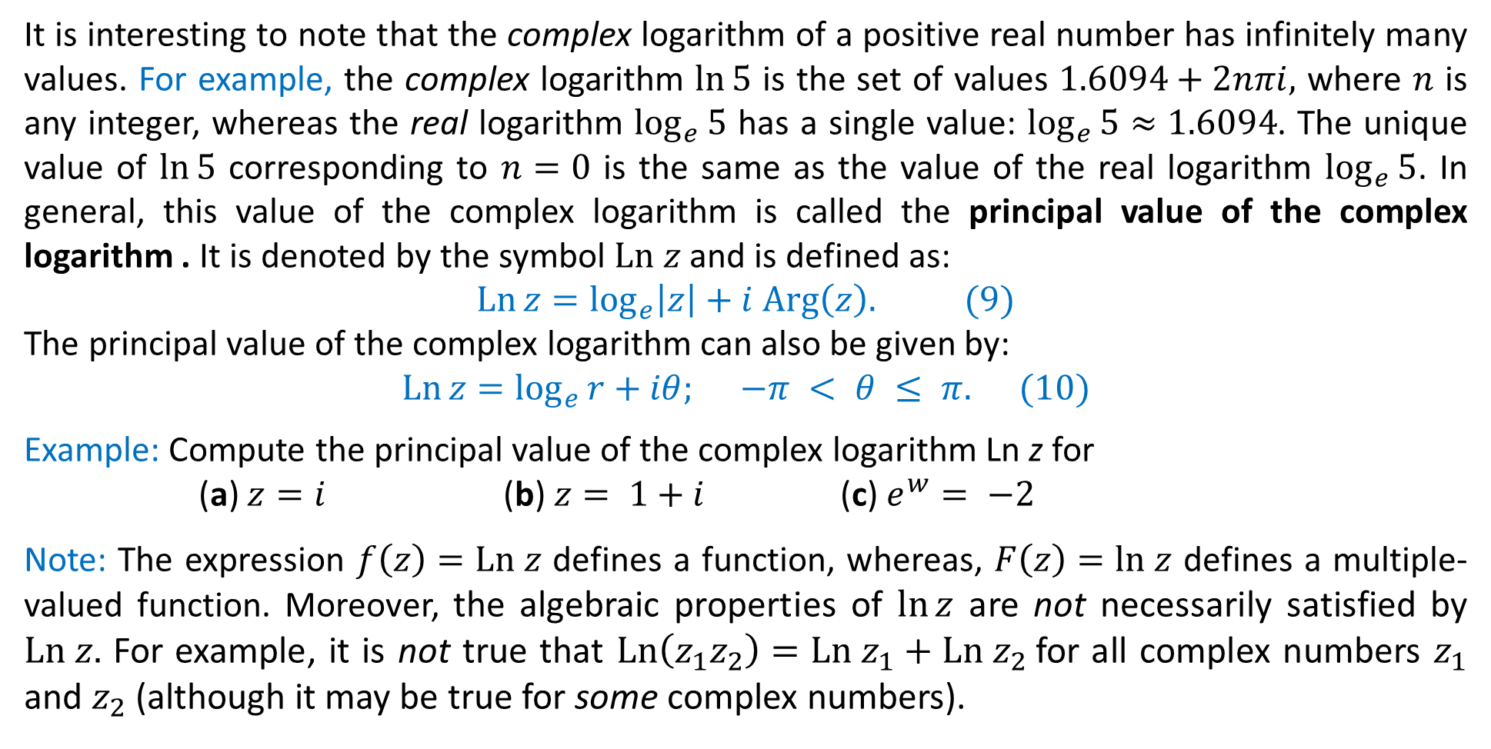
Principal Value of a Complex Logarithm
It is interesting to note that the complex logarithm of a positive real number has infinitely many values. For example, the complex logarithm $ln⁡5$ is the set of values $1.6094+2nπi,$ where $n$ is any integer, whereas the real logarithm $\log_{e}{5}$ has a single value: $\log_{e}{5}≈1.6094$. The unique value of $ln⁡5$ corresponding to $n=0$ is the same as the value of the real logarithm $\log_{e}{5}$. In general, this value of the complex logarithm is called the principal value of the complex logarithm . It is denoted by the symbol $Ln z$ and is defined as:
$\operatorname{Ln}{z}=\log_{e}\left|z\right|+i Arg\left(z\right). (9)$
The principal value of the complex logarithm can also be given by:
$\operatorname{Ln}{z}=\log_{e}{r}+iθ; −π < θ ≤ π. (10)$
Example: Compute the principal value of the complex logarithm Ln z for
(a) $z=i$ (b) $z= 1+i$ (c) $e^{w}= −2$
Note: The expression $f\left(z\right)=Ln z$ defines a function, whereas, $F\left(z\right)=ln z$ defines a multiple-valued function. Moreover, the algebraic properties of $\ln{z}$ are not necessarily satisfied by $Ln z.$ For example, it is not true that $Ln\left(z_{1}z_{2}\right)=Ln z_{1}+Ln z_{2}$for all complex numbers $z_{1}$ and $z_{2}$ (although it may be true for some complex numbers).

Slide 18
Branches of $\ln{z}$
The principal value of the complex logarithm $Ln z$ is discontinuous at the point $z=0$ and at every point on the negative real axis. However, it is continuous on the set consisting of the complex plane excluding the nonpositive real axis. The function $f_{1}$ defined by:
$$f_{1}\left(z\right)=\log_{e}{r}+iθ; −π < θ< π,$$
is continuous on the domain $|z|>0, −π<arg⁡(z)<π,$ where $r=|z|$ and $θ=arg⁡(z)$. Since the function $f_{1}$ agrees with the principal value of the complex logarithm $Ln z$, it follows that $f_{1}$ is the principal branch of the multiple-valued function $F\left(z\right)=\ln{z}$. The nonpositive real axis is a branch cut for $f_{1}$ and the point $z=0$ is a branch point.
The principal branch $f_{1}$ is just one of many possible branches of the multiple-valued function $F\left(z\right)=\ln{z}$. We can define other branches of $F$ by simply changing the interval defining $θ$ to a different interval of length $2π$. For example, $f_{2}\left(z\right)=\log_{e}{r}+iθ; −\frac{π}{2} < θ<\frac{3π}{2},$ defines a branch of $F$ whose branch cut is the nonpositive imaginary axis. In general
$$f_{k}\left(z\right)=\log_{e}{r}+iθ; θ_{0}< θ<θ_{0}+2π,$$
represents any branch of the multiple-valued function $F$ and the branch cut is the ray $θ=θ_{0},$ which includes the origin.

Slide 19

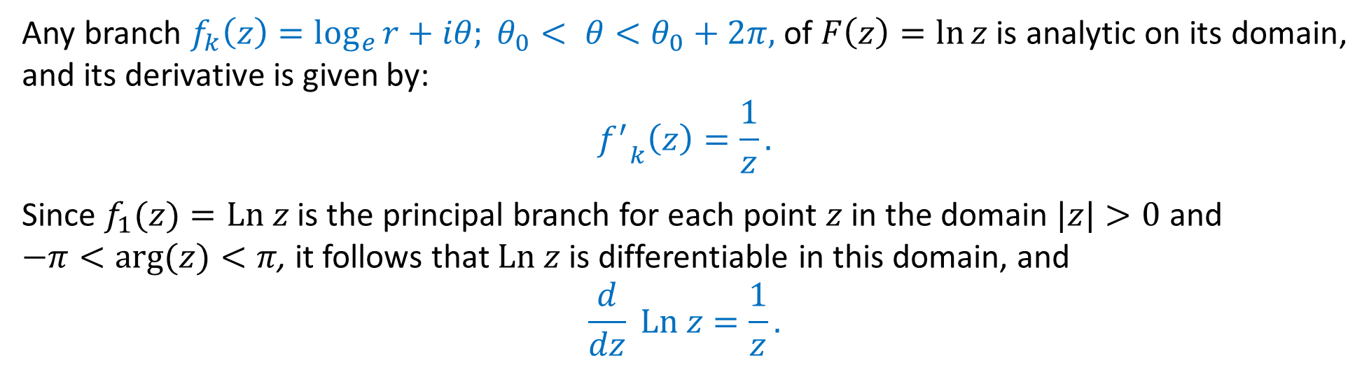
Analyticity of the Logarithm
Any branch $f_{k}\left(z\right)=\log_{e}{r}+iθ; θ_{0}< θ<θ_{0}+2π,$ of $F\left(z\right)=\ln{z}$is analytic on its domain, and its derivative is given by:
$${f^{′}}_{k}\left(z\right)=\frac{1}{z}.$$
Since $f_{1}(z)=Ln z$ is the principal branch for each point $z$ in the domain $|z|>0$ and
$−π<arg⁡(z)<π$, it follows that $Ln z$ is differentiable in this domain, and
$$\frac{d}{dz} Ln z=\frac{1}{z}.$$
$Ln z$as an Inverse Function of $e^{z}$
If the complex exponential function $f(z)=e^{z}$is defined on the fundamental region $−∞<x<∞,−π<y≤π,$ then $f$ is one-to-one and the inverse function of $f$ is the principal value of the complex logarithm $f^{−1}\left(z\right)=Ln z.$

Slide 20
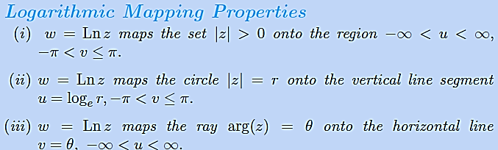
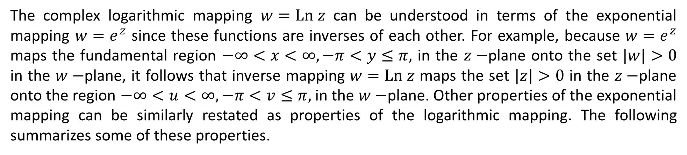
Logarithmic Mapping
The complex logarithmic mapping $w=Ln z$ can be understood in terms of the exponential mapping $w=e^{z}$ since these functions are inverses of each other. For example, because $w=e^{z}$ maps the fundamental region $−∞<x<∞,−π<y≤π,$ in the $z−$plane onto the set $|w|>0$ in the $w−$plane, it follows that inverse mapping $w=Ln z$ maps the set $|z|>0$ in the $z−$plane onto the region $−∞<u<∞,−π<v≤π,$ in the $w−$plane. Other properties of the exponential mapping can be similarly restated as properties of the logarithmic mapping. The following summarizes some of these properties.

Slide 21
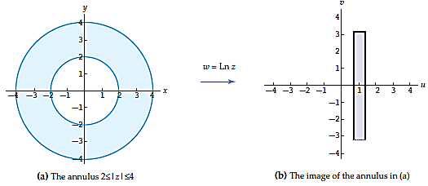
Example: Logarithmic Mapping
Find the image of the annulus $2≤|z|≤4$ under the logarithmic mapping $w=Ln z$.
Solution: From property $(ii)$of logarithmic mapping, the boundary circles $|z|=2$ and $|z|=4$ of the annulus map onto the vertical line segments $u=\log_{e}{2}$ and $u=\log_{e}{4}$, $−π<v≤π$, respectively. In a similar manner, each circle $|z|=r, 2≤r≤4,$ maps on to a vertical line segment $u=\log_{e}{r}, −π<v≤π$. Since the real logarithmic function is increasing on its domain, it follows that $u=\log_{e}{r}$ takes on all values in the interval $\log_{e}{2}≤ u ≤\log_{e}{4}$ when $2≤r≤4$. Therefore, the image of the annulus $2≤|z|≤4$ is the rectangular region: $\log_{e}{2}≤ u ≤\log_{e}{4}, −π < v ≤ π.$

Slide 22
Logarithmic Mapping
The complex logarithmic mapping $w=Ln z$ can be understood in terms of the exponential mapping $w=e^{z}$ since these functions are inverses of each other. For example, because $w=e^{z}$ maps the fundamental region $−∞<x<∞,−π<y≤π,$ in the $z−$plane onto the set $|w|>0$ in the $w−$plane, it follows that inverse mapping $w=Ln z$ maps the set $|z|>0$ in the $z−$plane onto the region $−∞<u<∞,−π<v≤π,$ in the $w−$plane. Other properties of the exponential mapping can be similarly restated as properties of the logarithmic mapping. The following summarizes some of these properties.

Slide 23
Practice Questions
Exercise 4.1:
Q-21 to Q-49, Q-51 to Q- 56

Slide 24
Complex Powers
Complex powers, such as ${(1+i)}^{i},$ defined in terms of the complex exponential and logarithmic functions. If $α$ is a complex number and $z=0$, then the complex power $z^{α}$ is
defined to be:
$$z^{α}=e^{α\ln{z}}. (1)$$
In general, $(1)$gives an infinite set of values because the complex logarithm $ln⁡z$ is a
multiple-valued function. Thus, $z^{α}=e^{α\ln{z}}$ defines a multiple-valued function. However, when $α=n$ is an integer, the expression in $(1)$ is single-valued in agreement with fact that $z^{n}$ (special power functions) is a function when $n$ is an integer.
Example: Find the values of the given complex power:
(a) $i^{2i}$ (b) ${(1+i)}^{i}$.

Slide 25
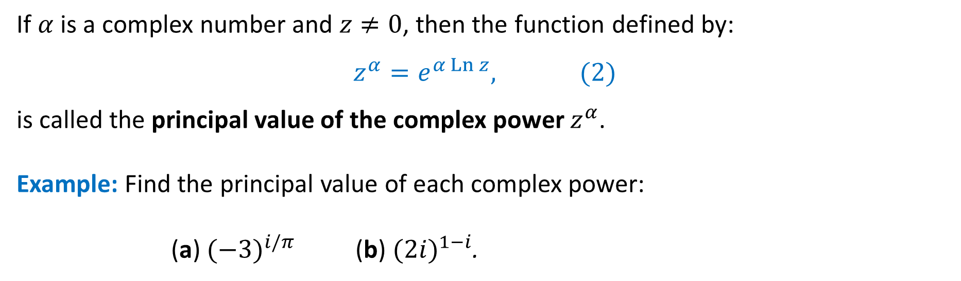
Principal Value of a Complex Power
If $α$ is a complex number and $z≠0$, then the function defined by:
$$z^{α}=e^{α\operatorname{Ln}{z}}, (2)$$
is called the principal value of the complex power $z^{α}$.
Example: Find the principal value of each complex power:
(a) ${(−3)}^{i/π}$ (b) ${(2i)}^{1−i}$.

Slide 26
Practice Questions
Determine the images of the following sets under the mapping $w=Ln z$:
$\left\{z=re^{iθ}:r>0, θ=\frac{π}{3}\right\}.$
$\left\{z=2e^{iθ}:\frac{−π}{2}≤θ≤\frac{π}{2}\right\}.$
$\left\{z=re^{iθ}:1≤θ≤2,\frac{π}{4}≤θ≤\frac{3π}{4}\right\}.$
$\left\{z=re^{iθ}:2≤θ≤4,−π≤θ≤0\right\}.$

Slide 27

Branches of $z^{α}$
In general, the principal value of a complex power $z^{α}$ defined by $(2)$ is not a continuous function on the complex plane because the function $Ln z$ is not continuous on the complex plane. However, since the function $e^{αz}$ is continuous on the entire complex plane, and since the function $Ln z$ is continuous on the domain $|z| > 0, −π < arg⁡(z) < π,$ it follows that $z^{α}$ is continuous on the domain $|z| > 0, −π < arg⁡(z) < π.$
Using polar coordinates $r = |z|$ and $θ =\arg\left(z\right),$ it is found that the function defined by:
$$f_{1}\left(z\right)=e^{α\left(\log_{e} r+iθ\right)}, −π < θ < π, (3)$$
is the principal branch of the multiple-valued function $F(z) =z^{α}=e^{α\ln{z}}$. Its branch cut is the non-positive real axis, and $z = 0$is a branch point. Other branches of the multiple-valued function $F(z) =z^{α}$can be defined using the formula in $(3)$ with a different interval of length $2π$ defining $θ$. For example,
$$f_{2}\left(z\right)=e^{α\left(\log_{e} r+iθ\right)}, −π/4 < θ <7π4,$$
defines a branch of $F(z)$ whose branch cut is the ray $arg⁡(z)=−π/4$ together with the branch point $z=0$.

Slide 28
Analyticity
The function defined by:
$$f_{1}\left(z\right)=e^{α\left(\log_{e} r+iθ\right)}, −π < θ < π, (3)$$
is the principal branch of the multiple-valued function $F(z) =z^{α}=e^{α\ln{z}}$. The branch $f_{1}$ defined by $(3)$ agrees with the principal value of $z^{α}$ defined by $(2)$ on the domain $|z|>0$, $−π < arg⁡(z) < π$. Consequently, the derivative of $f_{1}$ can be found using the chain rule:
$${f_{1}}^{′}\left(z\right)=\frac{d}{dz}\left(e^{αLn z}\right)=e^{αLn z}\frac{d}{dz}\left[αLn z\right]=e^{αLn z} \text{α}z^{−1}.$$
Using the principal value $z^{α}=e^{α\operatorname{Ln}{z}},$ the above equation simplifies to ${f_{1}}^{′}\left(z\right)=\text{α}z^{\text{α}−1}$. Thus, on the domain $|z| > 0, −π < arg⁡(z) < π,$the principal value of the complex power $z^{α}$ is differentiable and
$$\frac{d}{dz}\left(z^{α}\right)=\text{α}z^{α−1}.$$
Example: Find the derivative of the principal value $z^{i}$ at the point $z = 1+i.$

Slide 29
Practice Questions
Exercise 4.2:
Q-1 to Q-18

Slide 30
4.3 Trigonometric and Hyperbolic Functions
We will now define the complex trigonometric and hyperbolic functions.
Analogous to the complex functions $e^{z}$ and $Ln z$, these functions also agree with their real counterparts for real input.
In addition, we will show that the complex trigonometric and hyperbolic functions have the same derivatives and satisfy many of the same identities as the real trigonometric and hyperbolic functions.

Slide 31
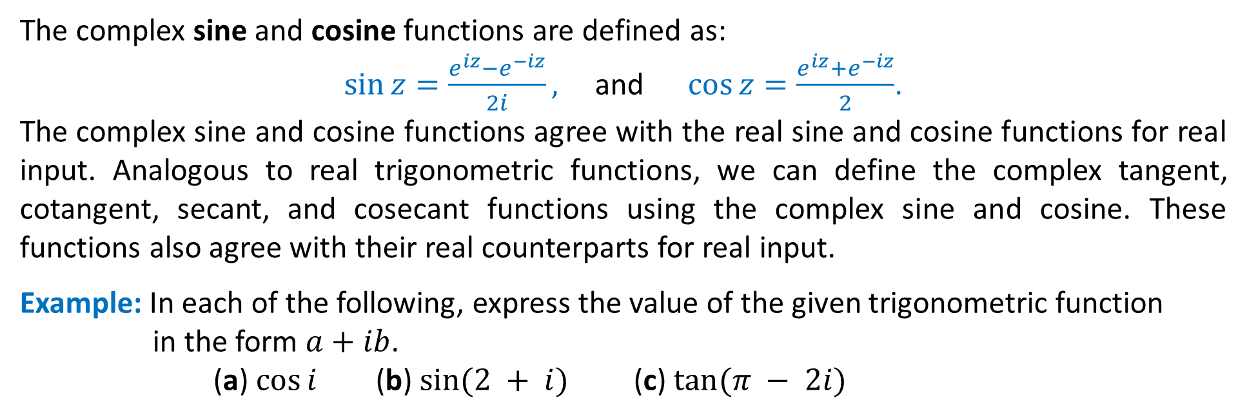
Complex Trigonometric Functions
The complex sine and cosine functions are defined as:
$\sin{z}=\frac{e^{iz}−e^{−iz}}{2i},$ and $\cos{z}=\frac{e^{iz}+e^{−iz}}{2}$.
The complex sine and cosine functions agree with the real sine and cosine functions for real input. Analogous to real trigonometric functions, we can define the complex tangent, cotangent, secant, and cosecant functions using the complex sine and cosine. These functions also agree with their real counterparts for real input.
Example: In each of the following, express the value of the given trigonometric function in the form $a+ib$.
(a) $cos⁡i$ (b) $sin⁡(2 + i)$ (c) $tan⁡(π − 2i)$
Periodicity
The complex sine and cosine are periodic functions with a real period of $2π,$ i.e.,
$sin⁡(z + 2π) = sin⁡z$ and $\cos\left( z + 2π\right)=\cos{z}.$
The identities $sin⁡(z+π)=−sin⁡z$ and $cos⁡(z+π)=−cos⁡z$ can be used to show that the complex tangent and cotangent are periodic with a real period of $π$.

Slide 32
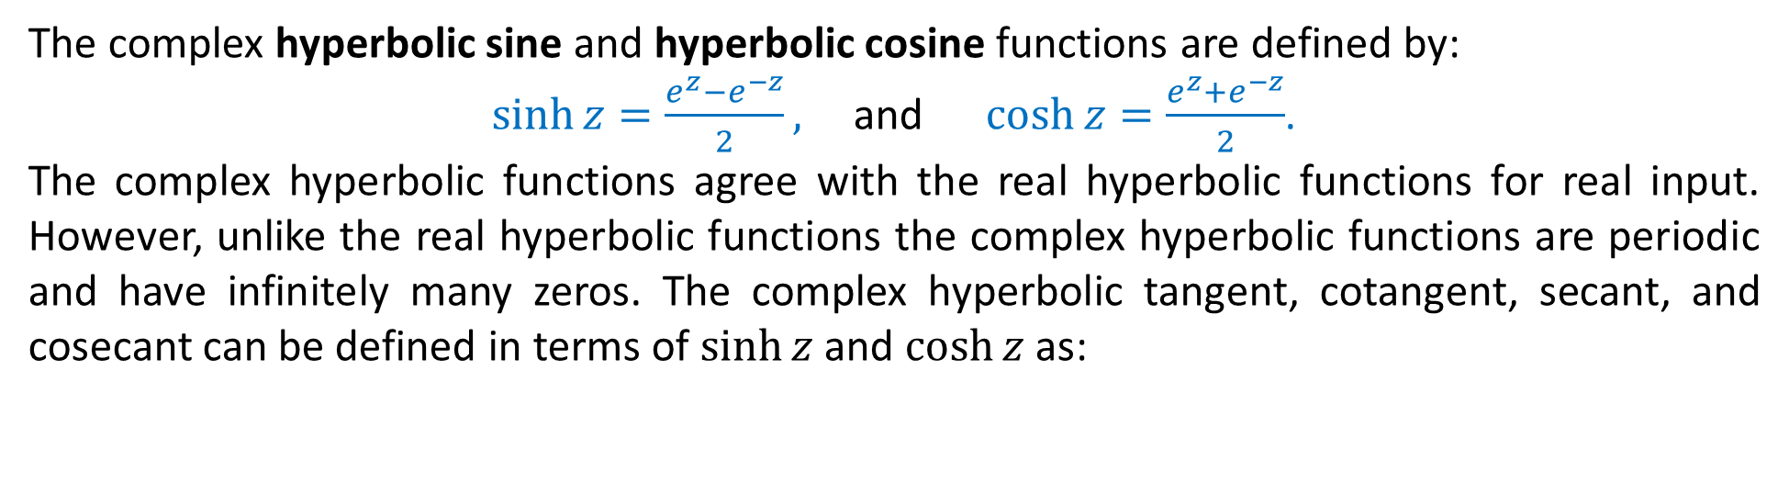
Complex Hyperbolic Functions
The complex hyperbolic sine and hyperbolic cosine functions are defined by:
$\sinh{z}=\frac{e^{z}−e^{−z}}{2},$ and $\cosh{z}=\frac{e^{z}+e^{−z}}{2}$.
The complex hyperbolic functions agree with the real hyperbolic functions for real input. However, unlike the real hyperbolic functions the complex hyperbolic functions are periodic and have infinitely many zeros. The complex hyperbolic tangent, cotangent, secant, and cosecant can be defined in terms of $sinh⁡z$ and $\cosh{z}$ as:
Periodicity
As functions of a real variable $x$, $sinh⁡x$ and $cosh⁡x$ are not periodic. In contrast, the complex hyperbolic functions $sinh⁡z$ and $cosh⁡z$are periodic. $sinh⁡z$ and $cosh⁡z$are periodic with fundamental period $2πi$ and $\tanh{z}$ is periodic with period $πi.$

Slide 33
Relation between trigonometric and hyperbolic functions
The hyperbolic functions are closely related to the trigonometric functions. Relationship between the complex trigonometric and hyperbolic functions is given as:
$sin⁡z = −i sinh⁡(iz)$ and $cos⁡z = cosh⁡(iz) (I)$
$sinh⁡z = −i sin⁡(iz)$ and $cosh⁡z = cos⁡( iz) (II)$
Relations between the other trigonometric and hyperbolic functions can now be derived from $(I)$ and $(II)$.
Trigonometric Equations
We now turn our attention to solve simple trigonometric equations. Since, the complex sine and cosine functions are periodic, there are always infinitely many solutions to equations of the form $sin⁡z=w$ or $cos⁡z=w.$
Example: Determine all complex values $z$ satisfying the given equation:
(a) $sin⁡z=i$ (b) $\cos{z}=0$ (c) $\sin{z}=0.$

Slide 34
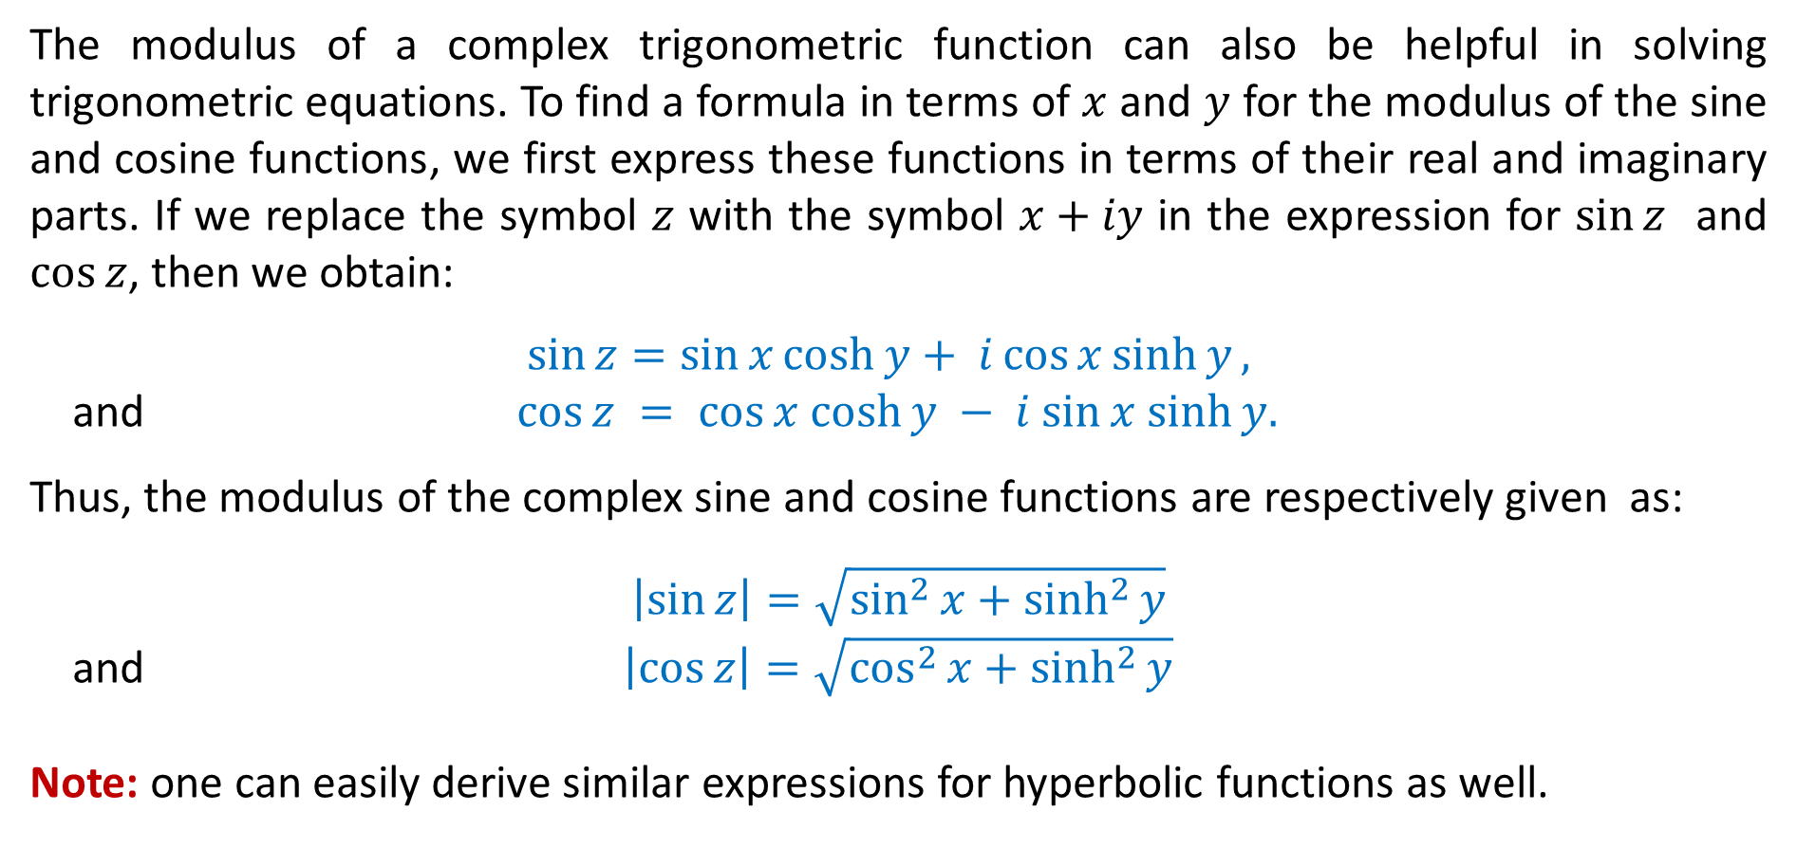
Modulus of trigonometric & Hyperbolic functions
The modulus of a complex trigonometric function can also be helpful in solving trigonometric equations. To find a formula in terms of $x$ and $y$ for the modulus of the sine and cosine functions, we first express these functions in terms of their real and imaginary parts. If we replace the symbol $z$ with the symbol $x+iy$ in the expression for $sin⁡z$ and $\cos{z}$, then we obtain:
$$\sin{z}=\sin{x}\cosh{y}+ i\cos{x}\sinh{y},$$
and $cos⁡z = cos⁡x cosh⁡y − i sin⁡x sinh⁡y.$
Thus, the modulus of the complex sine and cosine functions are respectively given as:
$$\left|\sin{z}\right|=\sqrt{\sin^{2}{x}+\sinh^{2}{y}}$$
and $\left|\cos{z}\right|=\sqrt{\cos^{2}{x}+\sinh^{2}{y}}$
Note: one can easily derive similar expressions for hyperbolic functions as well.

Slide 35
Zeros of trigonometric functions
A zero $α$ of a function $f(z)$ satisfies $f\left(α\right)=0.$
We are now interested in finding zeros of trigonometric functions. One way of obtaining these zeros is to solve the trigonometric equations $sin⁡z=0$ and $cos⁡z = 0.$ By solving these equations, we have already seen that like their real counterparts, the zeros of $\sin{z}$ are $nπ$ and the zeros of $\cos{z}$ are $nπ+π/2,$ where $n$ is any integer.
A different method for determining the zeros of these functions involves recognizing that a complex number is equal to $0$ if and only if its modulus is $0$. Thus, solving the equation $sin⁡z=0$ is equivalent to solving the equation $|sin⁡z|=0$. Thus, by using the formulas derived for the modulus of the complex sine and cosine functions one can easily obtain the zeros of the required functions.
Thus, the zeros of complex sine and cosine functions are:
$$\sin{z}= 0 if and only if z = nπ,$$
and $\cos{z}= 0 if and only if z=\frac{\left(2n + 1\right)π }{2 }, \text{for} n=0, ±1,±2,…$

Slide 36
Zeros of hyperbolic functions
It is well known that for any real $x,$ $sinh⁡x=0$ only when $x=0,$ i.e., real hyperbolic sine function has only one zero. While the real hyperbolic cosine function has no zeros.
In contrast to this complex hyperbolic sine and hyperbolic cosine functions have infinitely many zeros.
To find the zeros of $\sinh{z},$ we observe that
$$\sinh{z}=0⇔\left|\sinh{z}\right|=0⇔\sinh^{2}{x}+\sin^{2}{y}=0.$$
Hence, $x$ and $y$must satisfy $\sinh{x}=0$ and $\sin{y}=0,$ thus giving $x=0$ and $y=nπ,$
for $n=0, ±1,±2,…$. . On the similar lines one can obtain zeros of $\cosh{z.}$
Thus, the zeros of complex hyperbolic sine and hyperbolic cosine are:
$$\sinh{z}= 0 if and only if z = nπi,$$
and $\cosh{z}= 0 if and only if z=\frac{\left(2n + 1\right)πi}{2 },$
for $n=0, ±1,±2,…$

Slide 37
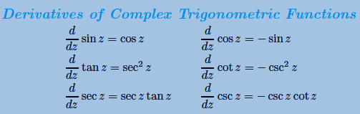
Analyticity of trigonometric functions
The complex sine and cosine functions are entire functions, since they are linear combinations of the entire functions $e^{iz}$ and $e^{−iz}.$ However, $tan⁡z$ and $sec⁡z$ are not entire; they are analytic except at the points where $cos⁡z$ is zero. Similarly, $cot⁡z$ and $csc⁡z$ are analytic except where $sin⁡z$ is zero. Since,
$$\sin{z}= 0 if and only if z = nπ, \left(1\right)$$
and $\cos{z}= 0 if and only if z=\frac{\left(2n + 1\right)π }{2 }, (2)$
for $n=0, ±1,±2,…$ . Thus, from $(1)$ and $(2)$ it follows that the $tan⁡z$ and $sec⁡z$ have singularities at $z = (2n + 1)π/2$ for $n=0, ±1,±2,…,$ whereas the $cot⁡z$ and $csc⁡z$ have singularities at $z=nπ$ for $n=0, ±1,±2,…$

Slide 38
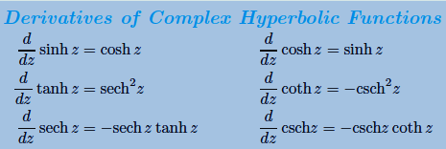
Analyticity of hyperbolic functions
The complex hyperbolic sine and hyperbolic cosine functions are entire functions, since they are linear combinations of the entire functions $e^{z}$ and $e^{−z}.$ However, $tanh⁡z$ and $sech⁡z$ are analytic except at the points where $cosh⁡z$ is zero. Similarly, $coth⁡z$ and $csch⁡z$ are analytic except where $sinh⁡z$ is zero. Since,
$$\sinh{z}= 0 if and only if z = nπi,$$
and $\cosh{z}= 0 if and only if z=\frac{\left(2n + 1\right)πi}{2 },$
for $n=0, ±1,±2,…$ . Thus, from $(1)$ and $(2)$ it follows that the $tanh⁡z$ and $sech⁡z$ have singularities at $z = (2n + 1)πi/2$ for $n=0, ±1,±2,…,$ whereas the $coth⁡z$ and $csch⁡z$ have singularities at $z=nπi$ for $n=0, ±1,±2,…$

Slide 39
Identities
Most of the familiar identities for real trigonometric functions hold for the complex trigonometric functions.
However, it is important to recognize that some properties of the real trigonometric functions are not satisfied by their complex counterparts. For example, $|sin⁡x|≤1$and $|cos⁡x| ≤ 1$for all real $x$, but these inequalities, in general, are not satisfied for complex input. Thus, we conclude that unlike the real sine and cosine functions, the complex sine and cosine functions are no longer bounded.

