Slide 1
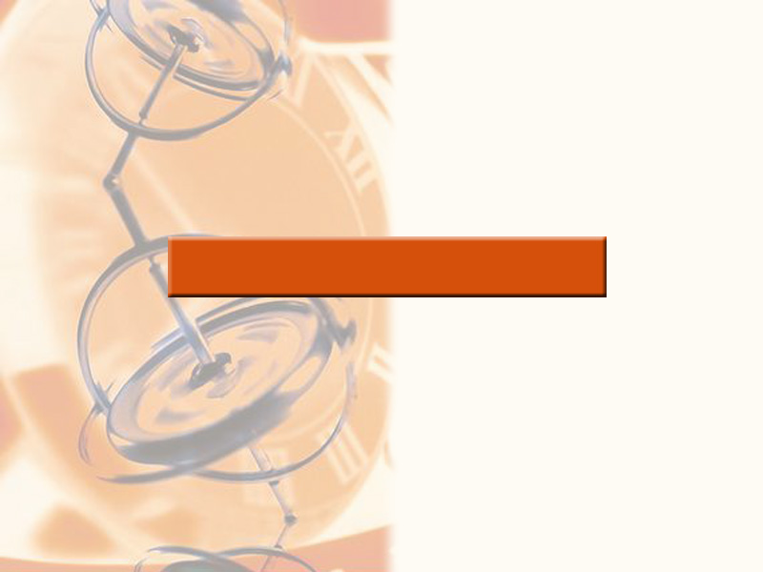
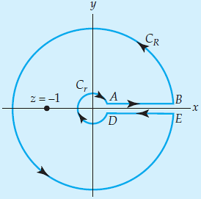
Complex Integration

Slide 2
Book: A First Course in Complex Analysis with Applications by Dennis G. Zill and
Patrick D. Shanahan.
Chapter: 5
Sections: 5.2, 5.3, 5.4
Book: Advanced Engineering Mathematics (9th Edition) by Ervin Kreyszig
Chapter: 14
Sections: 14.1, 14.2, 14.3

Slide 3
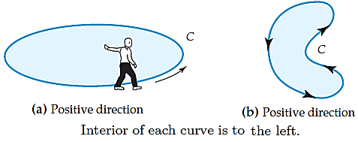
Complex Integral
Complex definite integrals are called (complex) line integrals. A complex line integral is given by
$$\int_{C}{f\left(z\right)dz,}$$
where $C$ is a parametrized positive oriented curve along which the integration is carried out. This curve $C$ in the complex plane is called the path of integration. We may represent C by a parametric representation:
$$z\left(t\right)=x\left(t\right)+iy\left(t\right), a ≤ t ≤b, (1)$$
where $t$ is a real variable. The sense of increasing t is called the positive sense on C, and we say that C is oriented by (1).

Slide 4
Common Parametric Curves in the Complex Plane
Line
A parametrization of the line containing the points $z_{0}$ and $z_{1}$ is:
$$z(t)=z_{0}(1−t)+z_{1}t, −∞ < t < ∞.$$
Line Segment
A parametrization of the line segment from $z_{0}$ to $z_{1}$ is:
$$z(t)=z_{0}(1−t)+z_{1}t, 0 ≤ t ≤ 1.$$
Ray
A parametrization of the ray emanating from $z_{0}$ and containing $z_{1}$ is:
$$z(t)=z_{0}(1−t)+z_{1}t, 0 ≤ t < ∞.$$
Circle
A parametrization of the circle centered at $z_{0}$ with radius $r$ is:
$$z(t)=z_{0}+r (cos⁡t+isin⁡t) , 0 ≤ t ≤ 2π.$$
In exponential notation, this parametrization is:
$$z(t)=z_{0}+re^{it}, 0 ≤ t ≤ 2π.$$

Slide 5
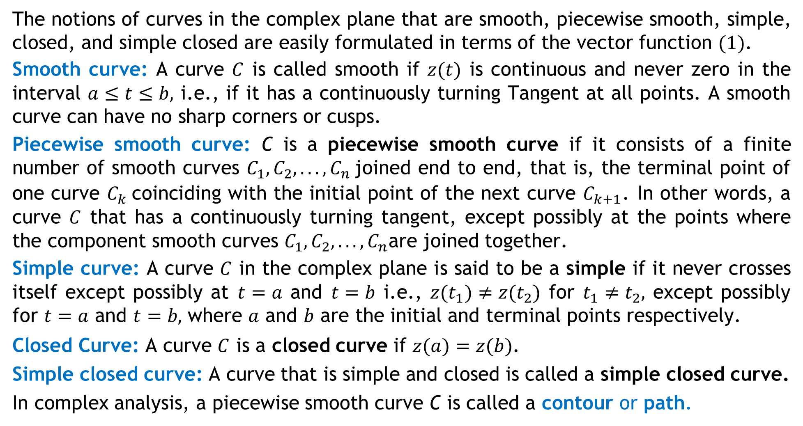
Contours
The notions of curves in the complex plane that are smooth, piecewise smooth, simple, closed, and simple closed are easily formulated in terms of the vector function $(1)$.
Smooth curve: A curve $C$ is called smooth if $z(t)$ is continuous and never zero in the interval $a≤t≤b,$ i.e., if it has a continuously turning Tangent at all points. A smooth curve can have no sharp corners or cusps.
Piecewise smooth curve: C is a piecewise smooth curve if it consists of a finite number of smooth curves $C_{1},C_{2}, . . . ,C_{n}$joined end to end, that is, the terminal point of one curve $C_{k}$coinciding with the initial point of the next curve $C_{k+1}$. In other words, a curve $C$ that has a continuously turning tangent, except possibly at the points where the component smooth curves $C_{1},C_{2}, . . . ,C_{n}$are joined together.
Simple curve: A curve $C$ in the complex plane is said to be a simple if it never crosses itself except possibly at $t=a$ and $t=b$ i.e., $z(t_{1})≠z(t_{2})$ for $t_{1}≠t_{2},$ except possibly for $t=a$ and $t=b,$ where $a$ and $b$ are the initial and terminal points respectively.
Closed Curve: A curve $C$ is a closed curve if $z(a)=z(b)$.
Simple closed curve: A curve that is simple and closed is called a simple closed curve.
In complex analysis, a piecewise smooth curve C is called a contour or path.

Slide 6
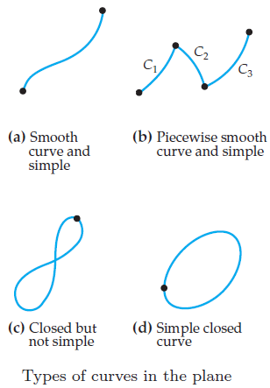
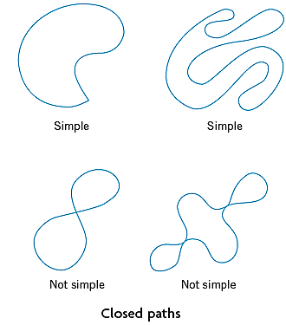
General Assumption. All paths of integration for complex line integrals are assumed to be piecewise smooth, that is, they consist of finitely many smooth curves joined end to end.

Slide 7
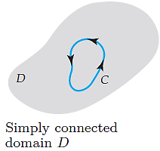
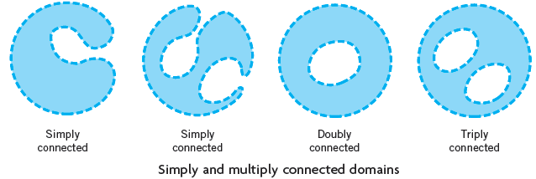
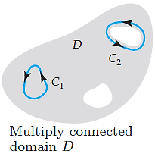
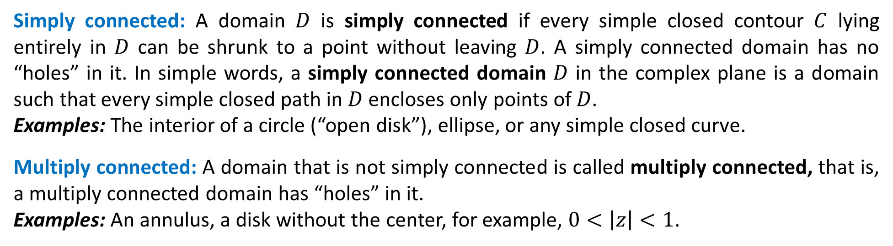
Simply and Multiply Connected Domains
Simply connected: A domain $D$ is simply connected if every simple closed contour $C$ lying entirely in $D$ can be shrunk to a point without leaving $D$. A simply connected domain has no “holes” in it. In simple words, a simply connected domain $D$ in the complex plane is a domain such that every simple closed path in $D$ encloses only points of $D$.
Examples: The interior of a circle (“open disk”), ellipse, or any simple closed curve.
Multiply connected: A domain that is not simply connected is called multiply connected, that is, a multiply connected domain has “holes” in it.
Examples: An annulus, a disk without the center, for example, $0<\left|z\right|<1$.

Slide 8
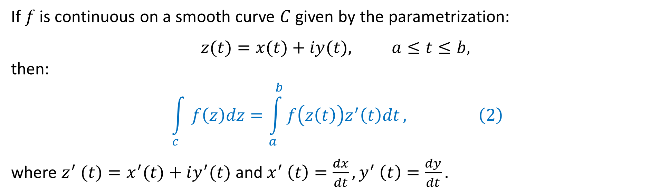
Evaluation of a Contour Integral
If $f$ is continuous on a smooth curve $C$ given by the parametrization:
$$z(t)=x(t)+iy(t), a≤t≤b,$$
then:
$$\int_{c}{f\left(z\right)dz}=\int_{a}^{b}{f\left(z\left(t\right)\right)z^{′}\left(t\right)dt}, \left(2\right)$$
where $z^{′} (t)=x^{′}(t)+iy^{′}(t)$ and $x^{′} \left(t\right)=\frac{dx}{dt},y^{′} \left(t\right)=\frac{dy}{dt}.$

Slide 9
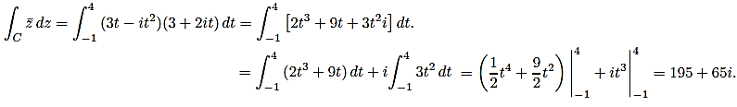

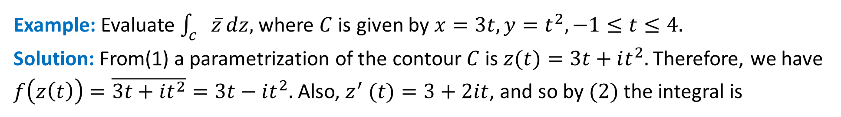
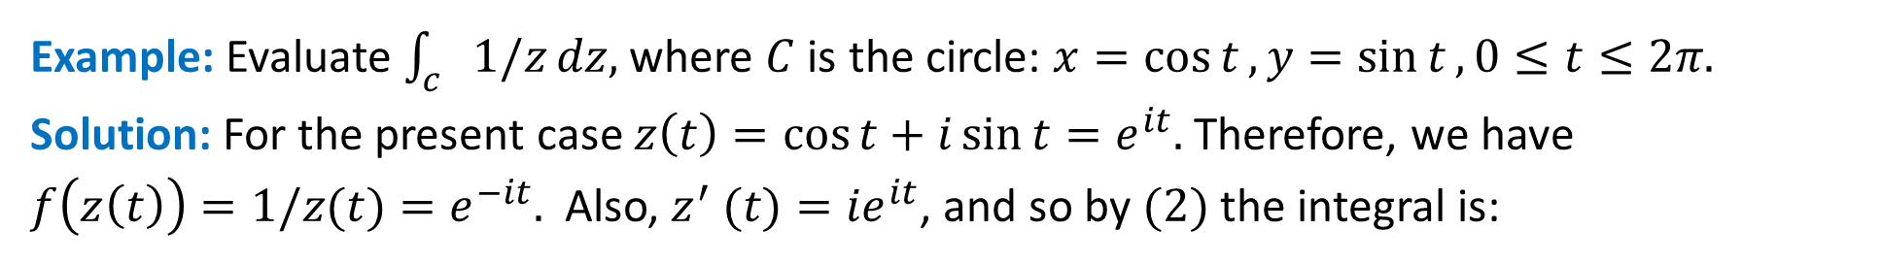
Evaluation of a Contour Integral
Example: Evaluate $\int_{c}{\overline{z}}dz,$ where $C$ is given by $x=3t, y=t^{2}, −1≤t≤4.$
Solution: From(1) a parametrization of the contour $C$ is $z(t)=3t+it^{2}.$ Therefore, we have
$f\left(z\left(t\right)\right)=\overline{3t+it^{2}}=3t−it^{2}.$ Also, $z^{′} (t)=3+2it$, and so by $(2)$ the integral is
Example: Evaluate $\int_{c}{1/z}dz,$ where $C$ is the circle: $x=\cos{t}, y=\sin{t}, 0≤t≤2π.$
Solution: For the present case $z\left(t\right)=\cos{t}+i\sin{t}=e^{it}.$ Therefore, we have
$f\left(z\left(t\right)\right)=1/z(t)=e^{−it}.$ Also, $z^{′} (t)={ie}^{it}$, and so by $(2)$ the integral is:

Slide 10
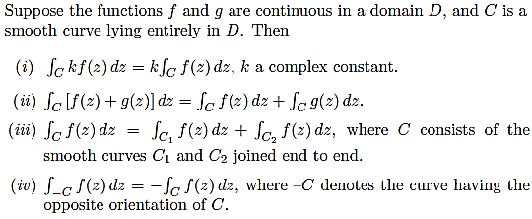

Basic Properties Directly Implied by the Definition

Slide 11
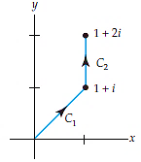
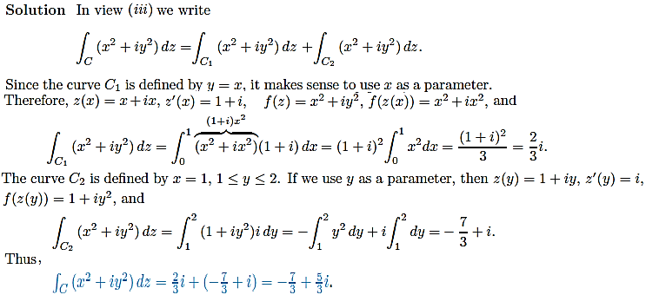

Slide 12
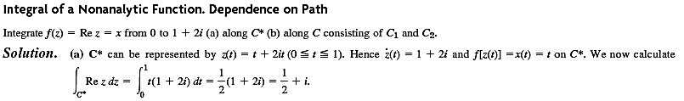
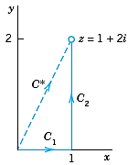
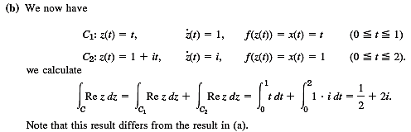
Dependence on path.
Now comes a very important fact. If we integrate a given function from a point to a point along different paths, the integrals will in general have different values. In other words, a complex line integral depends not only on the endpoints of the path but in general also on the path itself.

Slide 13
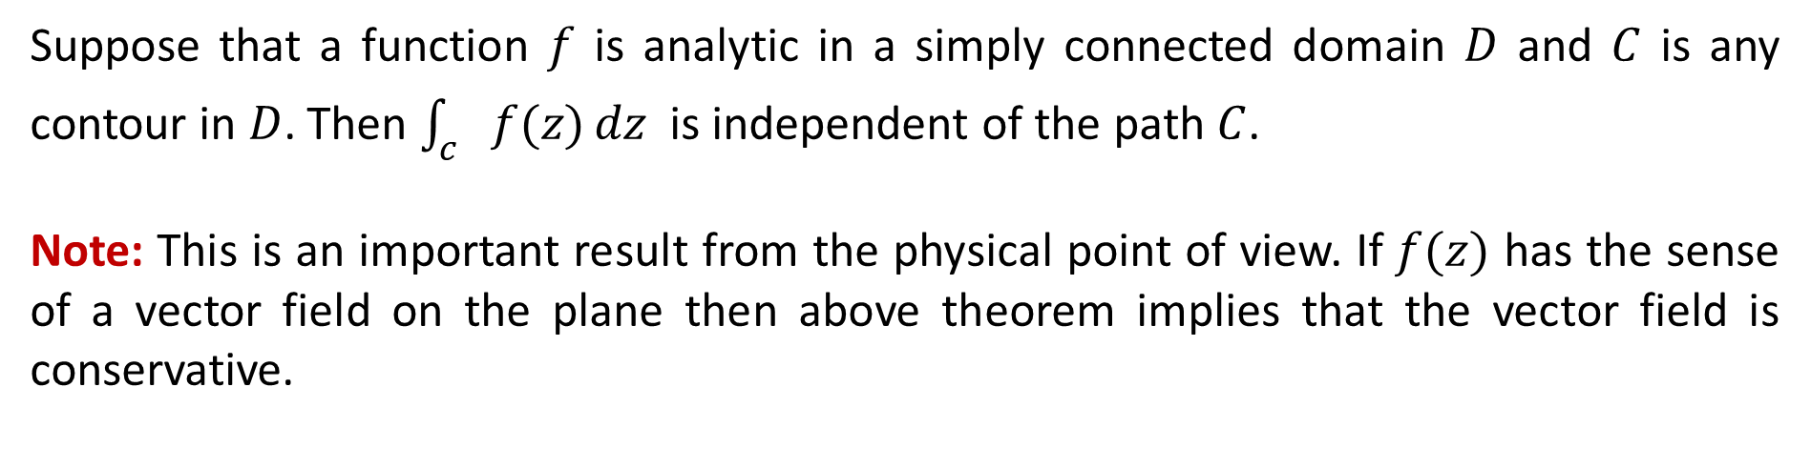
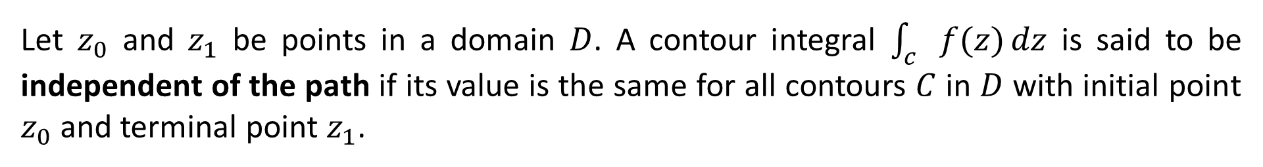
Independence of the Path
Let $z_{0}$ and $z_{1}$ be points in a domain $D$. A contour integral $\int_{c}{f(z)}dz$ is said to be independent of the path if its value is the same for all contours $C$ in $D$ with initial point $z_{0}$ and terminal point $z_{1}$.
Analyticity Implies Path Independence
Suppose that a function $f$ is analytic in a simply connected domain $D$ and $C$ is any contour in $D$. Then $\int_{c}{f(z)}dz$ is independent of the path $C$.
Note: This is an important result from the physical point of view. If $f(z)$ has the sense of a vector field on the plane then above theorem implies that the vector field is conservative.

Slide 14
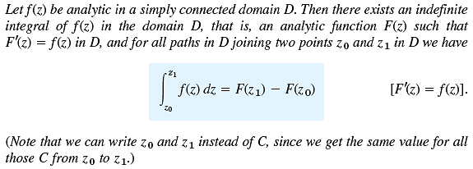
Fundamental Theorem for Contour Integrals

Slide 15




Examples:
1.
2.
3.
4.

Slide 16
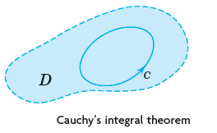
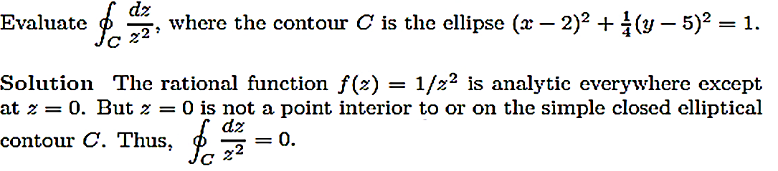
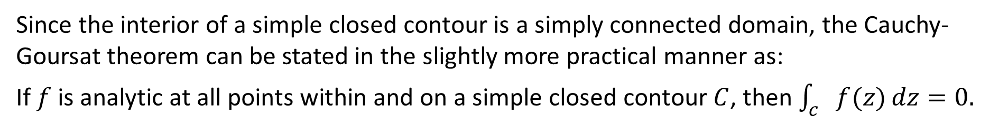
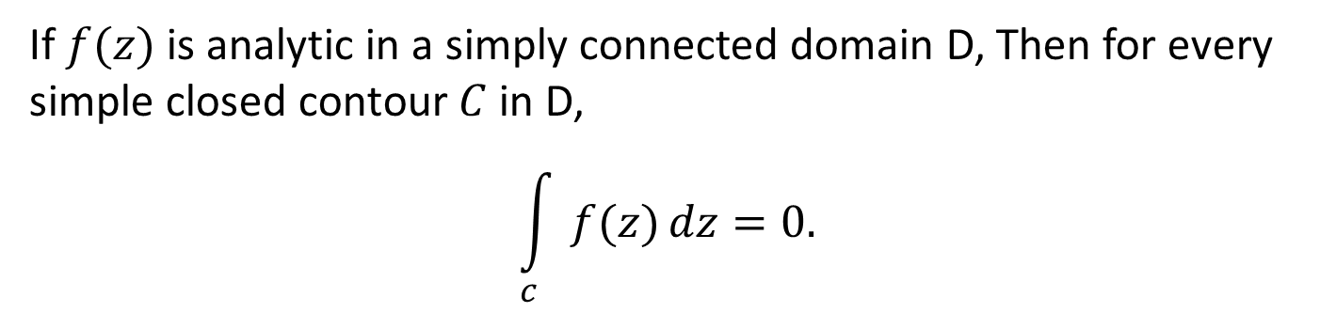
Cauchy’s Integral Theorem (Cauchy-Goursat Theorem)
If $f(z)$ is analytic in a simply connected domain D, Then for every simple closed contour $C$ in D,
$$\int_{c}{f(z)}dz=0.$$
Since the interior of a simple closed contour is a simply connected domain, the Cauchy-Goursat theorem can be stated in the slightly more practical manner as:
If $f$ is analytic at all points within and on a simple closed contour $C$, then $\int_{c}{f(z)}dz=0.$
Example:

Slide 17
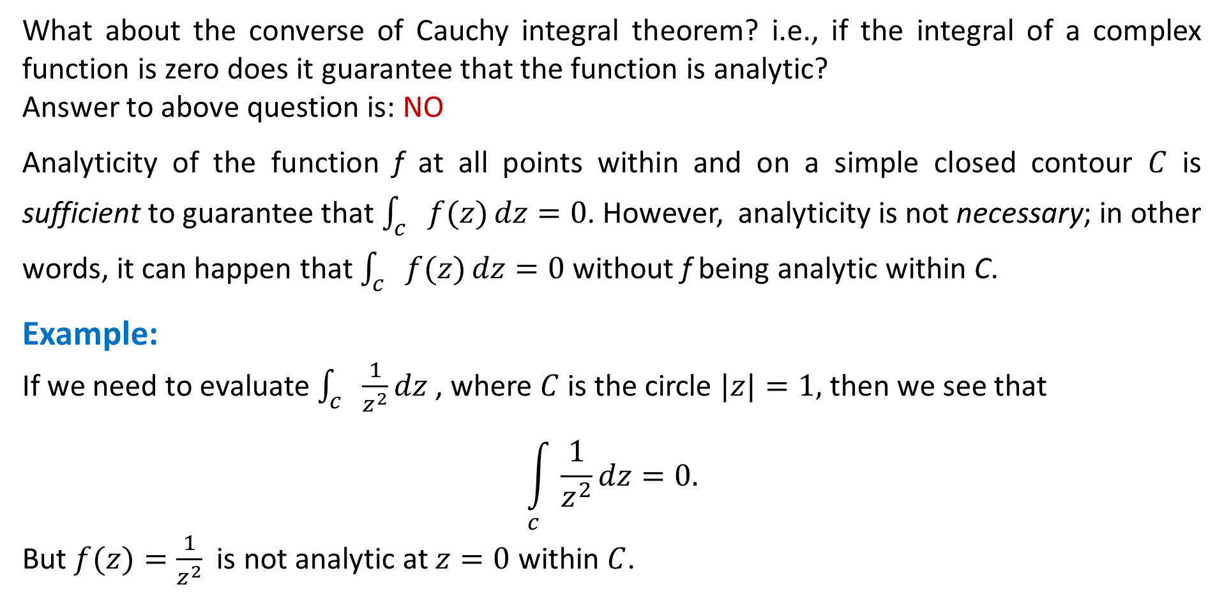
Important Remark
What about the converse of Cauchy integral theorem? i.e., if the integral of a complex function is zero does it guarantee that the function is analytic?
Answer to above question is: NO
Analyticity of the function f at all points within and on a simple closed contour $C$ is sufficient to guarantee that $\int_{c}{f(z)}dz=0$. However, analyticity is not necessary; in other words, it can happen that $\int_{c}{f(z)}dz=0$ without f being analytic within C.
Example:
If we need to evaluate $\int_{c}{\frac{1}{z^{2}}}dz$, where $C$ is the circle $|z|=1,$ then we see that
$$\int_{c}{\frac{1}{z^{2}}}dz=0.$$
But $f(z)=\frac{1}{z^{2}}$ is not analytic at $z=0$ within $C$.

Slide 18

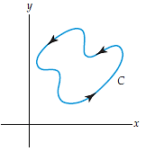
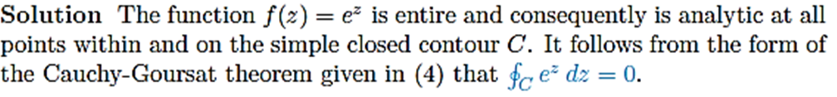

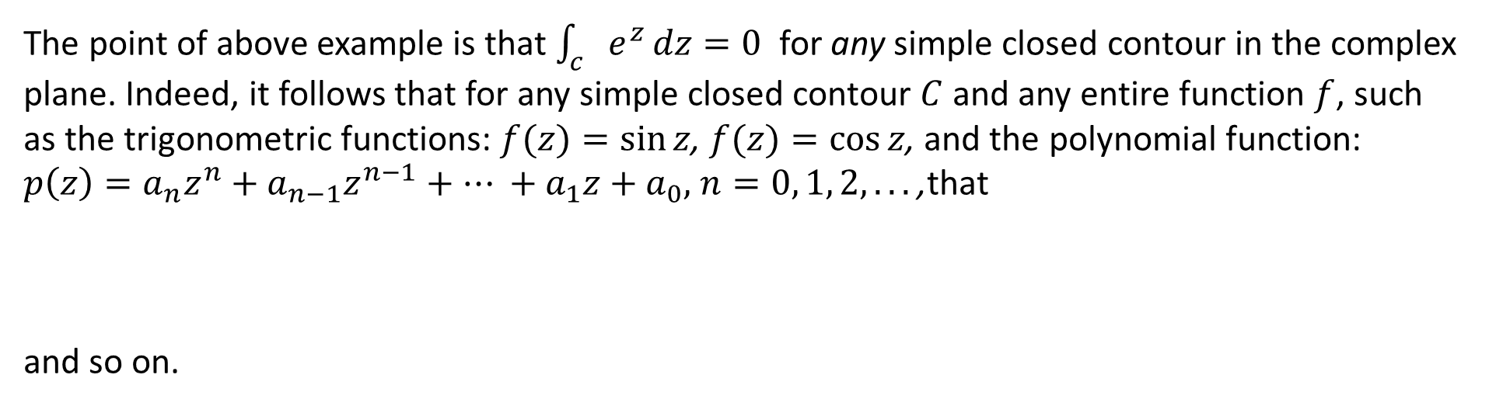
Note:
The point of above example is that $\int_{c}{e^{z}}dz=0$ for any simple closed contour in the complex plane. Indeed, it follows that for any simple closed contour $C$ and any entire function $f$, such as the trigonometric functions: $f(z)=sin⁡z$, $f(z)=cos⁡z$, and the polynomial function: $p\left(z\right)=a_{n}z^{n}+a_{n−1}z^{n−1}+… +a_{1}z+a_{0},$ $n=0, 1, 2, . . .$,that
and so on.

Slide 19



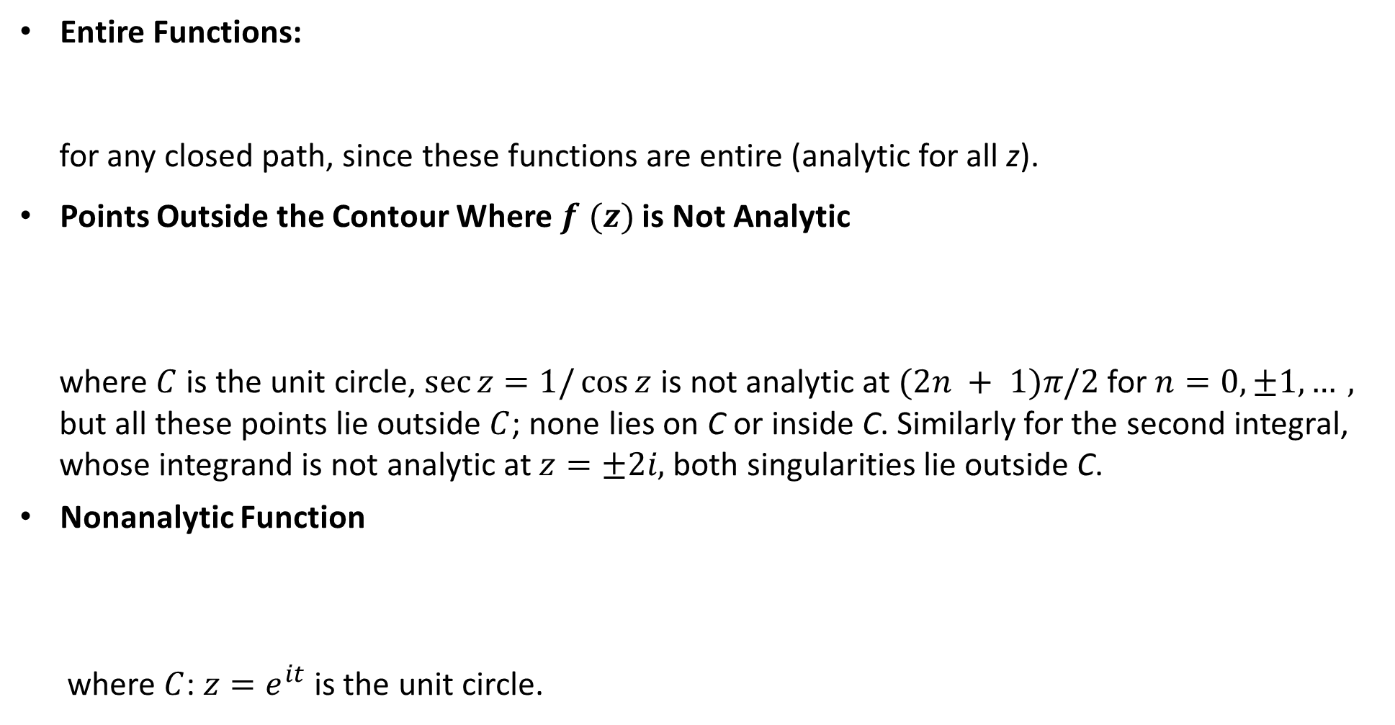
Examples:
Entire Functions:
for any closed path, since these functions are entire (analytic for all z).
Points Outside the Contour Where $f (z)$ is Not Analytic
where $C$ is the unit circle, $\sec{z=1/\cos{z}}$ is not analytic at $(2n + 1)π/2$ for $n=0, ±1,…,$
but all these points lie outside $C$; none lies on C or inside C. Similarly for the second integral,
whose integrand is not analytic at $z=±2i,$ both singularities lie outside C.
Nonanalytic Function
where $C$: $z=e^{it}$ is the unit circle.

Slide 20
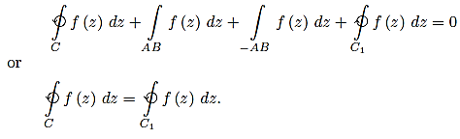
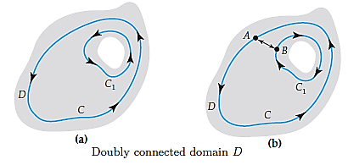

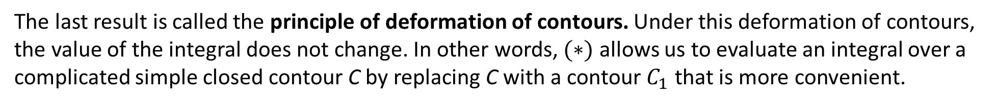
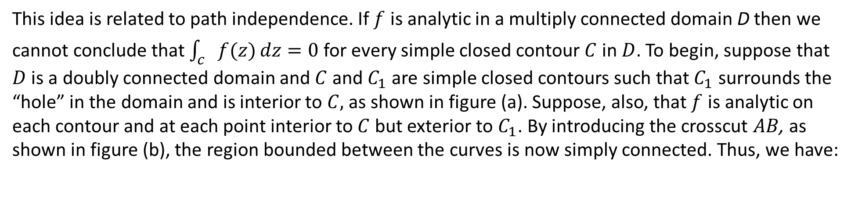
Cauchy-Goursat Theorem for Multiply Connnected Domains
This idea is related to path independence. If $f$ is analytic in a multiply connected domain D then we cannot conclude that $\int_{c}{f(z)}dz=0$ for every simple closed contour $C$ in $D$. To begin, suppose that $D$ is a doubly connected domain and $C$ and $C_{1}$ are simple closed contours such that $C_{1}$ surrounds the “hole” in the domain and is interior to $C,$ as shown in figure (a). Suppose, also, that $f$ is analytic on each contour and at each point interior to $C$ but exterior to $C_{1}$. By introducing the crosscut $AB$, as shown in figure (b), the region bounded between the curves is now simply connected. Thus, we have:
$$(∗)$$
The last result is called the principle of deformation of contours. Under this deformation of contours, the value of the integral does not change. In other words, $(∗)$ allows us to evaluate an integral over a complicated simple closed contour C by replacing C with a contour $C_{1}$ that is more convenient.

Slide 21
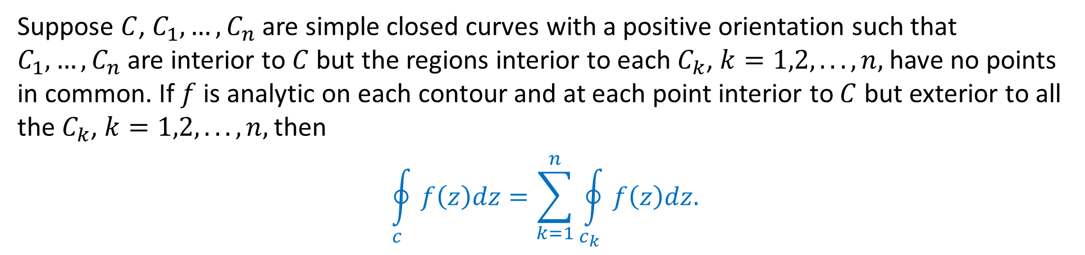
Cauchy-Goursat Theorem for Multiply Connected Domains
Suppose $C$, $C_{1}, …,C_{n}$ are simple closed curves with a positive orientation such that $C_{1}, …,C_{n}$are interior to $C$ but the regions interior to each $C_{k}$, $k=1,2, . . . ,n,$have no points in common. If $f$ is analytic on each contour and at each point interior to $C$ but exterior to all the $C_{k}$, $k=1,2, . . . ,n,$then
$$\oint_{c}{f\left(z\right)dz}=\sum_{k=1}^{n}{\oint_{c_{k}}{f\left(z\right)dz.}}$$

Slide 22
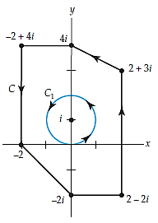
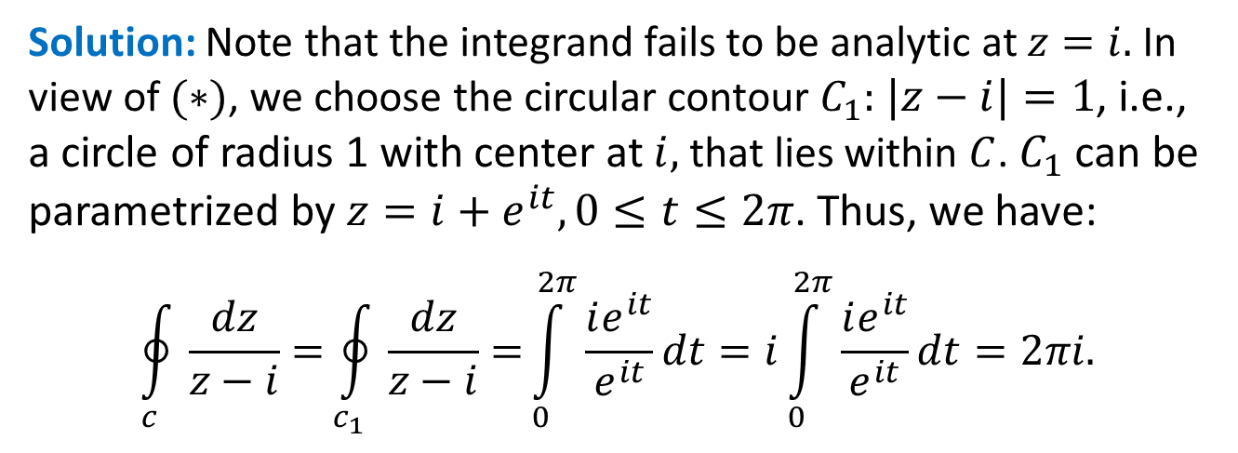
Example:
Evaluate $\int_{c}{\frac{dz}{z−i}},$ where $C$ is the contour shown in black in the figure.
Solution: Note that the integrand fails to be analytic at $z=i.$ In view of $(∗)$, we choose the circular contour $C_{1}:$ $|z−i|=1$, i.e., a circle of radius 1 with center at $i,$ that lies within $C$. $C_{1}$ can be parametrized by $z=i+e^{it},0≤t≤2π$. Thus, we have:
$$\oint_{c}{\frac{dz}{z−i}=}\oint_{c_{1}}{\frac{dz}{z−i}=}\int_{0}^{2π}{\frac{ie^{it}}{e^{it}}dt}=i\int_{0}^{2π}{\frac{ie^{it}}{e^{it}}dt}=2πi.$$

Slide 23

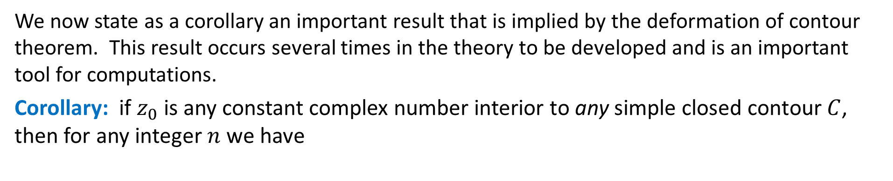

Principle of Deformation of Contours
We now state as a corollary an important result that is implied by the deformation of contour theorem. This result occurs several times in the theory to be developed and is an important tool for computations.
Corollary: if $z_{0}$ is any constant complex number interior to any simple closed contour $C$, then for any integer $n$ we have
$$(∗∗)$$
When $n$ is zero or a negative integer, $\frac{1}{{(z−z_{0})}^{n}}$ is a polynomial and therefore entire.

Slide 24
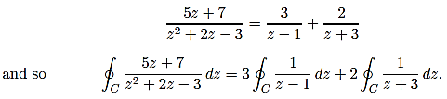



Example:
Evaluate $\oint_{c}{\frac{5z+7}{z^{2}+2z−3}dz},$ where $C$ is circle $|z−2|=2$.
Solution Since the denominator factors as $z^{2}+2z−3=(z−1)(z+3)$the integrand fails to be analytic at $z=1$ and $z=−3$. Of these two points, only $z=1$ lies within the contour $C$, which is a circle centered at $z=2$ of radius $r=2$. Now by partial fractions
$$(1)$$
In view of the result given in $(∗∗)$, the first integral in $(1)$has the value $2πi$, whereas the value of the second integral is $0$ by the Cauchy-Goursat theorem. Hence, $(1)$becomes

Slide 25
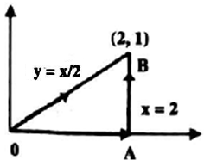
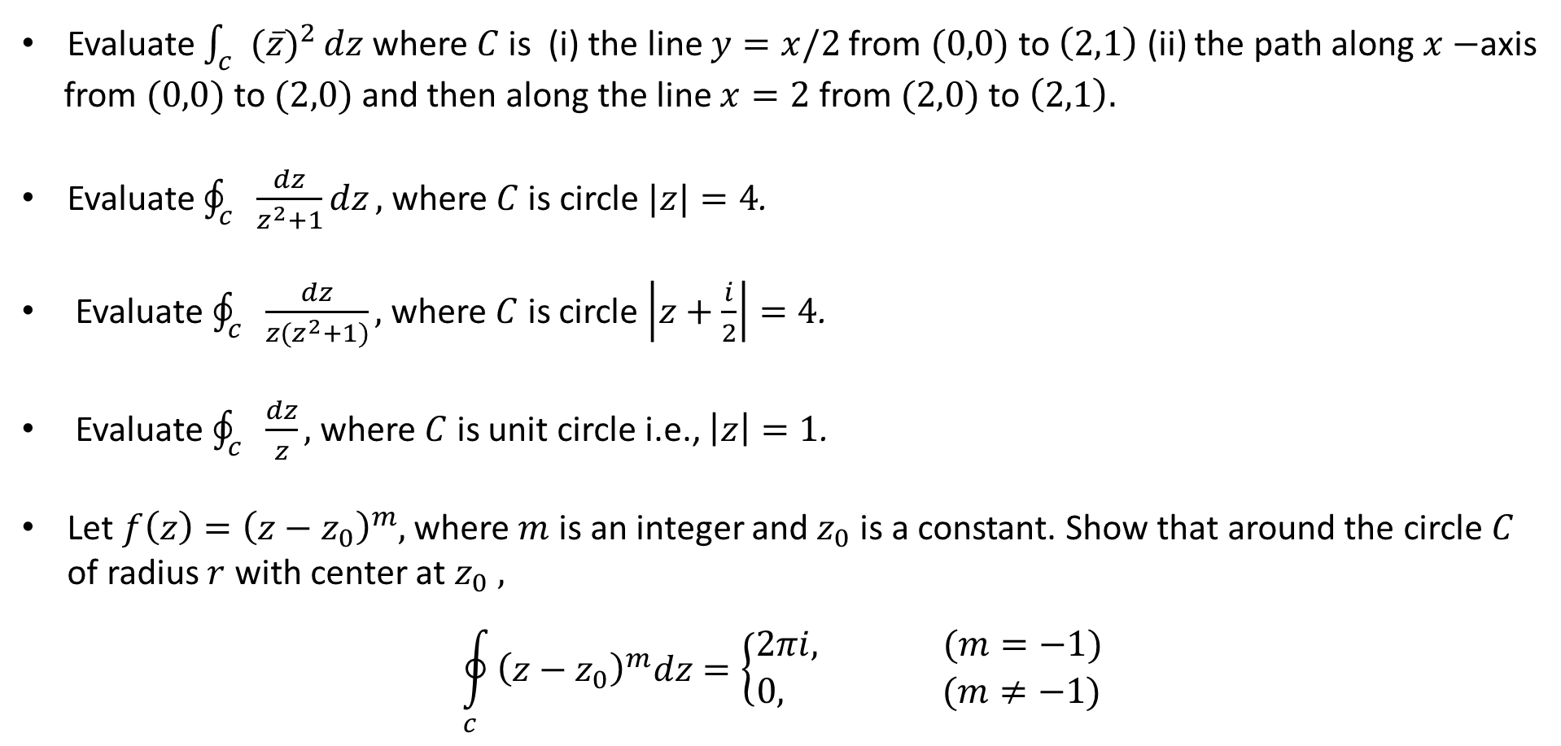
Practice Problems:
Evaluate $\int_{c}{{(\overline{z})}^{2}}dz$ where $C$ is (i) the line $y=x/2$ from $(0,0)$to $\left(2,1\right)$ (ii) the path along $x−$axis
from $(0,0)$to $(2,0)$and then along the line $x=2$ from $(2,0)$to $\left(2,1\right).$
Evaluate $\oint_{c}{\frac{dz}{z^{2}+1}dz},$ where $C$ is circle $|z|=4$.
Evaluate $\oint_{c}{\frac{dz}{{z(z}^{2}+1)}},$ where $C$ is circle $\left|z+\frac{i}{2}\right|=4$.
Evaluate $\oint_{c}{\frac{dz}{z}},$ where $C$ is unit circle i.e., $\left|z\right|=1$.
Let $f\left(z\right)={\left(z−z_{0}\right)}^{m},$ where $m$ is an integer and $z_{0}$ is a constant. Show that around the circle $C$ of radius $r$ with center at $z_{0} ,$
$$\oint_{c}{{\left(z−z_{0}\right)}^{m}dz=\left\{\begin{matrix}2πi, (m=−1) \\ 0, (m≠−1)\end{matrix}\right.}$$

Slide 26
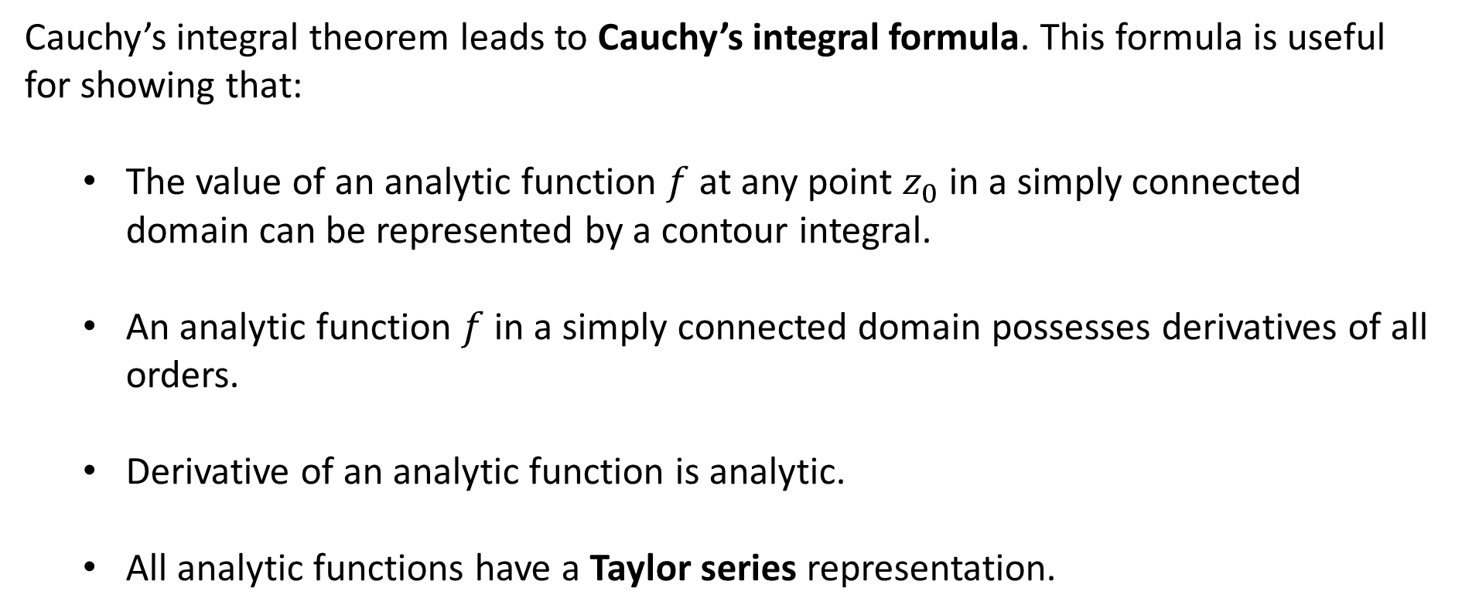
Cauchy’s Integral Formula
Cauchy’s integral theorem leads to Cauchy’s integral formula. This formula is useful for showing that:
The value of an analytic function $f$ at any point $z_{0}$ in a simply connected domain can be represented by a contour integral.
An analytic function $f$ in a simply connected domain possesses derivatives of all orders.
Derivative of an analytic function is analytic.
All analytic functions have a Taylor series representation.

Slide 27
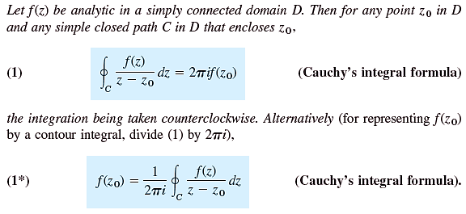
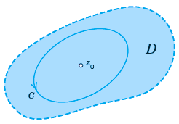
Cauchy’s Integral Formula

Slide 28

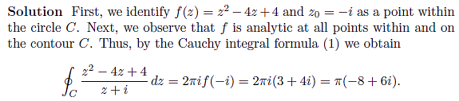
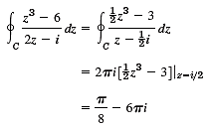
Examples:
1.
2.
Evaluate $\oint_{C}{\frac{z^{3}−6}{2z−i}}dz,$ where $C$ is any contour enclosing $z_{0}=\frac{i}{2}.$

Slide 29

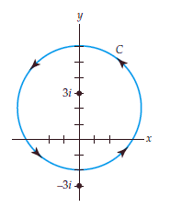
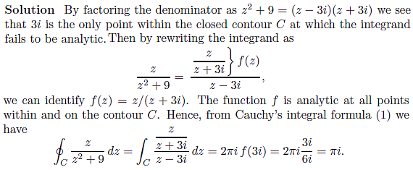
Examples:
3.

Slide 30

Cauchy’s integral formula for derivatives.

Slide 31


Example:

Slide 32

Practice Questions:
Evaluate $\int_{C}{\frac{z^{3}+3}{z{(z−i)}^{2}}dz,}$ where $C$ is the contour shown in figure.
Evaluate $\int_{C}{\frac{e^{z}}{{(z−1)}^{2}(z^{3}+4)}dz,}$ for any positive oriented contour $C$ for which 1 is interior to $C$ while $±2i$ lie outside the contour.
Evaluate $\int_{C}{\frac{z^{2}+1}{ z^{2}−1}dz,}$ where the contour $C$ is: (i) $\left|z−1\right|=1,$ (ii) $\left|z+1\right|=1.$
Evaluate $\int_{C}{\frac{1}{ z^{2}−4}dz,}$ where the contour $C$ is: (i) $\left|z\right|=1,$ (ii) $\left|z−1\right|=2,$ (i) $\left|z+1\right|=2.$

