Slide 1

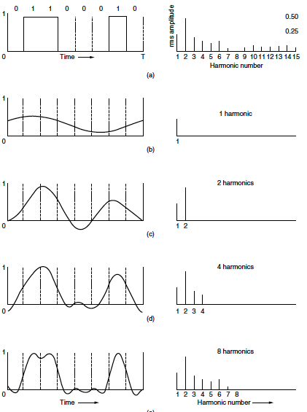
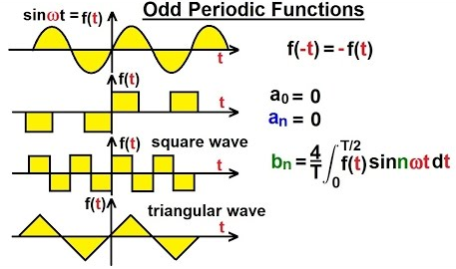
Fourier Series

Slide 2
Book: Advanced Modern Engineering Mathematics (4th Edition) by Glyn James
Chapter: 7
Sections: 7.6
Book: Signals and Systems (2nd Edition) by Alan V. Oppenheim, Alan S. Willsky, and S. Hamid Nawab
Chapter: 3
Sections: 3.3,3.9

Slide 3
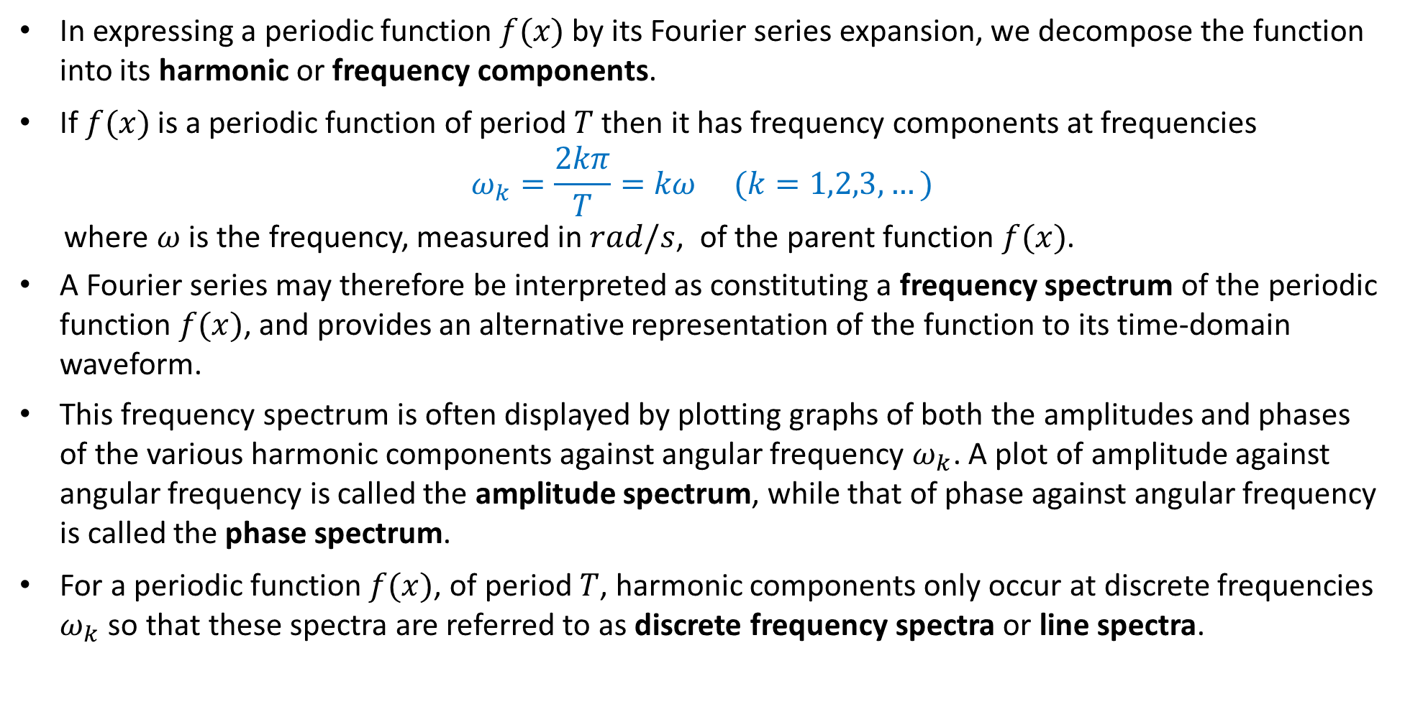
Discrete Frequency Spectra
In expressing a periodic function $f(x)$ by its Fourier series expansion, we decompose the function into its harmonic or frequency components.
If $f(x)$ is a periodic function of period $T$ then it has frequency components at frequencies
$$ω_{k}=\frac{2kπ}{T}=kω (k=1,2,3,…)$$
where $ω$ is the frequency, measured in $rad/s$, of the parent function $f(x)$.
A Fourier series may therefore be interpreted as constituting a frequency spectrum of the periodic function $f(x)$, and provides an alternative representation of the function to its time-domain waveform.
This frequency spectrum is often displayed by plotting graphs of both the amplitudes and phases of the various harmonic components against angular frequency $ω_{k}$. A plot of amplitude against angular frequency is called the amplitude spectrum, while that of phase against angular frequency is called the phase spectrum.
For a periodic function $f(x)$, of period $T$, harmonic components only occur at discrete frequencies $ω_{k}$ so that these spectra are referred to as discrete frequency spectra or line spectra.

Slide 4
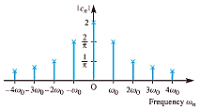
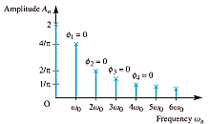
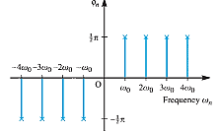
Discrete frequency spectra
With the growing ability to process signals digitally, the representation of signals by their corresponding spectra is an approach widely used in almost all branches of engineering, especially electrical engineering, when considering topics such as filtering and modulation.
An example of the use of a discrete spectral representation of a periodic function is in distortion measurements on amplifiers, where the harmonic content of the output, measured digitally, to a sinusoidal input provides a measure of the distortion.

Slide 5
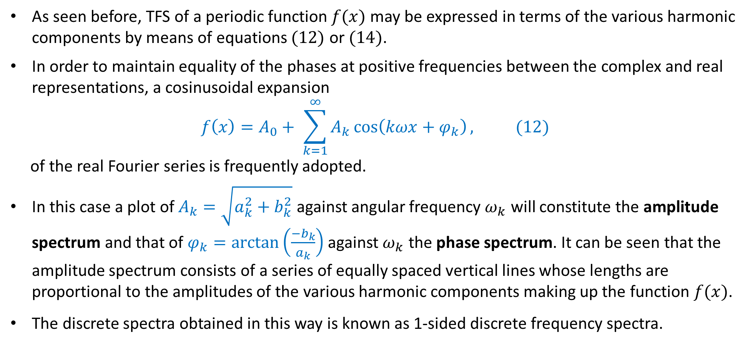
1-Sided Discrete Frequency Spectra
As seen before, TFS of a periodic function $f(x)$ may be expressed in terms of the various harmonic components by means of equations $(12)$ or $(14)$.
In order to maintain equality of the phases at positive frequencies between the complex and real representations, a cosinusoidal expansion
$$f\left(x\right)=A_{0}+ \sum_{k=1}^{∞}{A_{k}\cos\left(kωx+φ_{k}\right),} (12)$$
of the real Fourier series is frequently adopted.
In this case a plot of $A_{k}=\sqrt{a_{k}^{2}+b_{k}^{2}}$ against angular frequency $ω_{k}$ will constitute the amplitude spectrum and that of $φ_{k}=\arctan\left(\frac{−b_{k}}{a_{k}}\right)$against $ω_{k}$ the phase spectrum. It can be seen that the amplitude spectrum consists of a series of equally spaced vertical lines whose lengths are proportional to the amplitudes of the various harmonic components making up the function $f(x)$.
The discrete spectra obtained in this way is known as 1-sided discrete frequency spectra.

Slide 6
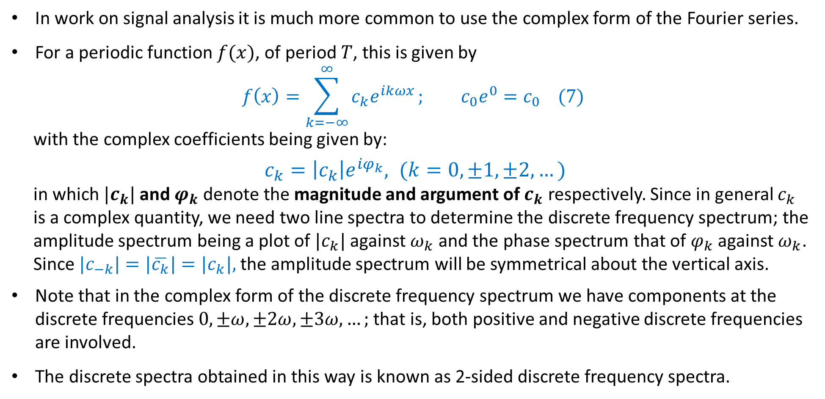
2-Sided Discrete Frequency Spectra
In work on signal analysis it is much more common to use the complex form of the Fourier series.
For a periodic function $f(x)$, of period $T$, this is given by
$$f\left(x\right)=\sum_{k=−∞}^{∞}{c_{k}e^{ikωx}}; c_{0}e^{0}=c_{0} (7)$$
with the complex coefficients being given by:
$c_{k}=\left|c_{k}\right|e^{iφ_{k}}, (k=0,±1,±2,…)$
in which $|c_{k}|$ and $φ_{k}$ denote the magnitude and argument of $c_{k}$ respectively. Since in general $c_{k}$
is a complex quantity, we need two line spectra to determine the discrete frequency spectrum; the
amplitude spectrum being a plot of $|c_{k}|$ against $ω_{k}$ and the phase spectrum that of $φ_{k}$ against $ω_{k}$.
Since $|c_{−k}|=|\overline{c_{k}}|=|c_{k}|,$ the amplitude spectrum will be symmetrical about the vertical axis.
Note that in the complex form of the discrete frequency spectrum we have components at the discrete frequencies $0, ±ω,±2ω,±3ω,…;$ that is, both positive and negative discrete frequencies are involved.
The discrete spectra obtained in this way is known as 2-sided discrete frequency spectra.

Slide 7
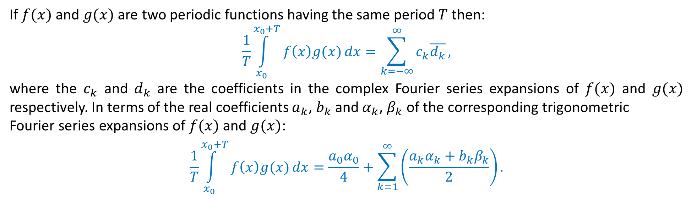
The multiplication theorem and Parseval’s theorem
Two useful results, particularly in the application of Fourier series to signal analysis, are the multiplication theorem and Parseval’s theorem.
The multiplication theorem enables us to write down the mean value of the product of two periodic functions over a period in terms of the coefficients of their Fourier series expansions.
Parseval’s theorem enables us to write down the mean square value of a periodic function which determines the power spectrum of the function.
The multiplication theorem
If $f(x)$ and $g(x)$ are two periodic functions having the same period $T$ then:
$$\frac{1}{T}\int_{x_{0}}^{x_{0}+T}{f\left(x\right)g(x)}dx=\sum_{k=−∞}^{∞}{c_{k}\overline{d_{k}}},$$
where the $c_{k}$ and $d_{k}$ are the coefficients in the complex Fourier series expansions of $f(x)$ and $g(x)$ respectively. In terms of the real coefficients $a_{k}$, $b_{k}$ and $α_{k}$, $β_{k}$ of the corresponding trigonometric
Fourier series expansions of $f(x)$ and $g(x)$:
$$\frac{1}{T}\int_{x_{0}}^{x_{0}+T}{f\left(x\right)g(x)}dx=\frac{a_{0}α_{0}}{4}+\sum_{k=1}^{∞}{\left(\frac{a_{k}α_{k}+b_{k}β_{k}}{2}\right).}$$

Slide 8
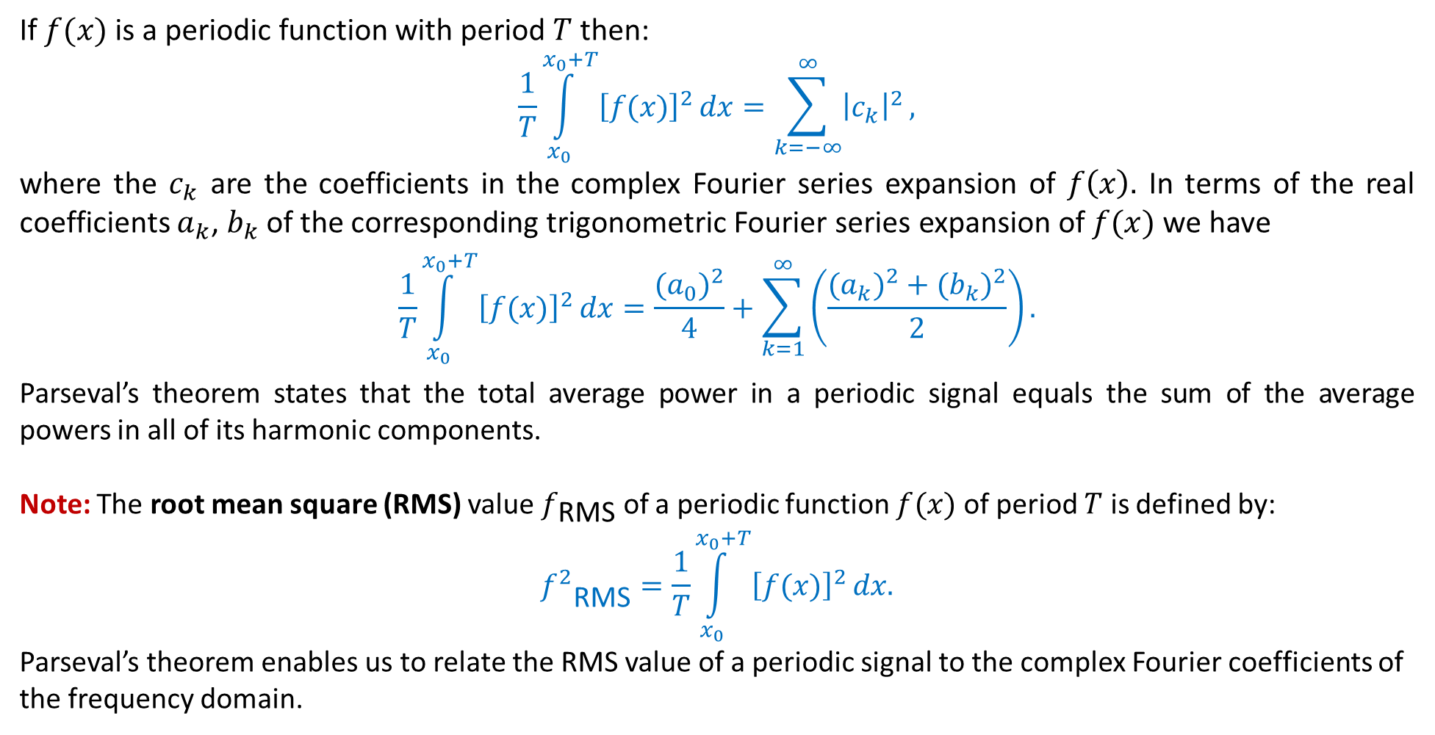
Parseval’s theorem
If $f(x)$ is a periodic function with period $T$ then:
$$\frac{1}{T}\int_{x_{0}}^{x_{0}+T}{{\left[f(x)\right]}^{2}}dx=\sum_{k=−∞}^{∞}{{\left|c_{k}\right|}^{2}},$$
where the $c_{k}$ are the coefficients in the complex Fourier series expansion of $f\left(x\right).$ In terms of the real coefficients $a_{k}$, $b_{k}$ of the corresponding trigonometric Fourier series expansion of $f(x)$ we have
$$\frac{1}{T}\int_{x_{0}}^{x_{0}+T}{{\left[f(x)\right]}^{2}}dx=\frac{{{(a}_{0})}^{2}}{4}+\sum_{k=1}^{∞}{\left(\frac{{{(a}_{k})}^{2}+{{(b}_{k})}^{2}}{2}\right).}$$
Parseval’s theorem states that the total average power in a periodic signal equals the sum of the average powers in all of its harmonic components.
Note: The root mean square (RMS) value $f_{\text{RMS}}$ of a periodic function $f(x)$ of period $T$ is defined by:
$${f^{2}}_{\text{RMS}}=\frac{1}{T}\int_{x_{0}}^{x_{0}+T}{{\left[f(x)\right]}^{2}}dx.$$
Parseval’s theorem enables us to relate the RMS value of a periodic signal to the complex Fourier coefficients of the frequency domain.

Slide 9
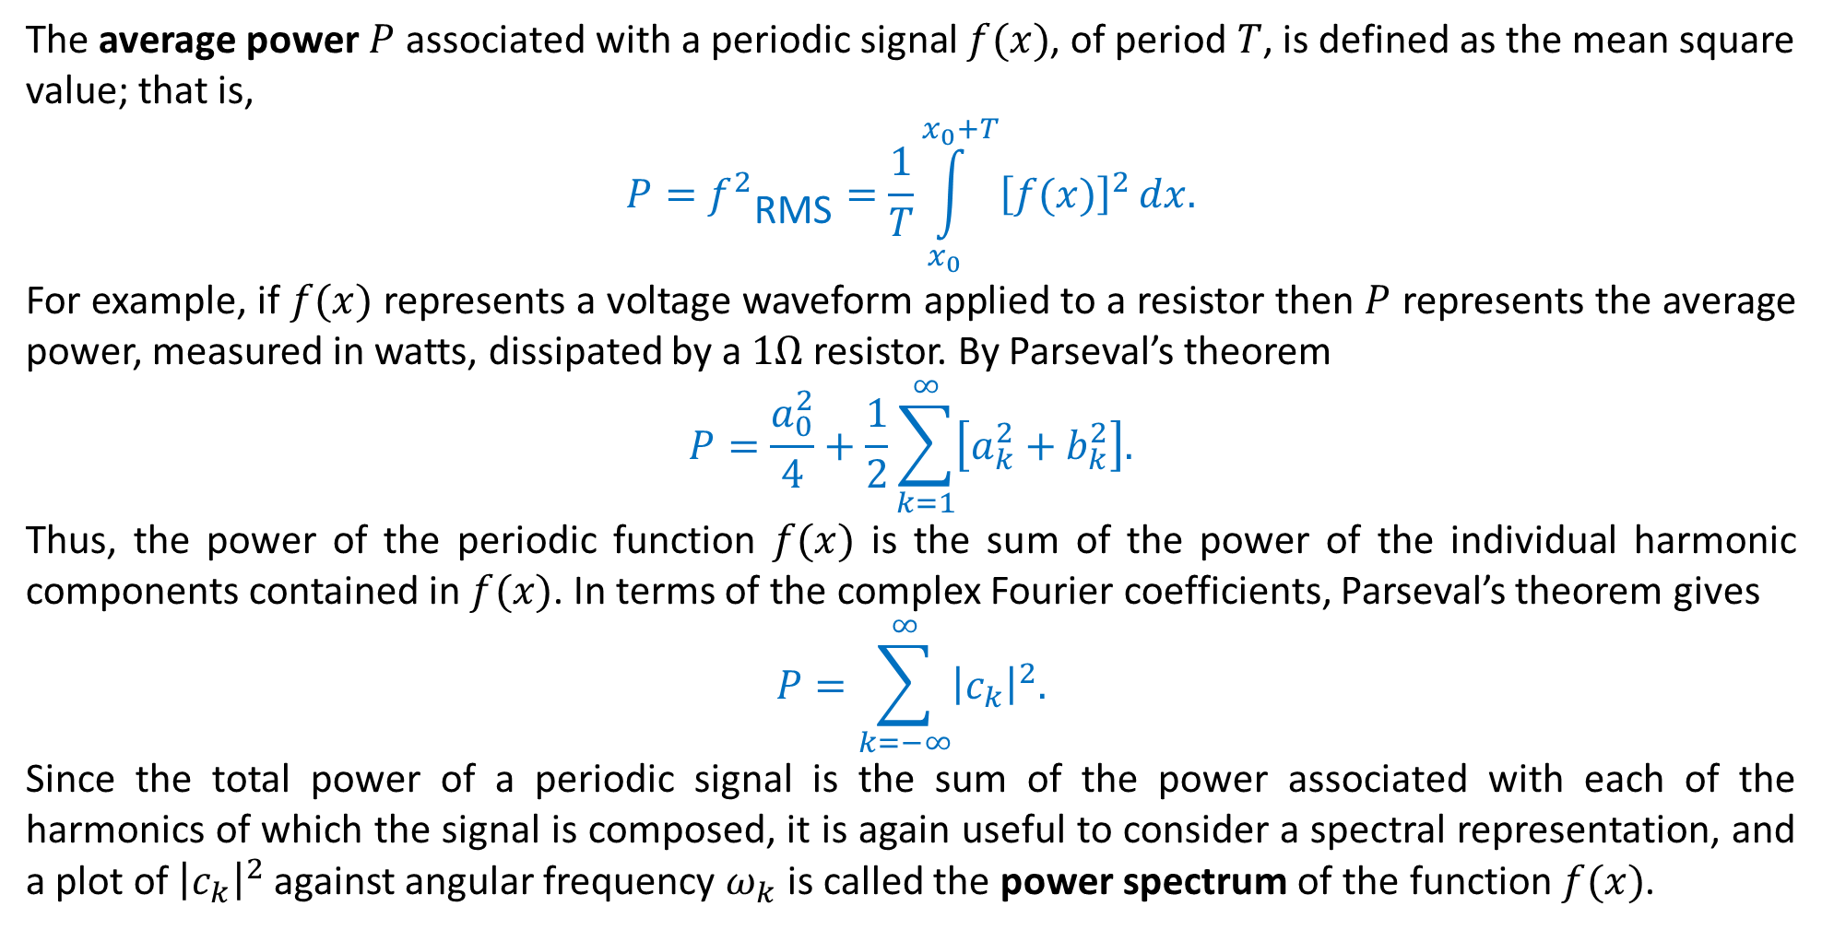
Power Spectrum
The average power $P$ associated with a periodic signal $f(x)$, of period $T$, is defined as the mean square value; that is,
$$P={f^{2}}_{\text{RMS}}=\frac{1}{T}\int_{x_{0}}^{x_{0}+T}{{\left[f(x)\right]}^{2}}dx.$$
For example, if $f(x)$ represents a voltage waveform applied to a resistor then $P$ represents the average power, measured in watts, dissipated by a $1Ω$resistor. By Parseval’s theorem
$$P=\frac{a_{0}^{2}}{4}+\frac{1}{2}\sum_{k=1}^{∞}{\left[a_{k}^{2}+b_{k}^{2}\right].}$$
Thus, the power of the periodic function $f(x)$ is the sum of the power of the individual harmonic components contained in $f(x)$. In terms of the complex Fourier coefficients, Parseval’s theorem gives
$$P=\sum_{k=−∞}^{∞}{{\left|c_{k}\right|}^{2}.}$$
Since the total power of a periodic signal is the sum of the power associated with each of the harmonics of which the signal is composed, it is again useful to consider a spectral representation, and a plot of ${\left|c_{k}\right|}^{2}$against angular frequency $ω_{k}$ is called the power spectrum of the function $f(x)$.

Slide 11
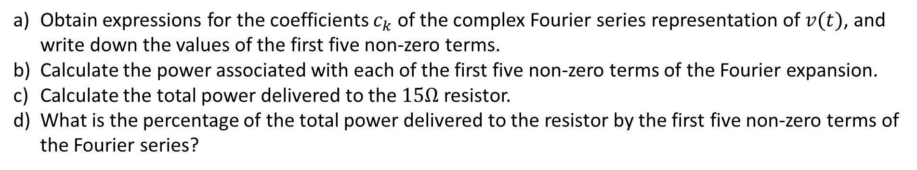

Practice Problems:
A periodic voltage $v(t)$ (in volts) of period $5 ms$ and specified by
$$v\left(t\right)=\left\{\begin{aligned}60, 0<t<1.25 \\ 0, 1.25<t<5 \end{aligned} and v\left(t+5\right)=v\left(t\right) ∀(for all )t. \right.$$
is applied across the terminals of a $15Ω$ resistor.
Obtain expressions for the coefficients $c_{k}$ of the complex Fourier series representation of $v(t)$, and write down the values of the first five non-zero terms.
Calculate the power associated with each of the first five non-zero terms of the Fourier expansion.
Calculate the total power delivered to the $15Ω$ resistor.
What is the percentage of the total power delivered to the resistor by the first five non-zero terms of the Fourier series?

Slide 17
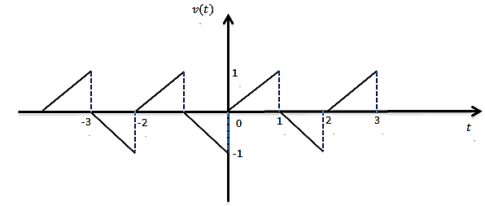
Filtering
In a variety of applications, it is of interest to change the relative amplitudes of the frequency
components in a signal or perhaps eliminate some frequency components entirely, a process referred to as filtering.
Example:
Identify the period and frequency in both hertz and radians/sec of the periodic voltage shown in figure.
Moreover, calculate the complex Fourier coefficients. The signal is passed through a band pass filter that passes only frequencies from 2.25 to 2.75 KHz. What signal emerges expressed as sines and cosines?

Slide 19
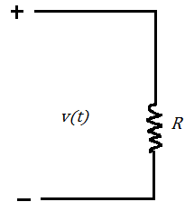
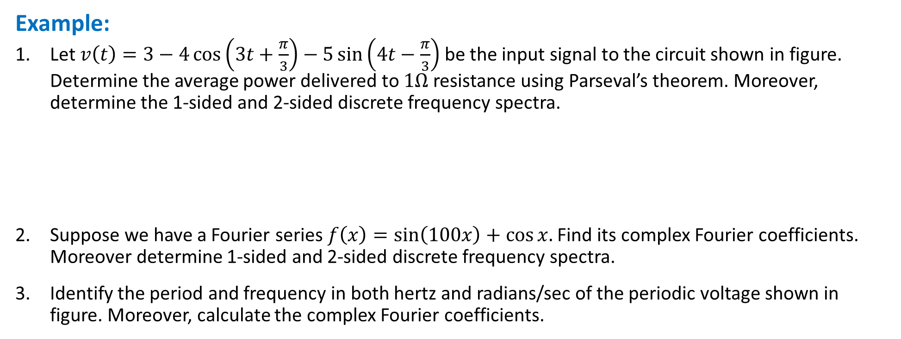
Example:
Let $v\left(t\right)=3−4\cos\left(3t+\frac{π}{3}\right)−5\sin\left(4t−\frac{π}{3}\right)$ be the input signal to the circuit shown in figure. Determine the average power delivered to $1Ω$ resistance using Parseval’s theorem. Moreover, determine the 1-sided and 2-sided discrete frequency spectra.
Suppose we have a Fourier series $f\left(x\right)=\sin\left(100x\right)+\cos{x.}$ Find its complex Fourier coefficients. Moreover determine 1-sided and 2-sided discrete frequency spectra.
Identify the period and frequency in both hertz and radians/sec of the periodic voltage shown in figure. Moreover, calculate the complex Fourier coefficients.

Slide 20
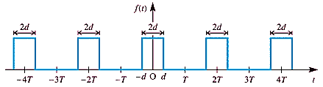
Practice Problems:
Plot the one sided and two sided discrete amplitude and phase spectra for the periodic function
$$f\left(x\right)=\frac{2x}{T} \left(0<x<2T \right), f\left(x+2T\right)=f\left(x\right).$$
Determine the complex form of the Fourier series expansion of the periodic (period $2T$) infinite train of identical rectangular pulses of magnitude $A$ and duration $2d$ illustrated in figure. Draw the discrete frequency spectrum in the particular case when $d=\frac{1}{10}$ and $T=\frac{1}{2}$ .
Let $v\left(t\right)=\sin\left(4πt\right)$ be the input signal to the circuit shown in figure. Using Parseval’s theorem, determine the average power delivered to the resistor $R=5Ω$.
Infinite train of rectangular pulses

Slide 21
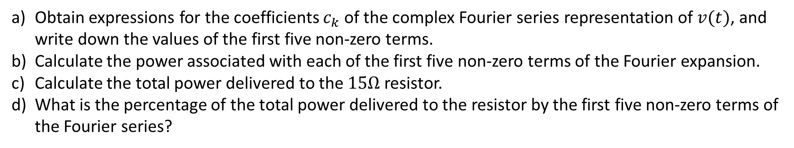
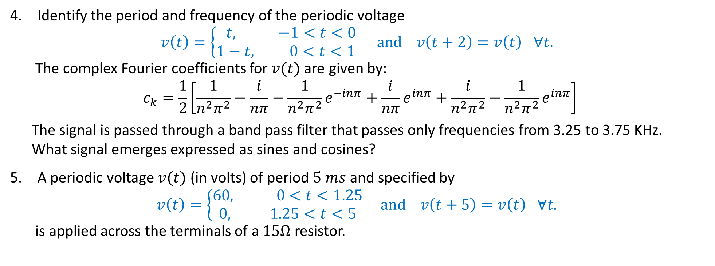
Practice Problems:
Identify the period and frequency of the periodic voltage
$$v\left(t\right)=\left\{\begin{aligned}t, −1<t<0 \\ 1−t, 0<t<1 \end{aligned}and v\left(t+2\right)=v\left(t\right) ∀t. \right.$$
The complex Fourier coefficients for $v(t)$ are given by:
$$c_{k}=\frac{1}{2}\left[\frac{1}{n^{2}π^{2}}−\frac{i}{nπ}−\frac{1}{n^{2}π^{2}}e^{−inπ}+\frac{i}{nπ}e^{inπ}+\frac{i}{n^{2}π^{2}}−\frac{1}{n^{2}π^{2}}e^{inπ}\right]$$
The signal is passed through a band pass filter that passes only frequencies from 3.25 to 3.75 KHz.
What signal emerges expressed as sines and cosines?
A periodic voltage $v(t)$ (in volts) of period $5 ms$ and specified by
$$v\left(t\right)=\left\{\begin{aligned}60, 0<t<1.25 \\ 0, 1.25<t<5 \end{aligned} and v\left(t+5\right)=v\left(t\right) ∀t. \right.$$
is applied across the terminals of a $15Ω$ resistor.
Obtain expressions for the coefficients $c_{k}$ of the complex Fourier series representation of $v(t)$, and write down the values of the first five non-zero terms.
Calculate the power associated with each of the first five non-zero terms of the Fourier expansion.
Calculate the total power delivered to the $15Ω$ resistor.
What is the percentage of the total power delivered to the resistor by the first five non-zero terms of the Fourier series?

