Slide 1


Slide 2
Review Chap-3 Semiconductors

Slide 3
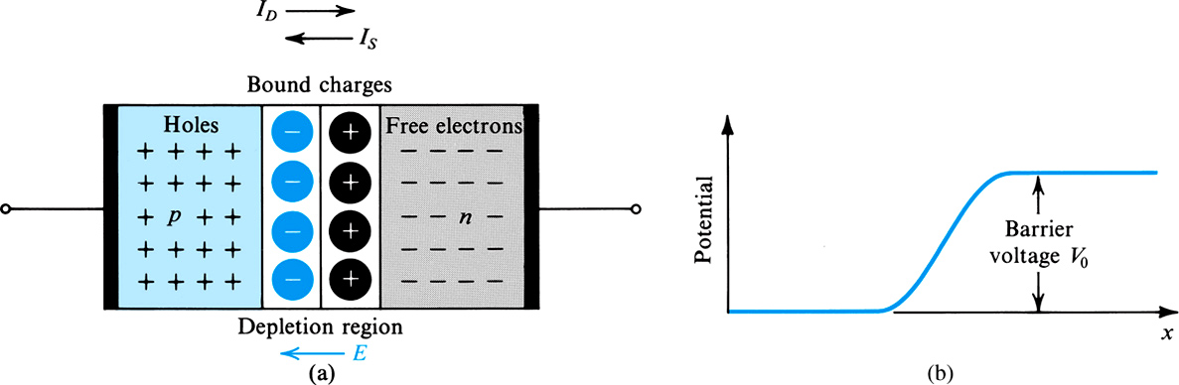
PN Junction with open Circuit Terminals

Slide 4
PN Junction with open Circuit Terminals
The drift current I_{S} is due to minority carrier
Electrons in the p-material at the edge of depletion region are swept into the n-side under the effect of electric field in the depletion region
Holes from n-material are swept into the p-side
Under the equilibrium condition I_{D} = I_{S}
The barrier voltage V_{o} is given by:

Slide 5
EE-215 Lectures
Electronic Devices & Circuits
Text Book: Chapter 04 (Sedra/Smith 6th Ed)
Diodes
4.1 Ideal Diode
4.1.1 Current–Voltage Characteristic
4.1.2 A Simple Application: The Rectifier
4.1.3 Diode Logic Gates
Instructor: Shakeel Alvi
Class: BEE 12 C&D
Electrical Engineering Department

Slide 6
1. The characteristics of the ideal diode and how to analyze and design circuits containing multiple ideal diodes together with resistors and dc sources to realize useful and interesting nonlinear functions.
2. The details of the i–v characteristic of the junction diode (which was derived in Chapter 3) and how to use it to analyze diode circuits operating in the various bias regions: forward, reverse, and breakdown.
3. A simple but effective model of the diode i–v characteristic in the forward direction; the constant-voltage-drop model.
4. A powerful technique for the application and modeling of the diode (and in later chapters, transistors): dc-biasing the diode and modeling its operation for small signals around the dc operating point by means of the small-signal model.

Slide 7
5. The use of a string of forward-biased diodes and of diodes operating in the breakdown region (zener diodes), to provide constant dc voltages
(voltage regulators).
6. Application of the diode in the design of rectifier circuits, which convert ac voltages to dc as needed for powering electronic equipment.
7. A number of other practical and important applications of diodes.

Slide 8
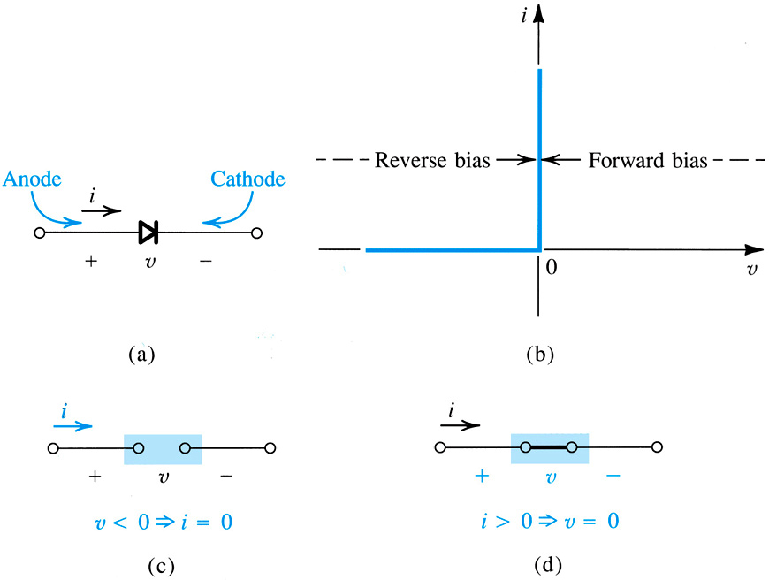
Current-Voltage Characteristic of Ideal Diode
What will be the relationship between current and voltage

Slide 9
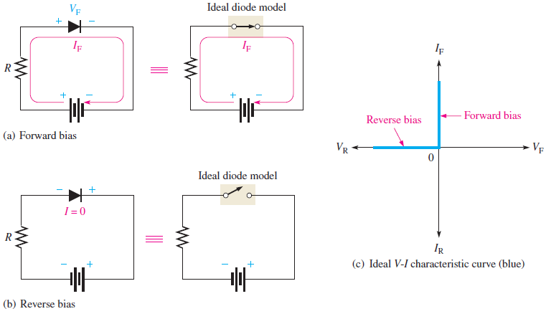
Ideal Diode Characteristics

Slide 10

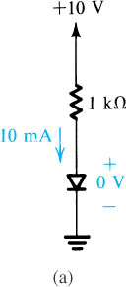


(a) In this circuit the diode is forward biased, meaning it will be short-circuited , so the dc source is shorted through a 1 k Ohm resistor . The current through the circuit is 10 m A
(b) In this circuit the diode is reversed biased, meaning it will be open-circuited , so there is no current flow through the circuit
Notes:
sedr42021_0302a.jpg

Slide 11
We saw the V-I characteristics of an Ideal Diode What are its input/ output characteristics?

Slide 12
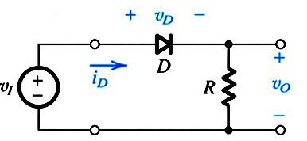
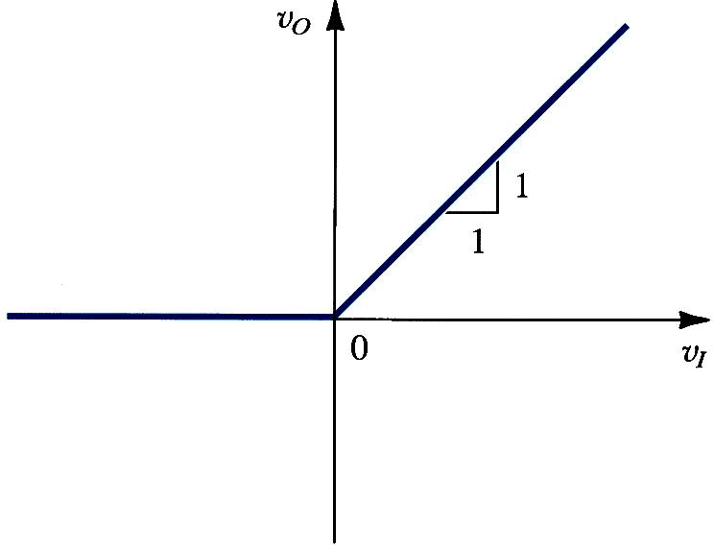
The Rectifier: v_{O} versus v_{I} Graph
No change
In this case what is the effect on slope of the line if R is increased
Output is following the input in positive half cycle

Slide 13
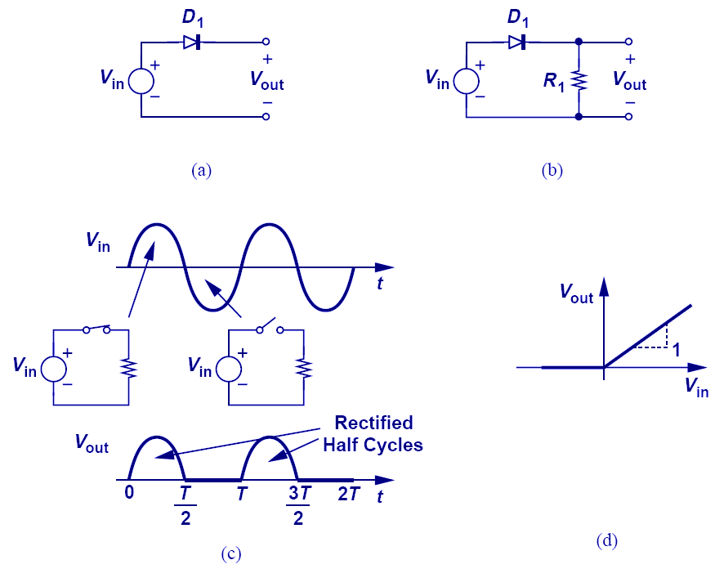
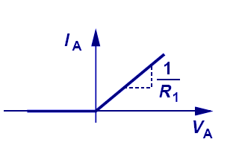
DIODE Circuit: Input / Output Characteristics
in
In this case what is the effect on slope of the line if R is increased

Slide 14
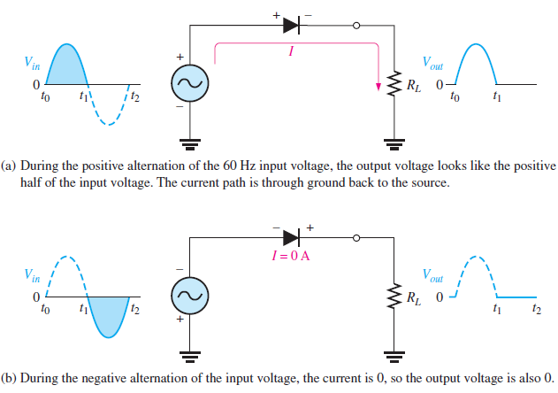
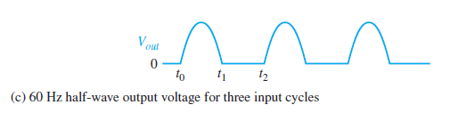
Half-wave Rectifier
Did this rectifier satisfied the input / output characteristics ?

Slide 15
What will be the output if we take output across the diode

Slide 16
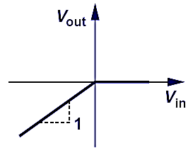
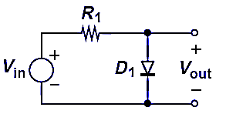
DIODE Circuit: Input / Output Characteristics

Slide 17
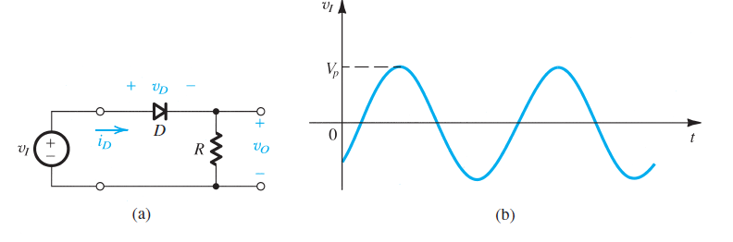
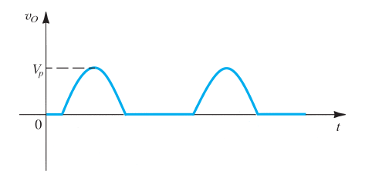
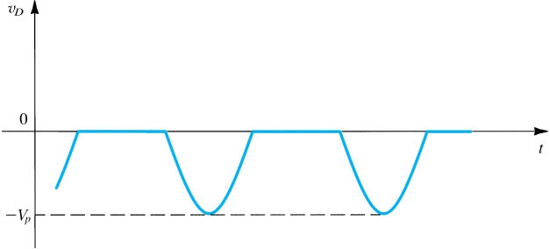
Signal at the resistance R
Signal at the Diode
Notes:
sedr42021_e0302.jpg

Slide 18
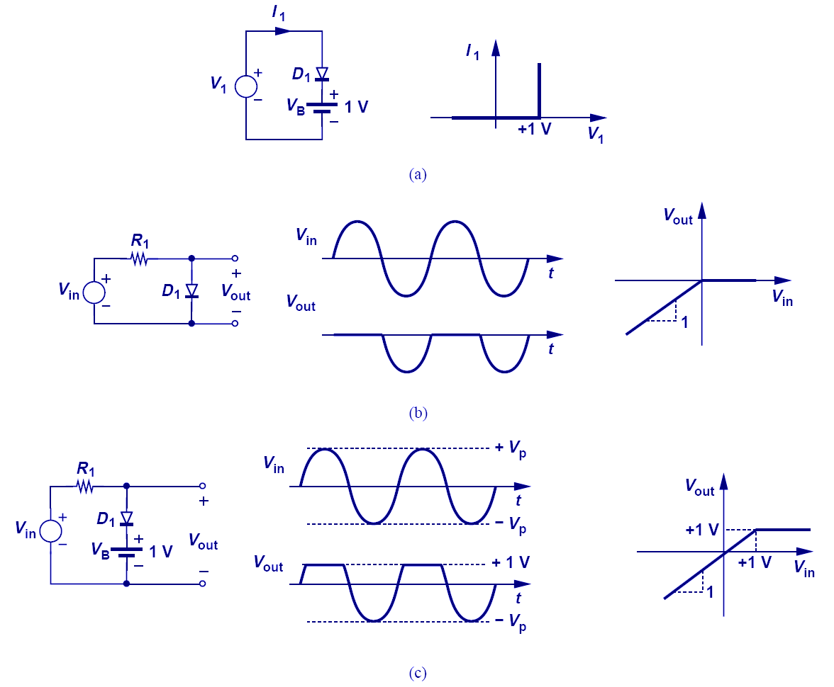
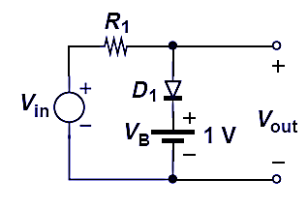
DIODE Circuit: Input / Output Characteristics
Why the curve shifts upwards ?????

Slide 19
What will be the V-I Characteristics

Slide 20
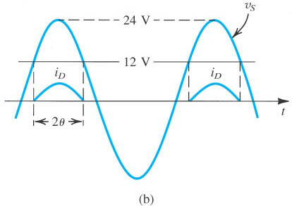
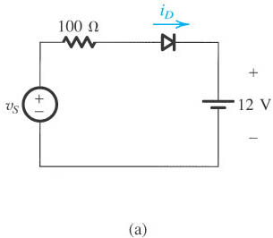
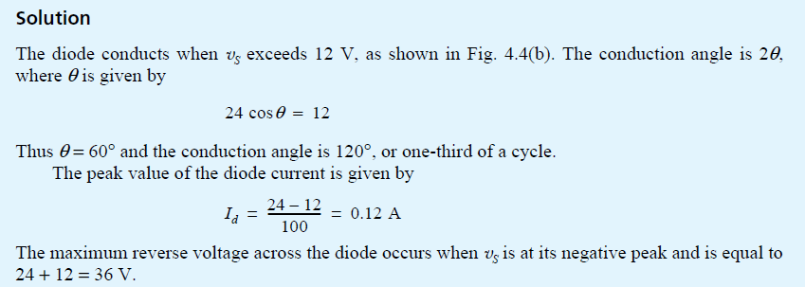
Example from text book
Notes:
sedr42021_0304a.jpg

Slide 21
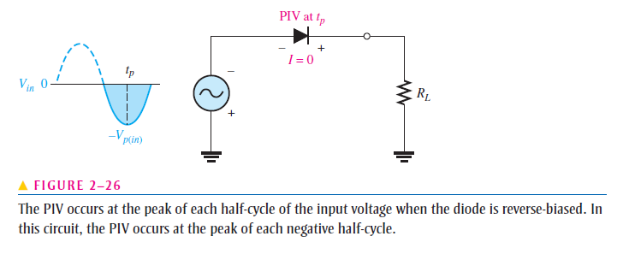
Care for reverse –bias voltage(PIV) in the circuit design
We are controlling max forward current using external resister ,
but are we catering for max reverse bias voltage ?

Slide 22
Average Values

Slide 23
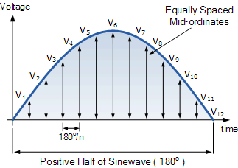
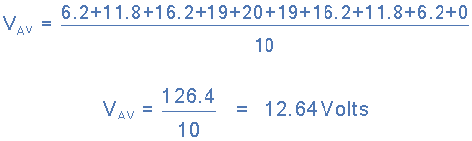


The Graphical Method
Voltage | 6.2V | 11.8V | 16.2V | 19.0V | 20.0V | 19.0V | 16.2V | 11.8V | 6.2V | 0V
Angle | 18º | 36º | 54º | 72º | 90º | 108º | 126º | 144º | 162º | 180º

Slide 24
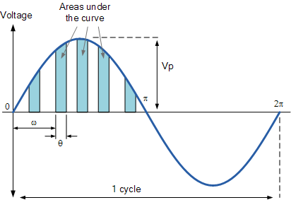

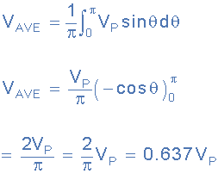

Analytical Method
Average Voltage Equation

Slide 25
The main differences between an RMS Voltage and an Average Voltage, is that the mean value of a periodic wave is the average of all the instantaneous areas taken under the curve over a given period of the waveform, and in the case of a sinusoidal quantity, this period is taken as one-half of the cycle of the wave. For convenience the positive half cycle is generally used.
The effective value or root-mean-square (RMS) value of the waveform is the effective heating value of the wave compared to a steady DC value and is the square root of the mean of the squares of the instantaneous values taken over one complete cycle.
For a pure sinusoidal waveform ONLY, both the average voltage and the RMS voltage (or currents) can be easily calculated as:
Average value = 0.637 × maximum or peak value, Vpk
RMS value = 0.707 × maximum or peak value, Vpk

Slide 26
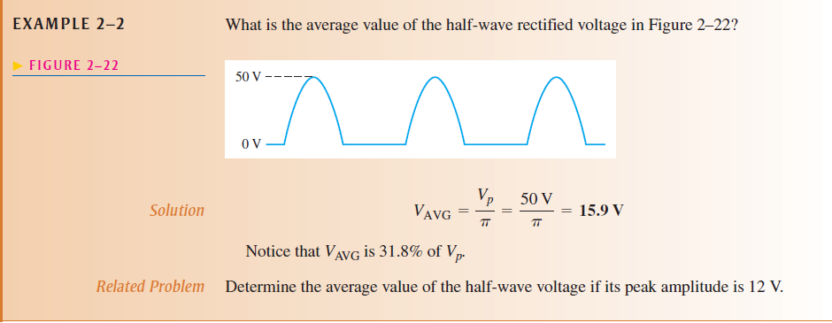
Example

Slide 27






A volt meter utilizes a moving coil meter that gives full scale reading when the average current flowing through it is 1 mA . The moving coil has a 50-Ὠ resistance find the value of R that results in in meter indication full scale reading when input sine wave voltage is 20v peak to peak
$$V_{P−P}=20 V$$
$$V_{P}=10 V$$
But the output from diode will be half-wave rectified
$${Therefore V}_{avg}=3.182 V$$
$$V=I×R$$
$$V=I×(R+50)$$
$$3.182=1×{10}^{−3}×(R+50)$$
R=3132

Slide 28
In class Practice Questions

Slide 29
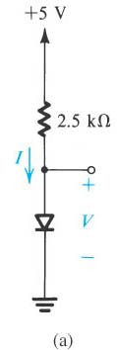
Practice Question 1
Notes:
sedr42021_e0304a.jpg

Slide 30
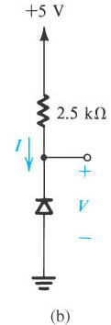
Practice Question 2

Slide 31
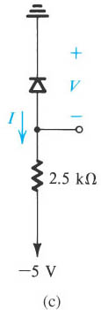
Practice Question 3

Slide 32
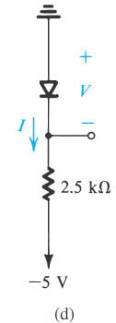
Practice Question 4

Slide 33
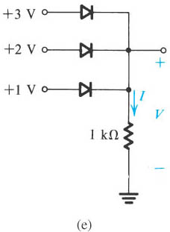
Practice Question 5

Slide 34
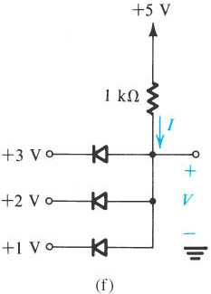
Practice Question 6

Slide 35
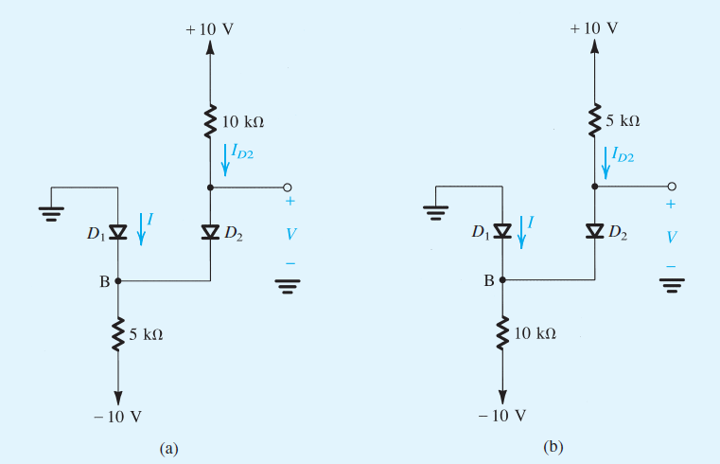
Example
Assuming Ideal Diode find I and V in the circuit

Slide 36
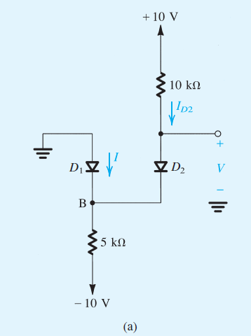


In these circuits it might be not obvious at first sight whether none, one, or both diodes are conducting . In such a case we take a assumption and proceed with the analysis, and then check whether we end up with a consistent solution. For circuit (a) we shall assume that both diodes are conducting . It follows the VB=0 and V=0 . The current through D2 can now be determined from

Slide 37
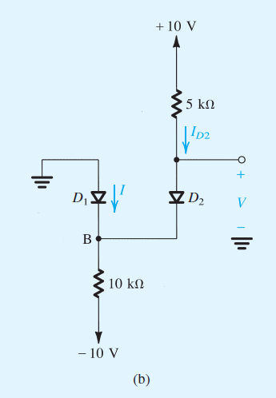
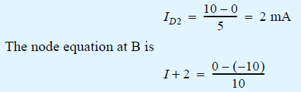

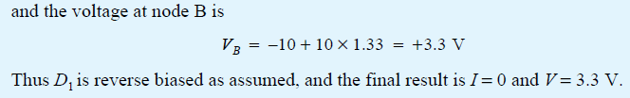
For the circuit in Fig B if we assume that both diodes are conducting , then VB =0 and V=0. the current in D2 is obtained from

Slide 38


Logic Gates
How can we make logic gates using diodes?
What are the truth Table for
Three input AND Gate?
Three input OR Gate?
BOOLEAN NOTATION

Slide 39
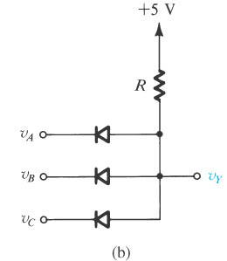
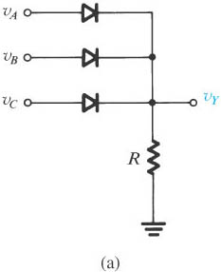
Diode logic gates
Diode logic gates: (a) OR gate; (b) AND gate (in a positive-logic system).
Notes:
sedr42021_0305a.jpg

Slide 41
EE-215 Lecture
Electronic Devices & Circuits
Text Book: Chapter 04 (Sedra/Smith 6th Ed)
4.2 Terminal Characteristics of Junction Diodes
4.2.1Forward bias region
4.2.2Reverse bias region
4.2.3Break down region
Instructor: Dr. Shakeel Alvi
Class: BEE 12 C & D
Electrical Engineering Department

Slide 42
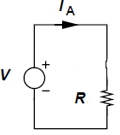
Simple Resistor in a circuit
What will happen if a battery is connected in the circuit ??

Slide 43
Ideal Diode

Slide 44
Gradually moving towards reality

Slide 45
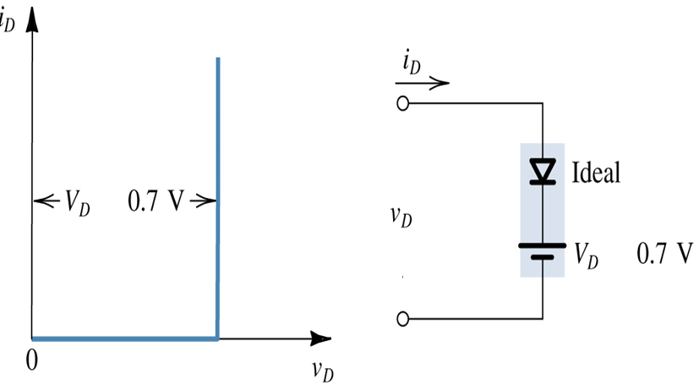
Taking into account the barrier voltage

Slide 46
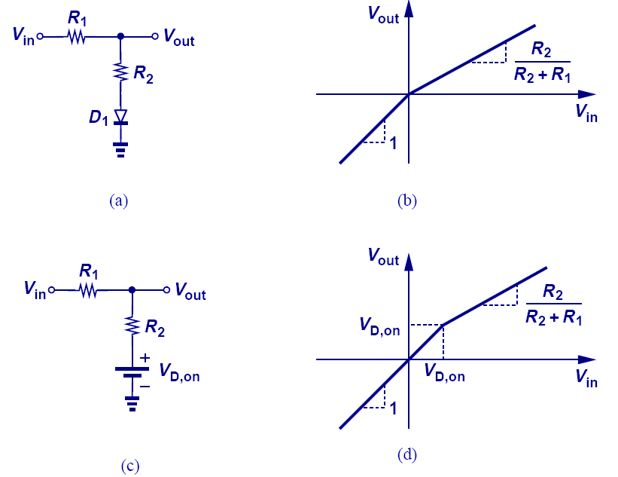
MORE: Input / Output Characteristics

Slide 47
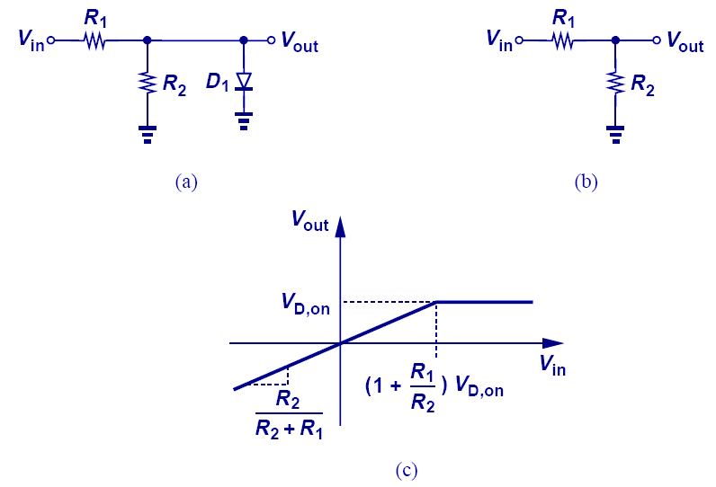
MORE: Input / Output Characteristics (Study and understand )
Constant voltage drop

Slide 48
Try it yourself

Slide 49
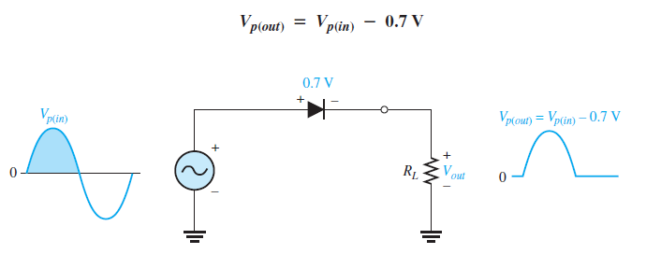
Effect of barrier potential

Slide 50
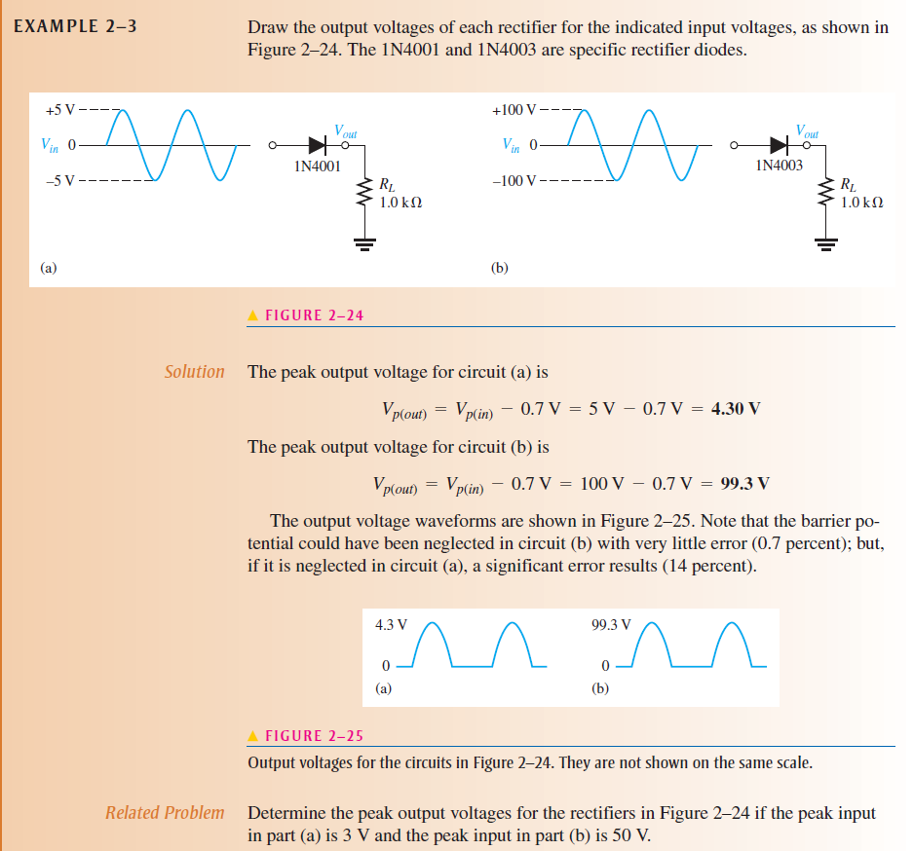
Draw the out put of each rectifier circuits shown below
When we should cater for this drop in our calculations

Slide 51
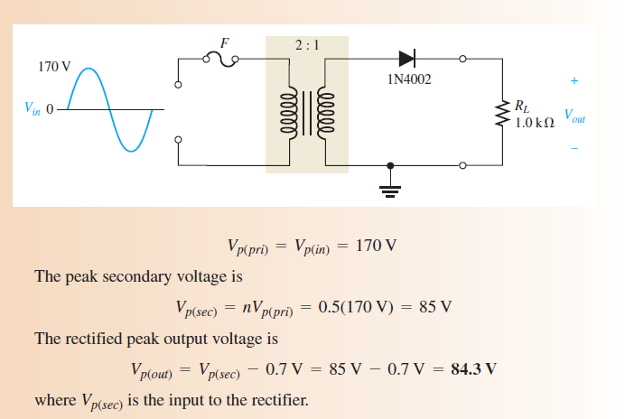
Example: Rectifier with a step down transformer

Slide 52
Review
SNo | v | I in terms of Is
Temperature Dependency

Slide 53

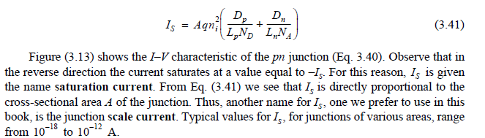
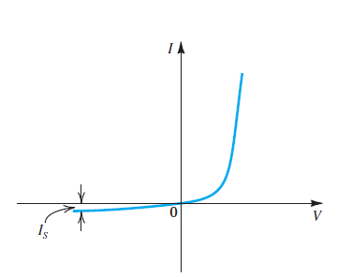
What is
Review
Observe that in the reverse direction the current saturates at a value equals to – . For this reason is given the name saturation current. As is directly proportional the cross-sectional area A of the junction . Thus another name for is the junction scale current. The typical value of is in range of

Slide 54
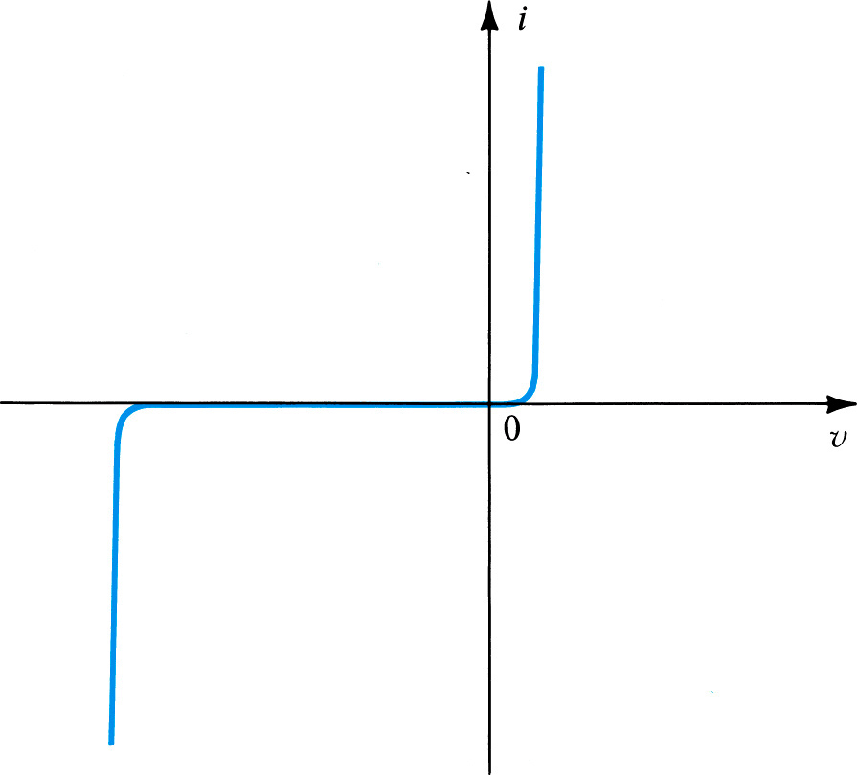
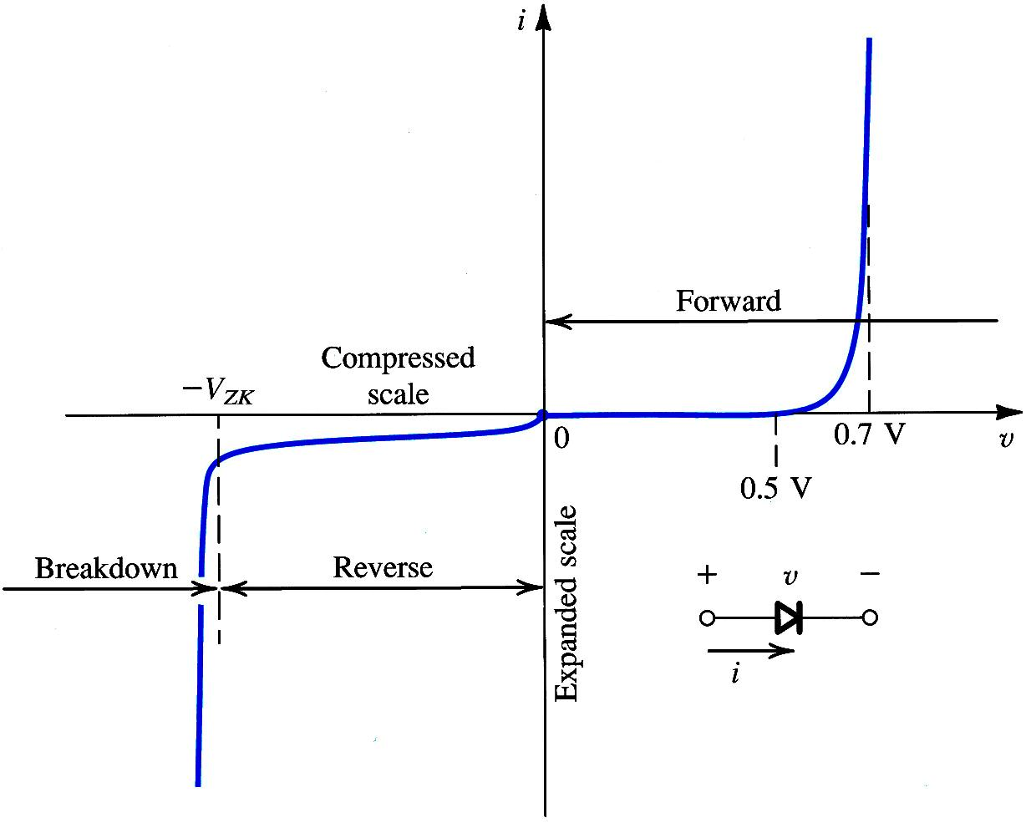


Diode V-I Characteristics
-
+

