Slide 1


Slide 2
Chapter 4-4

Slide 3
Rectifier Circuits

Slide 4
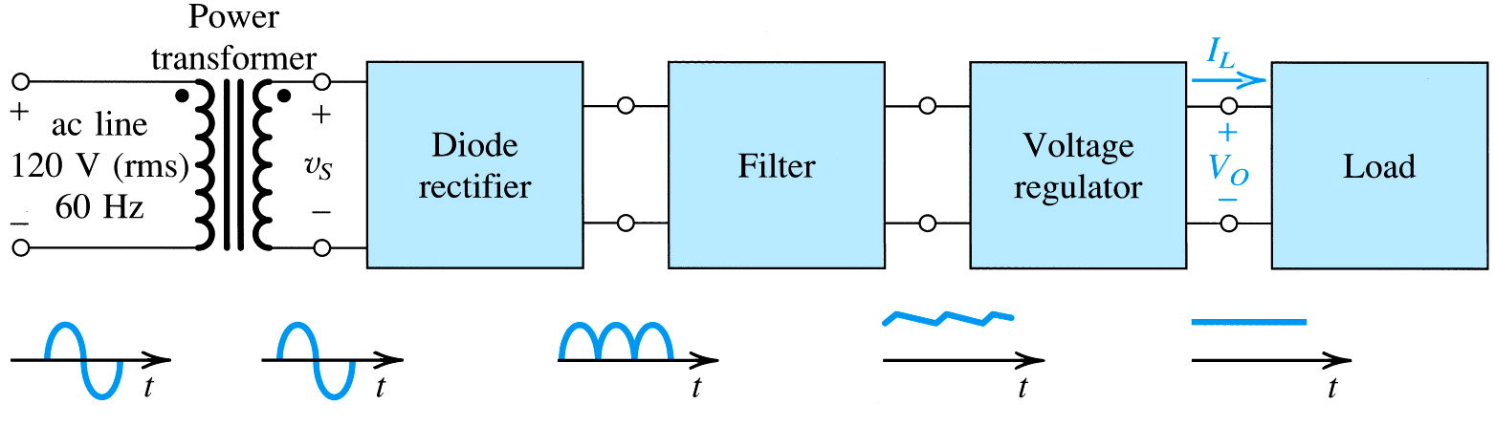
DC Power Supply: Block Diagram
Rectifier converts input sinusoid to a unipolar pulsating DC output
Regulator reduces the ripples and stabilizes the DC output against the changes caused by variations in the load current
Transformer used for stepping down and isolation
Filter reduces variations in the output
Diode rectifier is an essential building block of DC power supply

Slide 5
Now see what options do we have for this block and what are merits and demerits of each
Half-wave rectifier
Full-wave rectifier
Center-taped
Bridge rectifier

Slide 6
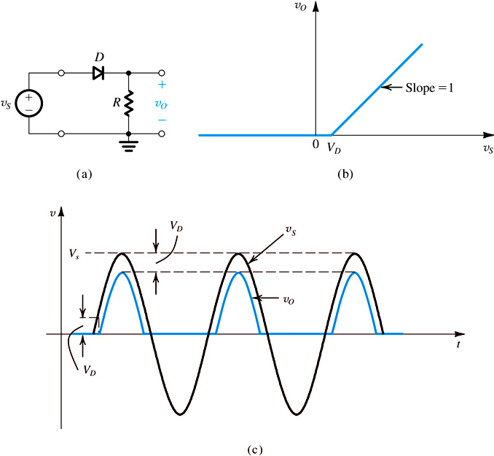
Half Wave Rectifier (HWR) (Here we are using constant voltage drop model)
(a) Half-wave rectifier circuit .
(b) Transfer characteristic
(c) Input and output waveforms.

Slide 7
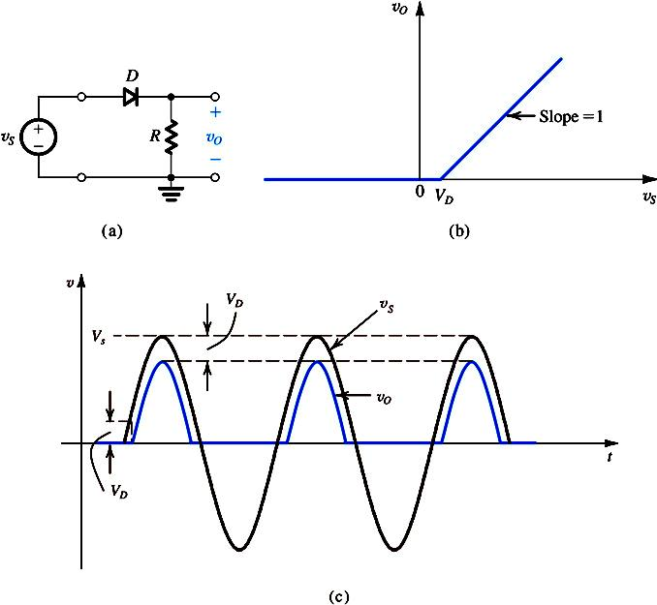
Half Wave Rectifier (Cont’d)

Slide 8
Half Wave Rectifier (Cont’d)

Slide 9
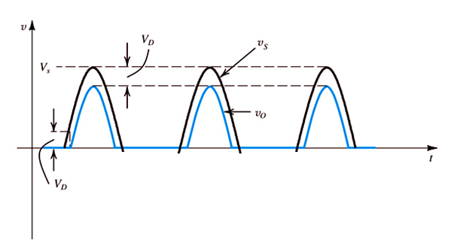
With inclusion of a Capacitor
in the circuit
Capacitor charges
Capacitor discharges

Slide 10
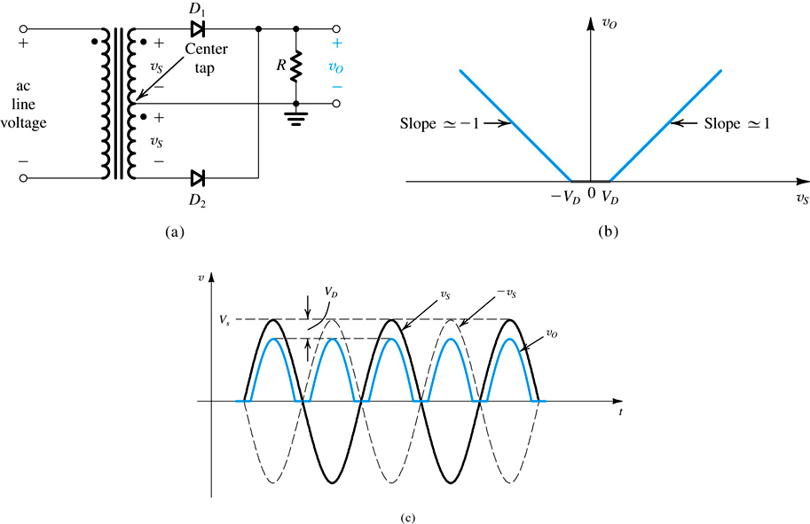
Full Wave Rectifier (FWR)
Full-wave rectifier circuit utilizing a transformer with a center-tapped secondary winding:
Transfer characteristic ,assuming a constant-voltage-drop model for the diodes;
Input and output waveforms.

Slide 11
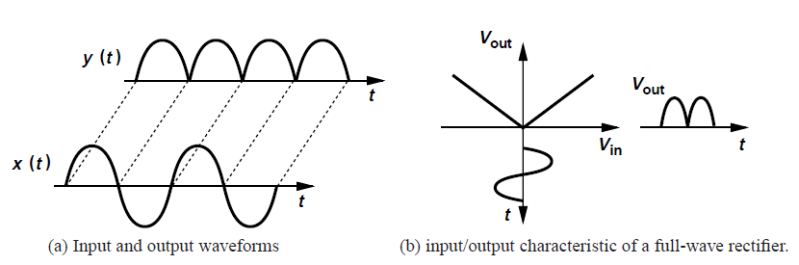
Ideal Diode model

Slide 12
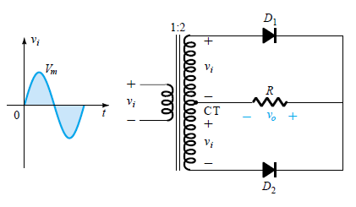
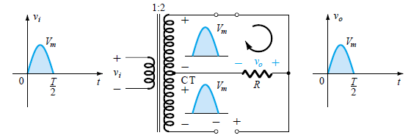
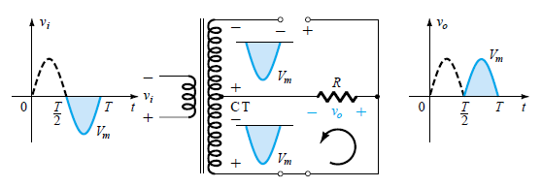
Working Principle of center-taped Full-wave rectifier
During the positive input voltage cycle diode D1
Conducts,
During the negative input voltage cycle diode D2
Conducts,
The direction of current flow through the resistor
for both cycle is same

Slide 13
Full Wave Rectifier (Cont’d)

Slide 14
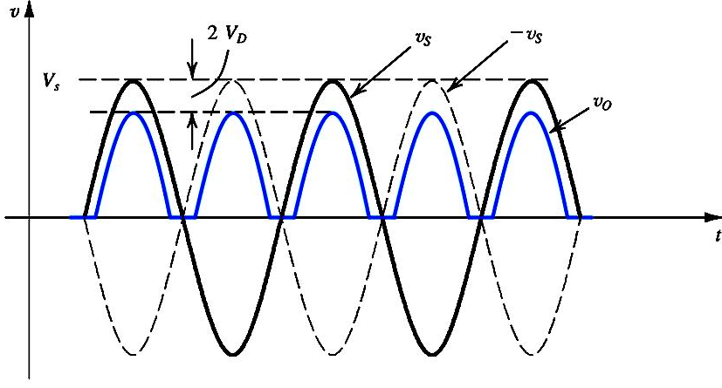

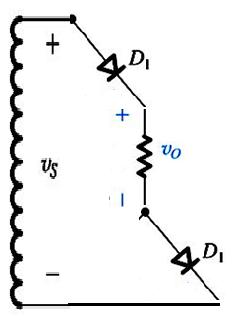


The Bridge Rectifier
$$v_{s}=2V_{D}+v_{o}$$
$$v_{o}=−2V_{D}+v_{s}$$

Slide 15
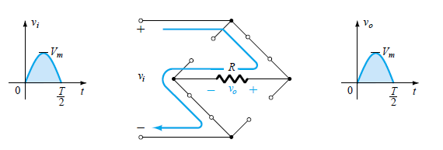
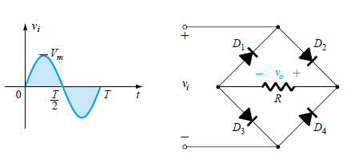
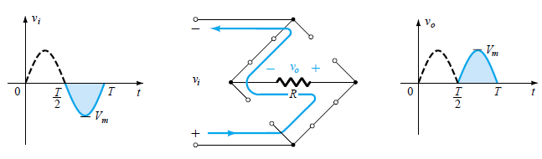
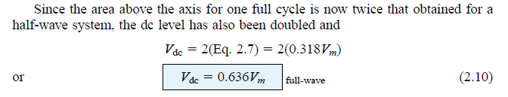
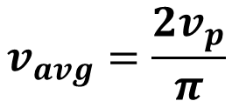
Working Principle of Bridge-diode
Full-wave rectifier
$$v_{avg}=\frac{2v_{p}}{π}$$

Slide 16
The Bridge Rectifier(Cont’d)

Slide 17
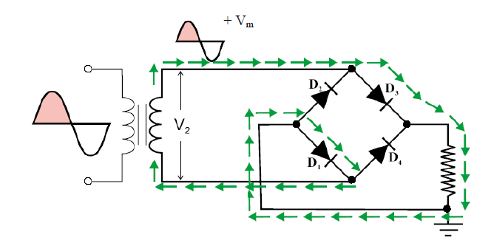
Animations

Slide 18
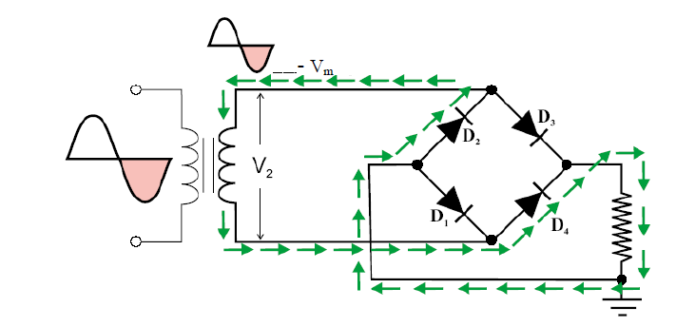
Animations

Slide 19
Animations

Slide 20
Advantage and disadvantages
The dc value of a sine wave is zero
Rectifiers converts ac to dc
In half wave rectifier half of the cycle is lost But PIV is less
In full wave rectifier with two diodes, the problem of half cycle lost is solved, but he PIV has increased
Full wave rectification using bridge rectifier reduces the PIV and a centered taped transformer is not required, but in each cycle two diodes are in series so the voltage drop equals 2 time the barrier voltage
The transformer of bridge diode requires half the turns as compared to center-taped transformer

Slide 21
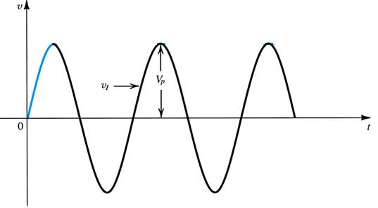
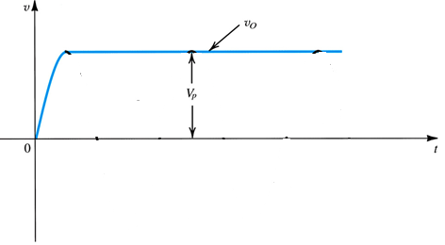
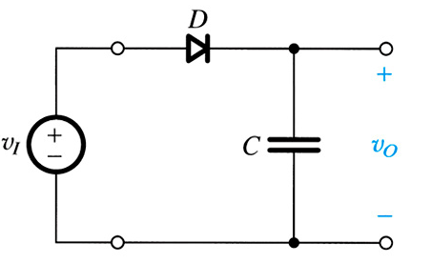
Peak Rectifier or a Peak Detector
ideal diode assumption
The circuit provides a dc voltage equal to the peak of the input sine wave

Slide 22
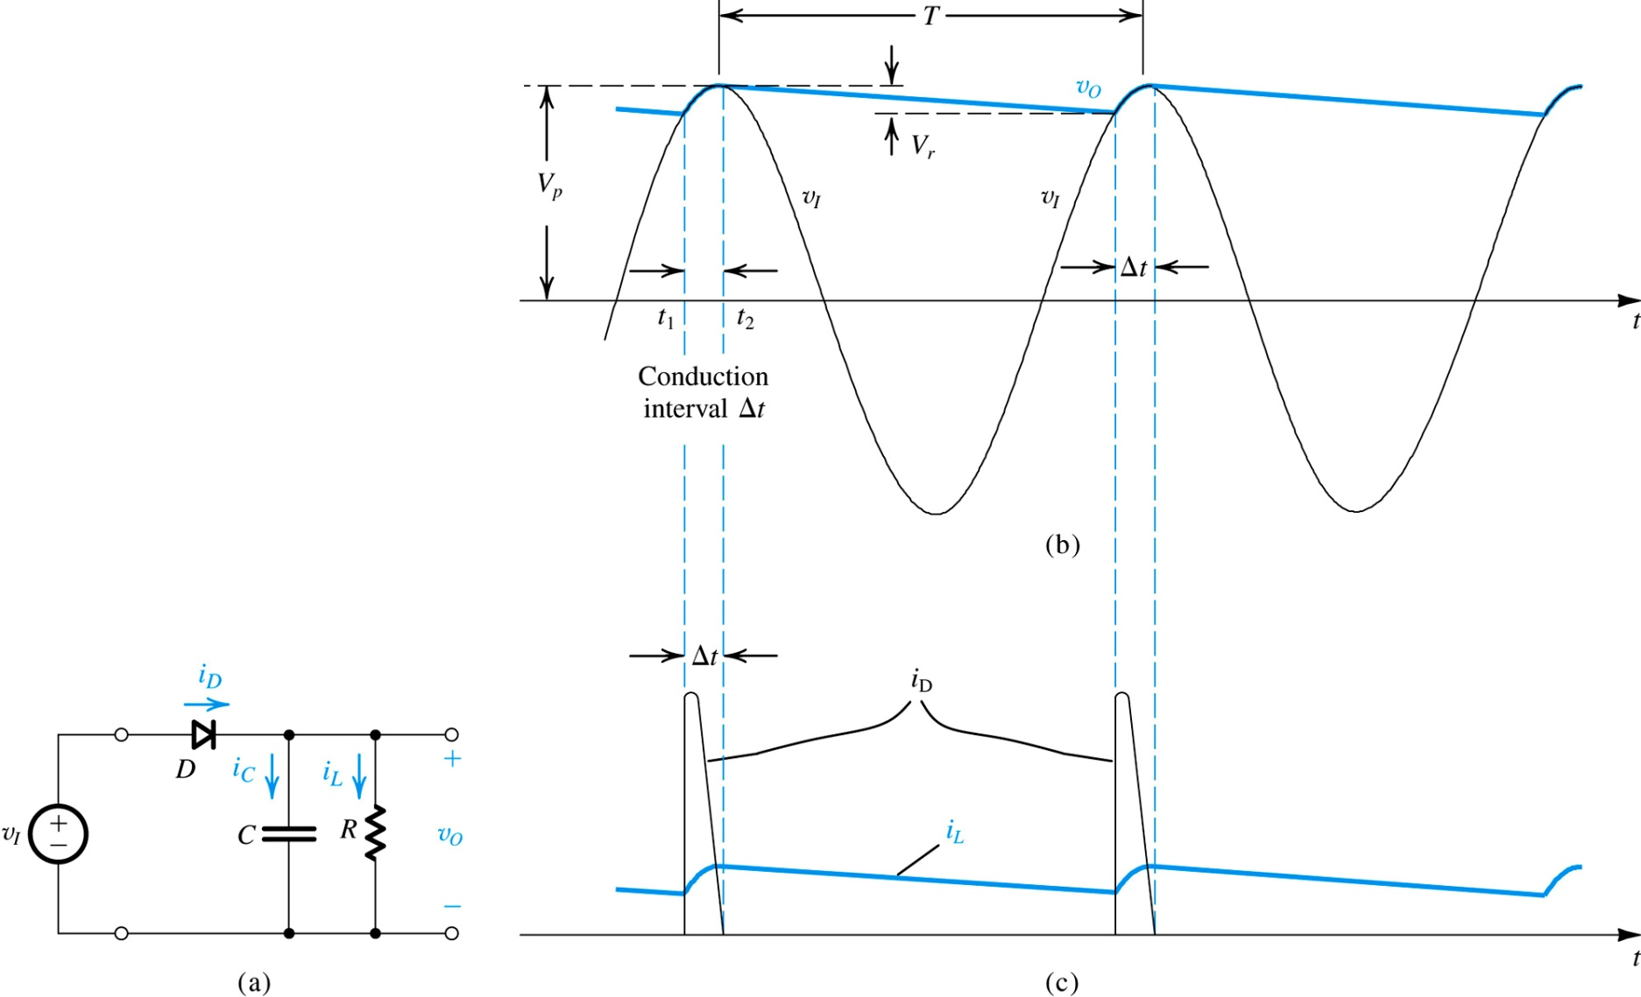

Peak Rectifier
Load resistance R is connected across the capacitor C
As CR >> T
$$v\left(t\right)=V_{O}\left(1−\frac{t}{RC}\right)$$

Slide 23







For
$${V_{P}−V}_{r}≈V_{P}×\left(1−T/{CR}\right)$$
Diode conducts for time interval ∆t
Replenish the capacitor charge
During capacitor discharge , v_{o} decays exponentially

Slide 24







The conduction interval ∆t ??
For small angle

Slide 26
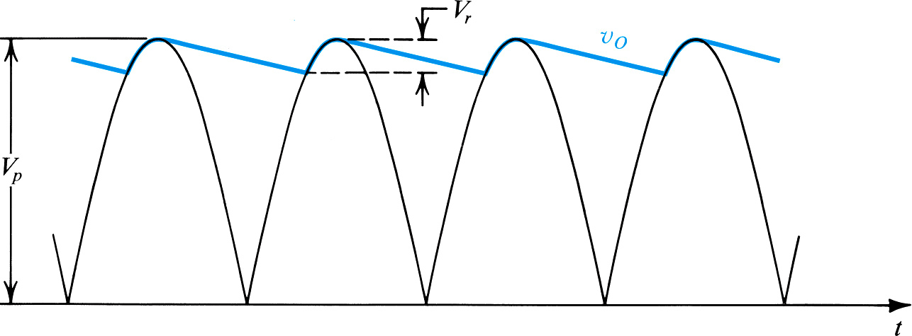



HWR
FWR
For the same values of V_{p}, f, R, V_{r} and I_{L}, we need a capacitor half the size of that required in the half-wave rectifier: Or the ripple voltage is half in full wave rectifier with same C and R

Slide 27





Example 4.8
Consider a peak rectifier fed by a 60-Hz sinusoid having a peak value Vp = 100 V. Let the load resistance R = 10 kΩ.
Find the value of the capacitance C that will result in a peak-to-peak ripple of 2 V. Also, calculate the fraction of the cycle during which the diode is conducting and the average and peak values of the diode current.
Solution
Diode conducts for 3.18% of the cycle

Slide 28
Assignment 3 Submit on Friday 1st April

Slide 29
Assignment3-Q1
Consider a bridge-rectifier circuit with a filter capacitor C placed across the load resistor R for the case in which the transformer secondary delivers a sinusoid of 12 V (rms) having a 60-Hz frequency and assuming V_{D} = 0.8 V and a load resistance R = 100 Ω.
Find the value of C that results in a ripple voltage no larger than 1 V peak-to-peak.
What is the dc voltage at the output?
Find the load current.
Find the diodes’ conduction angle.
Provide the average and peak diode currents .
What is the peak reverse voltage across each diode?
Specify the diode in terms of its peak current and its PIV.

Slide 30
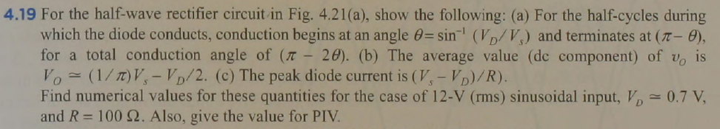
Assignment 3 –Q2

Slide 31
Limiter Circuits

Slide 32
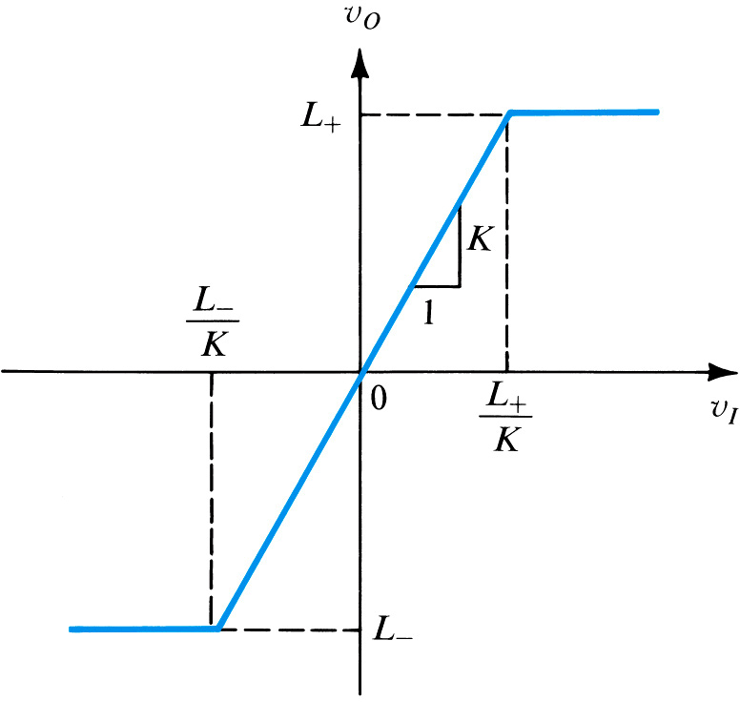
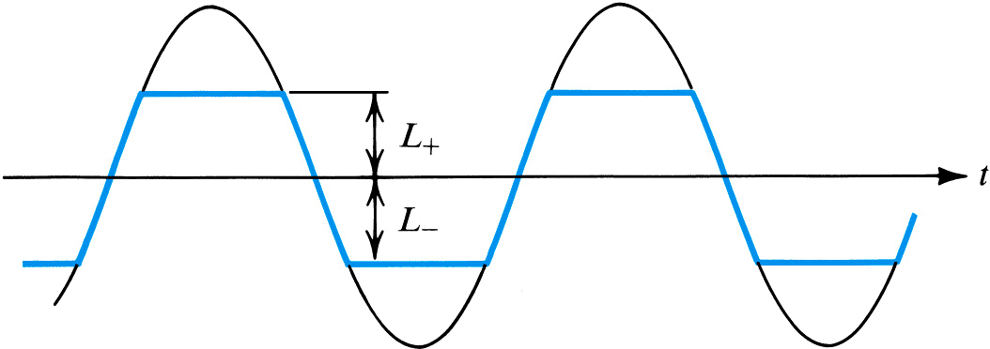
Transfer characteristic of a limiter circuit
L₋ / K ≤ v_{I} ≤ L₊ ⁄ K
v_{O} = Kv_{I}
If v_{I} exceeds the upper threshold , v_{O} is limited to the upper limiting level L₊
If v_{I} is reduced below the lower threshold , v_{O} is limited to the lower limiting level L₋

Slide 33
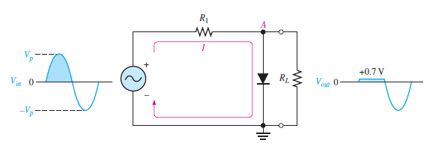

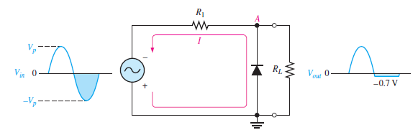
Assuming Constant Voltage drop model
Upper threshold = ??
If R₁ is small compared to R_{L}, then
Lower threshold = ??

Slide 34
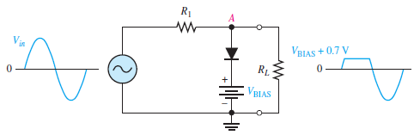
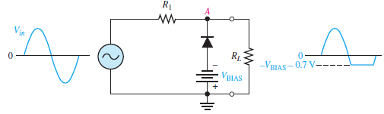
Upper threshold = ??
Lowe threshold = ??

Slide 35
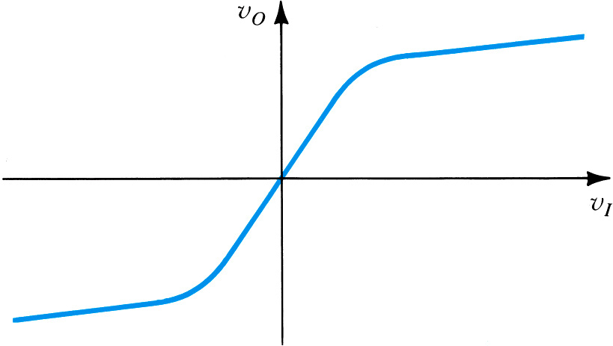
Soft limiting
Hard limiter

Slide 36
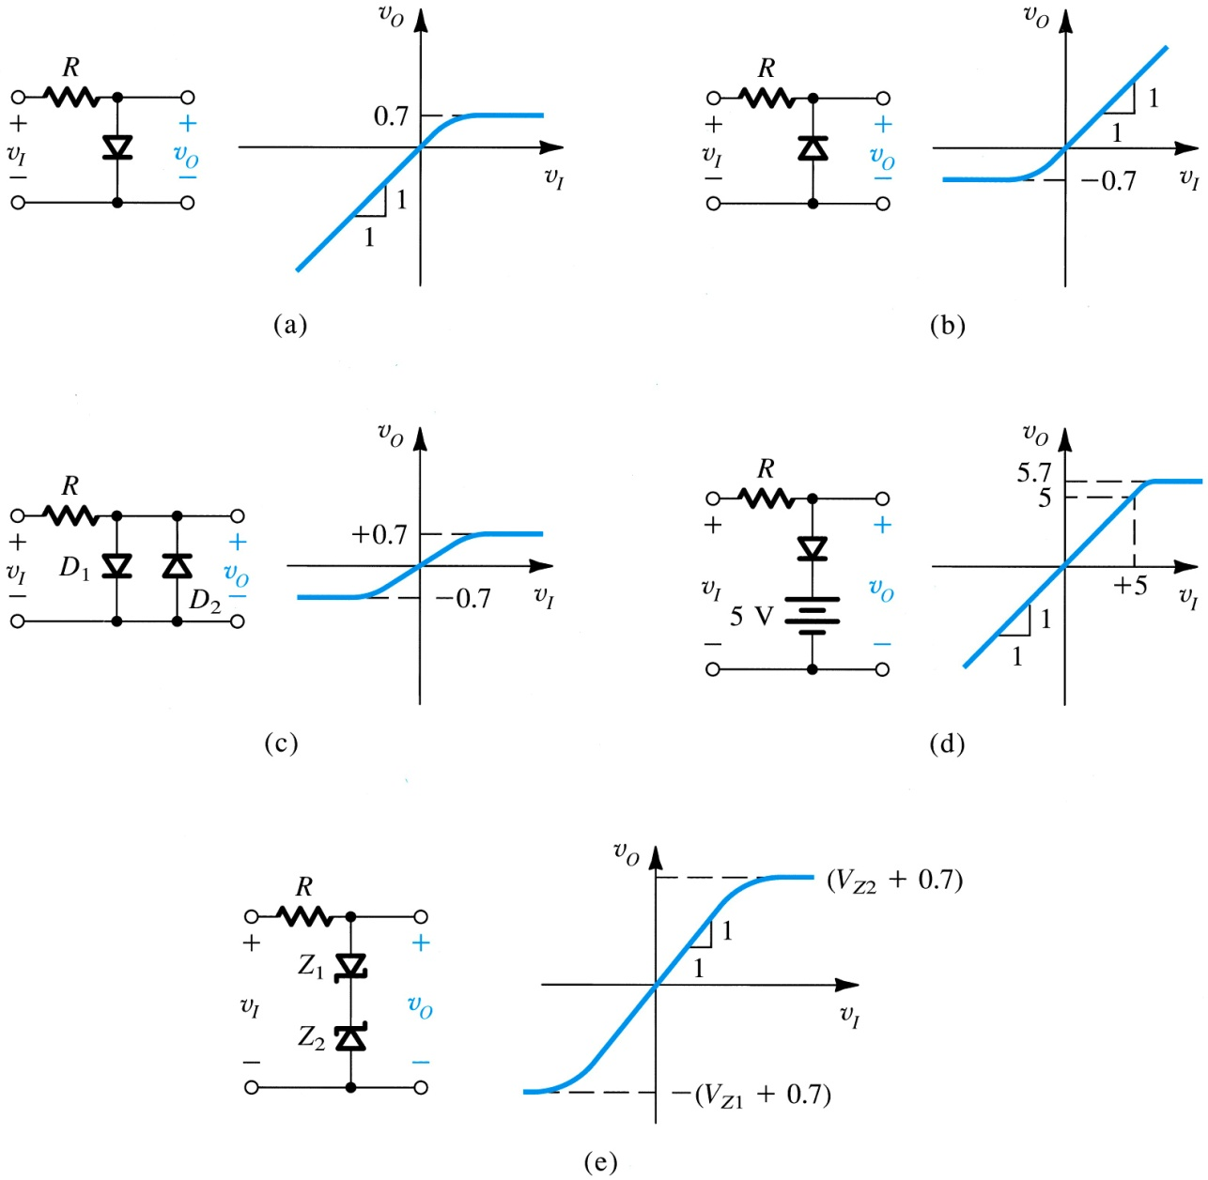
Examples of Clipping Circuits

Slide 37
Examples of Clipping Circuits

