Slide 1


Slide 2
The Clamped Capacitor or DC Restorer

Slide 3
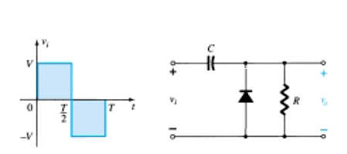
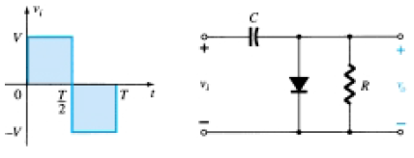
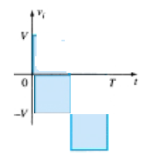
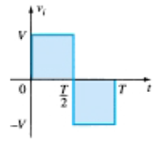
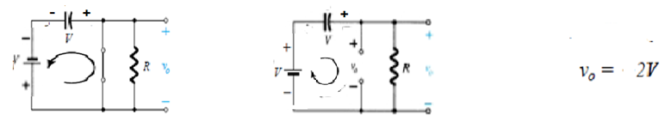
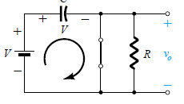
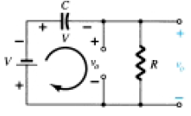


clampers
The clamping network is one that will “clamp” a signal to a different dc level.
The network must have a capacitor, a diode, and a resistor element ,
but it can also employ an independent dc supply to introduce an additional shift
The magnitude of R and C must be chosen such that the time constant $τ=RC$is large
enough to ensure that the voltage across the capacitor does not discharge significantly during
the interval the diode is non conducting

Slide 4
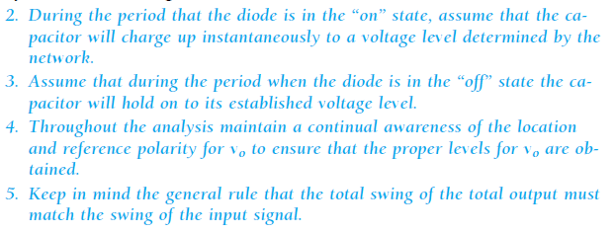
Analysis steps for clamping circuits

Slide 5
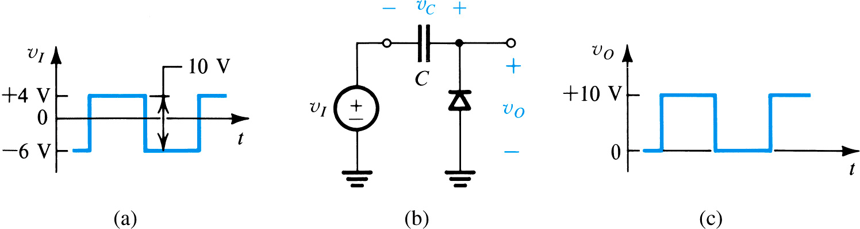
The dc component or average value of a pulse waveform is an effective measure of its duty cycle

Slide 6
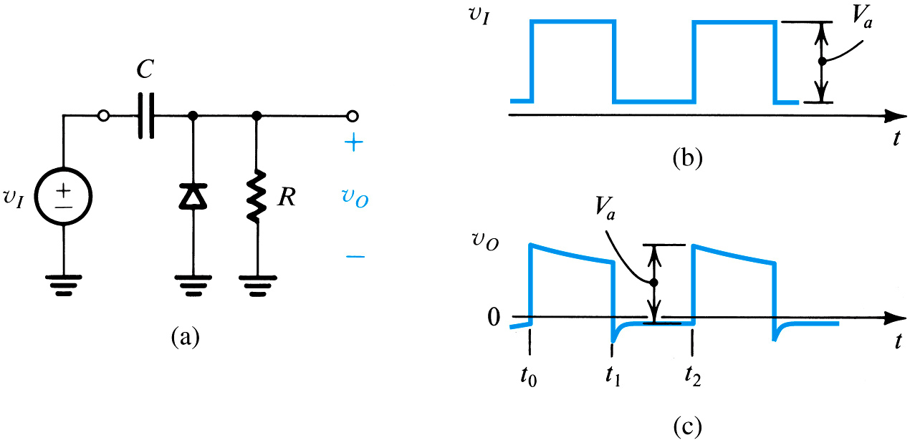
Effect of a load resistance R connected across the diode in a clamping circuit

Slide 7

Voltage Multiplier

Slide 8

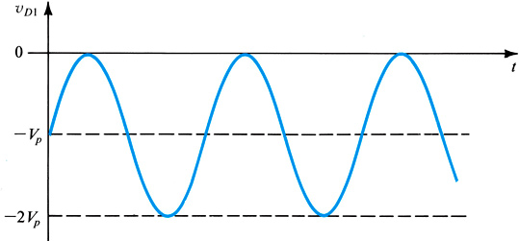
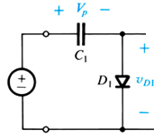





Some basics Concepts
$$v_{o}=0$$
$$C_{1}$$
$$\frac{V_{O}}{V_{in}}=\frac{C_{1}}{C_{1}+C_{2}}$$
$$C_{2}$$
$$v_{o}$$

Slide 9
The Voltage Doubler
A voltage doubler is an electronic circuit that produces an output voltage that is double the input voltage. It is a voltage multiplier with a voltage multiplication factor equal to 2.
The circuit is formed by an oscillating AC input voltage, two capacitors, and two diodes. The input voltage is AC, and the output is DC voltage with twice the peak value of the input AC voltage.

Slide 10
The Voltage Doubler
Half-wave Voltage Doubler
Full-wave Voltage Doubler

Slide 11
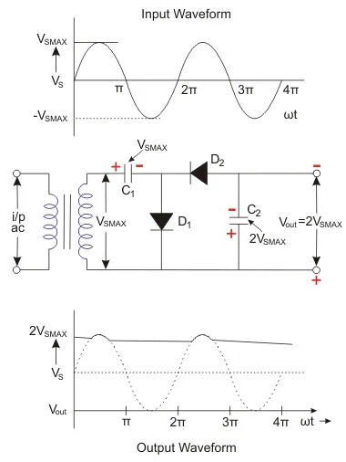
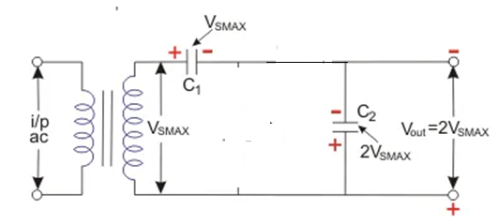
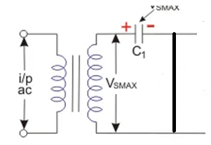
All over the positive half cycle of the AC sine wave, the first diode (D₁) is conducting. That is a forward biased state, and it will charge the connected capacitor (C₁) equal to the peak value of AC secondary voltage of transformer (V_{SMAX}).
Check polarity
This capacitor is unable to get discharged due to the unavailability of a path. So, it will remain in a fully charged condition.
Next, all over the negative half cycle, the second diode (D₂) is conducting or forward biased state, and the first diode (D₁) is non-conducting or in the reversed biased state.
The reversed biased diode (D₁) will block the discharging of the connected capacitor (C₁), and the forward-biased diode (D₂) will charge the connected capacitor (C₂)

Slide 12
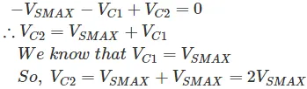
Here we can apply Kirchhoff’s voltage law to the outer loop, which starts from the bottom of the secondary of the transformer (the lower end is negative and the top end is in positive polarity) in the clockwise direction.
That is the voltage across the capacitor; C₂ will be equal to two times the peak value of input transformer secondary voltage (2V_{SMAX}).
Throughout the next positive half cycle of AC input, the second diode (D₂) will be open due to the reversed biased condition. So, the second capacitor (C₂) will get discharged through the load and the output voltage (V_{out}) < 2V_{S MAX}.

Slide 13
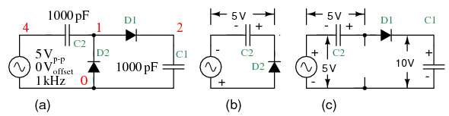
Now Example for a positive DC output

Slide 14
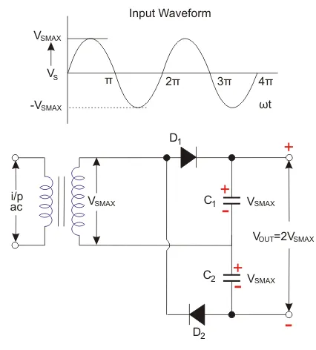
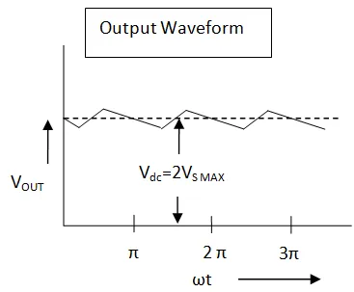
Full Wave Voltage Doubler
In this doubler, right through the positive cycle of input AC voltage, the first diode (D₁) is in the conducting state. That is a forward biased state, and it will charge the connected capacitor (C₁) equal to the peak value of AC secondary voltage of transformer (V_{SMAX}).
At this time, D₂ will be in reverse biased condition or non-conducting state. Throughout the negative cycle of input AC voltage, the second diode (D₂) will be in forwarding biased state, and the second capacitor (C₂) gets charged.
In the no-load condition, the entire voltages of two capacitors are delivered as the output voltage.
If there is some load connected across the output terminals, then output voltage (V_{out}) < 2V_{S MAX}.

Slide 16
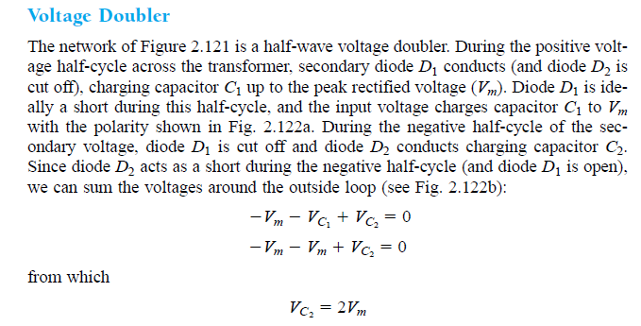
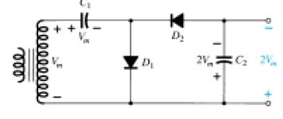
Text book reference
Check polarity

Slide 17
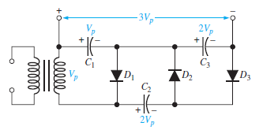
Voltage Tripler

Slide 18
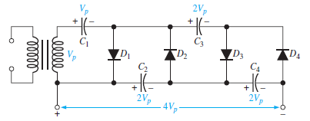
Voltage Quadrupler

Slide 19
Advantages of Voltage Doubler
Can replace the expensive and heavy transformers.
Negative voltage can also be created by reversing the polarity of the connected diodes and capacitors.
Can increase the voltage multiplication factor by cascading the similar voltage multipliers

Slide 20
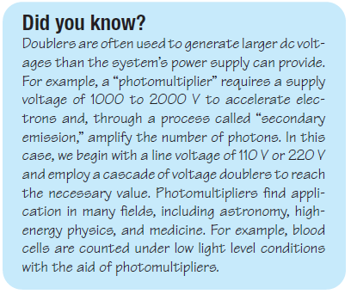

Slide 21
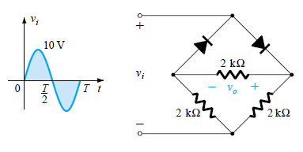
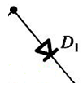


Example-Q1. Determine the output wave form for the following circuit and calculate output dc level
2k
$$v_{o}$$
2k
2k

Slide 23
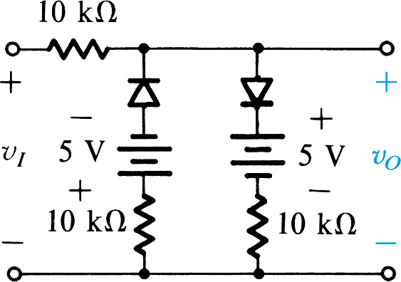
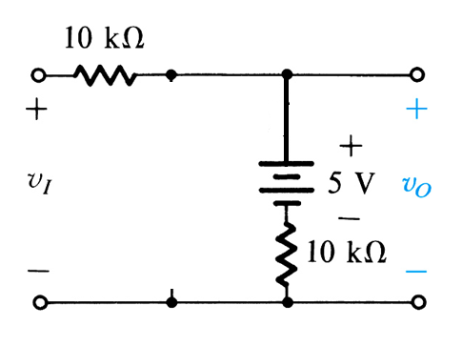
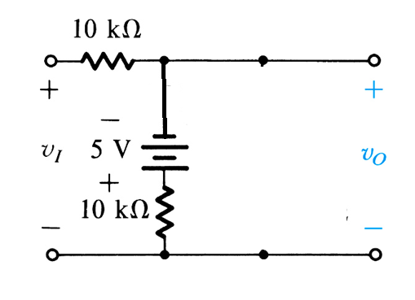
Assuming the diodes to be ideal, describe the transfer characteristic of the circuit shown in Fig. Prove by writing equations
Hint: Try using super-position

Slide 24
Some Special diodes types

Slide 25
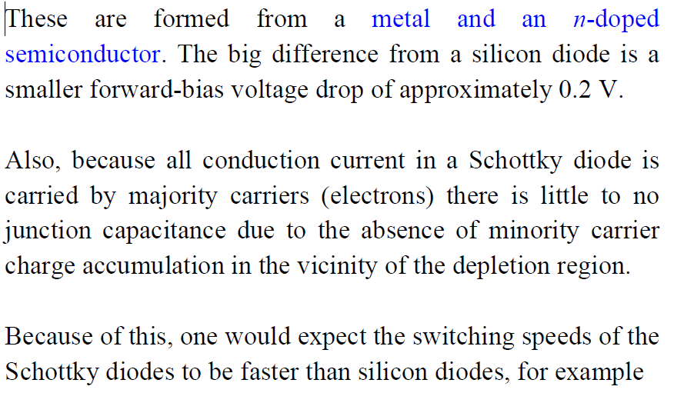
Schottky Barrier diode

Slide 26
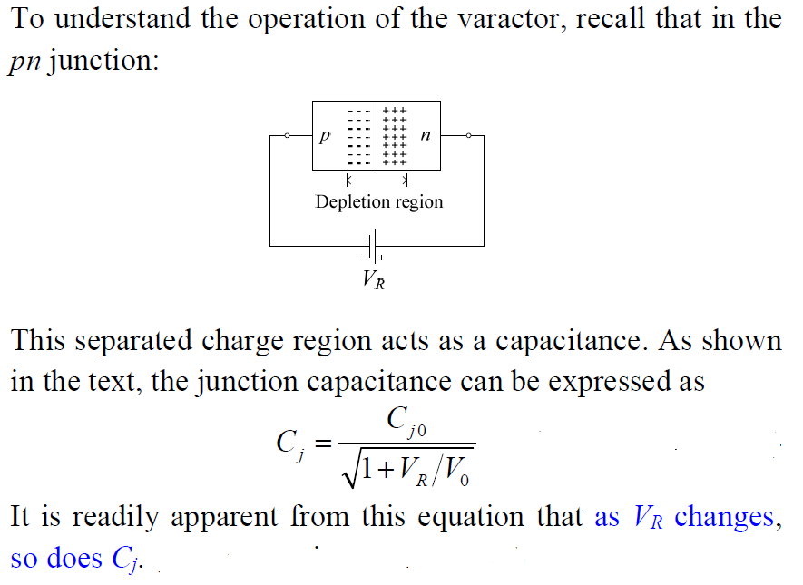
VARACTOR DIODE

Slide 27
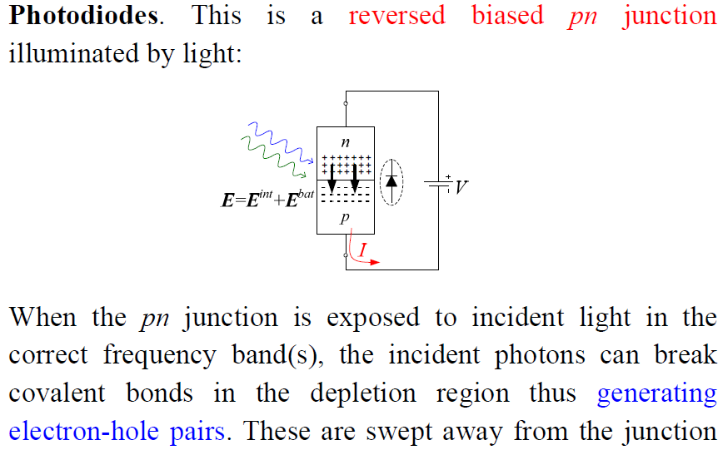
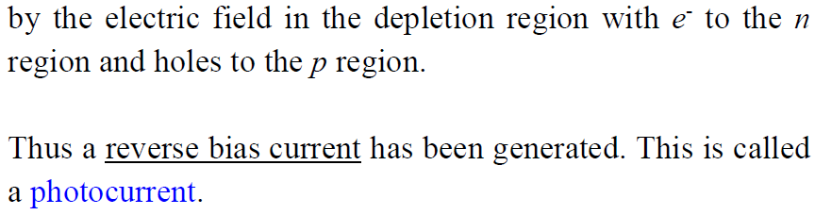

Slide 28
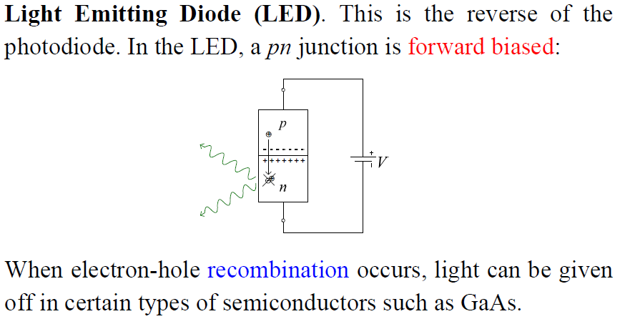

Slide 29
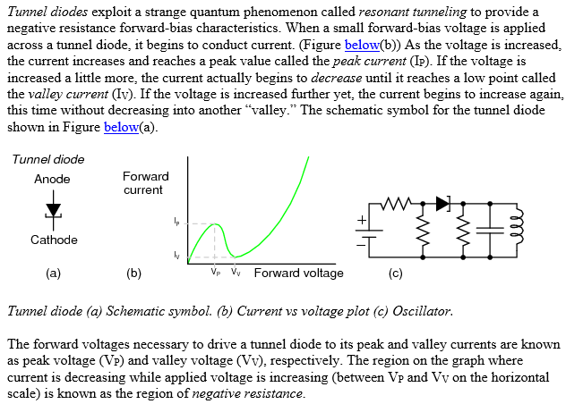

Slide 30


Slide 31
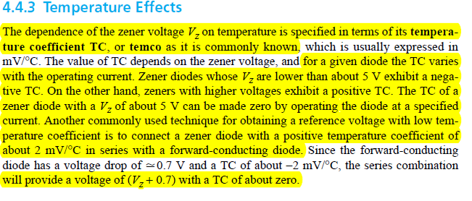

Slide 32
Thank you

