Slide 1


Slide 2
MOSFET

Slide 3
Topics in Chapter No 5- MOSFET
The physical structure of the MOS transistor and how it works
2. How the voltage between two terminals of the transistor controls the current that flows through the third terminal, and the equations that describe these current–voltage characteristics.
3. How to analyze and design circuits that contain MOS transistors, resistors, and dc sources.
4. How the transistor can be used to make an amplifier, and how it can be used as a switch in digital circuits
5. How to obtain linear amplification from the fundamentally nonlinear MOS transistor
6. The three basic ways for connecting a MOSFET to construct amplifiers with different properties
7. Practical circuits for MOS–transistor amplifiers that can be constructed using
discrete components.
Biasing in MOS Amplifier Circuits
Discrete-Circuit MOS Amplifiers

Slide 4
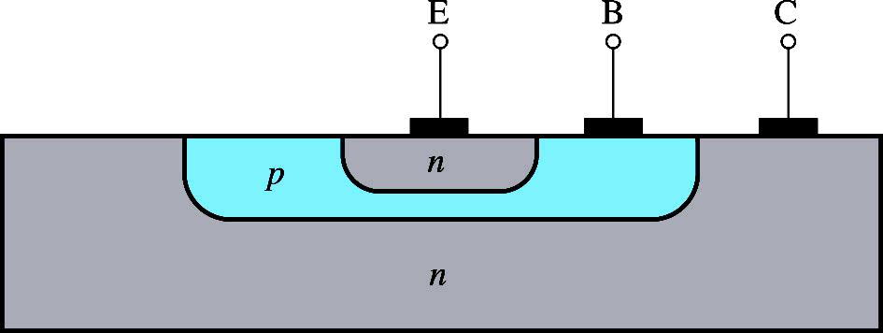
BJT Cross Sectional View
Recall BJT
Note that the collector is very large and virtually surrounds the base- emitter region thus no electrons escapes from being collected here.
This makes α very close to unity
The device is not symmetrical so emitter and collector cannot be interchanged.

Slide 5
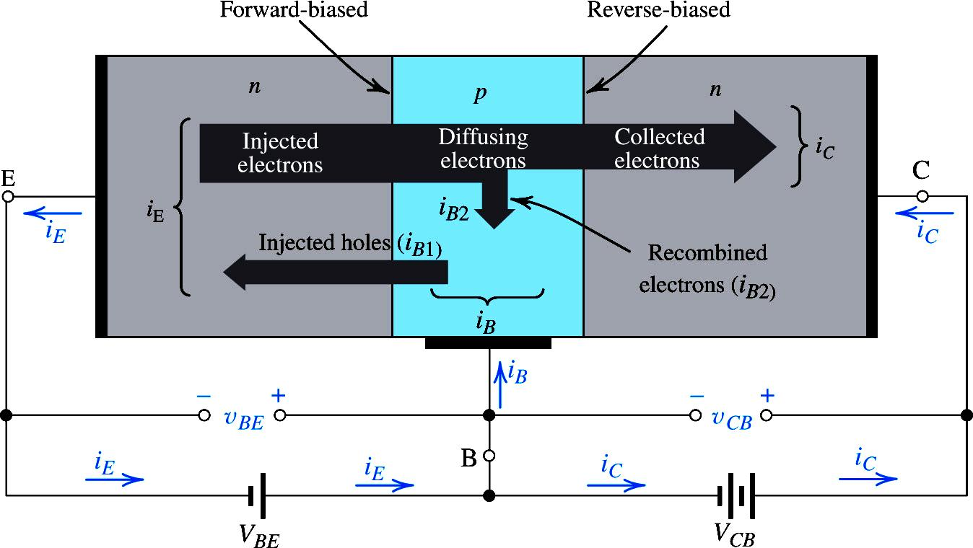
Current as a result of both Holes and Electrons. That is why referred to as Bipolar

Slide 6
Introduction
Compared to BJTs, MOSFETs can be made quite small
Manufacturing process is relatively simple .
Operation requires comparatively little power.
All of these properties have made it possible to pack large numbers of MOSFETs (as many as 5 billion!) on a single IC chip to implement very sophisticated, very-large-scale-integrated (VLSI) digital circuits such as those for memory and microprocessors.
Analog circuits such as amplifiers and filters can also be implemented in MOS technology.

Slide 7
Introduction
Here again we want to construct some sort of voltage dependent current source, pass this current through a resistor and get amplified voltage

Slide 8
Concept Building
Channel of free charges formed
+++
+++
+++
+++
+++
+++
+++
+++
- - - - - - - - - - - - - - - - - - - - - - - - - - - - - - -- - - - - ------
P

Slide 9
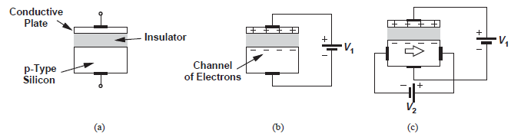
Hypothetical semiconductor device
(b) operation as a capacitor (c) current flow as a result of potential difference.
The density of electrons in the channel varies with V1, as evident from Q = CV, where C denotes the capacitance between the two plates.

Slide 10
The dependence of the electron density upon V1 leads to an interesting property: if, we allow a current to flow from left to right through the silicon material, V1 can control the current by adjusting the resistivity of the channel.
Note that the current prefers to take the path of least resistance, thus flowing primarily through the channel rather than through the entire body of silicon. This will serve our objective of building a voltage-controlled current source
Equation Q = CV suggests that, to achieve a strong control of Q by V, the value of C must be maximized, for example, by reducing the thickness of the dielectric layer separating the two plates.
Some sort of voltage control current source , being conceived
The foregoing thoughts lead to the MOSFET

Slide 11
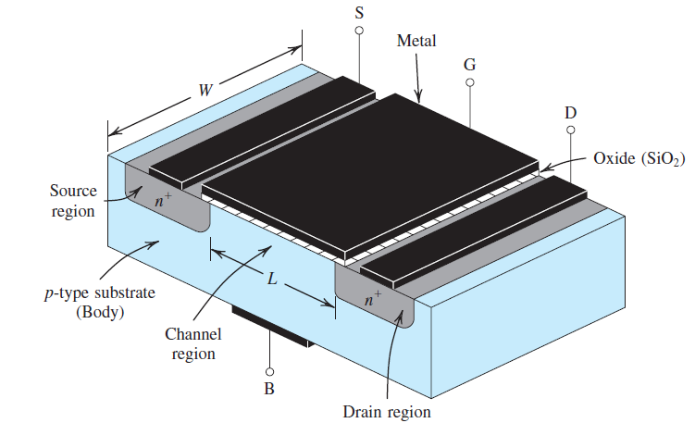
Device Structure

Slide 12
Device Structure
The transistor is fabricated on a p-type substrate.
Two heavily doped n-type regions, called source and the drain , are created in the substrate.
A thin layer of silicon dioxide (SiO2,which is an excellent electrical insulator) is grown on the surface of the substrate, covering the area between the source and drain regions.
Metal is deposited on top of the oxide layer to form the gate electrode of the device. Metal contacts are also made to the source region, the drain region, and the substrate, also known as the body
Thus four terminals are brought out: the gate terminal (G), the source terminal (S),the drain terminal (D), and the substrate or body terminal (B)
Unlike BJT, MOSFET are symmetric device meaning source and drain can be interchanged

Slide 13
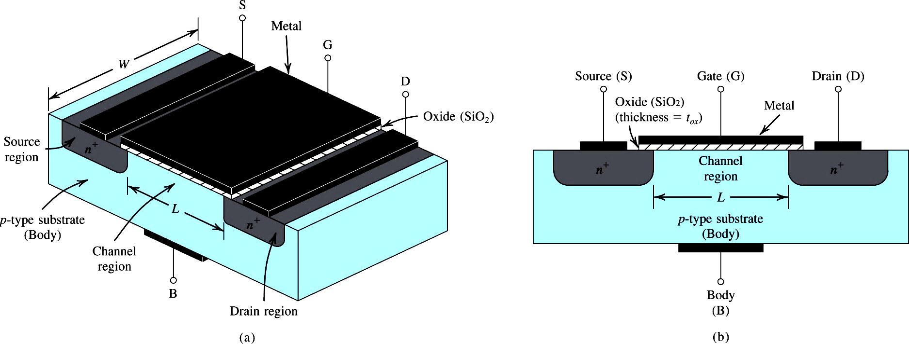

Device Structure

Slide 14
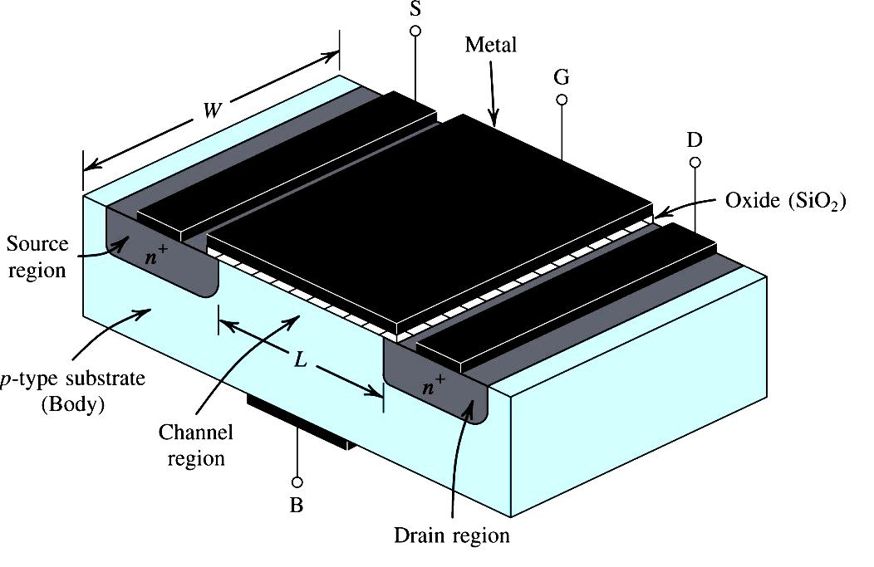
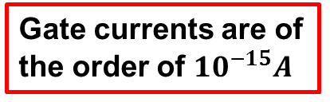

Device Structure
$${another name is IGFET}_{}$$
Gate currents are of the order of ${10}^{−15}A$

Slide 15
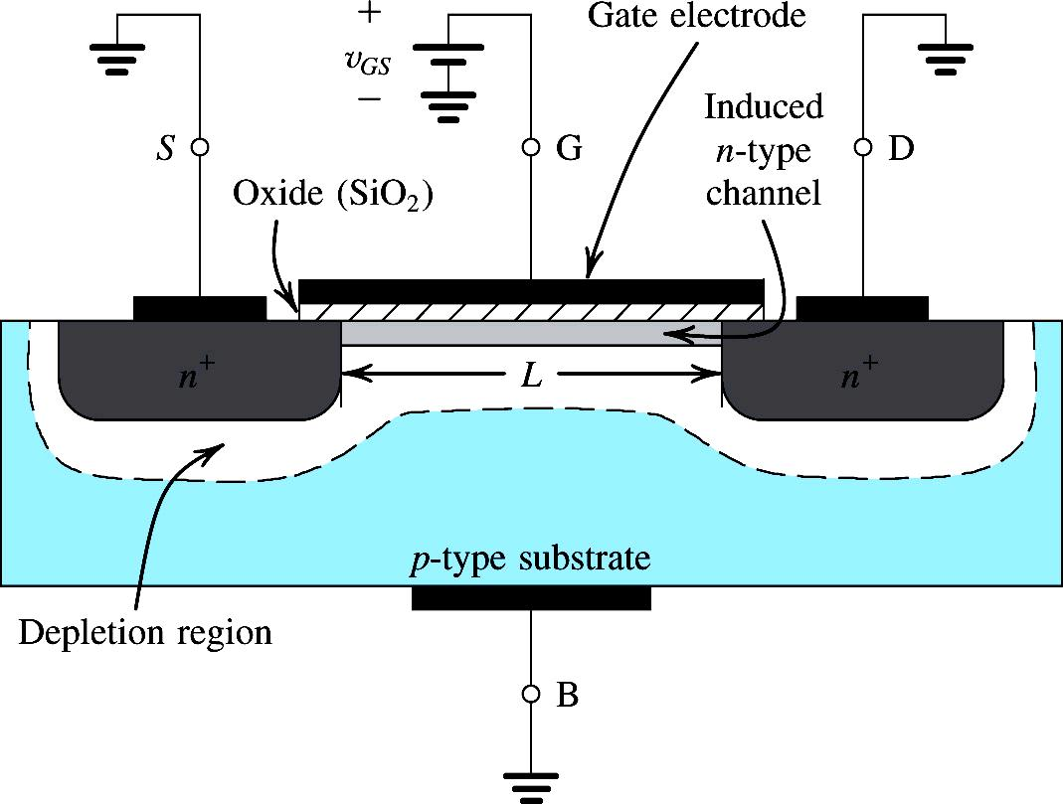

Operation with Zero Gate Voltage
Two back-to-back diodes in series b/w source and drain
No current b/w drain and source on application of v_{DS}
Resistance of the order of 10¹² ohms b/w source and drain

Slide 16
Creating a Channel for Current Flow
When we have grounded the source and the drain and applied a positive voltage to the gate. This gate voltage appears between gate and source and thus is denoted vGS.
The positive voltage on the gate causes, the free holes (which are positively charged) to be repelled from the region of the substrate under the gate (the channel region). leaving behind a carrier-depletion region.
The depletion region is populated by the bound negative charge associated with the acceptor atoms.
These charges are “uncovered” because the neutralizing holes have been pushed downward into the substrate.

Slide 17
Creating a Channel for Current Flow
As well, the positive gate voltage attracts electrons from the source and drain regions (where they are in abundance) into the channel region
When a sufficient number of electrons accumulate near the surface of the substrate under the gate, an n region is in effect created, connecting the source and drain regions
Now if a voltage is applied between drain and source, current flows through this induced n -region, carried by the mobile electrons.

Slide 18
Creating a Channel for Current Flow
Depletion region created under the Gate by pushing away the holes
Electrons are attracted from n+ source and drain regions into the channel
An n-region is created connecting source and drain
The induced channel is n-region, so the transistor is called n-channel MOSFET or NMOS Transistor

Slide 19
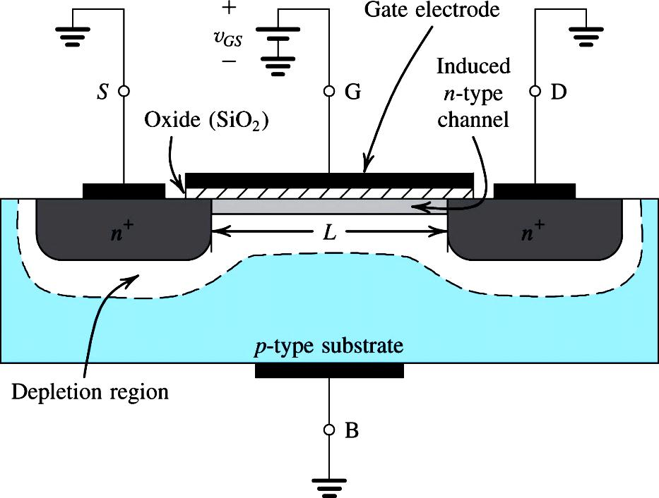
Creating a Channel for Current Flow
The value of V_{t} of a MOSFET is controlled during fabrication
(0.3 V to 1 V)

Slide 20
Creating a Channel for Current Flow
+ + + + + + + + + + + + + + + + + + + + + + + + + +
_ _ _ _ _ _ _ _ _ _ _ _ _ _ _ _ _ _ _ _ _ _
The gate and the channel regions form a parallel-plate capacitor, with
the oxide layer acting as dielectric
A vertical E-field develops that controls the amount of charge in the channel, which determines the channel conductivity and thus the current through the channel when v_{DS} is applied.
the origin of the name “field-effect transistor” (FET)

Slide 21
Creating a Channel for Current Flow

Slide 22
The channel is created by inverting the substrate surface from p
type to n type. Hence the induced channel is also called an inversion layer
The value of at which a sufficient number of mobile electrons accumulate in the channel region to form a conducting channel is called the threshold voltage and is denoted Vt.
The gate and the channel region of the MOSFET form a parallel-plate capacitor. An electric field thus develops in the vertical direction. It is this field that controls the amount of charge in the channel, and thus it determines the channel conductivity and, in turn, the current that will flow through the channel when a voltage vDS is applied.

Slide 23

The voltage across this parallel-plate capacitor, that is, the voltage across the oxide, must exceed Vt for a channel to form.
When VDS = 0 the voltage at every point along the channel is zero, and the voltage across the oxide (i.e., between the gate and the points along the channel) is uniform and equal to VGS .
The excess of is termed the effective voltage or the overdrive voltage and is the quantity that determines the charge in the channel.
Finally, note that as Vov is increased, the magnitude of the channel charge increases proportionately.

Slide 24
After understanding the Physical structure of MOSFET , lets see its Operation

Slide 25
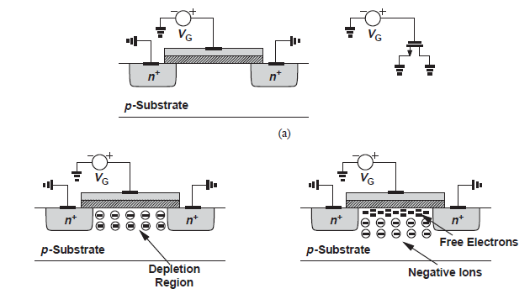
S
When Gate , Source and drain , all are at zero potential then no channel formed between source and drain - No current flow possible
D
When positive voltage applied at Gate only , The holes in the substrate are pushed down , leaving behind negative ions , balancing the positive charges on the top plate
S
D
When Gate potential crosses certain threshold voltage , the electrons from the two heavily doped S & D regions are attracted – the total negative charges i.e. ions and electrons balances the positive charges on the top plate
S
D

Slide 26
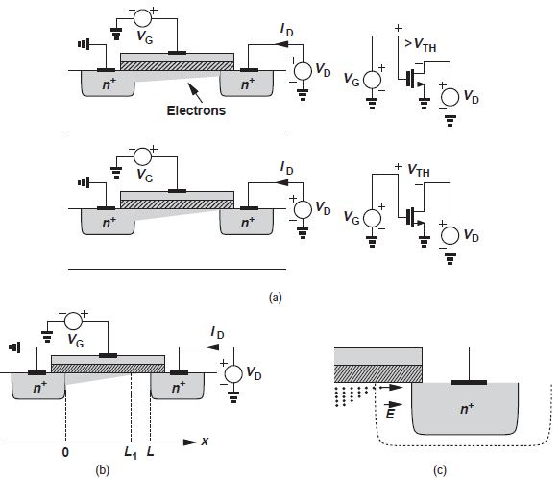

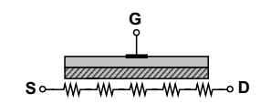
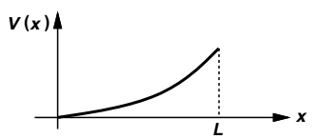
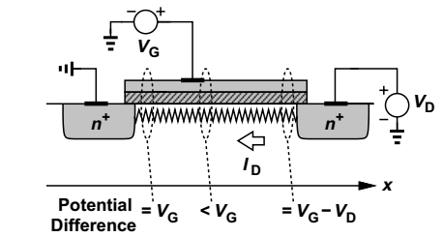
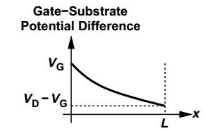


As we increase the potential at the drain , the channel starts to taper
$$Q=C ×V$$
S
$$V_{effective}=V_{G}−V_{x}$$

Slide 27
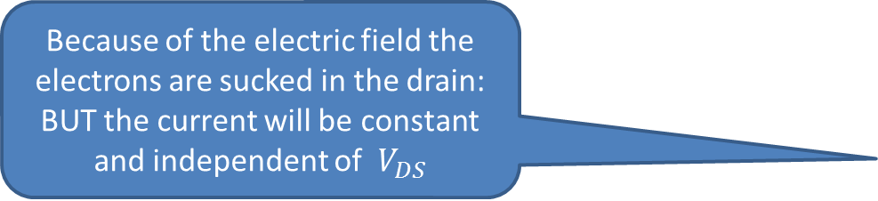

The channel gets tapered
Channel is pinched off
$$V_{DS}≥V_{GS}−V_{TH}$$
Pinch off point shifts to left
Because of the electric field the electrons are sucked in the drain: BUT the current will be constant and independent of $V_{DS}$

Slide 28




Derivation of current equation
Charge on the capacitor is = Capacitance x Voltage applied
$$Q=C ×V$$
$$Total charge=Area ×Capacitance ×Volatge$$
$$Q_{T}=W ×L×C_{ox}×V$$
Charge per unit length is
$$Q_{TL}=W ×C_{ox}×V_{G}$$
$$Q_{TL}=W ×C_{ox}×{(V}_{G}−V_{TH}−V_{x})$$

Slide 29
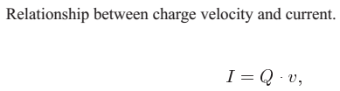
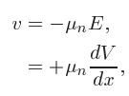



Derivation
Since
L

Slide 30
NEW LECTURE

Slide 31
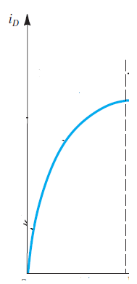

Plotting $i_{D} vs v_{DS}$ Curve
It’s a parabola , what after this point, and how to find peak value of this curve

Slide 32
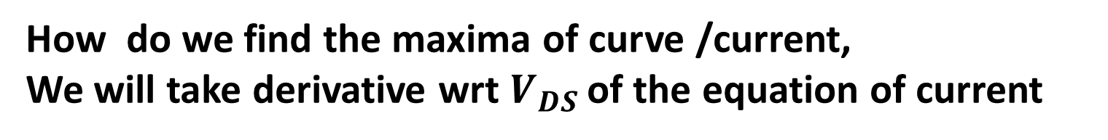
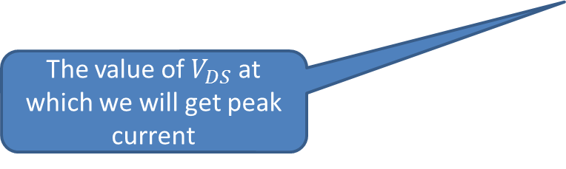
How do we find the maxima of curve /current,
We will take derivative wrt $V_{DS }$of the equation of current
Maximum value of current
The value of $V_{DS}$ at which we will get peak current
The point where the peak current occurs is when $V_{DS }= V_{GS} − V_{TH}= V_{OV}$

Slide 33
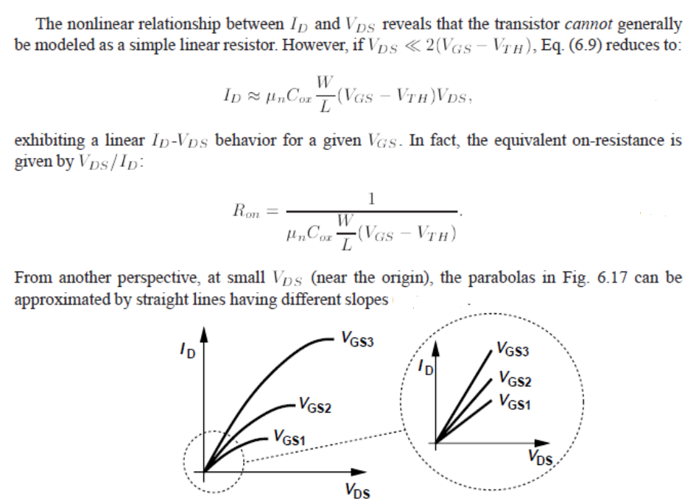
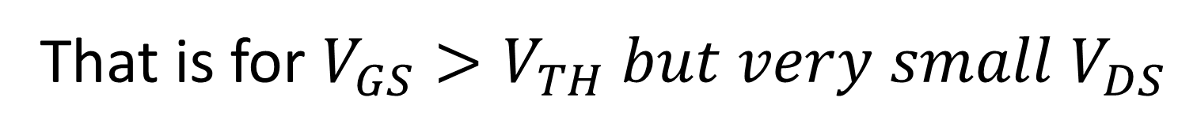

That is for $V_{GS}>V_{TH} but very small V_{DS}$
MOSFET acts as a resistor
$$\frac{I_{D}}{V_{DS}}=g_{DS}=1/2C_{ox}μ_{n}\frac{W}{L}\left(2×V_{GS}−V_{TH}\right)$$

Slide 34
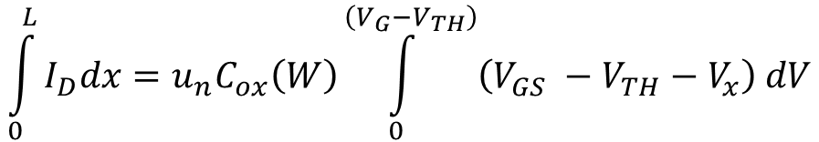
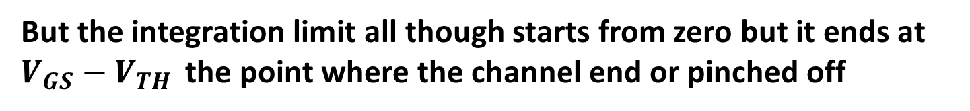
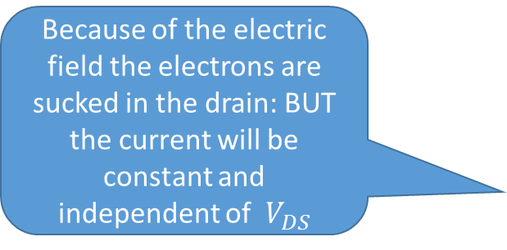
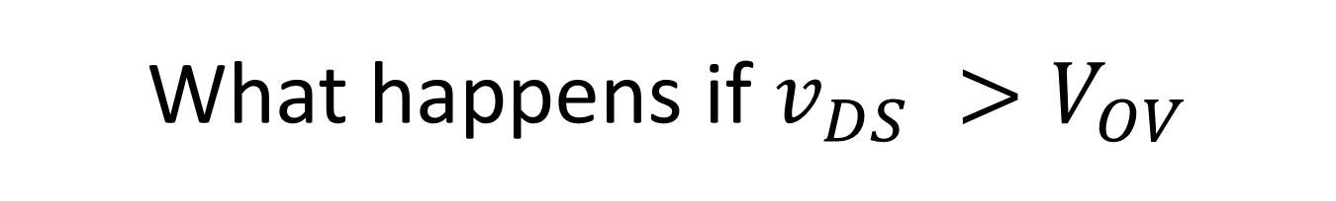
What happens if $v_{DS} >V_{OV}$
We start from the basic equation
But the integration limit all though starts from zero but it ends at $V_{GS}−V_{TH }$the point where the channel end or pinched off
$$\int_{0}^{L}{I_{D}dx=u_{n}C_{ox}\left(W\right)\int_{0}^{\left(V_{G}−V_{TH}\right)}{\left(V_{GS} −V_{TH}−V_{x}\right) dV}}$$
Because of the electric field the electrons are sucked in the drain: BUT the current will be constant and independent of $V_{DS}$
-
+
-
+
+
-

Slide 36
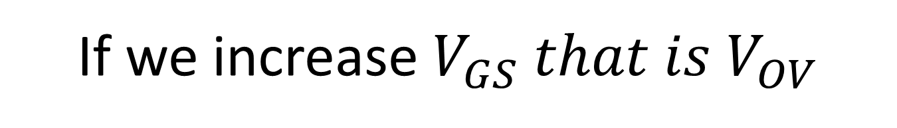
If we increase $V_{GS} that is V_{OV}$

Slide 37
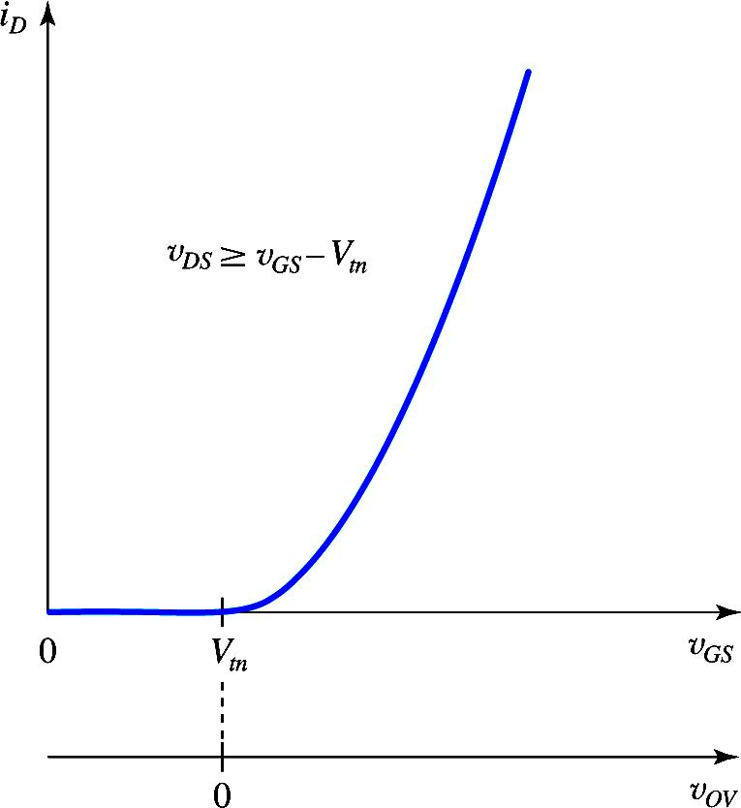

The $i_{D} Vs v_{GS}$ Curve

Slide 38
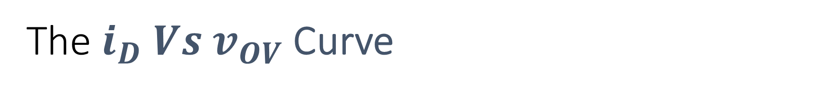
The $i_{D} Vs v_{OV}$ Curve
The i_{D} – v_{OV} curve can be obtained by shifting the origin to V_{th}

Slide 39
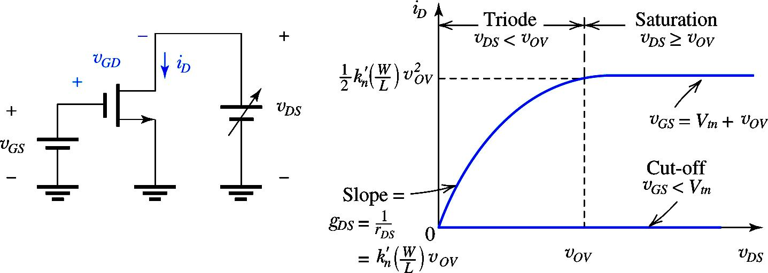
NMOS Transistor Regions of Operation: 1

Slide 40
NMOS Transistor Regions of Operation: 2

Slide 41
Summary of Regions of operation

Slide 42
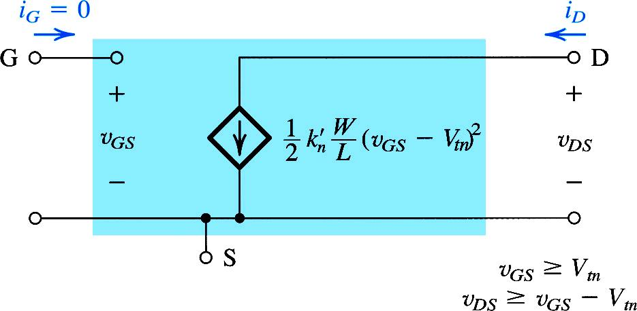
The Equivalent Circuit Model of the NMOS in Saturation
A voltage controlled current source
The drain current is a function of v_{OV}

Slide 43
Channel Length modulations

Slide 44
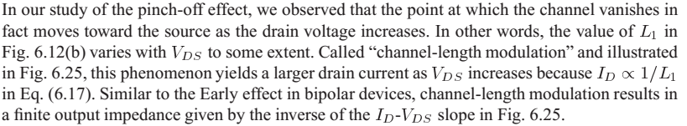
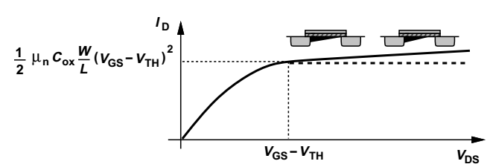
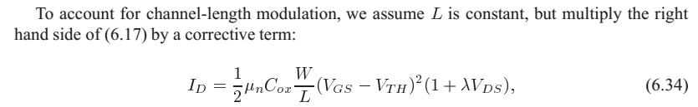
Channel-Length Modulation

Slide 45
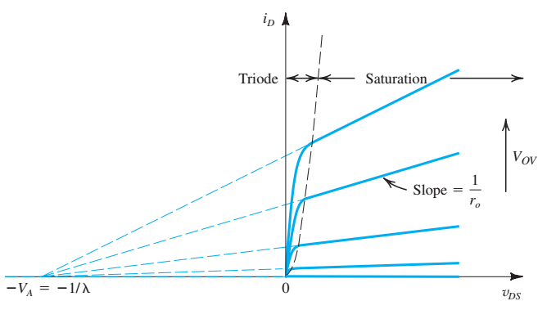
Channel Length Modulation

Slide 46
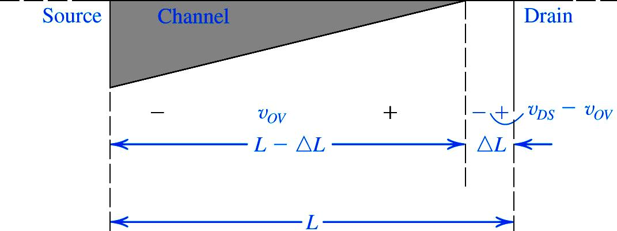
Output Resistance in Sat Mode:1

Slide 47
Output Resistance in Sat Mode:2

Slide 48
Output Resistance in Sat Mode:3

Slide 49
Output Resistance in Sat Mode:4

Slide 50
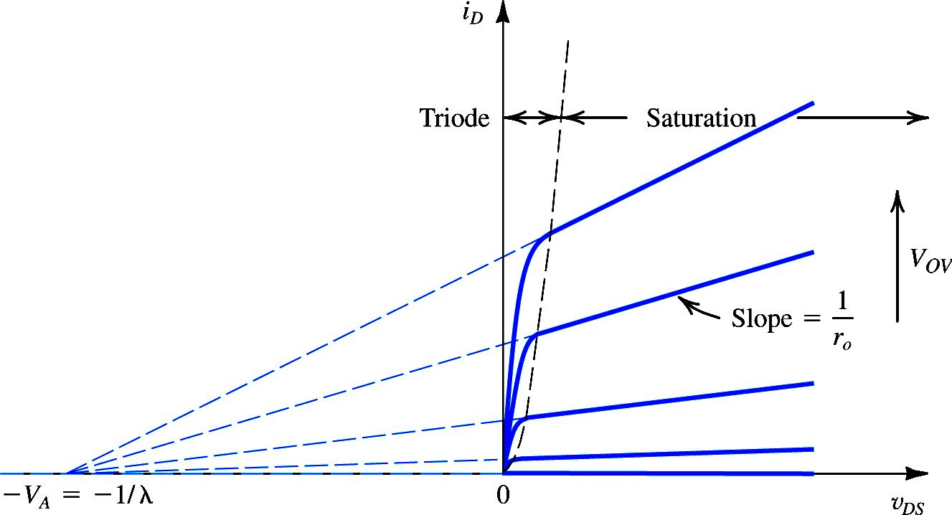
Output Resistance in Sat Mode:5
The MOSFET parameter V_{A} depends on the process technology, and for a given process, is proportional to the channel length

Slide 51
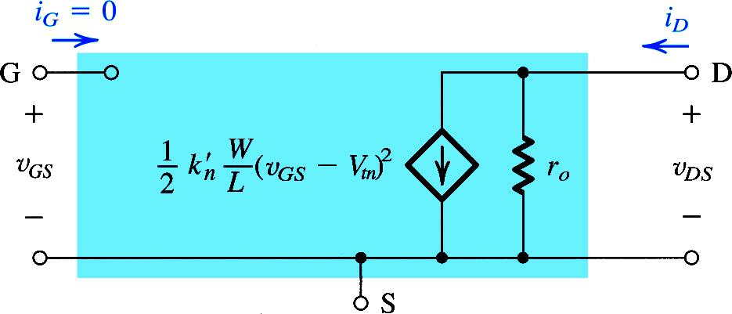
Output Resistance in Sat Mode:6
r_{o} incorporated in the large signal model of n-channel MOSFET

Slide 52
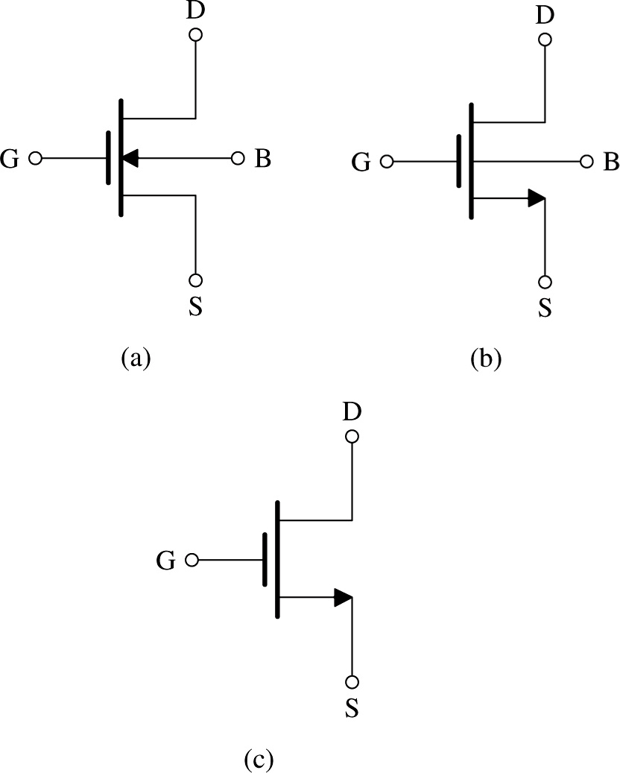
NMOS Circuit Symbols

Slide 53

Summary
$V_{GS} < V_{TH};with even V_{DS}>0 , still no current$
$V_{GS} ≥V_{TH} ; V_{DS}=0 . Though channel is formed but no current$
$V_{GS} ≥V_{TH} ; V_{DS} is very small then V_{OV} . MOSFET acts as resistor$
$V_{GS} ≥V_{TH} ; V_{DS}<V_{OV} . MOSFET in triode region$
$V_{GS} ≥V_{TH} ; V_{DS}≥V_{OV} . MOSFET in saturation region$
Note in MOSFETs $I_{G}=0 ; and I_{S}=I_{D}$

Slide 54
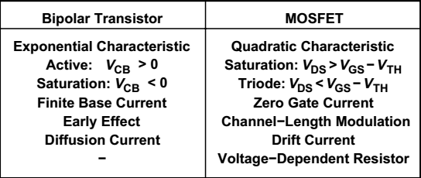
Comparison with BJT

Slide 55
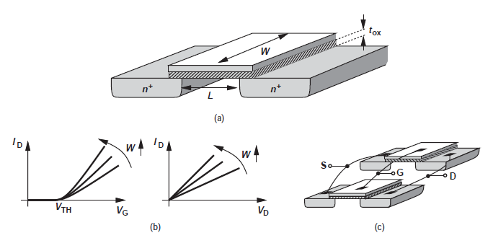
Effect of Channel Width

Slide 56
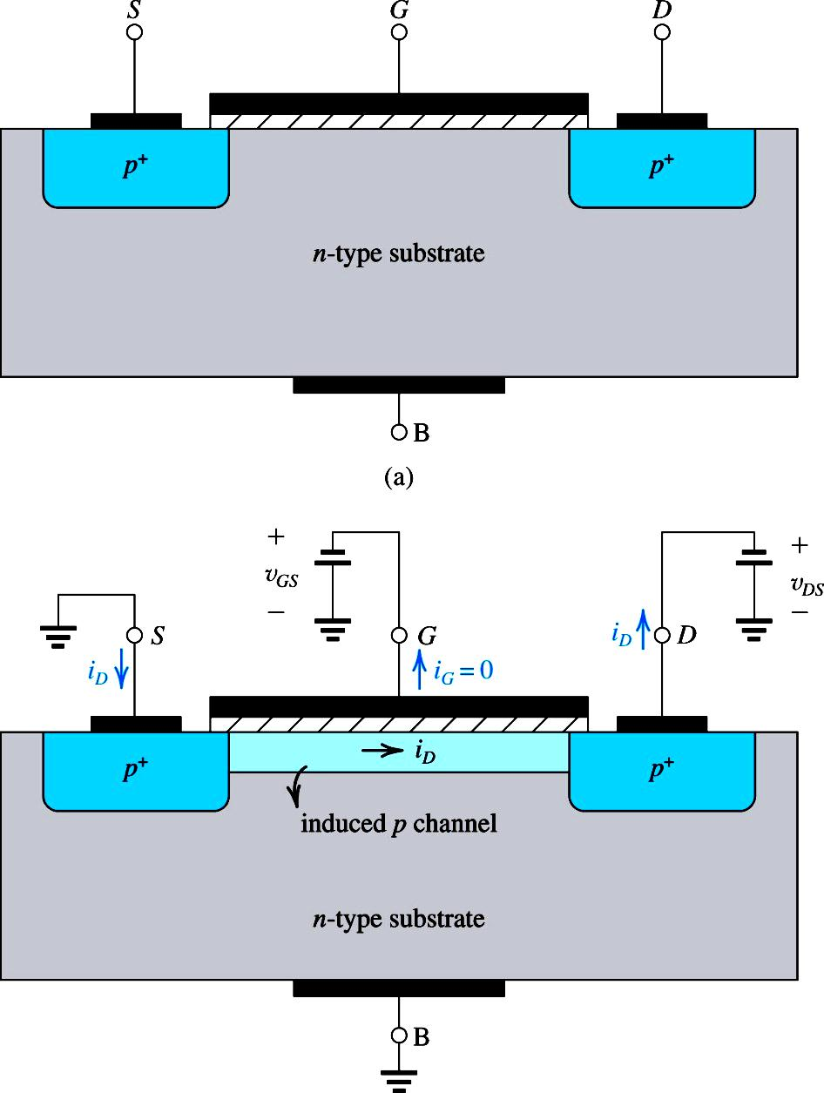
PMOS Transistor
Polarity of the terminal voltages !!!!!

Slide 57
PMOS Transistor

Slide 58
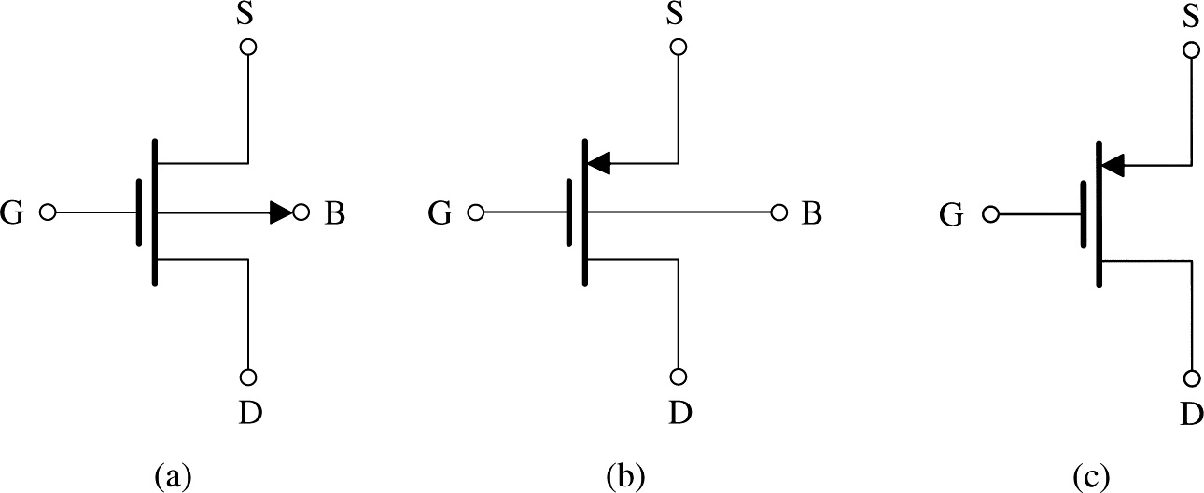
PMOS Circuit Symbols

Slide 59
CMOS Technology

Slide 60
EXAMPLES SOLVING

Slide 61

$$k_{n}^{/}=μ_{n}C_{ox}=194{μA}/{V^{2}}$$

Slide 64


Example 5.2
Consider an NMOS transistor fabricated in a 0.18-μm process with L = 0.18 μm and W = 2 μm. The process technology is specified to have C_{ox} = 8.6 fF/μm², μn = 450 cm²/ V.s and V_{tn} = 0.5 V.
(a) Find V_{GS} and V_{DS} that result in the MOSFET operating at the edge of saturation with I_{D} = 100 μA.
(b) If V_{GS} is kept constant, find V_{DS} that results in I_{D} = 50 μA.
(c) To investigate the use of the MOSFET as a linear amplifier, let it be operating in saturation with V_{DS} = 0.3 V. Find the change in i_{D} resulting from changing V_{GS} from 0.7 V by +0.01V and by - 0.01V.
Solution:
The FET transconductance parameter
The process transconductance parameter

Slide 65



(a) Find V_{GS} and V_{DS} that result in the MOSFET operating at the edge of saturation with I_{D} = 100 μA.
Since operating at the edge of saturation

Slide 66

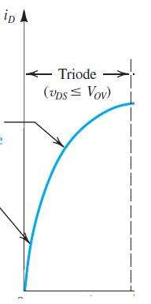


(b) If V_{GS} is kept constant, find V_{DS} that results in I_{D} = 50 μA.
As I_{D} is reduced from the value obtained at the edge of saturation, the MOSFET will now be operating in the triode region
In triode region V_{DS} can’t be greater than V_{ov}
$${V_{DS}=V}_{OV}=0.22$$

Slide 67



(c) To investigate the use of the MOSFET as a linear amplifier, let it be operating in saturation with V_{DS} = 0.3 V. Find the change in i_{D} resulting from changing V_{GS} from 0.7 V by +0.01V and by - 0.01V.

Slide 71



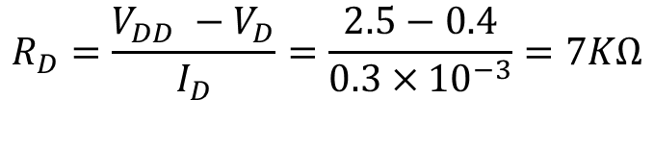

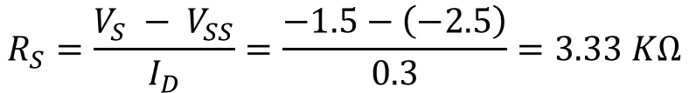
$$I_{D}=1/2μ_{n}C_{ox}\frac{W}{L}V_{OV}^{2}$$
$$0.3=0.5×\frac{60}{1000}×\frac{120}{3}×V_{OV}^{2}$$
$$Therefore V_{OV}=0.5V$$
$$V_{GS}−V_{TH}=V_{OV} → V_{GS}=1.5$$
$$Therefore V_{S}=−1.5$$
$$R_{S}=\frac{V_{S} − V_{SS}}{I_{D}}=\frac{−1.5−\left(−2.5\right)}{0.3}=3.33 KΩ$$
$$R_{D}=\frac{V_{DD} −V_{D}}{I_{D}}=\frac{2.5−0.4}{0.3×{10}^{−3}}=7KΩ$$

Slide 72
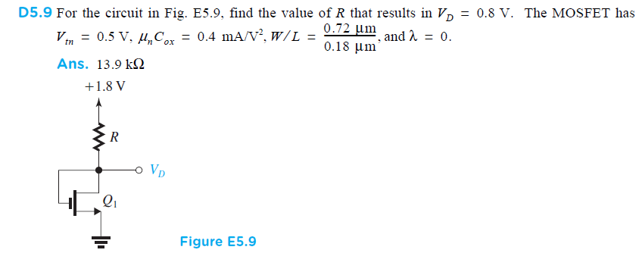
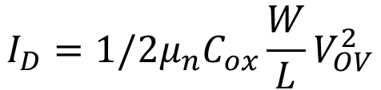


$$I_{D}=1/2μ_{n}C_{ox}\frac{W}{L}V_{OV}^{2}$$
$$V_{D}=V_{G}=0.8 V$$
$$V_{OV}=V_{GS}−V_{TH}=0.8−0.5=0.3$$
$$I_{D}=0.5× 0.4×{10}^{−3}×4× {\left(0.3\right)}^{2}=72μA$$
$$R=\frac{1.8−0.8}{72×{10}^{−6}}=13.9K$$

Slide 73


Since both transistor have same VGS , therefore their
currents will be same i.e. 72$μA$ (from previous example)
VD1 was found to be 0.8 V
VGS2 is also 0.8V
Operating at the edge of saturation means VDS =VGS-VT
Therefore
VDS2= 0.8-0.5=0.3
$$R_{2}=\frac{1.8−0.3}{{72×10}^{−6}}=20.8k$$

