Slide 1


Slide 2
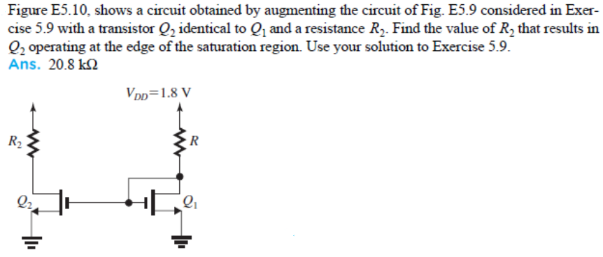
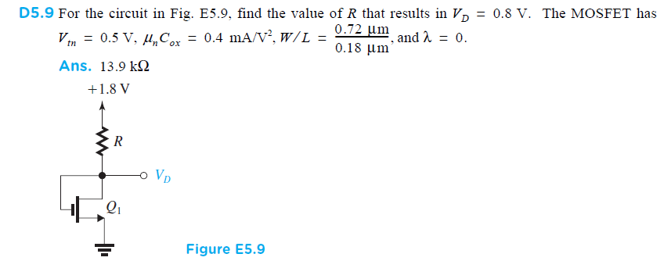

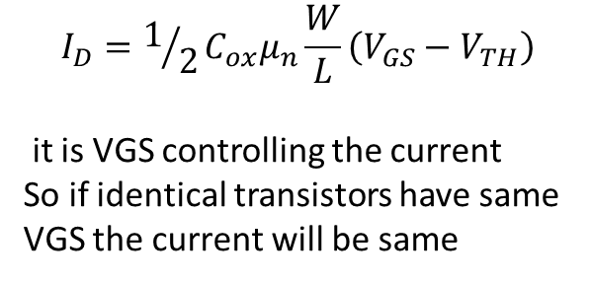

Since both transistor have same VGS , therefore their
currents will be same i.e. 72$μA$ (from previous example)
VD1 was found to be 0.8 V
VGS2 is also 0.8V
Operating at the edge of saturation means VDS =VGS-VT
Therefore
VDS2= 0.8-0.5=0.3
Once transistor are in saturation
Current is given by
$$I_{D}=1/2C_{ox}μ_{n}\frac{W}{L}\left(V_{GS}−V_{TH}\right)$$
it is VGS controlling the current
So if identical transistors have same
VGS the current will be same
$$R_{2}=\frac{1.8−0.3}{{72×10}^{−6}}=20.8k$$

Slide 3

$V_{DS}≥V_{GS}−V_{TH}$ For saturation mode but here
$$V_{DS}=0.1 and V_{GS}=5 so operatiing is Triode mode$$

Slide 4
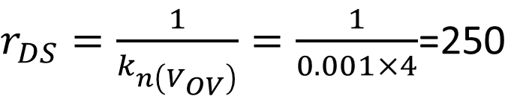
$r_{DS}=\frac{1}{k_{n\left(V_{OV}\right)}}=\frac{1}{0.001×4}$=250

Slide 10
MOSFET as an amplifier

Slide 11
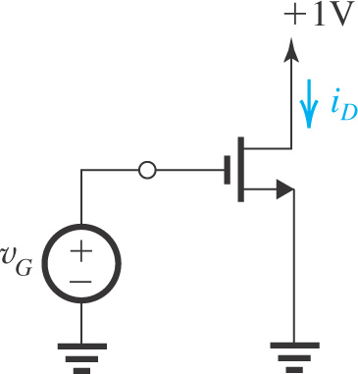
Obtaining a Voltage Amplifier :1
In saturation mode, the MOSFET is a voltage-controlled current source
The input signal is voltage
The output signal is current
The v_{GS} controls i_{D}
Transconductance amplifier
How do we obtain a voltage amplifier
?????

Slide 12
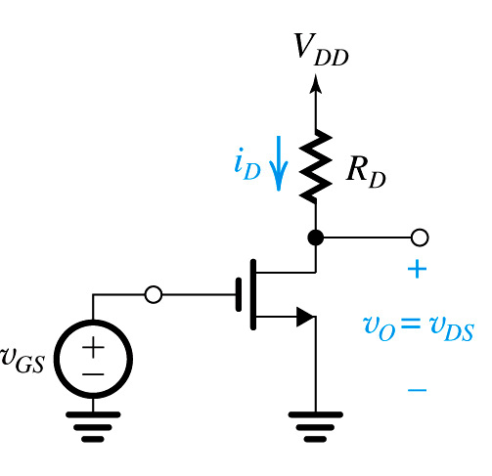
Obtaining a Voltage Amplifier :2
Voltage amplifier is obtained by connecting a resistor R_{D} b/w V_{DD} and the drain terminal
i_{D} converted to voltage i_{D}R_{D}
Output taken b/w drain and ground
v_{DS} is inverted version of i_{D}R_{D} shifted by V_{DD}

Slide 13
Voltage Transfer Characteristics (VTC)
A very useful tool that yields great insight into the operation of an amplifier circuit is its voltage transfer characteristic (VTC). This is simply a plot (or a clearly labeled sketch) of the output voltage versus the input voltage.
output
Input

Slide 14
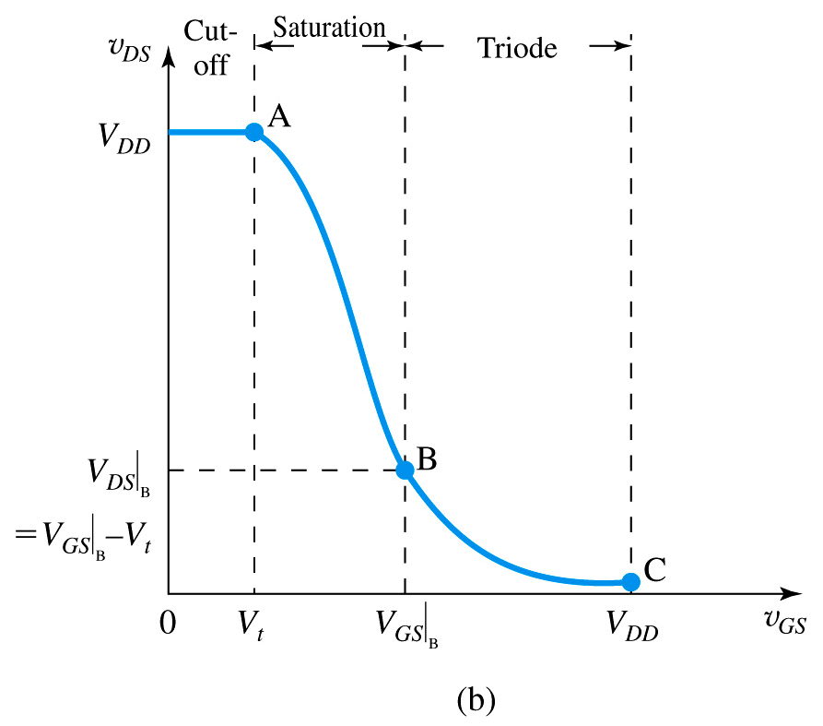
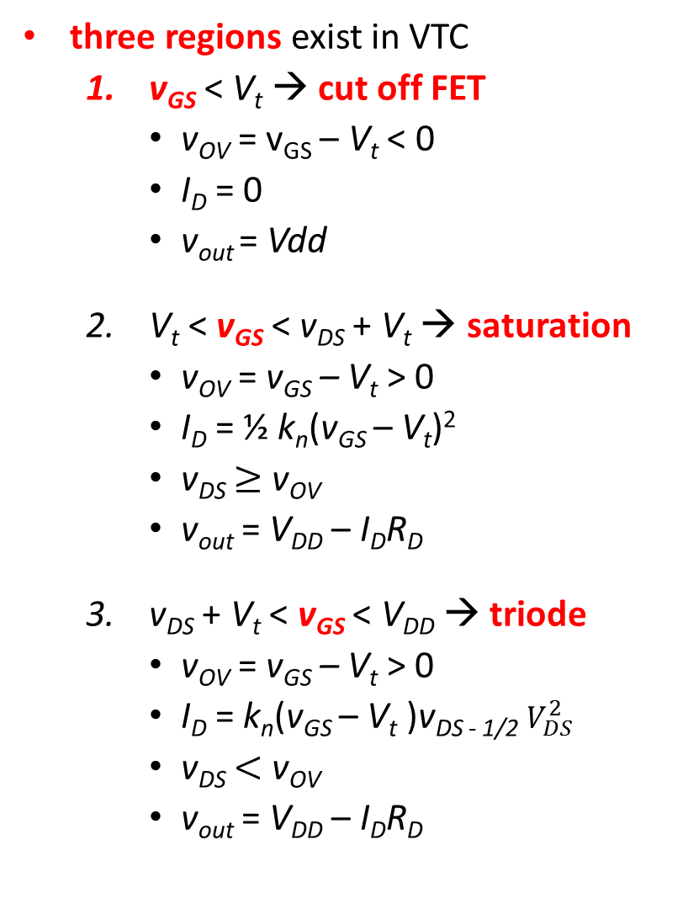
VTC
three regions exist in VTC
v_{GS} < V_{t} → cut off FET
v_{OV} = v_{GS} – V_{t} < 0
I_{D} = 0
v_{out} = Vdd
V_{t} < v_{GS} < v_{DS} + V_{t} → saturation
v_{OV} = v_{GS} – V_{t} > 0
I_{D} = ½ k_{n}(v_{GS} – V_{t})²
v_{DS} $≥$ v_{OV}
v_{out} = V_{DD} – I_{D}R_{D}
v_{DS} + V_{t} < v_{GS} < V_{DD} → triode
v_{OV} = v_{GS} – V_{t} > 0
I_{D} = k_{n}(v_{GS} – V_{t} )v_{DS - 1/2} $V_{DS}^{2}$
v_{DS} $<$ v_{OV}
v_{out} = V_{DD} – I_{D}R_{D}

Slide 15
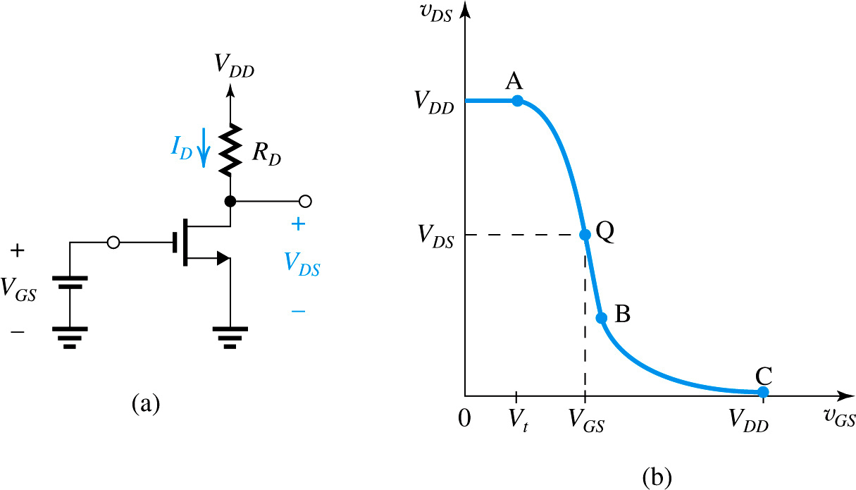
Biasing MOSFET for Linear Amplification
Biasing enables almost linear amplification from the MOSFET
Operation at point Q by appropriate selection of V_{GS}
Coordinates of Q are V_{GS} and V_{DS}
Biasing the MOSFET amplifier at a point Q located on the segment AB of the VTC.

Slide 16
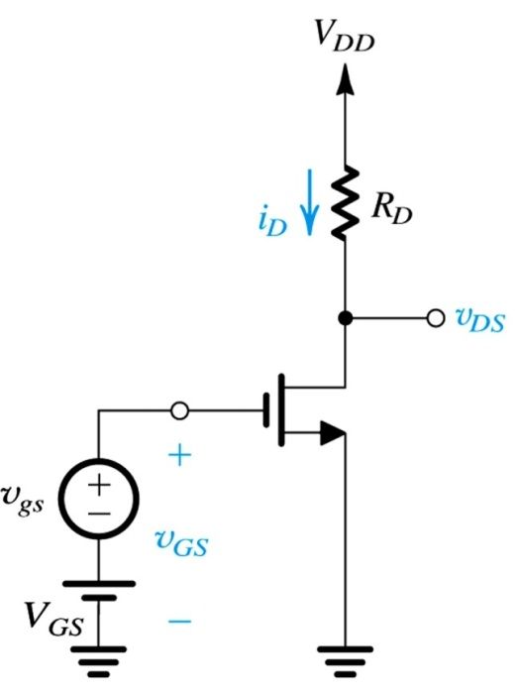

Linear Amplification
Signal v_{gs} super imposed on V_{GS}
Instantaneous value of v_{GS} and v_{DS} are:

Slide 17

Small-Signal Voltage Gain
For small v_{gs} , the v_{ds} is related to v_{gs} by slope of VTC at point Q
Slope of VTC at point Q is the small signal voltage gain
The negative gain signifies the amplifier is inverting

Slide 18
Small-Signal Voltage Gain
Alternate expression for voltage gain
Combining the two equations we get
Upper limit on the gain is:

Slide 19
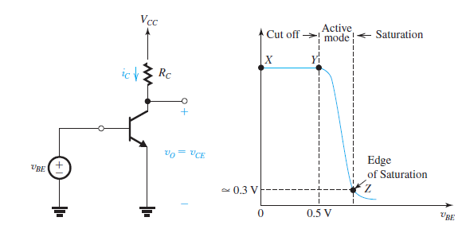
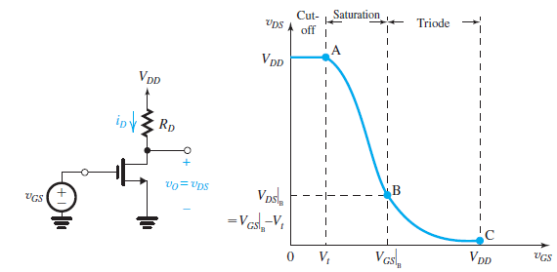
VTCs BJT & MOSFET
BJT Active region
=
MOS saturation region

Slide 20

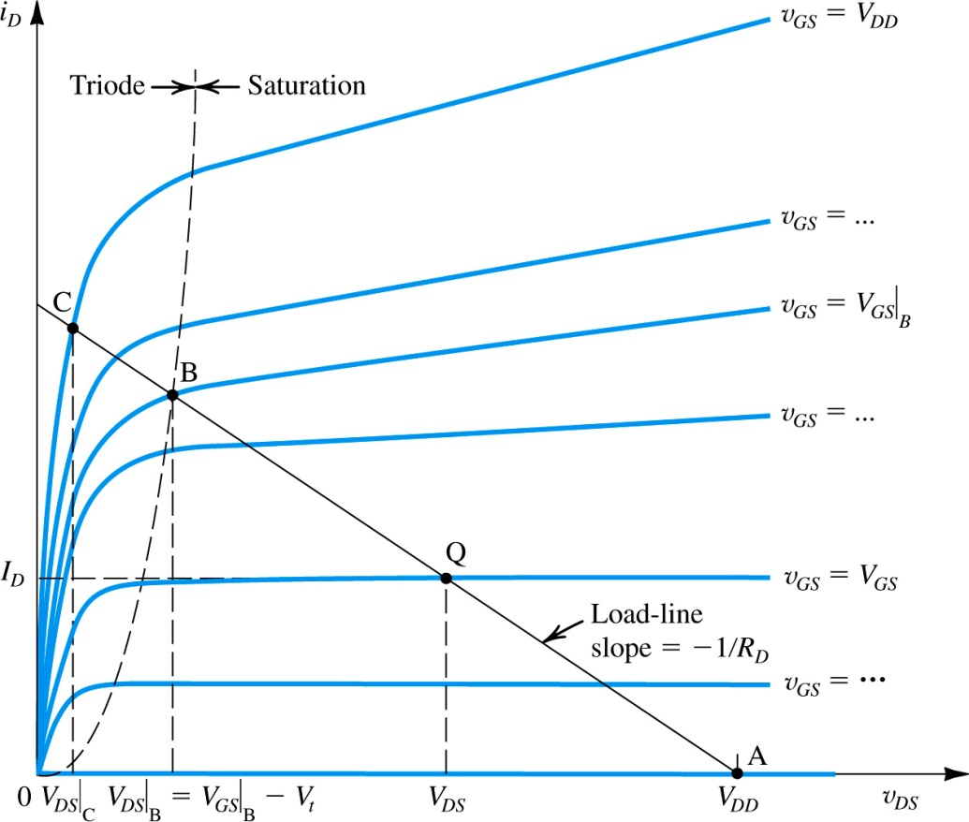
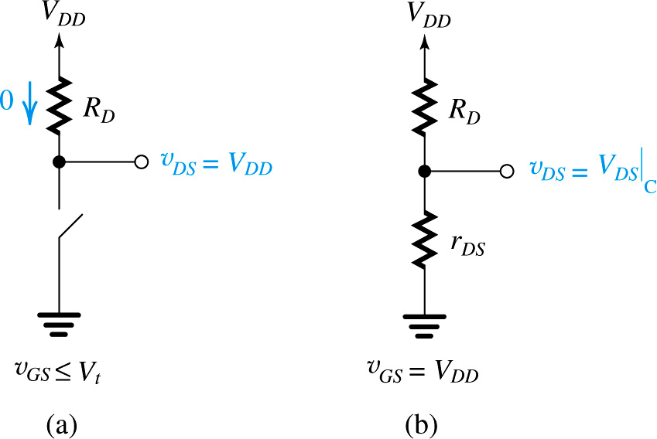
Operation of MOSFET as a Switch
The closure resistance is approximately equal to rDS because VDS is usually very small.

Slide 21
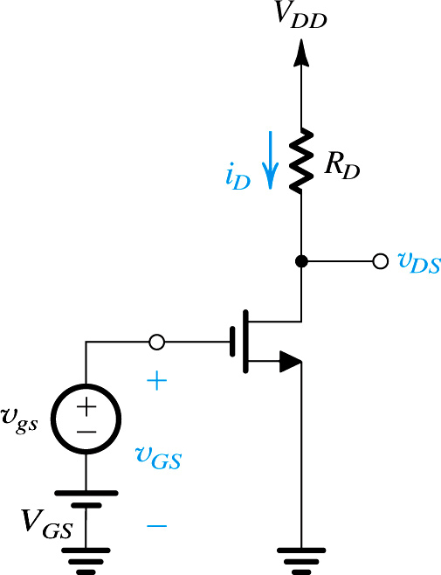
The DC Bias Point
Channel length modulation neglected
V_{DS} should be b/w V_{OV} and V_{DD} to allow for sufficient signal swing

Slide 22
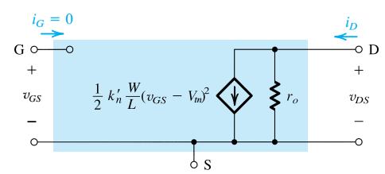
Large Signal Model
Large signal model are used when the input signal is large
Also used for DC analysis of the MOS circuit

Slide 23
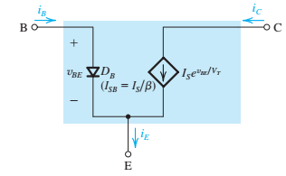
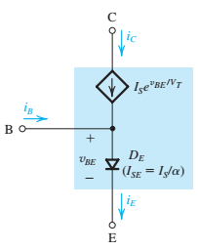
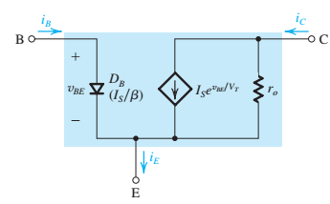

BJT Large signal π & T models

Slide 24
Small signal
Applying signal v_{gs}
Bias current
I_{D}
Undesirable part of signal current

Slide 25
Small signal
Bias current
I_{D}
Undesirable part of signal current, represents nonlinear distortion
To minimize nonlinear distortion, v_{gs} should be kept small so that

Slide 26
The MOSFET Transconductance

Slide 27
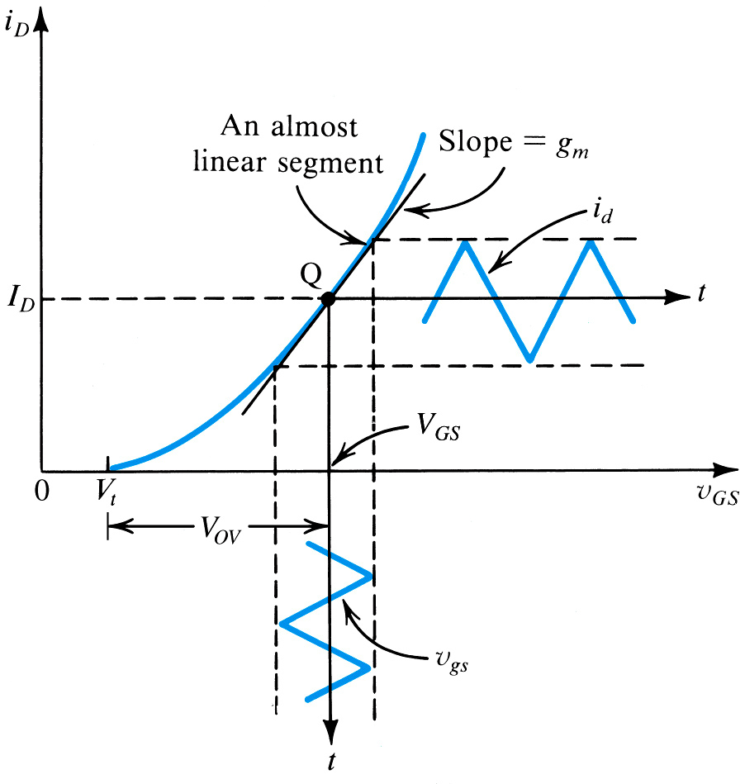
Graphical Interpretation of Small –Signal Operation
g_{m} is equal to the slope of i_{D} – v_{GS} characteristic curve at the bias point

Slide 28
Alternate expression for g_{m}
g_{m} is dependent on three design parameters---- W/L, V_{OV}, and I_{D;} two of which can be chosen independently by the designer

Slide 29
The Voltage Gain

Slide 30
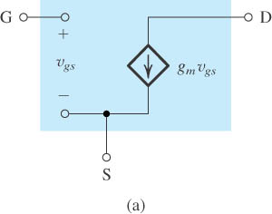
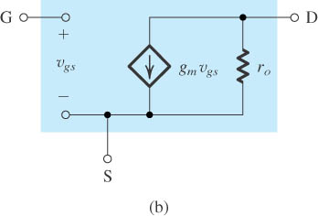
The Small-Signal Models
Neglecting the channel-length modulation effect
Including the effect of channel-length modulation, modeled by output resistance r_{o} = |V_{A}| /I_{D}.

Slide 31
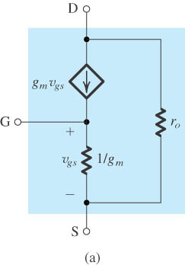
The T Equivalent Models
The T model of the MOSFET augmented with the drain-to-source resistance r_{o}.

Slide 32
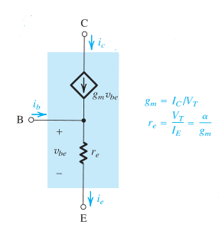

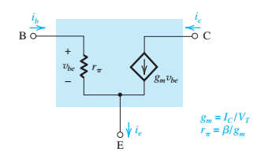

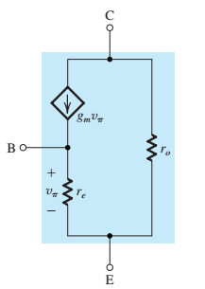
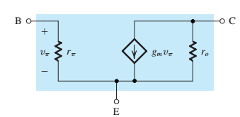
BJT Small signal π & T models

Slide 35
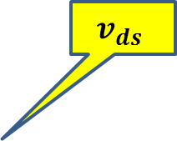
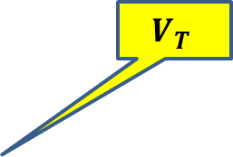
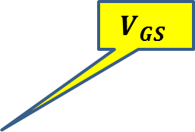
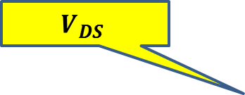
$$v_{ds}$$
$$V_{GS}$$
$$V_{T}$$
$$V_{DS}$$

Slide 37
Example 5.10: MOSFET Amplifier
Problem Statement: Figure 39 shows a discrete common-source MOSFET amplifier utilizing a drain-to-gate resistance R_{G} for biasing purposes. The input signal v_{I} is coupled to the gate via a large capacitor, and the output signal at the drain is coupled to the load resistance R_{L} via another large capacitor. The transistor has V_{t} = 1.5V, k’_{n}(W/L) = 0.25mA/V², and V_{A} = 50V. Assume the coupling capacitors to be sufficiently large so as to act as short circuits at the signal-frequencies of interest.
Q: We wish to analyze this amplifier circuit to determine its (a) small-signal voltage gain, its (b) input resistance, and the largest allowable input signal.

Slide 38
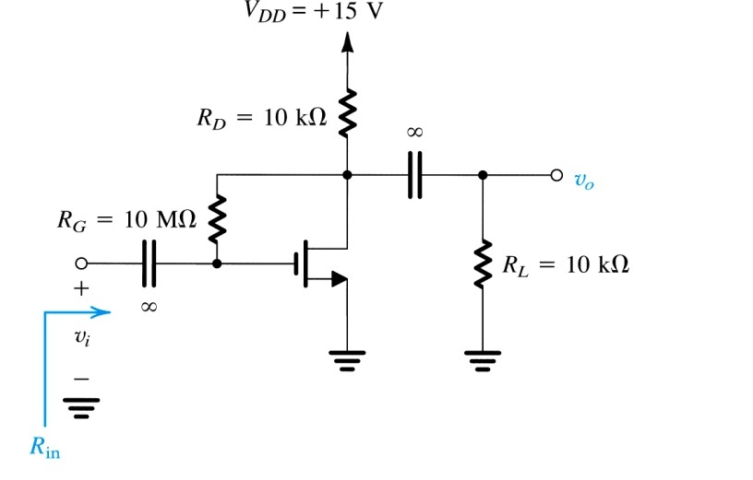

is $V_{DS} =V_{GS}$ ???
is MOSFET in saturation or in triode region ???
note: capacitors block dc signals completely, but have no effect on small-signal
Figure 20: Example 5 amplifier circuit.

Slide 39
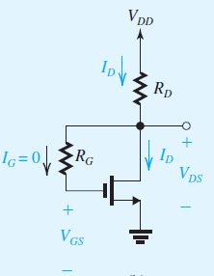





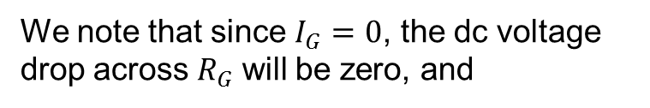

Example 5 – Sol
We first determine the dc operating point.
1- DC analysis: as shown in the figure
We note that since $I_{G}=0$, the dc voltage drop across $R_{G}$ will be zero, and
1
$$V_{DS}>V_{OV}$$
2
Solving the resulting quadratic equation in $I_{D}$ and discarding the root that is not physically meaningful yields the solution

Slide 40

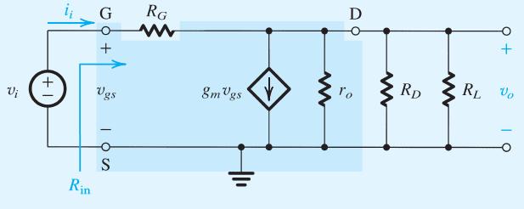
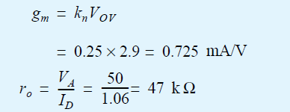
Example 5 – Sol, Cont.
Next we proceed with the small-signal analysis of the amplifier.
The values of the transistor small-signal parameters g_{m} and r_{o} can be determined by using the dc bias quantities found above,

Slide 41
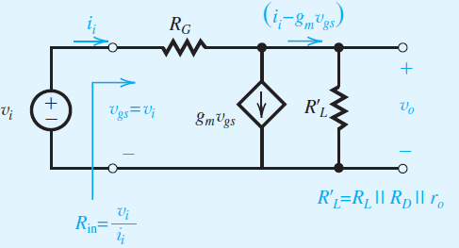



Example 5 – Sol, Cont.
Toward that end we simplify the circuit by combining the three parallel resistances $r_{o}$, $R_{D}$, $R_{L}$and in a single resistance ${R′}_{L}$,
→ (1)
→ (2)

Slide 42





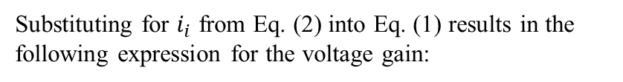

Example 5 – Sol, Cont.
Substituting for $i_{i}$ from Eq. (2) into Eq. (1) results in the following expression for the voltage gain:
To obtain the input resistance, we substitute in Eq. (1) for $v_{o}=A_{v}v_{\text{gs}}=−{\text{g}}_{m}R_{L}^{′}v_{\text{gs}}$, then use $R_{in}=v_{i}/i_{i}$ to obtain
$$R_{i}=\frac{v_{gs}}{\frac{v_{gs}−v_{o}}{R_{G}}}$$
which is still very large.

Slide 43
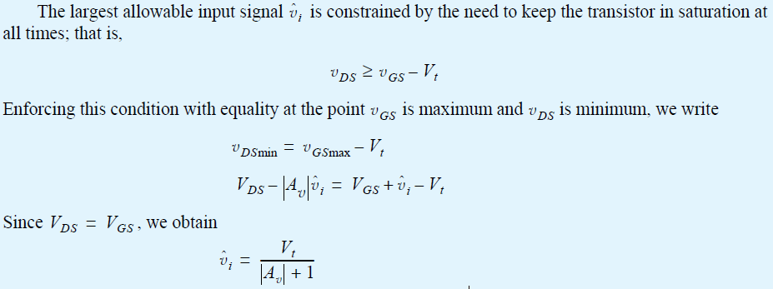

Example 5 – Sol, Cont.

Slide 44


$$V_{GS}=2V → V_{OV}=1V$$
$$V_{DS}=V_{DD}−I_{D}R_{D}=3V$$

Slide 45
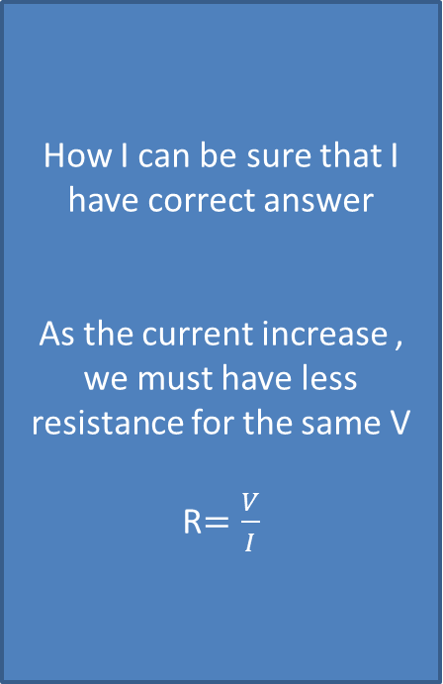
How I can be sure that I have correct answer
As the current increase , we must have less resistance for the same V
R$=\frac{V}{I}$

