Slide 1


Slide 2
Lecture No 7
MOSFET Amplifier Configurations

Slide 3
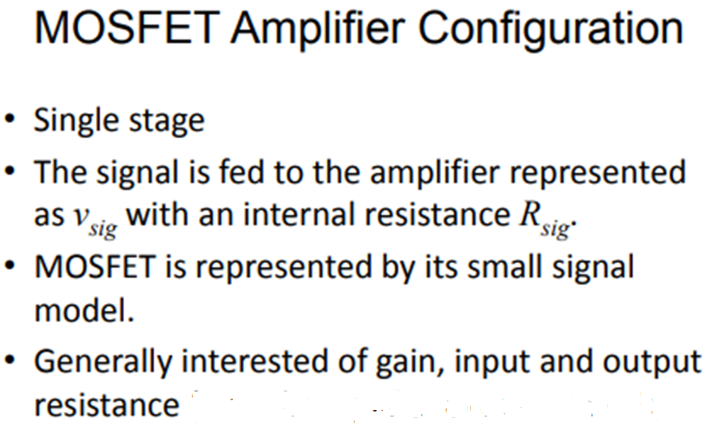

Slide 4
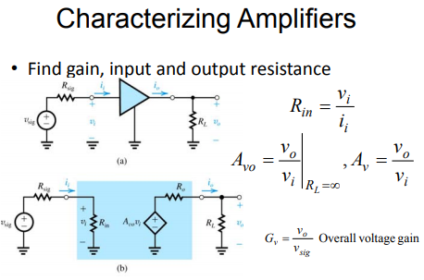
Amplifier Gains

Slide 5
BJT Configurations

Slide 6
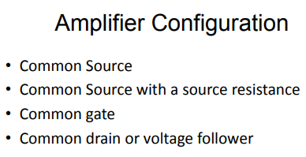

Slide 7
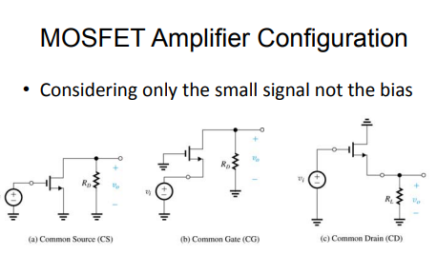

Slide 8
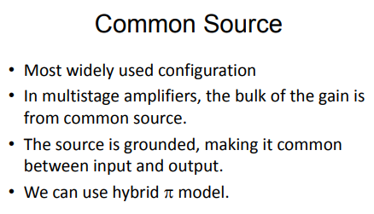

Slide 9
Characteristic Parameters of the CE Amplifier

Slide 10
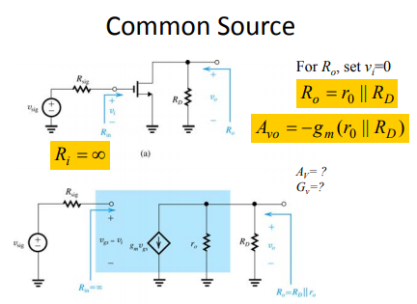

Slide 12
Summary of CS amplifier

Slide 13
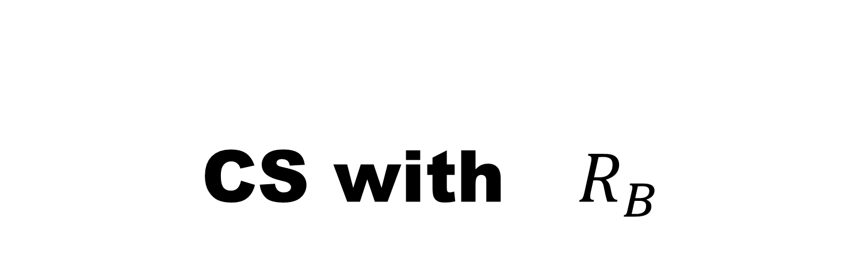
CS with ${ R}_{B}$

Slide 14
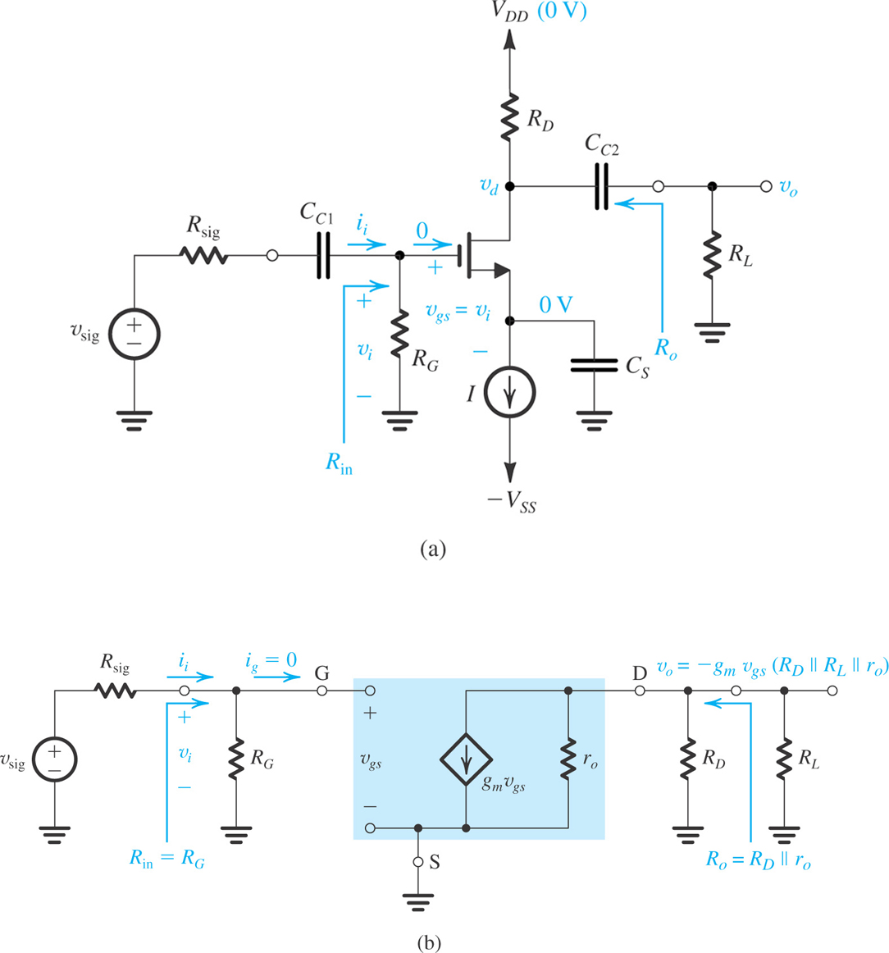
The Common Source Amplifier
Common-source amplifier based on the basic structure
Equivalent circuit of the amplifier for small-signal analysis.

Slide 15
CS with source resistance

Slide 16
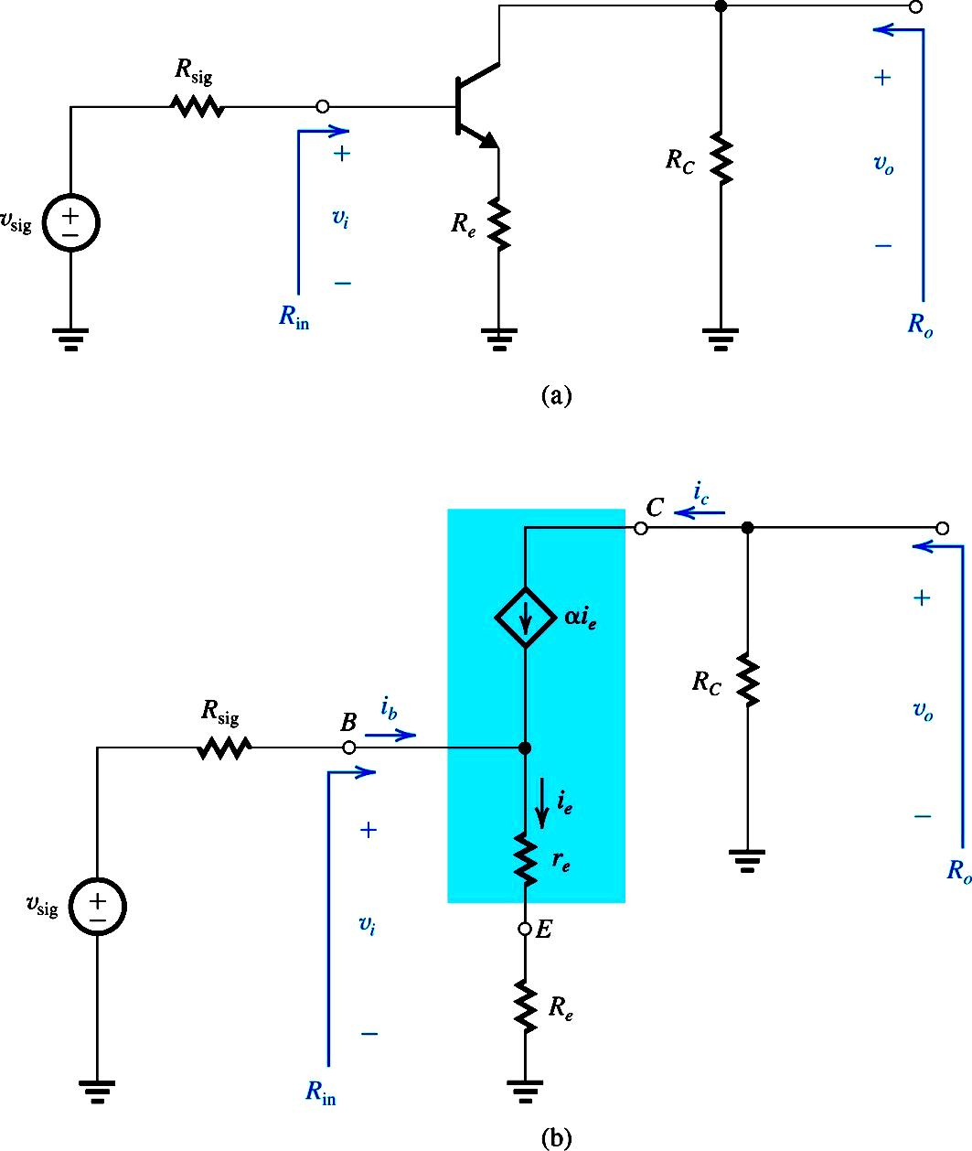
CE Amplifier with R_{E}

Slide 17

CE Amplifier with R_{E} and R_{L}
$$R_{L}$$

Slide 18
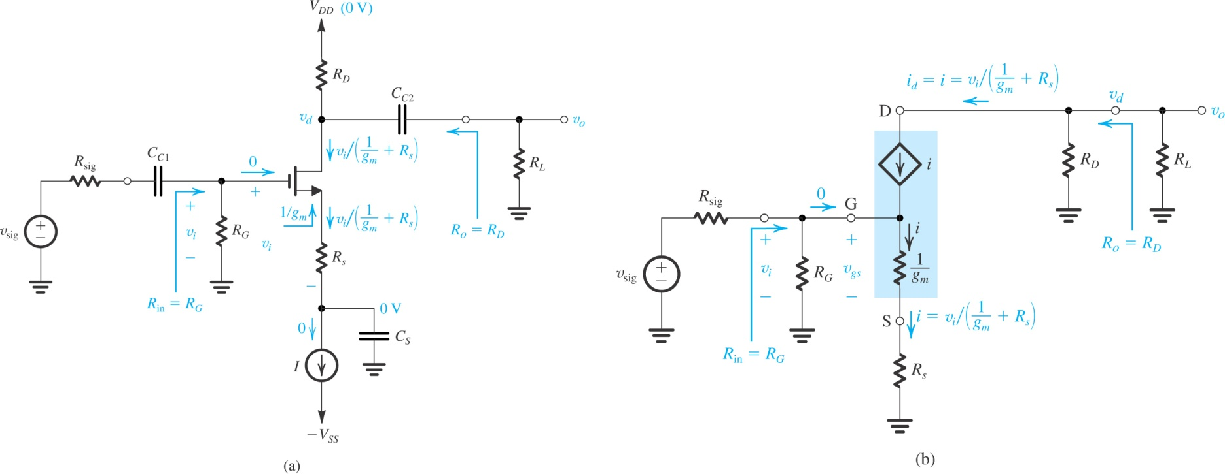
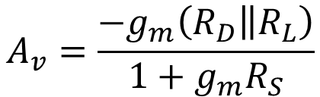
The Common-Source Amplifier with Source Resistance
Small-signal equivalent circuit with r_{o} neglected.
Common-source amplifier with a resistance R_{S} in the source lead
$$A_{v}=\frac{−g_{m}\left(\left.R_{D}\right\|R_{L}\right)}{1+g_{m}R_{S}}$$

Slide 20
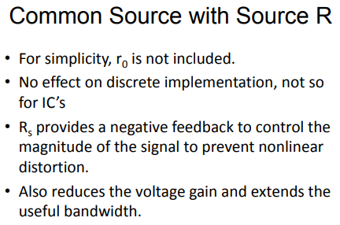

Slide 21
Common Gate Amplifier

Slide 22
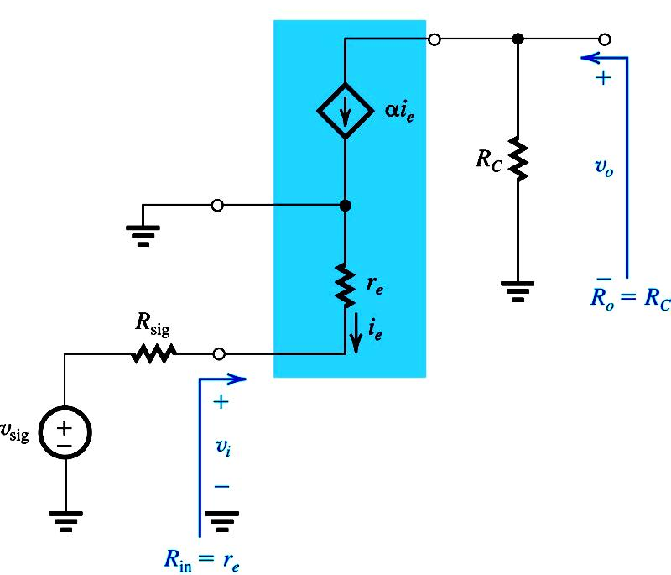
CB Amplifier
Any utility of CB with such a low impedance

Slide 23
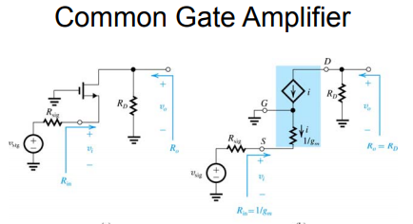

Slide 26
Common Drain

Slide 27
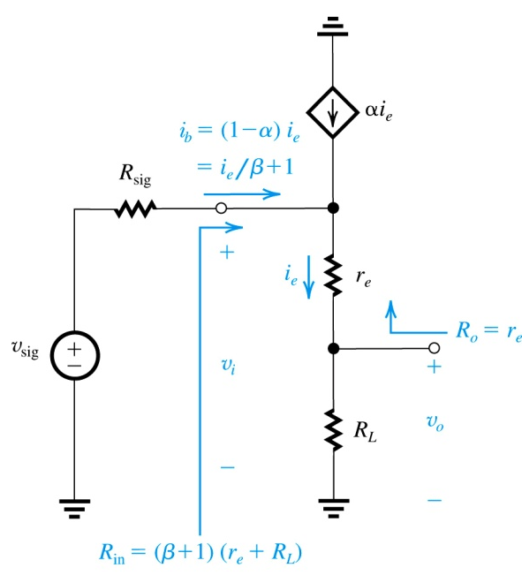
CC Amplifier

Slide 28
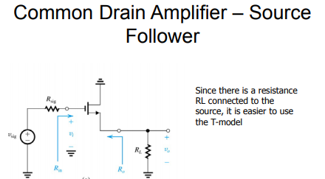

Slide 29
Common Drain Amplifier

Slide 30
The Common-Drain Amplifier or Source Follower

Slide 33
Common Source Configuration
CS without Source resistance
CS with Source resistance

Slide 35
Biasing in MOSFET Amplifier Circuits
Establishing a stable and predictable dc drain current (I_{D}), and a drain to source voltage (V_{DS}) to ensure operation in saturation region.
I_{D} has to be insensitive to temperature variations.
Maximum signal swing by optimal choice of operating point.

Slide 36
Biasing Arrangement
Fixing V_{GS}
Fixing V_{G} and Connecting a Resistance in the Source
Biasing Using Drain-to-Gate Feedback Resistor
Biasing Using a Constant-Current Source

Slide 37
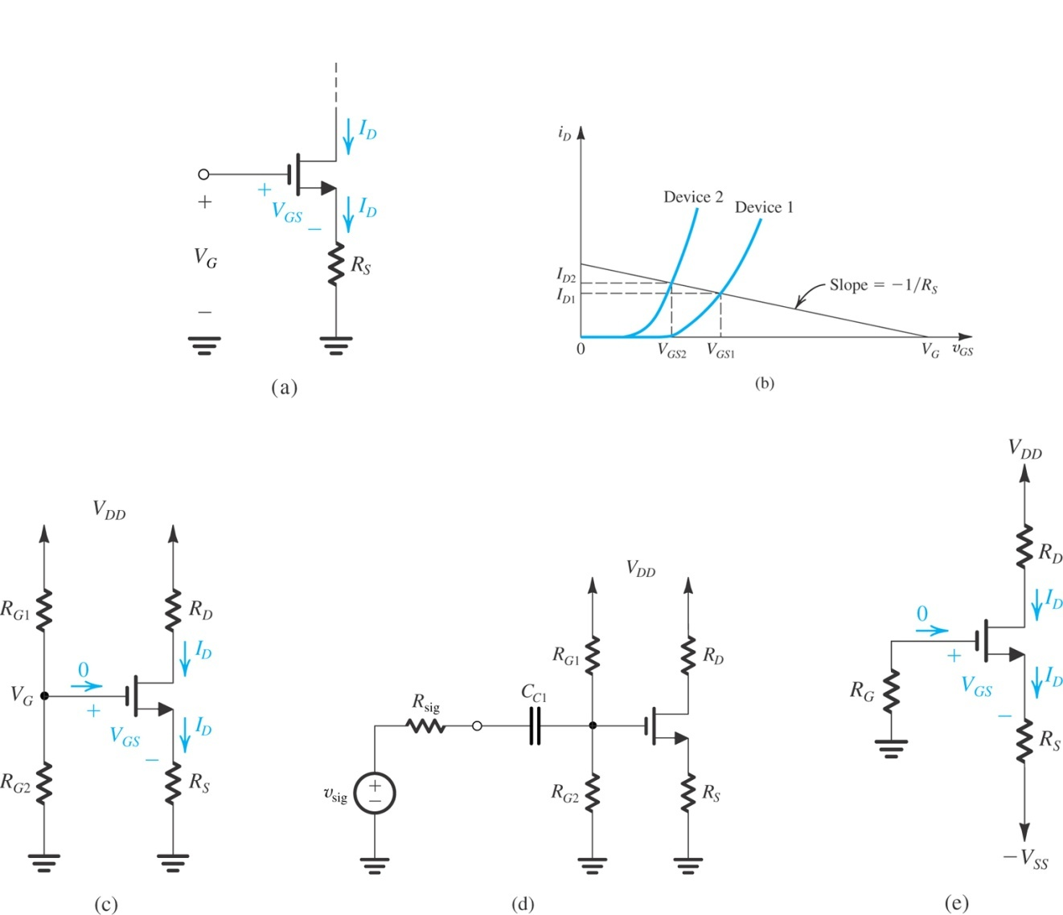
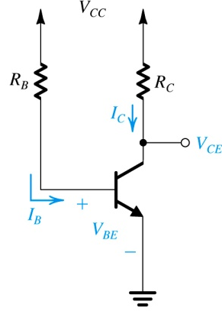
1. Fixing V_{GS}
Large variability of I_{D} due to:
Substantial variations in I_{D} in the MOSFETs of the same type
Variations in β and V_{BE} will cause large variations in I_{C}

Slide 38
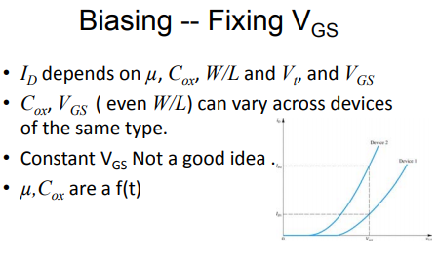

Slide 39
2. Biasing by fixing $V_{GS}$ and connecting a resistance in the source

Slide 41
Fixed V_{G} and a Source Resistance
R_{S} provides negative feedback, thus stabilizes I_{D}

Slide 42
3. Biasing Using a Drain-to-Gate Feedback Resistor
A simple and effective discrete-circuit biasing arrangement utilizing a feedback resistor connected between the drain and the gate is shown in Figure. Here the large feedback resistance RG (usually in the mega-ohm range) forces the dc voltage at the gate to be equal to that at the drain (because IG = 0). Thus we can write
If ID for some reason changes, say increases, then Eq. above indicates that VGS must decrease. The decrease in VGS in turn causes a decrease in ID,
Thus the negative feedback or degeneration provided by RG works to keep the value of ID as constant as possible

Slide 43
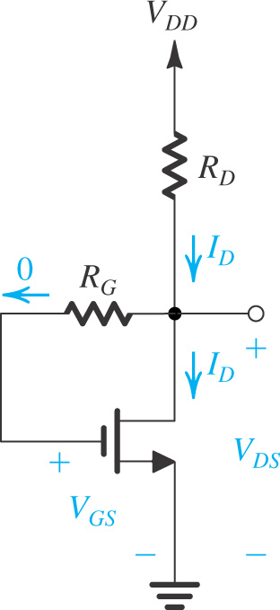
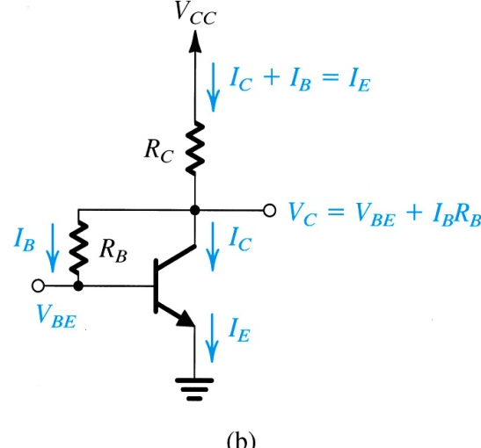
Biasing using Drain-to-Gate Feedback Resistor
R_{G} provides negative feedback, thus stabilizes I_{D}

Slide 44
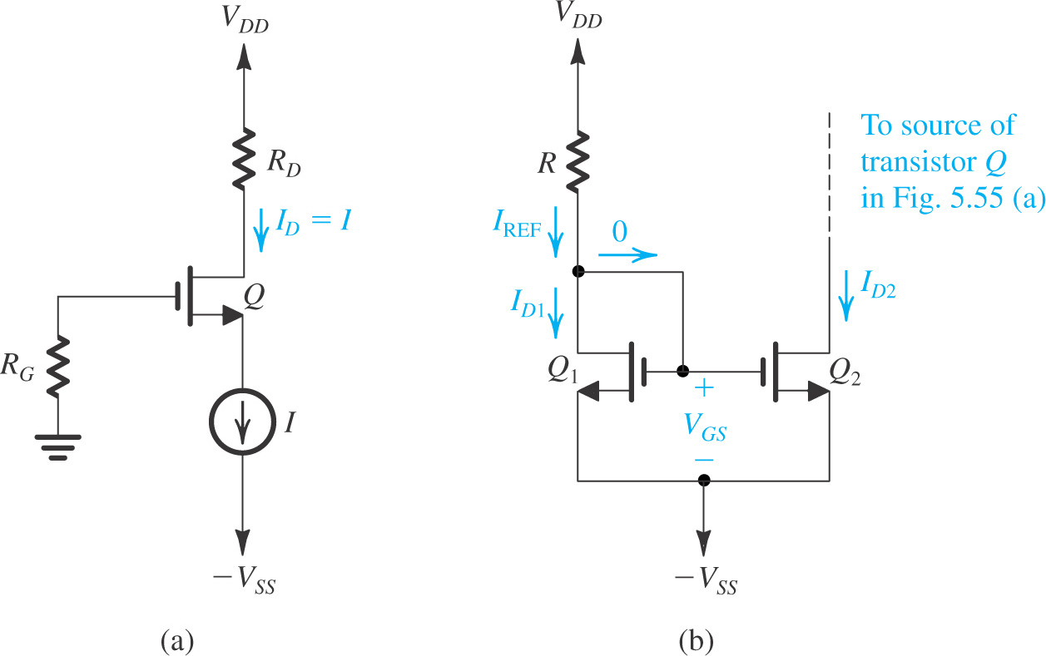
4. Biasing Using Constant Current Source
Figure 5.55
(b) Implementation of the constant-current
source I using a current mirror
Biasing the MOSFET using a
constant-current source I

Slide 45
Biasing Using a Constant-Current Source
The most effective scheme for biasing a MOSFET amplifier is that using a constant-current source. Figure shows such an arrangement applied to a discrete MOSFET. Here RG (usually in the mega-ohm range) establishes a dc ground at the gate and presents a large resistance to an input signal source that can be capacitively coupled to the gate. Resistor RD establishes an appropriate dc voltage at the drain to allow for the required output signal swing while ensuring that the transistor always remains in the saturation region

Slide 48
The Current Source Formula

Slide 50
To understand this problem let’s first review few things

Slide 51
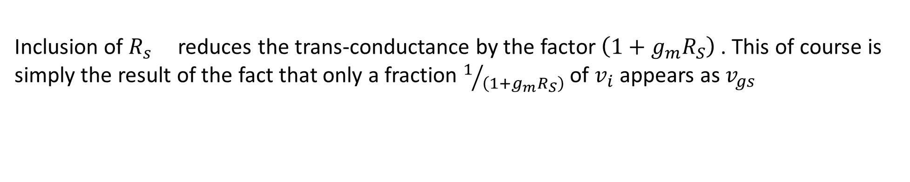
Inclusion of $R_{s }$reduces the trans-conductance by the factor $\left(1+g_{m}R_{S}\right)$ . This of course is simply the result of the fact that only a fraction $1/{\left(1+g_{m}R_{S}\right)}$of $v_{i}$appears as $v_{gs}$

Slide 52
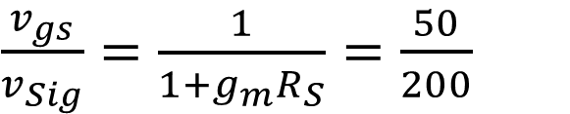

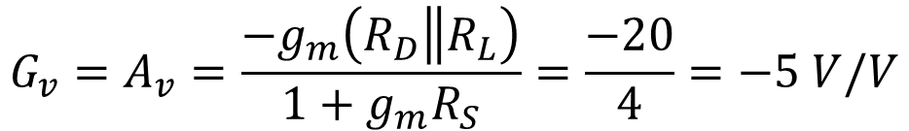
From Ex 5.27
$$g_{m}=2mS$$
$\frac{v_{gs}}{v_{Sig}}=\frac{1}{1+g_{m}R_{S}}=\frac{50}{200}$
$$Therefore g_{m}R_{S}=3 and R_{S}=1.5 kΩ$$
$$G_{v}=A_{v}=\frac{{−g}_{m}\left(R_{D}\left\|R_{L}\right.\right)}{1+g_{m}R_{S}}=\frac{−20}{4}=−5 V/V$$
$$v_{o}=\left|G_{V}v_{sig}\right|=200×{10}^{−3}×5=1V$$

Slide 53

MOS-Common Gate Amplifiers
$$A_{vo}≠G_{v}$$

Slide 54




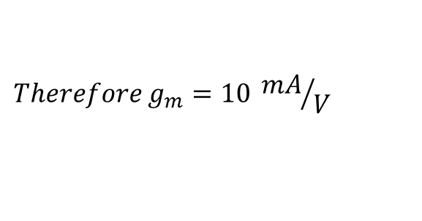
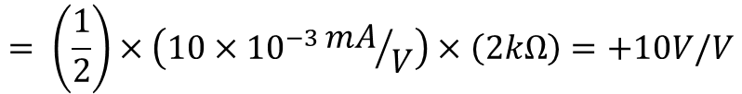
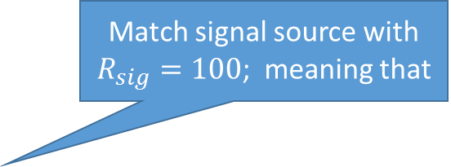

Match signal source with $R_{sig}=100$; meaning that
$$R_{in}=\frac{1}{g_{m}}=R_{sig}=100Ω$$
$$Therefore g_{m}=10 {mA}/V$$
$$Therefore g_{m}=10 {mA}/V = \frac{2I_{D}}{0.2}$$
$$g_{m} is also equal to \frac{2I_{D}}{V_{OV}}$$
$$OR I_{D} =1 mA$$
$$G_{v}=\frac{v_{o}}{v_{sig}}=\frac{R_{in}}{R_{sig}+R_{in}}×g_{m}R_{D}$$
$$= \left(\frac{1}{2}\right)×\left(10×{10}^{−3}{mA}/V\right)×\left(2kΩ\right)=+10V/V$$

Slide 55
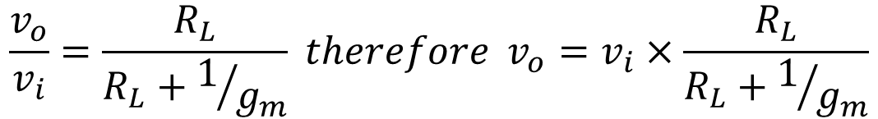
MOS Common Drain Amplifiers
$$\frac{v_{o}}{v_{i}}=\frac{R_{L}}{R_{L}+1/{g_{m}}} therefore v_{o}=v_{i}×\frac{R_{L}}{R_{L}+1/{g_{m}}}$$

Slide 56
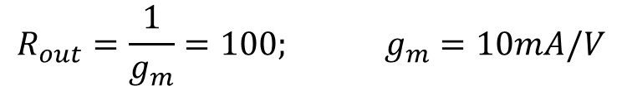
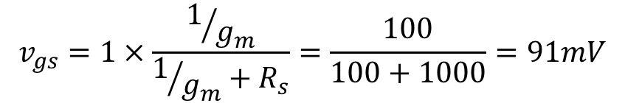
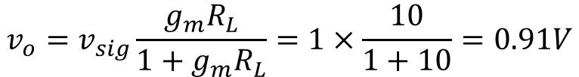
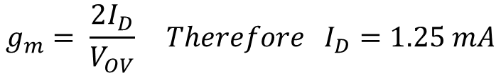
$$I_{D}=????? : v_{o}=???????; v_{gs}=?????$$
$$R_{out}=\frac{1}{g_{m}}=100; g_{m}=10mA/V$$
$$g_{m}= \frac{2I_{D}}{V_{OV}} Therefore I_{D}=1.25 mA$$
$$v_{o}=v_{sig}\frac{g_{m}R_{L}}{1+g_{m}R_{L}}=1×\frac{10}{1+10}=0.91V$$
$$v_{gs}=1×\frac{1/{g_{m}}}{1/{g_{m}}+R_{s}}=\frac{100}{100+1000}=91mV$$

Slide 57
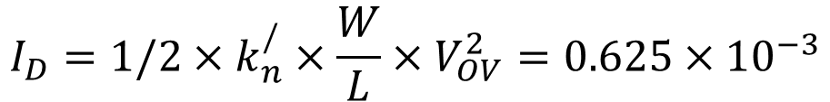
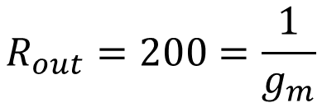
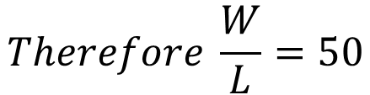
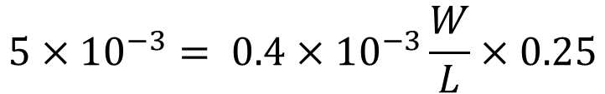

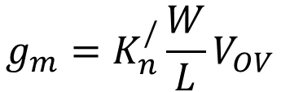


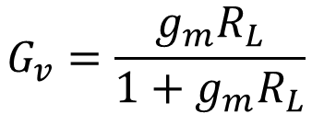
$$R_{out}=200=\frac{1}{g_{m}}$$
$$g_{m}=5mA/V$$
$$g_{m}=K_{n}^{/}\frac{W}{L}V_{OV}$$
$${5×10}^{−3}= {0.4×10}^{−3}\frac{W}{L}×0.25$$
$$Therefore \frac{W}{L}=50$$
$$I_{D}=1/2×k_{n}^{/}×\frac{W}{L}×V_{OV}^{2}=0.625×{10}^{−3}$$
$$G_{v}=\frac{g_{m}R_{L}}{1+g_{m}R_{L}}$$
$$fOR 1K <R_{L}<10K$$
$$0.83V/V<G_{v}<0.98V/V$$

Slide 58
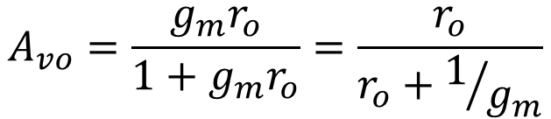

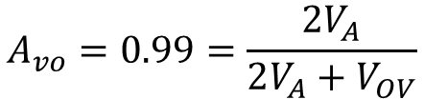
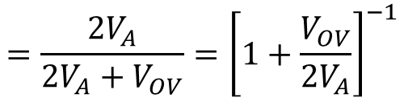
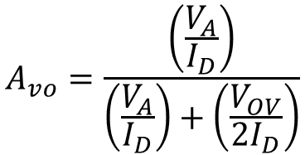
$$A_{vo}=\frac{\left(\frac{V_{A}}{I_{D}}\right)}{\left(\frac{V_{A}}{I_{D}}\right)+\left(\frac{V_{OV}}{{2I}_{D}}\right)}$$
$$=\frac{{2V}_{A}}{2V_{A}+V_{OV}}={\left[1+\frac{V_{OV}}{{2V}_{A}}\right]}^{−1}$$
$$A_{vo}=\frac{g_{m}r_{o}}{1+g_{m}r_{o}}=\frac{r_{o}}{r_{o}+1/{g_{m}}}$$
$$A_{vo}=0.99=\frac{{2V}_{A}}{2V_{A}+V_{OV}}$$
$$V_{OV}=0.4 V$$

Slide 60
Substituting The values in
$$i_{D}=0.5×250×{10}^{−6}×{\left(0.1\right)}^{2}=1.25×{10}^{−6}$$

Slide 61
$$v_{D}=5−1.25×{10}^{−6}×100=4.999875$$
$$v_{D}=5−1.25×{10}^{−6}×1000=4.99875$$
$$v_{D}=5−1.25×{10}^{−6}×10000=4.9875$$

Slide 65
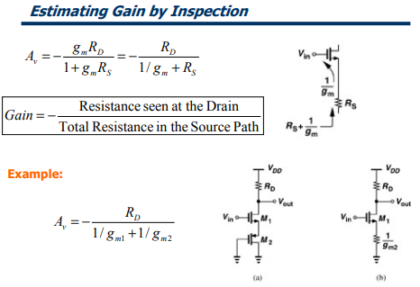

Slide 67
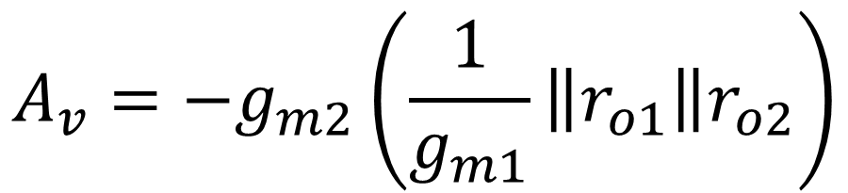
A more accurate expression for the gain of the stage in Figure below ; must take channel-length modulation into account.
$$A_{v}=−g_{m2}\left(\frac{1}{g_{m1}}\left\|r_{o1}\right\|r_{o2}\right)$$

Slide 70
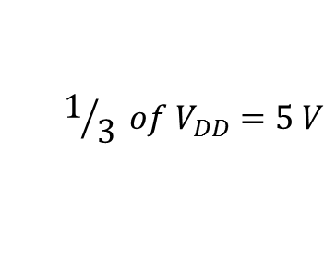
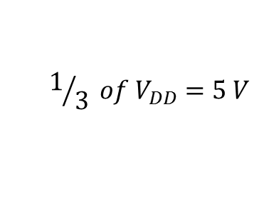
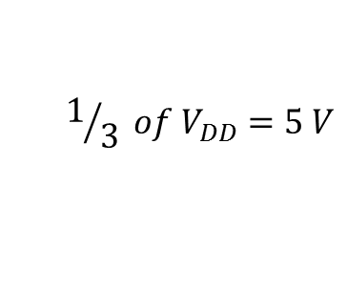
$$If R_{G1} and R_{G2} were equal then V_{G} would be 7.5V$$
$$1/3 of V_{DD}=5 V$$
$$1/3 of V_{DD}=5 V$$
$$1/3 of V_{DD}=5 V$$

Slide 72

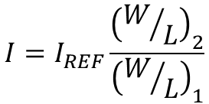







$$I=I_{REF}\frac{{\left(W/L\right)}_{2}}{{\left(W/L\right)}_{1}}$$
$$Therefore I_{REF}=0.5×{10}^{−3}×\frac{1}{5}=0.1 mA$$
-3.5
$$I_{REF}=0.1mA=\frac{1}{2}K_{n}^{/}{\left(\frac{W}{L}\right)}_{1}V_{OV}^{2}$$
$Therefore V_{OV}=0.5$V
-5V
$$V_{GS}=V_{OV}+V_{T}=1.5V$$
$$R=\frac{V_{GS}−V_{G}}{I_{REF}}=\frac{5−\left(−3.5\right)}{0.1×{10}^{−3}}=85 KΩ$$
$$V_{GS}=V_{G}−V_{S}=1.5V$$
$$V_{DS2}≥V_{OV} V_{DSmin}=V_{OV}=0.5$$
$Therefore V_{G}=−3.5$V
$Therefore V_{Dmin}=V_{D}−V_{S}=0.5−5=− 4.5$V

Slide 73
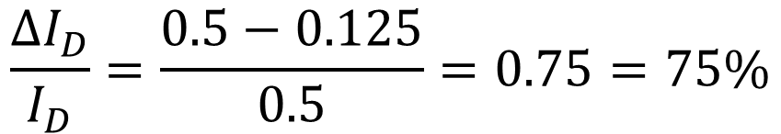

$I_{D}=\frac{1}{2}k_{n}^{/}\frac{W}{L}{\left(V_{GS}−V_{t}\right)}^{2}$ Substituting the values we get $V_{GS}=2V$
NOW IF $V_{t}=1.5 V then$
$I_{D}=\frac{1}{2}×1×{10}^{−3}×{\left(2−1.5\right)}^{2}$ Therefore $I_{D}=0.125m$A
$$\frac{∆I_{D}}{I_{D}}=\frac{0.5−0.125}{0.5}=0.75=75\%$$

Slide 74


$$R_{D}=\frac{V_{DD}−V_{D}}{I_{D}}=\frac{5−2}{0.5×{10}^{−3}}=6 KΩ=6.2KΩ$$
$I_{D}=\frac{1}{2}k_{n}^{/}\frac{W}{L}{\left(V_{OV}\right)}^{2}$ Therefore $V_{ov}=1V$
$$V_{GS}=V_{OV}+V_{T}=1+1=2 V$$
$${2=V}_{GS}=V_{G}−V_{S}=0−V_{S}=−2 V$$

Slide 75






$$R_{S}=\frac{V_{S}−V_{SS}}{I_{D}}=\frac{−2−\left(−5\right)}{0.5×{10}^{−3}}=6 KΩ=6.2KΩ$$
If we choose $R_{D}=R_{S} =6.2kΩ$ THEN $I_{D }$will slightly change
$I_{D}=\frac{1}{2}×1×{\left(V_{GS}−1\right)}^{2}$ and also
$$V_{GS}=−V_{S}=5−R_{S}I_{D}$$
$$2I_{D}={\left(4−6.2I_{D}\right)}^{2}$$
$$I_{D}=0.49 mA OR 0.86 mA$$
$$I_{D}=0.86 results in V_{S}>0 or V_{S}>V_{G} which is not acceptable, therefore I_{D}=0.49 mA$$
$$V_{S}=−5+6.2×0.49=−1.96$$
$$V_{D}=5−6.2×0.49=1.96$$
$$R_{G} Should be in the range of 10 MΩ to have low current$$

Slide 76





$$I_{D}=0.5mA=\frac{1}{2}K_{n}^{/}{\left(\frac{W}{L}\right)}_{1}V_{OV}^{2}$$
$Therefore V_{OV}=$1 V
$$R_{D}=\frac{5−2}{0.5}=6K$$
$$V_{GS}=1+1=2V$$
$$For R_{D}=6.2 k standard value . For this R_{D} we$$
Have to recalculate $I_{D}$

