Slide 1


Slide 2
Chapter No 6 : BJTs
Introduction

Slide 3
Chapter 6 CLOs
1. The physical structure of the bipolar transistor and how it works.
2. How the voltage between two terminals of the transistor controls the current that flows through the third terminal, and the equations that describe these current–voltage characteristics.
3. How to analyze and design circuits that contain bipolar transistors, resistors, and dc sources.
4. How the transistor can be used to make an amplifier.
5. How to obtain linear amplification from the fundamentally nonlinear BJT.
6. The three basic ways for connecting a BJT to be able to construct amplifiers with different properties.
7. Practical circuits for bipolar-transistor amplifiers that can be constructed by using discrete components.

Slide 4
Mapping topics to sections
SNO | Topic | Section
1 | Device Structure & Physical Operation Current-Voltage Characteristics | 6.1,6.2
2 | BJT Circuit at DC | 6.3
3 | Applying the BJT in Amplifier Design | 6.4
4 | Small-Signal Operations and Models | 6.5
5 | Basic BJT Amplifier Configurations | 6.6
6 | Biasing in BJT Amplifier Circuit | 6.7
7 | Discrete-Circuit BJT Amplifier Transistor Breakdown and Temperature Effect | 6.8, 6.9

Slide 5
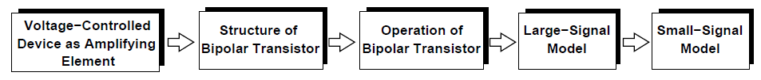
Class Lecture Sequence

Slide 6
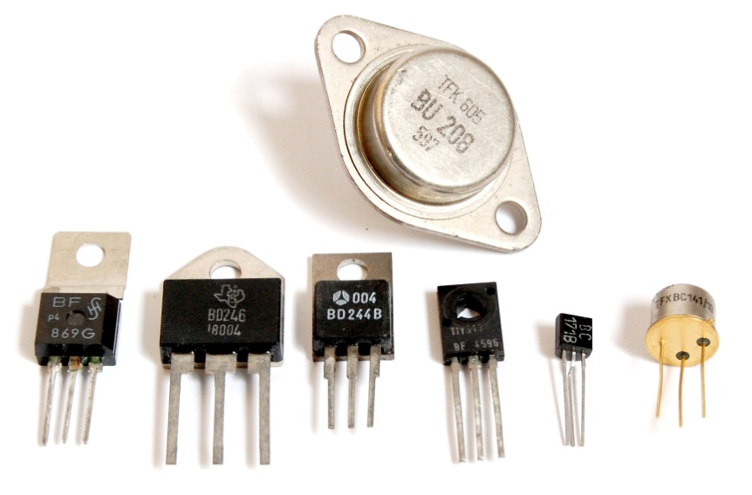
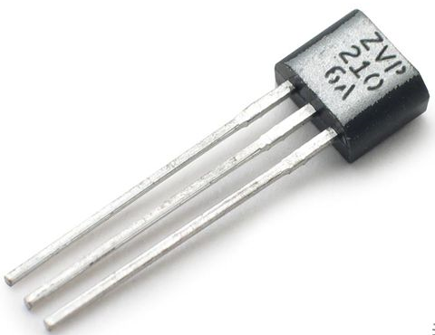
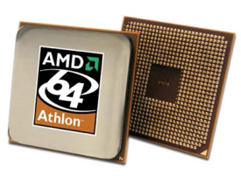


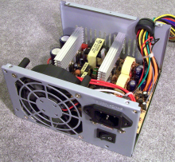
Basic Purpose
[1] To electronically switch (no moving parts) a signal on or off (high/low)
[2] To amplify signals
[3] Oscillators
Role in Modern Electronics
Basic building blocks for all modern electronics
Microprocessors, Microcontrollers, Computers, Digital watches, Digital Logic Circuits, Cell Phones….
Microprocessor
Headphones
PC & Cell Phones
Motor Controllers
Notes:
ROADMAP OF BUILD TRANSISTOR -> PROPERTIES

Slide 7
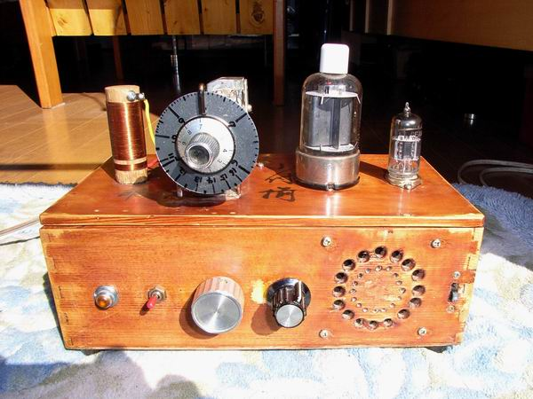
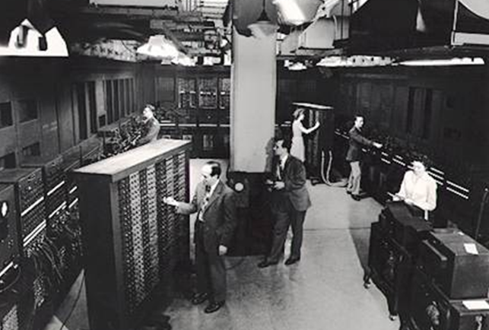
Reason for Transistor’s Invention:
Early 20th century, vacuum tube were used as signal amplifiers & switches.
Use of vacuum tube* resulted in extremely large, fragile, energy inefficient, and expensive electronics.
Evolution of electronics required device that was small, light weight, robust, reliable, cheap to manufacture, energy efficient…
Vacuum Tube Radios
ENIAC : 17, 468 vacuum tubes

Slide 8
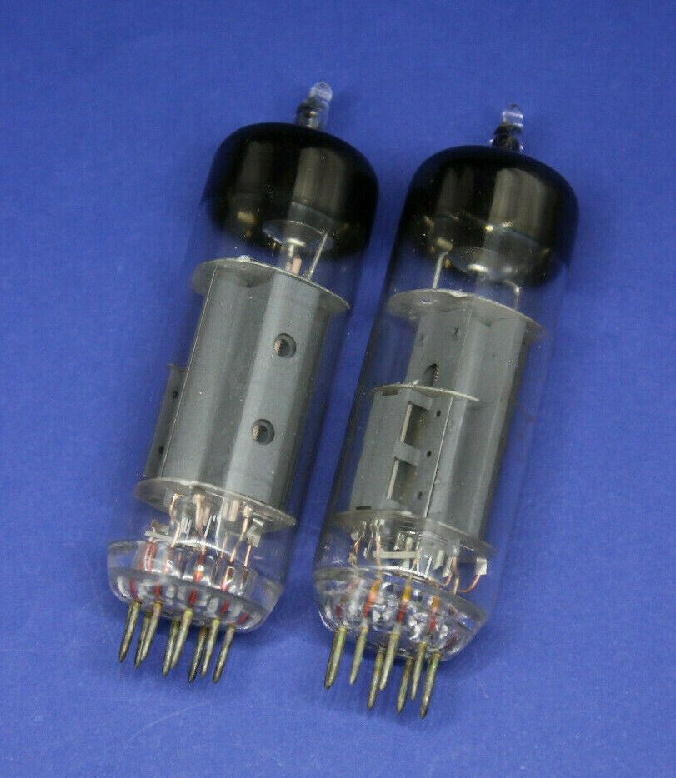
Tubes used in old electronics equipment

Slide 9
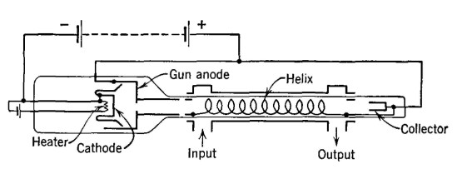
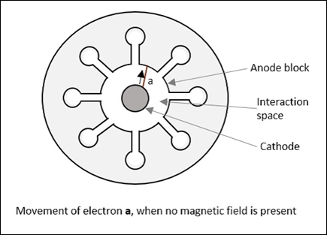
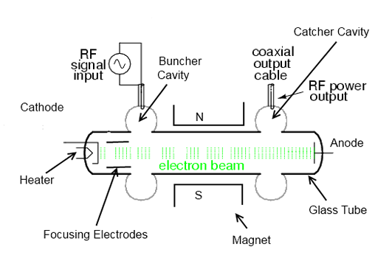
Tubes Amplifiers

Slide 10
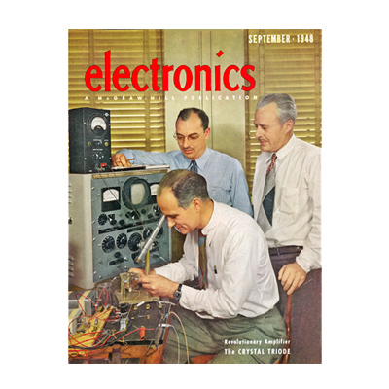
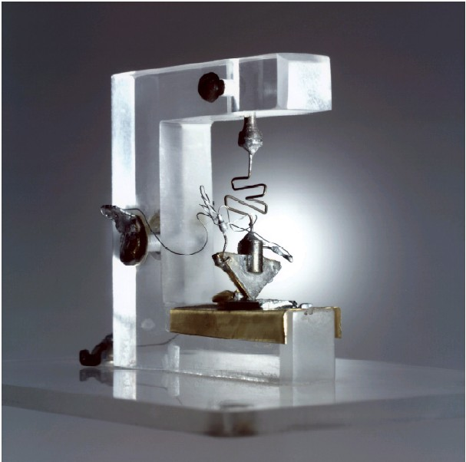

The Transistor is Born
Bell Labs (1947): Bardeen, Brattain, and Shockley
Originally made of germanium
Current transistors made of doped silicon

Slide 11
Introduction BJTs
Two terminal devices (Resistor,Capacitors, Inductors , diodes)
Transistor is a three terminal device
The basic principle involved is the use of the voltage between two terminals to control the current flowing in the third terminal
Transistors are Asymmetric devices

Slide 12
Two types of transistors (NPN, & PNP)
Four modes of operation
At least three type of configuration
Many applications; but we will concentrate on two, that is amplifier and switch
Many types of biasing arrangements but we will discuss only four
Low frequency and high frequency responses

Slide 13
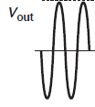

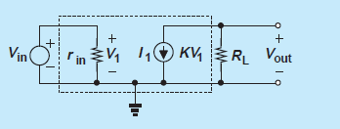
Amplifier
Key element for my Amplifier
A voltage dependent current source

Slide 14
Analogies

Slide 15
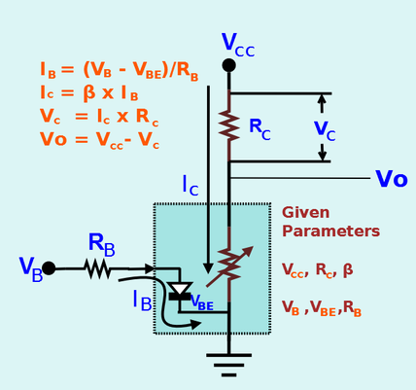
Analogy-1
Transistor is nothing but a variable resistor. The resistance value of Transistor is changed by the Base current (BJT) or Gate voltage (FET). The value of resistance varies between Zero and Infinity. When the resistance is Zero the transistor operates in Saturation mode. For specific Base current, if the resistance reached Zero after that increasing the Base current will not have any effect on the collector current. The same way when the Base current is Zero the Transistor resistance is Infinity.

Slide 16

Terminal -3
Terminal -1
Terminal -2
Analogy-2
Output current can toggle between large and small
(Switching → Digital logic; create 0s and 1s)
Small change in ‘valve’ (3rd terminal) creates Large
change in output between 1st and 2nd terminal
(Amplification → Analog applications; Turn 0.5 → 50)

Slide 17
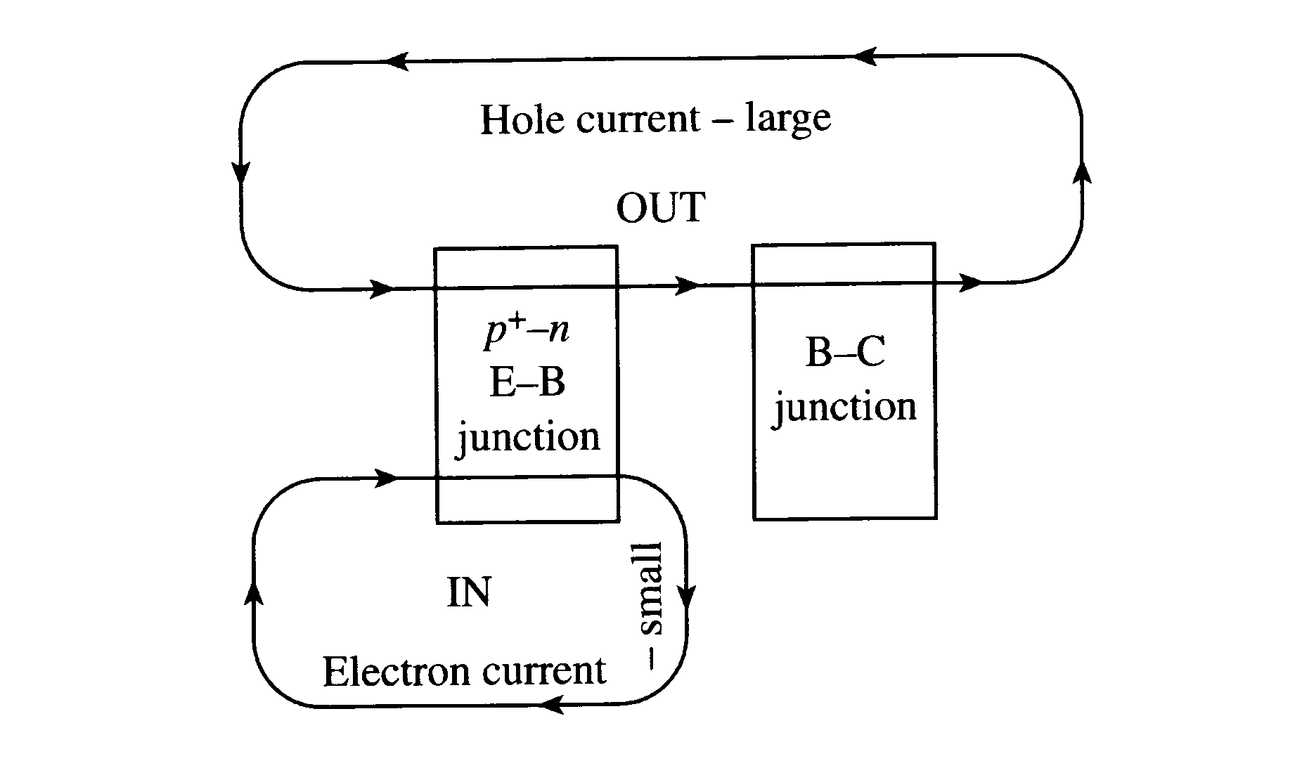
PNP transistor amplifier action
Analogy-2
IN (small)
OUT (large)
Clearly this works in common emitter
configuration

Slide 18
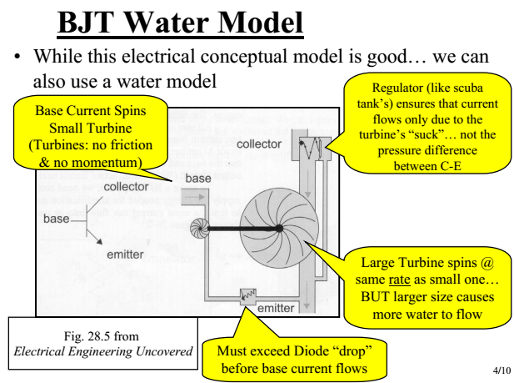
Analogy-3

Slide 19
Analogy-4
Collector
Base
Emitter

Slide 20
Review of some concepts

Slide 21
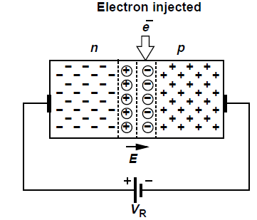
Carrier injection

Slide 22

Asymmetric Doping
$$p^{++}$$

Slide 23
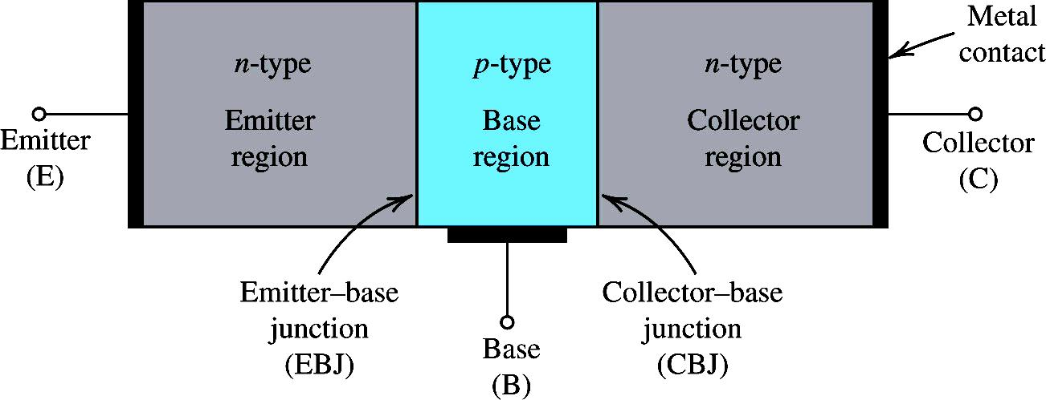
NPN Transistor Simplified Structure
Three regions & two junctions

Slide 24
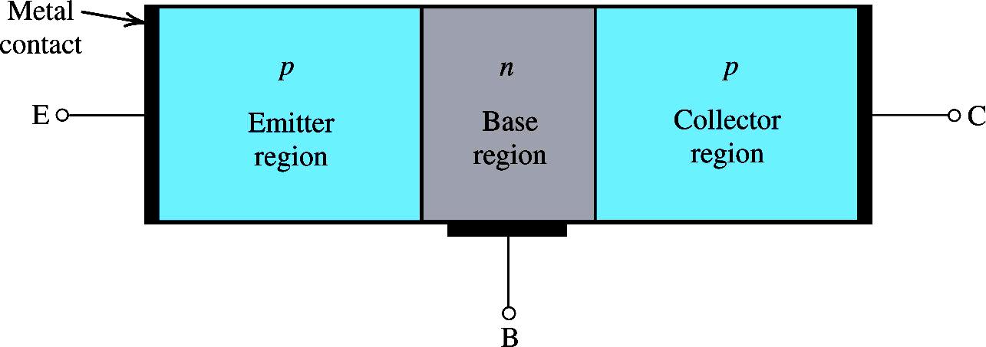
PNP Transistor Simplified Structure

Slide 25
NPN Transistor Modes of Operations
For Amplifier
As per our text book

Slide 26
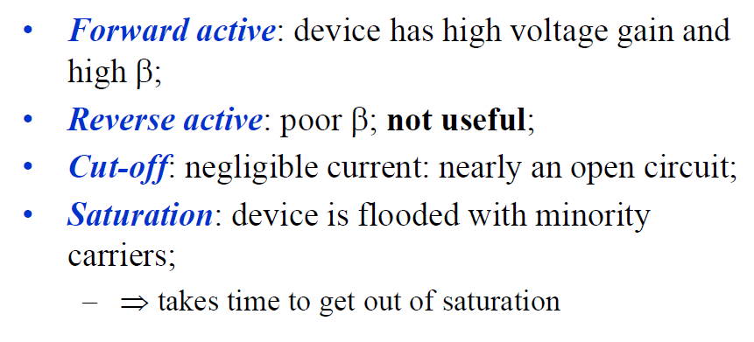

BJT Modes of Operation
Find out why not useful

Slide 27
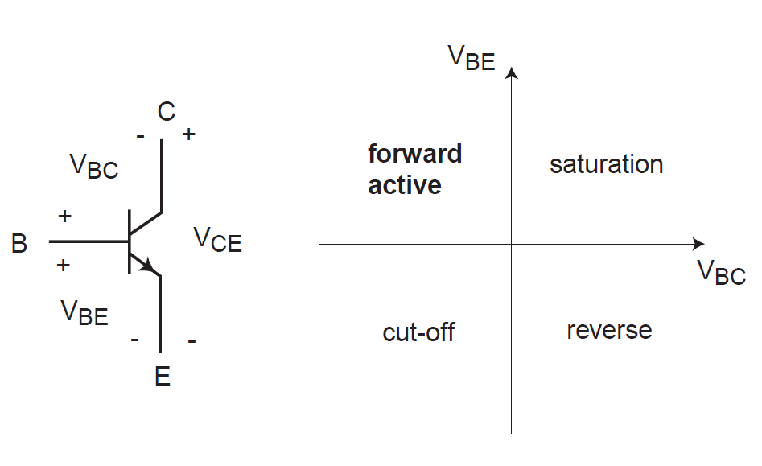
BJT Modes of Operation

Slide 28
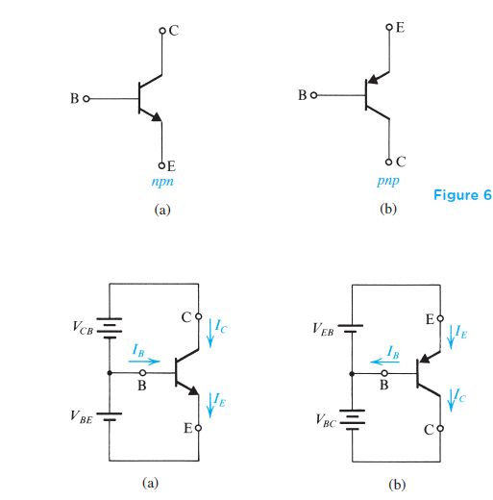
Symbol and basing of NPN and PNP transistors
High
High
Low
Low
Lowest
Lowest

Slide 29
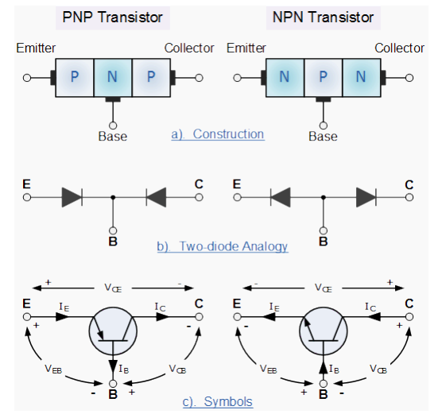

Slide 30
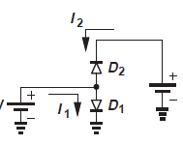
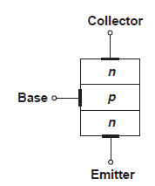
Can we model transistor as two back to back connected diodes?
From above figure it can be implied that D1 carries a current and D2 does not. Meaning we should anticipate current flow from the base to emitter but no current through the collector .
If this was true then transistor would not operate as voltage controlled current source and would prove of little value

Slide 31
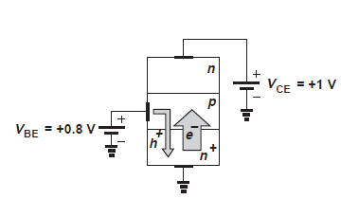
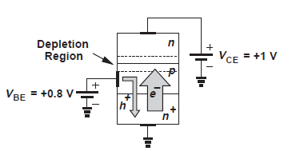
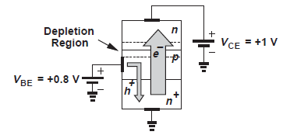
Then what is different here ?
Summary: In active mode an npn bipolar transistor carriers a large number of electrons from the emitter, through the base , to the collector while drawing a small current of holes through the base terminal
Emitter is heavily doped
Base is lightly doped
Base is very thin
Area of collector is much greater then emitter

Slide 33
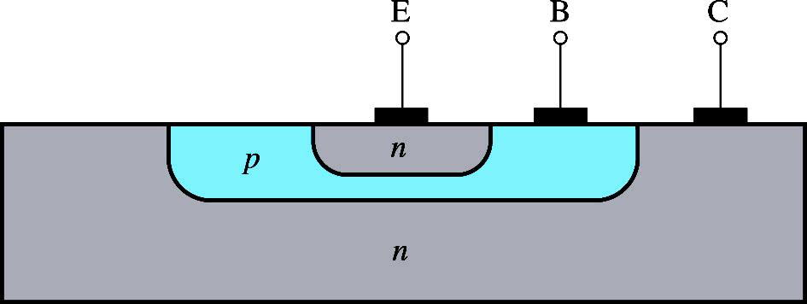
BJT Cross Sectional View
A more realistic cross section of an npn BJT
Note that the collector is very large and virtually surrounds the base- emitter region thus no electrons escapes from being collected here.
This makes α very close to unity
The device is not symmetrical so emitter and collector cannot be interchanged.

Slide 34
Question
It is highly desirable to have the electrons from emitter to base at a much higher level than the holes from base to emitter. Which is accomplished by fabricating the device with a heavily doped emitter and a lightly doped base; that is, the device is designed to have a high density of electrons in the emitter and a low density of holes in the base.
WHY ?

Slide 35
Important questions
How do electrons travel through the base?
Diffusion
Drift
How does resulting current depends upon terminal voltages?
How large is the base current?

Slide 36
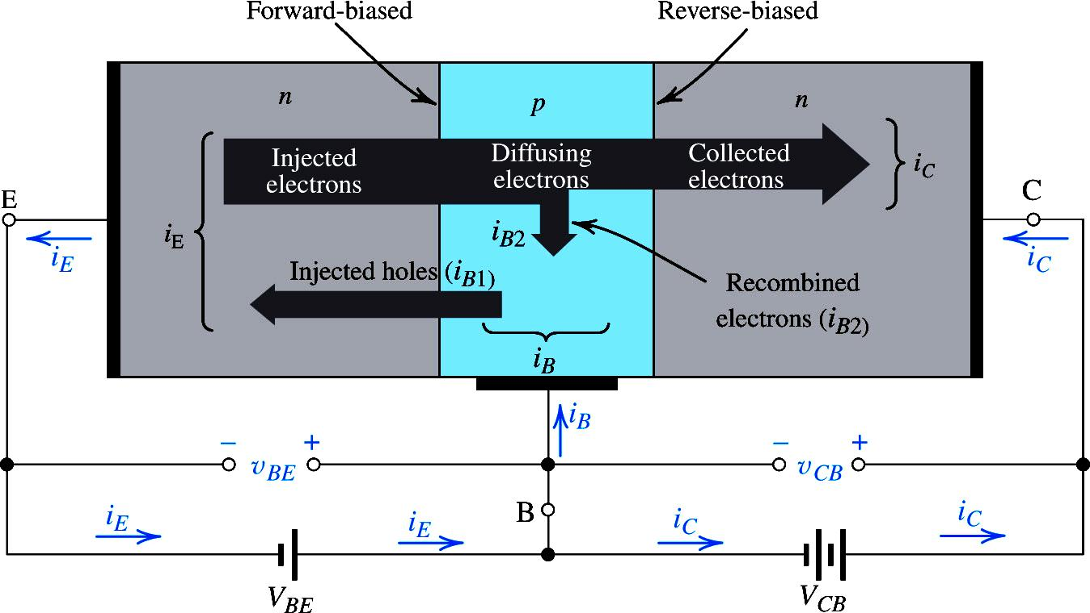
NPN Transistor Function
The Emitter Region is highly doped n-type material, so high density of electrons
Thus a large quantity of electrons flow from emitter to base
The base is lightly doped and it’s width is smaller than the emitter and collector, so low density of holes
Thus the quantity of holes flowing from base to emitter is very small compared to the electrons flowing in from the emitter

Slide 37
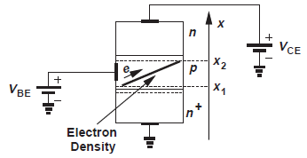
Because base is very thin and lightly doped, the electric field is negligible ,meaning negligible drift current and majority of current is by diffusion mechanism

Slide 38
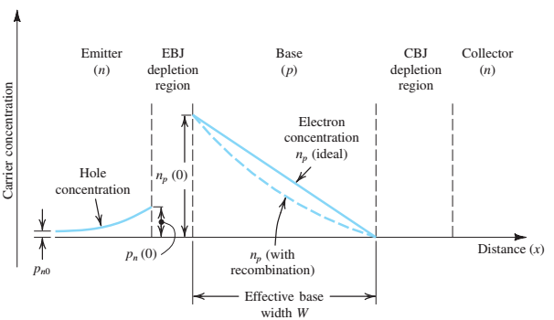
Further elaboration on current flow in transistor

Slide 39
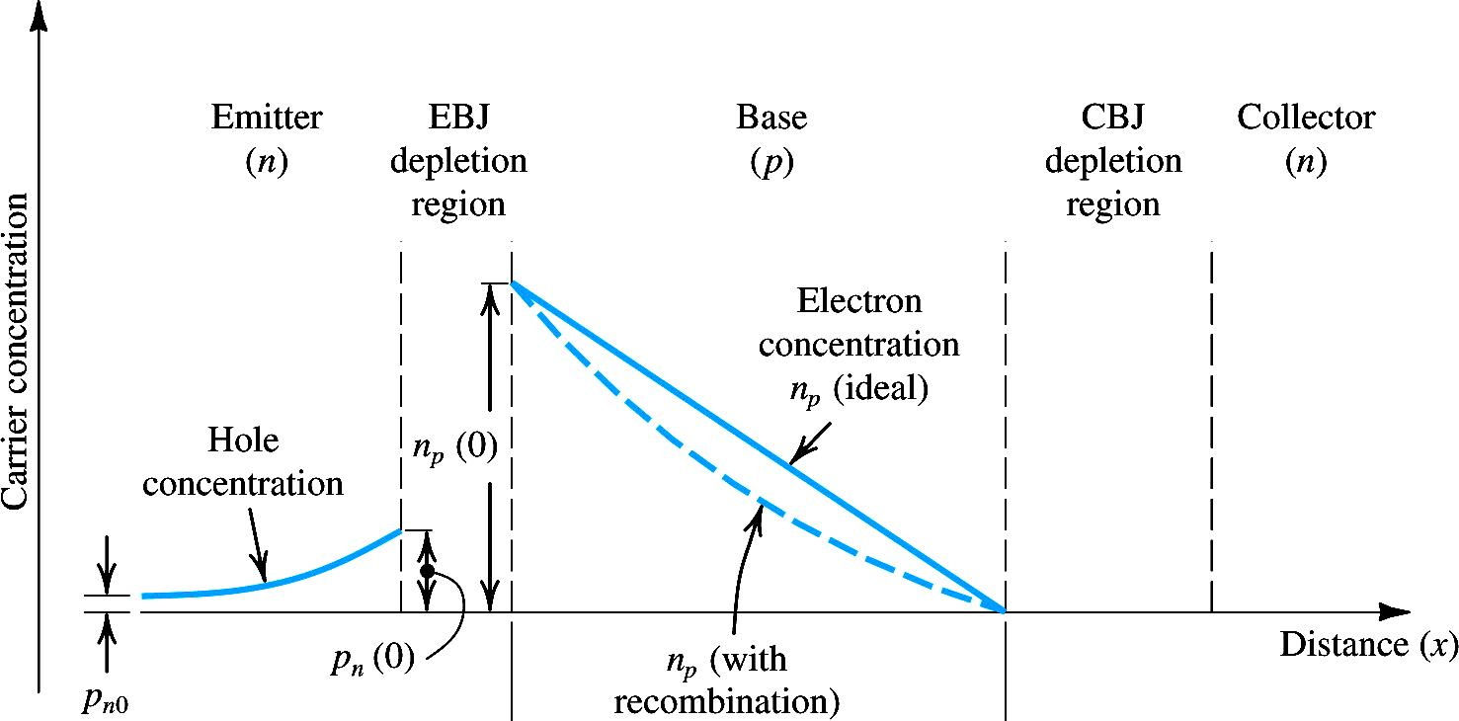
Further elaboration on current flow in transistor
The minority carrier distribution in the base results from the boundary conditions imposed by the two junctions.
It is not an exponentially decaying distribution, which would result if the base region were infinitely thick.
Furthermore, the reverse bias on the collector–base junction causes the electron concentration at the collector side of the base to be zero.

Slide 40
NPN Transistor Current Flows
The recombination of electrons and holes in base region makes the electrons concentration deviate from the straight line profile
Once the diffusing electrons reach the Base-Collector depletion region boundary, they will be swept away due to collector being more positive than base

Slide 41
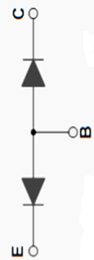


C
$$n^{+}$$
+
+
E
+
+
+
+
+
+
-
-
-
-
+
+
+
+
B
$$n^{++}$$
E

Slide 43
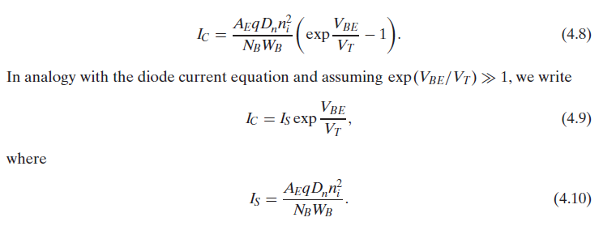
Answering the second question: dependence of current on voltage
Now we address the second question and compute the current flowing from collector to the emitter. As a forward bias diode , the equation for base-emitter junction is given by
Recall from the chapter 4 (Diodes); for the forward bias-region the current is given by the exponential relationship . The above equation implies that the bipolar transistor indeed operates as a voltage controlled current source , proving a good candidate for amplifier
Note that in an npn transistor electrons go from emitter to collector . Thus the conventional direction of current is from collector to the emitter

Slide 44
QUIZ ….only to Recap
How many terminals and regions are in BJT
How many junctions in BJT
BJT is asymmetric or symmetric device
How many types of BJT transistor are there
What are modes of operations of BJT
Why is emitter heavily doped while base is lightly doped
How does charges flow from emitter to collector
In which type of BJT current flows out of the base

Slide 45
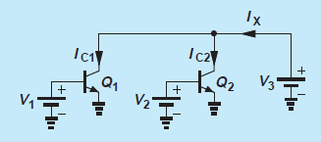
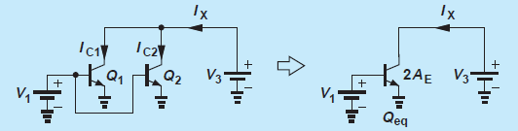
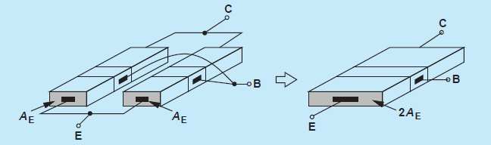
Example
Determine the current Ix, if Q1 and Q2 are identical and operate in active mode and V1=V2

Slide 46
Solution
Since
We have
The result can also be viewed as collector current of a single transistor having an emitter area of 2x A. In fact, redrawing the circuit and noting that Q1 and Q2, experiences identical voltages at their respective terminals, we say the two transistors are “parallel”, operating as a single transistor with twice the emitter area of each.

Slide 47
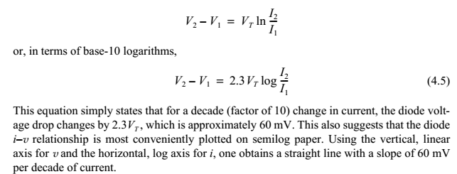
Example:2
If we double Area of a transistor and decrease its Base-Emitter voltage by 60 mv . What is the change in collector current
Because of the double Area
=0.1 , decade decrease in current
So almost 5 times reduction in collector current

Slide 48
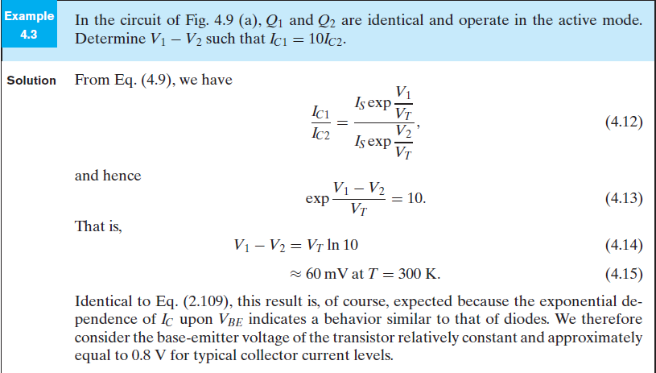
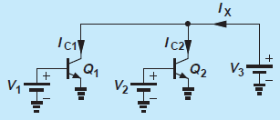

$$=57.5 mV$$

Slide 49
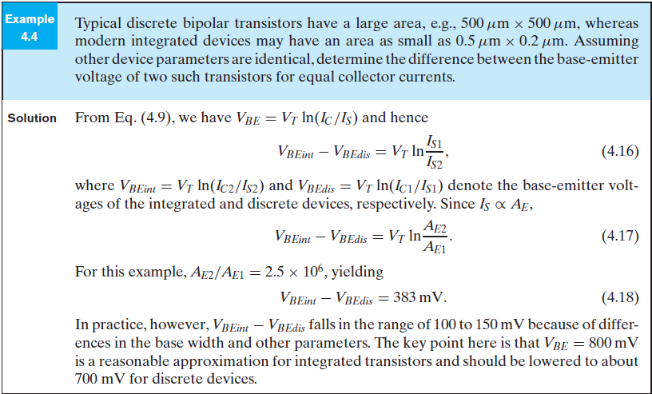

Since
or

Slide 50
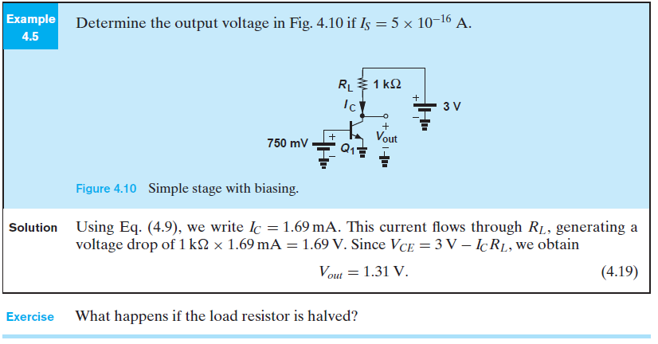

Determine output voltage if
This current flows through RL , generating a voltage drop of 1.69 V

Slide 51
Example: A transistor has a collector current of 1 mA and What is the value of VBE
Therefore VBE =778 mV
Now if β= 50,
This relationship you will understand in subsequent slides

Slide 52
Current Flows
Basically Three types of currents
Collector current
Base Current
Emitter Current

Slide 53
DC Analysis of BJTs
Transistor Currents:
I_{E} = I_{C} + I_{B}
alpha (α_{DC})
I_{C} = α_{DC}I_{E}
beta (β_{DC})
I_{C} = β_{DC}I_{B}
β_{DC} typically has a value between 20 and 200

Slide 54


NPN Transistor : Current Flow
This causes a diffusion current in the base region.
n_{p0} : the thermal-equilibrium value of the minority carrier concentration in the base region
$$n_{p(o)}$$
$$\frac{y_{2}−y_{1}}{x_{2}−x_{1}} =Slope=m$$
W

Slide 55
NPN Transistor: Collector Current

Slide 56
NPN Transistor: Collector Current

Slide 57
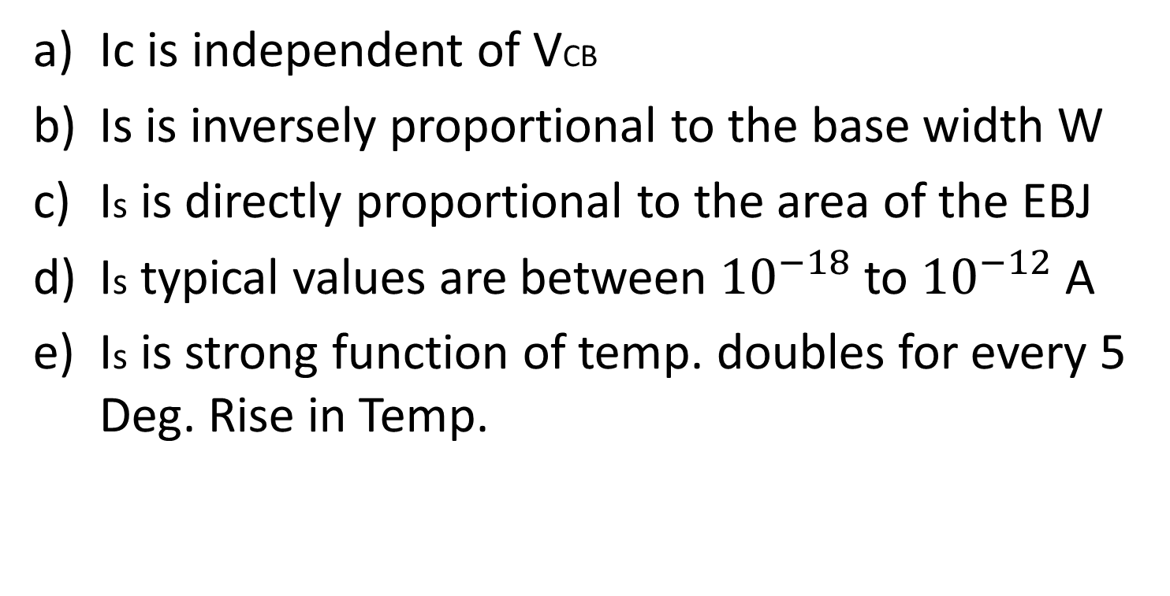
Important observations
Ic is independent of VCB
Is is inversely proportional to the base width W
Is is directly proportional to the area of the EBJ
Is typical values are between ${10}^{−18}$ to ${10}^{−12}$ A
Is is strong function of temp. doubles for every 5 Deg. Rise in Temp.

Slide 58
NPN Transistor: Base Current
Note it is proportional to not equal to

Slide 59
NPN Transistor: Base Current
The parameter β is called the common-emitter current gain
β is in the range 50 to 200, but it can be as high as 1000 for special devices

Slide 60
NPN Transistor: Emitter Current
α is called the common-base current gain.

Slide 61
Recapitulation
Basically, the forward-bias voltage VBE causes an exponentially related current iC to flow in the collector terminal.
The collector current Ic is independent of the value of the collector voltage as long as the collector–base junction remains reverse biased; that is, vCB ≥ 0.
Thus in the active mode the collector terminal behaves as an ideal constant-current source where the value of the current is determined by vBE. The base current iB is a factor 1/β of the collector current, and the emitter current is equal to the sum of the collector and base currents.
Since iB is much smaller than iC (i.e., β>> 1), iE = iC. More precisely, the collector current is a fraction α of the emitter current, with α smaller than, but close to, unity.

Slide 62
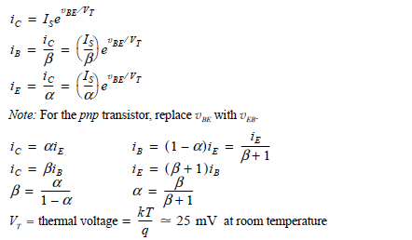
Summary of the BJT current – voltage Relationship in Active Mode

Slide 63
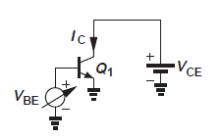

What is wrong here?
And desired
I wanted to have an output of 100mV ; it implies that I must have a resistance equal to

Slide 64
How can I fix it
2.48mA
1.7mA
760mv
10 mv
750mv

Slide 65
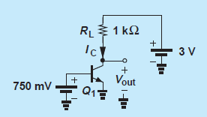
Biasing the transistor

Slide 66
Recommendations
Only class lecture are not enough self study is must
Must read text book
Understand and do examples from the book

