Slide 1


Slide 2
Solution Quiz No 3

Slide 3
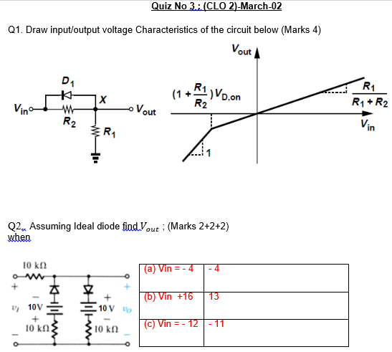

Slide 4
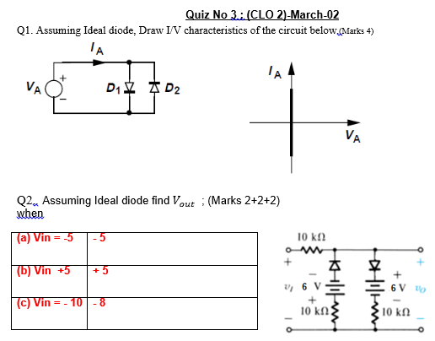

Slide 5
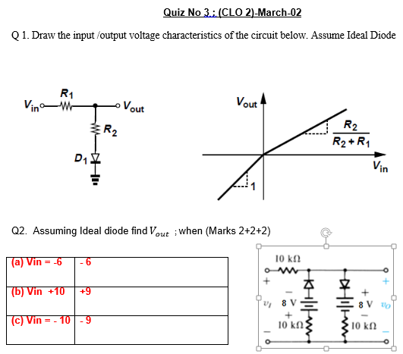

Slide 6
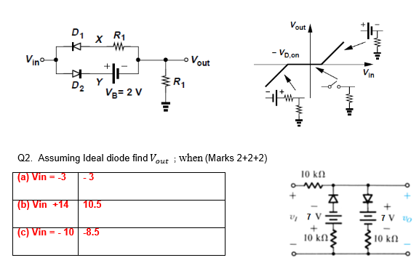

Slide 7
Sequence of Lecture
Review of previous lecture
Equivalent-Circuit Models (Large Signal Models)
Problem solving-1 (Example & Exercise problems)
Operation in the Saturation Mode
The pnp Transistor (Structure , Operation and equations)
Problem Solving-2 (Example & Exercise problems)

Slide 8
Brief Review

Slide 9
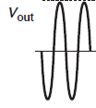

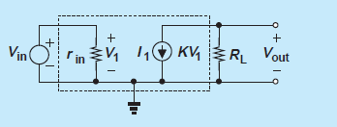
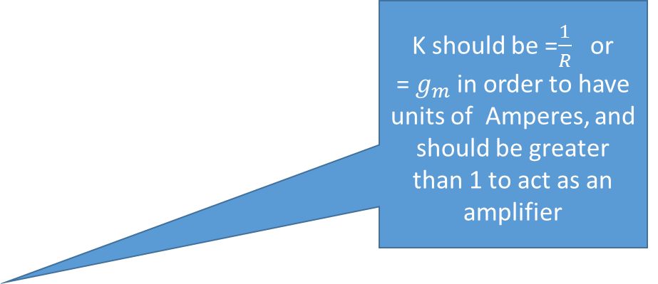
Checking your previous knowledge of BJT, which configuration of BJT this amplifier may be using ????
Amplifier
K should be =$\frac{1}{R}$ or
= $g_{m}$ in order to have units of Amperes, and should be greater than 1 to act as an amplifier
Key element for my Amplifier
A voltage dependent current source

Slide 10
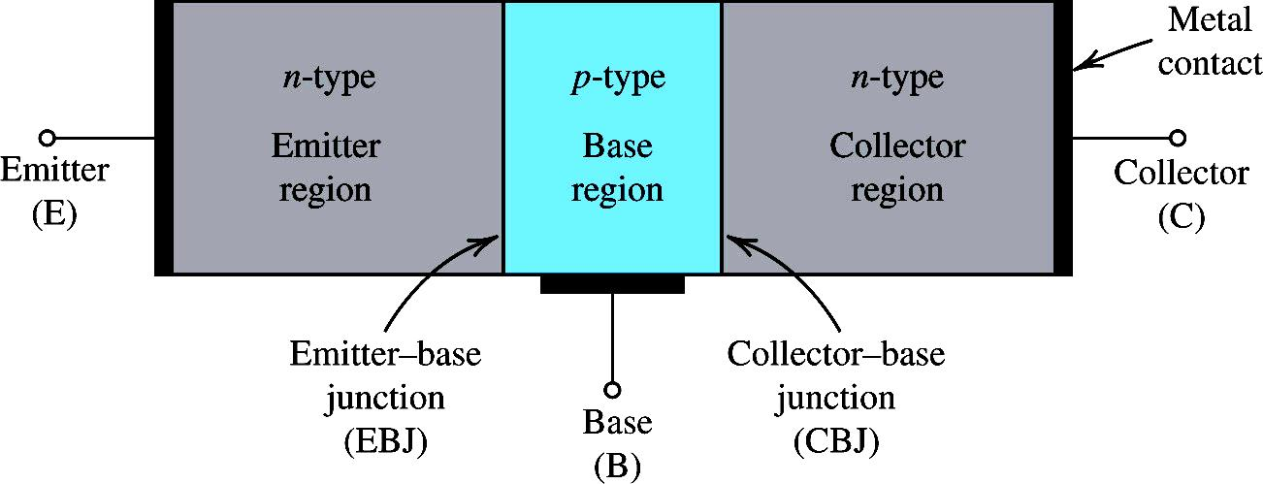
NPN Transistor Simplified Structure
Three regions & two junctions

Slide 11
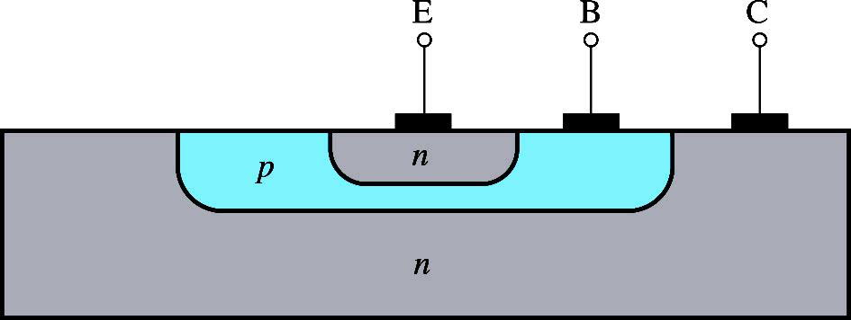
BJT Cross Sectional View
A more realistic cross section of an npn BJT
Note that the collector is very large and virtually surrounds the base- emitter region thus no electrons escapes from being collected here.
This makes α very close to unity
The device is not symmetrical so emitter and collector cannot be interchanged.

Slide 12
NPN Transistor Modes of Operations
For Amplifier
As per our text book

Slide 13
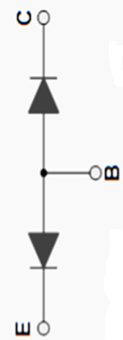
C
$$n^{+}$$
+
+
E
+
+
+
+
+
+
-
-
-
-
+
+
+
+
B
$$n^{++}$$
E

Slide 14
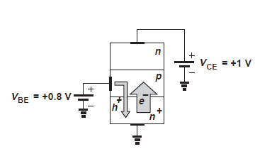
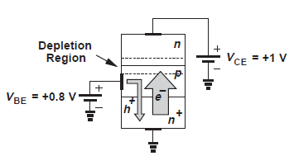
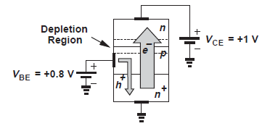
Then what is different here ?
Summary: In active mode an npn bipolar transistor carriers a large number of electrons from the emitter, through the base , to the collector while drawing a small current of holes through the base terminal
Emitter is heavily doped
Base is lightly doped
Base is very thin
Area of collector is much greater then emitter

Slide 15

Symbol & current flow
RB
FB
FB
RB
For active mode
of operation. Irrespective
of it is NPN or PNP
EBJ = FB
CBJ = RB
$$I_{E}=I_{C}+I_{B}$$

Slide 16
Lecture No 5

Slide 17
Large Signal $π$-model
Note:- W e would usually use T-model when there is a resistor connected between emitter and the ground or an input signal given from the emitter side. Otherwise we may prefer to use π- model, specially when emitter is grounded

Slide 18
Large Signal T-model
This first-order model of transistor operation in the active mode can be represented by the equivalent circuit shown in Fig
$$I_{SE}≥I_{S} As α≤1$$

Slide 19
NPN Transistor: Emitter Current
α is called the common-base current gain.

Slide 21
$$I_{B}=\frac{I_{C}}{β}=\frac{I_{S}}{β}e^{{V_{BE}}/{V_{T}}}$$

Slide 23
Exercise problems

Slide 24
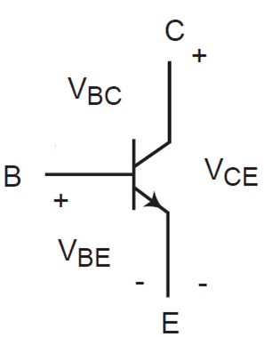
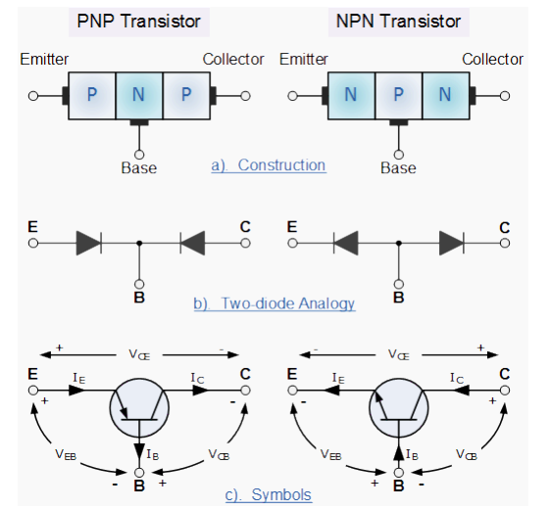
C
C
+
+
0.4 V
1.7 V
$$V_{CB}$$
-
B
$$V_{CE}$$
2.4 V
+
0.3 V
0.7 V
$$V_{BE}$$
0.7 V
$$V_{CE}=V_{CB}+V_{BE}$$
E
-
-
E
$$V_{CE}=−V_{BC}+V_{BE}$$

Slide 25
Operation in Saturation mode

Slide 26
$$V_{CE}=V_{CB}+V_{BE}$$

Slide 27
Model in Saturation mode

Slide 28
PNP Transistor

Slide 29
PNP Transistor

Slide 31
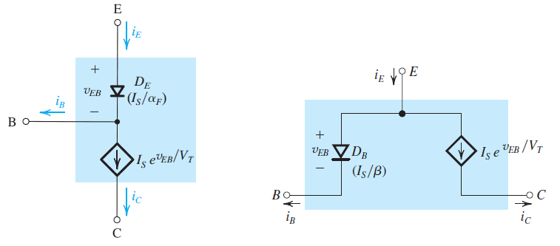

Slide 32
Graphical Representations

Slide 33
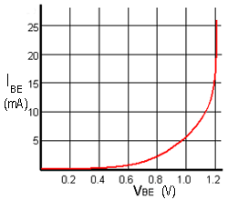
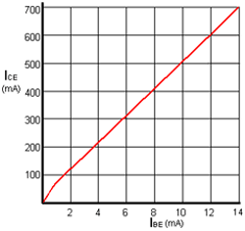
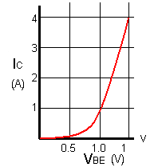
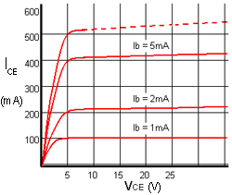
Transfer Characteristic
Input Characteristic
Output Characteristic
Mutual Characteristic

Slide 34
Problem Solving

Slide 35
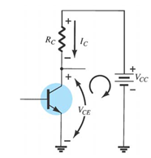
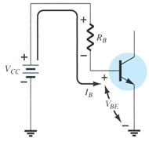
We can see basically two loops BE and CE

Slide 36
$$V_{Supply}=15$$
$$I_{C}=2mA$$
$$\frac{V_{Supply}−V_{C}}{I_{C}}$$
$$V_{Collector}=5$$

Slide 37
Solution

Slide 38
$$I_{E}=\frac{V_{E}−V_{EE}}{R_{E}}$$
$$I_{E}=\frac{−0.7−\left(−10\right)}{10×{10}^{3}}=0.93mA$$
$$α=\frac{β}{1+β}=\frac{50}{51}=0.98$$
$$I_{C}=α×I_{E}=0.98×0.93×{10}^{−3}=0.91mA$$
$$I_{B}=\frac{I_{C}}{β}=\frac{0.91}{50}=18.2μA$$
$$V_{C}=V_{CC}−I_{C}×R_{C}=5.45V$$
Please note that $V_{CE}=6.15 so not in saturation$

Slide 39
Note PNP , so current flows from emitter to colector; and out of the base
$$I_{E}=\frac{10−1.7}{5000}=1.66mA$$
$$I_{B}=\frac{1}{100000}=10μA$$
$1+β=\frac{I_{E}}{I_{B}}=16$6-1=165
$$α=\frac{β}{1+β}=0.994$$
$$I_{C}=\frac{V_{C}−{(−V}_{EE})}{R_{C}}$$
$$I_{C}=α×I_{E}=1.65mA$$
${Therefore V}_{C}=I_{C}×R_{C}−V_{EE}$= -1.75

Slide 41
As not in saturation so we used specified value of $β$

Slide 43
Home Assignment:
Do it yourself and cross check answers
Not to be submitted

Slide 44
Early effect
More Slope means more current
This increase & decrease in base width due to variation in VCE is called base-width modulation

Slide 45
Early effect
$$I_{C}=I_{S}×e^{{V_{BE}}/{V_{T}}}$$

Slide 46
Relationship

Slide 47
Modified Large signal model with early effect

Slide 48
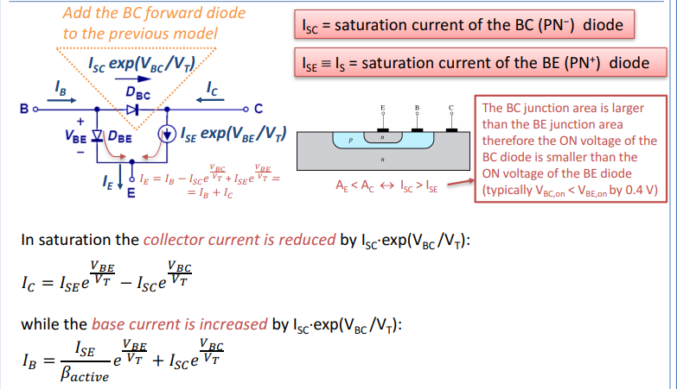

Slide 49
Reviewing Saturation: text book explnation

Slide 51
Reviewing Saturation

