Slide 1
Dr. Usman covered chapter 6 until 6.5.1: the collector current and its transconductance
6.1 Device Structure and Physical Operation
6.1.1 Simplified Structure and Modes of Operation
6.1.2 Operation of the npn Transistor in the Active Mode
6.1.3 Structure of Actual Transistors
6.1.4 Operation in the Saturation Mode
6.2 Current–Voltage Characteristics
6.2.1 Circuit Symbols and Conventions
6.2.3 Dependence of iC on the Collector Voltage—The Early Effect
6.3 BJT Circuits at DC
6.4 Applying the BJT in Amplifier Design
6.4.2 The Voltage Transfer Characteristic (VTC)
6.4.4 The Small-Signal Voltage Gain
6.5 Small-Signal Operation and Models
6.5.1 The Collector Current and the Transconductance

Slide 2
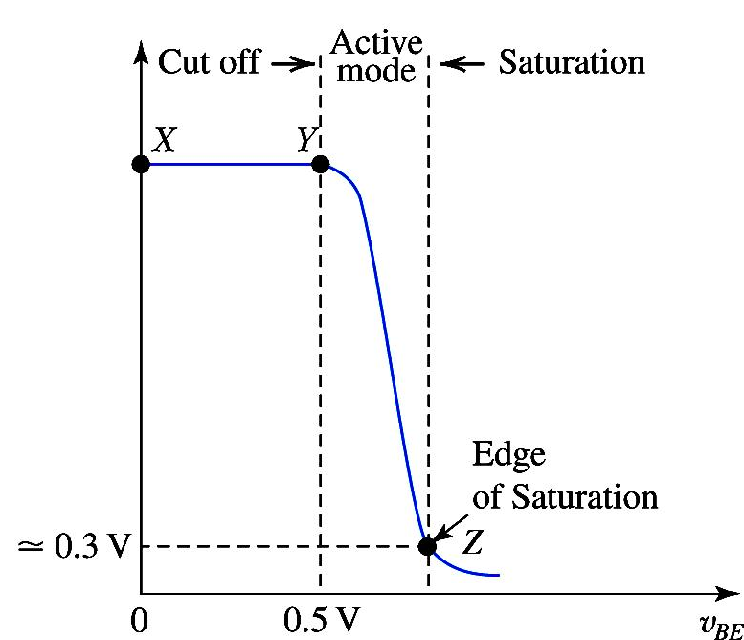
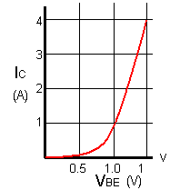
Some of the graphs to be kept in mind

Slide 3
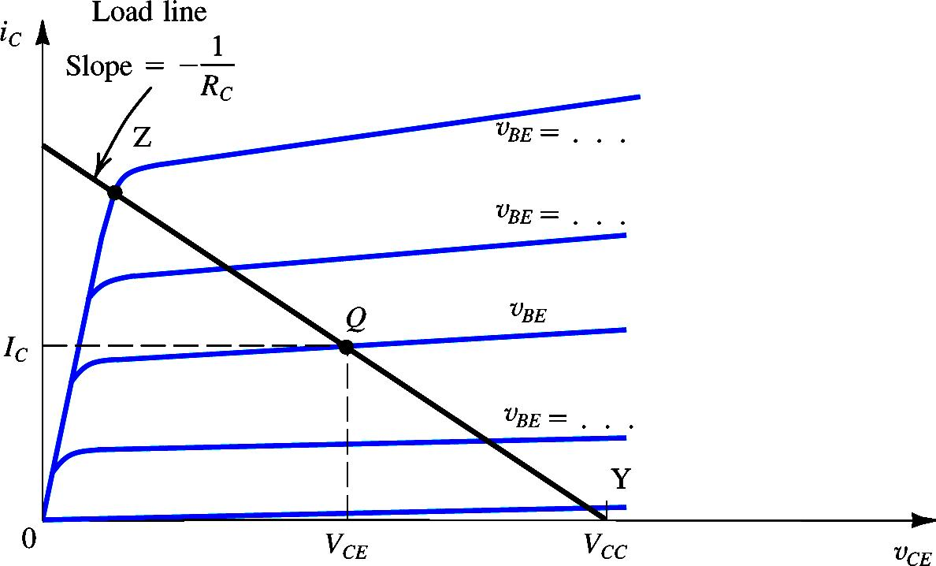
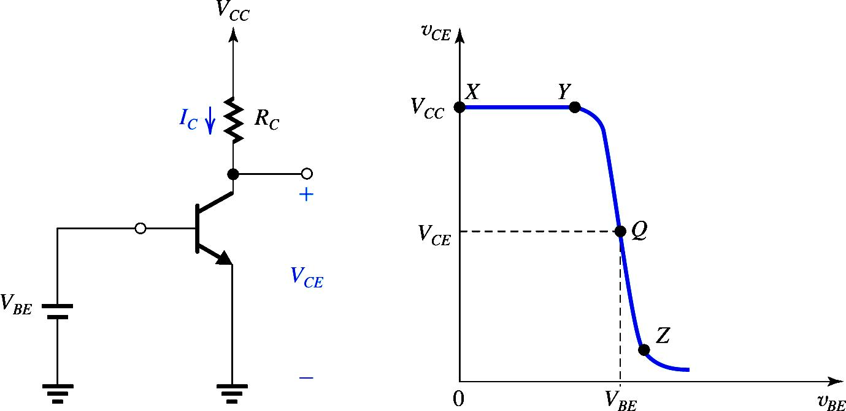
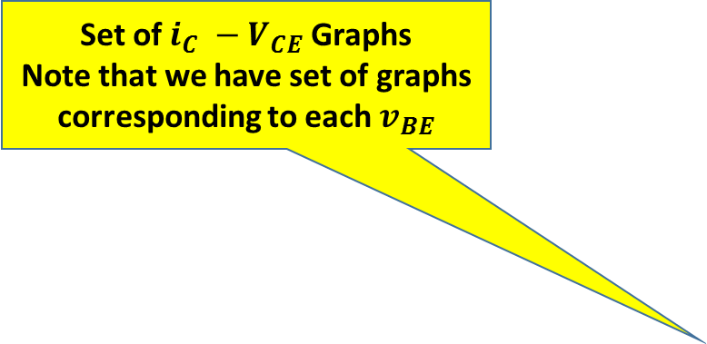
Set of $i_{C} −V_{CE}$ Graphs
Note that we have set of graphs corresponding to each $v_{BE}$
Graphical Analysis: Locating Bias Point
Determine Load Line
Which point on Load line
Point Y : v_{BE} = 0.5
Point Z : BJT leave the active mode

Slide 4
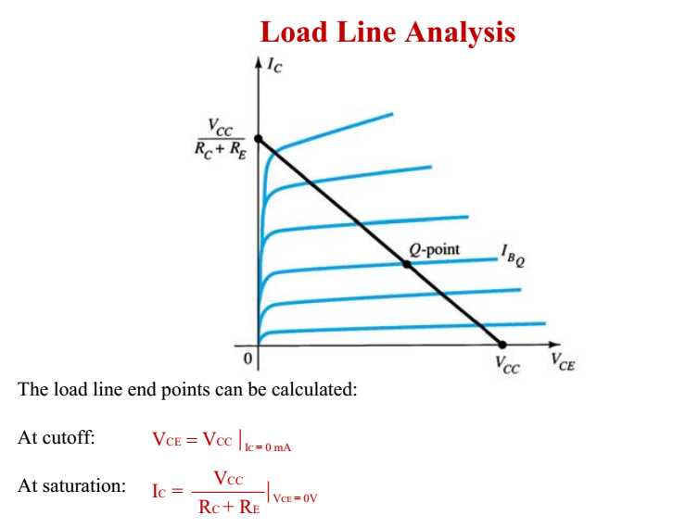

Slide 5
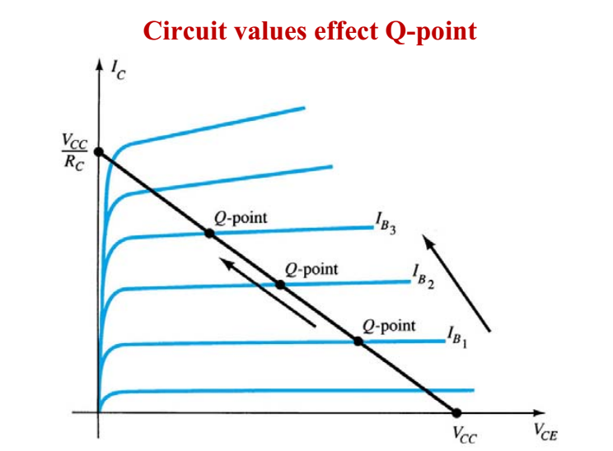
Note :As we increase IB The Q point moves upward, that is closer to saturation region

Slide 6
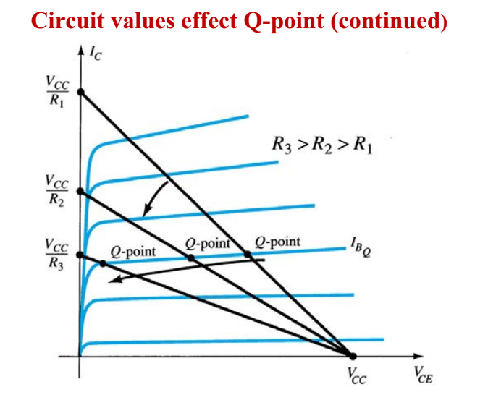
With increasing R the slope decreases

Slide 7
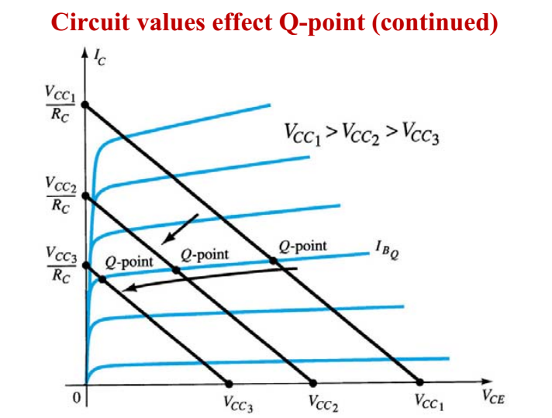
What is observation Here?

Slide 8
6.4 Applying the BJT in Amplifier Design
6.4.2 The Voltage Transfer Characteristic (VTC)
6.4.4 The Small-Signal Voltage Gain

Slide 9
BJT as Amplifier

Slide 10
BJT as Amplifier
when operated in the active mode, the BJT functions as a voltage-controlled current source: the base–emitter voltage controls the collector current
Although the control relationship is nonlinear (exponential), we will shortly devise a method for obtaining almost-linear amplification from this fundamentally nonlinear device.

Slide 11
BJT as Amplifier
A voltage-controlled current source can serve as a transconductance amplifier, that is, an amplifier whose input signal is a voltage and whose output signal is a current
A simple way to convert a transconductance amplifier to a voltage amplifier is to pass the output current through a resistor and take the voltage across the resistor as the output.

Slide 12
The Voltage Transfer Characteristic (VTC)
A very useful tool that yields great insight into the operation of an amplifier circuit is its voltage transfer characteristic (VTC). This is simply a plot of the output voltage versus the input voltage.( Graph)

Slide 13
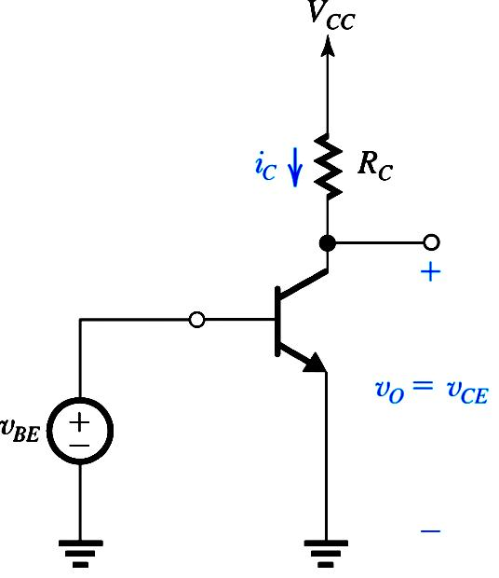
v_{O}
Negative Slope

Slide 14
Note that the output voltage is taken between the collector and ground, rather than simply across Rc. This is done because of the need to maintain a ground reference throughout the circuit. The output voltage is given by
The out put is 180 Deg. Phase shifted
(x-y) For Cutoff mode and
(y-Z) Active mode
Saturation mode
For greater than that at point Z,
the transistor operates in the saturation region and decreases very slowly

Slide 15
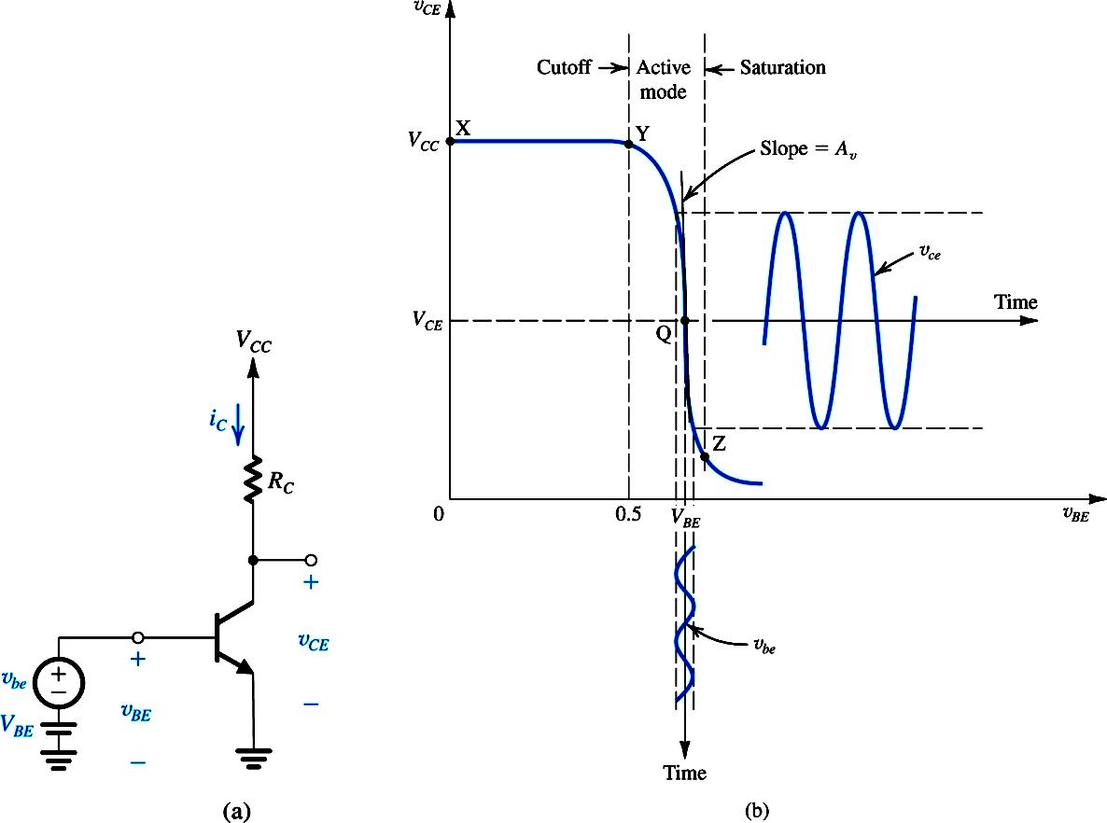
The VTC indicates that the segment of greatest slope (and hence potentially the largest amplifier gain) is that labeled YZ, which corresponds to operation in the active mode. An expression for the segment YZ can be obtained by
This is obviously a nonlinear relationship.
linear (or almost-linear) amplification can be obtained by using the technique of biasing the BJT.

Slide 16
Biasing the BJT to Obtain Linear Amplification
Biasing enables us to obtain almost-linear amplification from the BJT.
A dc voltage is selected to obtain operation at a point Q on the segment YZ of the VTC.
observe that the coordinates of Q are the dc voltages and which are related by

Slide 17
Biasing BJT for Linear Amplification

Slide 18
Biasing BJT for Linear Amplification

Slide 19
Biasing BJT for Linear Amplification

Slide 20

Next the signal to be amplified a function of time t is superimposed on the bias voltage . Thus the total instantaneous value of becomes

Slide 21
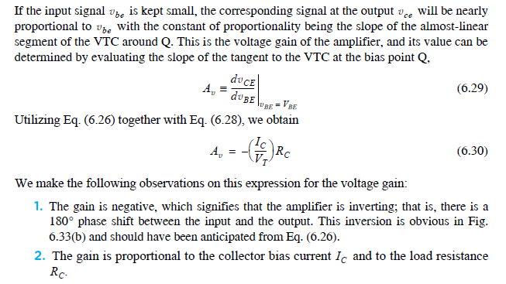
The Small-Signal Voltage Gain

Slide 22
The Small-Signal Voltage Gain

Slide 23
We make the following observations on this expression for the voltage gain:
The gain is negative, which signifies that the amplifier is inverting; that is, there is a 180 phase shift between the input and the output
2. The gain is proportional to the collector bias current and to the load resistance

Slide 24
Example 6.13
Consider an amplifier circuit using a BJT having IS = A, a collector resistance RC = 6.8 kΩ, and a power supply VCC = 10 V.
Determine the value of the bias voltage VBE required to operate the transistor
at VCE = 3.2 V. What is the corresponding value of IC?
(b) Find the voltage gain Av at this bias point. If an input sine-wave signal of 5-mV peak amplitude is superimposed on VBE, find the amplitude of the output sine-wave signal (assume linear operation).
(c) Find the positive increment in vBE (above VBE) that drives the transistor to the edge of saturation, where vCE = 0.3 V.
(d) Find the negative increment in vBE that drives the transistor to within 1% of cutoff (i.e., to vCE = 0.99VCC).

Slide 25
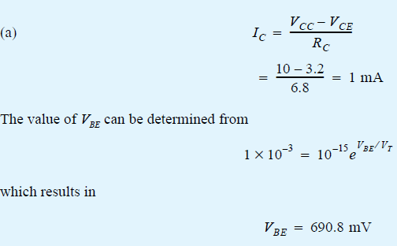

Slide 26
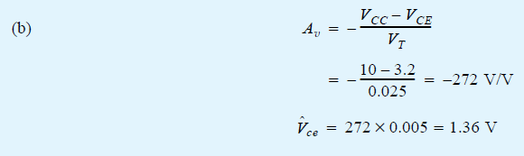
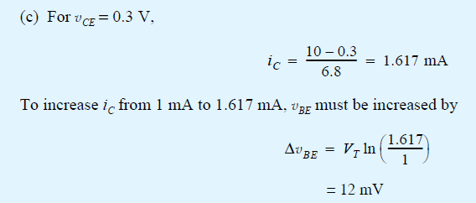
Voltage gain X input Voltage= Output voltage

Slide 27
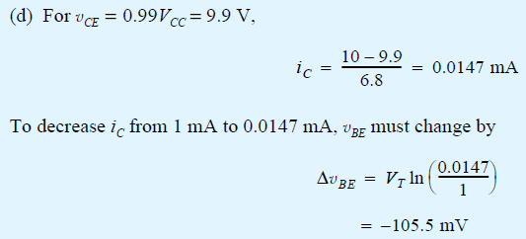

Slide 28
Assignment # 4
Example :6.14 and
Problems: 6.28, 6.29, 6.39

Slide 29
Small-Signal Operation and Models

Slide 30
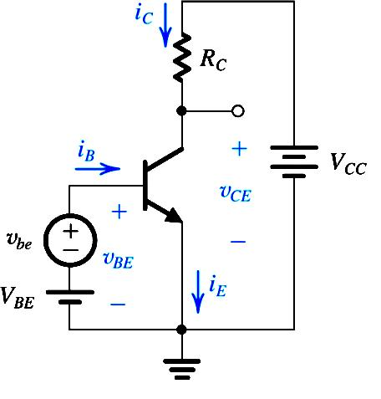
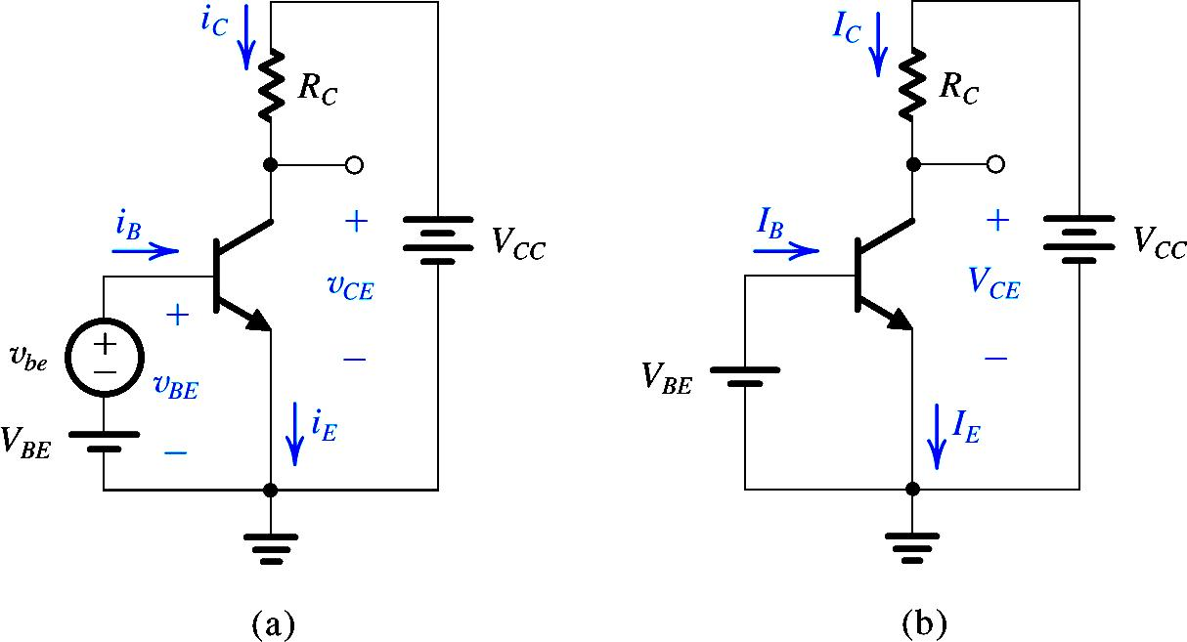
Small Signal Operation and Models

Slide 31
Transconductance

Slide 32
Transconductance
SS
DC
g_{m} is the
“transconductance”

Slide 33
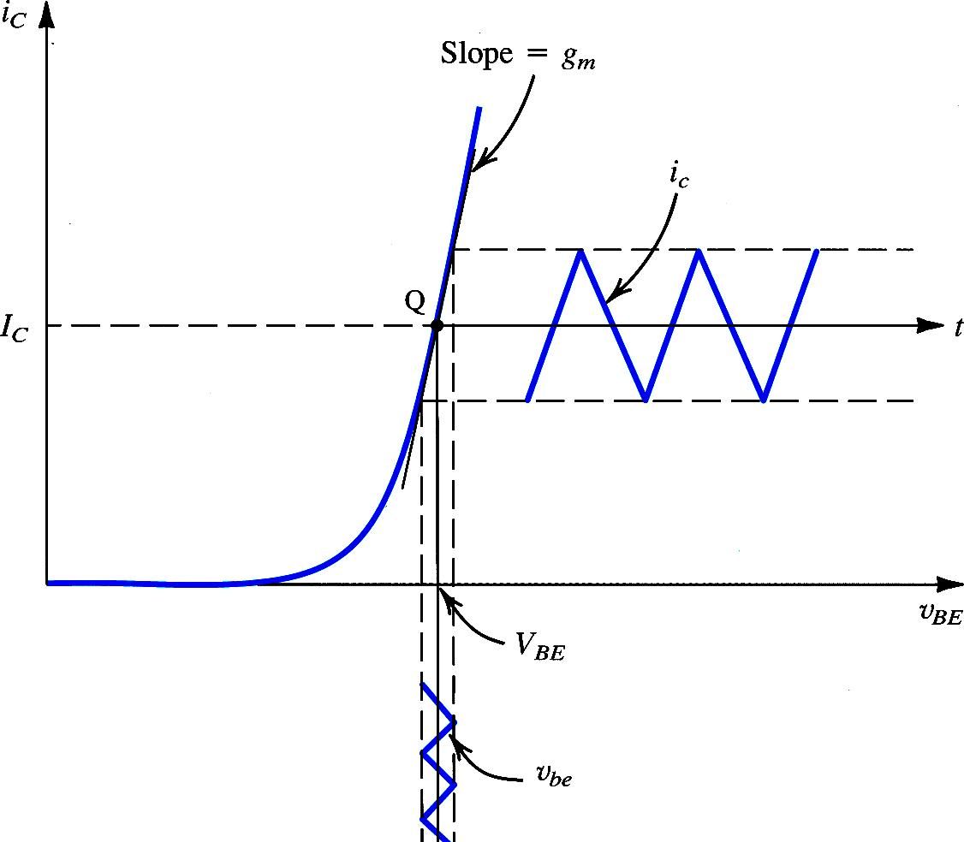
Transconductance
The signal amplitude should be small enough that operation is restricted to an almost linear segment of the
i_{C}-v_{BE} exponential curve
g_{m} varies with variation of Q point

Slide 34
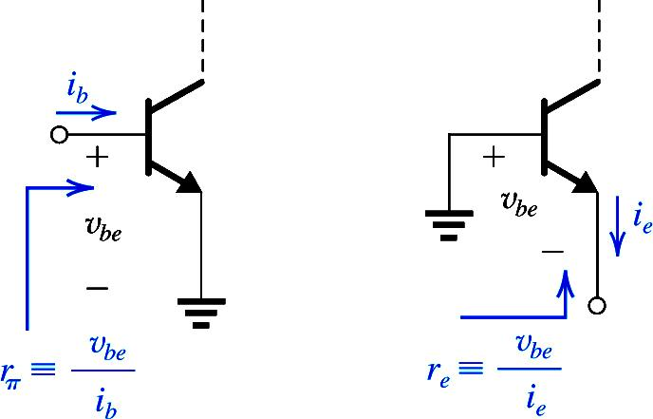
Base Current and Input Resistance

Slide 35
Emitter Current and Input Resistance

Slide 36
Did we use such eq. before?
Also Do Exercise 6.36 and 6.37 as part of assignment

Slide 37
Voltage Gain

Slide 38
Separating the DC & Signal Quantities
The total DC and Small signal circuit is shown.
The DC analysis yield the currents and voltages based on the relevant equations.
The DC sources do no change their values when the signal is applied.
We can replace DC voltages by short circuits and current sources by open circuits respectively to get the Small Signal Model.

Slide 39
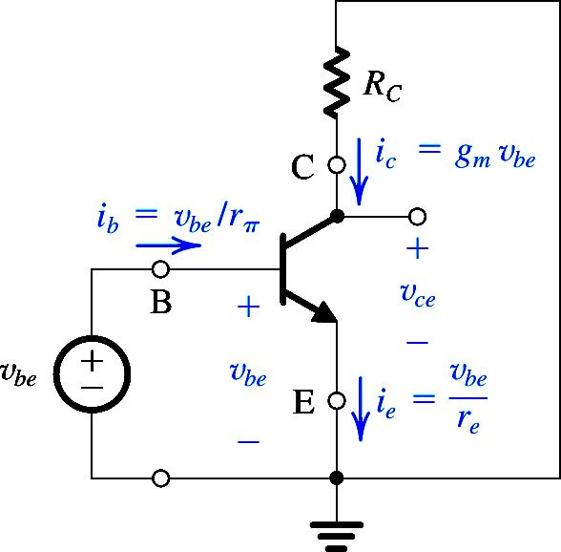
Separating the DC & Signal Quantities
The Small signal circuit is shown.
This circuit is useful only to analyze signal voltages and currents.
This is not an actual amplifier circuit.
This circuit shows all the incremental currents and voltages that occur due to applied small signal at the base.

Slide 40
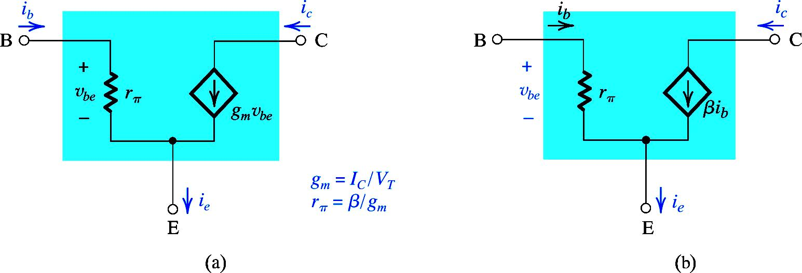
The Hybrid –π Model of BJT
Ie in terms of base resistance
Ie in terms of emitter resistance

Slide 41
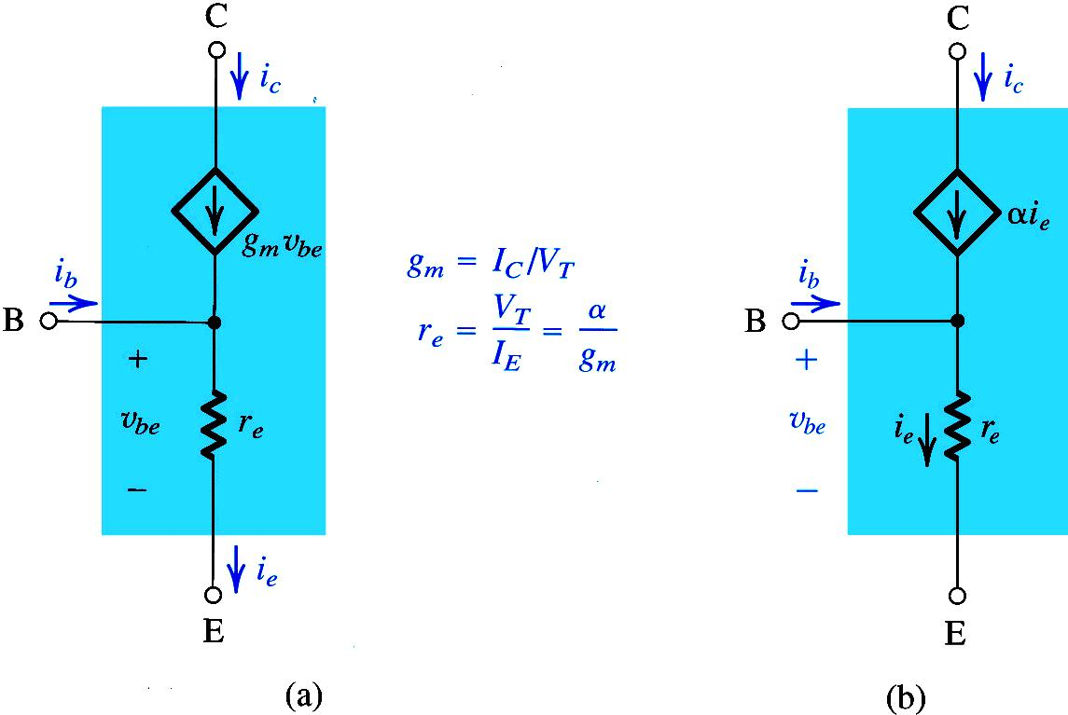
The T-Model of BJT

Slide 42
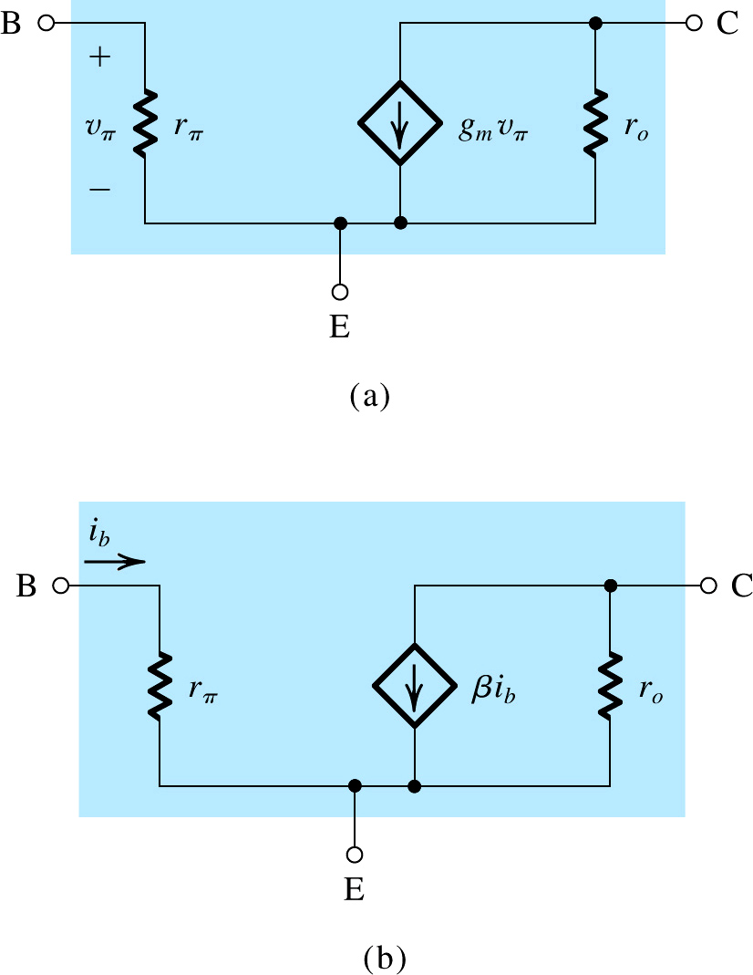
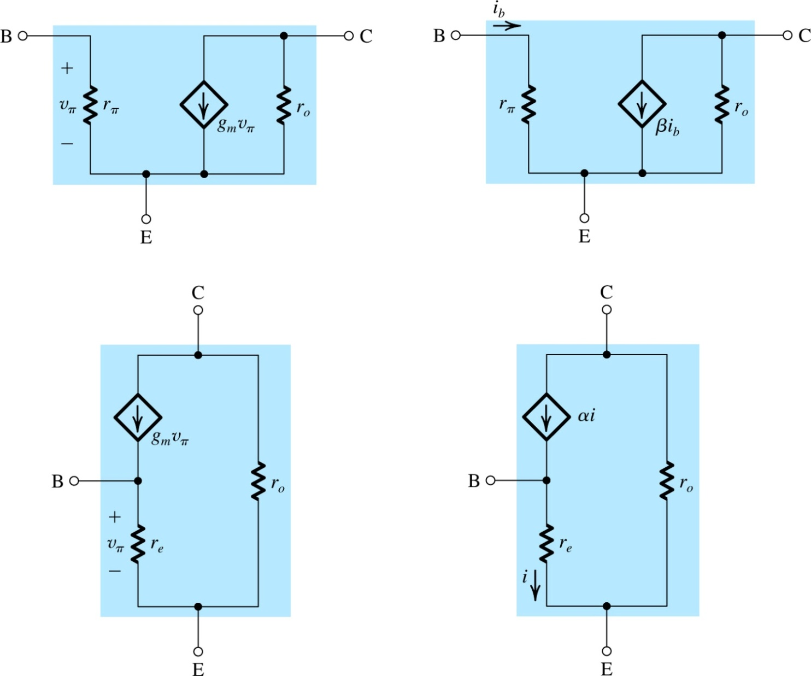
Small-Signal Models Accounting for the Early Effect
The gain will be reduced, depending upon ro

Slide 43
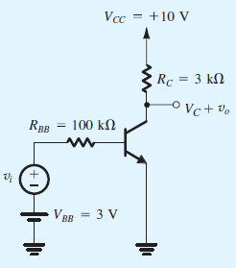

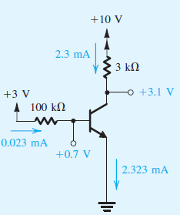

Example 6.14
Analyze the transistor amplifier shown in the Figure to determine its voltage gain v_{o}/v_{i}.
Assume β = 100.
Solution:
1. Determine the operating point. For this purpose.
assume v_{i} = 0 and obtain the dc circuit.
The dc currents and voltage will be:
Since V_{B} = 0.7 V is less than V_{C} , the transistor is operating in the active mode

Slide 44



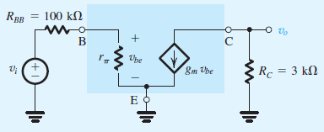
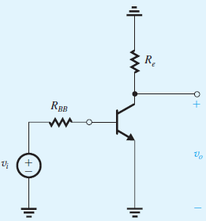
2. Determine the small-signal model parameters:
3. Replace V_{BB} and V_{CC} with short circuits.
4. Replace the transistor in the circuit by hybrid-π, equivalent-circuit model
5. Analyze of the equivalent circuit

Slide 45



5. Analyze of the equivalent circuit

Slide 46
Steps for the Small-Signal Equivalent Circuits
Eliminate the signal source and determine the dc operating point of the BJT and in particular the dc collector current IC.
2. Calculate the values of the small-signal model parameters
3. Eliminate the dc sources by replacing each dc voltage source with a short circuit and each dc current source with an open circuit.
4. Replace the BJT with one of its small-signal equivalent circuit models.
5. Analyze the resulting circuit to determine the required quantities (e.g., voltage gain, input resistance.

Slide 47
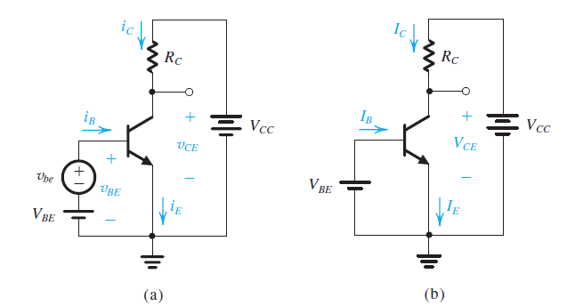
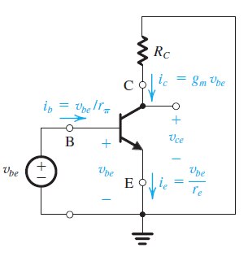
For DC analysis the signal source is removed

Slide 48
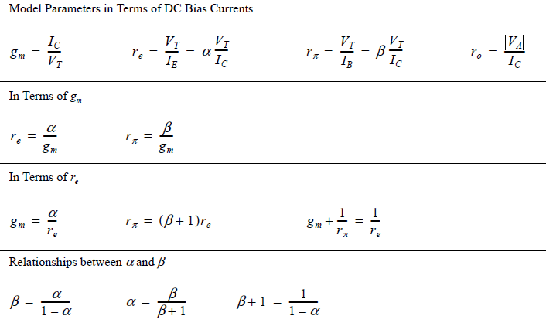

Slide 49
Transconductance
Our study so far shows that the bipolar transistor acts as a voltage-dependent current source, when operating in the forward active region
But how we can quantify the performance of such a device, that is the measure of the goodness of a voltage dependent current source
Recalling the first lecture, the device becomes stronger as K increases, because as K is increased , results in larger output current thus larger output voltage
So we concentrate on the voltage –to-current conversion property of the transistor
If a signal changes the base-emitter voltage of a transistor by a small amount, how much change is produced in the collector current
The strength of the device can be represented by ∆Ic/ ∆Vbe
The ratio ∆Ic/ ∆Vbe approaches dIc/dVbe for very small changes in the limit, is called the “ Transconductance , gm

Slide 50
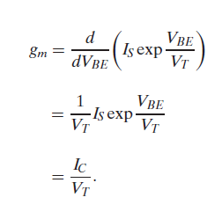
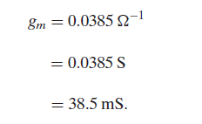
The above equation reveals that as Ic increase, the transistor becomes a better amplifying device by producing larger collector excursions in response to a given signal level applied between the base and emitter
The transconductance may be expressed in or “siemens” S.
For example if Ic =1 mA, then with Vt =26 mv , we have

Slide 51
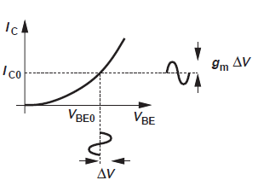
If experiences a small perturbation ± ∆ V around then the collector current displays a change of × ∆ V around

Slide 52
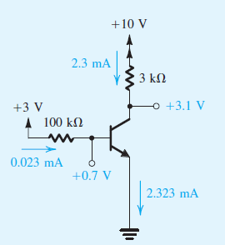
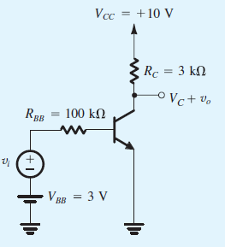
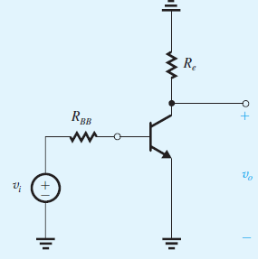
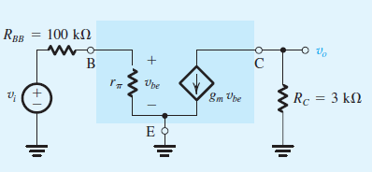
While considering the small signal notice the output is across Rc

Slide 53
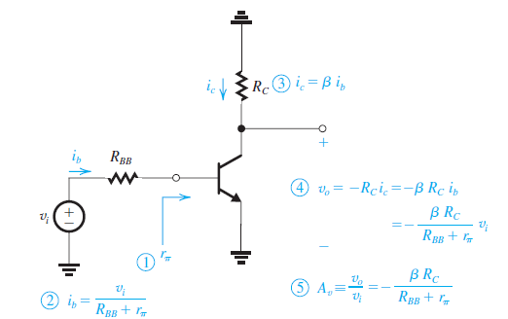
Performing small signal analysis directly on the circuit

Slide 54
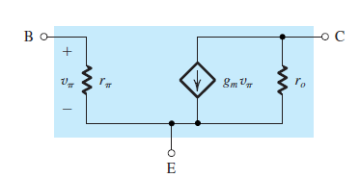
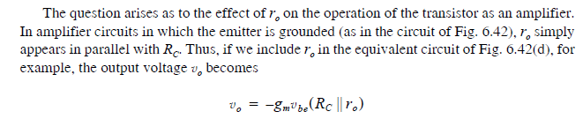
Small signal equivalent model with Early Effect

Slide 55





$$V=I×R$$
$$1/R=g_{m}=\frac{I}{V}$$
$g_{m}=$Trans-conductance
$$A_{v}={− g}_{m}×R_{C}$$
$v_{BE}$- $I_{c}$ Methd
VTC- Method

Slide 56
