Slide 1
BJT-Lecture

Slide 2
Dr. Usman covered chapter 6 until 6.5.1: the collector current and its transconductance
6.1 Device Structure and Physical Operation
6.1.1 Simplified Structure and Modes of Operation
6.1.2 Operation of the npn Transistor in the Active Mode
6.1.3 Structure of Actual Transistors
6.1.4 Operation in the Saturation Mode
6.2 Current–Voltage Characteristics
6.2.1 Circuit Symbols and Conventions
6.2.3 Dependence of iC on the Collector Voltage—The Early Effect
6.3 BJT Circuits at DC
6.4 Applying the BJT in Amplifier Design
6.4.2 The Voltage Transfer Characteristic (VTC)
6.4.4 The Small-Signal Voltage Gain
6.5 Small-Signal Operation and Models
6.5.1 The Collector Current and the Transconductance

Slide 3
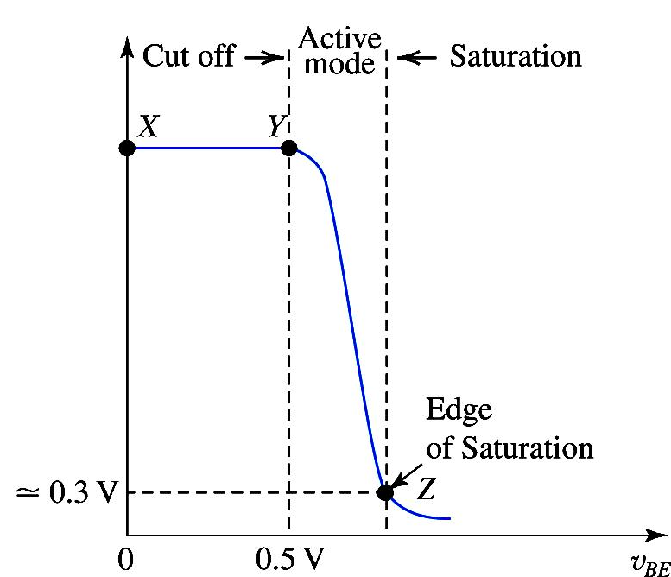
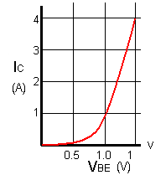
Some of the graphs to be kept in mind

Slide 4
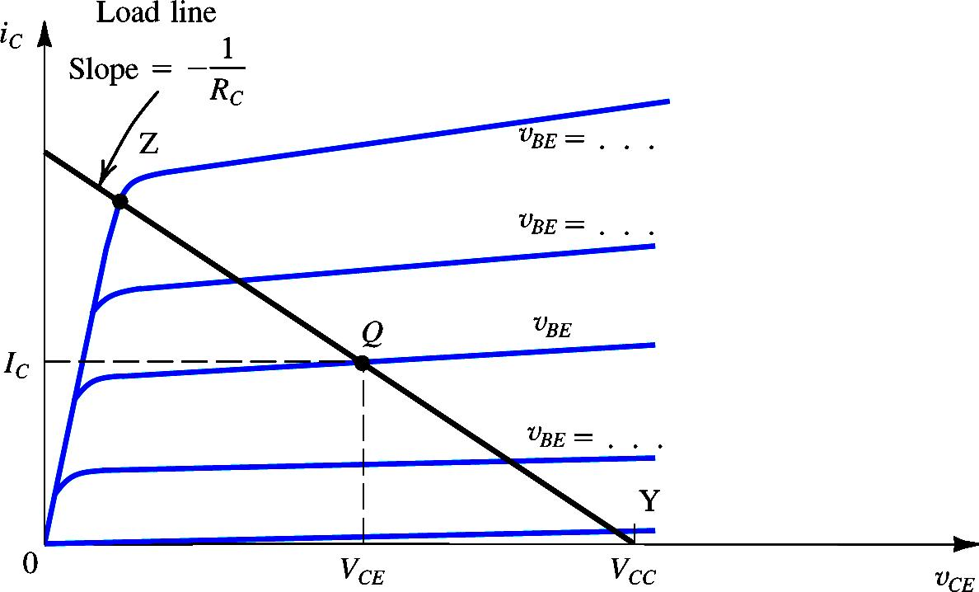
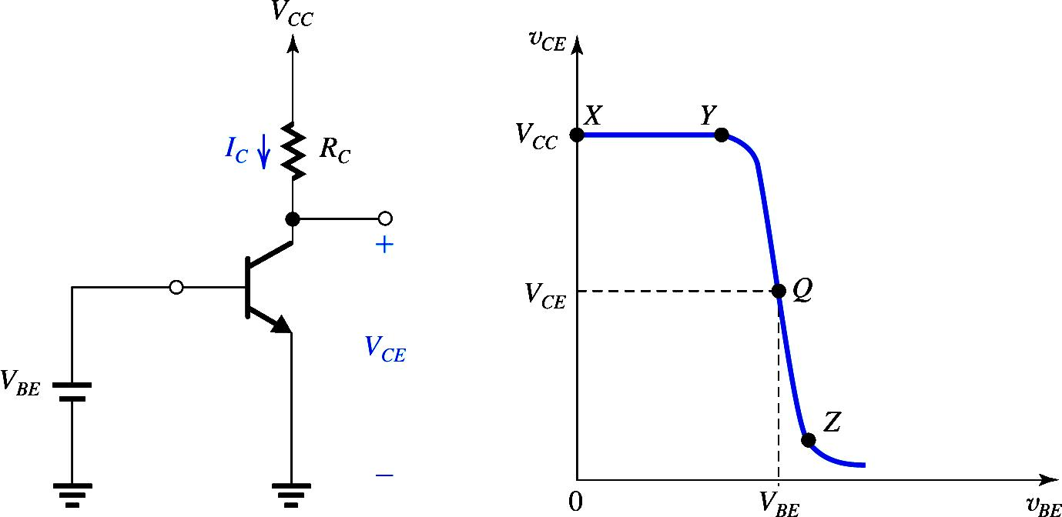
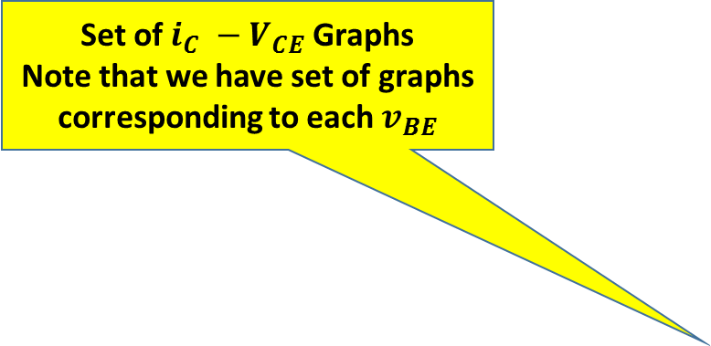
Set of $i_{C} −V_{CE}$ Graphs
Note that we have set of graphs corresponding to each $v_{BE}$
Graphical Analysis: Locating Bias Point
Determine Load Line
Which point on Load line
Point Y : v_{BE} = 0.5
Point Z : BJT leave the active mode

Slide 5
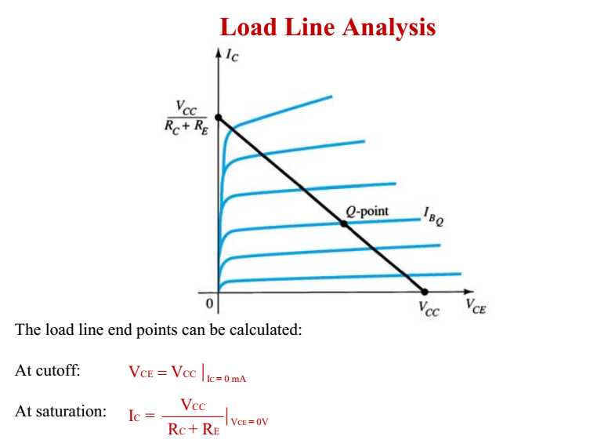

Slide 6
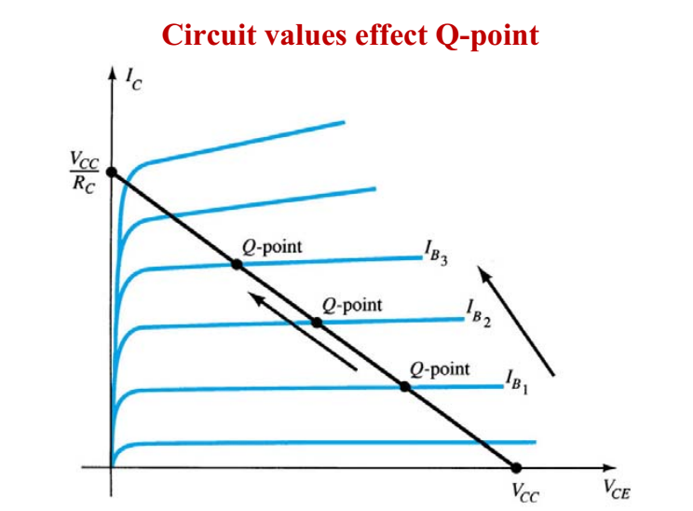
Note :As we increase IB The Q point moves upward, that is closer to saturation region

Slide 7
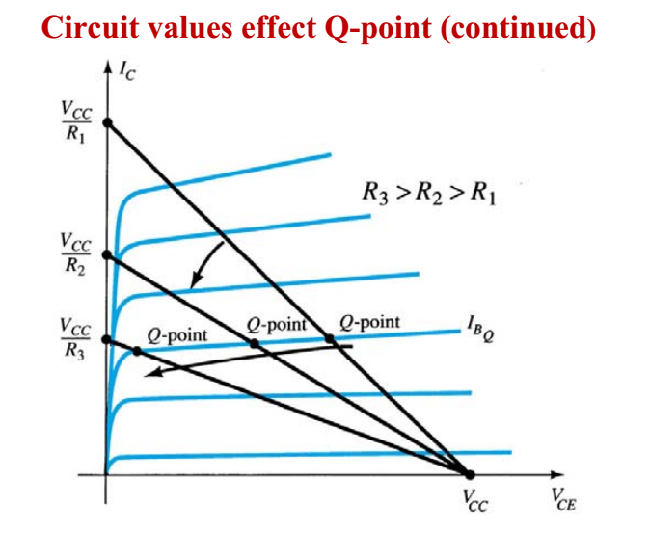
With increasing R the slope decreases

Slide 8
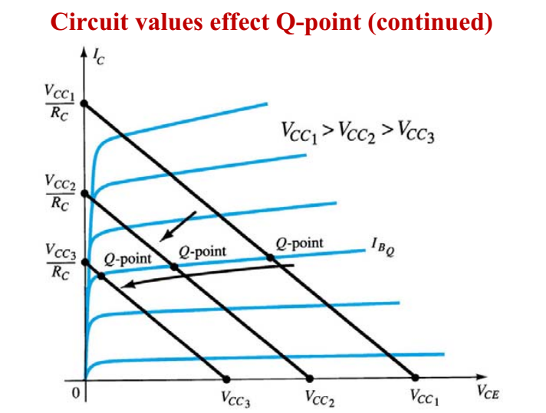
What is observation Here?

Slide 9
6.4 Applying the BJT in Amplifier Design
6.4.2 The Voltage Transfer Characteristic (VTC)
6.4.4 The Small-Signal Voltage Gain

Slide 10
BJT as Amplifier

Slide 11
BJT as Amplifier
when operated in the active mode, the BJT functions as a voltage-controlled current source: the base–emitter voltage controls the collector current
Although the control relationship is nonlinear (exponential), we will shortly devise a method for obtaining almost-linear amplification from this fundamentally nonlinear device.

Slide 12
BJT as Amplifier
A voltage-controlled current source can serve as a transconductance amplifier, that is, an amplifier whose input signal is a voltage and whose output signal is a current
A simple way to convert a transconductance amplifier to a voltage amplifier is to pass the output current through a resistor and take the voltage across the resistor as the output.

Slide 13
The Voltage Transfer Characteristic (VTC)
A very useful tool that yields great insight into the operation of an amplifier circuit is its voltage transfer characteristic (VTC). This is simply a plot of the output voltage versus the input voltage.( Graph)

Slide 14
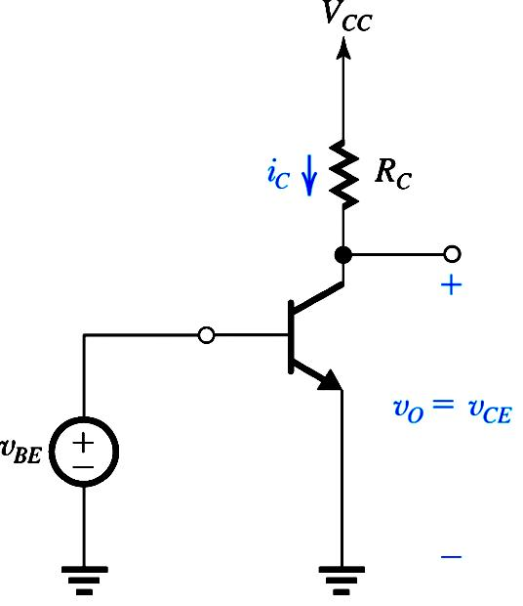
v_{O}

Slide 15
Note that the output voltage is taken between the collector and ground, rather than simply across Rc. This is done because of the need to maintain a ground reference throughout the circuit. The output voltage is given by
The out put is 180 Deg. Phase shifted
(x-y) For Cutoff mode and
(y-Z) Active mode
Saturation mode
For greater than that at point Z,
the transistor operates in the saturation region and decreases very slowly

Slide 16
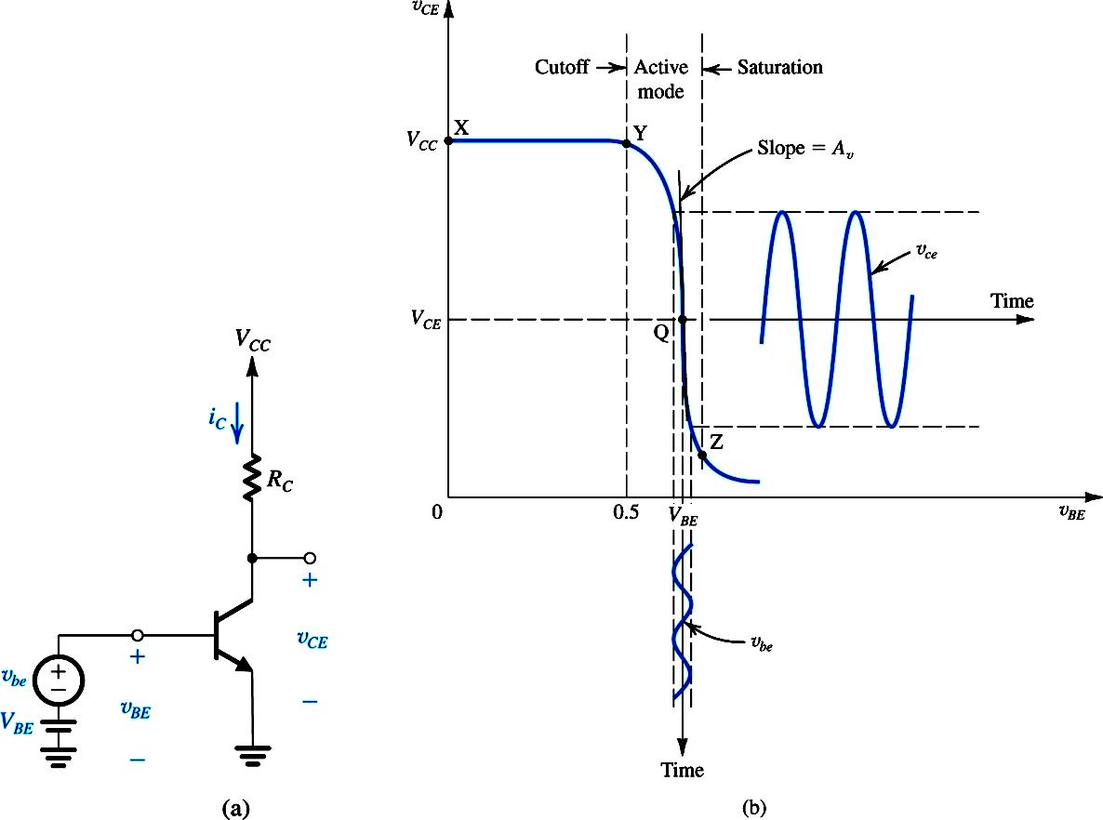
The VTC indicates that the segment of greatest slope (and hence potentially the largest amplifier gain) is that labeled YZ, which corresponds to operation in the active mode. An expression for the segment YZ can be obtained by
This is obviously a nonlinear relationship.
linear (or almost-linear) amplification can be obtained by using the technique of biasing the BJT.

Slide 17
Biasing the BJT to Obtain Linear Amplification
Biasing enables us to obtain almost-linear amplification from the BJT.
A dc voltage is selected to obtain operation at a point Q on the segment YZ of the VTC.
observe that the coordinates of Q are the dc voltages and which are related by

Slide 18
Biasing BJT for Linear Amplification

Slide 19
Biasing BJT for Linear Amplification

Slide 20
Biasing BJT for Linear Amplification

Slide 21

Next the signal to be amplified a function of time t is superimposed on the bias voltage . Thus the total instantaneous value of becomes

Slide 22
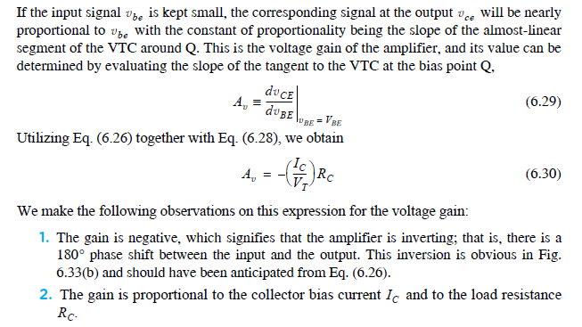
The Small-Signal Voltage Gain

Slide 23
The Small-Signal Voltage Gain

Slide 24
We make the following observations on this expression for the voltage gain:
The gain is negative, which signifies that the amplifier is inverting; that is, there is a 180 phase shift between the input and the output
2. The gain is proportional to the collector bias current and to the load resistance

Slide 25
The simple expression shows that to maximize the voltage gain we should use as large a voltage drop across RC as possible.
For a given value of VCC, Eq. (6.32) indicates that to increase VRC we have to operate at a lower VCE. However, a lower VCE means a bias point Q close to the end of the active-region segment, which might not leave sufficient room for the negative-output signal swing without the amplifier entering the saturation region. If this happens, the negative peaks of the waveform of vce will be flattened.
Placing Q too high on this segment not only results in reduced gain (because VRC is lower) but could possibly limit the available range of positive signal swing. At the positive end, the limitation is imposed by the BJT cutting off, in which event the positive-output peaks would be clipped off at a level equal to VCC.

Slide 26
Example 6.13
Consider an amplifier circuit using a BJT having IS = A, a collector resistance RC = 6.8 kΩ, and a power supply VCC = 10 V.
Determine the value of the bias voltage VBE required to operate the transistor
at VCE = 3.2 V. What is the corresponding value of IC?
(b) Find the voltage gain Av at this bias point. If an input sine-wave signal of 5-mV peak amplitude is superimposed on VBE, find the amplitude of the output sine-wave signal (assume linear operation).
(c) Find the positive increment in vBE (above VBE) that drives the transistor to the edge of saturation, where vCE = 0.3 V.
(d) Find the negative increment in vBE that drives the transistor to within 1% of cutoff (i.e., to vCE = 0.99VCC).

Slide 27
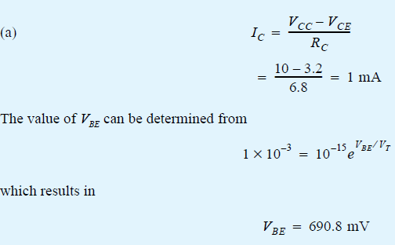
Determine the value of the bias voltage VBE required to operate the transistor
at VCE = 3.2 V. What is the corresponding value of IC?

Slide 28
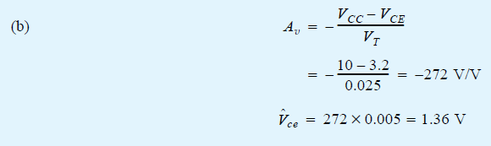
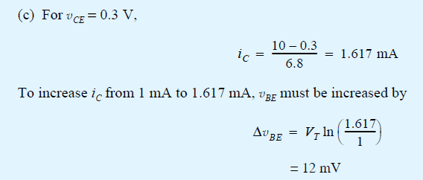
(b) Find the voltage gain Av at this bias point. If an input sine-wave signal of 5-mV peak amplitude is superimposed on VBE, find the amplitude of the output sine-wave signal (assume linear operation).
Voltage gain X input Voltage= Output voltage
(c) Find the positive increment in vBE (above VBE) that drives the transistor to the edge of saturation, where vCE = 0.3 V.

Slide 29
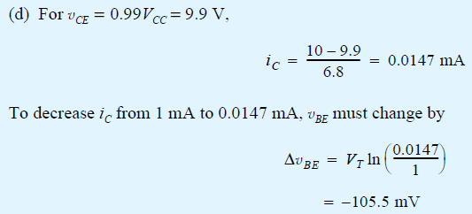
(d) Find the negative increment in vBE that drives the transistor to within 1% of cutoff (i.e., to vCE = 0.99VCC).

Slide 30
Assignment # 4
Example :6.14 and
Problems: 6.28, 6.29, 6.39

Slide 31
Small-Signal Operation and Models

Slide 32
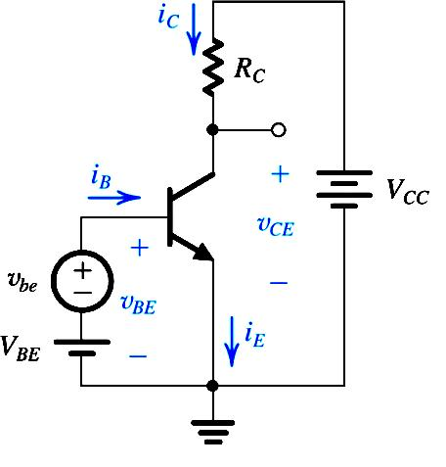
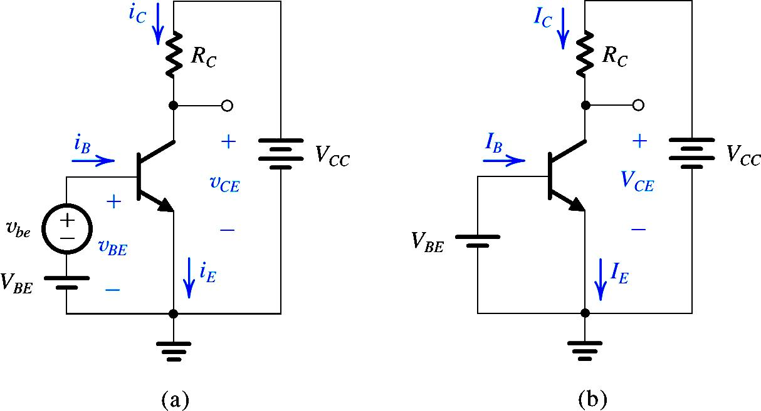
Small Signal Operation and Models

Slide 33
Transconductance

Slide 34
Transconductance
SS
DC
g_{m} is the
“transconductance”

Slide 35
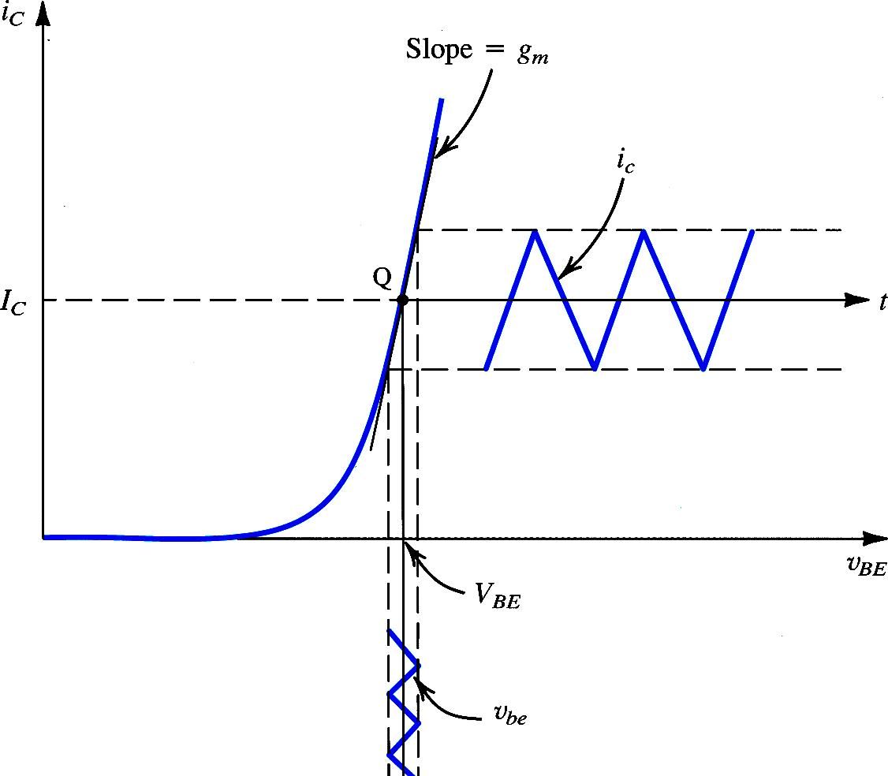
Transconductance
The signal amplitude should be small enough that operation is restricted to an almost linear segment of the
i_{C}-v_{BE} exponential curve
g_{m} varies with variation of Q point

Slide 36
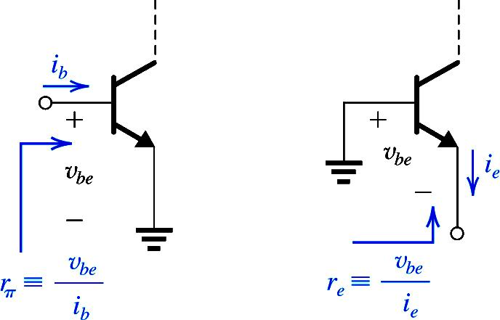
Base Current and Input Resistance

Slide 37
Emitter Current and Input Resistance

Slide 38
Also Do Exercise 6.36 and 6.37 as part of assignment

Slide 39
Voltage Gain

Slide 40
Separating the DC & Signal Quantities
The total DC and Small signal circuit is shown.
The DC analysis yield the currents and voltages based on the relevant equations.
The DC sources do no change their values when the signal is applied.
We can replace DC voltages by short circuits and current sources by open circuits respectively to get the Small Signal Model.

Slide 41
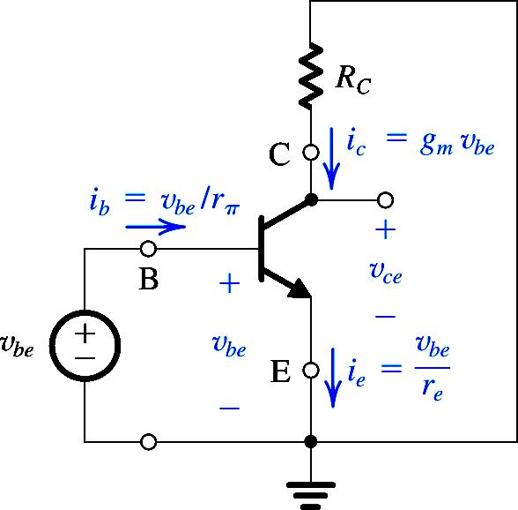
Separating the DC & Signal Quantities
The Small signal circuit is shown.
This circuit is useful only to analyze signal voltages and currents.
This is not an actual amplifier circuit.
This circuit shows all the incremental currents and voltages that occur due to applied small signal at the base.

Slide 42
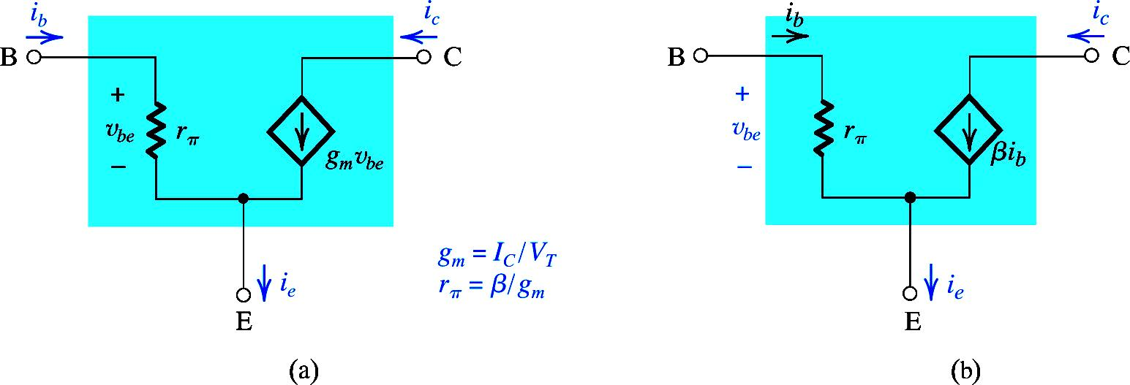
The Hybrid –π Model of BJT
Ie in terms of base resistance
Ie in terms of emitter resistance

Slide 43
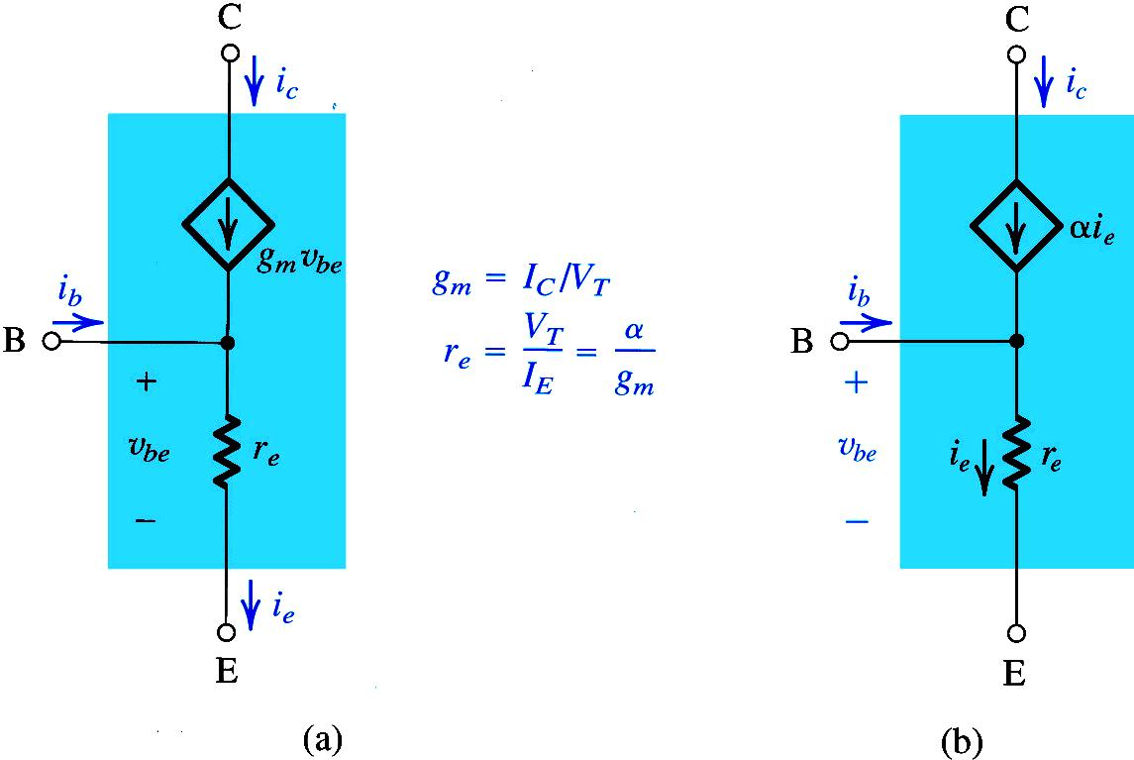
The T-Model of BJT

Slide 44
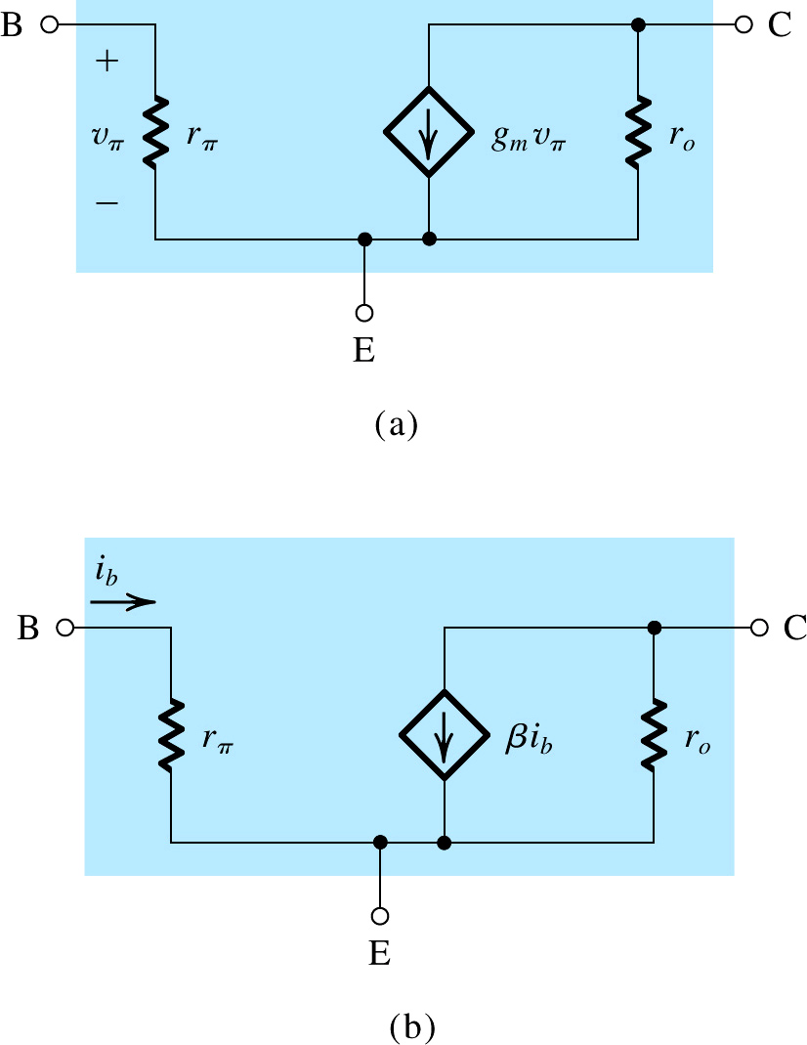
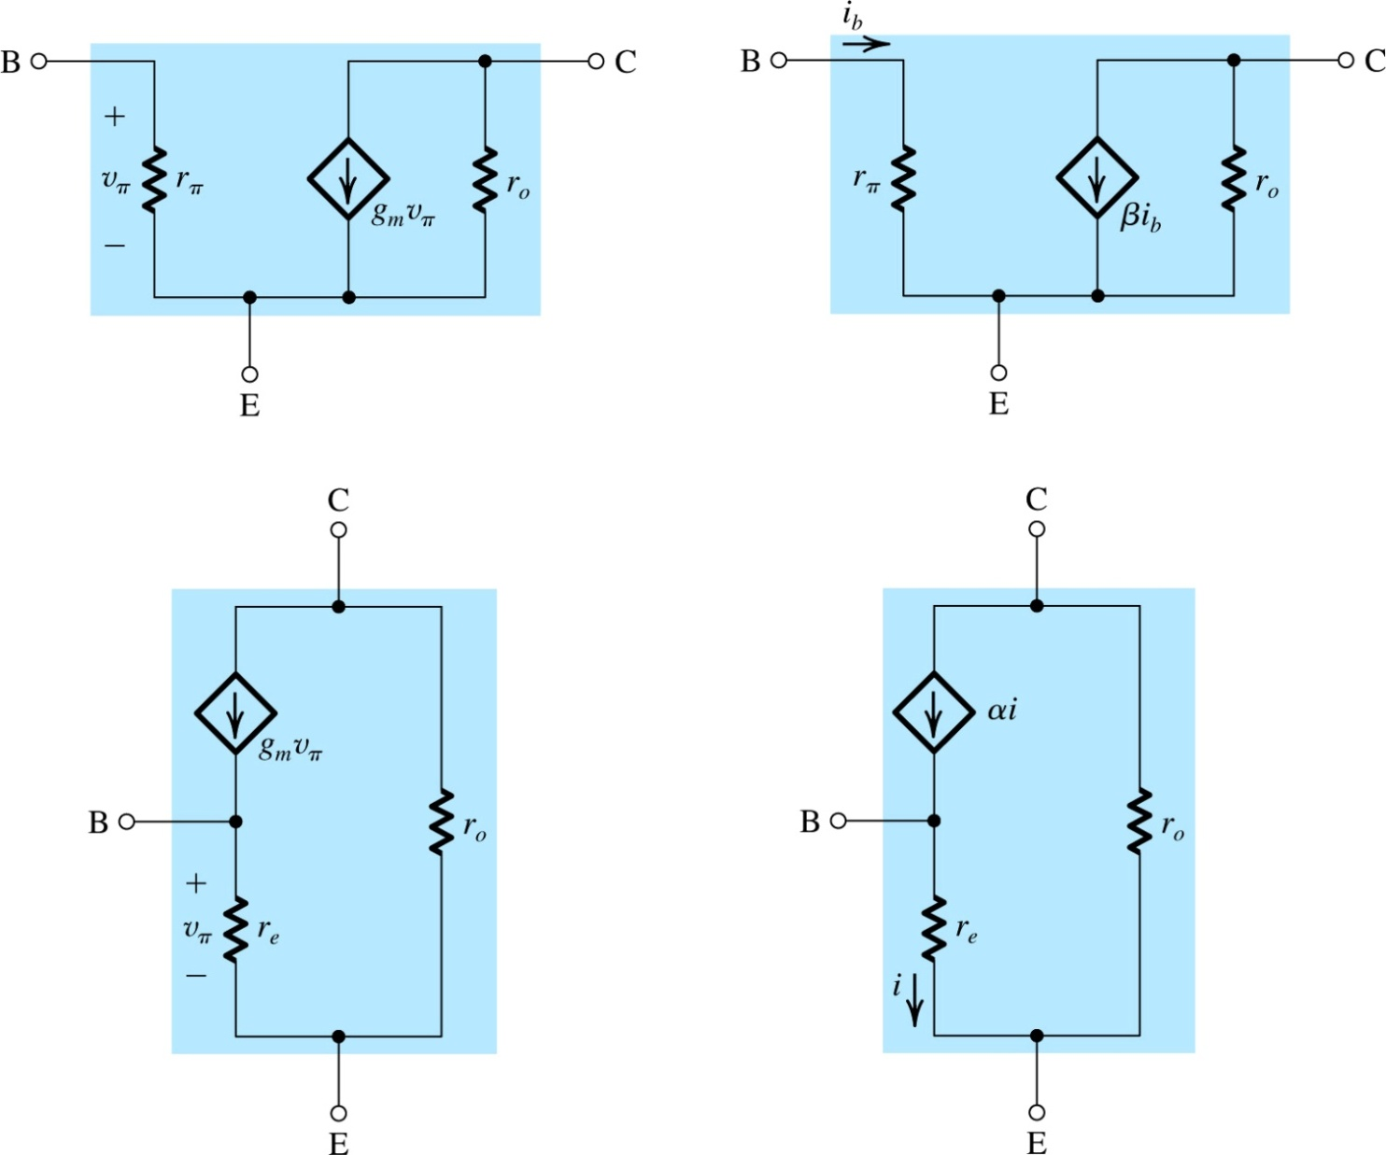
Small-Signal Models Accounting for the Early Effect
The gain will be reduced, depending upon ro

Slide 45
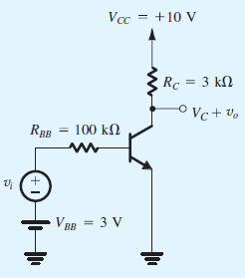

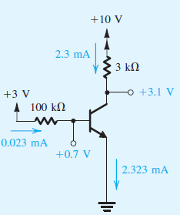

Example 6.14
Analyze the transistor amplifier shown in the Figure to determine its voltage gain v_{o}/v_{i}.
Assume β = 100.
Solution:
1. Determine the operating point. For this purpose.
assume v_{i} = 0 and obtain the dc circuit.
The dc currents and voltage will be:
Since V_{B} = 0.7 V is less than V_{C} , the transistor is operating in the active mode

Slide 46



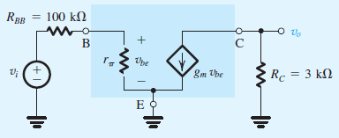
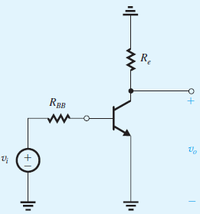
2. Determine the small-signal model parameters:
3. Replace V_{BB} and V_{CC} with short circuits.
4. Replace the transistor in the circuit by hybrid-π, equivalent-circuit model
5. Analyze of the equivalent circuit

Slide 47



5. Analyze of the equivalent circuit

Slide 48
Steps for the Small-Signal Equivalent Circuits
Eliminate the signal source and determine the dc operating point of the BJT and in particular the dc collector current IC.
2. Calculate the values of the small-signal model parameters
3. Eliminate the dc sources by replacing each dc voltage source with a short circuit and each dc current source with an open circuit.
4. Replace the BJT with one of its small-signal equivalent circuit models.
5. Analyze the resulting circuit to determine the required quantities (e.g., voltage gain, input resistance.

Slide 49
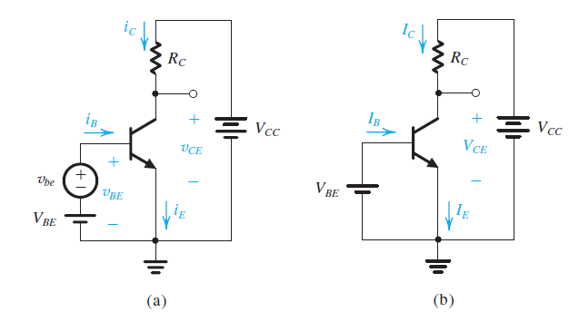
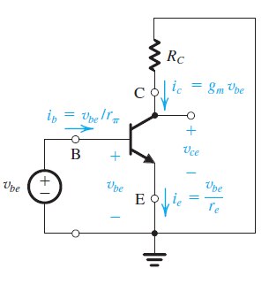
For DC analysis the signal source is removed

Slide 50
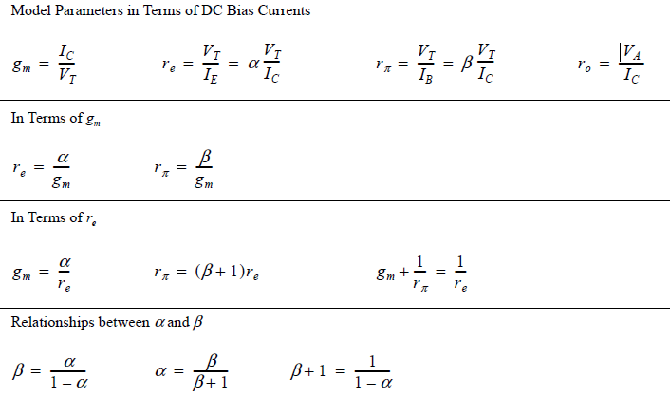

Slide 51
Three Basic Configurations of BJT Amplifier

Slide 52
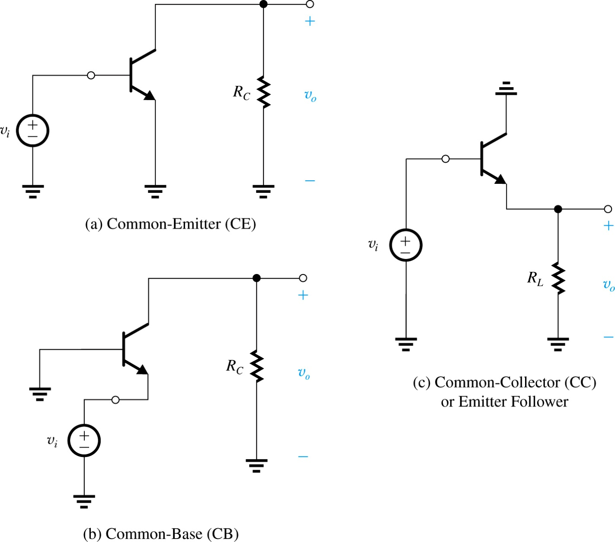
Three Basic Configurations

Slide 53

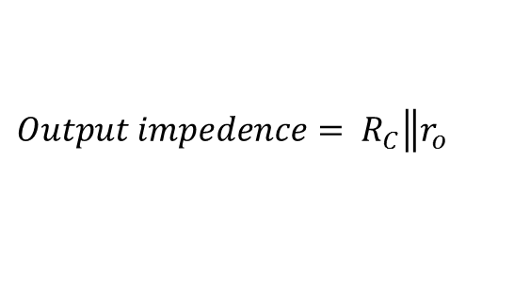


General Characteristics of each configuration
$$\frac{v_{o}}{v_{i}}=Voltage gain=−g_{m}×R_{C}\left\|r_{o}\right.$$
1. Common-Emitter Amplifier - CE
$$\frac{i_{c}}{i_{b}}=Current gain=β$$
$$input impedence= r_{π}$$
$$Output impedence= R_{C}\left\|r_{o}\right.$$
Power Amplifier as both current and voltage is amplified
Input from base and Output from collector ;
Output is 180 degree out of phase with respect to input

Slide 54


$$\frac{v_{o}}{v_{i}}=Voltage gain≈1$$
$$\frac{i_{b}}{i_{b}}=Current gain=1+β$$
$$input impedence= r_{π}$$
Only gives amplified current, voltage is unchanged
Input from base output from emitter
Output is in- phase with respect to input

Slide 55

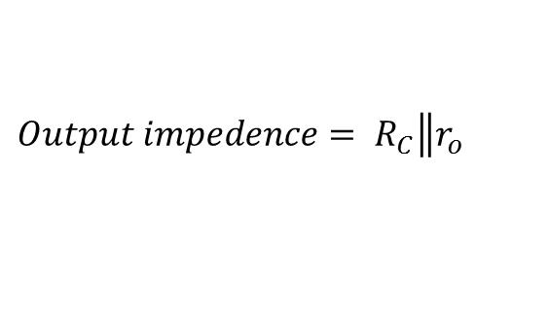


$$\frac{v_{o}}{v_{i}}=Voltage gain=+g_{m}×R_{C}\left\|r_{o}\right.$$
$$\frac{i_{c}}{i_{e}}=Current gain=α$$
$$input impedence= r_{e}$$
$$Output impedence= R_{C}\left\|r_{o}\right.$$
Input from Emitter and Output from collector ;
Output is in- phase with respect to input

Slide 56
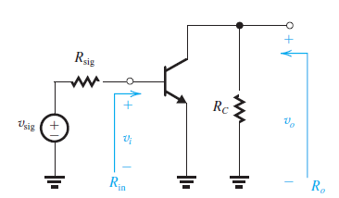

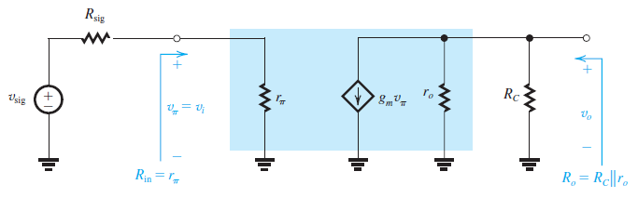

CE-Amplifier
$$\frac{v_{o}}{v_{π}}=A_{v}=−g_{m}×\left.R_{C}\right\|r_{o}$$

Slide 57
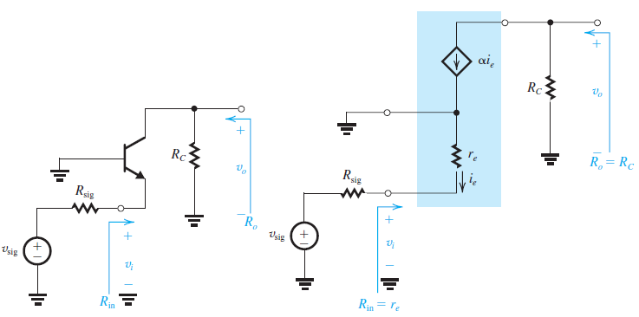
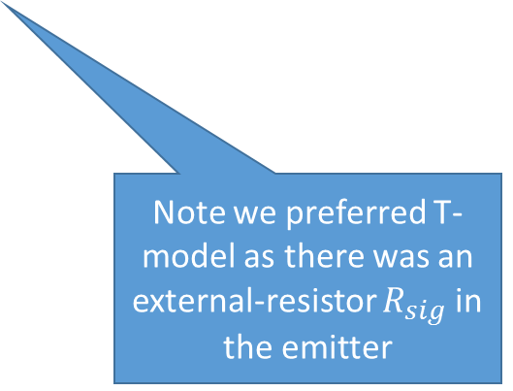
CB-Amplifier
Note we preferred T-model as there was an external-resistor $R_{sig}$ in the emitter

Slide 58
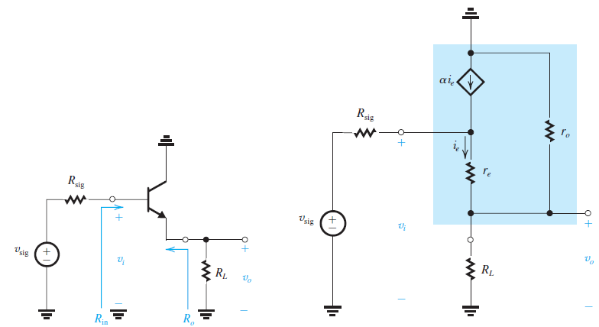
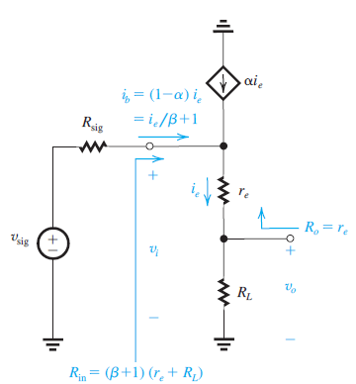

What source sees
What Load sees

Slide 59
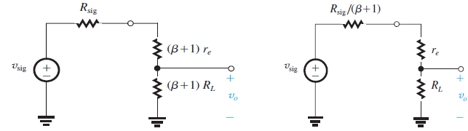
Simple cc circuit

Slide 60
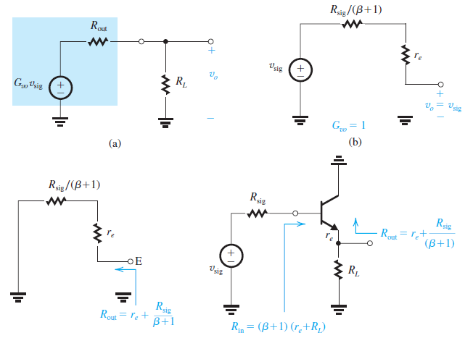


Slide 61
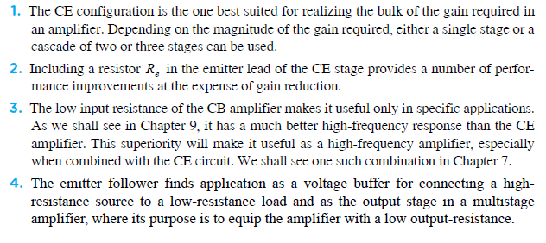
Summary of BJT Configurations

Slide 62
Lecture No 13
Input/output Impedances
&
Transistor Configuration

Slide 63
General Characteristics of an Amplifier
Gain
Input /output impedance
Frequency response
Bandwidth
Efficiency
Immunity to Noise/ Temperature variation
Immunity to differences due to manufacture processes
Cost, rigidness , reliability (MTBF)

Slide 64
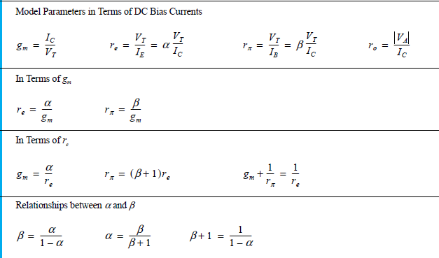

Slide 65
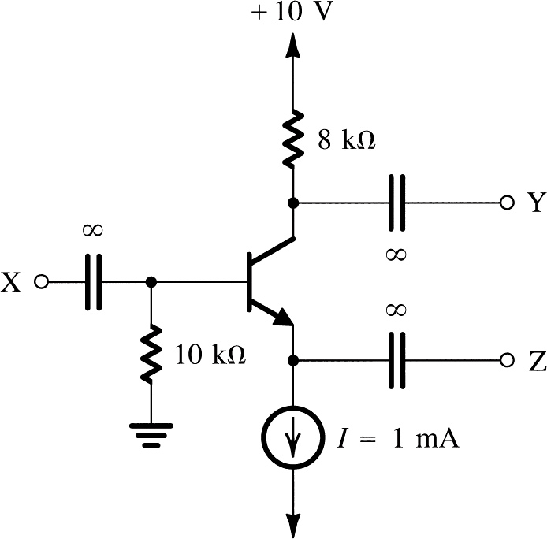


Example
The transistor shown in the Figure is biased with a constant current source I = 1 mA and has β = 100 and V_{A} = 100 V.
(a) Find the dc voltages at the base, emitter, and collector.
(b) Find g_{m}, r_{π} , and r_{o}.
Solution
(a)
(b)
$$V_{BE}=V_{B} − V_{E}$$
$$V_{E}=V_{B}− V_{BE}$$

Slide 66
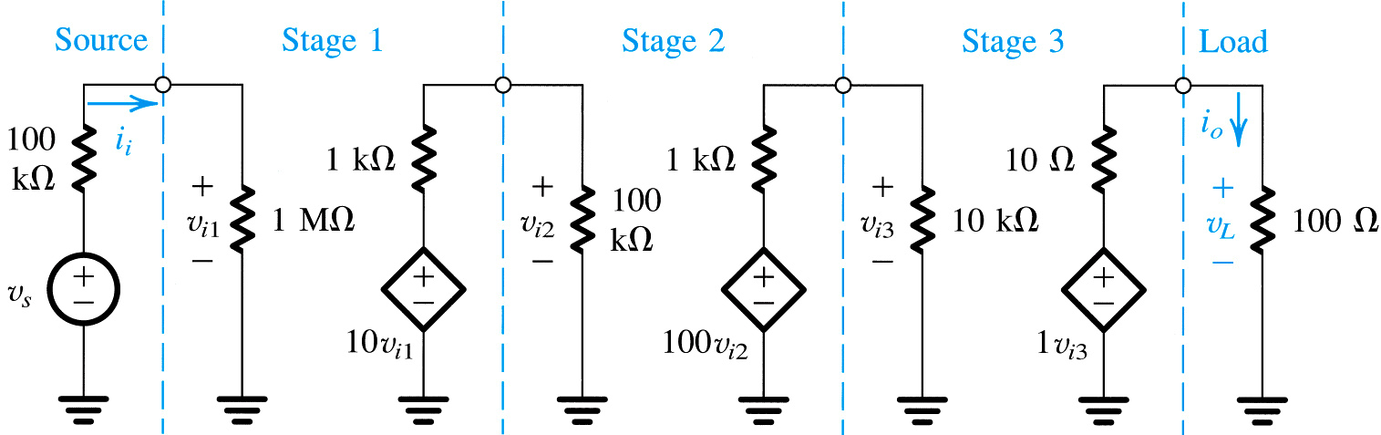
Cascaded Amplifier
Example from Chapter No 1
High i/p impedance
Low o/p impedance
Why did we use different stages of amplifier?

Slide 67
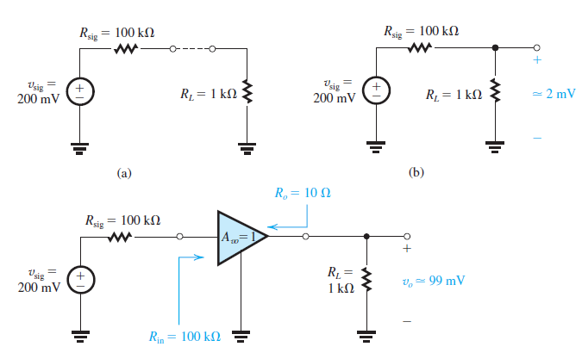
Another Example to show effect of Impedances
Voltage Buffer

Slide 68
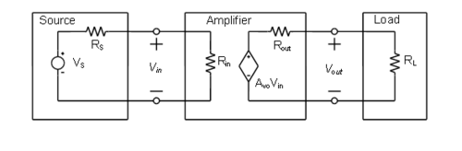
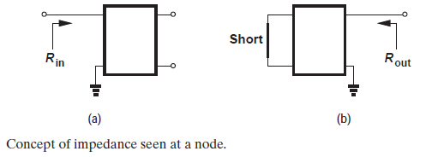

Slide 69

Amplifier Characteristics
May affected by R_{L}

Slide 70
Amplifier Characteristics
For measuring R_{o}
Signal source is replaced with short circuit
Test voltage v_{x} is applied
The resultant current i_{x} is measured

Slide 71
Amplifier Characteristics

Slide 72

Triangle in blue = rectangle in blue below
Amplifier Characteristics
Note the difference between $A_{v0}; A_{v}$
$$and G_{v}$$
Can you identify and differentiate various gains here

