Slide 1
Quick review of BJT amplifier configurations

Slide 2
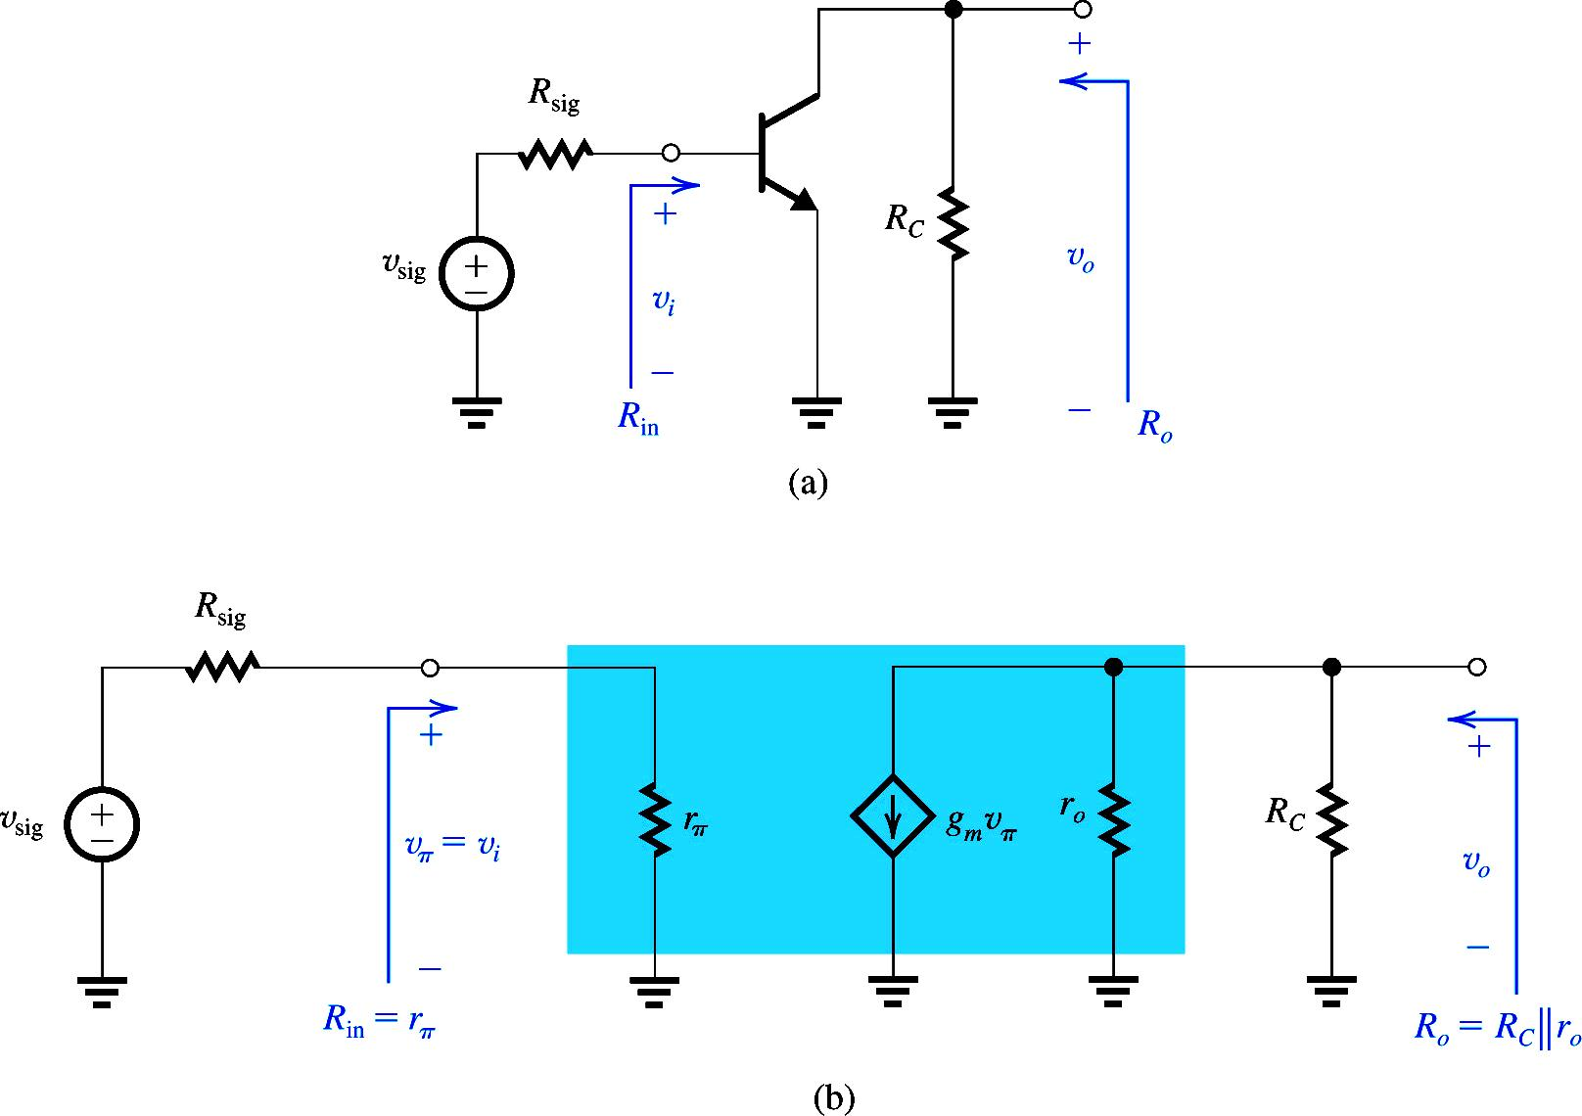


CE Amplifier
$$R_{L}$$
$$v_{out}={− g}_{m}×v_{π}×R_{eq}$$

Slide 3
CE Amplifier (Alternate Gain Expressions)
$$R_{L}$$
-gm X total resistance at the collector

Slide 4
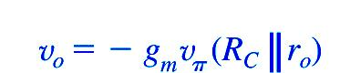
CE Amplifier (Overall gain)
R_{L}

Slide 5
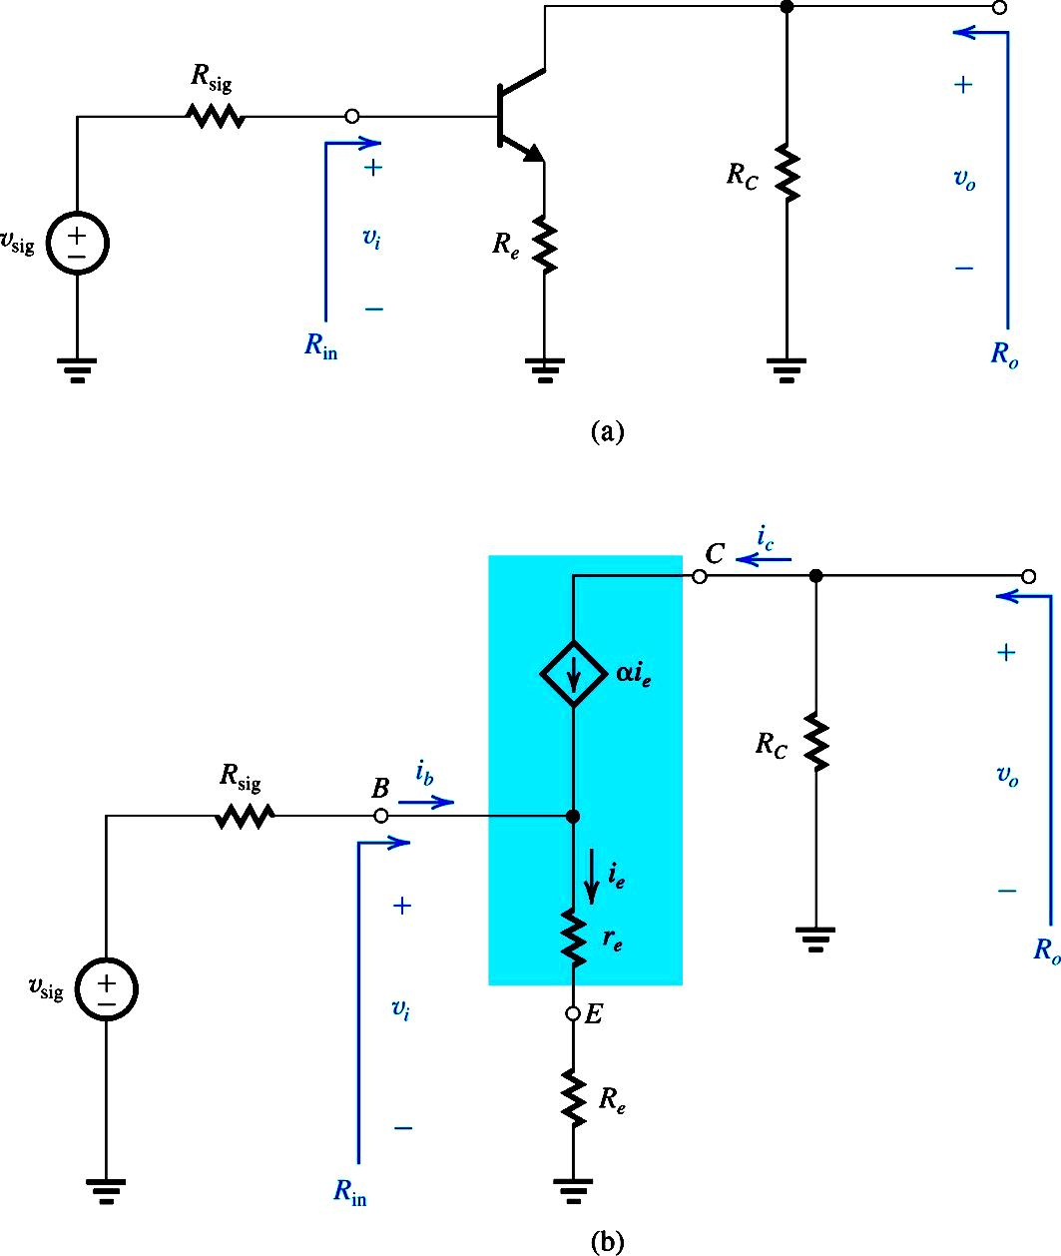
Improving performance-CE Amplifier with R_{E}
Notice now we are using T-Model as it eases our calculation

Slide 6
CE Amplifier with R_{E}
Resistance Reflection Rule

Slide 7


Effect of $R_{E} on input Resistance$
CE Amplifier with R_{E}
Re included
Without Re
$$\frac{\left(1+β\right)r_{e}}{\left(1+β\right)r_{e}} +\frac{\left(1+β\right)R_{e}}{\left(1+β\right)r_{e}}$$

Slide 8

Effect of $R_{E} on Gain$
CE Amplifier with R_{E}
The gain is reduced by the factor (1+g_{m}R_{e})

Slide 9
CE Amplifier without R_{E}
CE Amplifier with R_{E}

Slide 10
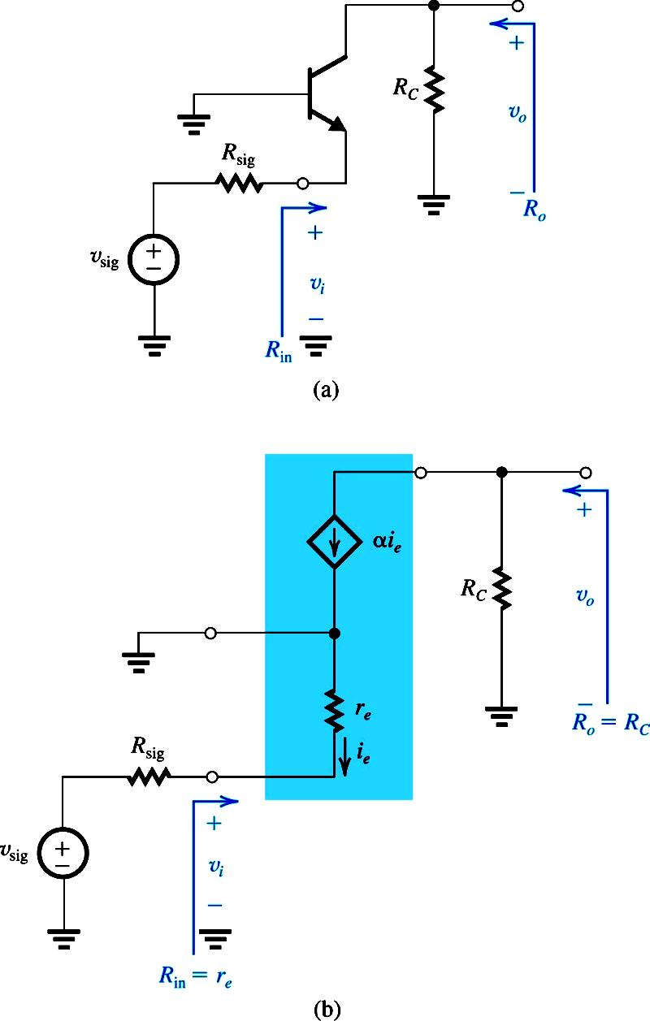
CB Amplifier
Note that the currents relationship between input and output is with α

Slide 11
CB Amplifier

Slide 12
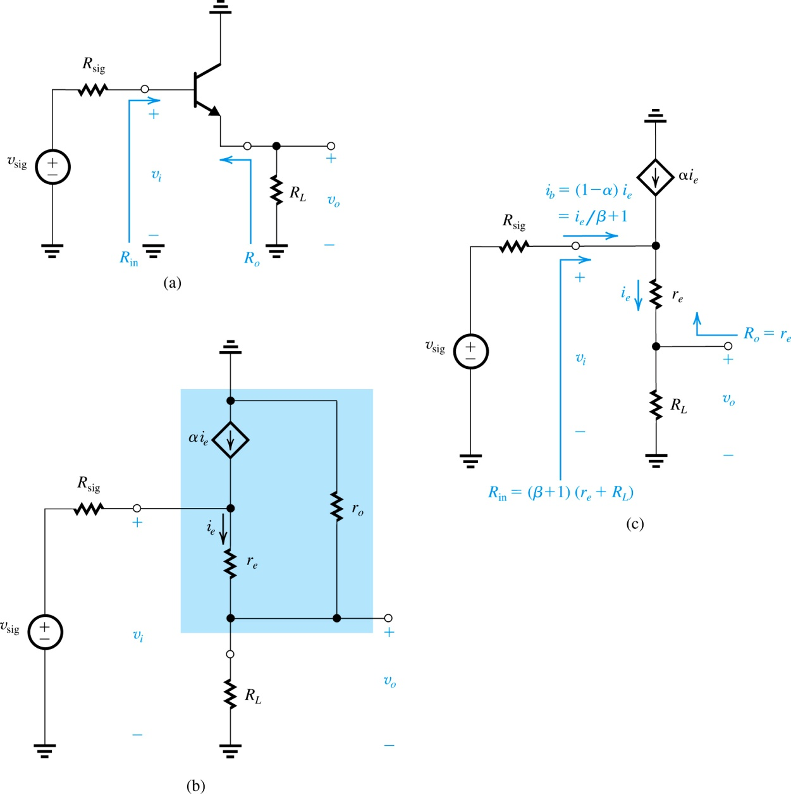
CC Amplifier

Slide 13
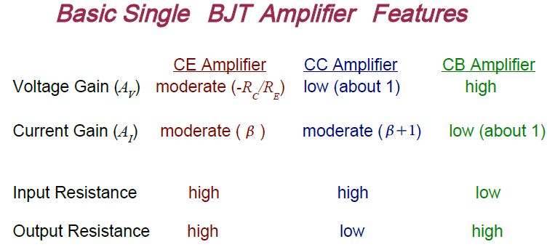
The CB stage displays a current gain of unity because the current flowing into the emitter simply emerges from the collector

Slide 14
Biasing The Transistor

Slide 15
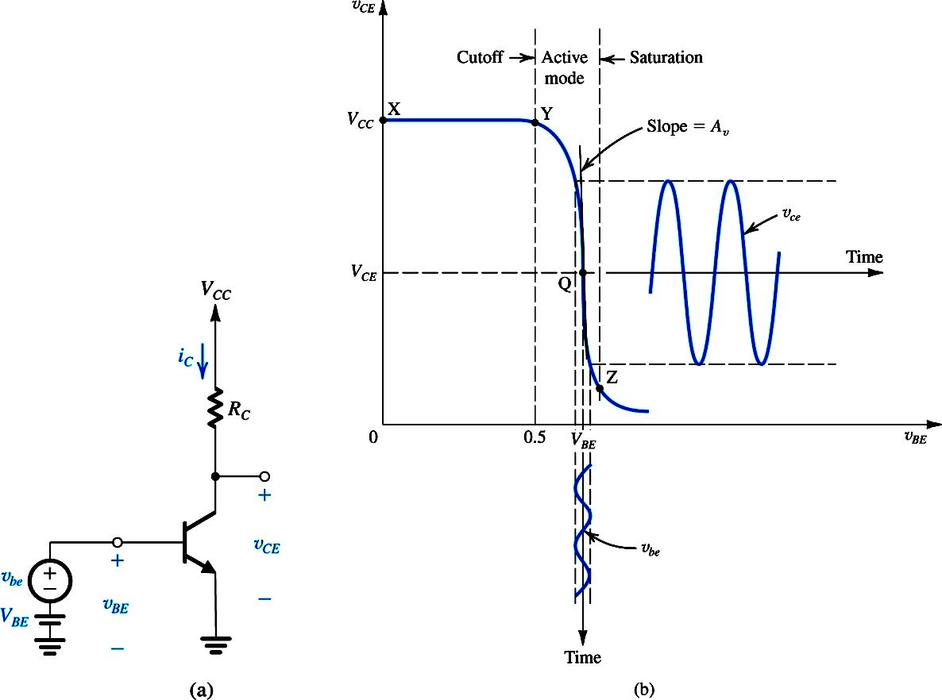
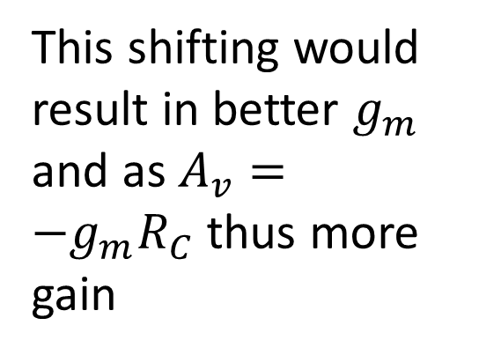


$$I_{C}$$
This shifting would result in better $g_{m}$ and as $A_{v}={−g}_{m}R_{C}$ thus more gain
$$V_{BE}$$

Slide 16
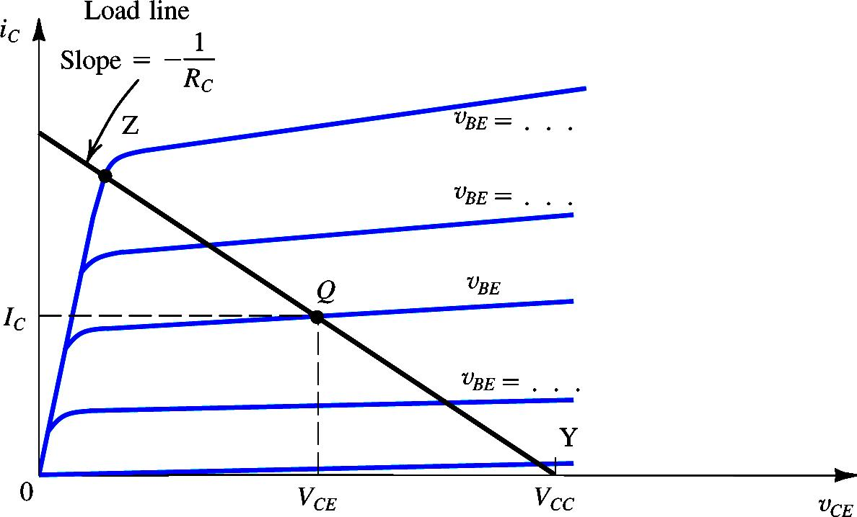
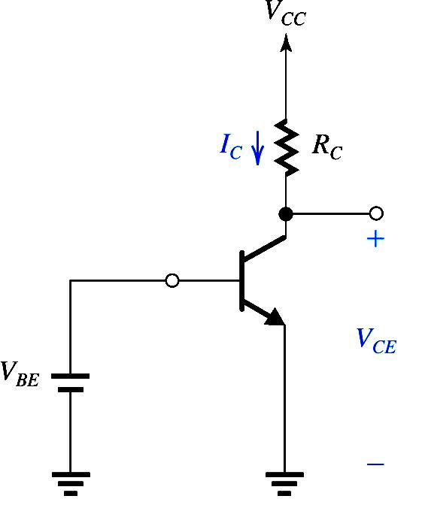
Significance of DC Biasing – Locating the Q-point
Determine Load Line
Which point on Load line
Point Y : v_{BE} = 0.5
Point Z : BJT leave the active mode

Slide 17
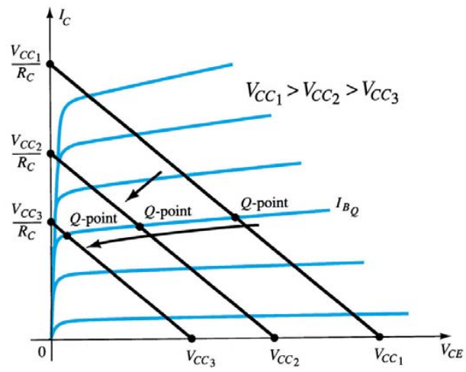
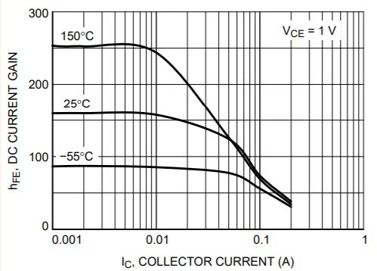
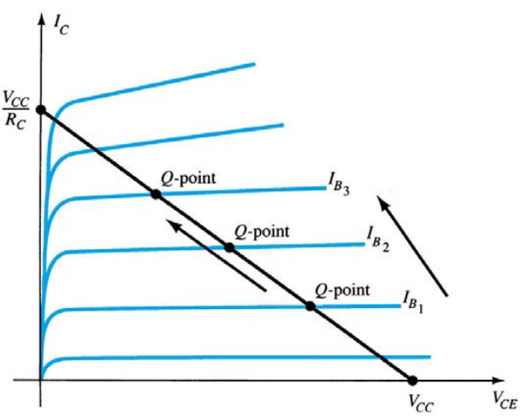
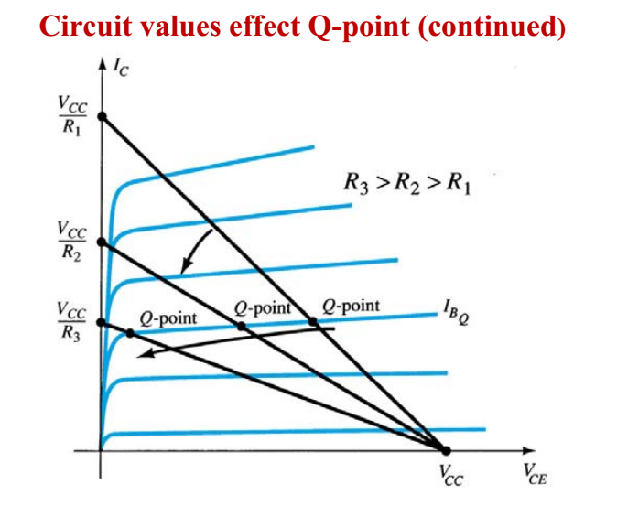
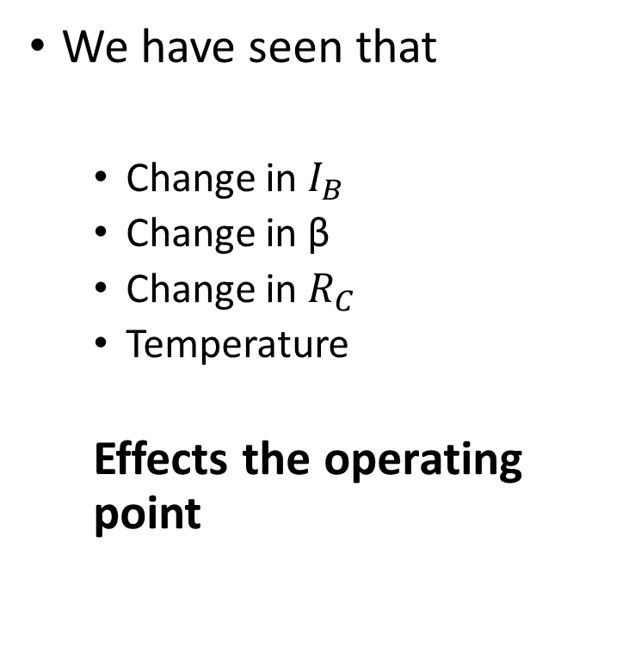
Introduction
We have seen that
Change in $I_{B}$
Change in β
Change in $R_{C}$
Temperature
Effects the operating point

Slide 18
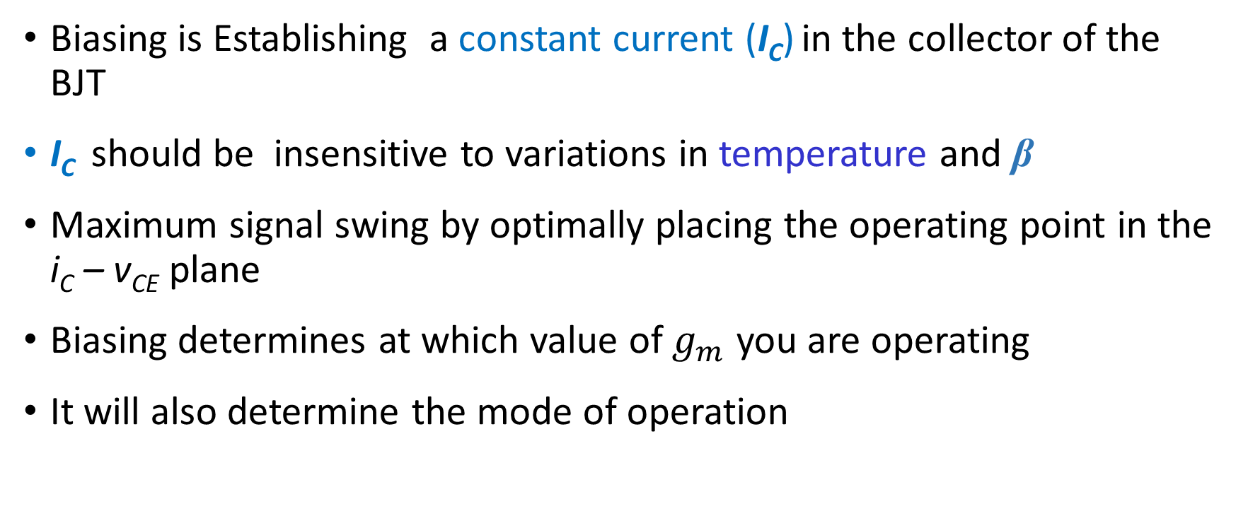
Biasing in BJT Amplifier Circuits
Biasing is Establishing a constant current (I_{C}) in the collector of the BJT
I_{C} should be insensitive to variations in temperature and β
Maximum signal swing by optimally placing the operating point in the i_{C} – v_{CE} plane
Biasing determines at which value of $g_{m}$ you are operating
It will also determine the mode of operation
Midpoint of the Load Line
To increase the range of allowable input signal without distortion

Slide 19
Biasing Arrangements
Classical Discrete-Circuit Bias Arrangement
Biasing Using Collector-to-Base Feedback Resistor
Biasing Using a Constant-Current Source

Slide 20
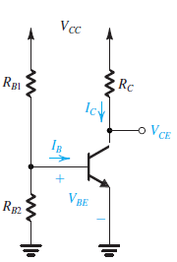
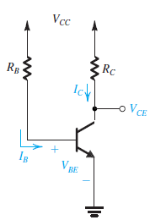
Two Not Good Approaches
Fixing V_{BE}
bias the BJT by fixing the voltage VBE
The very sharp exponential relationship iC –vBE means that any small and inevitable differences in VBE from the desired value will result in large differences in IC and in VCE
biasing the BJT by establishing a constant current in the base
large variations in the value of β will result in correspondingly large variations in IC and hence in VCE.
Variations in β and V_{BE} will cause large variations in I_{C}
Fixing I_{B}

Slide 21
A generic dc load line.

Slide 22
Example
Plot the dc load line for the circuit shown in Fig.
Fixing I_{B}

Slide 23
Example
Plot the dc load line for the circuit shown in Fig. Then, find the values of V_{CE} for I_{C} = 1, 2, 5 mA respectively.
Fixing I_{B}
I_{C} (mA) | V_{CE} (V)
1 | 9
2 | 8
5 | 5

Slide 24
Base bias (fixed bias).
β = dc current gain = h_{FE}

Slide 25
Example
The circuit is midpoint biased.

Slide 26
Base bias characteristics. (1)
Circuit recognition:
A single resistor (R_{B}) between the base terminal and V_{CC}.
No emitter resistor.
Advantage: Circuit simplicity.
Disadvantage: Q-point shift with temp.
Applications: Switching circuits only.

Slide 27
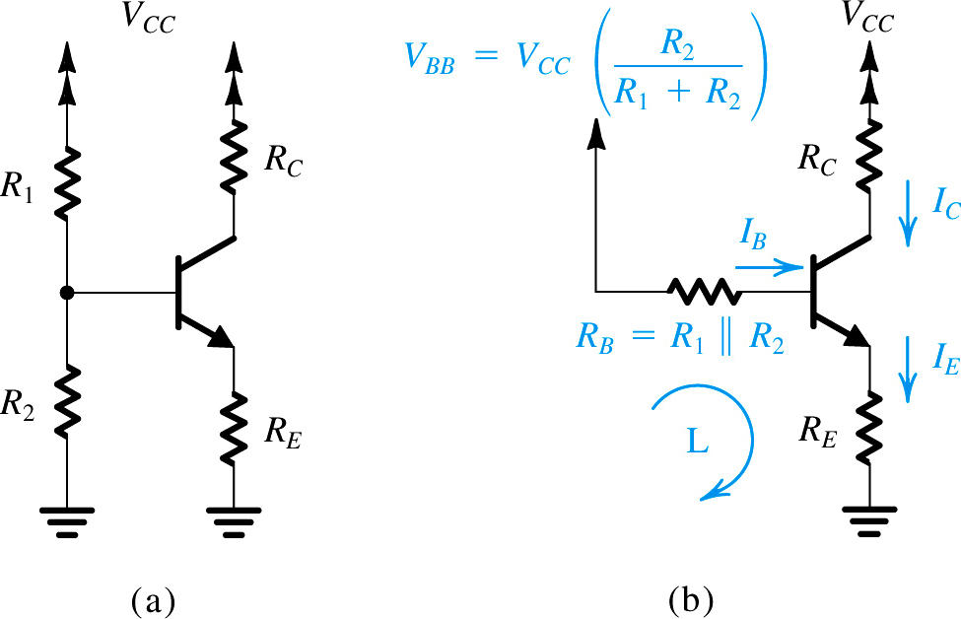
Classical Discrete-Circuit Bias Arrangement
The technique consists of supplying the base of the transistor with a fraction of the supply voltage VCC through the voltage divider R1, R2. In addition, a resistor RE is connected to the emitter
Note the difference from base biasing, previously discussed

Slide 28
Classical Discrete-Circuit (Voltage divider Bias)
To make I_{E} insensitive to temperature and β variations, the two constraints should be satisfied
Increasing V_{BB} will reduce signal swing at collector
Reduction in R_{B} results in lowering the R_{in}
Rule of thumb
V_{BB} = 1/3 V_{CC}
V_{CB} = 1/3 V_{CC}
I_{C}R_{C} = 1/3 V_{CC}

Slide 29

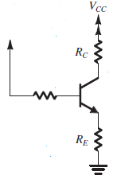



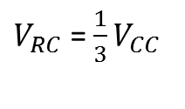
The above Condition ensures that small variations in VBE ( 0.7 V) will be swamped by the much larger VBB.
There is a limit, however, on how large VBB can be:
For a given value of the supply voltage VCC, the higher the value we use for VBB, the lower will be the sum of voltages across RC and the collector–base junction (VCB).
On the other hand, we want the voltage across RC to be large in order to obtain high voltage gain and large signal swing (before transistor cutoff).
We also want VCB (or VCE) to be large to provide a large signal swing (before transistor saturation).
$V_{BB}$=$\frac{1}{3}V_{CC}$
$V_{RC}$ = $\frac{1}{3}V_{CC}$
Rule of thumb
V_{BB} = 1/3 V_{CC}
V_{CB} = 1/3 V_{CC}
I_{C}R_{C} = 1/3 V_{CC}
$$V_{CE}$$
$$V_{CE}=V_{CB}+V_{BE}$$

Slide 30

The condition above makes IE insensitive to variation in β and could be satisfied by selecting RB small, this in turn is achieved by low values of R1 and R2
Lower values for R1 and R2, however, will mean a higher current drain from the power supply, and also will result in a lowering of the input resistance of the amplifier

Slide 31
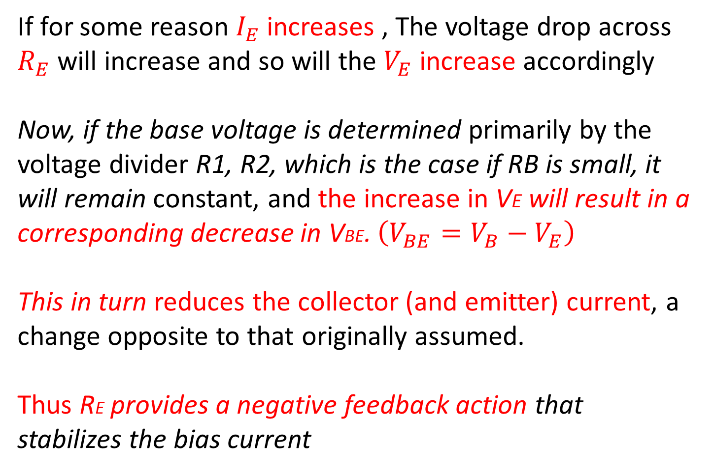
Stability through Negative Feedback by Resistance RE
If for some reason $I_{E}$ increases , The voltage drop across $R_{E}$ will increase and so will the $V_{E}$ increase accordingly
Now, if the base voltage is determined primarily by the voltage divider R1, R2, which is the case if RB is small, it will remain constant, and the increase in VE will result in a corresponding decrease in VBE. $\left(V_{BE}=V_{B}−V_{E}\right)$
This in turn reduces the collector (and emitter) current, a change opposite to that originally assumed.
Thus RE provides a negative feedback action that stabilizes the bias current

Slide 32
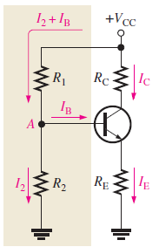
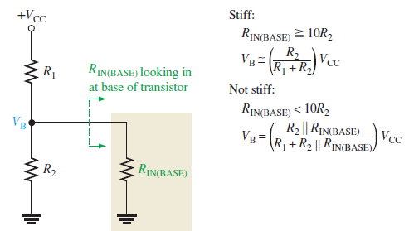
A voltage divider in which the base current is small compared to the current in R2 is said to be a stiff voltage divider because the base voltage is relatively independent of different transistors and temperature effects
To make the base voltage independent of the value of β and determined solely by the voltage divider. is achieved if the current in the divider is made much larger than the base current. Typically one selects R1 and R2 such that their current is in the range of IE to 0.1IE.

Slide 33
Q. Design the bias network of the amplifier in Fig. to establish a current IE = 1 mA using a power supply VCC = +12 V. The transistor is specified to have a nominal β value of 100.
Solution : We shall allocate one-third of the supply voltage to the voltage drop across R2 and another one-third to the voltage drop across RC, leaving one-third for possible negative signal swing at the collector. Thus,

Slide 34
Solving the above two equations yields

Slide 37
Voltage divider bias. (1)
Assume that I₂ > 10I_{B}.
Assume that I_{CQ} ≅ I_{E} (or β >> 1). Then

Slide 38
Example (1)
Determine the values of I_{CQ} and V_{CEQ} for the circuit shown in Fig. 7.15.
Because I_{CQ} ≅ I_{E} (or β >> 1),

Slide 39
Example (2)
Verify that I₂ > 10 I_{B}.

Slide 40
Stability of Voltage Divider Bias Circuit
The Q-point of voltage divider bias circuit is less dependent on β than that of the base bias (fixed bias).
For example, if I_{E} is exactly 10 mA, the range of β is 100 to 300. Then
I_{CQ} hardly changes over the entire range of β

Slide 41
Fig Load line for voltage divider bias circuit.
Circuit values are from previuos Example .

Slide 42
Example

Slide 43
Voltage-divider bias characteristics. (1)
Circuit recognition: The voltage divider in the base circuit.
Advantages: The circuit Q-point values are stable against changes in β.
Disadvantages: Requires more components than most other biasing circuits.
Applications: Used primarily to bias linear amplifier.

Slide 44
Voltage-divider bias characteristics. (2)
Load line equations:
Q-point equations (assume that βR_{E} > 10R₂):

Slide 45
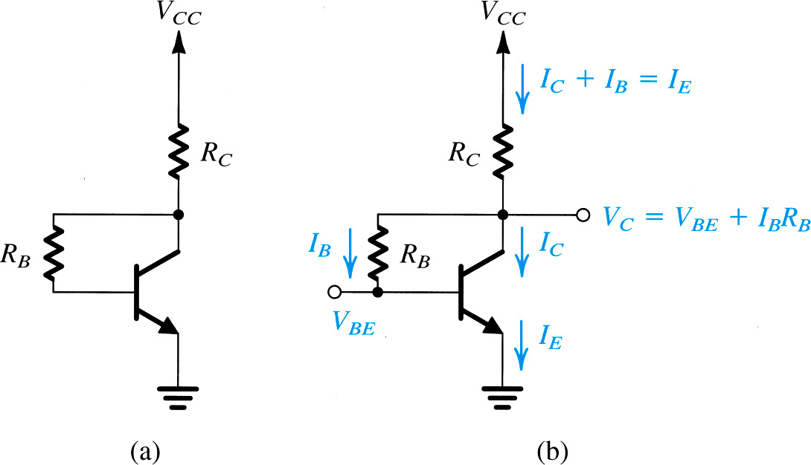
Biasing Using Collector-to-Base Feedback Resistor

Slide 46
Biasing Using Collector-to-Base Feedback Resistor
An improved level of stability can also be obtained by introducing a feedback path from collector to base
To make I_{E} insensitive to temperature and β variations, the two constraints should be satisfied
Reducing R_{B} will reduce sensitivity of I_{E} to variation in β, but will adversely affect the negative swing at collector.

Slide 47
Collector-feedback bias.

Slide 48
Example
Determine the values of I_{CQ} and V_{CEQ} for the amplifier shown in Fig. 7.30.

Slide 49
Collector-Feedback Characteristics (2)
Q-point relationships:

Slide 50
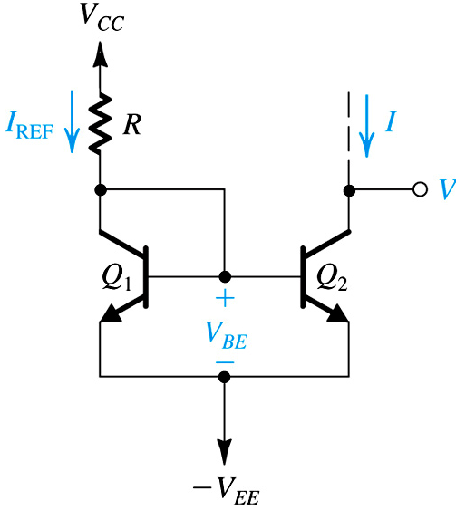
Implementation of Constant-Current Source
Pair of matched transistors Q₁ and Q₂ with high β value
Neglecting the base currents, the current through Q₁ will be approximately equal to I_{REF}
As both the transistors have the same V_{BE} , the collector currents will be equal
Current Mirror

