Slide 1



TIME VALUE OF MONEY

Slide 2
Agenda
Cash Flow Diagram
Time Value of Money
Present and Future Value
Interest
Types of Interest
Single Payment Compound Amount Factor
Functional Notation Of Compound Interest Factor
Applications

Slide 3

CASH FLOW DIAGRAM:
A cash flow diagram is a picture of a financial problem that shows all cash inflows and outflows plotted along a horizontal time line. It help us to visualize a financial problem and to determine if it can be solved using TVM methods.

Slide 4



Types of cash flow:
+ + + +
- - - -

Slide 5
Cash Flow Diagram
Cash Flow Diagram represents the flow of money regarding a particular monetary matter.
Time elapsing is along the horizontal direction
The starting point or current time, is usually taken as 0
Amount received (receipts) is taken as positive having upward direction
Amount released (disbursement) is taken as negative having downward direction

Slide 6
Suppose Mr. A borrows Rs. 500 from Mr. B. After 2 days, Mr. A returns Rs. 500 back to Mr. B.
The cash flow diagram for this transaction, from Mr. B’s perspective will be:
500
Receipts (+ Rs.)
0 1 2
Disbursements (- Rs.)
500

Slide 7
Suppose Mr. A borrows Rs. 500 from Mr. B After 2 days, Mr. A returns Rs. 500 back to Mr. B.
The cash flow diagram for this transaction, from Mr. A’s perspective will be:
500
Receipts (+ Rs.)
0 1 2
Disbursements (- Rs.)
500

Slide 8
Time Value Of Money
Money has value associated with it which changes with time.

Slide 9
Present Value & Future Value
Present Value | How much you are getting now.
Future Value | How much will that be in future!

Slide 10
Future Value
It is the value of money after a particular time period.
It is denoted by “F”.
Rs. 5000 today may have a value of Rs. 5100 after 5 years.
So, Rs. 5100 is the future value of Rs. 5000

Slide 11
Interest
Money is a valuable asset.
Just like with any other asset, such as a house or a car, people are willing to pay for the use of money for some time.
The “rent” for the use of money is called “Interest”.

Slide 12
Interest Period
It is the time period after which the interest is calculated according to the interest rate.
If the interest period is not explicitly mentioned, it is taken as one year.
Package | Loan Package | Interest | Interest Period
1 | 5% interest per year | 5% | 1 year
2 | 10% interest per month | 10% | 1 month
3 | 9% interest per quarter | 9% | 3 months

Slide 13
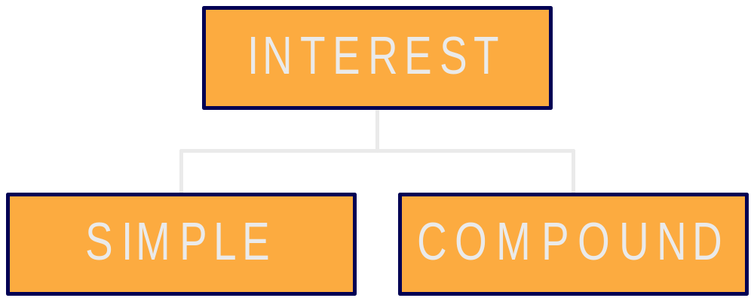


TYPES OF INTEREST

Slide 14
Simple Interest
It is the interest calculated on the original amount after every interest period.
It does not involve the calculation of interest on the previously accumulated interest.
Mathematically:
Total interest payable
= P x i x n
And F = P + P x i x n
Where, P = Amount taken as loan
i = Interest rate
n = Number of interest periods
F = Total amount payable or Future Value

Slide 15
DIFFERENCE B/W SIMPLE AND COMPOUND INTEREST
Q.Calculate the future value of 1000$ after three years at interest
rate of 5%?
P=$1,000
1 2 3
I₁=$50.00
I₂=$50.00
I₃=$50.00
FUTURE VALUE $1,000 + $150 of interest

Slide 16
Compound flow chart:
P=$1,000
Future value:
$1,000 + 50.00 + 52.50 + 55.13 = $1,157.63
1 2 3
I₁=$50.00
I₂=$52.50
I₃=$55.13
CONCLUSION
Compound interest is more effective than simple interest

Slide 17

Example Of Simple Interest
Habib bank offers a loan of Rs. 100,000 at a simple interest rate of 10% per year.
How much would the interest be after 5 years?

Slide 18
Habib bank offers a loan of Rs. 100,000 at a simple interest rate of 10% per year.
How much would the interest be after 5 years?
Solution:
Here, P = Rs. 100,000
i = 10% = 10 / 100 = 0.1
n = 5
Interest after 5 years
= 100,000 x 0.1 x 5
= 50,000 rupees

Slide 19
Cash Flow Diagram
Habib bank’s perspective:
Receipts (+ Rs.)
F = 150,000
0 1 2 3 4 5
P = 100,000
Disbursements (- Rs.)

Slide 20
Compound Interest
It is the interest calculated on the total amount payable.
The interest calculation is performed upon the original amount plus the unpaid interest for the preceding periods.
Mathematically:
F = P(1 + i)^{n}
Where, P = Amount taken
i = Interest rate
n = Number of interest periods
F = Total amount payable or Future Value

Slide 21
Compound Interest Formula
Amount payable after “1” interest period:
F = P + P x i = P + Pi = P(1 + i)
Amount payable after “2” interest periods:
F = P(1 + i) + P(1 + i) x i
= P(1 + i) (1 + i)
= P(1 + i)²
Amount payable after “3” interest periods:
F = P(1 + i)² + P(1 + i)² x i
= P(1 + i)² (1 + i)
= P(1 + i)³
Amount payable after “n” interest periods:
F = P(1 + i)^{n}

Slide 22
Compound Interest Factor /Single Payment Compound Amount Factor
Compound Interest Formula is given as:
F = P (1 + i)^{n}
= (1 + i)^{n}
This is called “Compound Interest Factor” or “Single Payment Compound Amount Factor”.

Slide 23
Functional Notation Of Compound Interest Factor
= (1 + i)^{n}
Therefore, F = P x f ( , i, n)
Where, f ( , i, n) is a function of three parameters and is the compound interest factor.

Slide 24

Example Of Compound Interest
Mr. Fawad is in the need of Rs. 100,000 to start his own business. Allied bank offers a loan of Rs. 100,000 at a compound interest rate of 10% per year.
How much does Mr. Fawad have to pay back to the bank after 5 years?

Slide 25
Solution (Method - I):
Here, P = 100,000
i = 10% = 10 / 100 = 0.1
n = 5
F = ?
F = P (1 + i)^{n}
= 100,000 (1 + 0.1)⁵
= 161,051 rupees
Net amount payable after 5 years = 161,051 rupees
Money above principal amount = 61,051 rupees

Slide 26
Solution (Method - II):
Here, P = 100,000
i = 10%
n = 5
F = ?
= (1 + i)^{n}
= 1.61051
F = 100,000 x 1.61051
= 161,051 rupees
Compound Interest Table
for 10% Interest
n | Compound Interest Factor
1 | 1.10000
2 | 1.21000
3 | 1.33100
4 | 1.46410
5 | 1.61051

Slide 27
Cash Flow Diagram
Fawad ’s perspective:
Receipts (+ Rs.)
P = 100,000
0 1 2 3 4 5
F = 161,051
Disbursements (- Rs.)

Slide 28
Various Types Of Charging Interest
Interest rates are mentioned in several ways and have different meanings.
Interest Mentioned | Interest | Interest Period
5% interest | 5% | 1 year
10% interest per year compounded annually | 10% | 1 year
20% interest per year compounded semiannually | 10% | 6 months
12% interest compounded quarterly | 3% | 3 months

Slide 29

Difference b/w nominal and real interest rates
The nominal interest rate includes compensation for the lender's lost value due to inflation,
whereas the real interest rate excludes inflation.

Slide 30
The relationship between real and nominal interest rates can be described in the equation:
real interest rate = nominal interest rate - expected inflation
Nominal interest rate =12%
Inflation = 7%
Real interest =5%

