Slide 1
Market structures

Slide 2
Competitive Market
A competitive market, sometimes called a perfectly competitive market has three characteristics:
There are many buyers and many sellers in the market.
The goods offered by the various sellers are largely the same.
Firms can freely enter or exit the market.
As a result of these condition, the actions of any single buyer or seller in the market have a negligible impact on the market price. Each buyer and seller takes the market price as given.

Slide 3
Revenue of a Competitive Firm
Total revenue for a firm is the selling price times the quantity sold.
TR = P × Q

Slide 4
Revenue of a Competitive Firm
Marginal Revenue is the increase (Δ) in total revenue when an additional unit is sold.
MR = ΔTR / ΔQ
For competitive firms, marginal revenue equals the price of the good.
In perfect competition, marginal revenue equals price: P = MR and P = AR
Therefore, for all firms in perfect competition, P = AR = MR

Slide 5
Total, Average, and Marginal Revenue for a Competitive Firm
Note: (a) P = AR = MR (b) P does not fall as Q increases
Notes:
Point out that price does not decrease even when output increases. Point out that P = AR = MR.

Slide 6
PROFIT MAXIMIZATION
The goal of a competitive firm is to maximize profit.
This means that the firm will want to produce the quantity that maximizes the difference between total revenue and total cost.

Slide 7
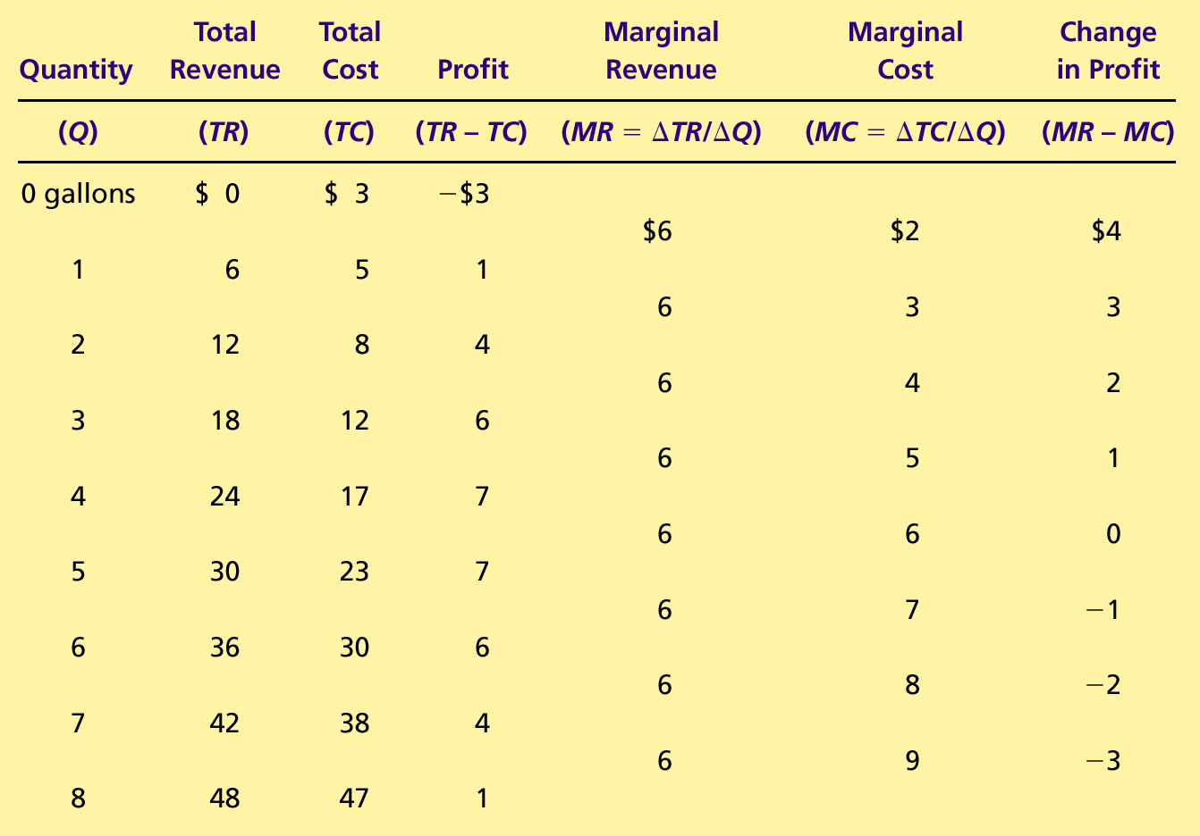
Profit Maximization: A Numerical Example

Slide 8
Profit Maximization for a Competitive Firm
Costs
and
The firm maximizes
Revenue
profit by producing
the quantity at which
marginal cost equals
MC
marginal revenue.
MC
2
ATC
P
=
MR
1
=
MR
2
P
=
AR
=
MR
AVC
MC
1
0
Q
1
Q
MAX
Q
2
Quantity
Copyright © 2004 South-Western

Slide 9
The Firm’s Short-Run Decision to Shut Down
The firm shuts down if the revenue it gets from producing is less than the variable cost of production.
Shut down if TR < VC
Shut down if TR/Q < VC/Q
Shut down if P < AVC

Slide 10
Profit as the Area between Price and Average Total Cost
(a) A Firm with Profits
Price
MC
ATC
Profit
P
ATC
P
=
AR
=
MR
0
Q
Quantity
(profit-maximizing quantity)
Copyright © 2004 South-Western

Slide 11
Profit as the Area between Price and Average Total Cost
(b) A Firm with Losses
Price
MC
ATC
ATC
P
P
=
AR
=
MR
Loss
0
Q
Quantity
(loss-minimizing quantity)
Copyright © 2004 South-Western

Slide 12
Why Do Competitive Firms Stay in Business If They Make Zero Profit?
Profit equals total revenue minus total cost.
Total cost includes all the opportunity costs of the firm.
In the zero-profit equilibrium, the firm’s revenue compensates the owners for the time and money they expend to keep the business going.

Slide 13
Monopoly
While a competitive firm is a price taker, a monopoly firm is a price maker.
A firm is considered a monopoly if . . .
it is the sole seller of its product.
its product does not have close substitutes.

Slide 14
WHY MONOPOLIES ARISE
The fundamental cause of monopoly is barriers to entry.
Barriers to entry have three sources:
Ownership of a key resource.
The government gives a single firm the exclusive right to produce some good.
Costs of production make a single producer more efficient than a large number of producers.

Slide 15
Government-Created Monopolies
Although exclusive ownership of a key resource is a potential source of monopoly, in practice monopolies rarely arise for this reason.
Governments may restrict entry by giving a single firm the exclusive right to sell a particular good in certain markets.
Patent and copyright laws are two important examples of how government creates a monopoly to serve the public interest.

Slide 16
HOW MONOPOLIES MAKE PRODUCTION AND PRICING DECISIONS
Monopoly
Competitive Firm
Is the sole producer
Faces a downward-sloping demand curve
Is a price maker
Reduces price to increase sales
Is one of many producers
Faces a horizontal demand curve
Is a price taker
Sells as much or as little at same price

Slide 17

Demand Curves for Competitive and Monopoly Firms
(a) A Competitive Firm
’
s Demand Curve
(b) A Monopolist
’
s Demand Curve
Price
Price
Demand
Demand
0
Quantity of Output
0
Quantity of Output

Slide 18
A Monopoly’s Revenue
Total Revenue
P × Q = TR
Average Revenue
TR/Q = AR = P
Marginal Revenue
ΔTR/ΔQ = MR

Slide 19
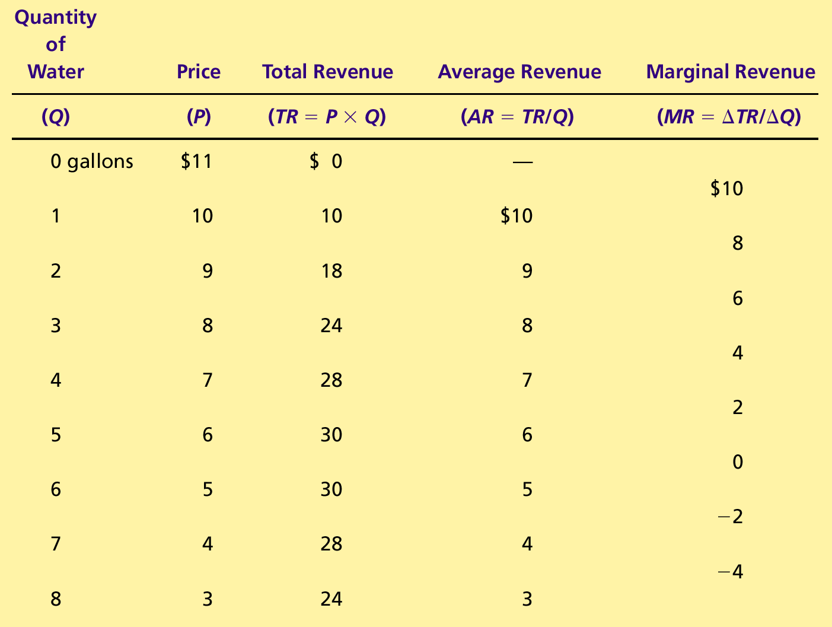
A Monopoly’s Total, Average, and Marginal Revenue

Slide 20
A Monopoly’s Revenue
A Monopoly’s Marginal Revenue
A monopolist’s marginal revenue is always less than the price of its good.
The demand curve is downward sloping.
When a monopoly drops the price to sell one more unit, the revenue received from previously sold units also decreases.

Slide 21
A Monopoly’s Revenue
A Monopoly’s Marginal Revenue
When a monopoly increases the amount it sells, it has two effects on total revenue (P × Q).
The output effect—more output is sold, so Q is higher.
The price effect—price falls, so P is lower.

Slide 22
Demand and Marginal-Revenue Curves for a Monopoly
Price
$11
10
9
8
7
6
5
4
3
Demand
2
Marginal
(average
1
revenue
revenue)
0
–1
1
2
3
4
5
6
7
8
Quantity of Water
–2
–3
–4

Slide 23
Profit Maximization
A monopoly maximizes profit by producing the quantity at which marginal revenue equals marginal cost.
It then uses the demand curve to find the price that will induce consumers to buy that quantity.

Slide 24
Profit Maximization for a Monopoly
Costs and
Revenue
2. . . . and then the demand
1. The intersection of the
curve shows the price
marginal-revenue curve
consistent with this quantity.
and the marginal-cost
curve determines the
B
profit-maximizing
Monopoly
quantity . . .
price
Average total cost
A
Marginal
Demand
cost
Marginal revenue
0
Q
Q_{MAX}
Q
Quantity

Slide 25
Profit Maximization
Comparing Monopoly and Competition
For a competitive firm, price equals marginal cost.
P = MR = MC
For a monopoly firm, price exceeds marginal cost.
P > MR = MC

Slide 26
A Monopoly’s Profit
Profit equals total revenue minus total costs.
Profit = TR - TC
Profit = (TR/Q - TC/Q) × Q
Profit = (P - ATC) × Q

Slide 27
The Monopolist’s Profit
Costs and
Revenue
Marginal cost
Monopoly
E
B
price
Monopoly
Average total cost
profit
Average
total
D
C
cost
Demand
Marginal revenue
0
Q_{MAX}
Quantity

Slide 28
A Monopolist’s Profit
The monopolist will receive economic profits as long as price is greater than average total cost.

