Slide 1
The Costs of Production

Slide 2
WHAT ARE COSTS?
The amount that firm pays to buy inputs is called its total costs
The Firm’s Objective
The economic goal of the firm is to maximize profits.

Slide 3
Total Revenue, Total Cost, and Profit
Total Revenue
The amount a firm receives for the sale of its output.
Total Cost
The market value of the inputs a firm uses in production.
Profit
is the firm’s total revenue minus its total cost.
Profit = Total revenue - Total cost

Slide 4
Costs as Opportunity Costs
A firm’s cost of production includes all the opportunity costs of making its output of goods and services.
Explicit and Implicit Costs
A firm’s cost of production include explicit costs and implicit costs.
Explicit costs are input costs that require a direct outlay of money by the firm.
Implicit costs are input costs that do not require an outlay of money by the firm.

Slide 5
Sunk cost
Sunk costs are those which have already been incurred and which are unrecoverable.
In business, sunk costs are typically not included in consideration when making future decisions, as they are seen as irrelevant to current and future budgetary concerns.
Sunk costs are in contrast to relevant costs, which are future costs that have yet to be incurred.

Slide 6
Economic Profit versus Accounting Profit
Economists measure a firm’s economic profit as total revenue minus total cost, including both explicit and implicit costs.
Accountants measure the accounting profit as the firm’s total revenue minus only the firm’s explicit costs.

Slide 7
Economic Profit versus Accounting Profit
When total revenue exceeds both explicit and implicit costs, the firm earns economic profit.
Economic profit is smaller than accounting profit.

Slide 8
How an Economist
Views a Firm
How an Accountant
Views a Firm
Economic Profit
Implicit Costs
Explicit Costs
Accounting Profit
Explicit Costs
Revenue
Revenue
Total
Opportunity
Costs

Slide 9

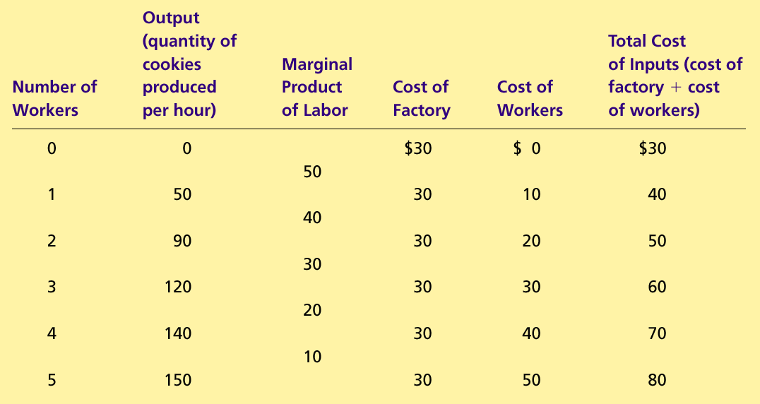
Production Function and Total Cost: A Cookie Factory

Slide 10
PRODUCTION AND COSTS
The Production Function
The production function shows the relationship between quantity of inputs used to make a good and the quantity of output of that good.

Slide 11
The Production Function
Marginal Product
The marginal product of any input in the production process is the increase in output that arises from an additional unit of that input.

Slide 12
The Production Function
Diminishing Marginal Product
Diminishing marginal product is the property whereby the marginal product of an input declines as the quantity of the input increases.
Example: As more and more workers are hired at a firm, each additional worker contributes less and less to production because the firm has a limited amount of equipment.

Slide 13

Production Function
Quantity of
Output
(cookies
per hour)
150
Production function
140
130
120
110
100
90
80
70
60
50
40
30
20
10
0
1
2
3
4
5
Number of Workers Hired

Slide 14
From the Production Function to the Total-Cost Curve
The relationship between the quantity a firm can produce and its costs determines pricing decisions.
The total-cost curve shows this relationship graphically.

Slide 15
Production Function and Total Cost: A Cookie Factory

Slide 16
Total-Cost Curve
Total
Cost
$80
Total-cost
curve
70
60
50
40
30
20
10
0
10
20
30
40
50
60
70
80
90
100
110
120
130
140
150
Quantity
of Output
(cookies per hour)

Slide 17


THE VARIOUS MEASURES OF COST
Costs of production may be divided into fixed costs and variable costs.
Fixed costs are those costs that do not vary with the quantity of output produced.
Variable costs are those costs that do vary with the quantity of output produced.

Slide 18
Fixed and Variable Costs
Total Costs
Total Fixed Costs (TFC)
Total Variable Costs (TVC)
Total Costs (TC)
TC = TFC + TVC

Slide 19
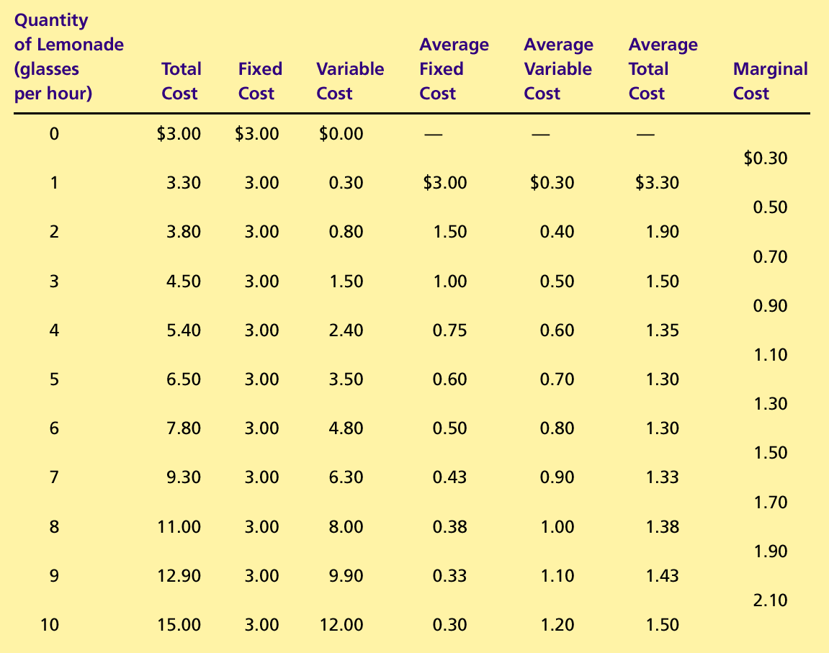
The Various Measures of Cost

Slide 20
Fixed and Variable Costs
Average Costs
Average costs can be determined by dividing the firm’s costs by the quantity of output it produces.
The average cost is the cost of each typical unit of product.
Average Fixed Costs (AFC)
Average Variable Costs (AVC)
Average Total Costs (ATC)
ATC = AFC + AVC

Slide 21
Average Costs

Slide 22
The Various Measures of Cost

Slide 23
Fixed and Variable Costs
Marginal Cost
Marginal cost (MC) measures the increase in total cost that arises from an extra unit of production.
Marginal cost helps answer the following question:
How much does it cost to produce an additional unit of output?

Slide 24
Marginal Cost

Slide 25
Total-Cost Curves
Total Cost
$15.00
Total-cost curve
14.00
13.00
12.00
11.00
10.00
9.00
8.00
7.00
6.00
5.00
4.00
3.00
2.00
1.00
0
1
2
3
4
5
6
7
8
9
10
Quantity
of Output
(glasses of lemonade per hour)

Slide 26
Average-Cost and Marginal-Cost Curves
Costs
$3.50
3.25
3.00
2.75
2.50
2.25
MC
2.00
1.75
1.50
ATC
1.25
AVC
1.00
0.75
0.50
0.25
AFC
0
1
2
3
4
5
6
7
8
9
10
Quantity
of Output
(glasses of lemonade per hour)

Slide 27
Cost Curves and Their Shapes
Marginal cost rises with the amount of output produced.
This reflects the property of diminishing marginal product.

Slide 28
Average-Cost and Marginal-Cost Curves
Costs
$3.50
3.25
3.00
2.75
2.50
2.25
MC
2.00
1.75
1.50
1.25
1.00
0.75
0.50
0.25
0
1
2
3
4
5
6
7
8
9
10
Quantity
of Output
(glasses of lemonade per hour)

Slide 29
Cost Curves and Their Shapes
The average total-cost curve is U-shaped.
At very low levels of output average total cost is high because fixed cost is spread over only a few units.
Average total cost declines as output increases.
Average total cost starts rising because average variable cost rises substantially.
The bottom of the U-shaped ATC curve occurs at the quantity that minimizes average total cost. This quantity is sometimes called the efficient scale of the firm.

Slide 30
Average-Cost and Marginal-Cost Curves
Costs
$3.50
3.25
3.00
2.75
2.50
2.25
2.00
1.75
1.50
ATC
1.25
1.00
0.75
0.50
0.25
0
1
2
3
4
5
6
7
8
9
10
Quantity
of Output
(glasses of lemonade per hour)

Slide 31
Cost Curves and Their Shapes
Relationship between Marginal Cost and Average Total Cost
Whenever marginal cost is less than average total cost, average total cost is falling.
Whenever marginal cost is greater than average total cost, average total cost is rising.
The marginal-cost curve crosses the average-total-cost curve at the efficient scale.
Efficient scale is the quantity that minimizes average total cost.

Slide 32
Average-Cost and Marginal-Cost Curves
Costs
$3.50
3.25
3.00
2.75
2.50
2.25
MC
2.00
1.75
1.50
ATC
1.25
1.00
0.75
0.50
0.25
0
1
2
3
4
5
6
7
8
9
10
Quantity
of Output
(glasses of lemonade per hour)

Slide 33
Typical Cost Curves
It is now time to examine the relationships that exist between the different measures of cost.

Slide 34
Typical Cost Curves
Three Important Properties of Cost Curves
Marginal cost eventually rises with the quantity of output.
The average-total-cost curve is U-shaped.
The marginal-cost curve crosses the average-total-cost curve at the minimum of average total cost.

Slide 35
COSTS IN THE SHORT RUN AND IN THE LONG RUN
For many firms, the division of total costs between fixed and variable costs depends on the time horizon being considered.
In the short run, some costs are fixed.
In the long run, fixed costs become variable costs.
Because many costs are fixed in the short run but variable in the long run, a firm’s long-run cost curves differ from its short-run cost curves

Slide 36
Average Total Cost in the Short and Long Run
Average
Total
ATC
in short
ATC
in short
ATC
in short
Cost
run with
run with
run with
small factory
medium factory
large factory
$12,000
ATC
in long run
0
1,200
Quantity of
Cars per Day

Slide 37
Economies and Diseconomies of Scale
Economies of scale refer to the property whereby long-run average total cost falls as the quantity of output increases.
Diseconomies of scale refer to the property whereby long-run average total cost rises as the quantity of output increases.
Constant returns to scale refers to the property whereby long-run average total cost stays the same as the quantity of output increases

Slide 38
Average Total Cost in the Short and Long Run
Average
Total
ATC
in short
ATC
in short
ATC
in short
Cost
run with
run with
run with
small factory
medium factory
large factory
ATC
in long run
$12,000
10,000
Economies
Constant
of
returns to
scale
scale
Diseconomies
of
scale
0
1,000
1,200
Quantity of
Cars per Day

Slide 39
Class activity
Calculate the following
Total cost
Average total cost
Average fixed cost
Average variable cost
Marginal cost
Also graphically illustrate all the cost curves.

Slide 40
Quantity of Bagels (per hour) | Fixed Cost | Variable Cost
Q | FC | VC
0 | $2.00 | $0.00
1 | 2.00 | 1.00
2 | 2.00 | 1.80
3 | 2.00 | 2.40
4 | 2.00 | 2.80
5 | 2.00 | 3.20
6 | 2.00 | 3.80
7 | 2.00 | 4.60
8 | 2.00 | 5.60
9 | 2.00 | 6.80
10 | 2.00 | 8.20
11 | 2.00 | 9.80
12 | 2.00 | 11.60
13 | 2.00 | 13.60
14 | 2.00 | 15.80

