Slide 1
The Circular Flow Model
How Things Work in an economy

Slide 2
Economic activities
Primary economic activity
It is the production and sale of raw goods;
Secondary economic activity
It refers to the purchase and sale of finished goods (consumer durable or non-durable). ...
Tertiary economic activity
It refers to the service sector
The tertiary sector involves services.

Slide 3
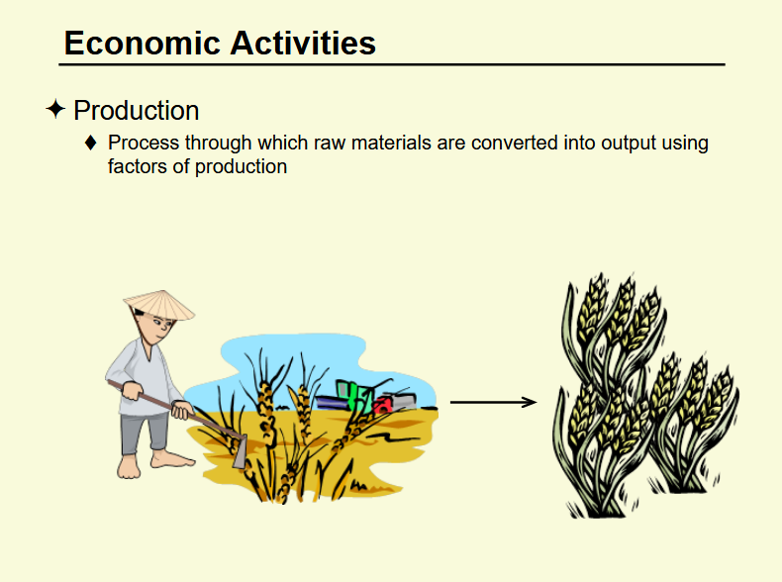


Slide 4
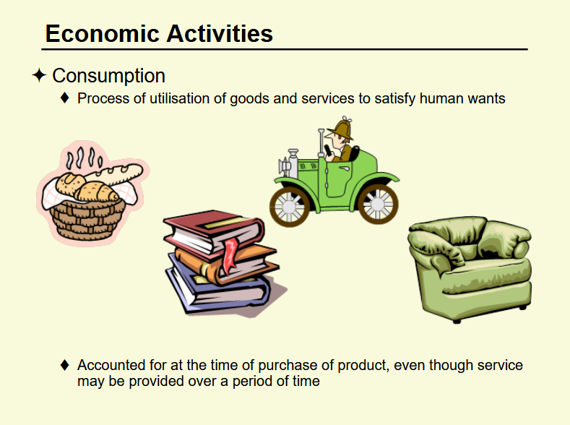

Slide 5
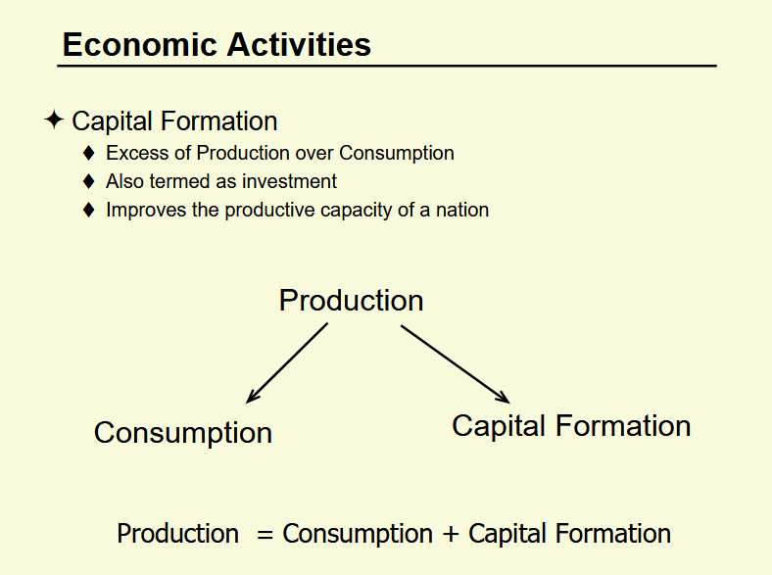

Slide 6
Equilibrium
Output/Production = Consumption + Saving
Production = Consumption + Capital Formation
Y = C+S = C+I
Income = Consumption + (Saving=Investment)
So S=I

Slide 7
2 Sectors Model in an Economy

Slide 8


Sectors in an Economy

Slide 9
Households
Demand consumer goods, like: cars, computers, washers, lawnmowers, etc and spend income.
Households provide labor resources to business and own most of the resources of production and get rewards

Slide 10
Businesses/Firms
Include both Private and Government owned
Produce and supply goods and services for Revenues/Income
Businesses demand resources for production and paid the rewards of the factors(land, labor, capital, and entrepreneurs)

Slide 11
In our economic system we take initially two sectors
the business sector and the household sector

Slide 12
These two sectors interact in two markets:
the Product Market and the Factor Market

Slide 13
Product Markets
are the markets where households acquire finished (consumer) goods & services.
The markets we are most familiar with are retail markets.
Examples include: Wal-Mart, gas stations, Burger King, Best Buy, the dentist.

Slide 14
Product
Markets

Slide 15
Factor Markets
are the markets where business acquire the factors of production (land, labor, capital..)
When you are looking for a job you are in the factor (labor) market.
Examples include: Cowan Equipment, IBM Business Solutions, Snelling Personnel

Slide 16
Product
Markets
Businesses produce goods and provide
services in the product market.
In exchange households pay for goods &
services with consumption expenditures
(money)
Factor
Markets

Slide 17
Product
Markets
Households provide labor, own land,
invest in capital and have the talent
businesses need to produce goods and
services.
To pay for these resources business pay
wages and salaries, pay rent, purchase raw
material, pay dividends to households.
Factor
Markets

Slide 18
goods & services…
Product
Markets
….goods & services
….consumption spending….
….salaries, wages, rent, dividends…..
Factor
Markets
land, labor, capital……
…entrepreneurial ability

Slide 19
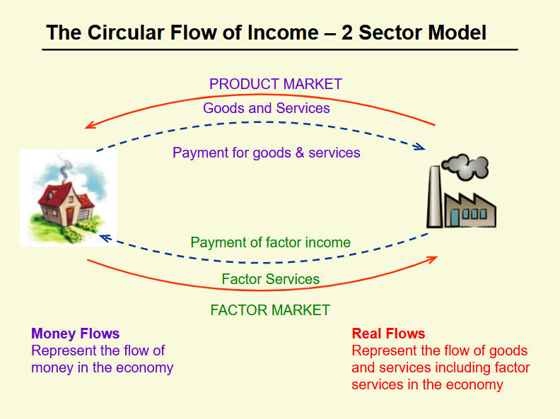

Slide 20
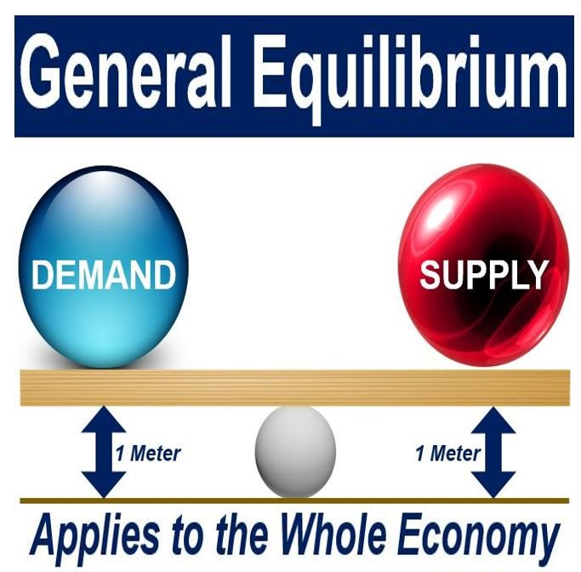

Slide 21
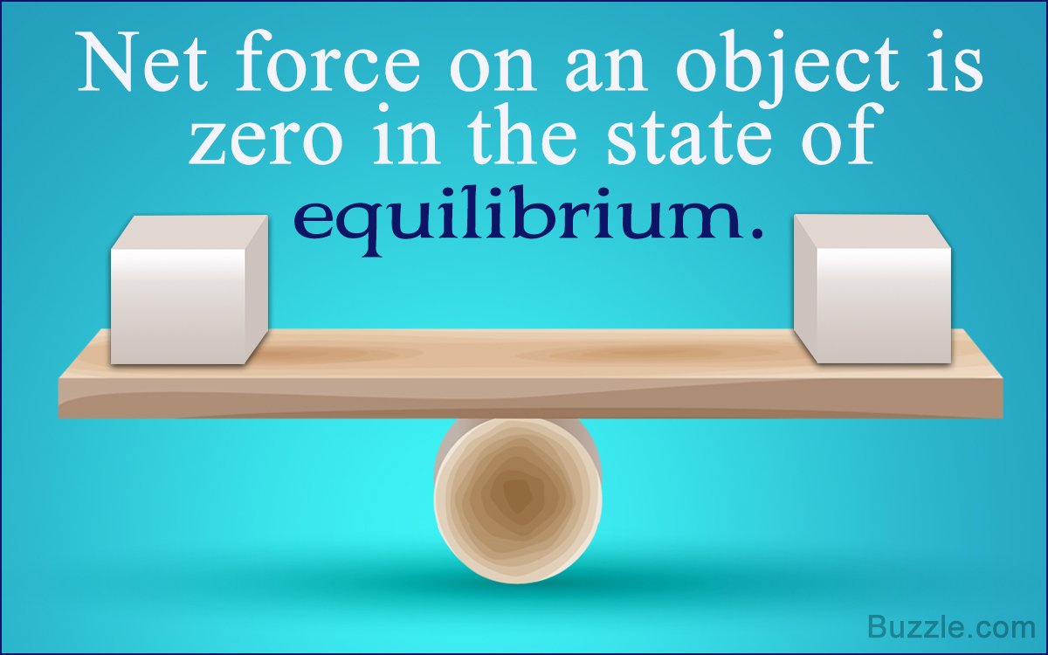

Slide 22
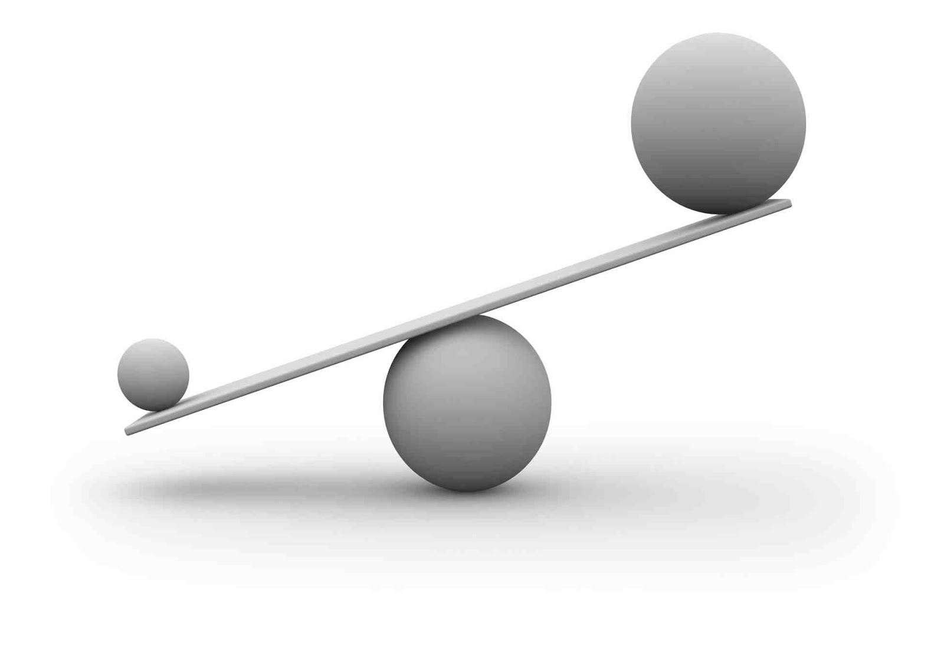

Slide 23


Slide 24
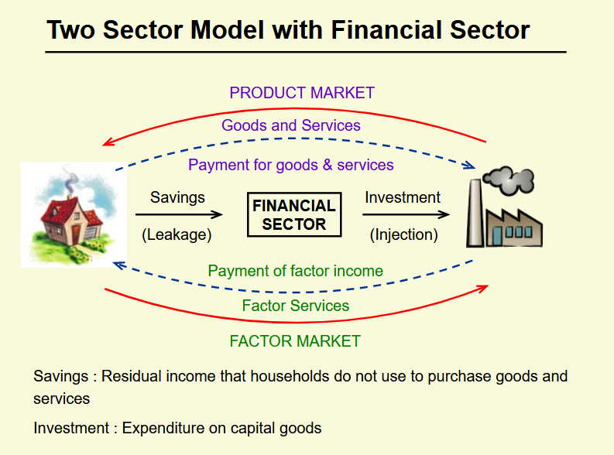

Slide 25
Equilibrium
Savings = Investment
Leakages = Injections
S = I

Slide 26
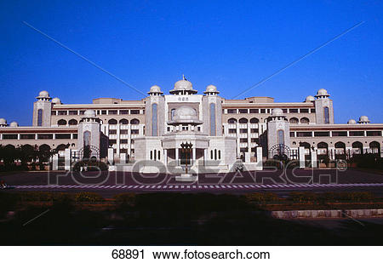
Sectors in an Economy
In a mixed economy its not always this
simple, something is missing.
The Government

Slide 27
Governments
Federal, Provincial & Local
Governments require resources to provide services for the welfare.
To purchase these resources governments collect taxes
Profit is not an objective

Slide 29
Equilibrium
S = I
Saving = Inestment
Leakages = Injections

Slide 30
3 Sectors Model in an Economy

Slide 31
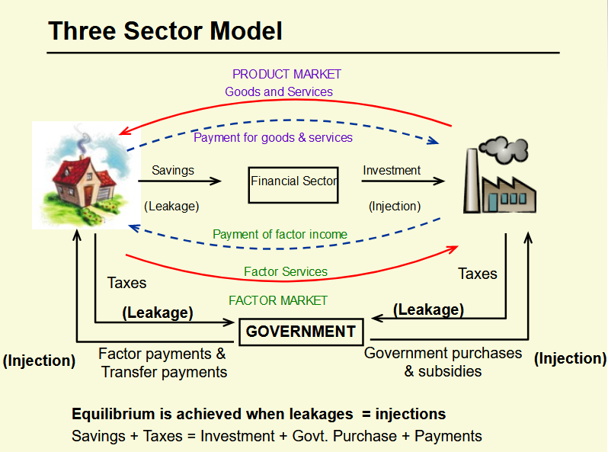

Slide 32
Equilibrium
Saving +Taxes = Investment + Govt Spendings + payments
Leakages = Injections
S+T = I+G

Slide 33
4 Sectors Model in an Economy

Slide 34

4 Sectors in an Economy

Slide 35
Rest of the World
External Economy
Domesic economy undertakes transactions with the exetnal economy
  Imports: Puchase of foreign products by domesitc economy
  Exports: Sale of domestic poducts to the external economy

Slide 37
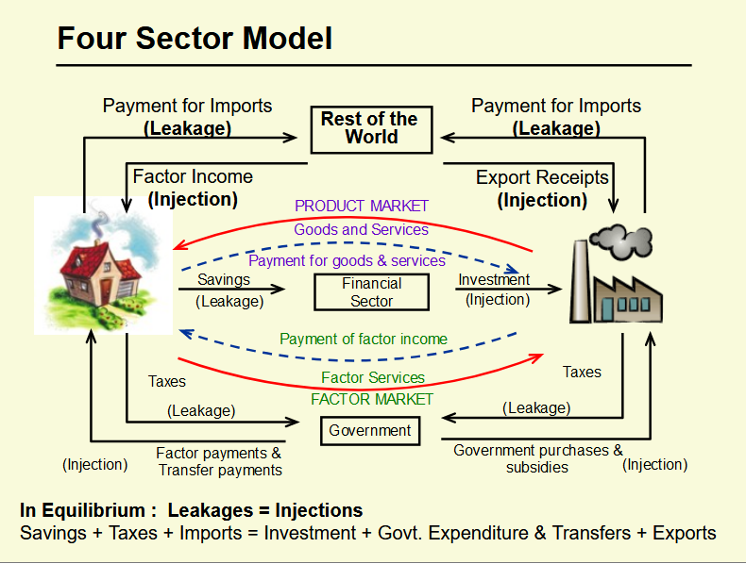

Slide 38
Equilibrium
Saving +Taxes + Imports = Investment + Govt Spending + Exports
Leakages = Injections
S+T+M = I+G+X

Slide 39
Summary

Slide 40
