Slide 1
Demand, Supply and Equilibrium in the Market

Slide 2
Basic concepts of demand and supply (Mathematically & Graphically).
Equilibrium Quantity and Price.
Impacts of different factors on equilibrium quantity and price.

Slide 3
Introduction
Supply and demand are the two words that economists use most often.
Supply and demand are the forces that make market economies work.
Modern microeconomics is about supply, demand, and market equilibrium.
Notes:
2

Slide 4
Economic Activities
Consumption
Production
Demand
Supply

Slide 5
MARKETS AND COMPETITION
Buyers determine demand.
Sellers determine supply
A competitive market is a market in which there are many buyers and sellers so that each has a negligible impact on the market price.

Slide 6
Markets
Market bring together buyers (demanders) and sellers (suppliers), and they exist in many forms.
The corner gas station , an e-commerce site, the local music store , a farmer’s roadside stand all are familiar markets.
Some markets are local , others are national or international. Some are highly personal , involving face to face contact between demander and supplier, others are faceless with buyer and seller never seeing or knowing each other.

Slide 7
Demand
Quantity demanded is the amount of a good that buyers are willing and able to purchase over a given period of time.
Law of Demand
The law of demand states that, other things equal, the quantity demanded of a good falls when the price of the good rises.
Demand Schedule
The demand schedule is a table that shows the relationship between the price of the good and the quantity demanded.
Demand Curve
The demand curve is a graph of the relationship between the price of a good and the quantity demanded.

Slide 8

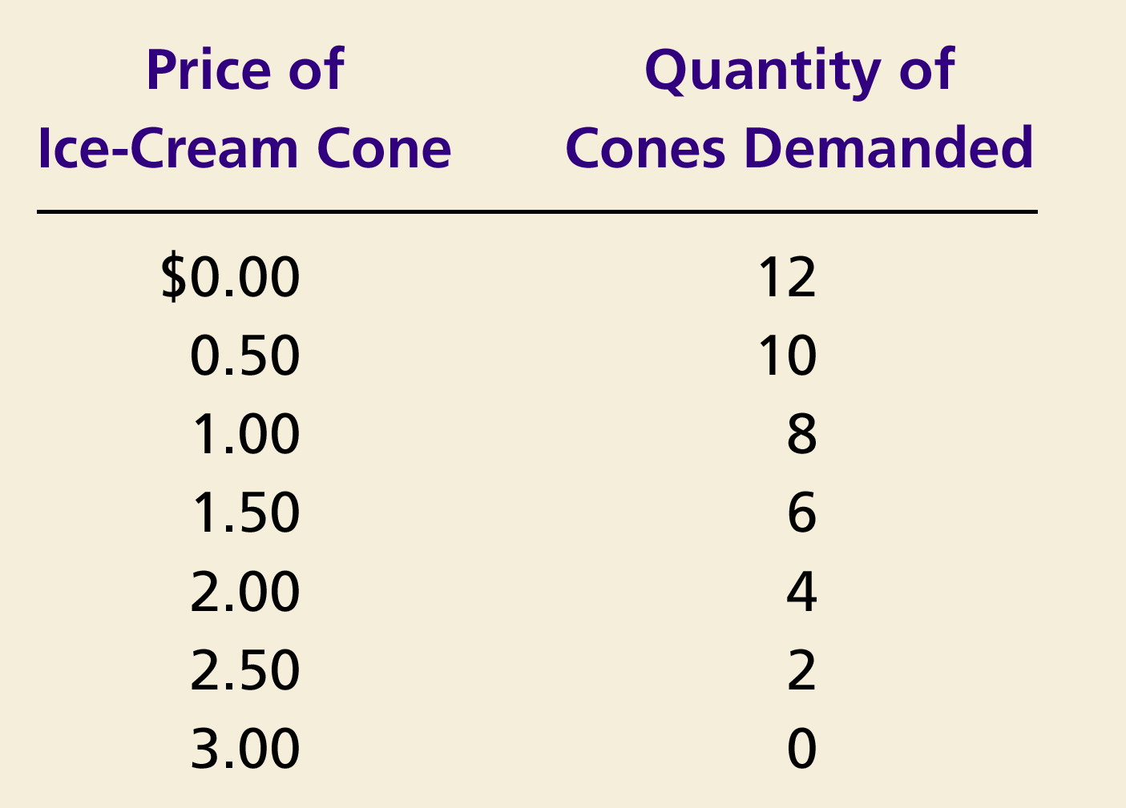
Demand Schedule and Demand Curve
Price of
Ice-Cream Cone
$3.00
2.50
1. A decrease
2.00
in price
...
1.50
1.00
0.50
0
1
2
3
4
5
6
7
8
9
10
11
12
Quantity of
Ice-Cream Cones
2.
...
increases quantity
of cones demanded.
Copyright © 2004 South-Western

Slide 9
Market Demand versus Individual Demand
Market demand refers to the sum of all individual demands for a particular good or service.
Graphically, individual demand curves are summed horizontally to obtain the market demand curve.

Slide 10
Demand
Amount of a good or service that consumers are willing
and able to purchase during a given period of time is
called quantity demanded.
Demand Relations
Generalized
Demand Function
Ordinary
Demand Function
Q_{D}=D(P,α)
Q_{D}=D(P)
(Where α shows other factors)
(Keeping α as constant)

Slide 11
Ordinary Demand Function Q_{D}=D(P) (Keeping α as constant)
Change in Quantity Demanded
Movement along the demand curve.
Caused by a change in the price of the product.
Notes:
19

Slide 12
Changes in Quantity Demanded
Price of Ice-Cream Cones
A tax that raises the price of ice-cream cones results in a movement along the demand curve.
B
$2.00
A
1.00
D
0
4
8
Quantity of Ice-Cream Cones

Slide 13
The Generalized Demand Function
The relation between quantity demanded and all the factors
that affect quantity demanded
Q_{D}= D(P,α)
∂D/∂P=D_{P}<0
∂D/∂α=D_{α} may have any sign depending upon the factors

Slide 14
Factors in α
Q_{D} = D(M, P_{R}, T, P_{e}, N)
Where
Q_{D} the quantity demanded of the good or service
M the consumes’ income (generally per capita)
P_{R} the price of related goods or services,
T the taste patterns of consumers,
P_{e} the expected price of the good in some future period,
N the number of consumers in the market.

Slide 15
Shifts in the Demand Curve
Economists assume that price is the most important influence on the amount of any product purchased. But Economists know that other factors can and do affect purchases. These factors are called determinants of demand and are assumed to be constant when a demand curve is drawn. Determinants of demand are also known as demand shifters.
Shift in Demand
A shift in the demand curve, either to the left or right.
Caused by any change that alters the quantity demanded at every price.
Shifts in the Demand Curve
Consumer income
Prices of related goods ( substitutes and complements)
Tastes and preferences
Expectations
Number of buyers
Notes:
19

Slide 16
Shifts in the Demand Curve
Price of
Ice-Cream
Cone
Increase
in demand
Decrease
in demand
Demand
curve,
D
2
Demand
curve,
D
1
Demand curve,
D
3
0
Quantity of
Ice-Cream Cones
Copyright©2003 Southwestern/Thomson Learning

Slide 17
Shifts in the Demand Curve
Consumer Income
As income increases the demand for a normal good will increase.
As income increases the demand for an inferior good will decrease.

Slide 18
Consumer Income Normal Good
Price of Ice-Cream Cone
$3.00
An increase in income...
2.50
Increase
in demand
2.00
1.50
1.00
0.50
D₂
D₁
Quantity of Ice-Cream Cones
0
1
2
3
4
5
6
7
8
9
10
11
12

Slide 19
Consumer Income Inferior Good
Price of Ice-Cream Cone
$3.00
2.50
An increase in income...
2.00
Decrease
in demand
1.50
1.00
0.50
D₂
D₁
Quantity of Ice-Cream Cones
0
1
2
3
4
5
6
7
8
9
10
11
12

Slide 20
Shifts in the Demand Curve
Prices of Related Goods
When a fall in the price of one good reduces the demand for another good, the two goods are called substitutes. ( A substitute good is the one that can be used in place of another good.)
When a fall in the price of one good increases the demand for another good, the two goods are called complements. ( A complement good is the one that is used together with another good.)

Slide 21

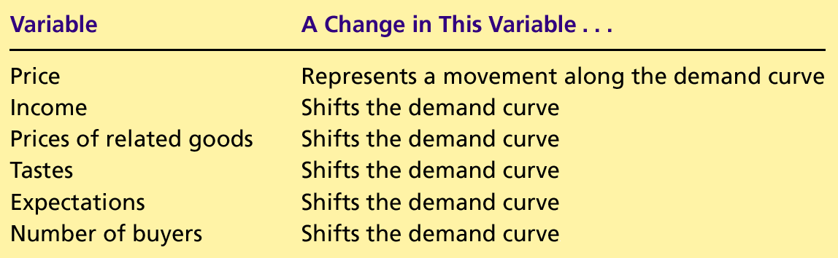
Variables That Influence Buyers
Copyright©2004 South-Western

Slide 22
Mathematical Expression in Linear Functional Form
Q_{D} = a + bP + cM + d P_{R} + eT + fP_{e} + gN
Where Q_{D,} P ,M, P_{R,} T, P_{e,}and N are as defined above, and
a, b, c, d, e, f, and g are parameters.
Intercept Parameter: (a)
It shows the value of Q_{d,} when
the variables P ,M, P_{R,} T, P_{e,}and
N are all simultaneously
equal to zero
Slope Parameters: (b,c,d,e,f,g)
Parameters in a linear function that
measure the effect on the dependent
variable (Q_{d}) of changing one of the
independent variables (P ,M, P_{R,} T, P_{e}
and N), while holding the rest of these
variables constant.

Slide 23
Summary of the Generalized a(linear) Demand Function
Variable Relation to Sign of
quantity demanded Slope parameter
P Inverse b=ΔQ_{D}/ΔP is (-)ve
M Direct for normal goods c=Δ Q_{D} /ΔM is (+)ve
Inverse for inferior goods c=Δ Q_{D} /ΔM is (-)ve
P_{R} Direct for substitute goods d=Δ Q_{D} /ΔP_{R} is (+)ve
Inverse for complement goods d=Δ Q_{D} /ΔP_{R} is (-)ve
T Direct e=Δ Q_{D} /ΔT is (+)ve
P_{e} Direct f=Δ Q_{D} /Δ P_{e} is (+)ve
N Direct g=Δ Q_{D} /ΔN is (+)ve

Slide 24
The Ordinary Demand Function
A demand function can be expressed in the most general form
as the equation:
Q_{D} = D(P)
It means that the quantity demanded is a function of
(depends on) the price of the good, holding all other variables
constant.
Q_{D} = D(P;M΄, P_{R}΄, T΄, P_{e}΄, N΄)= D(P)
Where
the prime on the right of the semicolon means that variables
are held constant at some specified amount no matter what value the product price takes.

Slide 25
Derivation of Demand Function from Generalized demand function
Suppose the generalized demand function is
Q_{D} = 280 - 20P + 60M - 50P_{R} + 20T + 10P_{e} + 4N
To derive demand function, Q_{D} = D(P),
the variables M, P_{R}, T, P_{e}, and N must be assigned fixed values.
Q_{D} = 280-20P+60(15)-50(10)+20(8)+10(6) + 4(100)
Q_{D} = 1300-20P
Where 1300 is the Intercept Parameter
-20 is the slope of the demand function (=ΔQ_{d}/ΔP)

Slide 26
Law of Demand (Schedule & Curve)
Quantity demanded increases when price falls, other things held constant (vice versa) is called Law of Demand. And a table showing a list of possible product prices and the corresponding quantities demanded.
Demand Schedule
Price Quantity Demanded
65 0
60 100
50 300
40 500
30 700
20 900
10 1100
Q_{d} = 1300-20P

Slide 27
Demand Curve
Q_{d} = 1300-20P
Price
D
D
Quantity Demanded

Slide 28
Changes in Demand
Extension/Contraction
Change in Demand due
to Product Price
Rise/Fall
Change in Demand due
to other factors
Price
D
Price
D1
D
D1
D
D
Movement along the curve
Shift to right or left
Q
Q

Slide 29
Change in quantity demanded
A change in demand must not be confused with the change in quantity demanded. A change in the demand is a shift in the demand curve to the right ( in case of an increase in demand) or to the left ( a decrease in demand). It occurs because of the determinants of demand.
In contrast a change in quantity demanded is a movement along the demand curve, from one point to the other on the same demand curve.

