Slide 1
Elasticity Examples and Applications

Slide 2
Law of demand
Quantity demanded increases when price falls, other things held constant (vice versa) is called Law of Demand.
It can be written as
P = Q
Price
Qd=1300-20P
Quantity Demanded

Slide 3
The Concept of Elasticity
Elasticity is a measure of the responsiveness of one variable to another.
The greater the elasticity, the greater the responsiveness.
is a measure of how much buyers and sellers respond to changes in market conditions
allows us to analyze supply and demand with greater precision.

Slide 4
THE ELASTICITY OF DEMAND
Price elasticity of demand is a measure of how much the quantity demanded of a good responds to a change in the price of that good.
Price elasticity of demand is the percentage change in quantity demanded given a percent change in the price.

Slide 5
Price Elasticity
The price elasticity of demand is the percentage change in quantity demanded divided by the percentage change in price.

Slide 6
Sign of Price Elasticity
According to the law of demand, whenever the price rises, the quantity demanded falls. Thus the price elasticity of demand is always negative.
Because it is always negative, economists usually state the value without the sign.

Slide 7
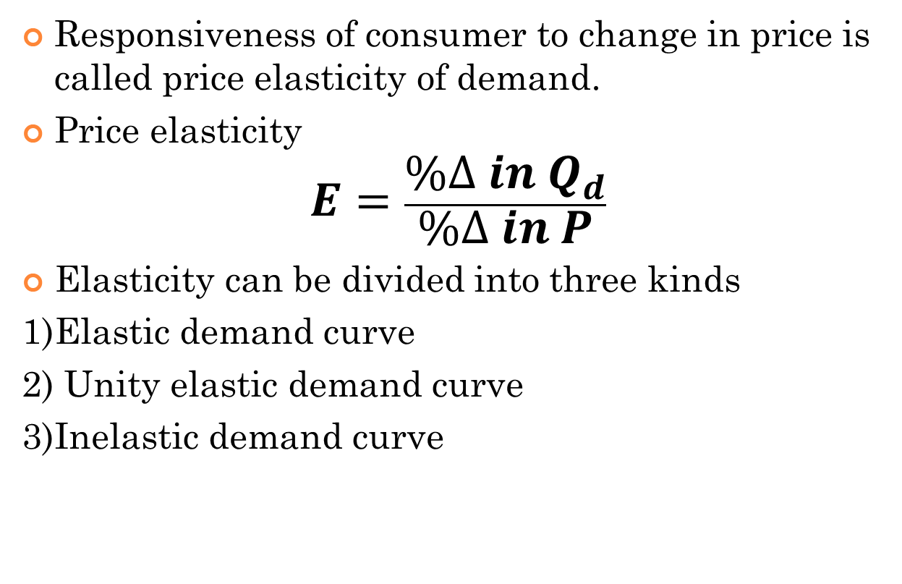
elasticity
Responsiveness of consumer to change in price is called price elasticity of demand.
Price elasticity
$$E=\frac{\%∆ in Q_{d}}{\%∆ in P}$$
Elasticity can be divided into three kinds
1)Elastic demand curve
2) Unity elastic demand curve
3)Inelastic demand curve

Slide 8











Curves of the elasticity of demand
$$P$$
$$D_{1}$$
$$D$$
$$D_{2}$$
E>1
(elastic demand curve)
$$P_{2}$$
E=1
(unity elastic demand curve)
$$P_{1}$$
E<1
(inelastic demand curve)
$$D_{1}$$
D
$$D_{2}$$
$$Q_{2}$$
$$Q_{1}$$
$$Q$$

Slide 9






Perfectly elastic and inelastic curve
E=0
(perfectly inelastic demand curve)
$$P$$
$$P_{2}$$
P$′$
E=∞
(perfectly elastic demand curve)
$$P_{1}$$
$$Q′$$
$$Q_{1}$$
$$Q_{2}$$
$$Q$$

Slide 10
Types of elasticity
Elasticity
Point elasticity
Arc elasticity
Mathematical Approach
Graphical Approach
Formula Method
Total Revenue
Total Expenditure Method

Slide 11

Point elasticity
If small changes occur then it is called point elasticity.
We can say that elasticity on a single point.
$$P$$
(P1,Q1)
$$Q$$

Slide 12
Arc elasticity
If changes between two distinct points occur is called arc elasticity.
We can say that elasticity when large changes occur.
$$P$$
(P1,Q1)
(P2,Q2)
$$Q$$

Slide 13
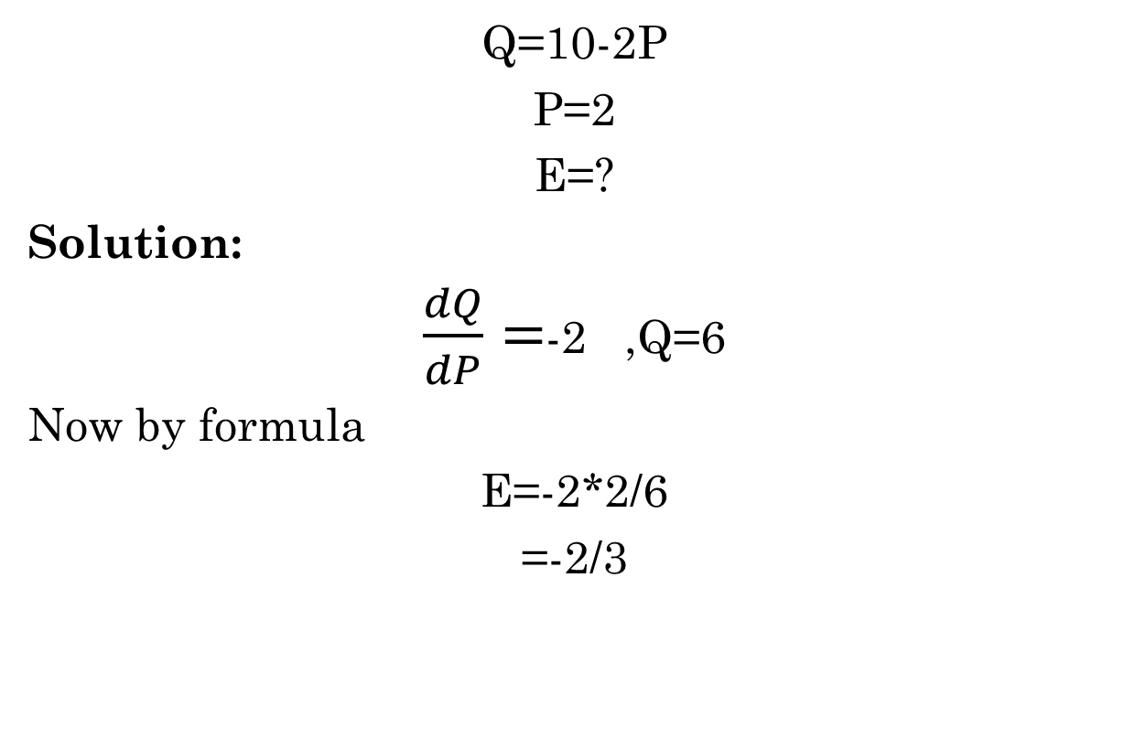
Mathematical approach
Q=10-2P
P=2
E=?
Solution:
$\frac{dQ}{dP}=$-2 ,Q=6
Now by formula
E=-2*2/6
=-2/3

Slide 14
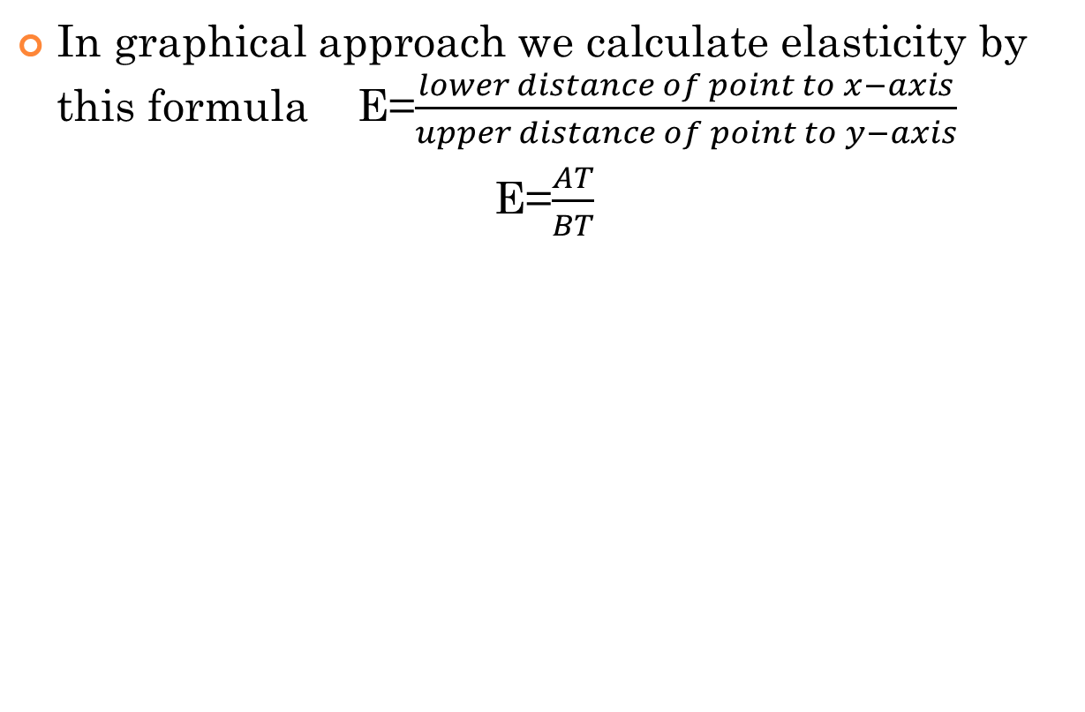
Graphical approach
In graphical approach we calculate elasticity by this formula E=$\frac{lower distance of point to x−axis}{upper distance of point to y−axis}$
E=$\frac{AT}{BT}$
$$P$$
B
T
A
Q

Slide 15
Computing the Price Elasticity of Demand
Example: If the price of an ice cream cone increases from $2.00 to $2.20 and the amount you buy falls from 10 to 8 cones, then your elasticity of demand would be calculated as:

Slide 16
Price elasticity of demand for Arc elasticity
Point A Price =$4 quantity = 120
Pont B Price =$6 quantity = 80
PED = (Q₂ – Q₁ ) / [( Q₂ + Q₁ ) /2]
_____________________
(P₂ – P₁) / [(P₂ + P₁) /2]

Slide 17
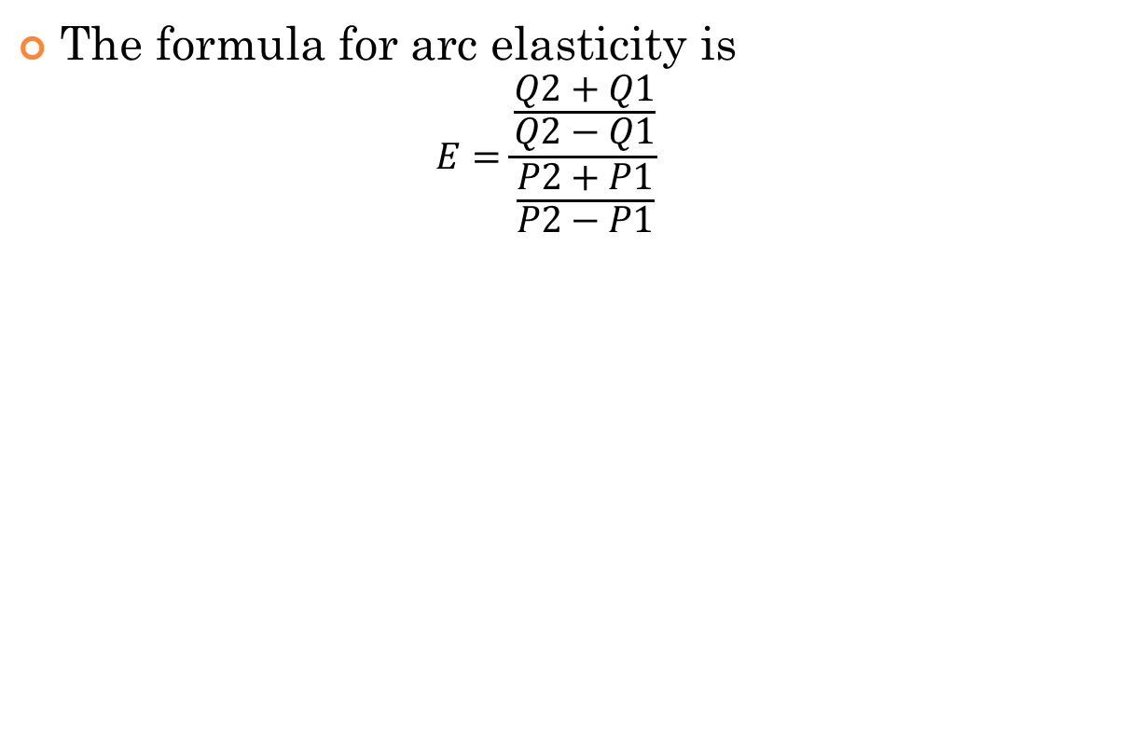
Formula method
The formula for arc elasticity is
$$E=\frac{\frac{Q2+Q1}{Q2−Q1}}{\frac{P2+P1}{P2−P1}}$$
$$P$$
(P1,Q1)
(P2,Q2)
$$Q$$

Slide 18
Total revenue /total expenditure method
If %change in Qd=% change in P
Which means P R(remain the same) E=1
If %change in Qd>% change in P
Which means P R E>1
If %change in Qd<% change in P
Which means P R E<1

Slide 19
Elasticity of Demand (Some details with examples)

Slide 20
Classifying Demand and Supply as Elastic or Inelastic
Demand is elastic if the percentage change in quantity is greater than the percentage change in price.
E > 1
Demand is inelastic if the percentage change in quantity is less than the percentage change in price.
E < 1

Slide 21
Elastic Demand
Elastic Demand means that quantity changes by a greater percentage than the percentage change in price.
Quantity demanded responds strongly to changes in price.
Price elasticity of demand is greater than one.
Demand tends to be more elastic :
the larger the number of close substitutes.
if the good is a luxury.
the more narrowly defined the market.
the longer the time period.

Slide 22
Inelastic Demand
Inelastic Demand means that quantity doesn't change much with a change in price.
Quantity demanded does not respond strongly to price changes.
Price elasticity of demand is less than one.

Slide 23
The Variety of Demand Curves
Perfectly Inelastic
Quantity demanded does not respond to price changes.
Perfectly Elastic
Quantity demanded changes infinitely with any change in price.
Unit Elastic
Quantity demanded changes by the same percentage as the price.

Slide 24

The Price Elasticity of Demand
(a) Perfectly Inelastic Demand: Elasticity Equals 0
Price
Demand
$5
4
1. An
increase
in price . . .
0
100
Quantity
2. . . . leaves the quantity demanded unchanged.
Copyright©2003 Southwestern/Thomson Learning

Slide 25
The Price Elasticity of Demand
(b) Inelastic Demand: Elasticity Is Less Than 1
Price
$5
4
1. A 22%
Demand
increase
in price . . .
0
90
100
Quantity
2. . . . leads to an 11% decrease in quantity demanded.

Slide 26
The Price Elasticity of Demand
(c) Unit Elastic Demand: Elasticity Equals 1
Price
$5
4
1. A 22%
Demand
increase
in price . . .
0
80
100
Quantity
2. . . . leads to a 22% decrease in quantity demanded.
Copyright©2003 Southwestern/Thomson Learning

Slide 27
The Price Elasticity of Demand
(d) Elastic Demand: Elasticity Is Greater Than 1
Price
$5
4
Demand
1. A 22%
increase
in price . . .
0
50
100
Quantity
2. . . . leads to a 67% decrease in quantity demanded.

Slide 28
The Price Elasticity of Demand
(e) Perfectly Elastic Demand: Elasticity Equals Infinity
Price
1. At any price
above $4, quantity
demanded is zero.
$4
Demand
2. At exactly $4,
consumers will
buy any quantity.
0
Quantity
3. At a price below $4,
quantity demanded is infinite.

Slide 29
Some other Elasticities of Demand

Slide 30
Income Elasticity of Demand
Income elasticity of demand measures how much the quantity demanded of a good responds to a change in consumers’ income.
It is computed as the percentage change in the quantity demanded divided by the percentage change in income.

Slide 31

Computing Income Elasticity
Positive income elasticity ⇒ normal good
Negative income elasticity ⇒ inferior good

Slide 32
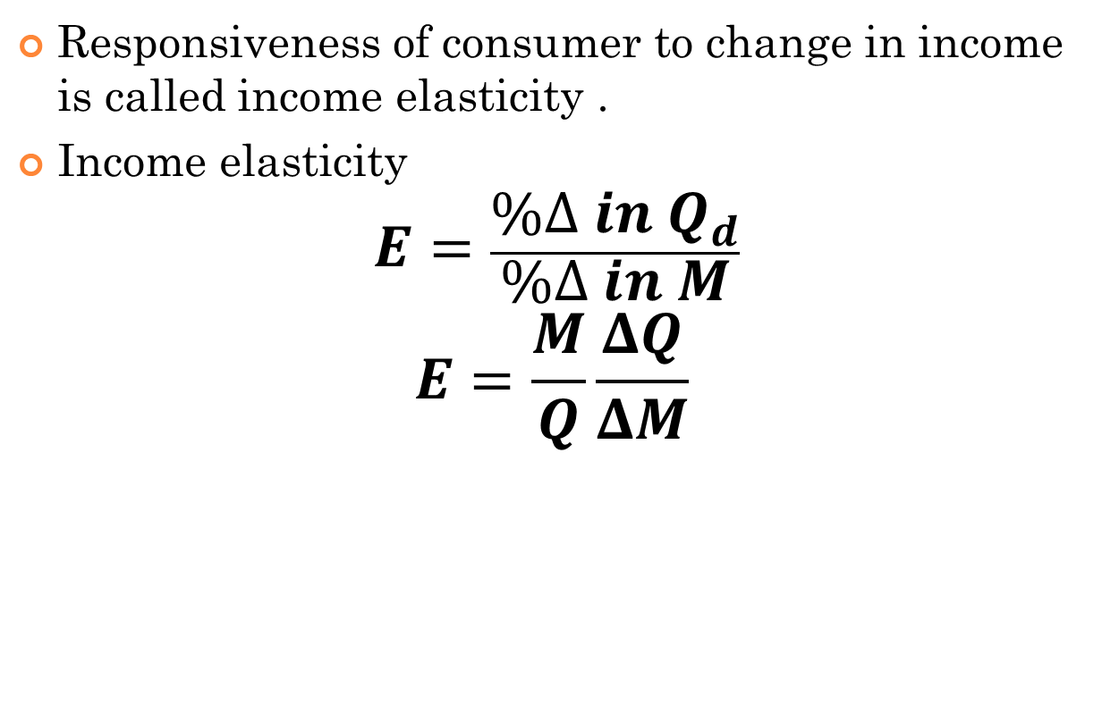
Income Elasticity
Responsiveness of consumer to change in income is called income elasticity .
Income elasticity
$$E=\frac{\%∆ in Q_{d}}{\%∆ in M}$$
$$E=\frac{M}{Q}\frac{ΔQ}{ΔM}$$

Slide 33
Income Elasticity
Types of Goods
Normal Goods
Inferior Goods
Higher income raises the quantity demanded for normal goods but lowers the quantity demanded for inferior goods.

Slide 34
Income Elasticity
Goods consumers regard as necessities tend to be income inelastic
Examples include food, fuel, clothing, utilities, and medical services.
Goods consumers regard as luxuries tend to be income elastic.
Examples include sports cars, furs, and expensive foods.

Slide 35
CROSS PRICE ELASTICITY of Demand
The ratio of the percent change in quantity demanded of a good to the percent change in the price of a substitute or a complement.

Slide 36
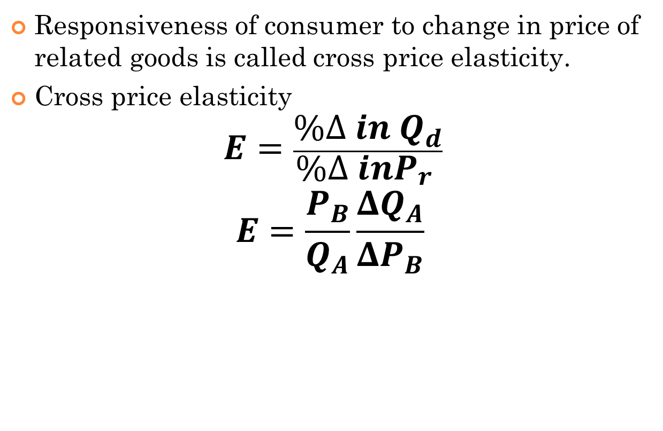
Cross price elasticity
Responsiveness of consumer to change in price of related goods is called cross price elasticity.
Cross price elasticity
$$E=\frac{\%∆ in Q_{d}}{\%∆ inP_{r} }$$
$$E=\frac{P_{B}}{Q_{A}}\frac{ΔQ_{A}}{ΔP_{B}}$$

Slide 37
CROSS PRICE ELASTICITY of Demand
Substitutes
The cross price elasticity of demand between substitutes is positive.
E.g.: Coke vs. Pepsi
Complements
The cross price elasticity of demand between complements is negative.
E.g.: Tire and Tube
computers and softwares

Slide 38
THE ELASTICITY OF SUPPLY
Price elasticity of supply is a measure of how much the quantity supplied of a good responds to a change in the price of that good.
Price elasticity of supply is the percentage change in quantity supplied resulting from a percent change in price.

Slide 39
Price Elasticity: Supply
Supply is elastic if the percentage change in quantity is greater than the percentage change in price
Elastic supply is when E_{S} > 1
Supply is inelastic if the percentage change in quantity is less than the percentage change in price
Inelastic supply is when E_{S} < 1
7-39
Notes:
39

Slide 40
The Price Elasticity of Supply
(a) Perfectly Inelastic Supply: Elasticity Equals 0
Price
Supply
$5
4
1. An
increase
in price . . .
0
100
Quantity
2. . . . leaves the quantity supplied unchanged.
Copyright©2003 Southwestern/Thomson Learning

Slide 41
The Price Elasticity of Supply
(b) Inelastic Supply: Elasticity Is Less Than 1
Price
Supply
$5
4
1. A 22%
increase
in price . . .
0
100
110
Quantity
2. . . . leads to a 10% increase in quantity supplied.
Copyright©2003 Southwestern/Thomson Learning

Slide 42
The Price Elasticity of Supply
(c) Unit Elastic Supply: Elasticity Equals 1
Price
Supply
$5
4
1. A 22%
increase
in price . . .
0
100
125
Quantity
2. . . . leads to a 22% increase in quantity supplied.
Copyright©2003 Southwestern/Thomson Learning

Slide 43
The Price Elasticity of Supply
(d) Elastic Supply: Elasticity Is Greater Than 1
Price
Supply
$5
4
1. A 22%
increase
in price . . .
0
100
200
Quantity
2. . . . leads to a 67% increase in quantity supplied.
Copyright©2003 Southwestern/Thomson Learning

Slide 44
The Price Elasticity of Supply
(e) Perfectly Elastic Supply: Elasticity Equals Infinity
Price
1. At any price
above $4, quantity
supplied is infinite.
$4
Supply
2. At exactly $4,
producers will
supply any quantity.
0
Quantity
3. At a price below $4,
quantity supplied is zero.
Copyright©2003 Southwestern/Thomson Learning

Slide 45
Determinants of Elasticity of Supply
Ability of sellers to change the amount of the good they produce.
Beach-front land is inelastic.
Books, cars, or manufactured goods are elastic.
Time period.
Supply is more elastic in the long run.

Slide 46
PRICE ELASTICITY OF SUPPLY
Substitution effects
If it is easy for sellers to switch production and sales to another good, if they have good alternative uses for their productive inputs, then, ceteris paribus, the supply of the good tends to be more elastic or less inelastic.
More or better substitutes ⇒ Higher elasticity
If it is harder for sellers to switch to production and sales of alternative goods, if inputs tend to be more specialized, then, ceteris paribus, the supply of the good tends to be more inelastic or less elastic.
Few or poorer substitutes ⇒ Lower elasticity

Slide 47
Factors determining Price Elasticity of demand
The elasticity of demand on the following factors
Nature of product
Extent of usage
Availability of substitutes
Income level of people
Proportion of the income spent on the product
Urgency of demand durability of the product
Notes:
http://books.google.com.pk/books?id=pxNHRjlmq8EC&pg=PA24&lpg=PA24&dq=elasticity+of+demand+in+engineering+economics&source=bl&ots=vwraOgd8P8&sig=Z6fGxKzgTA2n9bpL5EEHZaGgsaA&hl=en&sa=X&ei=b3aXU_ucHoeP0AXdjIGwBg&redir_esc=y#v=onepage&q=elasticity%20of%20demand%20in%20engineering%20economics&f=false
This material is taken from this book.

Slide 48
Importance of elasticity
Relationship between changes in price and total revenue
Importance in determining what goods to tax (tax revenue)
Importance in analyzing time lags in production
Influences the behavior of a firm

