Slide 1
Consumption theory

Slide 2
When you walk into a store you are confronted with thousands of good that you might buy. Because your financial resources are limited , however , you can not buy everything that you want. You therefore consider the prices of the various goods offered for sale and buy a bundle that , given your resources , best suits your needs and desires.
In this presentation we are going to develop a theory that describes how consumers make decisions about what to buy.
As we now know the demand curve for a good reflects consumer’s willingness to pay for it. When the price of a good rises , consumers are willing to pay for fewer units, so the quantity demanded falls.
We are now going to look deeply at the decisions that lie behind the demand curve.

Slide 3
One of the important principles of Economics , trade-offs that people face in their role as consumers.
When a consumer buy more of one good , he can afford less of other goods.
When people spend more time enjoying leisure and less time working , he has lower income and can afford less consumption.
When he spends more of his income in the present and save less for future , he must accept a lower level of consumption in the future. The theory of consumer choice examines how consumers facing these trade-offs make decisions and how they respond to changes in the environment.

Slide 4
The Budget constraint: what the consumer can afford
The budget constraint shows the combinations of goods the consumer can afford given his income and the prices of the goods.
Most people would like to increase the quantity or the quality of the goods they consume, e.g. to take longer vacations, drive fancier cars or eat at better restaurants. People consume less than they desire because their spending is constrained , or limited by their income.
Budget line is the limit on the consumption bundles that a consumer can afford.

Slide 5
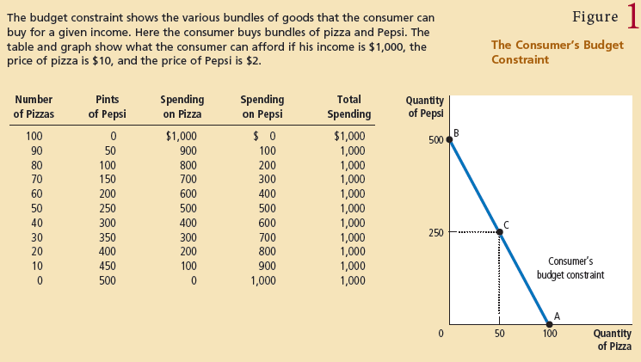
All the points from A to B are possible. This line, called the budget constraint, shows the consumption bundles that the consumer can afford.

Slide 6
Slope of the budget line
The slope of the budget constraint measures the rate at which the consumer can trade one good for the other.
Slope between the two points is calculated as
Slope = vertical difference / horizontal difference
In other words we can call it as “rise over run”.
Slope = 500/100 = 5 pints per pizza.

Slide 7
Preferences: What the consumer wants
The consumer choices , however, depend not only on consumer’s budget constraint but also on his preferences regarding the two goods. Preferences are represented with indifference curves.
A curve that shows consumption bundles that give the consumer the same level of satisfaction. In other words we can say an indifference curve shows various bundles of consumption that make the consumer equally happy.

Slide 8
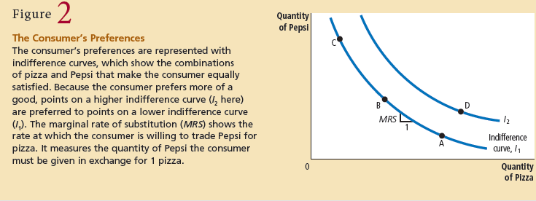
Marginal rate of substitution : the rate at which a consumer is willing to trade one good for another.

Slide 9
Four properties of indifference curves
Higher indifference curves are preferred to lower ones.
Indifference curves are downward sloping.
Indifference curves do not cross.
Indifference curves are bowed inward.
However, there are two extreme cases
One is the case for perfect substitutes
Second is the case for perfect complements.

Slide 10
Optimization: what the consumer chooses
The consumer choses the points on the budget line that lies on the highest indifference curve. This point is known as the optimum , and the marginal rate of substitution equals the relative price of two goods. We know the marginal rate of substitution is the slope of indifference curve where as the relative price is the slope of budget line.
MRS = P_{x} / P_{y}

Slide 11
