Slide 1


Slide 2

You can’t eliminate darkness by arguing
with it;
The only way to eliminate darkness is
to turn on a Light.

Slide 3
Problem-free society
Desire of every individual

Slide 4

Little human infant thought about the ideal life but has to face the challenges of the world.

Slide 5
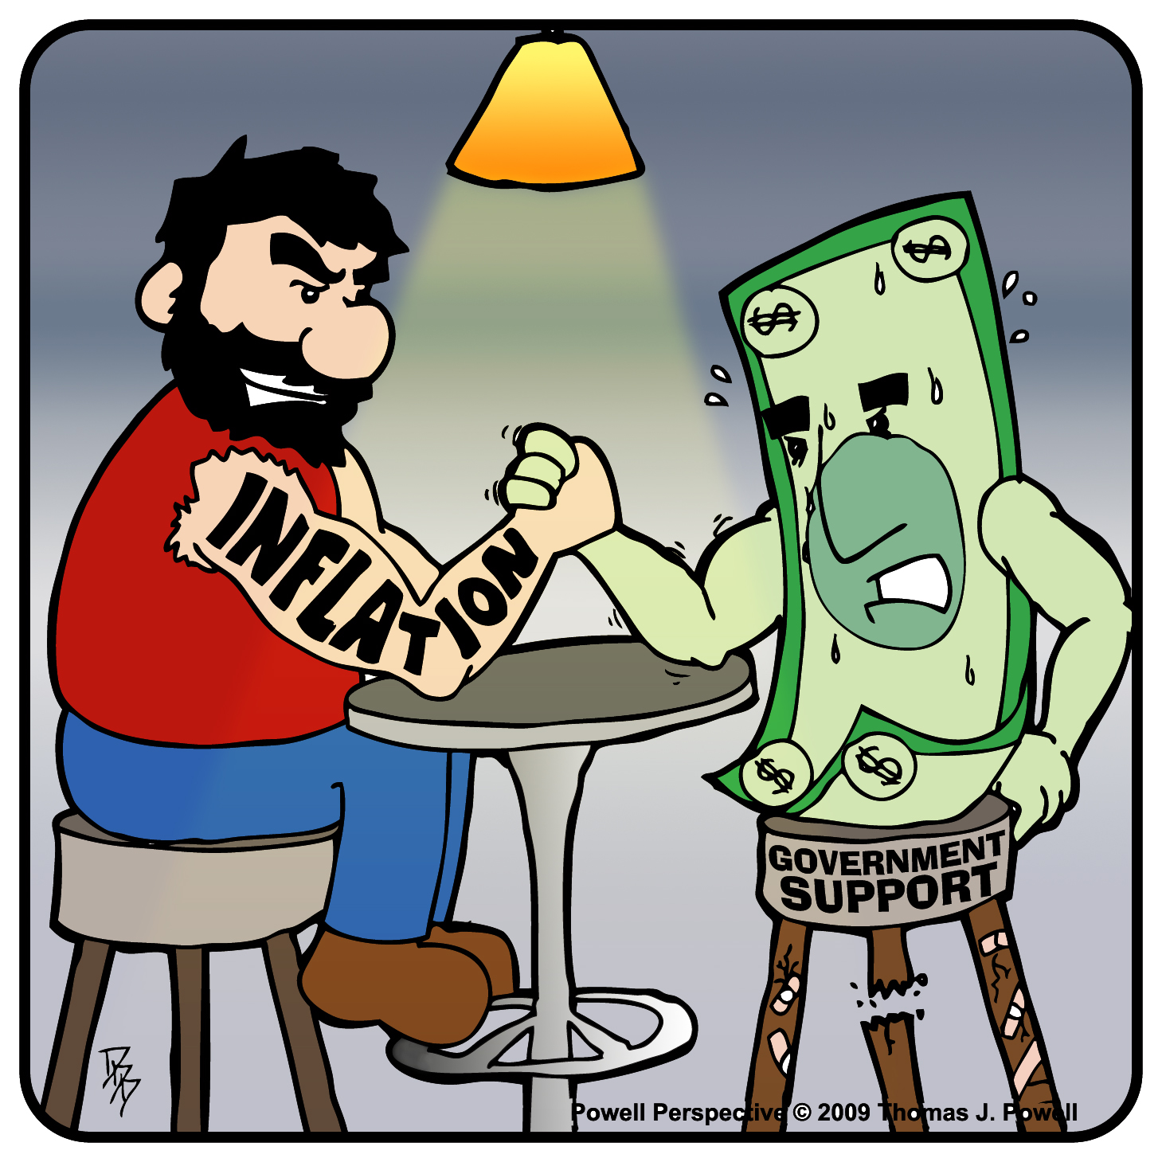

Slide 6
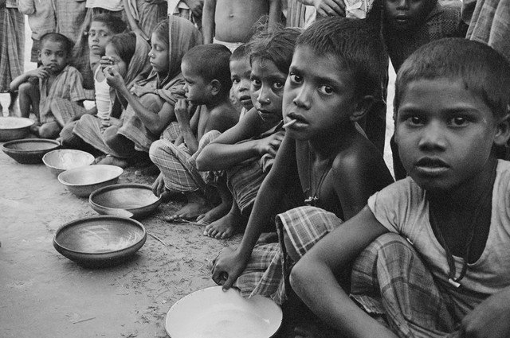

Slide 7

Illiteracy
Inability to read and write is called illiteracy.

Slide 8
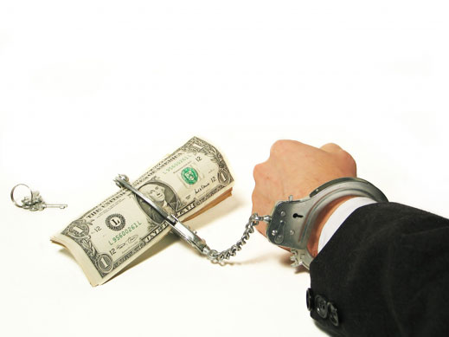
Corruption

Slide 9


Slide 10

Health Problem

Slide 11
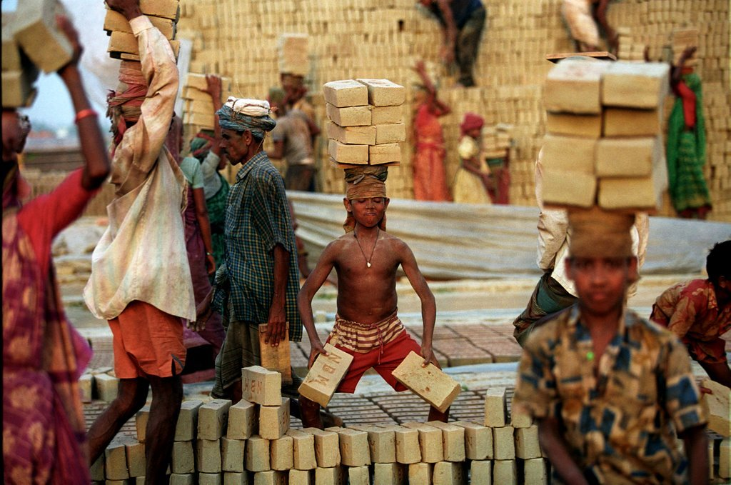

Slide 12


Slide 13
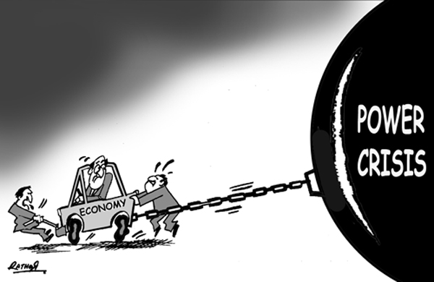

Slide 14


Slide 15


War on Terrorism

Slide 16

Declining Exports

Slide 17

Lack of tourism

Slide 18

Loss in Business

Slide 19
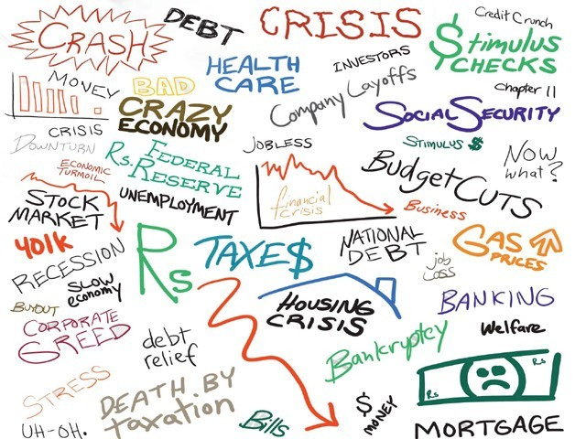

Slide 20


Slide 21
Income tax

Slide 22
Property tax

Slide 23
Sales tax

Slide 24
Tax on the business

Slide 25
Toll Tax

Slide 26
Import Tax

Slide 27
Export Tax

Slide 28
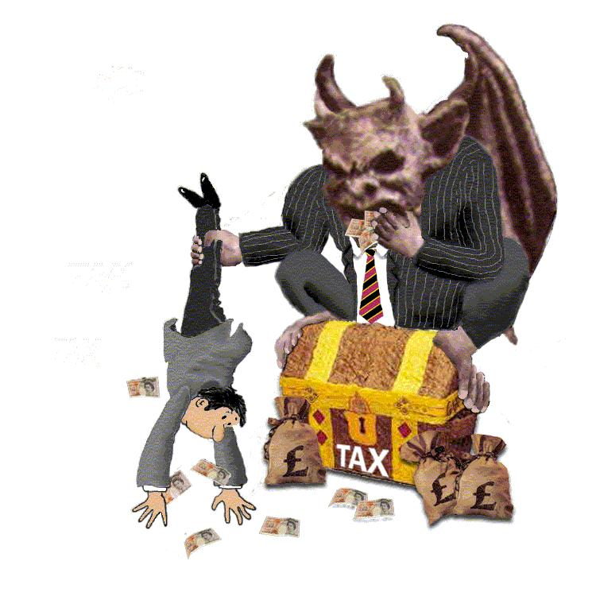

Slide 29
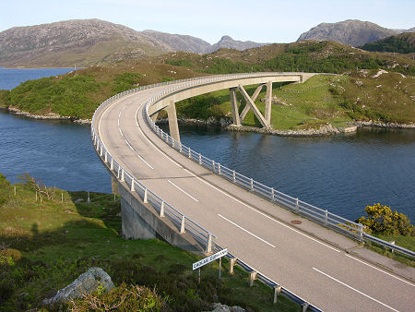
Roads and Bridges

Slide 30

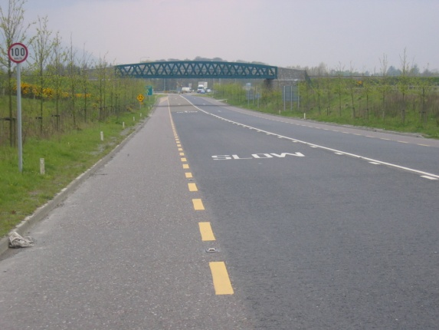

Slide 31

Health care….

Slide 32


Slide 33


Slide 34


Slide 35


Slide 36
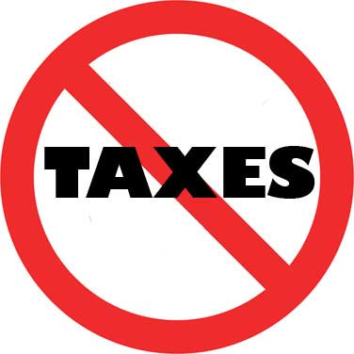

Slide 37
Conclusion

Slide 38
No taxes
Imagine if zero tax
?

Slide 39
Pakistan

Slide 40
CONCEPT OF TAX
EVOLUTION OF INCOME TAX (History )
Pakistan adopted the Income – tax Act 1922 when it became Independent in 1947 and this act was followed up to 1979 when a new Income – Tax Ordinance 1979 was promulgated.

Slide 41
CONCEPT OF TAX
EVOLUTION OF INCOME TAX (History )
The concept of the Income – Tax Ordinance was very much the same as the Act of 1922 but was brought into a serial order till a new Law called the Income–Tax Ordinance 2001 was enacted which came into force from 2003.

Slide 42
PUBLIC Vs PRIVATE SECTOR
PUBLIC FINANCIAL MANAGEMENT SYSTEM IS EXPENDITURE BASED.
PRIVATE OR CORPORATE FINANCIAL SYSTEM IS INCOME BASED.

Slide 43
Rationale of Public Sector
Market Failure
B. Fiscal Functions

Slide 44
Rationale of Public Sector
Market Failure
Public Goods
Externalities
Incomplete Information
Unemployment and Inflation
Failure of Competition

Slide 45
Public Goods
Pure Public Good
Impure Public Good
Private Good Publically provided
Non Rivalness
Non Excludable
Congested Highway
Education/ Health
Defence
Motorway

Slide 46
Externalities
Action of one effecting other party.
It may be positive or negative.
We pay price for the flour which is demanded
but not we also pay for the pollution
Which we did not demand.
Price
D
S
Price
D
P*
P*
0
Q*
Q for Flour
0
Q for Flour
Q*

Slide 47
Unemployment & Inflation
We need to go for some kind of Fiscal Policy to stabilize the situation in both cases. Expansionary or Contractionary
Price
D
S
D
S
Excess SS
P*
P*
Excess DD
0
Q*
Q
0
Q
Q*

Slide 48
Imperfect Competition
If something is not being produced
to fulfill the demand of the society.
Public Sector will have to come into the picture to fulfill the demand of the consumer and to save them from the exploitation of monopolistic competitors.

Slide 49
Rationale of Public Sector
Fiscal Functions
Allocative Functions
Stabilization Functions
Distributive Functions

Slide 50
Rationale of Public Sector
Fiscal Functions
Allocative Functions
As Market is consumer’s demand driven and if it is unable to provide resources. Who will do this ????????
e.g. Demand of rice, wheat, computer etc

Slide 51
Rationale of Public Sector
Fiscal Functions
2. Stabilization Functions
Unemployment ---------→ Exp Fiscal Policy
Inflation ---------→ Cont Fiscal Policy
Public Sector can do this to stabilize the economy.

Slide 52
Rationale of Public Sector
Fiscal Functions
3. Distributive Functions
In built distributive problem
Rich ---------→ Richer
Poor ---------→ Poorer
Who will tax heavily to rich and subsidize to the poor.
Encouraging ---------→ beneficial activities e.g. Utility Stores
Discouraging ---------→ harmful products e.g. Tobacco

Slide 53
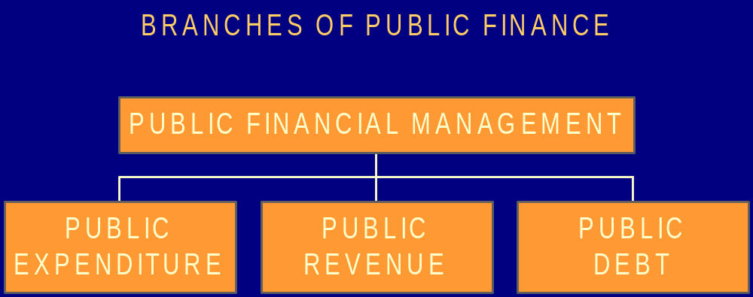
PUBLIC FINANCE

Slide 54
BUDGET
“ The document which is used to express the annual income & expenditure of state is called as budget.”

Slide 55
Types of Budget
Surplus Budget
Balanced Budget
Deficit Budget

Slide 56
Budget: a tool of Economic Management
Budget is an instrument of economic management. The function of a modern state is to maintain and promote prosperity and growth. This is done by keeping aggregate demand strong enough to avoid recession and slumps but not so strong as to cause inflation or unemployment.

Slide 57
Budget Deficit
“ An excess of liabilities over assets.”
or
“ An excess of expenditure flow over income flow.”

Slide 58
Twin Deficits:
Fiscal Deficit
Balance of Payment Deficit
  Current account deficit
  Trade deficit

Slide 59
Deficit Financing:
“It is the planned excess of expenditure over income.”
Most governments often spend more than they collect in taxation; the difference is financed by deficit financing. The term is normally used to refer to a planned budget deficit incurred in the interest of expanding aggregate demand by relaxing fiscal policy & thus injecting purchasing power into the economy, a policy of J.M.Keynes to increase employment in the Great Depression of 1930s.”

Slide 60
Modes of Deficit Financing:
External Borrowing
Internal or Domestic Borrowing
Printing of Money

Slide 61
Debt Trap
& Debt Recycle Theory:
Three Stages:
  Borrowing is done.
  Generation of additional resources & borrowing continues.
  Surplus of resources & Repayment of loans.

Slide 62
The Real Dilemma:
Gross Mismanagement of Resources
Discontinuity in Policies

Slide 63
Where did we go wrong ?
We borrowed heavily without creating additional resources.
Short-run govt deficits may help the economy cope with shocks & provide some room to come out of crisis.
Likewise, if time lag between the injection of created money & completion of project is long & the extra demand for goods is not matched by additional out-put, inflation may go beyond desired level.

Slide 64
The Way Out:
Suggested Policy Measures
Creation of tax culture & broadening tax base by making it progressive.
Rationalizing Defense expenditure.
Documentation of economy to off set the impact of black economy.
Export promotion by finding new markets and maintaining the existing one. Preparing for WTO.
Investor friendly policies.
Slashing non-productive expenditure.
Fiscal Responsibility Law.

Slide 65
...continued
Sustained GDP growth rate.
Debt management strategy.
Poverty alleviation strategy (PRSP).
Increase in rate of savings.
Agricultural & Industrial Reform Packages.
Overall financial discipline.

Slide 66
Socio-political Factors:
Political stability & continuity of policies.
Law and order
Population control
Good governance
Eradication of corruption
Introduction of new concepts like TQM,MIS, HRM etc
Human development programs

Slide 67

Recommendations
Economic Policies
Monetary Measures
Fiscal Measures
Good Governance
Control on unnecessary Expenditures

Slide 68
Conclusion
Government as well as every single citizen has to play its own specific role to bring about a positive change.

Slide 69
“NEVER FORGET THE BEST CURE FOR ECONOMY IS ECONOMY.”

