Slide 1
Islamic & Modern Western Economic Systems: An In-Depth Analysis & Comparison
Presented by:
Danial Ahmad
Muhammad Ahmed Mohsin
Muhammad Umer
Imran Haider
Tariq Umar
Saad Bakhtiar

Slide 2
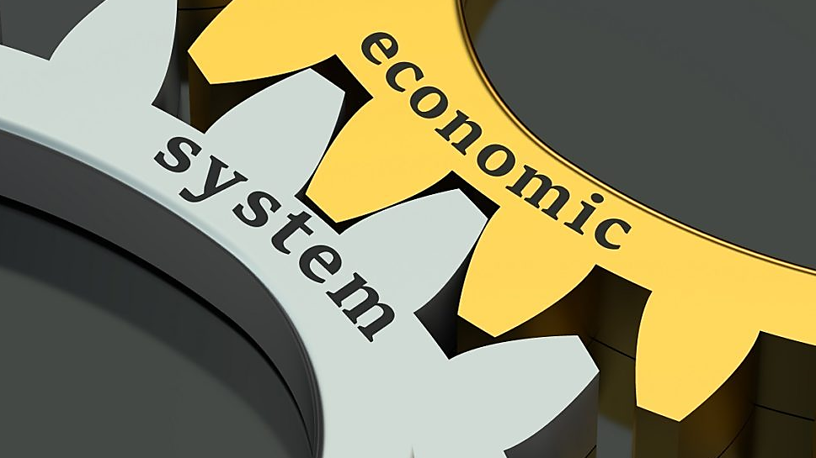

Slide 3
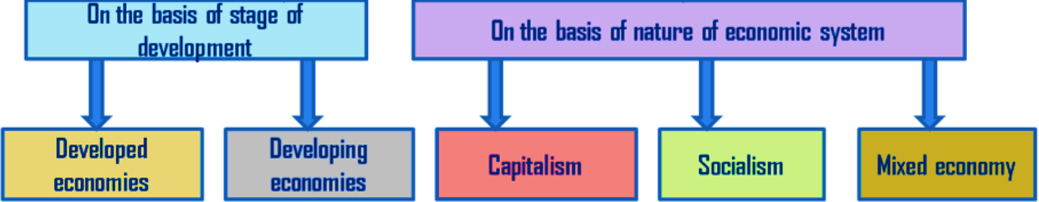
Type of Western Economies
Our focus is on analyzing the different natures of western economies & contrast them with the basis of an Islamic one

Slide 4
TableNet: A brief overview
The model utilizes a base network that is initialized with pre-trained VGG-19 features.
The model takes a single input image and produces two different semantically labelled output images for tables and columns.
TableNet approach used ICDAR 2013 data set for detection.
The model can generalize to other datasets with minimal fine tuning, thereby enabling transfer learning.

Slide 5
Capitalism
Principles of Capitalism
Private Ownerships
Free Markets
Profit Driven
Profits & Losses
Voluntary Trade
An economic system in which the means of production (capital) are privately owned, and goods and services are produced for profit in a free market.

Slide 6
Communism
B
I
T
C
H
P
L
S
Buuhhhh.

Slide 7
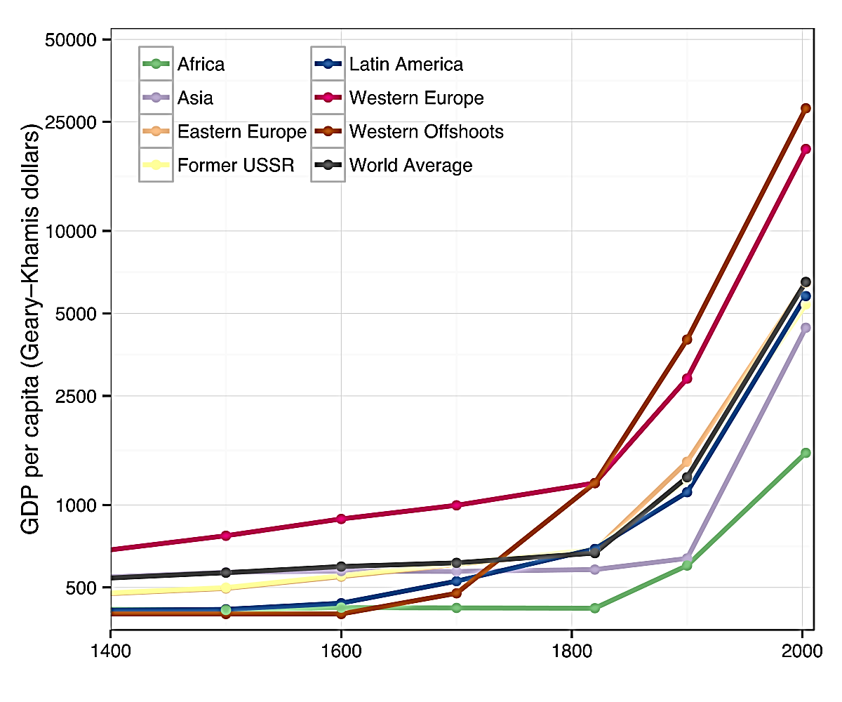
Capitalism & Economic Growth
Capitalism has shown to be a highly successful vehicle for economic progress
Prior to the 18th and 19th centuries, rapid economic growth was mostly achieved by conquest
Average global per-capita income remained unchanged until the first Industrial Revolution began

Slide 8
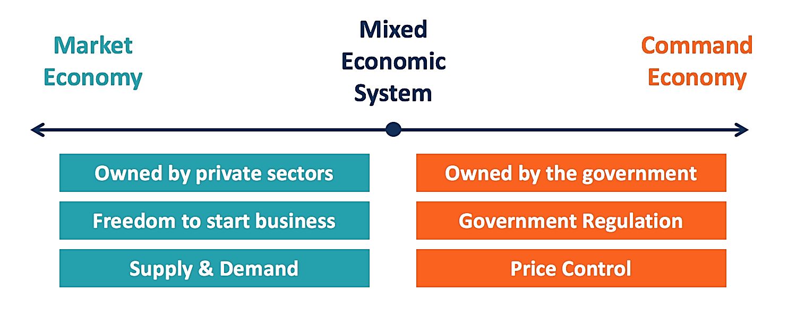
Mixed Economy
Mixed economy combines various aspects of market and command economies
Most of the countries around the globe utilize mixed economy to varying extents
For Example, In a mixed economy, post offices and other government buildings are controlled by the government while still allowing for private ownership in other industries such as restaurants, etc.

Slide 9
Conclusion
Huh?

Slide 10
Thank You
Any Questions?

