Slide 1
Fetch and execute
Old Architectures
00 E205
01 E314
02 E321
03 0F01
04 0F02
05 E01B
06 0F01
07 9300
08 0300
09 940C
0A 0009
Instruct 4
Instruct 3
Instruct 2
Instruct 1
16-bit
Fetch
Execute

Slide 2
Pipelining
Pipelining
00 E205
01 E314
02 E321
03 0F01
04 0F02
05 E01B
06 0F01
07 9300
08 0300
09 940C
0A 0009
Instruct 4
Instruct 3
Instruct 2
16-bit
Instruct 1
Fetch
Execute

Slide 3
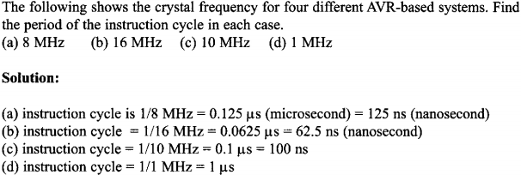
Example

Slide 4
Time delay
machine cycle
1
1
1
1/2
LDI R16, 100
AGAIN: ADD R17,R16
DEC R16
BRNE AGAIN
*100
*100
*100
Branch penalty
The penalty is an extra instruction cycle to fetch the instruction from the target
location instead of executing the instruction right below the branch.

Slide 5
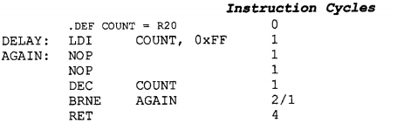
Delay Calculation
Find the size of the delay of the code snippet below if the crystal frequency is 10MHz.
Is this correct?
BRNE takes two MCs if it jumps, else one MC when falling through the loop
[1+((1+1+1+2)x255)-1+4] x 0.1us = 127 us

