Slide 1

Web Controlled Multi-Functional Car
Presented by:
M. Ahmed Mohsin (333060)
Muhammad Umer (345834)
Tariq Umar (334943)

Slide 2
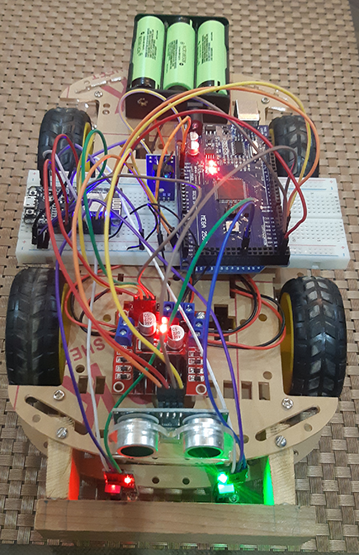
Introduction
Web-Controlled Multifunctional Car
We used the Web Server / Local Host and used ESP8266’s in built Wi-Fi module to connect with the App (.apk)
A local area network was generated which is utilized to send instructions to the ESP8266 from the App

Slide 3
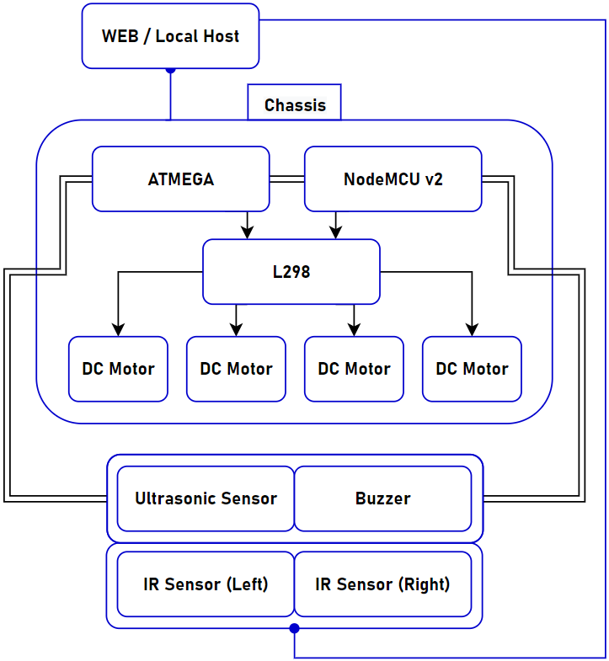
Block Diagram

Slide 4
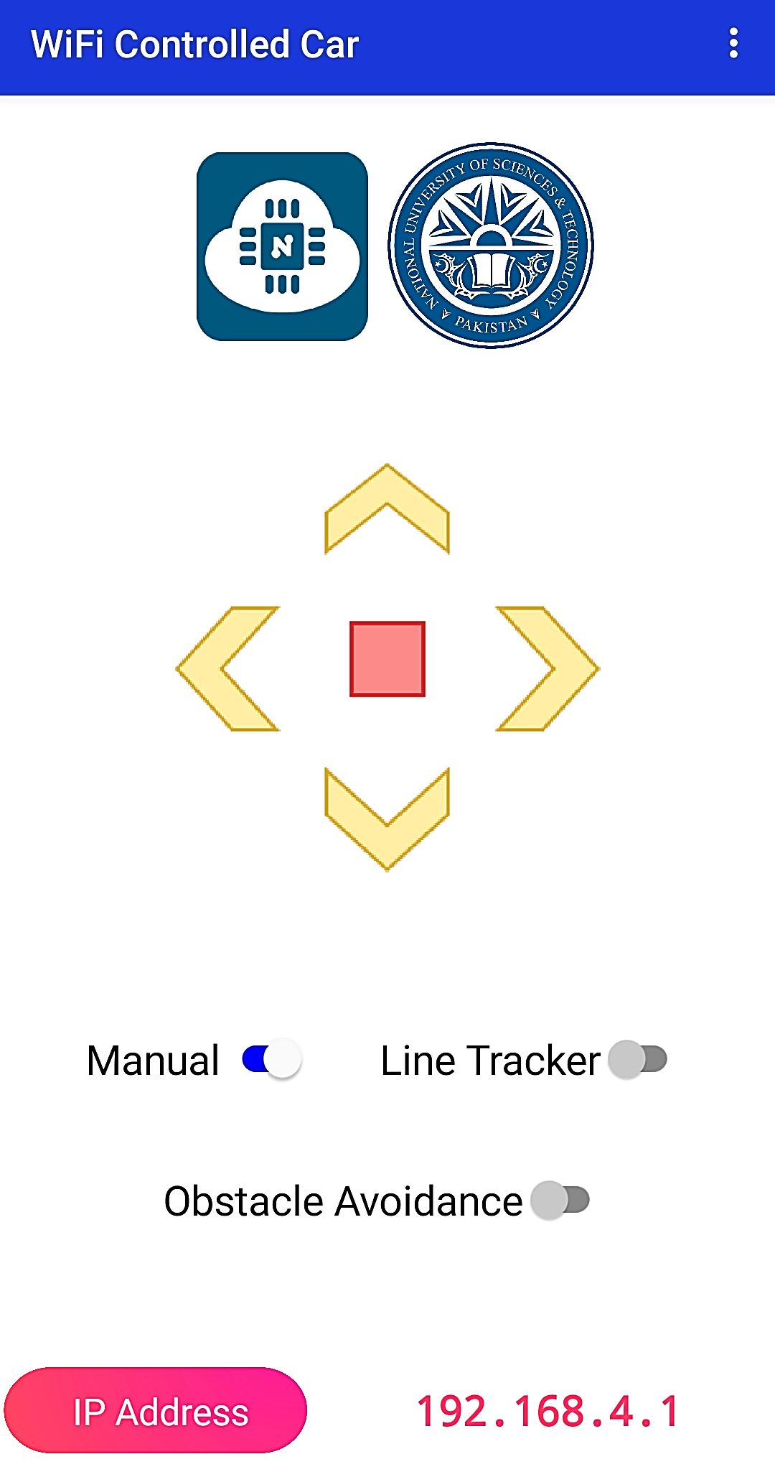

Android Application

Slide 5
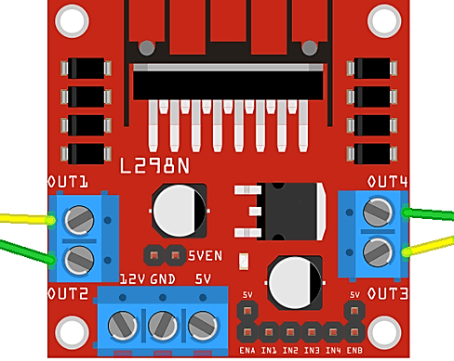
L298 Motor Driver
This L298N Motor Driver Module is a high-power motor driver module for Driving DC and Stepper Motors.
L298N IC can control up to 4 DC motors, or 2 DC motors with directional and speed control.

Slide 6
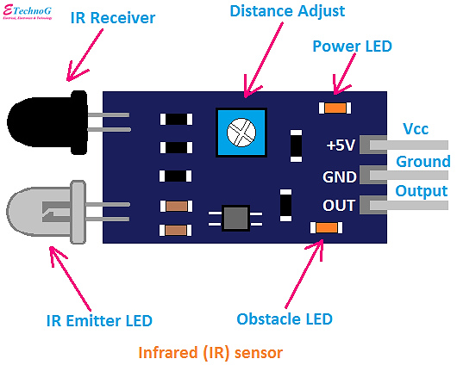
Line Tracking
Infrared Sensor (IR) Module has a built-in transmitter and receiver to detect the presence of a black body in front of the module.
Both the sensors were place with an equal distance from the ground and with the same sensitivity, to implement line tracking

Slide 7
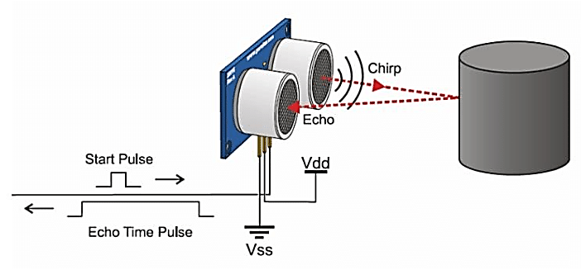
Obstacle Avoidance
HC-SR04 Ultrasonic (US) sensor is a 4-pin module, whose pin names are Vcc, Trigger, Echo and Ground, respectively.
At about 15 cm from the obstacle, the car rotates 90 degrees to the left and starts detecting objects again before moving forward

Slide 8
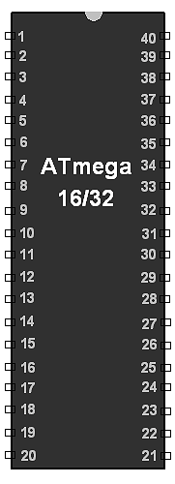
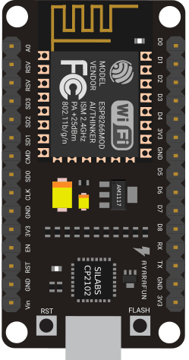
Interfacing ATMega16A with NodeMCU
Two Separate Codes:
ATMega16 to act as a sender and processes data from sensors
ESP8266 NodeMCU to act as a receiver of instructions and drives the motor
Collectively, they receive data from the sensors and drive the motors to implement the functionalities implemented

Slide 9
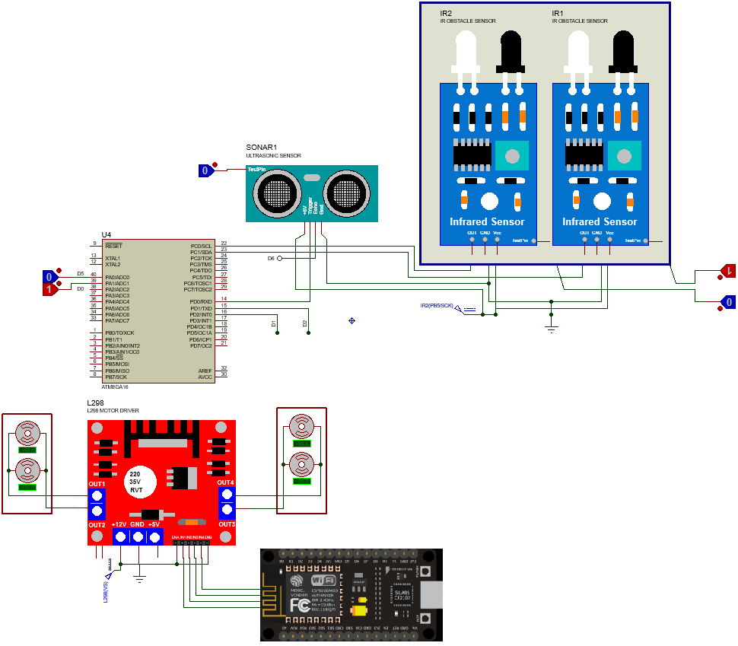
Schematic

Slide 10
Conclusion
It developed our interest in Microprocessor Systems.
We learnt about the microprocessor industry and its vast scale.
Gave us an intuition about the future courses relevant to this domain and novel research in this field.

Slide 11
Thank You
Thank You
Any Questions?
Any Questions?

