Slide 1
Communication Skills

Slide 2
What is Communication?
Communication is the sharing of ideas and information.
A communication process involves a sender, a receiver and the message to be sent.
Effective Communication is a process where a message is received and understood by the receiver in the manner that the sender intended it to be.
A common mistake people make is to focus only on the delivery of message, rather than how it is received. Communication has to be two-way!

Slide 3
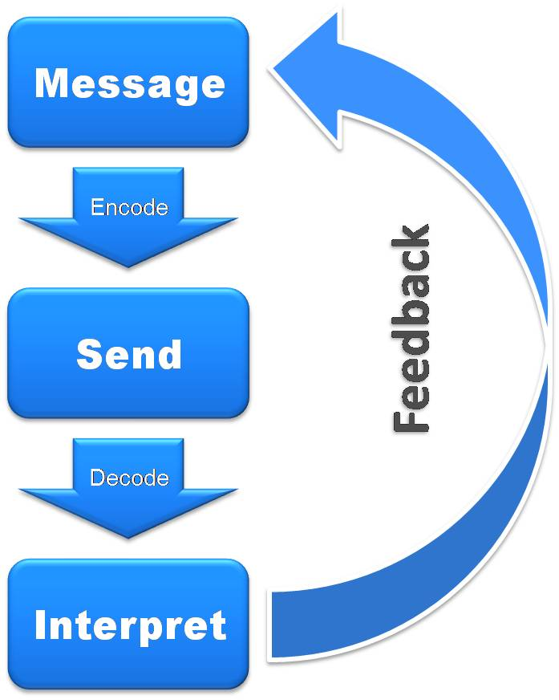
Communication Process
Sender- formulate (encode) an idea or message - through communication channel deliver the message to receiver, who receives or acts on the message (decode).
Receiver responds by formulating his own message and communicates to sender (feedback) .
Communication is a two way process, that is, the ability to receive iI as important as the ability to send. For successful communication, feedback is important- it tells how the message is being interpreted.

Slide 4
Communication Models..
3 basic models
Linear
Transactional
Interactive
Linear Model

Slide 5
Aristotle Model

Slide 6
Berlo’s Model

Slide 7
2. Transactional Model
The originator of the communication ( the sender) conveys it to someone else.
The transmission vehicle might be correspondence, telephone, fax or e-mail.
The receiver’s reaction ?(the feedback) can have effect on the sender, who may then modify any further communication accordingly.

Slide 9
3. Interactive Model
Schramm’s Model

Slide 10
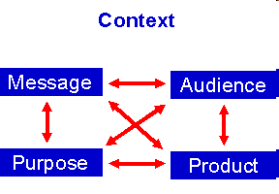
CMAPP ANALYSIS

Slide 11
Context:
Personal relationship.
Time and place.
External and internal interference.
Message:
An overview of the situation.
The most significant facts, issues and questions.
Relevant details.
A primary message.

Slide 12
Audience:
A Primary audience.
A secondary audience.
Purpose:
Motive for communicating.
The response you wish to elicit.
Product:
Written
Oral

Slide 13
Theories of Communication
Electronic theory
No place for emotions
Mathematical theory
Terminology
Accuracy
Socio environment theory
Social setting is important
Culture
Misunderstanding
Rhetorical theory
Response is important
Circular

