Slide 1


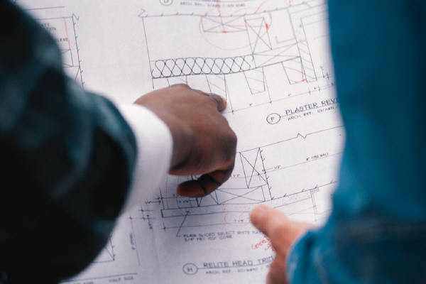
Chapter 6
Orthographic Reading

Slide 2
Contents
Introduction
Visualization techniques
Analysis by solids
Analysis by surfaces
Higher level of visualization problem:
A missing view problem

Slide 3
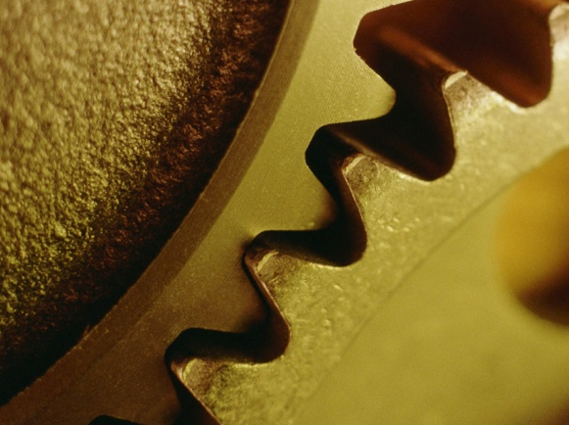
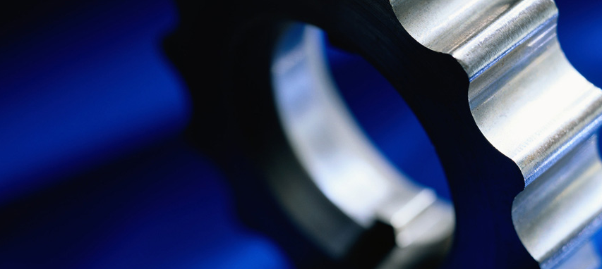

Introduction
Contents

Slide 4
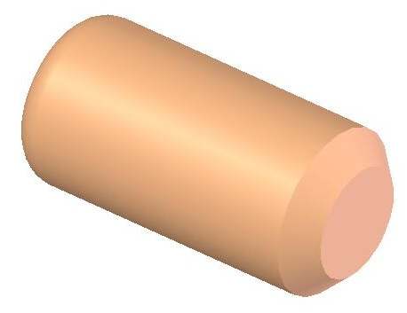
Scope
Orthographic reading covers 2 aspects
1. Gather an information from a given orthographic drawing.
Type of material
size and location of object’s features, e.g. holes, slot, chamfer etc.
additional treatment of an object, e.g. heat treatment, surface finish
…
2. Recognizing shape of an object from a given orthographic
drawing.

Slide 5
Visualization techniques
Given
1. Identify the views orientation,
e.g. Front-Right-Top etc.
Orthographic
multiview drawing
2. Choose an area and its projected area or line
appeared in the other views.
Analysis by solids
Analysis by surfaces
3. Form a simple shape object
that represents the chosen
information.
3. Identify type of a plane or
a surface.
4. Sketch a pictorial view of
the reading surface.
4. Sketch a pictorial view of that
simple shape object.
5. Repeat steps 2-4 until all areas are analyzed.
6. Combine all of the reading results according to their positions
shown in the orthographic view.
Contents

Slide 6
Visualization
techniques :
Analysis by solids

Slide 7
Guidance
A successful application of this technique requires that
1. The readers have a stock of a pair of an orthographic
views and a simple shape object.
2. The readers familiar with a generic object, i.e. an object
that is modified from a simple shape object.
3. The readers can decompose a complex orthographic
views to a set of simpler orthographic views that is
easier to match a simple shape or generic object.

Slide 8
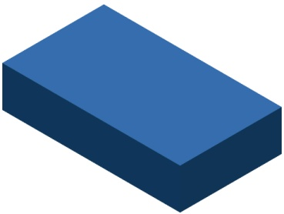
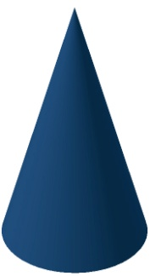
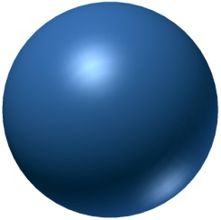
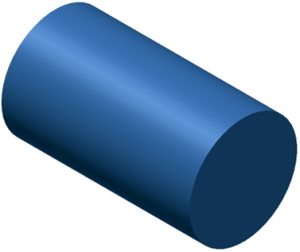
Guidance 1 : Examples
The readers have a stock of a pair of an orthographic views and a simple shape object.
Cylinder
Cone
Rectangular prism
Sphere

Slide 9


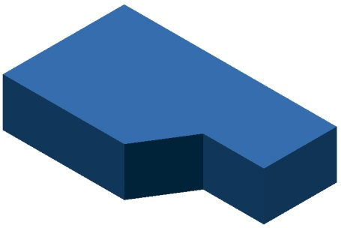
Guidance 2 : Examples
The readers familiar with a generic object, i.e. an object that is
modified from a simple shape object.
Simple shape
object database
Generic object database

Slide 10
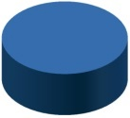
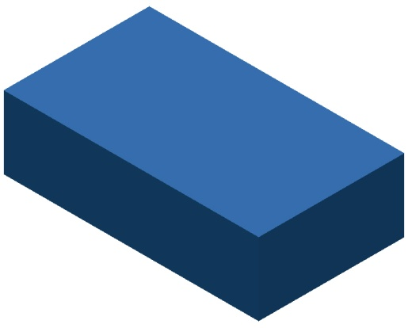
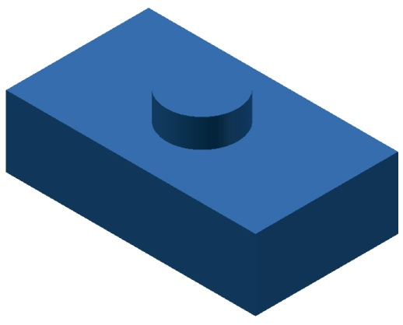
Guidance 3 : Examples
The readers can decompose a complex orthographic views to a set of
simpler orthographic views that is easier to match a simple shape or
generic object.
1
Given
+
2
=

Slide 11

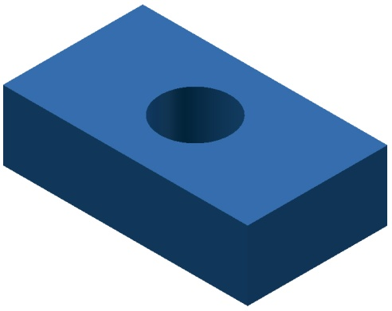
Example 1
Given
1
2
+
Negative cylinder (Hole)
=

Slide 12

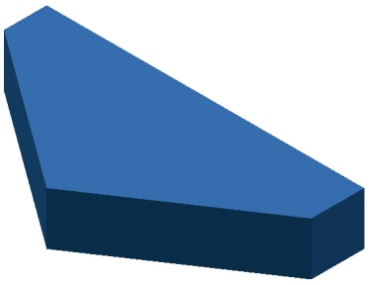

Example 2
Given
1
2
+
=

Slide 13


Example 2 : Method 2
Given
Familiar shape in database
Recall

Slide 14



Example 3
1
2
Given
+
Note
This example shows the difficulty
in decomposition of the areas in
orthographic views, i.e. a limitation
of this method.
=

Slide 15
Visualization
techniques :
Analysis by surfaces
Techniques
Contents

Slide 16
Guidance
1. Adjacent areas that are not lie in the same plane are
separated by lines.
2. Areas that show a similar shape in more than one view
is the same surface.

Slide 17
Example 1 (1/3)
1
2
1
1
2
2
2
1

Slide 18
Example 1 (2/3)
3
3
3
3
4
3
3
4
4
4

Slide 19

Example 1 (3/3)
5
5
5
Final shape
of an object
5

Slide 20
Example 2 (1/3)
2
1
1
2
2
1
1
2

Slide 21
Example 2 (2/3)
3
3
4
3
3
4
4
4

Slide 22
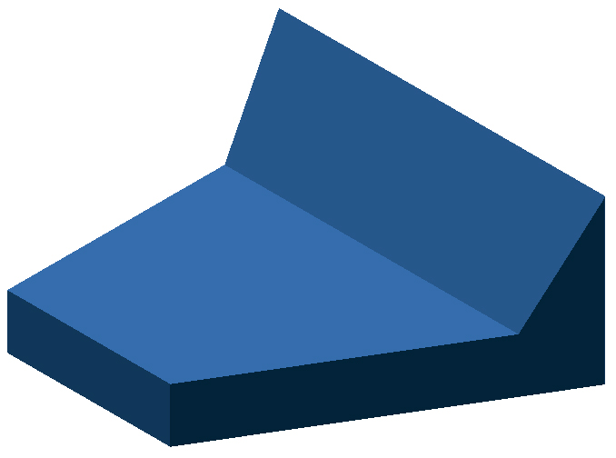
Example 2 (3/3)
Final shape
of an object

Slide 23
Example 3 (1/4)
1
1
2
2
2
1
1
2

Slide 24
Example 3 (2/4)
3
4
3
3
3
4
4
4

Slide 25
Example 3 (3/4)
5
6
6
7
5
8
5
6
5
6
7
7
8
8
7
8

Slide 26

Example 3 (4/4)
Final shape
of an object

Slide 27
Higher level of
visualization problem:
A missing view problem
Techniques
Contents

Slide 28
Notes
1. For a given three (independent) orthographic views of
an object, there is a unique object that is satisfied
with a given information.
2. The lesser of a given number of orthographic views,
the higher in a number of possible objects will be.

Slide 29










Example : No. of views vs. Possible objects
Possible objects

Slide 30

Missing view problems : solution steps
Procedures
Examples
1. Analyze the alignment of a
given orthographic views and
a missing view.
T
T
T
F
R
F
R
F
R
2. Incrementally and iteratively
sketch a pictorial view of a
possible object.
3. Sketch the missing (or a
required) view from a possi-
ble object

Slide 31
Example 1 : (1/3)
1
3
1
2
1
3
2
2
3

Slide 32
Example 1 : (2/3)
4
5
8
6
7
4
5
6
7
8
4
6
5
7
8

Slide 33

Example 1 : (3/3)
Final shape
of an object

Slide 34
Example 2 : (1/3)
1
1
2
3
1
2
3
2
3

Slide 35

Example 2 : (2/3)
4
5
4
6
6
5
Expect the remaining surface and add holes
4
6
5

