Slide 1



PROPRIETARY MATERIAL. © 2008 The McGraw-Hill Companies, Inc. All rights reserved. No part of this PowerPoint slide may be displayed, reproduced or distributed in any form or by any means, without the prior written permission of the publisher, or used beyond the limited distribution to teachers and educators permitted by McGraw-Hill for their individual course preparation. If you are a student using this PowerPoint slide, you are using it without permission.

Slide 2
DIMENSIONING
Dimensioning refers to the act of giving dimensions. BIS (SP 46: 2003) defines dimension as a numerical value expressed in appropriate units of measurement and indicated graphically on technical drawings with lines, symbols and notes.
The important aspects of dimensioning are as follows:
Units of Measurement The most convenient unit for length is millimetre. In civil engineering and architectural drawing, inch or foot is often used as a unit of length. Angles are shown in degrees.
Symbols are incorporated to indicate specific geometry wherever necessary.
Notes are provided to give specification of a particular feature or to give specific information necessary during the manufacturing of the object.

Slide 3
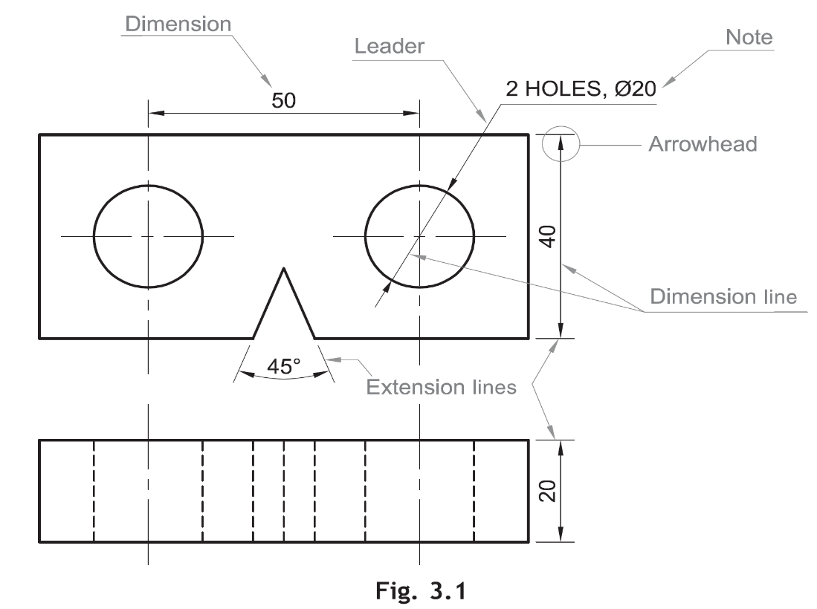
ELEMENTS OF DIMENSIONING
A line on the drawing whose length is to be shown is called an object line. The object line is essentially an outline representing the feature(s) of the object. While showing an angle, the two lines forming the angle will be the object lines.
Dimensioning is often done by a set of elements, which includes extension lines, dimension lines, leader lines, arrowheads and dimensions. These are shown in Fig. 3.1.

Slide 4
SYSTEMS OF DIMENSIONING
Aligned System
In the aligned system, dimensions are placed perpendicular to the dimension line so that they may be read from the bottom or right-hand side of the drawing sheet. Dimensions are placed at the middle and on top of the dimension lines.
Unidirectional System
In the unidirectional system, dimensions are placed in such a way that they can be read from the bottom edge of the drawing sheet. all horizontal dimensions are placed at the middle and on top of the dimension lines while vertical and inclined dimensions are inserted by breaking the dimension lines at the middle.

Slide 5
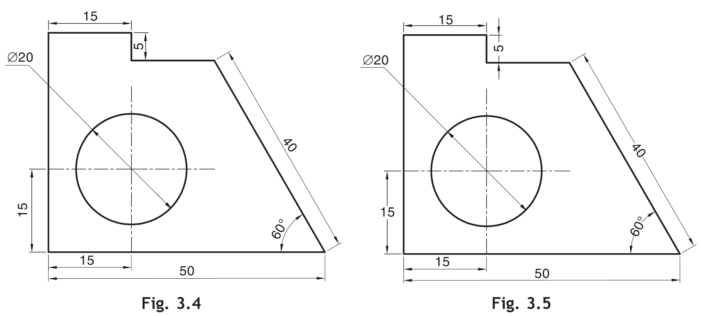

Slide 6
RULES OF DIMENSIONING
Between any two extension lines, there must be one and only one dimension line bearing one dimension.
As far as possible, all the dimensions should be placed outside the views. Inside dimensions are preferred only if they are clearer and more easily readable.
All the dimensions on a drawing must be shown using either Aligned System or Unidirectional System. In no case should, the two systems be mixed on the same drawing.
The same unit of length should be used for all the dimensions on a drawing. The unit should not be written after each dimension, but a note mentioning the unit should be placed below the drawing.
Dimension lines should not cross each other. Dimension lines should also not cross any other lines of the object.
All dimensions must be given.
Each dimension should be given only once. No dimension should be redundant.

Slide 7
Do not use an outline or a centre line as a dimension line. A centreline may be extended to serve as an extension line.
Avoid dimensioning hidden lines.
For dimensions in series, adopt any one of the following ways.
  Chain dimensioning (Continuous dimensioning) All the dimensions are aligned in such a way that an arrowhead of one dimension touches tip-to-tip the arrowhead of the adjacent dimension. The overall dimension is placed outside the other smaller dimensions, Fig. 3.13(a).
  Parallel dimensioning (Progressive dimensioning) All the dimensions are shown from a common reference line. Obviously, all these dimensions share a common extension line. This method is adopted when dimensions have to be established from a particular datum surface, Fig. 3.13(b).
  Combined dimensioning When both the methods, i.e., chain dimensioning and parallel dimensioning are used on the same drawing, the method of dimensioning is called combined dimensioning, Fig. 3.13(c).

Slide 8
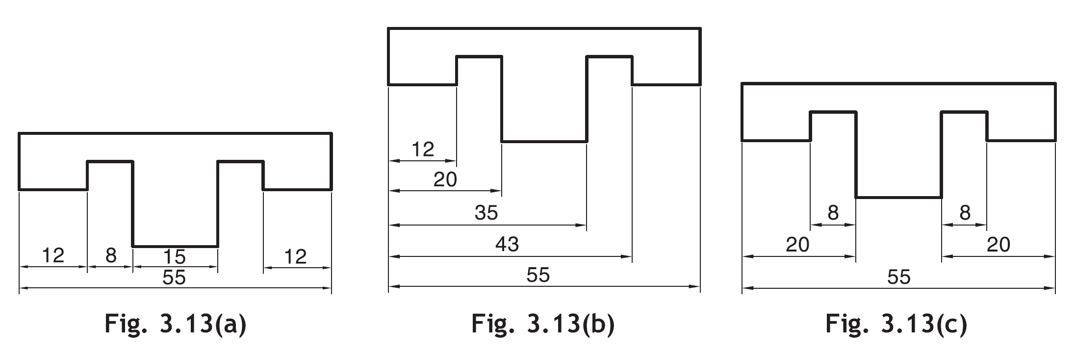
Smaller dimensions should always be placed nearer the view. The next smaller dimension should be placed next and so on.
All notes should be written horizontally.

Slide 9
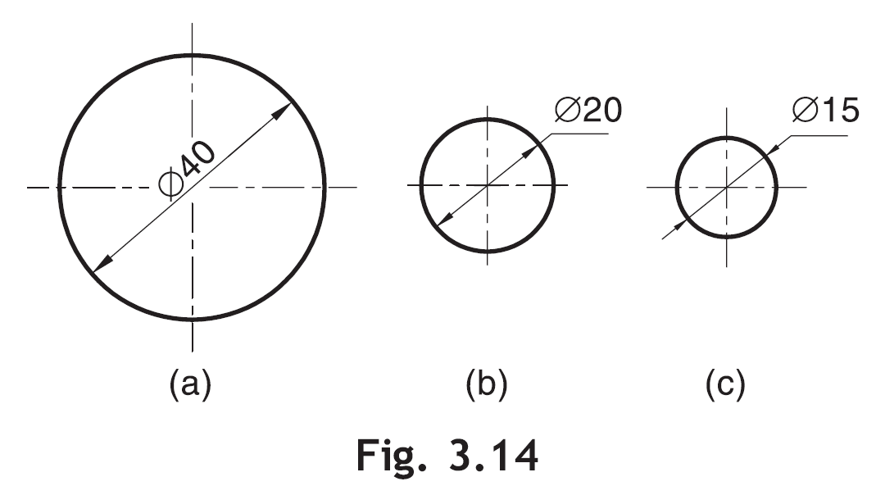
Dimensioning of Circular Features
A circle should be dimensioned by giving its diameter instead of radius. The dimension indicating a diameter should always be preceded by the symbol ø, Fig. 3.14.

Slide 10
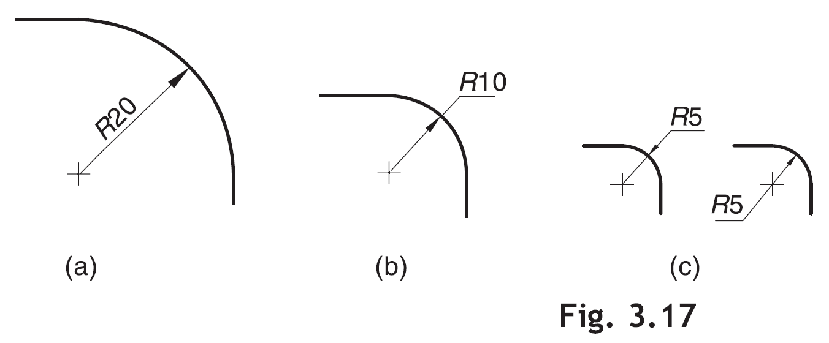
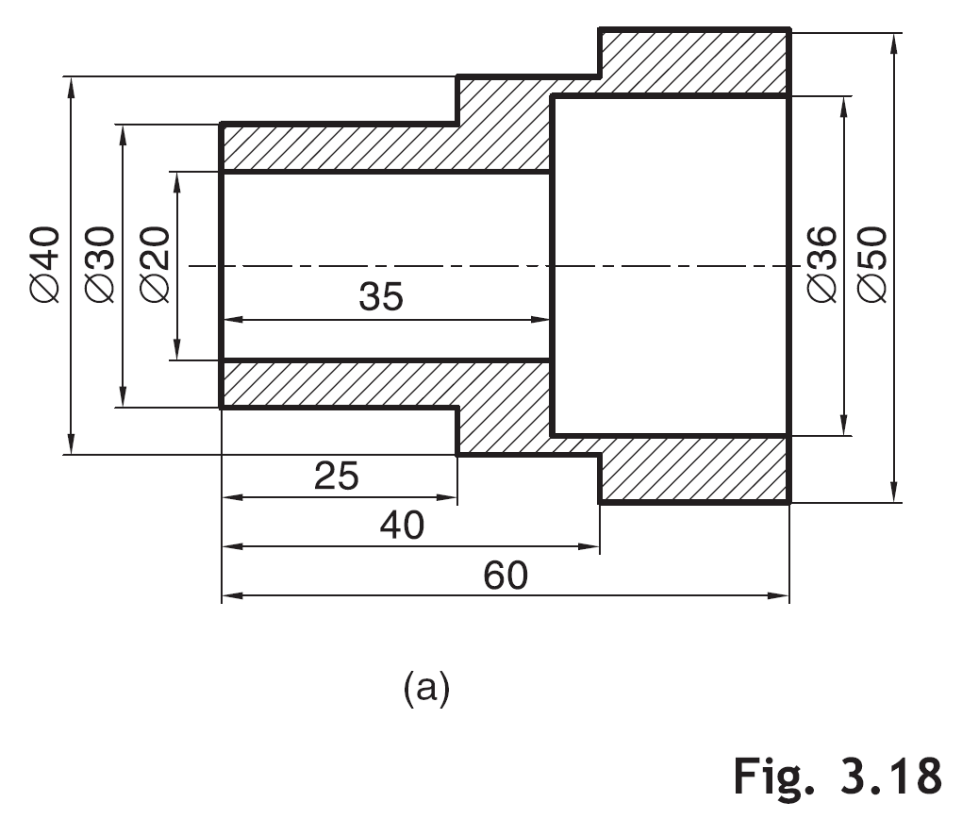
An arc should be dimensioned by giving its radius. The dimension indicating radius should be preceded by symbol R, Fig. 3.17.
Cylindrical features should be dimensioned by giving their diameters. As far as possible, they should be dimensioned in the views in which they appear as rectangles, Fig. 3.18(a).

Slide 11
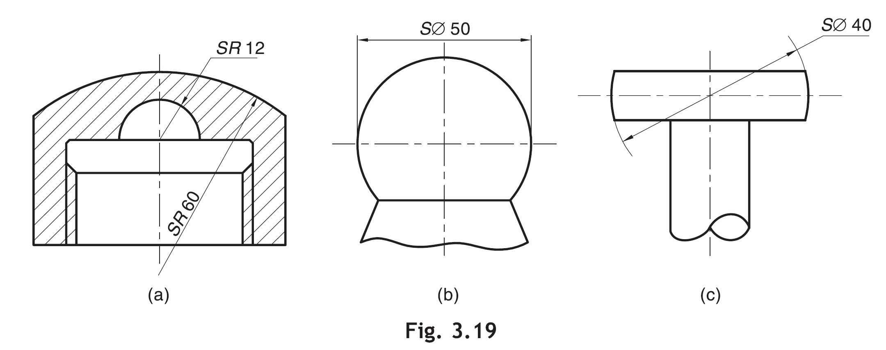
Dimensioning of Spherical Features
Spherical features may be dimensioned by giving either the radius or diameter of a sphere. The symbols SR or Sø must precede the dimension for radius or diameter respectively, Fig. 3.19.

Slide 12
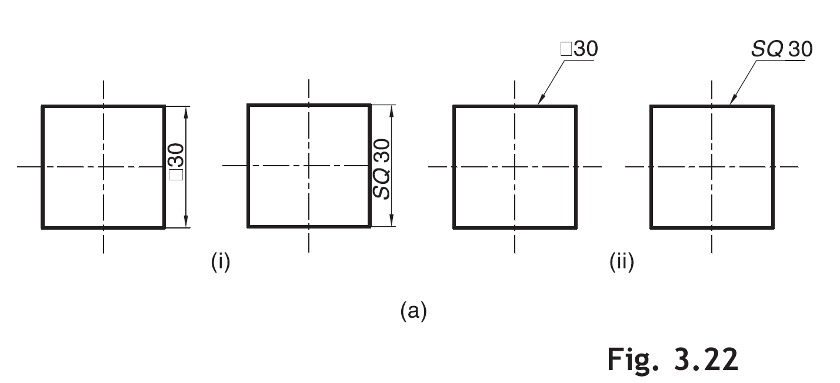
Dimensioning of Square Features
Square features (e.g., a rod of square cross-section) are dimensioned using symbol or SQ as shown in (i) or (ii), Fig. 3.22(a).

Slide 13
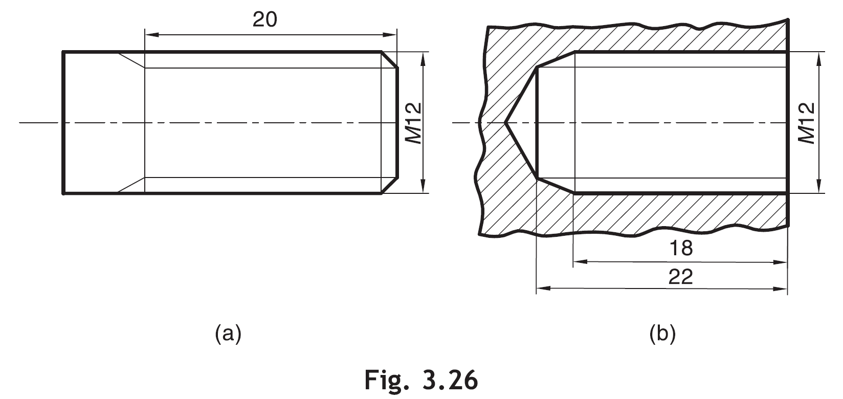
Dimensioning of Screw Threads
External metric threads are dimensioned by giving the threaded length and nominal diameter preceded by symbol ‘M ’, Fig. 3.26(a).
Internal metric threads are dimensioned by giving the threaded length, depth of drilled hole before threading and nominal diameter preceded by symbol ‘M’, Fig. 3.26(b).

Slide 14
USE OF NOTES
Notes are used in technical drawings to give specifications of particular features or some specific information. A note may be a general sentence applied to the entire or some part of the drawing, or a note may be a specific sentence applied to a particular feature. The use of notes in dimensioning of some specific feature is explained below.
1. Circular hole Fig. 3.27(a): A hole of diameter 16, drilled to the depth of 25.
2. Spot face Fig. 3.27(b): A spot face of diameter 22 on a hole of diameter 10.
3. Counterbore Fig. 3.27(c): A counterbore of root diameter 10, top diameter 20 and depth 10.
4. Keyway Fig. 3.27(d).

Slide 15
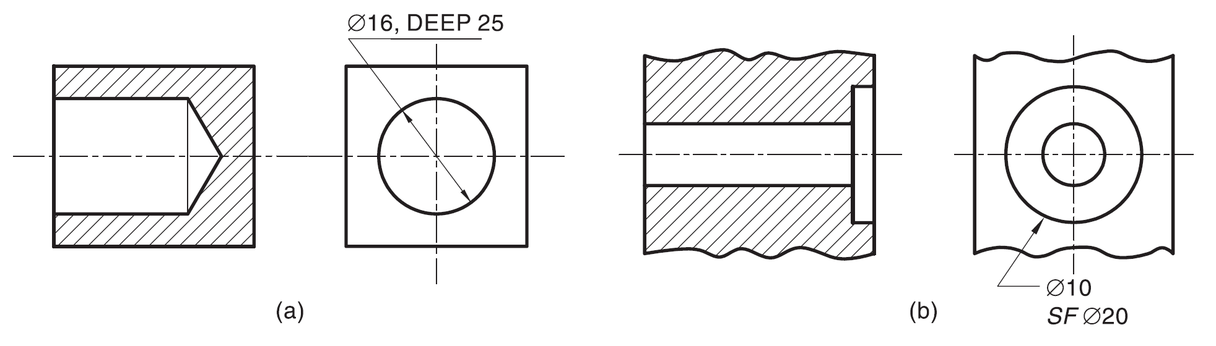
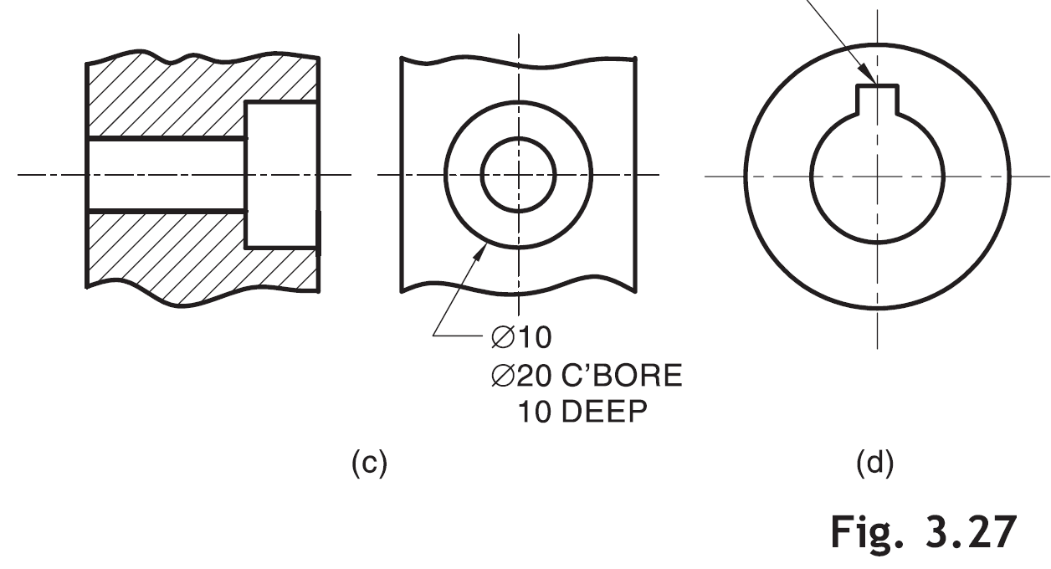
KEYWAY 4 WIDE x 3 DEEP

Slide 16
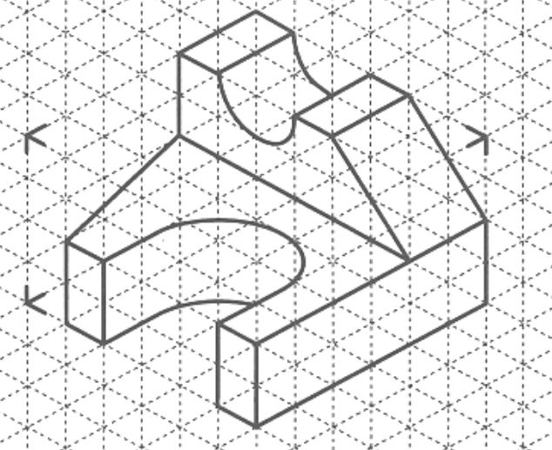
Task-4

