Slide 1


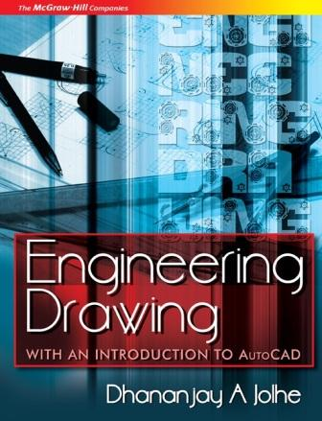
PROPRIETARY MATERIAL. © 2008 The McGraw-Hill Companies, Inc. All rights reserved. No part of this PowerPoint slide may be displayed, reproduced or distributed in any form or by any means, without the prior written permission of the publisher, or used beyond the limited distribution to teachers and educators permitted by McGraw-Hill for their individual course preparation. If you are a student using this PowerPoint slide, you are using it without permission.

Slide 2
Chapter 4
GEOMETRICAL CONSTRUCTIONS
TO BISECT A LINE / AN ARC
Example 4.1 To bisect a given straight line AB.
Solution Refer Fig. 4.6.
With A as centre and radius greater than half of AB, mark two arcs, one on each side of AB.
With B as centre and same radius, mark two arcs intersecting the previous arcs at C and D.
Join CD. CD is the perpendicular bisector of AB.

Slide 3
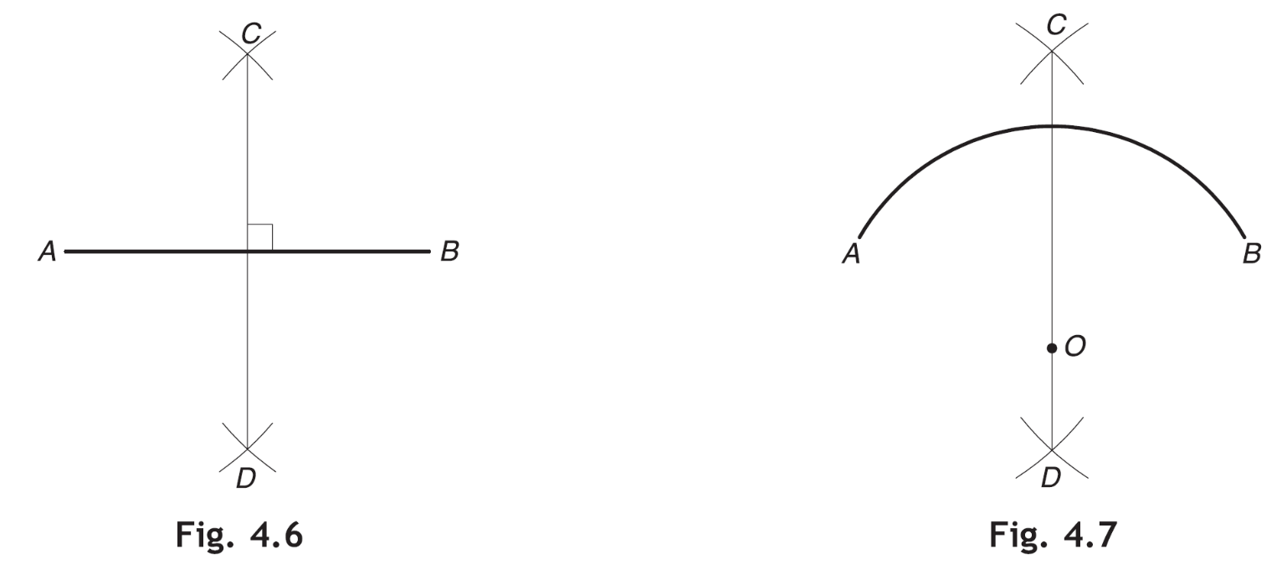
Example 4.2 To bisect a given arc AB.
Solution Refer Fig. 4.7.
Follow the same procedure as explained in Example 4.1. CD is the bisector of arc AB. It will pass through the centre O (produced if necessary).

Slide 4
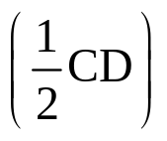
TO DRAW A PERPENDICULAR TO A LINE
Example 4.3 To draw a perpendicular to a given line AB from a point P anywhere on it.
Solution Refer Fig. 4.8.
With P as centre and any convenient radius r1, mark two arcs cutting AB at C and D. Produce AB if necessary.
With C and D as the centres and radius r₂ > r₁, mark two arcs intersecting each other at Q.
Join QP. QP is perpendicular to AB.
Example 4.4 To draw a perpendicular to a given line AB from a point P outside it.
Solution Refer Fig. 4.9.
With P as centre and any convenient radius, mark two arcs intersecting AB at C and D.
With C and D as centres and radius > , mark two arcs intersecting each other at E.
Join PE for the required perpendicular.

Slide 5
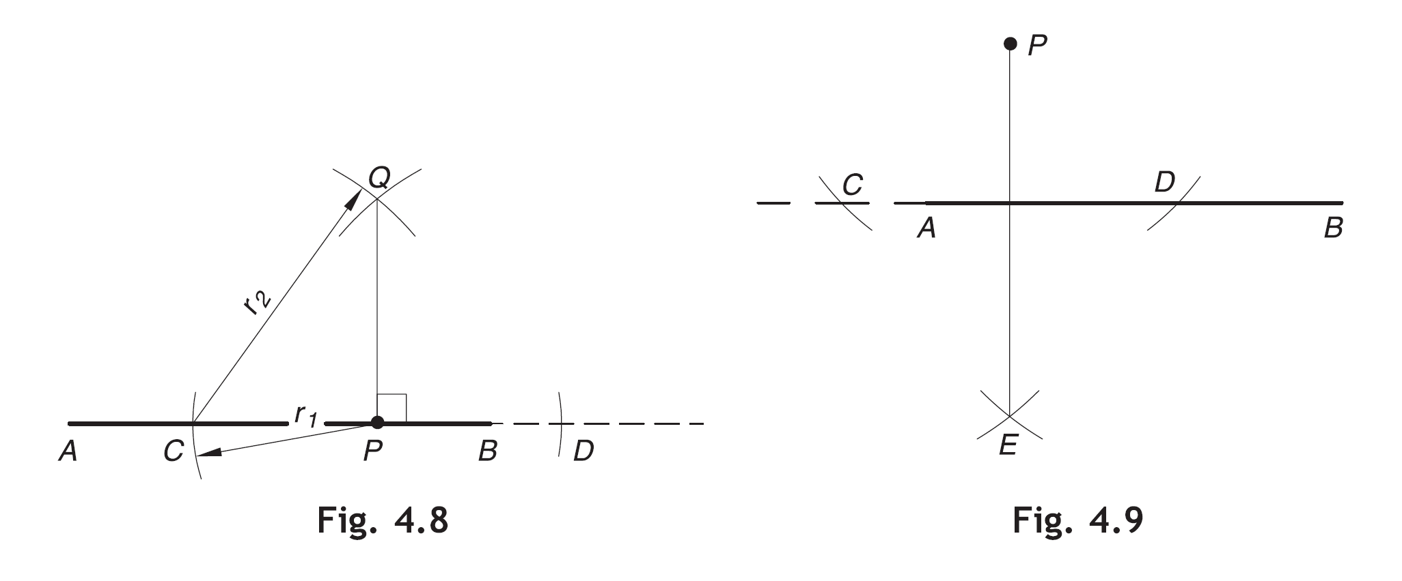

Slide 6
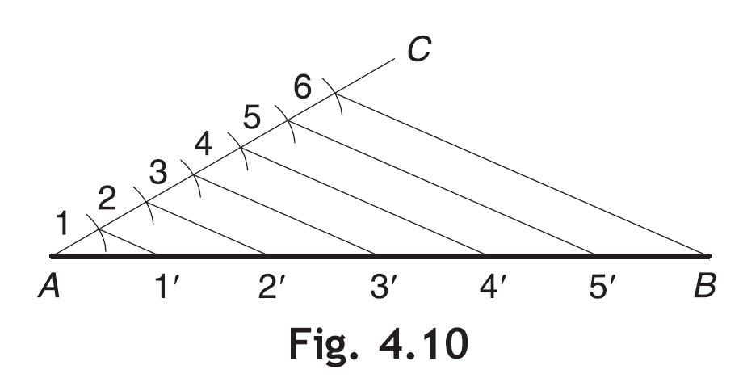
TO DIVIDE A LINE
Example 4.5 To divide a given line AB into any number of equal parts.
Solution Suppose the line AB is to be divided into 6 equal parts. Refer Fig. 4.10.
Draw a line AC of any length inclined to AB at some convenient angle (preferably between 20° and 40°).
Mark off six equal divisions on AC by cutting arcs of suitable radii consecutively starting from A. Number these divisions as 1, 2, 3, 4, 5 and 6.
Join 6 with B.
Draw lines through 5, 4, 3, 2 and 1 parallel to 6– B and cutting AB at points 5’, 4’, 3’, 2’ and 1’ respectively. Set-squares or drafter may be used for this purpose. The divisions 1’, 2’, 3’, 4’, 5’ divide the line AB into 6 equal parts.

Slide 7
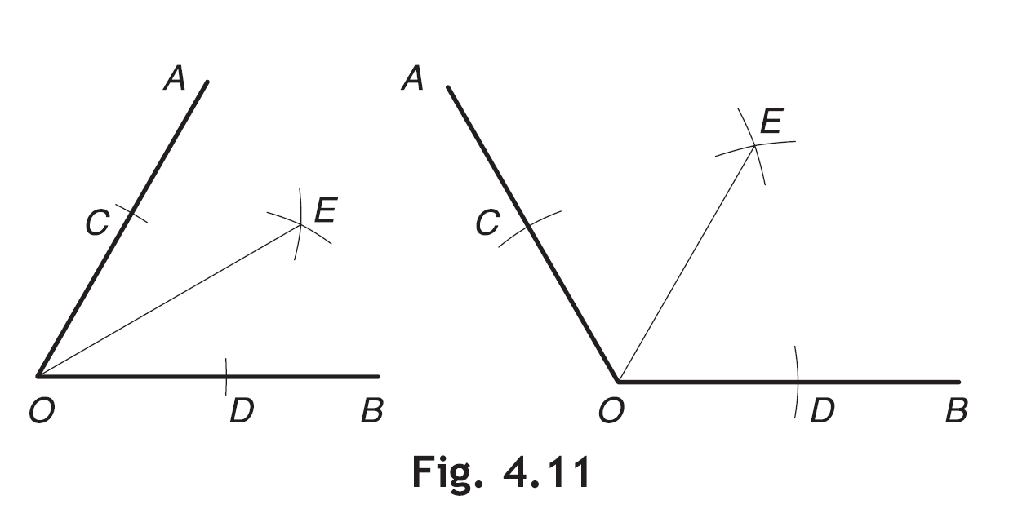
TO BISECT AN ANGLE
Example 4.6 To bisect a given angle AOB.
Solution Refer Fig. 4.11.
With O as centre and any convenient radius, mark arcs cutting OA and OB at C and D respectively.
With C and D as centres and same or any other convenient radius, mark two arcs intersecting each other at E.
Join OE. OE is the bisector ∠AOB, i.e., ∠AOE = ∠EOB.

Slide 8
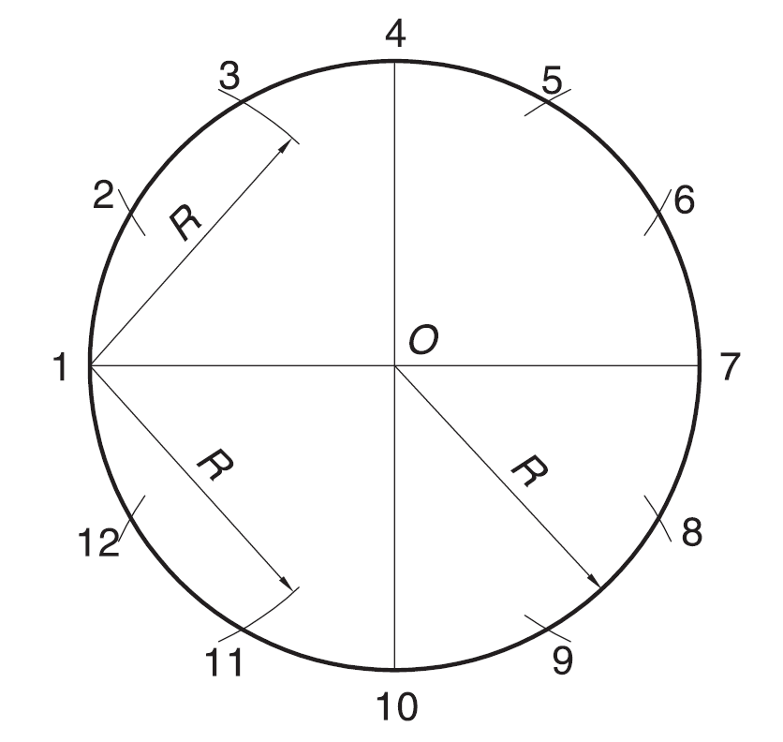
TO DIVIDE A CIRCLE
Example 4.9 To divide a given circle into 12 equal parts.
Solution Refer Fig. 4.14.
Draw the two diameters 1–7 and 4–10, perpendicular to each other.
With 1 as a centre and radius = R (= radius of the circle), cut two arcs at 3 and 11 on the circle.
Similarly, with 4, 7 and 10 as the centres and the same radius, cut arcs on the circle respectively at 2 and 6, 5 and 9, and 8 and 12. The points 1, 2, 3, etc., give 12 equal divisions of the circle.
Fig. 4.14

Slide 9
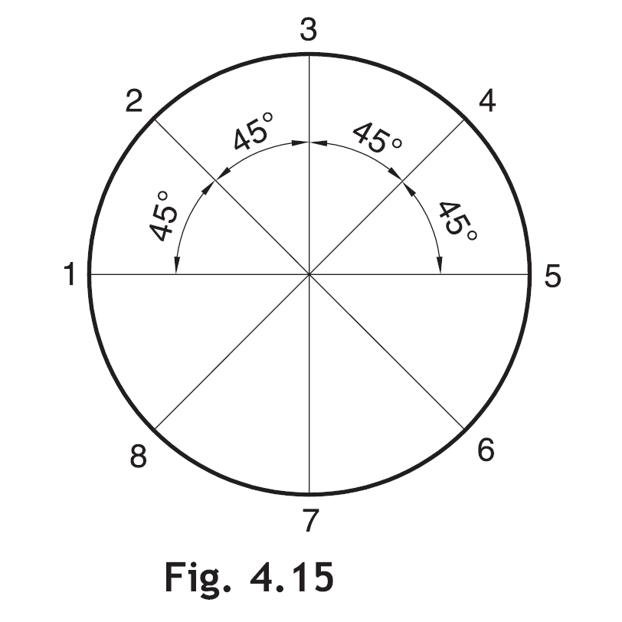
Example 4.10 To divide a given circle into 8 equal parts.
Solution Refer Fig. 4.15.
Draw the diameters 1–5, 2–6, 3–7 and 4–8, each inclined to the adjacent at 45°. These diameters give 8 equal parts of the circle.

Slide 10
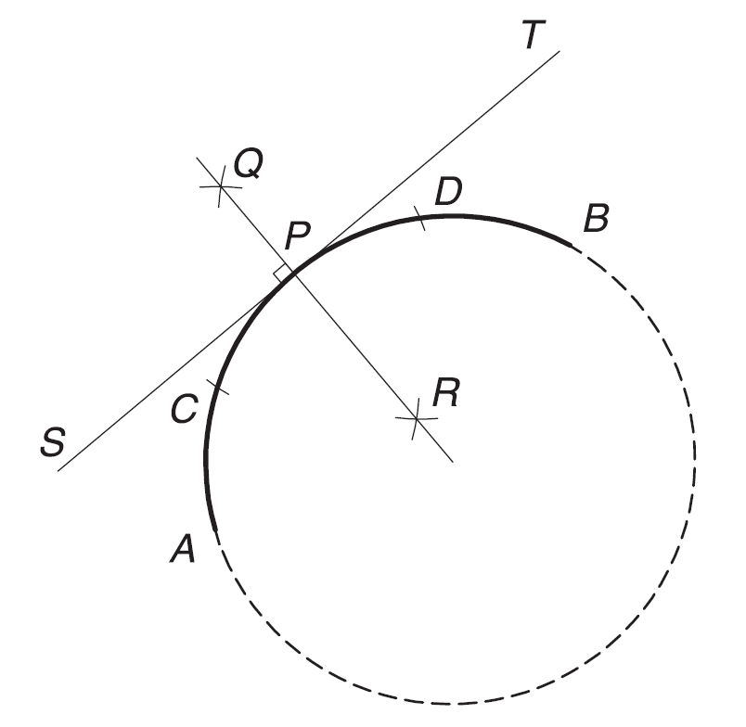
TO DRAW A NORMAL AND A TANGENT TO ARC(S)/CIRCLE(S)
Example 4.12 To draw a normal and a tangent to a given arc AB (or a circle) at a point P on it.
Solution Refer Fig. 4.17.
With centre P and any convenient radius, mark off two arcs cutting the arc/circle at C and D.
Obtain QR, the perpendicular bisector of arc CD. QR is the required normal.
Draw the perpendicular ST to QR for the required tangent.
Fig. 4.17

Slide 11
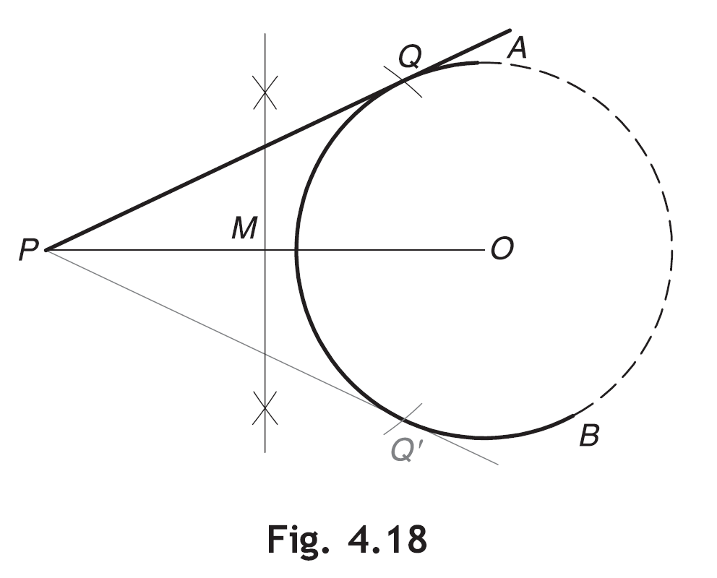
Example 4.13 To draw a tangent to a given arc AB (or a circle) from a point P outside it.
Solution Refer Fig. 4.18.
Join the center O with P and locate the midpoint M of OP.
With M as a center and radius = MO, mark an arc cutting the circle at Q.
Join P with Q. PQ is the required tangent.
Another tangent PQ’ can be drawn in a similar way.

Slide 12
Example 4.15 To draw a common tangent to two given arcs AB and CD (or two circles) of equal radius R.
Solution
Case (a): External Tangent: Refer Fig. 4.20(a).
Join centres O₁ and O₂ of the given arcs (or circles).
Draw perpendiculars O₁S and O₂ T to O₁ O₂ on the same side of it and meeting the arcs AB and CD at S and T respectively.
Join ST for the required tangent. Another tangent S’ T’ can be drawn in a similar way.
Case (b): Internal Tangent: Refer Fig. 4.20(b).
Join centres O₁ and O₂. Obtain the midpoint P of O₁O₂.
Draw a semicircle of diameter O₁ P cutting the arc AB at S.
Join S to P and extend it to touch the arc CD at T. ST is the required tangent. Another tangent S’ T’ can be drawn in a similar way.

Slide 13
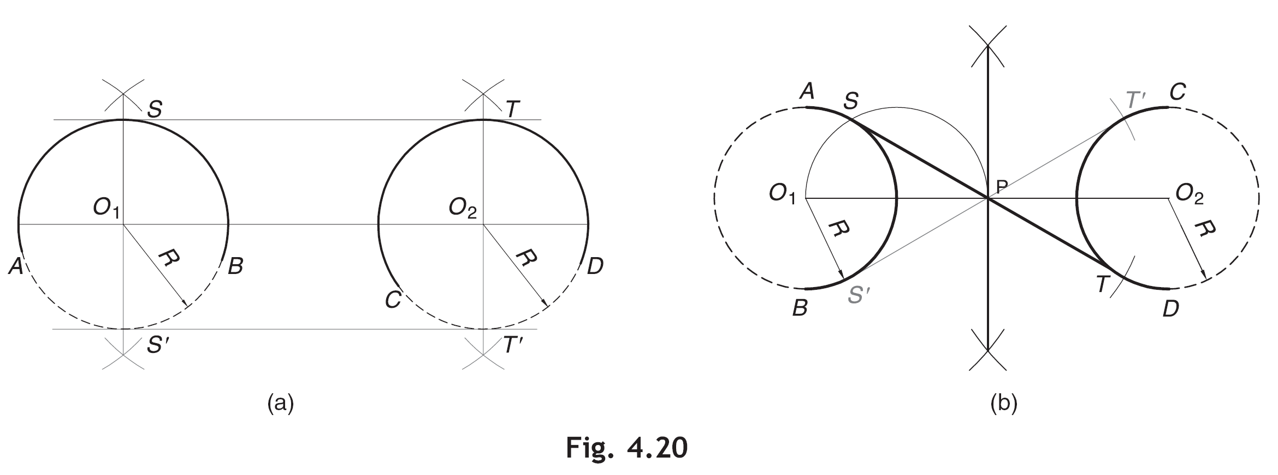

Slide 14
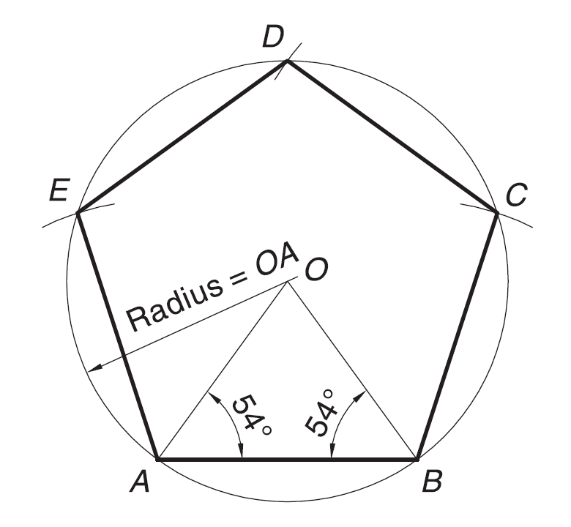
TO CONSTRUCT REGULAR POLYGONS
Example 4.17 To construct a regular pentagon of known side AB.
Solution Refer Fig. 4.22.
Draw a line AB of given length.
Construct an isosceles triangle ABO such that –ABO = –BAO = 54°.
Draw a circle with O as centre and radius = OA.
On the circle, locate points C, D and E by marking off the arcs consecutively with centres B, C and D and radius AB.
Join BC, CD, DE and EA for the required pentagon.
Fig. 4.22

Slide 15
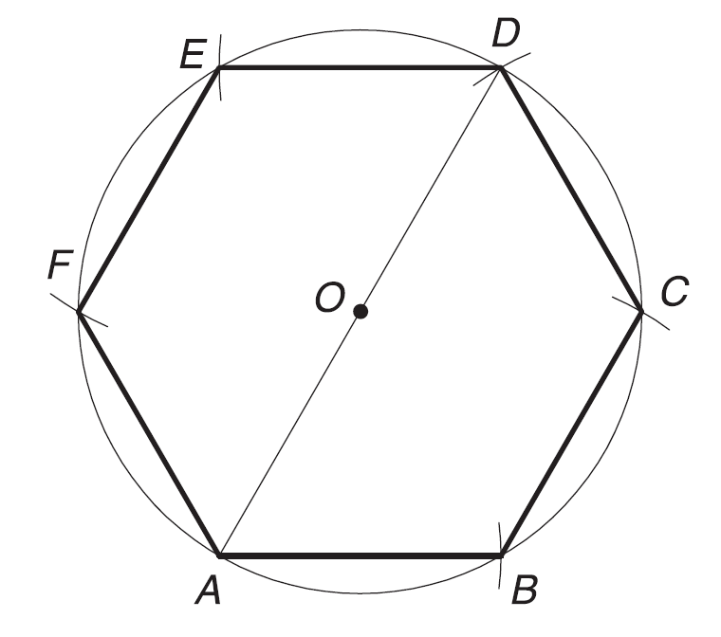
To construct a regular hexagon of known side AB.
Refer Fig. 4.23.
With any point O as centre and radius = AB, draw a circle.
Starting from any point (say A) on the circle, mark off the five arcs of radius = AB consecutively cutting the circle at B, C, D, E and F.
Join A, B, C, D, E and F for the required hexagon.
Fig. 4.23

Slide 16
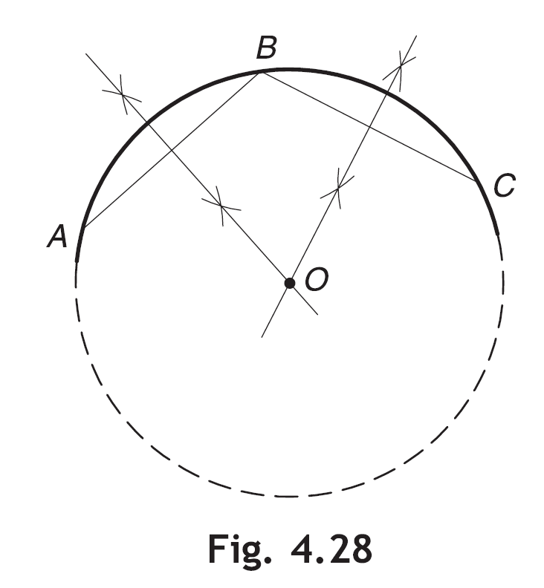
TO DRAW AN ARC/A CIRCLE PASSING THROUGH THREE GIVEN POINTS
To draw an arc (or a circle) passing through three given non-collinear points A, B and C.
Refer Fig. 4.28.
Join AB and BC.
Draw perpendicular bisectors of AB and BC intersecting each other at point O. O is the centre of the required arc/circle.
With O as centre and radius = OA, draw the required arc/circle.

Slide 17
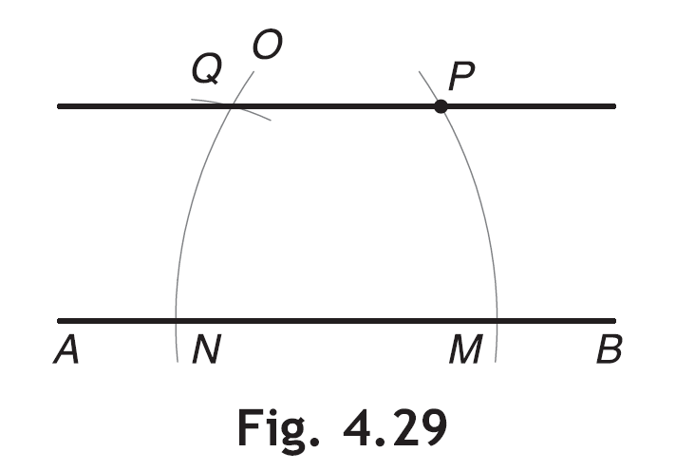
TO DRAW PARALLEL LINES
To draw a line passing through a point P and parallel to the given line AB.
Refer Fig. 4.29.
With A as centre and radius = AP, draw an arc cutting AB at M. AB may be produced if necessary.
With B as centre and the same radius, draw an arc ON, cutting AB at N.
With N as centre and radius = PM, mark an arc cutting arc ON at Q.
Join PQ. PQ is parallel to AB.

Slide 18
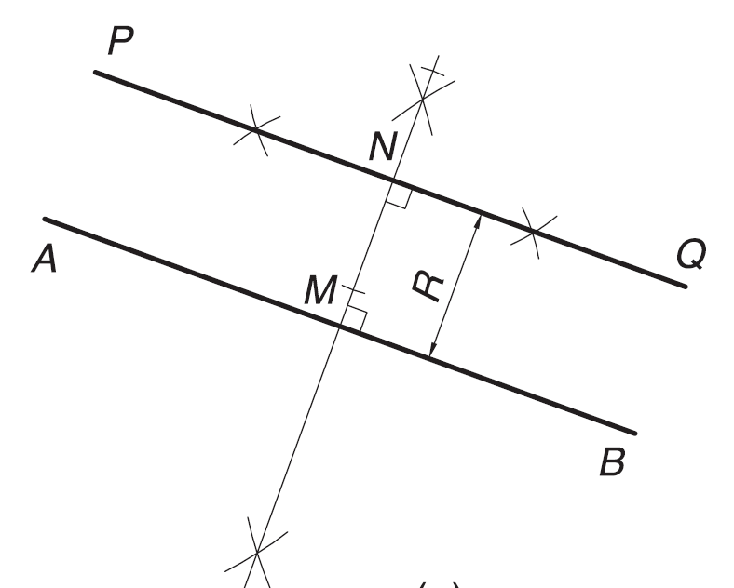
Example 4.24 To draw a line parallel to a given line AB and at a given distance R from it.
Solution Refer Fig. 4.30.
1. Draw a perpendicular bisector of the line AB, cutting it at M.
2. Set off MN = R. Draw PQ perpendicular to MN at N. PQ is parallel to AB.
Fig. 4.30

Slide 19
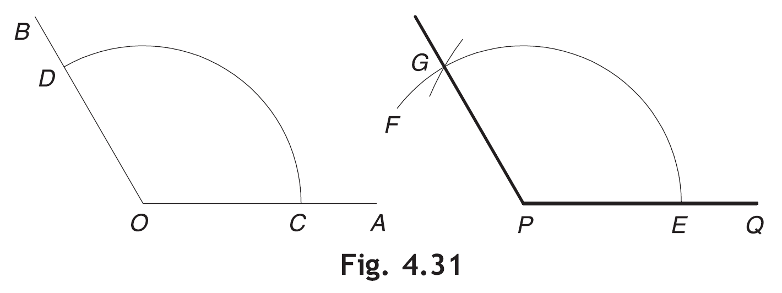
TO CONSTRUCT AN ANGLE EQUAL TO A GIVEN ANGLE
Example 4.25 To construct an angle equal to a given angle, –AOB.
Solution Refer Fig. 4.31.
With O as centre and any convenient radius, draw an arc cutting OA and OB at C and D respectively.
Draw any line PQ. With P as centre and the same radius, draw an arc EF cutting PQ at E.
With E as centre and radius = CD, mark an arc cutting EF at G.
Join PG. – GPQ is the required angle.

Slide 20
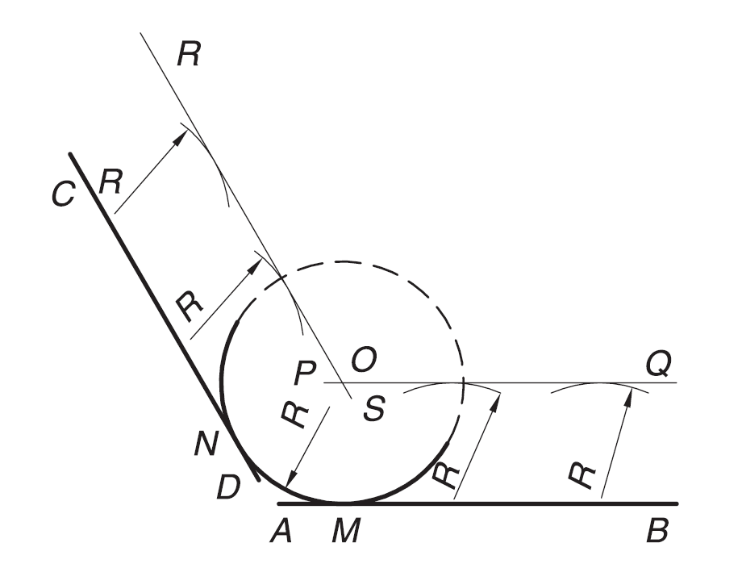
TO DRAW AN ARC/A CIRCLE TANGENT TO LINE(S)/ARC(S)
Example 4.27 To draw an arc (or a circle) of given radius R tangent to two given lines AB and CD inclined to each other.
Solution Refer Fig. 4.33.
Draw lines PQ and RS parallel to AB and CD respectively and at a distance of R from each of them.
Locate O at the intersection of PQ and RS. With O as centre and radius = R, draw the required arc (or circle) touching AB and CD, each at a point, say M and N.
Fig. 4.33

Slide 21
Example 4.28 To draw an arc (or a circle) of given radius R, passing through a given point P and tangent to a given arc AB.
Solution
Case (a): Point P is outside the arc AB. Refer Fig. 4.34(a).
With centre O₁ of the arc AB and radius = (R₁ + R), draw an arc EF.
With P as centre and radius = R, cut the arc EF at O.
With O as centre and radius = R, draw the required arc (or circle) touching arc AB at a point, say M.
Case (b): Point P is inside the arc AB. Refer Fig. 4.34(b).
With centre O1 and radius = ( R1 – R) [if R1 > R] or (R – R1) [if R > R1], draw an arc EF.
Follow the steps 2 and 3 mentioned in case (a) above.

Slide 22
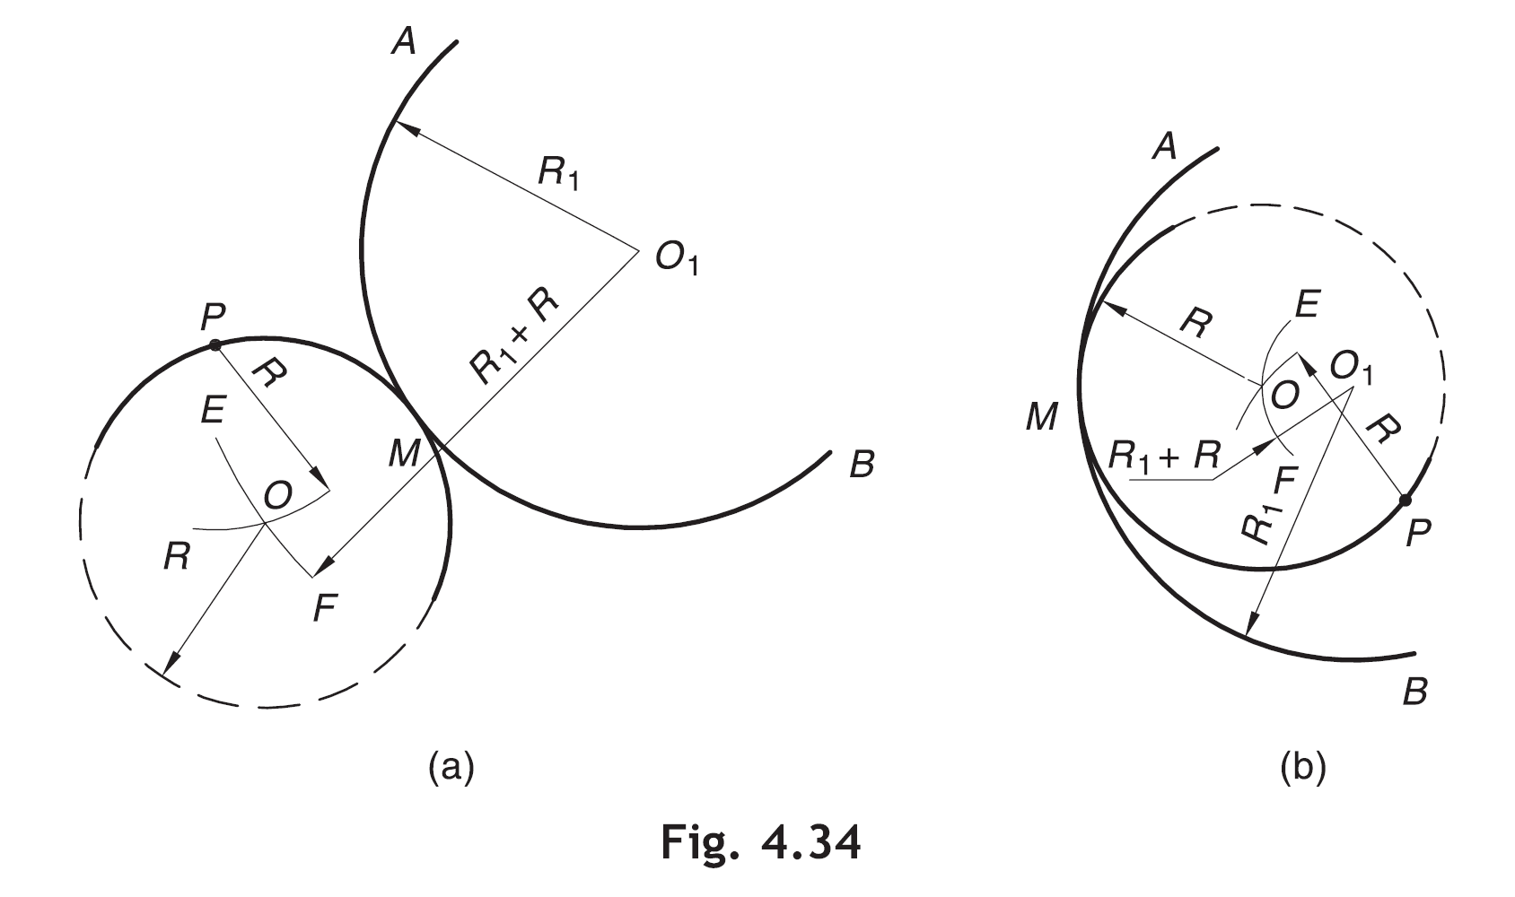

Slide 23
Example 4.29 To draw an arc (or a circle) of given radius R tangent to two given arcs AB and CD.
Solution
Case (a): The arc touches both the given arcs externally.
Refer Fig. 4.35(a).
With centre O₁ of arc AB, draw an arc EF of radius = ( R₁ + R).
With centre O₂ of arc CD, draw an arc GH of radius = ( R₂ + R), cutting the arc EF at O.
With centre O and radius = R, draw the required arc (or circle), touching each of the arcs AB and CD at a point, say M and N.
Case (b): The arc touches both the given arcs internally.
Refer Fig. 4.35(b).
Repeat the procedure as in case (a) above. Take radius of EF = ( R1 – R) and radius of GH = ( R2 – R).

Slide 24
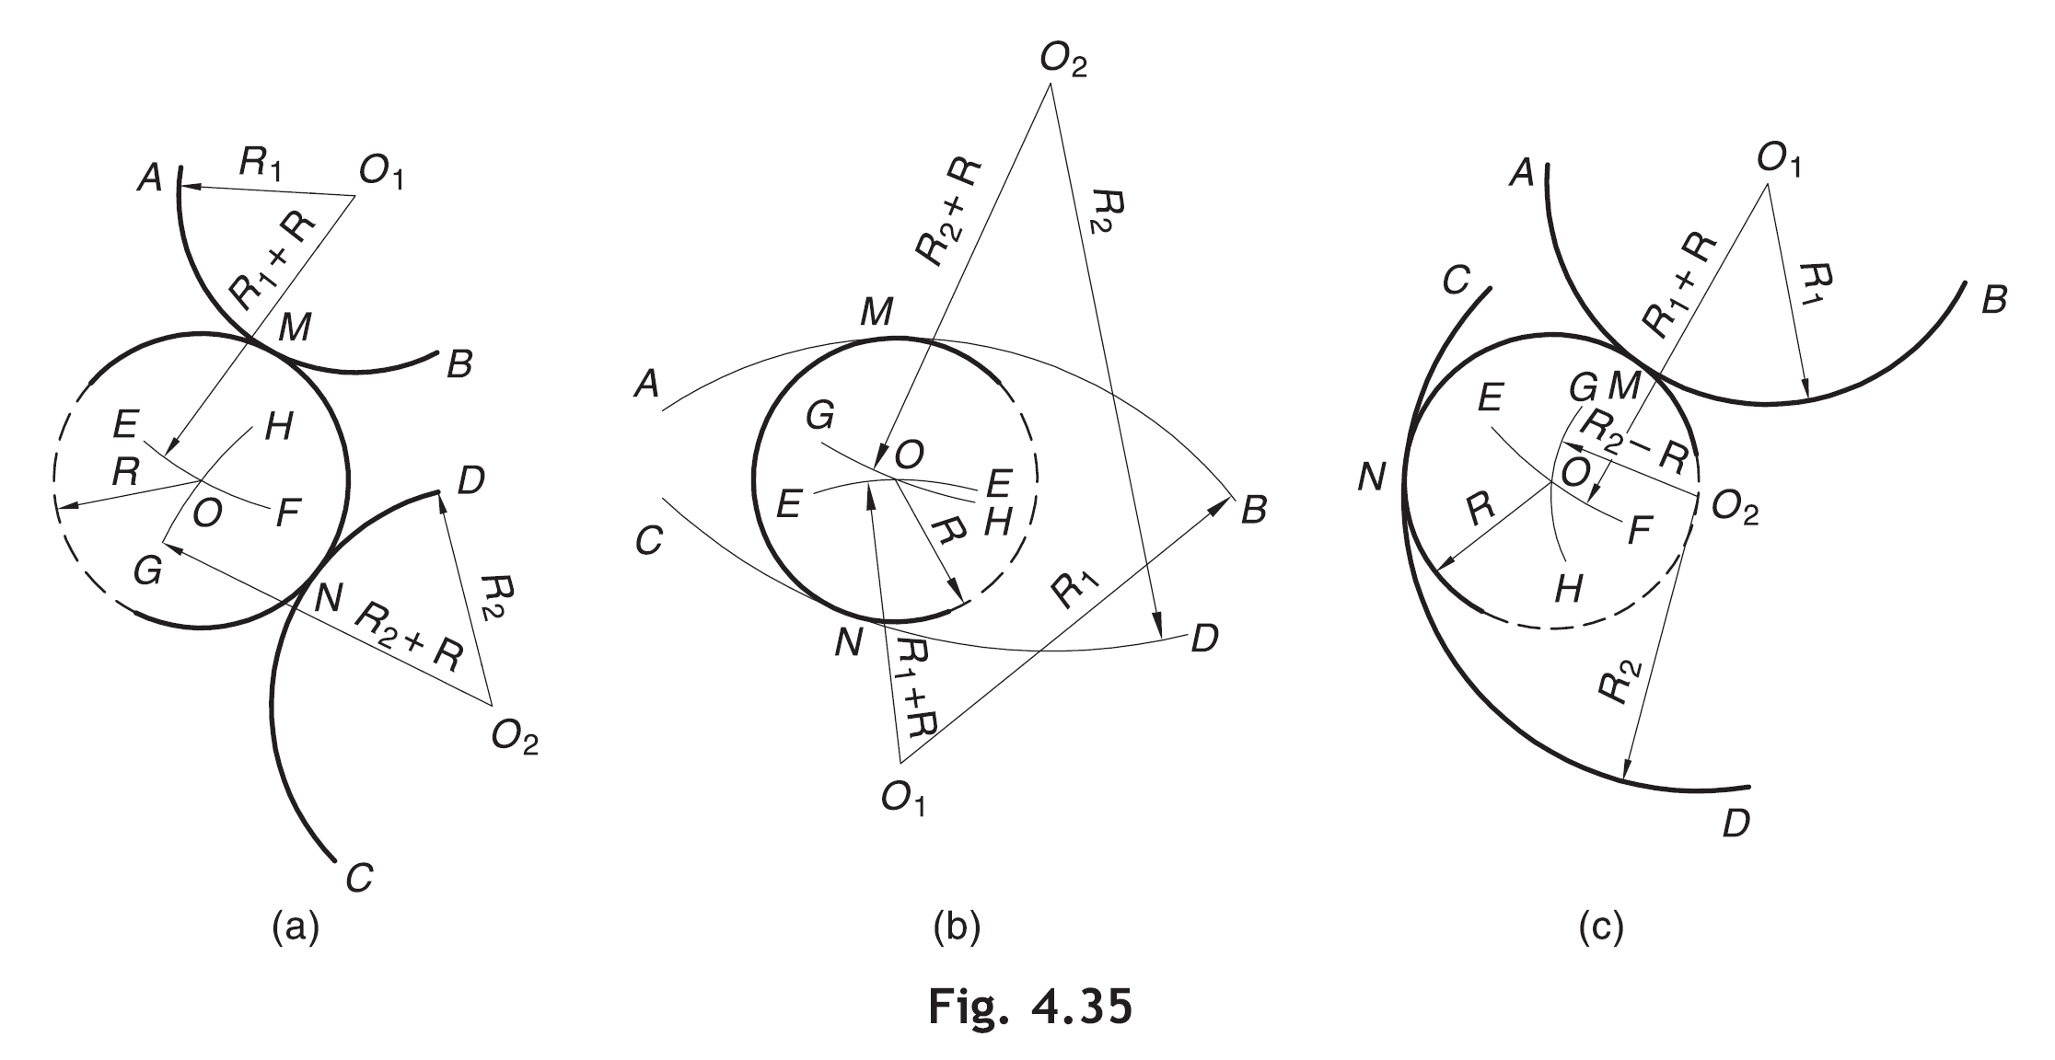
Case (c): The arc touches one of the given arcs (say AB) externally and the other arc (say CD) internally.
Refer Fig. 4.35(c).
Repeat the procedure as in case (a) above. Take radius of EF = ( R₁ + R) and radius of GH = ( R₂ – R).

Slide 25
Example 4.35 To draw an arc (or a circle) tangent to two given arcs AB and CD (or two given circles) at a point P on one of the arcs, say AB.
Solution Refer Fig. 4.41(a) and (b).
Join centre O₁ of the arc AB with P.
Draw a line through centre O₂ of the arc CD parallel to O₁ P and intersecting the arc CD at E (or E’).
Join E (or E’) with P. Locate G (or G’) at the intersection of PE (or PE’), produced if necessary, with the arc CD.
Join O₂ G (or O₂ G’) and produce it if necessary to mark its intersection with O₁ P (produced) at O (or O’). O (or O’) is the centre of the required arc/circle.
With O (or O’) as centre and radius = OP (or O’ P) draw the required arc (or circle).

Slide 26
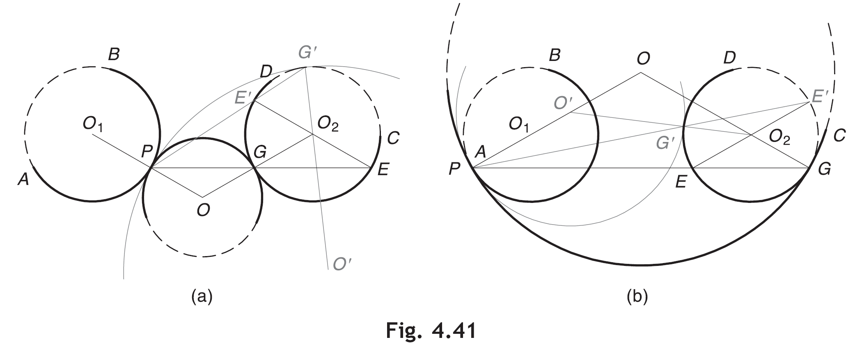

Slide 27
Example 4.36 To draw a smooth continuous curve of circular arcs passing through any number of noncollinear points, say A, B, C, D and E.
Solution Refer Fig. 4.42.
Join AB, BC, CD and DE.
Draw perpendicular bisectors of AB and BC to meet at O1.
With O₁ as a centre and radius = O₁ A, draw an arc ABC.
Join O₁ C. Draw the perpendicular bisector of CD to meet O₁C produced at O₂.
With O₂ as centre and radius = O₂ C, draw the arc CD.
Join O₂ D. Draw the perpendicular bisector of DE to meet O₂D produced at O₃.
With O₃ as centre and radius = O₃ D, draw the arc DE.
The above procedure may be repeated for any number of given points. Note that each arc is tangent to the arc that follows it.

Slide 28
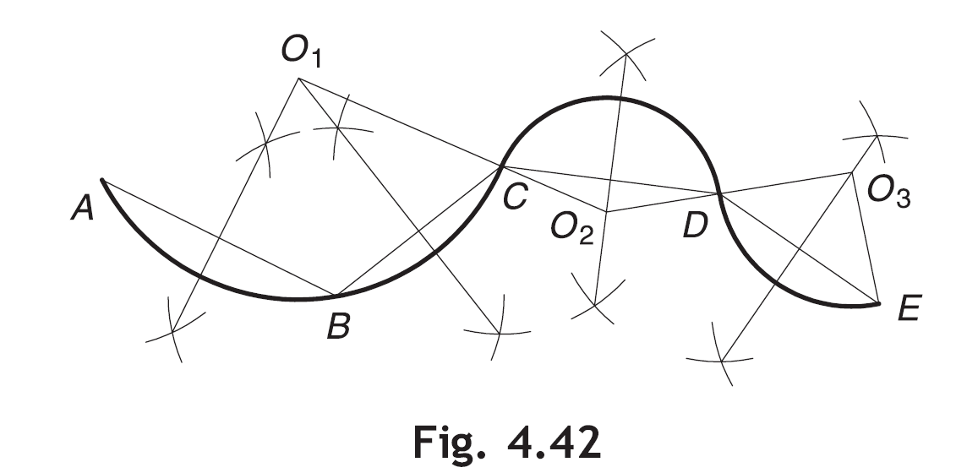

Slide 29
TO DRAW REVERSE OR OGEE CURVES
The reverse (or ogee) curve is a curve composed of two consecutive tangent circular arcs that curve in opposite directions.
Example 4.37 To draw a reverse curve tangent to two parallel or inclined lines AB and CD at given points (say P and Q) on them.
Solution Refer Fig. 4.43.
Two lines AB and CD are parallel to each other.
Join P with Q. On PQ, mark any point R at which the curve is supposed to change the direction.
Draw a perpendicular bisector of PR. Also draw a perpendicular to AB at P. Mark point O₁ at the intersection of these perpendiculars.
With O₁ as centre and radius = O₁ P, draw the arc PR.
Locate point O₂ at the intersection of the perpendicular bisector of RQ and the perpendicular to CD at Q.
With O₂ as centre and radius = O₂ Q, draw the arc RQ.
PRQ is the desired reverse curve.

Slide 30
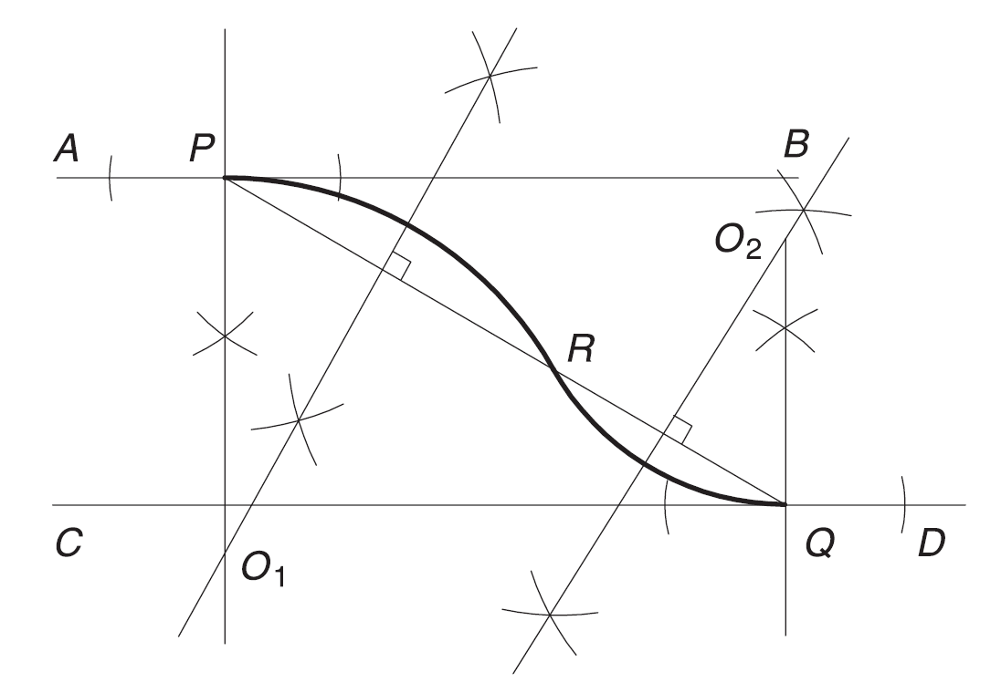
Fig. 4.43

Slide 31
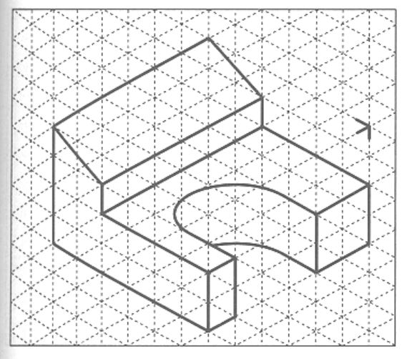
TASK-5

Slide 32
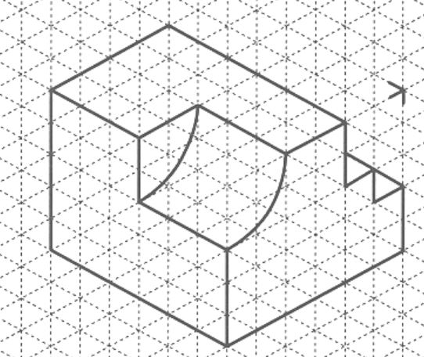
Task-6

Slide 33
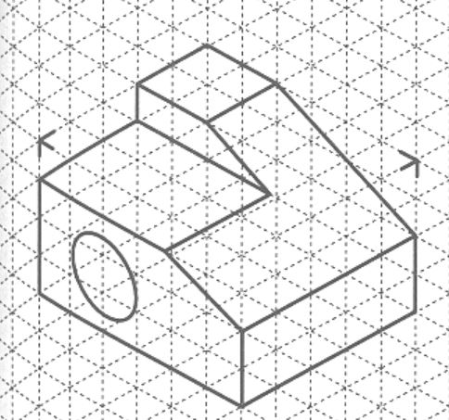
Task-7

Slide 34
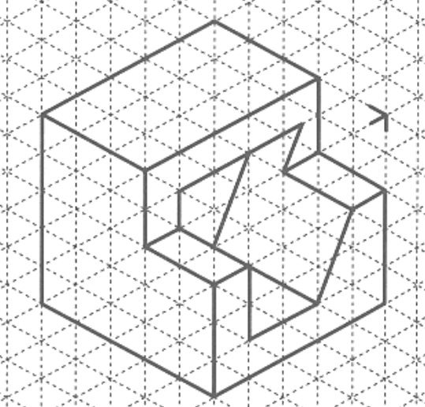
Task-8

Slide 35
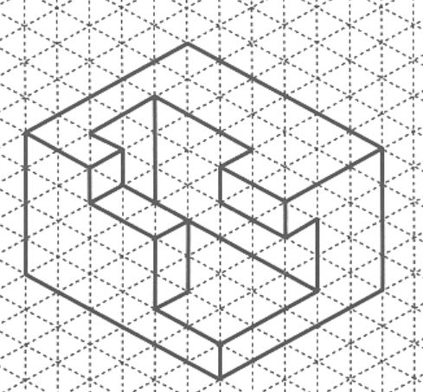
Task-9

