Slide 1
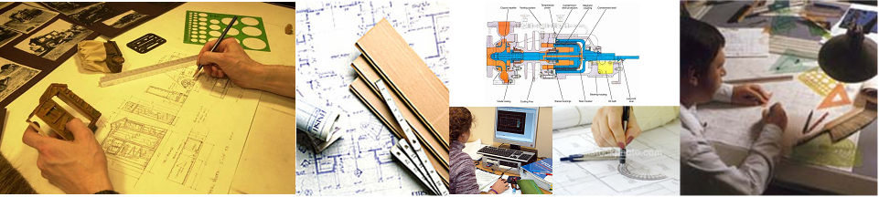
Chapter 3
Orthographic Projection

Slide 2
TOPICS
Object representation
Multiview projection
Glass box concept
Orthographic projection of point,
line, plane, surface and object.
Line convention

Slide 3
OBJECT REPRESENTATION
Axonometric projection
Multiview projection

Slide 4
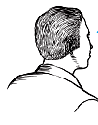
MULTIVIEW PROJECTION
Three principle dimensions
of an object …
… can be presented only
two in each view.
Adjacent view(s)
is needed to
fulfill the size
description.
Height
Depth
Width
Depth
Height
Width
Depth

Slide 5
TO OBTAIN MULTIVIEW REPRESENTATION OF AN OBJECT
Revolve the object with respect
to observer.
The observer move around the
object.

Slide 6
REVOLVE THE OBJECT
Top view
Front view
Right side view

Slide 7

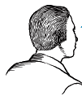
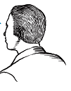
OBSERVER MOVE AROUND
Top view
Front view
Right side view

Slide 8
THE GLASS BOX CONCEPT
Rear view
Left side view
Bottom view

Slide 9
History
Depth
Width
Height

Slide 10


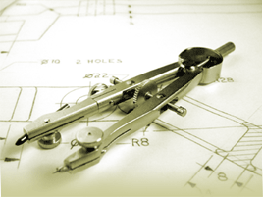
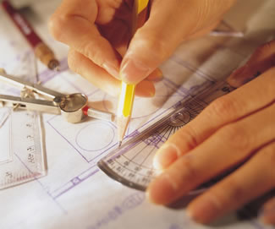
Orthographic Projection
of Object Features

Slide 11
OBJECT FEATURES
Edges
are lines that represent the boundary
between two faces.
Corners
Represent the intersection of two or
more edges.
Edge
Edge
No edge
Corner
No corner
No corner

Slide 12
OBJECT FEATURES
Surfaces
are areas that are bounded by edges
or limiting element.
Limitingelement
is a line that represents the last visible
part of the curve surface.
Surface
Surface
Surface
Limit
Limit

Slide 13
PROJECTION OF OBJECT
The views are obtained by projecting all object features to the picture plane.
You have to project the remaining surfaces which are
invisible too !

Slide 14
PROJECTION OF OBJECT
s
s
s

Slide 15
PROJECTION OF OBJECT

Slide 16
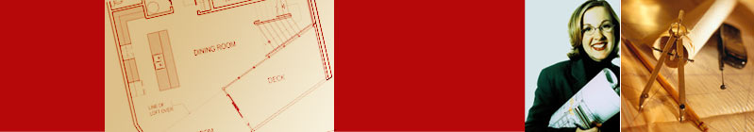

Line Convention

Slide 17
LINE CONVENTION
Precedence of coincide lines.
Hidden line drawing.
Center line drawing.

Slide 18
PRECEDENCE OF LINE
Order of
importance
Visible
line
Hidden
line
Center
line

Slide 19
HIDDEN LINE PRACTICE
Hidden line should join a visible line, except it
extended from the visible line.
Leave
space
Correct
Join
No !

Slide 20
HIDDEN LINE PRACTICE
Hidden line should join a visible line, except it
extended from the visible line.
Leave
space
Leave
space
Correct
No !

Slide 21
HIDDEN LINE PRACTICE
Hidden line should intersect to form L and T
corners.
L
T
Correct
No !

Slide 22
HIDDEN LINE PRACTICE
Hidden arcs should start on a center line.

Slide 23
CENTER LINE PRACTICE
In circular view, short dash should cross at the intersections of center line.
For small hole, center line is presented as thin continuous line.
Center line should not extend between views.
Leave space
Leave space

Slide 24
CENTER LINE PRACTICE
Leave the gap when centerline forms a continuation with a visible or hidden line
Center line should always start and end with
long dash.
Leave
space
Leave
space
Leave
space
Leave
space

Slide 26
1st Angle
First angle projection is a method of creating a 2D drawing of a 3D object.
Object is placed in the first quadrant.
Object is placed between plan of projection and observer

Slide 27
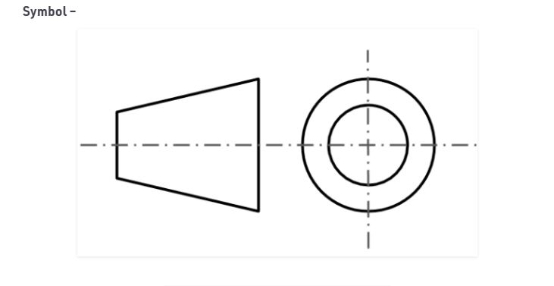
1st Angle

Slide 28
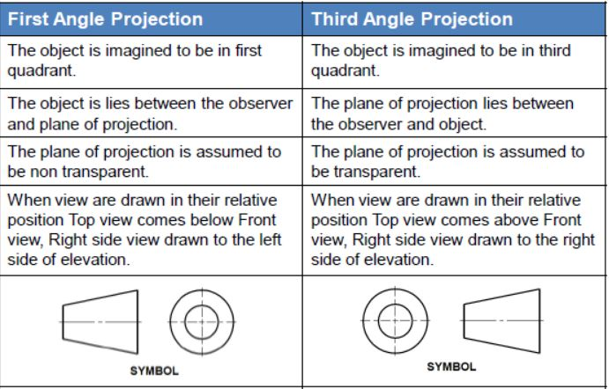

Slide 29
3rd Angle
Third angle projection is a method of creating a 2D drawing of a 3D object.
Object is placed in the third quadrant.
Plan of projection lies between observer and object.

Slide 30
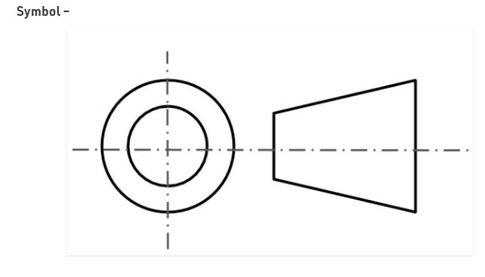
3rd Angle

Slide 31
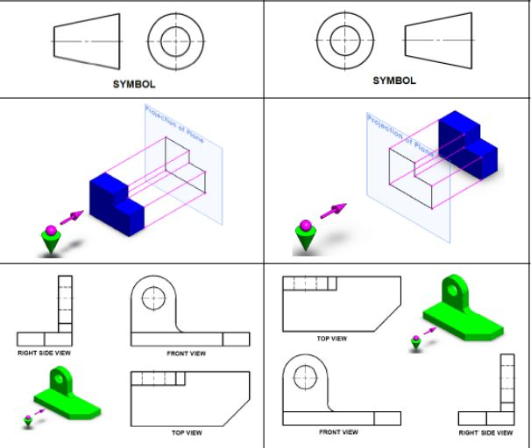

Slide 32
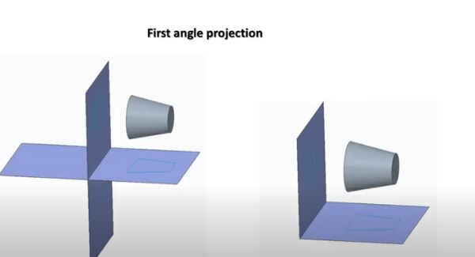
1st Angle…

Slide 33
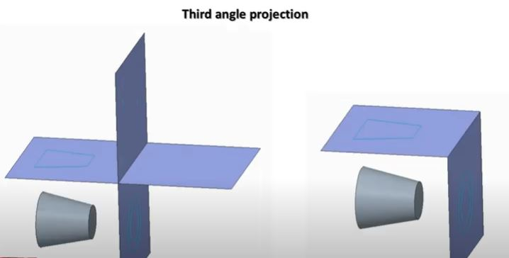
3rd Angle

Slide 34
