Slide 1

 | National University of Sciences & Technology (NUST) School of Electrical Engineering and Computer Science (SEECS) Department of Basic Sciences
Linear Algebra & Ordinary Differential Equations
MATH-121
Lecture # 1
Course Instructor: Dr Saira Zainab
Ph. # 03325193283
Email: saira.zainab@seecs.edu.pk
Office # 207, Faculty Block, SEECS

Slide 2
Some Relevant Information
Linear Algebra & Ordinary Differential Equations
Course Code: | MATH-121 | Semester: | 2nd
Credit Hours: | 3+0 | Prerequisite Codes: | NIL
Instructor: | Dr. Saira Zainab | Class: | BEE12 ABC 2k20
Office: | 207 | Telephone: | 03325193283
Lecture Days: | Tuesday, Wednesday , Friday | E-mail: | saira.zainab@seecs.edu.pk
Class Room: | CR-12,13,14,05 | Consulting Hours: | Monday 9:00-1:00 Thursday 9:30-1:30
Lab Engineer: | N/A | Lab Engineer Email: | N/A
Knowledge Group: | N/A | Updates on LMS: | After every Lecture

Slide 3
Objectives of the course
The successful completion of the course should develop the ability to select an appropriate and efficient method for solving linear system of equations.
The handling with the Eigenvalue problems which are extensively studied for example in resonance and vibration theory.
The understanding of Ordinary Differential Equations which is a strong tool for Mathematical Modeling.
The Understanding of Laplace transforms with applications in various engineering/technological concepts.

Slide 4
Course Learning Outcomes
CLO1: Solve the system of linear equations using matrices and
determinants.
CLO2: Explain concept of vector spaces, Linear Transformations
and applications.
CLO3: Solve ordinary differential equations using various techniques including Laplace transform and engineering applications.

Slide 5
Topics to be covered in this course
Linear Algebra
First Order Ordinary Differential Equations
Linear Differential Equations of Higher Order
Non-Homogeneous Linear Equations with constant coefficients
Non-Homogeneous Linear Equations with Variable Coefficients
Laplace Transform

Slide 6
Reference/Text Books
Advanced Engineering Mathematics
Erwin Kreyszig
Differential Equations with boundary value problems
Dennis G. Zill and Michael Cullen
Introductory Linear Algebra
B. Kolman, David R Hill
Linear Algebra with Applications
Gareth Williams
Modern Engineering Mathematics
Glyn Jame

Slide 7
Linear Algebra
Basic Concepts
(Matrix Addition. Scalar Multiplication, Matrix Multiplication)
Linear Systems of Equations
(Gauss Elimination)
Solution of Linear Systems
(Existence, Uniqueness, General Form)
Inverse of a Matrix
(Gauss-Jordan Elimination)
Vector Spaces,
(Sub Spaces and Linear Transformations, Linear dependence/ independence, spanning set, basis)
Eigenvalues and Eigenvectors

Slide 8
Today’s Lecture
Basic Concepts
Matrix Addition
Scalar Multiplication
Matrix Multiplication

Slide 9
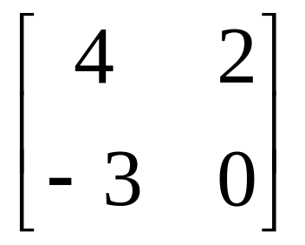
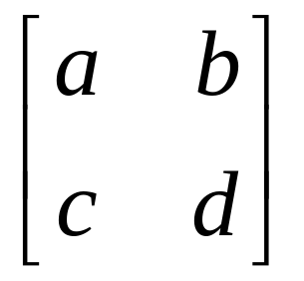
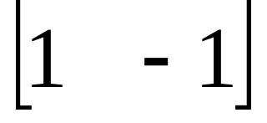
Introduction
Matrix algebra has at least two advantages:
Reduces complicated systems of equations to simple expressions
Adaptable to systematic method of mathematical treatment and well suited to computers
Definition:
A matrix is a set or group of numbers arranged in a square or rectangular array enclosed by two brackets

Slide 10
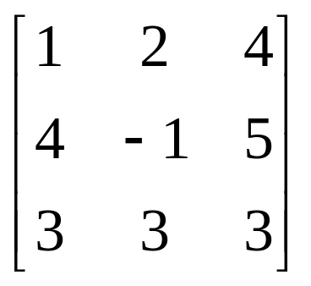
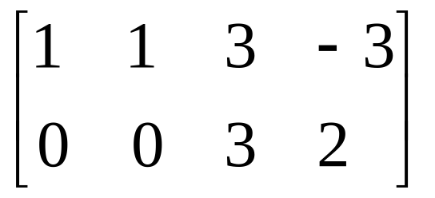
Introduction
Properties:
A specified number of rows and a specified number of columns
Two numbers (rows x columns) describe the dimensions or size of the matrix.
Examples:
3x3 matrix
2x4 matrix
1x2 matrix

Slide 11
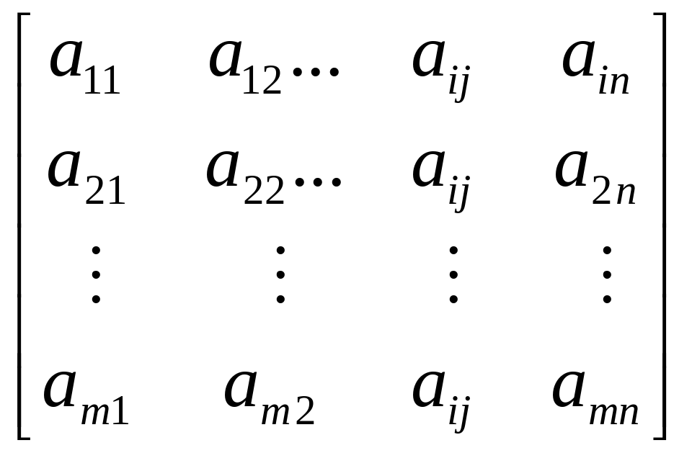
Introduction
A matrix is denoted by a bold capital letter and the elements within the matrix are denoted by lower case letters
e.g. matrix [A] with elements a_{ij}
A_{mxn}=

Slide 12
Types of Matrices
1. Column matrix or vector
The number of rows may be any integer but the number of columns is
always 1.
2. Row matrix or vector
Any number of columns but only one row.
3. Rectangular matrix
Contains more than one element and number of rows is not equal to the number of
columns.
4. Square matrix
The number of rows is equal to the number of columns.
5. Diagonal matrix
A square matrix where all the elements are zero except those on the main diagonal.
6. Unit or Identity matrix - I
A diagonal matrix with ones on the main diagonal

Slide 13
Types of Matrices
7. Null (zero) matrix - 0
All elements in the matrix are zero.
8. Triangular matrix
A square matrix whose elements above or below the main diagonal are all zero.
8a. Upper triangular matrix
A square matrix whose elements below the main diagonal are all zero.
8b. Lower triangular matrix
A square matrix whose elements above the main diagonal are all zero.
9. Scalar matrix
A diagonal matrix whose main diagonal elements are equal to the same scalar.
A scalar is defined as a single number or constant.

Slide 14

Matrices - Operations
Equality of Matrices
Two matrices are said to be equal only when all corresponding elements are equal. Therefore, their size or dimensions are equal as well.
Addition and Subtraction of Matrices
Scalar Multiplication of Matrices
Matrices can be multiplied by a scalar (constant or single element).

Slide 15
Matrices - Operations
Equality of Matrices
Two matrices are said to be equal only when all corresponding elements are equal. Therefore, their size or dimensions are equal as well.
Addition and Subtraction of Matrices
Scalar Multiplication of Matrices
Matrices can be multiplied by a scalar (constant or single element).
Multiplication of Matrices
Two matrices A and B must be conformable for multiplication to be possible
i.e. the number of columns of A must equal the number of rows of B.

Slide 16
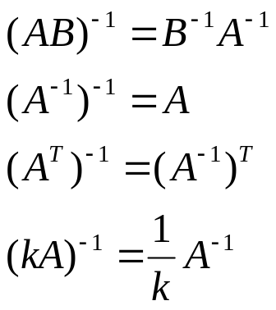
Matrices - Operations
Inverse of A Matrix
The inverse of a square matrix, A, if it exists, is the unique matrix A⁻¹ where:
AA⁻¹ = A⁻¹ A = I
Properties of the inverse
Determinant of A Matrix
If A is (n x n), its determinant may be defined in terms of order (n-1) or less.

Slide 17
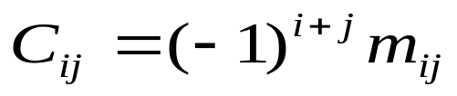
Determinants
Minors
If A is an n x n matrix and one row and one column are deleted, the resulting matrix is an (n-1) x (n-1) submatrix of A.
The determinant of such a submatrix is called a minor of A and is designated by m_{ij} , where i and j correspond to the deleted row and column, respectively.
m_{ij} is the minor of the element a_{ij} in A.
Cofactors
The cofactor C_{ij} of an element a_{ij} is defined as:

Slide 18


Determinants
The determinant of an n x n matrix A can now be defined as:
Adjoint of a Matrix
The adjoint matrix of A, denoted by adj A, is the transpose of its cofactor matrix.

