Slide 1

 | National University of Sciences & Technology (NUST) School of Electrical Engineering and Computer Science (SEECS) Department of Basic Sciences
Linear Algebra & Ordinary Differential Equations
MATH-121
Lecture # 10
Course Instructor: Dr Saira Zainab
Ph. # 03325193283
Email: saira.zainab@seecs.edu.pk
Office # 207, Faculty Block, SEECS
1

Slide 2
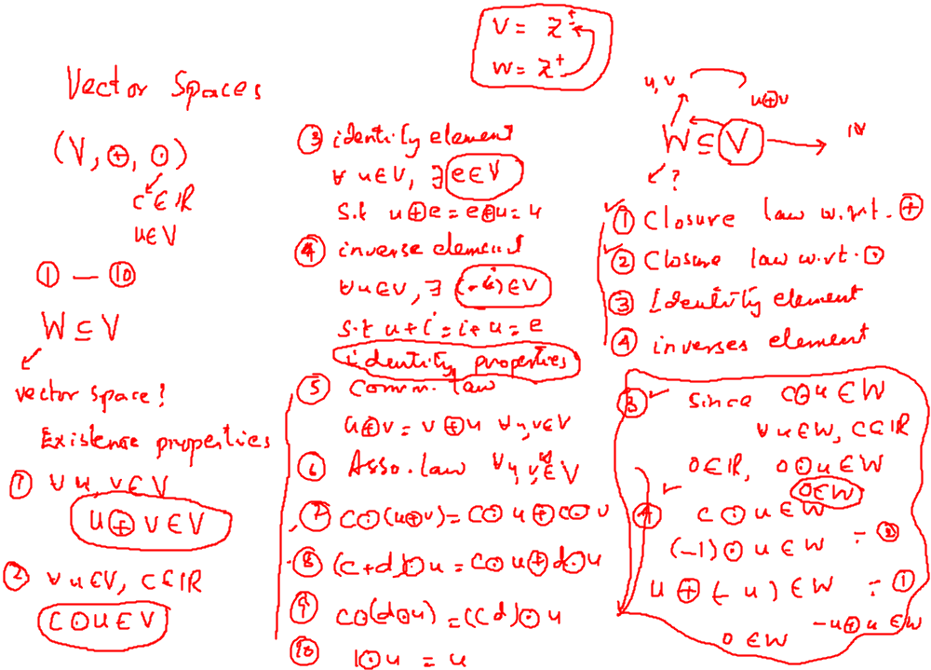

Slide 3
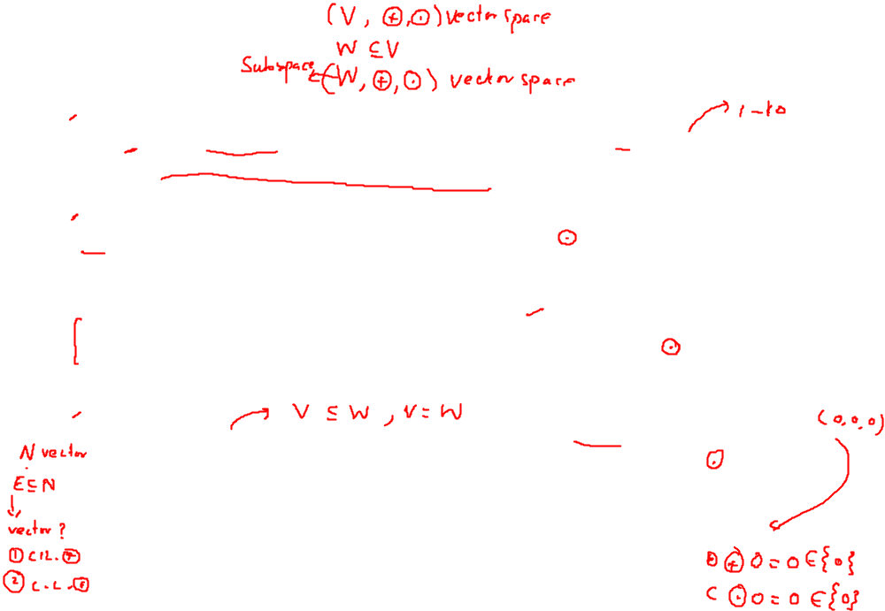


Subspace
Definition
Let V be a vector space and W a nonempty subset of V. If W is a vector space with respect to the operations in V, then W is called a subspace of V.
Theorem
Let V be a vector space with operations and and let W be a nonempty subset of V. Then W is a subspace of V if and only if the following conditions hold:
(a) If u and v are any vectors in W, then u v is in W.
(b) If c is any real number and u is any vector in W. then c u is in W.
Example
Every vector space has at least two subspaces, itself and the subspace {0} consisting only of the zero vector. (Recall that 0 0 = 0 and c 0 = 0 in any vector space.) Thus {0} is closed for both operations and hence is a subspace of V. The subspace {0} is called the zero subspace of V.

Slide 4
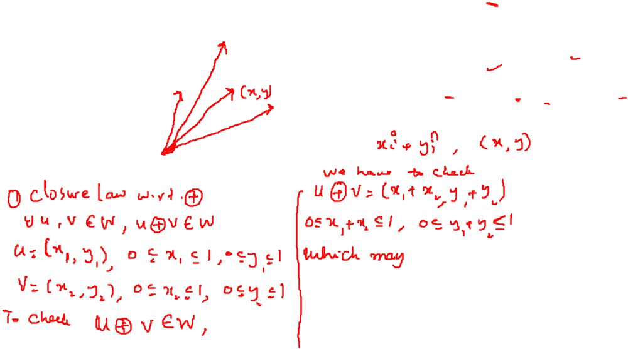
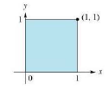
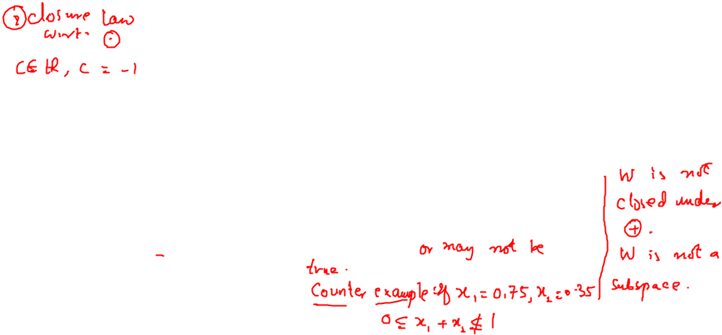
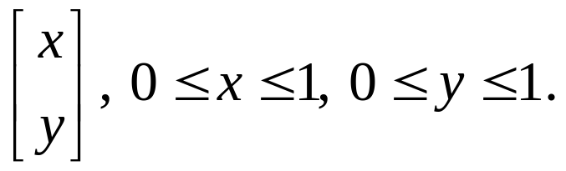
Examples
Consider the unit square shown in the accompanying figure.
Let W be the set of all vectors whose tail is at the origin and whose head is a point inside or on the square. Is W a subspace of R²? Explain.

Slide 5
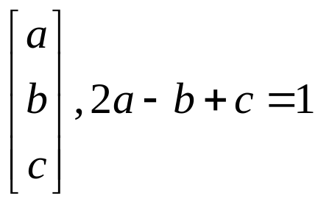
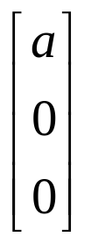
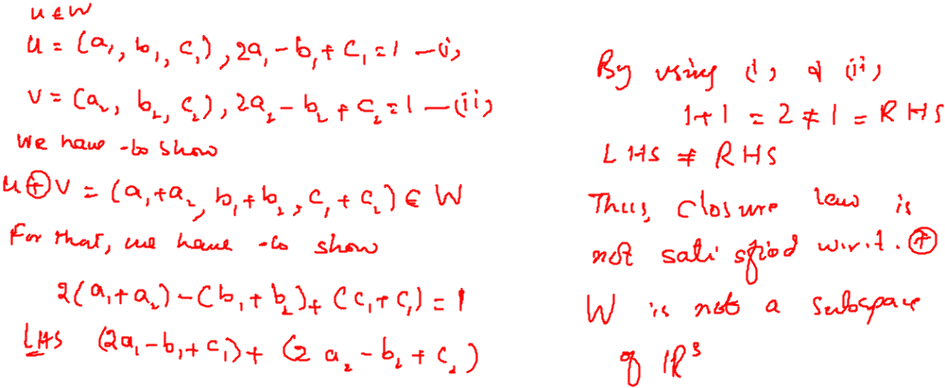
Examples
Check which of the given are the subspaces of R³?
1.
2.

Slide 6
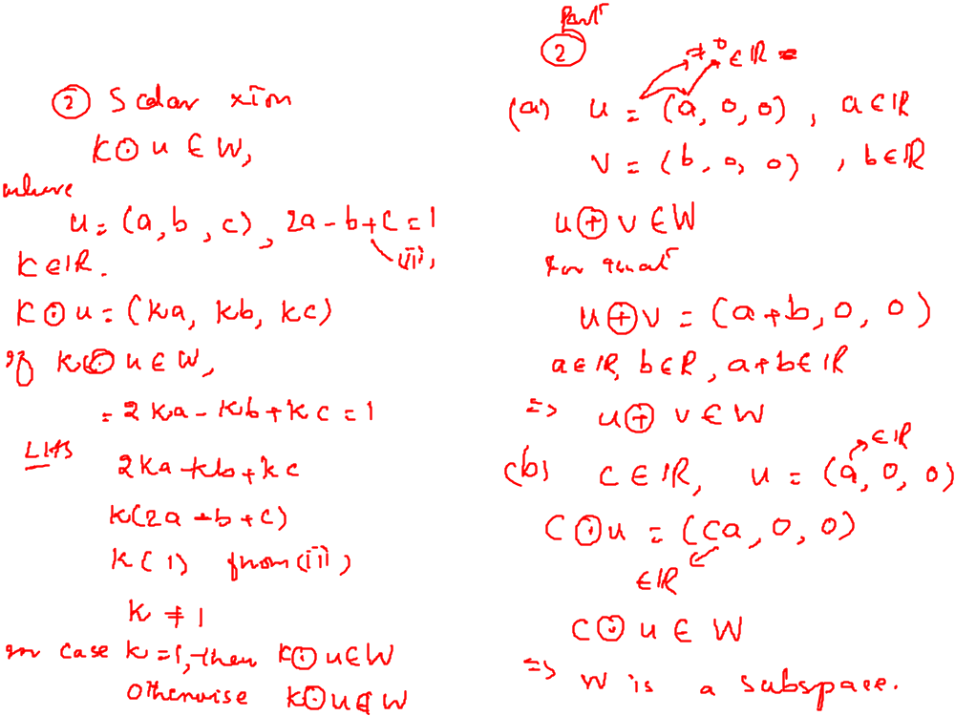
Examples

Slide 7
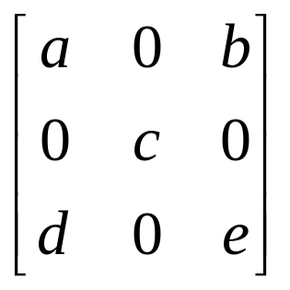
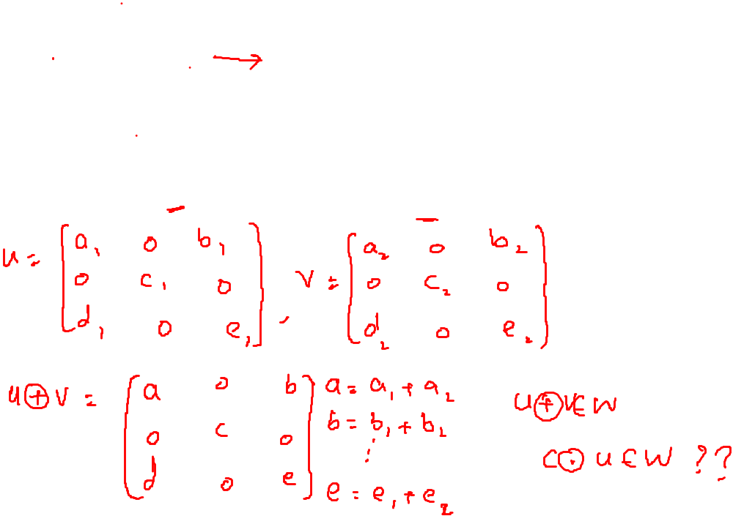
Examples
Let W be the set of all 3 x 3 matrices of the form
Show that W is the subspace of M₃₃

Slide 8
Examples

Slide 9
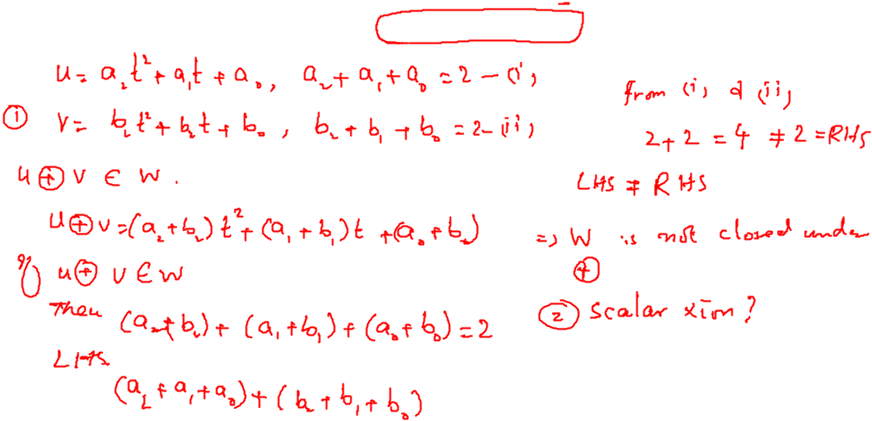
Examples
Check if the following subset of the vector space P₂ is a subspace.

Slide 10
Examples

Slide 11
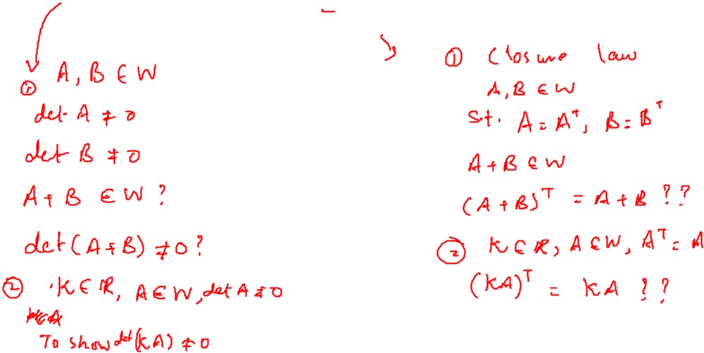
Examples
Check if the following subset of the vector space M_{nn} is a subspace.
The set of all nonsingular nxn matrices
The set of all nxn symmetric matrices

Slide 12
Examples

