Slide 1

 | National University of Sciences & Technology (NUST) School of Electrical Engineering and Computer Science (SEECS) Department of Basic Sciences
Linear Algebra & Ordinary Differential Equations
MATH-121
Lecture # 11
Course Instructor: Dr Saira Zainab
Ph. # 03325193283
Email: saira.zainab@seecs.edu.pk
Office # 207, Faculty Block, SEECS

Slide 2
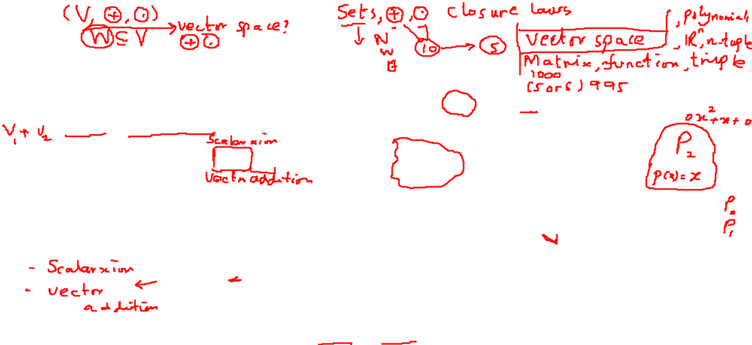
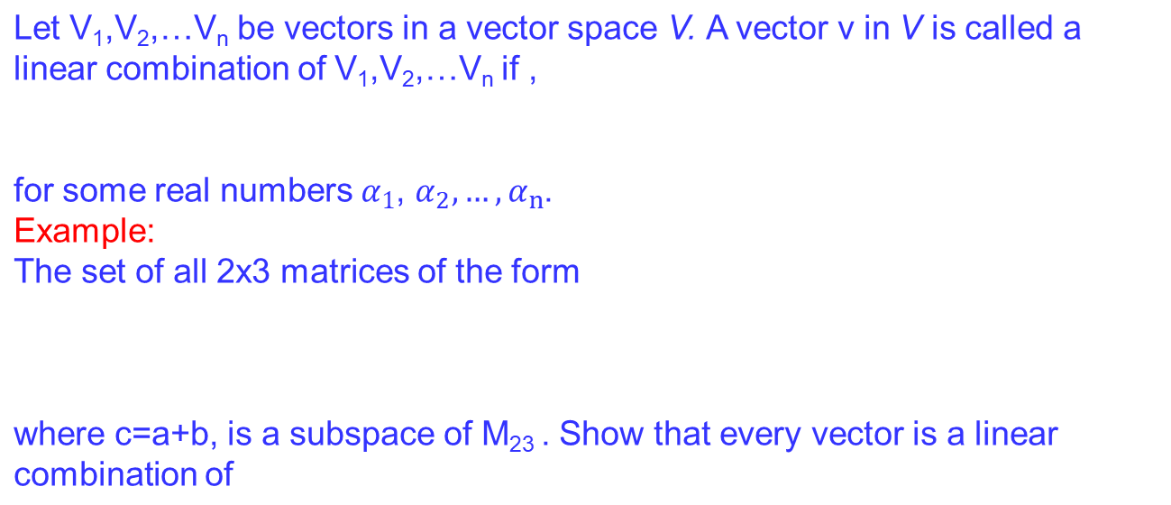
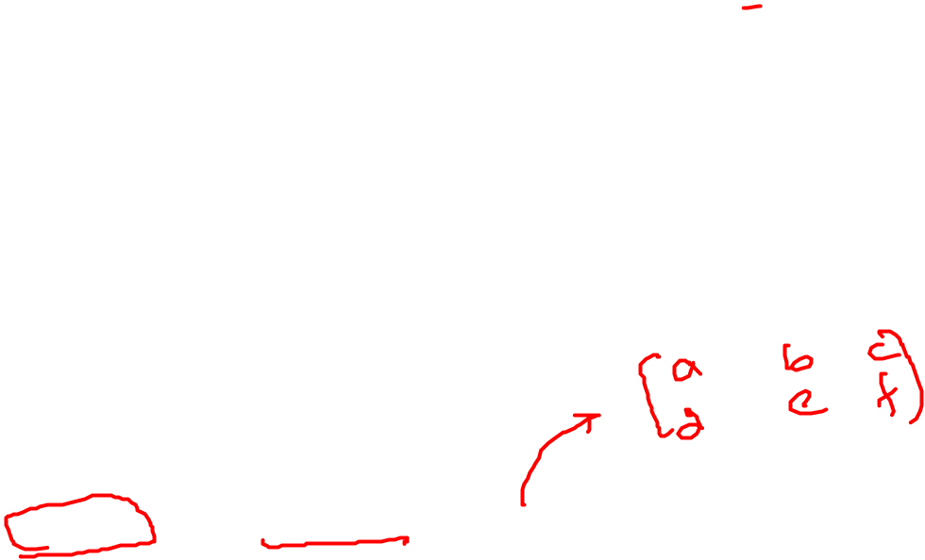
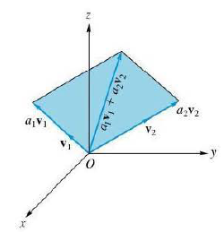
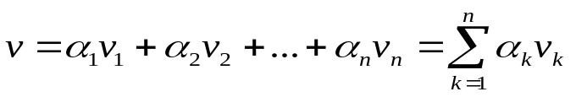
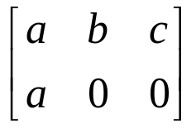
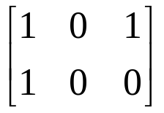
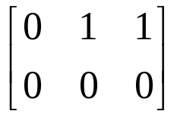
Linear Combination

Slide 3
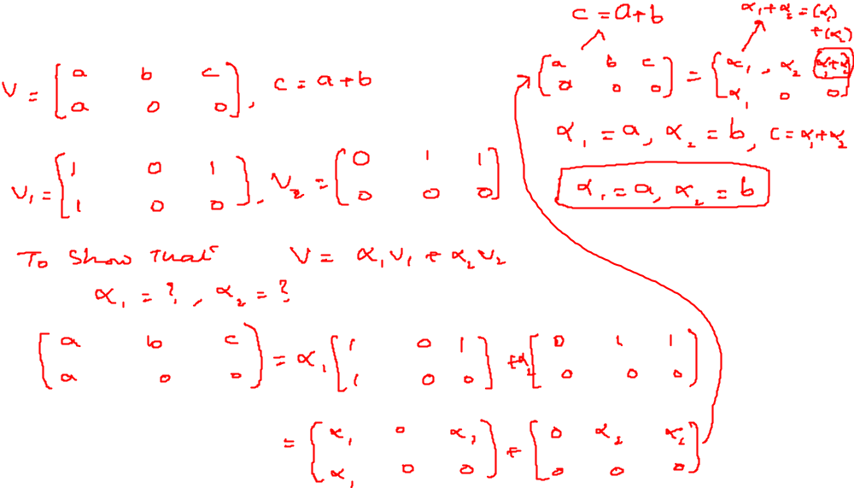
Examples

Slide 4
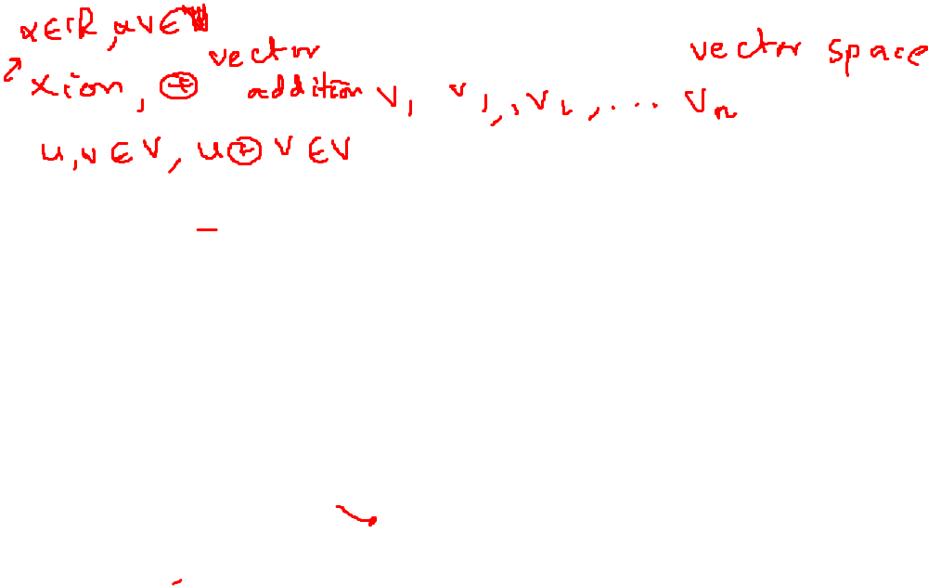
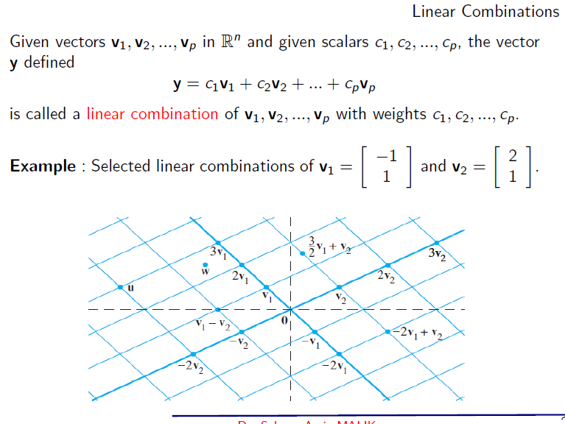
Examples

Slide 5
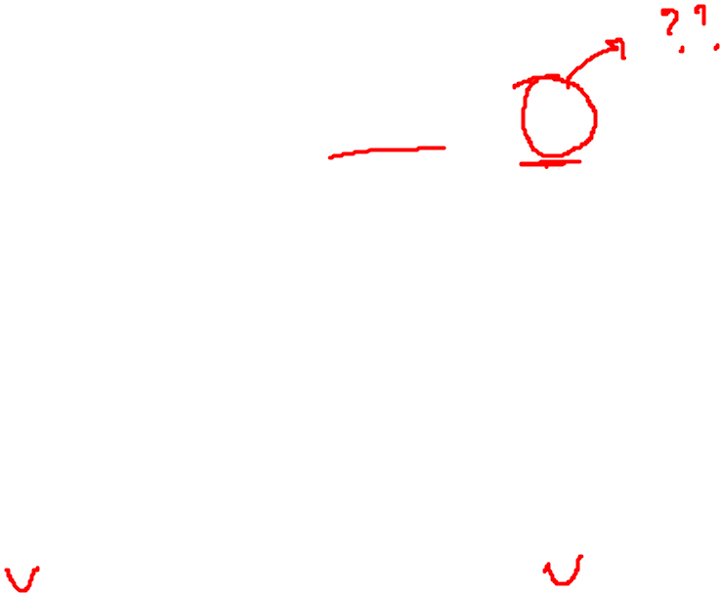
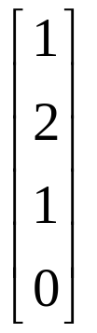
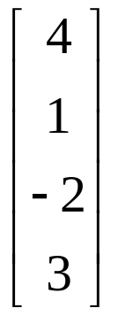
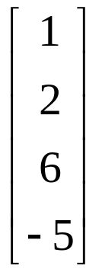
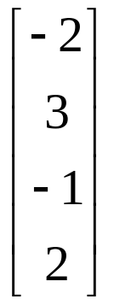

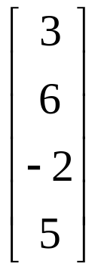
Examples
Check which of the given vectors in R⁴ are the linear combinations of?
V₁=
V₂=
V₃=
V₄=
1.
2.

Slide 6
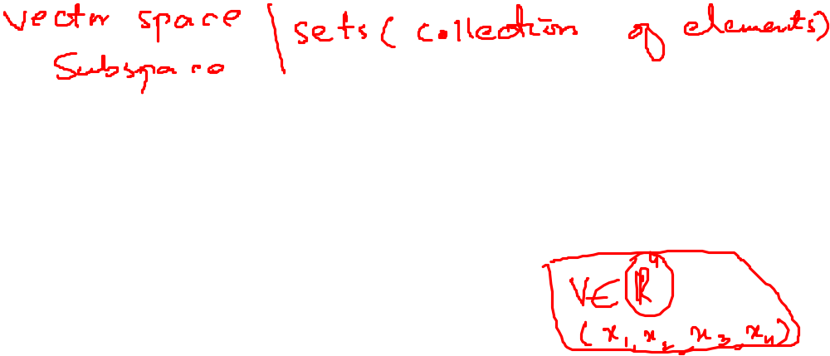
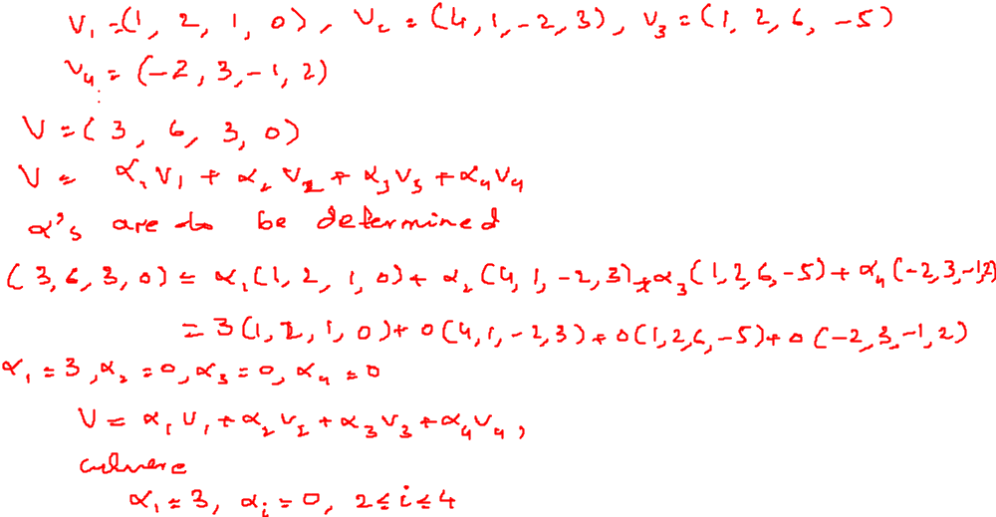
Examples

Slide 7
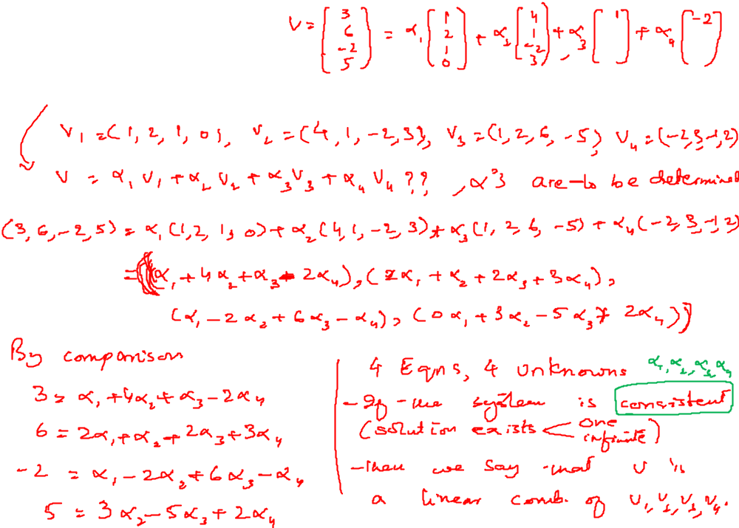

Examples

Slide 8
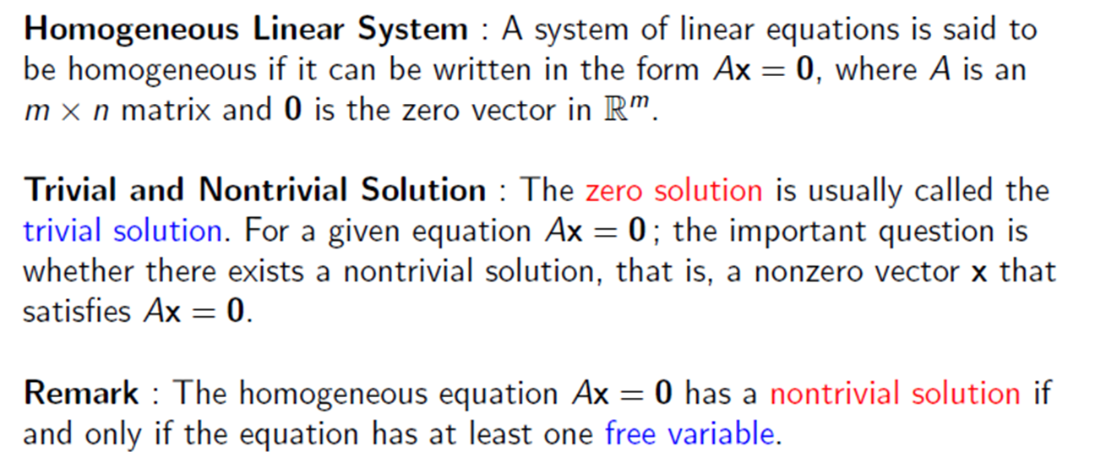

Homogeneous Linear System

Slide 9
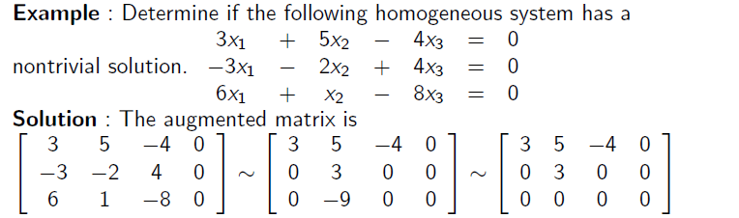
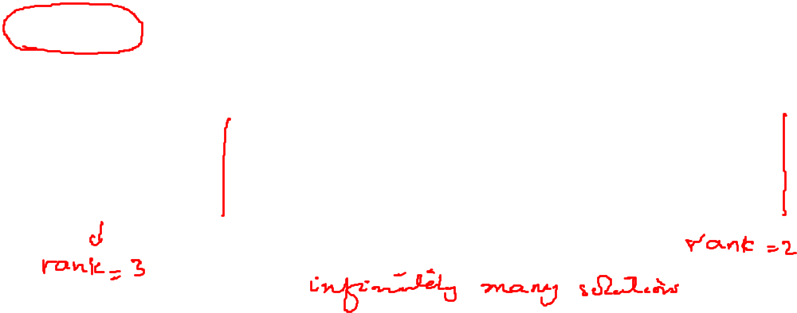
Homogeneous Linear System

Slide 10
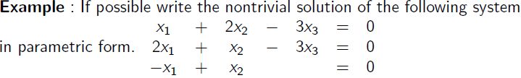
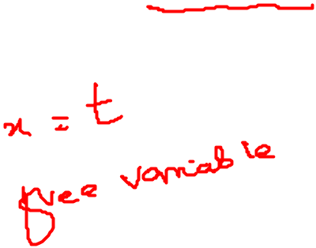
Homogeneous Linear System

Slide 11
Examples

Slide 12
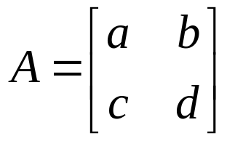
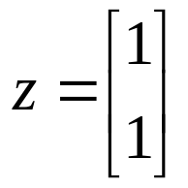
Example
Example: Let W be the set of all 2 x 2 matrices
Such that AZ =0 where . Is W a subspace of M₂₂? Explain.

Slide 13

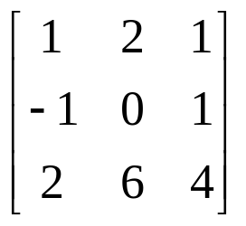
Null Space
If A is an m x n matrix, then the homogeneous system of m equations in n unknowns with coefficient matrix A can be written as
Ax = 0
where x is a vector in R^{n} and 0 is the zero vector.
Thus the set W of all solutions is a subset of R". We now show that W is a subspace of R" (called the solution space of the homogeneous system, or the null space of the matrix A).
Example: Show that every vector in R³ of the form for any real number t, is in the Null space of the matrix

Slide 14
Examples

