Slide 1

 | National University of Sciences & Technology (NUST) School of Electrical Engineering and Computer Science (SEECS) Department of Basic Sciences
Linear Algebra & Ordinary Differential Equations
MATH-121
Lecture # 12
Course Instructor: Dr Saira Zainab
Ph. # 03325193283
Email: saira.zainab@seecs.edu.pk
Office # 207, Faculty Block, SEECS
1

Slide 2
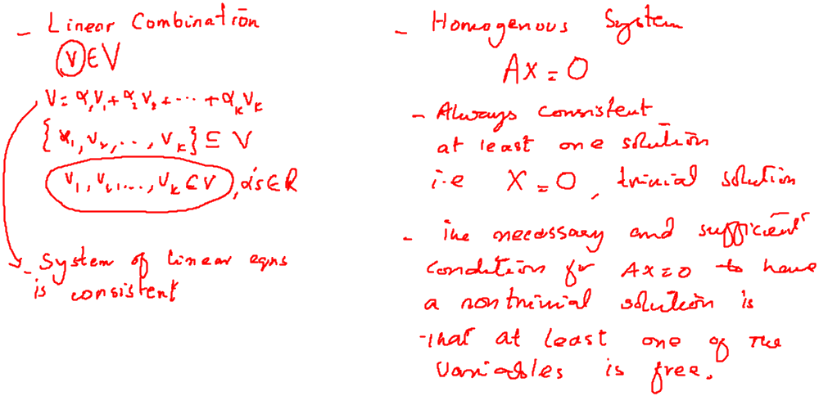
Recalling Previous Lecture

Slide 3
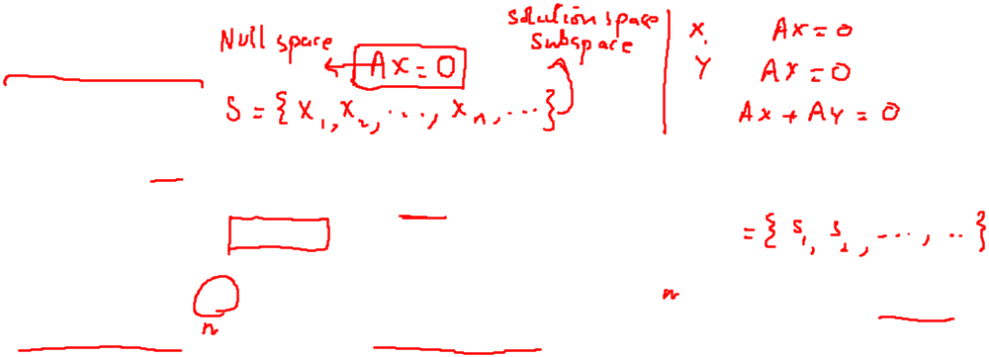
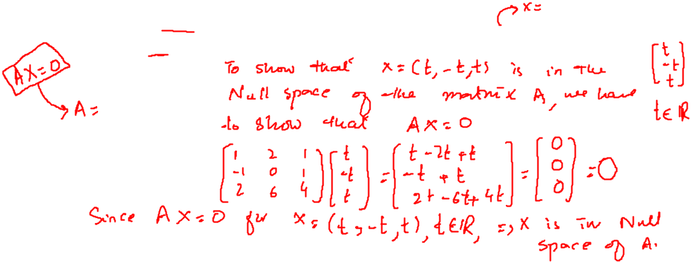

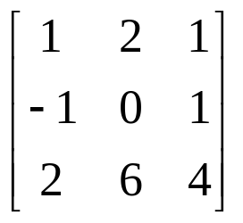
Null Space
If A is an m x n matrix, then the homogeneous system of m equations in n unknowns with coefficient matrix A can be written as
Ax = 0
where x is a vector in R^{n} and 0 is the zero vector.
Thus the set W of all solutions is a subset of R". We note that W is a subspace of R" (called the solution space of the homogeneous system, or the null space of the matrix A).
Example: Show that every vector in R³ of the form for any real number t, is in the Null space of the matrix

Slide 4
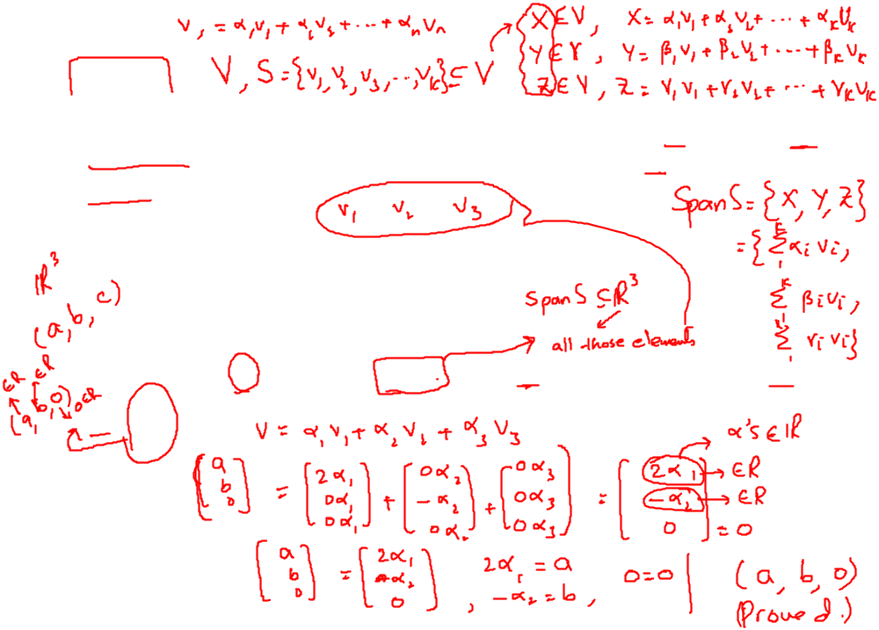
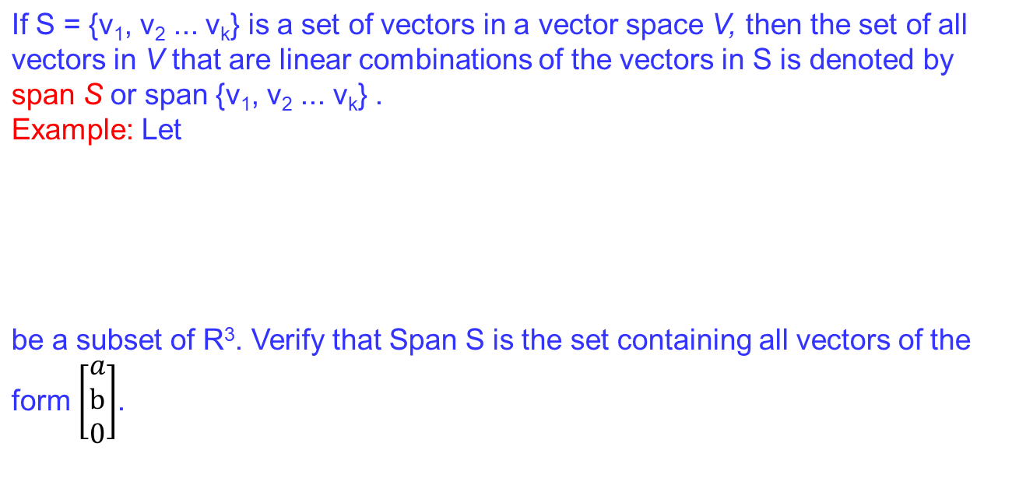
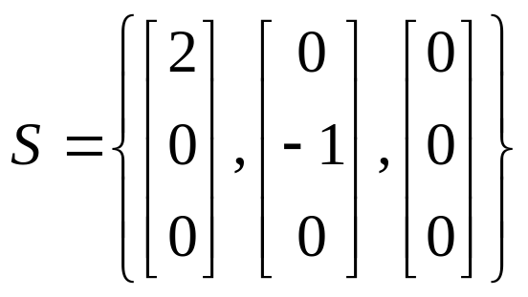
Span

Slide 5
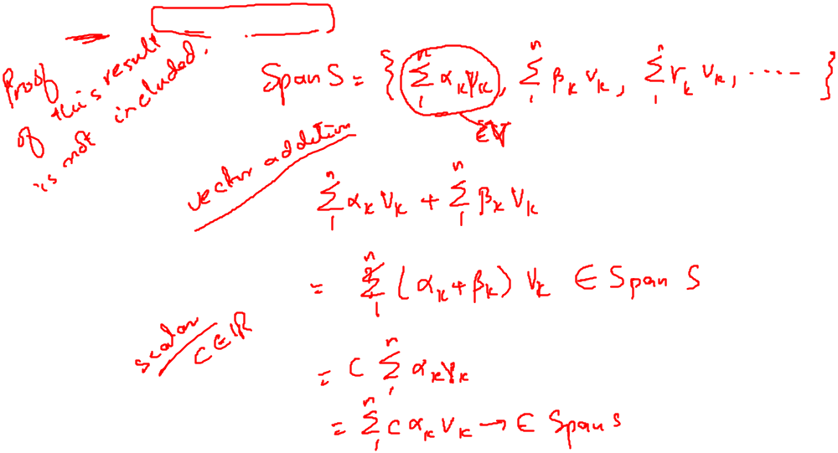
Span
Theorem: Let S = {v₁, v₂ ... v_{k}} be a set of vectors in a vector space V, then span S or span {v₁, v₂ ... v_{k}} is a subspace of V .

Slide 6
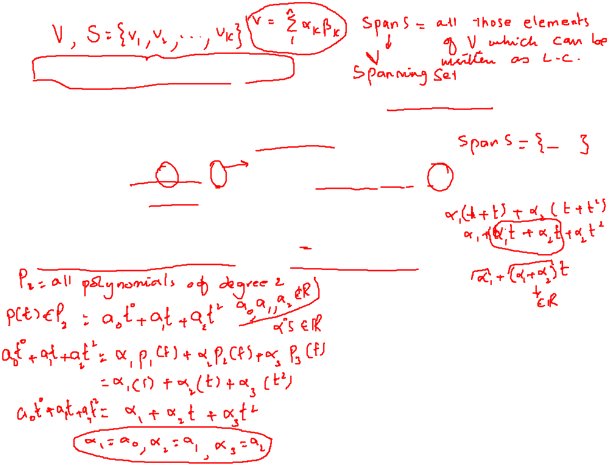
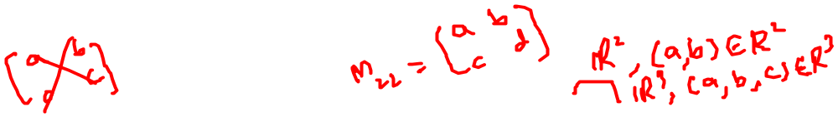
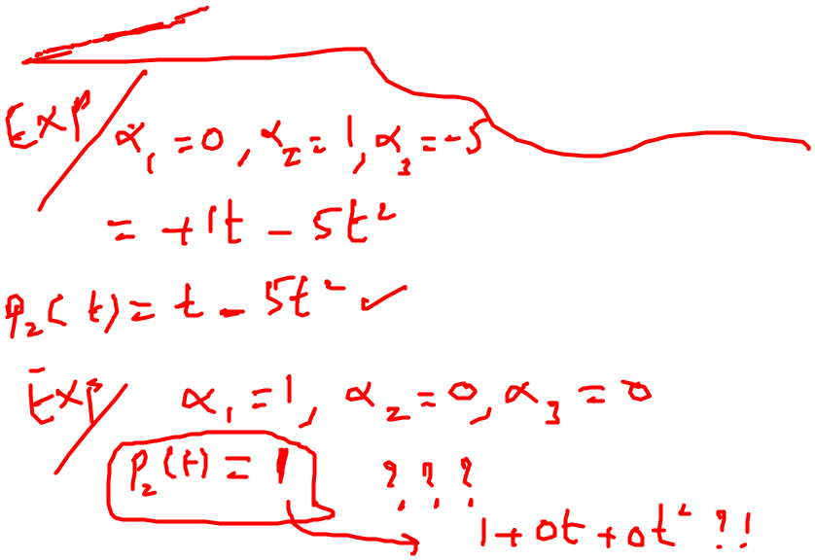
Spanning Set of a Vector Space
Let S be a set of vectors in a vector space V. If every vector in V is a linear
combination of the vectors in S, then the set S is said to span V, or V is spanned by the set S; that is, span S = V.
Remark: If span S = V, S is called the spanning set of V. A vector space can have many spanning sets.
Example: The two spanning sets of P₂ are :
S₁={p₁(t)=1, p₂(t)=t, p₃(t)=t²} and S₂={q₁(t)=1+t, q₂(t)= t+t², q₃(t)=t}

